Slide 1

E-Paper Display-Based Shelf Updation System
A complete low-power electronic shelf label (ESL) solution combining ESP32 microcontrollers, Bluetooth Low Energy, and e-paper displays. This
dual-firmware system enables wireless price updates for retail environments with ultra-low power consumption and web-based management.

Slide 2

The Problem with Traditional Shelf Labels
Manual Updates Are Costly
Traditional paper labels require manual updates across thousands of products, consuming valuable staff time and creating opportunities for pricing errors.
Time-consuming manual price changes High labor costs for updates
Frequent human errors and inconsistencies No real-time synchronization capability

Slide 3

System Architecture Overview
Cloud / MQTT
Shelf Label
Gateway
The system architecture separates concerns: ultra-low-power shelf labels communicate via BLE with a gateway controller that bridges to Wi-Fi, MQTT, and web interfaces.
Shelf Label
BLE receiver, E-Paper display, deep sleep mode
Gateway
Wi-Fi bridge, Web UI, MQTT client, OTA updates
Cloud Backend
MQTT broker, data feeds, remote control

Slide 4
Shelf Label Core Features
BLE Communication
Short-range wireless data updates using custom service and characteristic UUIDs for secure, efficient transmission
E-Paper Display
2.9" GPD2-driven screen with full and partial refresh logic for crisp product information visibility
Flash Storage
NVS-based persistent data retention ensures label content survives power cycles and reboots
Deep Sleep Mode
Ultra-low power consumption with RTC timer wake-up extends battery life to weeks or months

Slide 5
Hardware & Software Requirements
Shelf Label Hardware
ESP32 (any variant with BLE)
2.9" E-Paper GDEH029A / T94
Li-Ion/Li-Po battery (1000-2000mAh) TP4056 charging module
Gateway Hardware
ESP32 with Wi-Fi capability USB power supply (5V/1A) Internet connection via router
Shelf Label Libraries
BLEDevice, Preferences, GxEPD2, Adafruit_GFX, ESP Deep Sleep APIs
Gateway Libraries
WiFi, WebServer, PubSubClient, ArduinoOTA, ESPmDNS, BLEDevice, Preferences

Slide 6
Power Optimization Strategy
01
02
03
Active BLE Window
Bluetooth radio enabled only during scheduled update intervals, minimizing active power draw
Deep Sleep Entry
System enters ultra-low power mode immediately after successful update or timeout expiration
RTC Wake-Up
Internal timer triggers periodic wake cycles for scheduled content refreshes and connection availability
This three-stage approach achieves micro-amp deep sleep current while maintaining reliable update availability during defined windows.

Slide 7
Power Consumption Profile
180mA
Active Mode
BLE receiving + E-Paper refresh
10µA
Deep Sleep
RTC + RAM retention only
1yr
Battery Life
2000mAh Li-Po with daily updates
Data is stored in NVS (non-volatile storage) so labels retain information even during extended sleep periods. The GxEPD2 library manages partial refresh to minimize power draw.

Slide 8
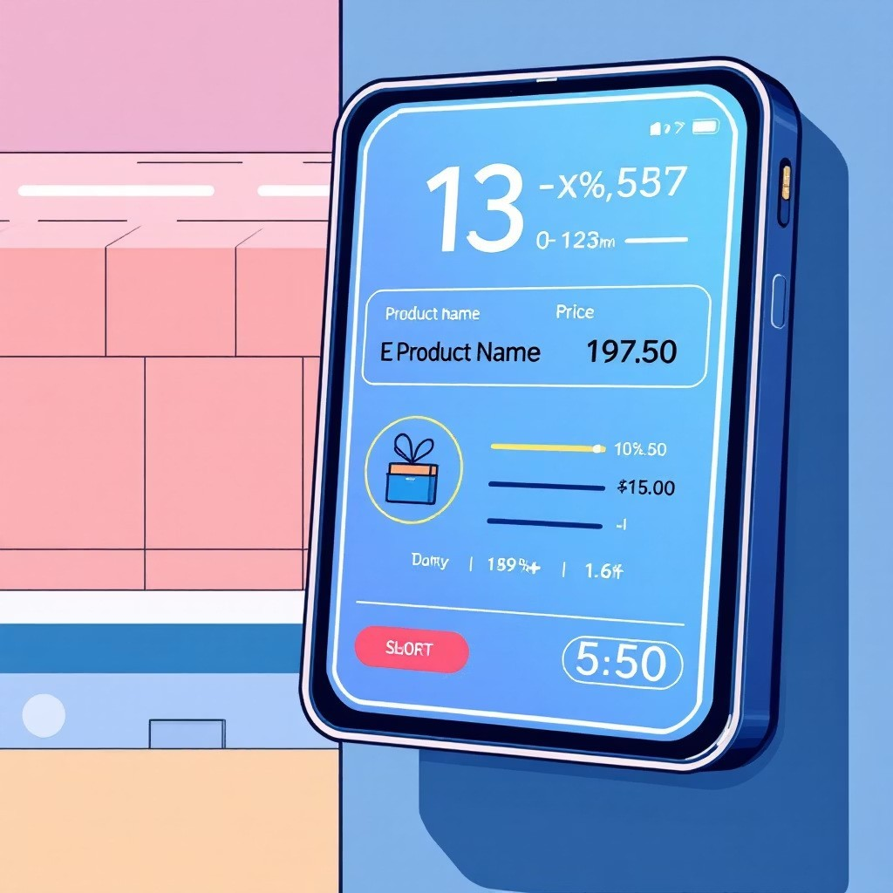
Display Layout Design
The 2.9" e-paper screen presents four critical pieces of retail information in a clear, readable format optimized for quick customer scanning:
Product Name – Primary identification Price (₹) – Large, prominent font Quantity – Unit or volume specification Discount/Offer – Promotional messaging

Slide 9
BLE Protocol Specification
Connection Parameters
Service UUID: Custom 128-bit identifier
Characteristic UUID: Write-enabled data endpoint
Payload Format: Pipe-delimited string
Data Structure
Messages follow a simple parsing format:
ProductName|Price|Qty|Discount
Example transmission:
Milk|36|500ml|12
Each field separated by pipe character for straightforward firmware parsing with minimal processing overhead.

Slide 10

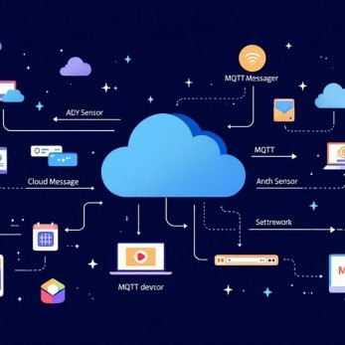
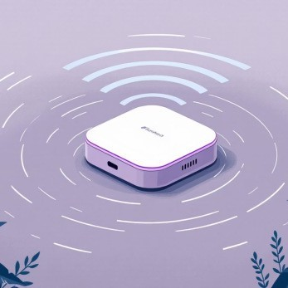
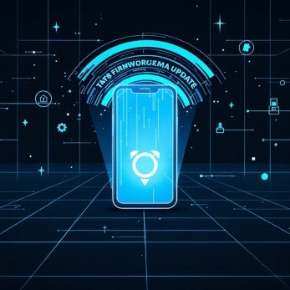
Gateway Controller Capabilities
Web Dashboard
Mobile-friendly interface for label data entry and system monitoring
MQTT Integration
Adafruit IO feeds enable remote control and IoT platform connectivity
BLE Central Mode
Automatic scanning and connection to shelf label peripherals
OTA Updates
Wireless firmware upgrades without physical access to hardware

Slide 11
Web Interface & MQTT Workflow
Dashboard Routes
/ – Sales dashboard for pushing label data
/ota – System version and update information
/log – Live system logs for debugging
/admin – Wi-Fi configuration (auth required)
MQTT Feed Pipeline
When shelf-send feed receives 1:
Gateway saves data to Flash storage
BLE scan initiated for shelf label
Formatted packet transmitted via BLE
Success confirmation logged
Feeds: shelf-prod, shelf-qty, shelf-price, shelf-disc
Access via shelf.local using mDNS. Default credentials: admin/admin

Slide 12
MQTT Data Flow
Update Workflow
01
Data Received
MQTT message arrives on subscribed feed
02
Flash Storage
Gateway saves to NVS preferences
03
BLE Scan
Gateway scans for shelf label advertisement
04
Data Transfer
BLE characteristic write with new values
MQTT Feed Structure
shelf-prod: Product name string
shelf-qty: Quantity integer shelf-price: Price float value shelf-disc: Discount percentage shelf-send: Trigger command
The gateway subscribes to all feeds simultaneously, caching values until the send trigger initiates the BLE transmission sequence.

Slide 13
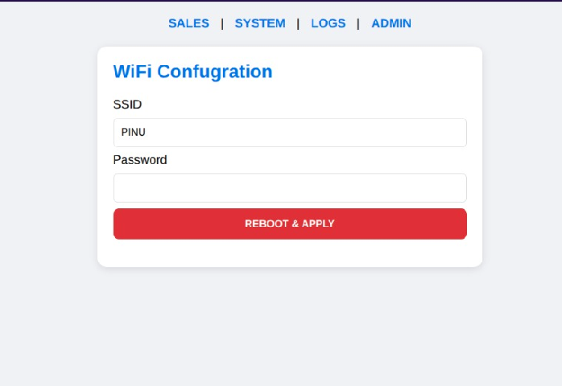
Admin Page
Display Layout Components
SSID of Wi-Fi:
Password of Wi-Fi
Whenever user or admin required to change the credentials they can access this page and can change them.

Slide 14
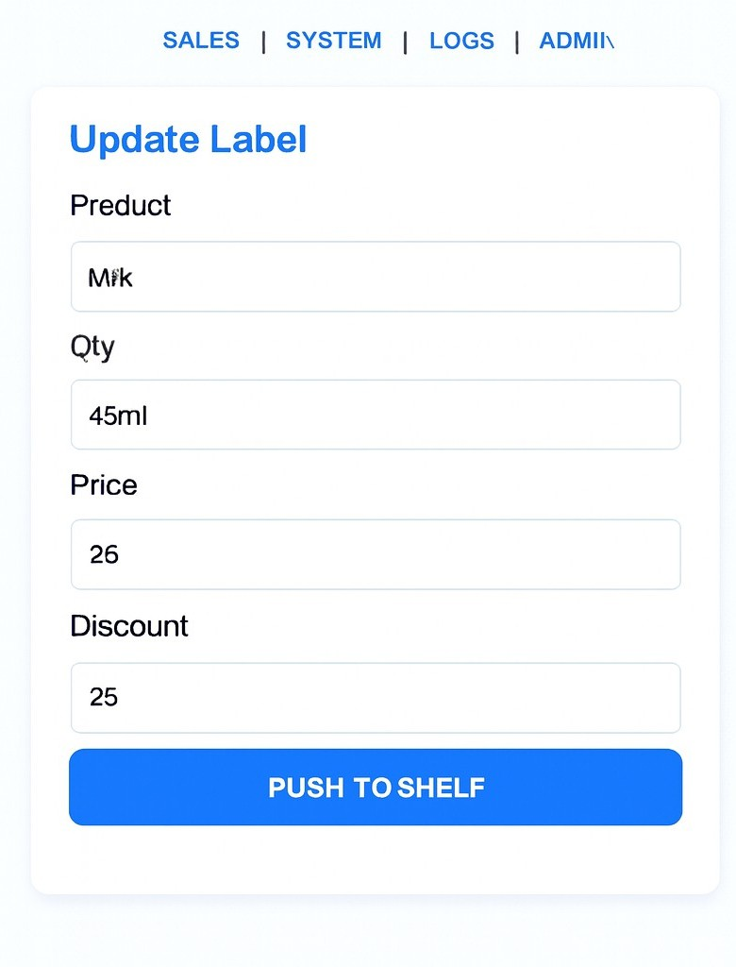
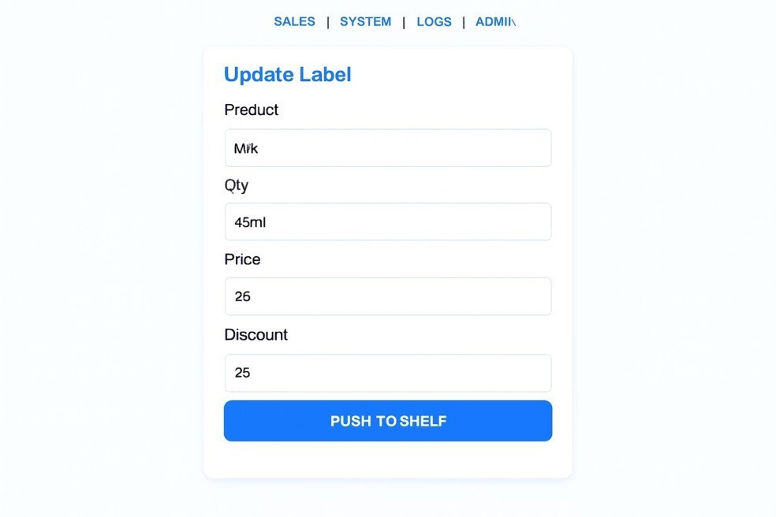
Shelf Label: Low-Power BLE + E-Paper
Display Layout Components
Product Name (bold, top line) Price (large, center-left) Quantity Available (top-right)
Discount Badge (when applicable)

Slide 15
Deployment & Future Roadmap
Quick Start Steps
Flash shelf label firmware to first ESP32
Flash gateway firmware to second ESP32
Connect gateway to Wi-Fi network
Navigate to http://shelf.local
Enter product details and push to label
Security: BLE operates on short-range with time-limited windows. Admin pages require authentication. All credentials stored securely in NVS Flash.
Enhancement Pipeline
Multi-label support for store-wide deployments Label grouping and zone management
BLE encryption for enhanced security Battery voltage monitoring and alerts QR-based label provisioning

