Slide 1

PERFORMANCE ANALYSIS OF WEB BROWSER FORENSIC TOOLS (CSE Semester IV mini project)
Name: Yadeesh Bhagnal
B.Tech CSE - SE/74
Roll No. : 2015117

Slide 2
GRAPHIC ERA DEEMED UNIVERSITY DEHRADUN
About Project
This project is based on the demonstration of performance of some web forensic tools as well as its implementation to analyze the activity logs of a Browser.
What is a web browser forensic tool?
Web Browser Forensic Tools helps to analyze evidence like history, cache, cookies, downloads list, entering URL addresses, access time of visit, frequency of visits from the user's computer etc. It can be very useful for tracing a criminal in case any sort of crime occurs.

Slide 3
PERFORAMNCE ANALYSIS OF WEB BROWSER FORENSIC TOOLS
The Web Browser Forensic Tools which have been used are as follows:
EnCase Forensic
Forensic Toolkit (FTK)
X-Ways Forensic (XWF)
ENCASE FORENSICS :
The software comes in several product designed for forensic, cyber security, security analysis and e-discovery use.
EnCase is generally used to recover evidence from seized hard drives.
Encase allows the investigator to conduct in depth analysis of user files to collect evidence such as documents, pictures, internet history and Windows Registry information.

Slide 4
PROS:
EnCase is a very user-friendly forensic tool. It provides the analyst to work with a user-friendly interface.
This tool also has good reporting functionalities built into it, in terms of processing and analysis feature.
It also has a free version that can be used for evidence acquisition and is easy to use.
EnCase has built in support for almost all types of encryption including Bitlocker, MacAfee, Symantec etc.
Good keyword searching capabilities and scripting features are available.
CONS:
This is a very expensive tool ( approx. 3600 $).
Encase processing can take a lot of time in case of very large compound files and mails.
The latest versions of Encase sometimes are not compatible with other forensic based tools.

Slide 5
FORENSIC TOOLKIT (FTK)
Forensic Toolkit or FTK is a computer forensics software made by AccessData.
It scans a hard drive looking for various information.
It can potentially locate deleted emails and scan a disk for text strings to use them as password dictionary to crack encryption.
PROS:
It has a simpler user interface and advanced search capabilities.
FTK supports Encrypting File System (EFS) decryption.
It produces a case log file.
It has significant bookmarking and salient reporting features.
CONS:
FTK does not support scripting features.
It also does not have a timeline view.
It does not have multi-tasking capabilities.
There is no progress bar to estimate the time remaining.

Slide 6
X-WAYS FORENSIC (XWF)
X-ways Forensic is a powerful, commercial computer forensic tool.
It is windows based licensed software which offers many functionalities pertaining to computer forensics.
PROS:
Evidence processing options can be customized as per the requirement of the case .
It has a very flexible filtering options as well as highly customized search functions.
It is portable in nature and it checks for new feature on a regular basis.
CONS:
The user interface is complex.
It is a dongle-based software and does not work without it.
There is no support for Bitlocker

Slide 7
ACTIVITY LOGS ANALYSIS OF WEB BROWSER USING WEB FORENSIC TOOL
We have analyzed the activity logs of one of the most famous browser i.e. Google Chrome.
Forensic tool used in this analysis was Browser History Examiner.
About Browser History Examiner
Browser History Examiner (BHE) is a forensic software tool for capturing, analyzing and reporting internet history from the main desktop web browsers such as Google Chrome, Microsoft edge, Mozilla Firefox and Internet Explorer
It is developed by Foxton Forensics.
Steps for using BHE Forensic Tool.

Slide 8
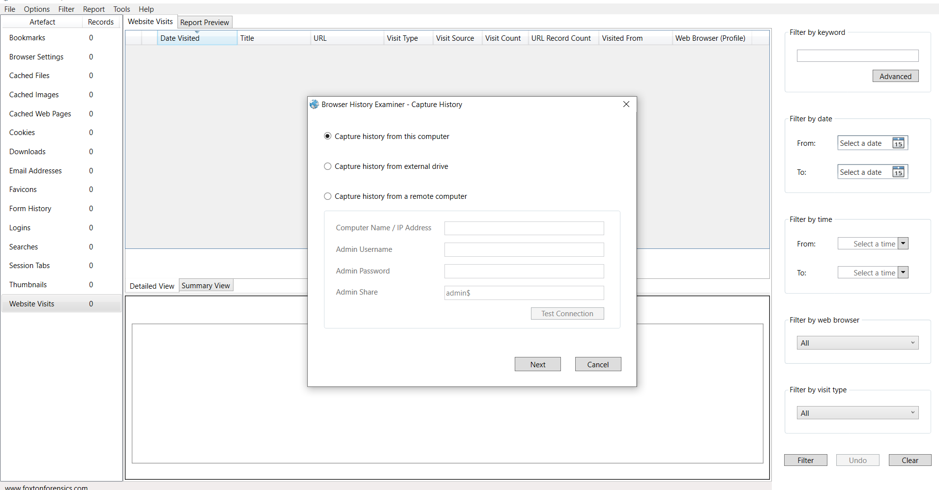
To check the activity logs, first we need to capture history from the computer.

Slide 9
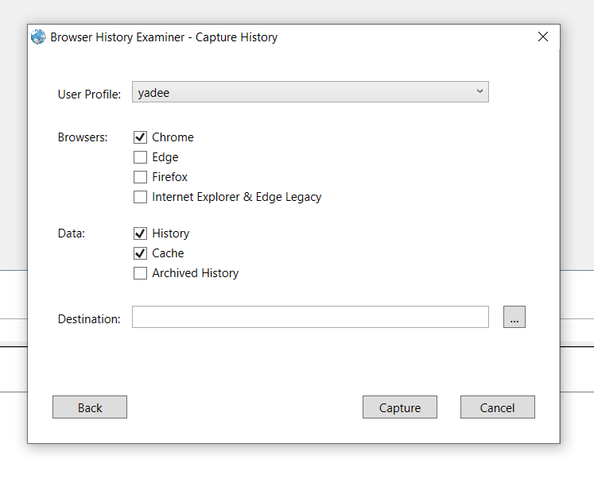
Select browser and the type of data that you want to analyze.
Select the destination folder where you want information to be stored.
Click on Capture.

Slide 10
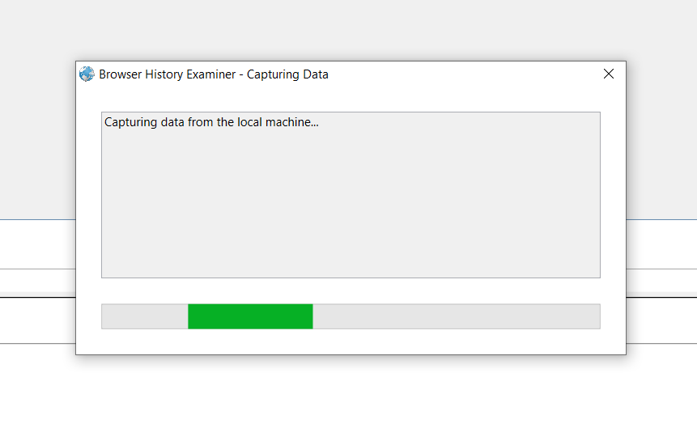
The Browser history examiner will begin to capture data from the machine.

Slide 11
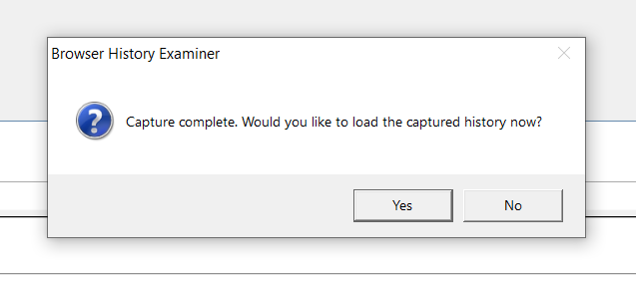
A pop up will appear saying that capture is complete and whether the user wants to load captured history now.
Click yes to view the history.

Slide 12
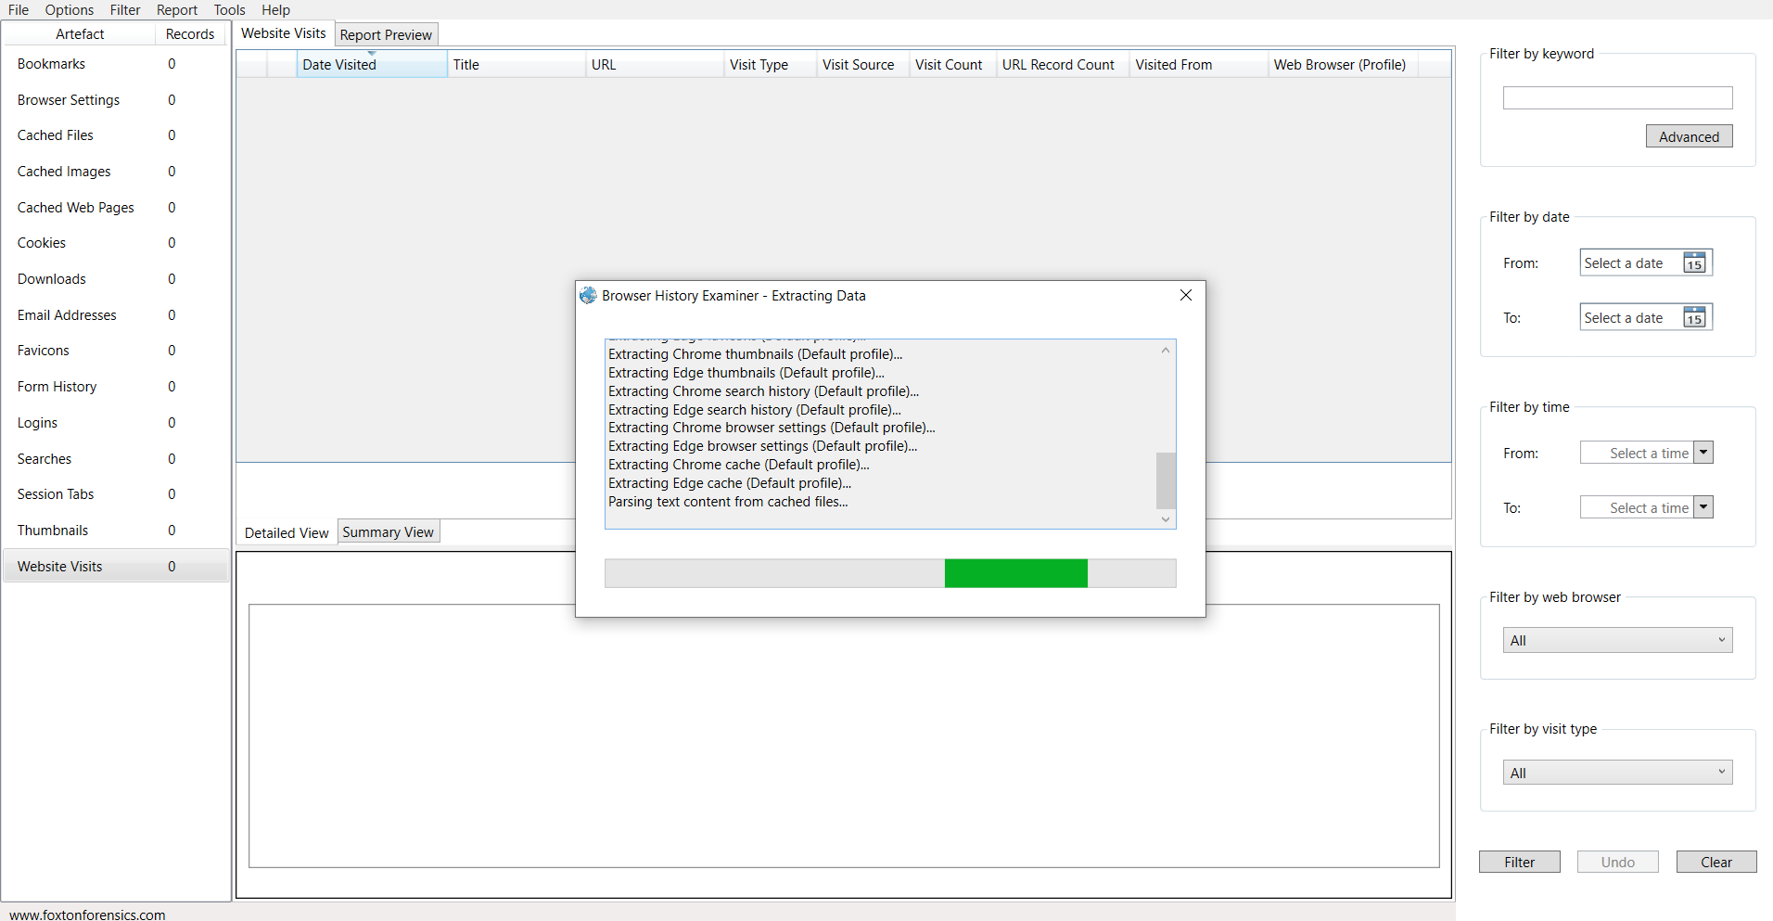
Data extraction process will be started.

Slide 13
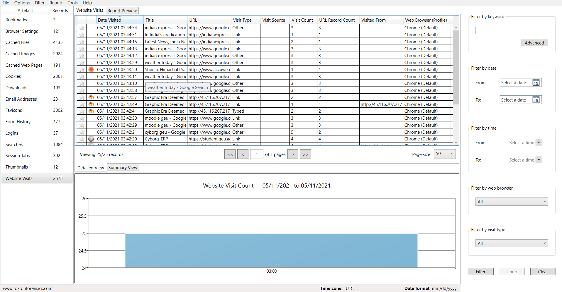
After completion of the process the user can check information like visited websites, recent tabs, searches, logins, downloads etc.
Viewing the websites visited.

Slide 14
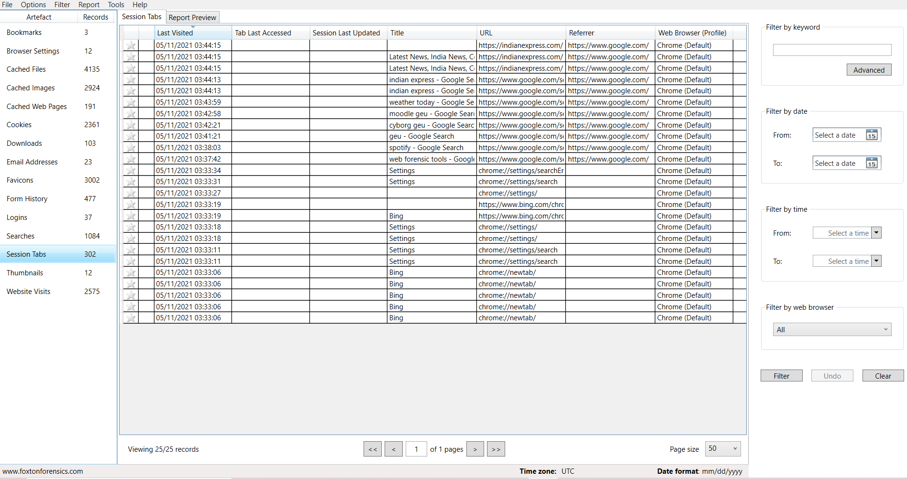
Viewing the session tabs.

Slide 15
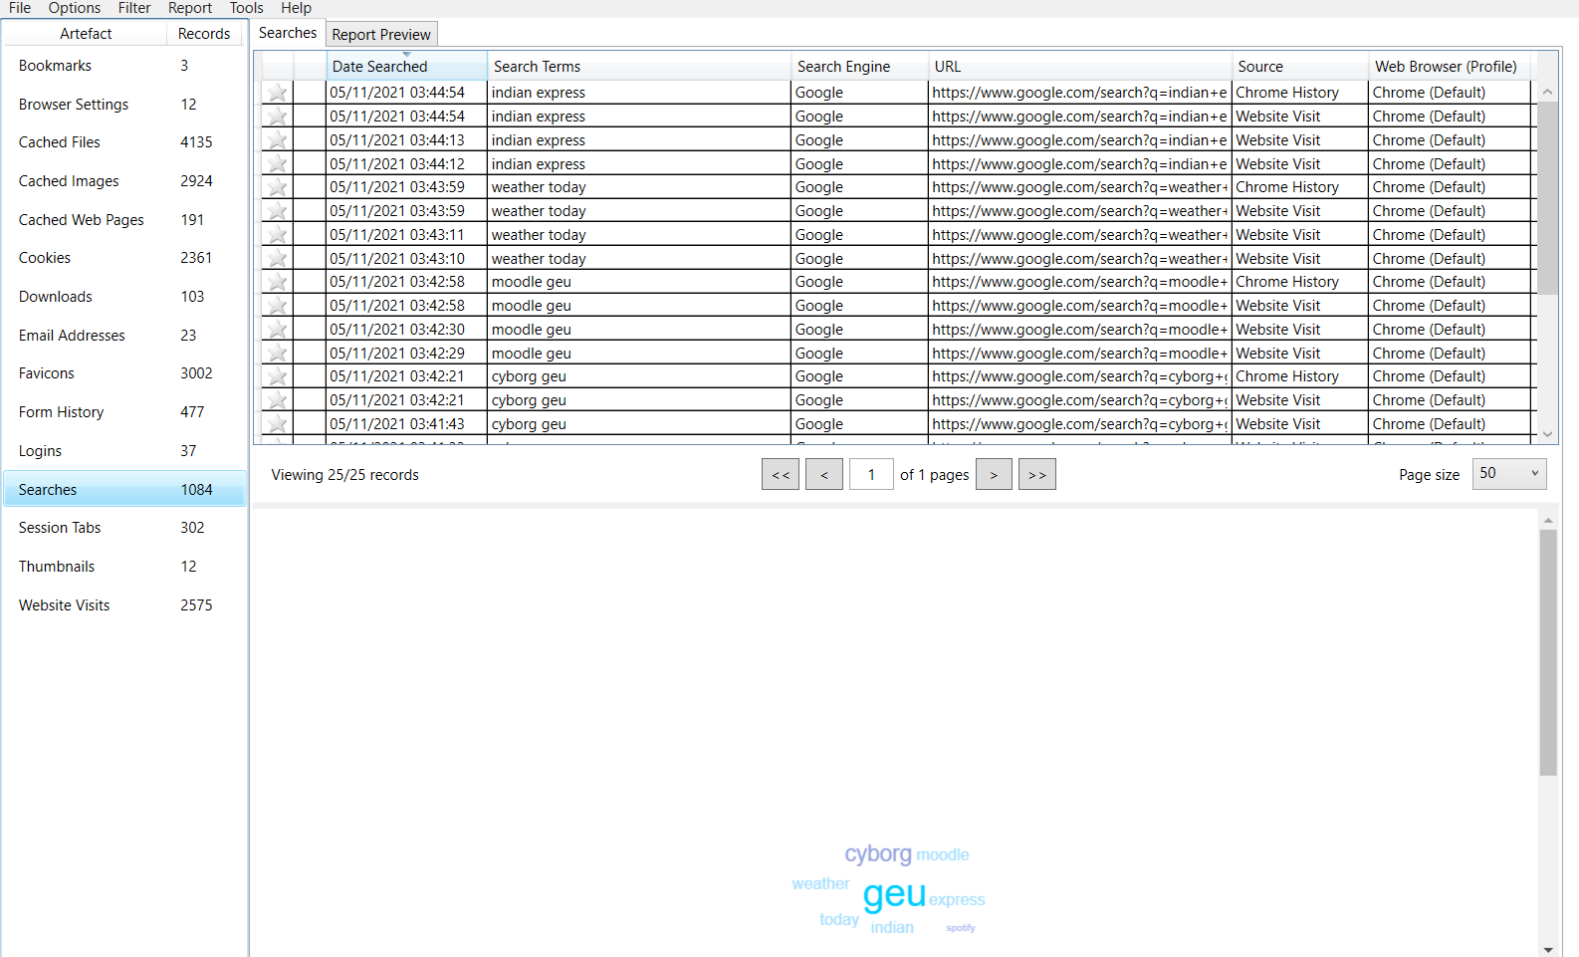
Viewing the search history.

