Slide 1
Climate, Sunspots, and Forestry: Global Approaches to Understanding Malaria in British Mauritius
Yadhav Deerpaul (Presentation File – May 2023)

Slide 2
Purpose
The spread of malaria was documented in colonial reports which were lengthy and contained sometimes no visualizations at all.
These reports were also flawed at times while correct at other times.
How can the colonial reports be visualized and analyzed?

Slide 3
Data
There are two types of data.
Those of a description nature such as a description of how the disease malaria spread.
Then, there are the statistical data which need to be georeferenced (used ArcGIS Pro).
All of them have to be transcribed and cleaned especially from wide to long format (used OpenRefine).

Slide 4
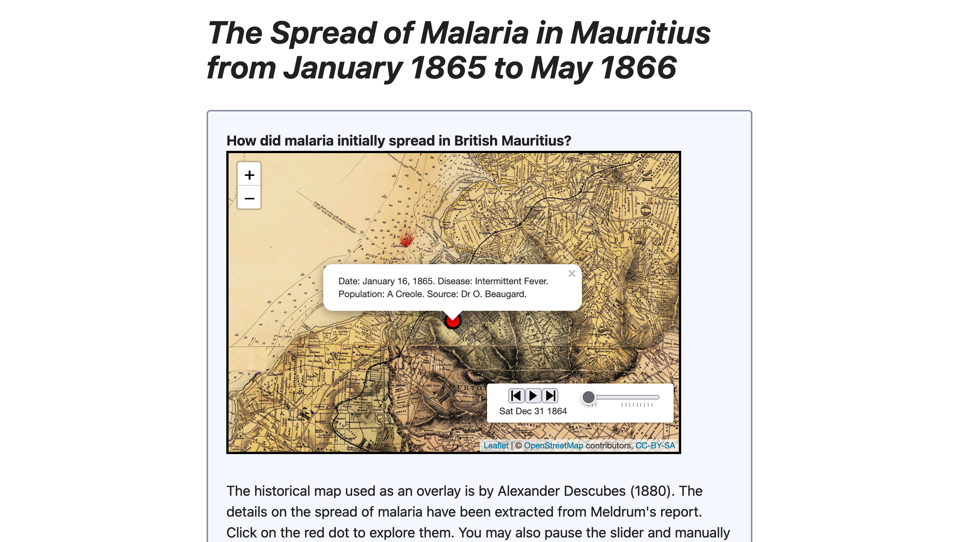
Leaflet Map
One of the most challenging parts of the project.
Leaflet does not natively allow timelines and there are no tutorials online on how to do all of them together with popups and rasters.
The package leaftime which did allow timelines does not support popups.
The popups which are visible when clicking on the red markers from the sliders is actually generated from Leaflet’s addCircleMarkers.
The reason why you cannot see the original circle markers is because they are hidden using Timeslider from leaflet.extras2.
Adding a raster layer on top of them using addRasterImage is not possible as it breaks the timeline and popups mechanism.
The solution was a georeferenced TIFF converted to PNG: https://stackoverflow.com/questions/47170828/overlay-image-on-r-leaflet-map.

Slide 5
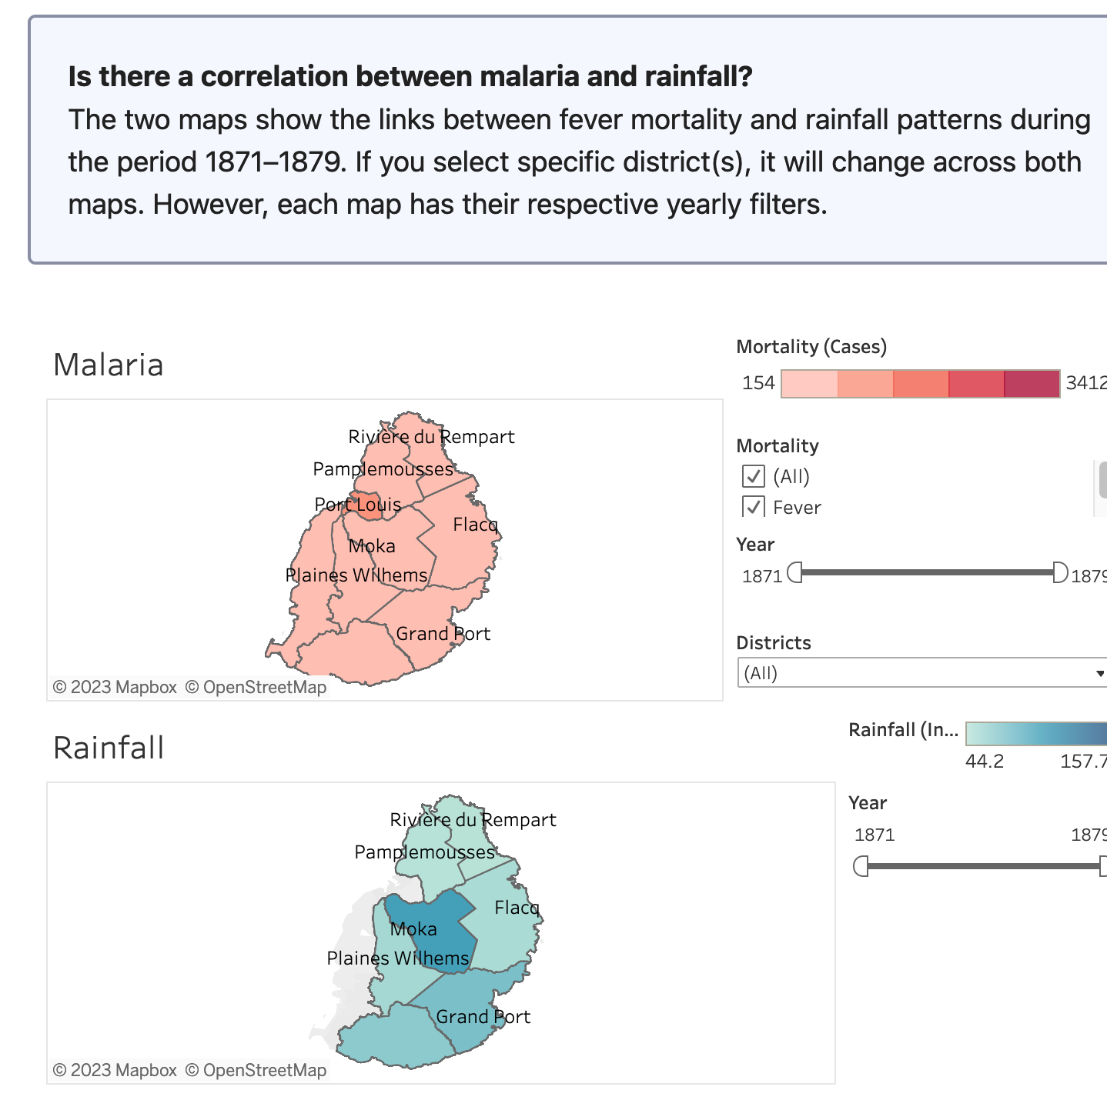
Tableau Chart
The Tableau charts use filters for the Districts.
The one difference was I used my own shapefiles (because Tableau is a bit tricky with non-US districts).
However, I kept the basemap. So, when the user deselects a district, a grey basemap is visible instead of an empty space.

Slide 6
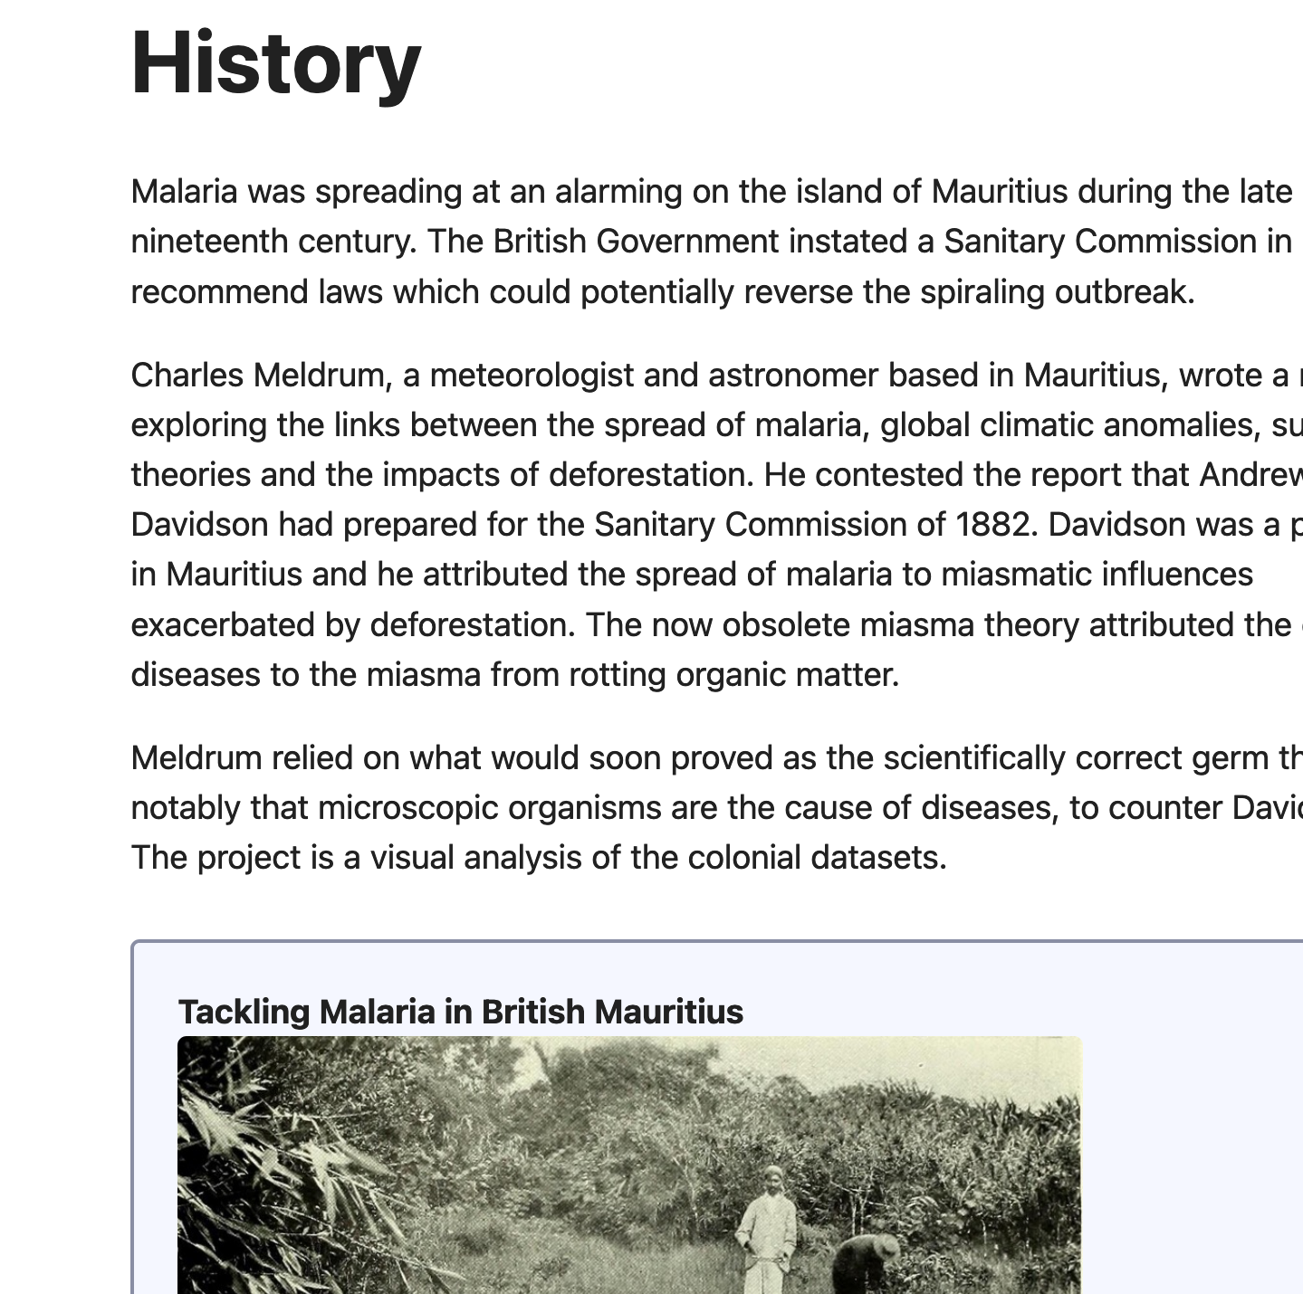
Website
I used Simple.css (https://simplecss.org/) for the website design.
It also adapts to the dark mode.
I particularly also appreciated the <p class="notice"> paragraphs which make the image and even map stand out.

Slide 7
Future Plans
As the research project is an ongoing one, I have not used all my datasets at the current stage.
Further adjustments are required especially for the historically coordinates.
Two things I plan to try for future iterations is how to integrate 3D DEMs using perhaps OL-Celcium (https://openlayers.org/ol-cesium/) instead of ArcGIS StoryMaps and then doing correlational analyses using web maps using Turf.js (https://turfjs.org/).

Slide 8
Thank You

