Slide 1

S7 PROJECT FINAL REVIEW
Group C3
Secure and Role-Aware Explainable Occupant Tracking in Multi-Building Indoor Smart Spaces
Guided by,
Dr. Lakshmi Mohan
Ajith Ashok AM.U4.U4CSE23204
Arjun Rajesh AM.U4.U4CSE23208
D Aditya Kiran AM.U4.U4CSE23215
Yadhu Vipin Madhilakath Madathil AM.U4.U4CSE23270
Notes:
Good morning, ma'am and members of the panel. We are Group C3, and this is the final review of our project, Secure and Role-Aware Explainable Occupant Tracking in Multi-Building Indoor Smart Spaces, guided by Dr. Lakshmi Mohan. The work was done by Ajith Ashok, Arjun Rajesh, D Aditya Kiran and me, Yadhu Vipin.

Slide 2
Outline
Introduction
Problem Definition
Objectives
Literature Review
Research Gap
Datasets, Platforms and Tools
Proposed Methodology
Proposed Approach
Evaluation Setup and Criteria
Results and Analysis
Discussion and Limitations
Conclusion
Future Work
Team Contribution
Appendix A: Code and Demo
Project Time Line
Reference
Secure and Role-Aware Explainable Occupant Tracking in Multi-Building Smart Spaces
Notes:
This is the outline. We start with the introduction, the problem and the objectives, then the literature and the gap it leaves. After that come our tools, the methodology and the approach, the evaluation setup, the results, and the discussion with its limitations. We close with the conclusion, future work, team contribution, the code and demo, the time line and the references.

Slide 3
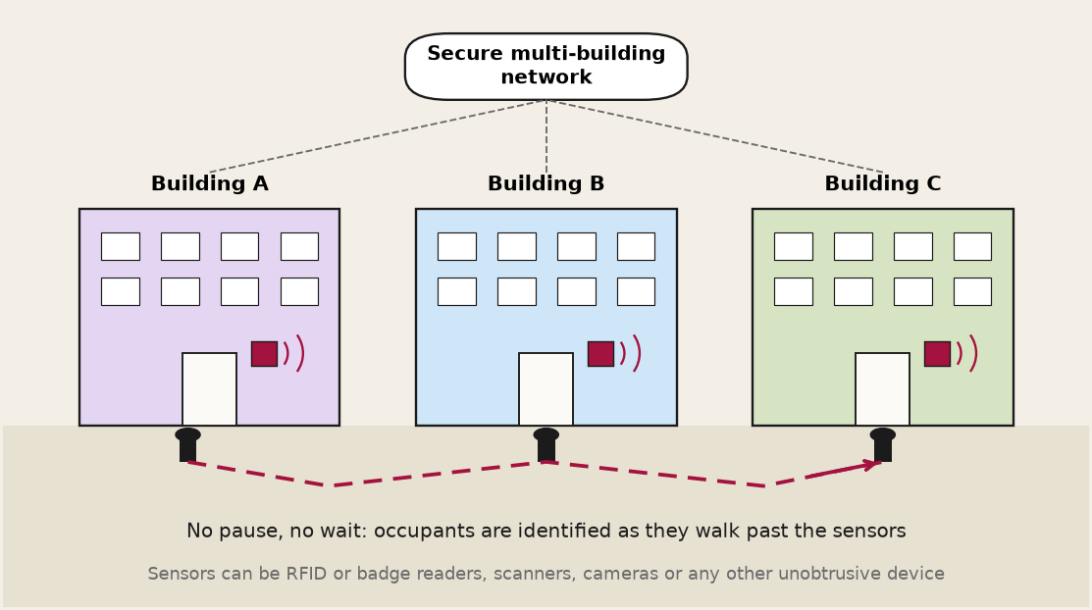

INTRODUCTION
Background
A smart space is an indoor environment with sensors, IoT devices and intelligent infrastructure that collect and analyse indoor location data, making it more responsive to visitors and staff.
We model an unobtrusive smart space, so the sensor is a camera: no one has to pause and wait, unlike with RFID or badge scanners.
A campus has many buildings, and a person registered in one building is a visitor in every other. Tracking has to continue as people move between buildings.
Keeping all identities in one central store is the usual design, and today's technology can secure it well.
Motivation
A distributed aspect: each building keeps its own data, and only a small summary is shared between buildings
A fair comparison: how close can a distributed design come to a centralised one?
Controlled access: who may ask where a person is, and why an answer was given
Problem: bring a distributed aspect to unobtrusive occupant tracking across buildings, and compare it with the centralised design.
Notes:
A smart space is an indoor environment equipped with a network of sensors, IoT devices and intelligent infrastructure that collect and analyse indoor location data. That data is used to make the space more responsive to the needs of visitors and staff.
We model an unobtrusive smart space, and that is why we use cameras: nobody has to pause and wait, unlike with RFID or badge scanners. Our experiments use face images, but this is not a face-recognition project: the face is only the sensor reading, and the question is how identity is found and shared across buildings.
On a campus a person is registered in one building and is a visitor in every other, so tracking has to continue as people move. Keeping all identities in one central store is the usual design, and today's technology can secure it well. Two alternatives are sometimes suggested: a distributed hash table, or ID cards. A distributed hash table needs an exact key, while a sensor reading is noisy and only ever similar to the stored one, so exact lookup does not apply. ID cards make people stop and present something, which is exactly the pause we want to avoid.
So our motivation is a distributed aspect, where each building keeps its own data and only a small summary is shared, a fair comparison of how close this can come to a centralised design, and controlled access to who may ask where a person is and why an answer was given.

Slide 4
Problem Definition
Motivation
Problem statement
Existing multi-building occupant tracking approaches address distributed tracking and cross-building identification, but a unified system combining decentralised identity discovery, role-aware access control and explainable querying has not been sufficiently explored. This motivates investigating such an integrated approach.
To identify and track occupants across wide-area, multi-building indoor smart spaces, while enabling secure, role-based and explainable access to their whereabouts — justifying both the access decisions and the tracking evidence behind them.
Notes:
Existing work covers distributed tracking and cross-building identification separately. What has not been sufficiently explored is a unified system that combines decentralised identity discovery, role-aware access control and explainable querying. That is what this project investigates.
The problem statement is therefore: identify and track occupants across wide-area, multi-building indoor smart spaces, while giving secure, role-based and explainable access to where they are, and justifying both the access decision and the tracking evidence behind it.

Slide 5
Objectives
1
To extend the DSTS (Distributed State Transition System) framework to support distributed, multi-building occupant identification and tracking.
2
To develop an RBAC-based query interface covering the Dean, Teacher and Student roles.
Status: Achieved
Status: Achieved
3
To generate explainable responses that justify both the access decision and the tracking evidence behind it.
4
To design an LSH (Locality-Sensitive Hashing) and Bloom-filter mechanism for decentralised visitor lookup.
Status: Achieved
Status: Achieved
5
To integrate security measures — encrypted embedding transfers, role-based filtering and audit logging — across the system.
6
To evaluate the system on tracking precision and recall, communication cost (gallery touched per lookup) and explanation quality.
Status: Achieved (simulated network)
Status: Achieved
Notes:
We set six objectives. First, extend the DSTS framework, the Distributed State Transition System of our base paper, to multiple buildings. Second, build a role-based query interface for the Dean, Teacher and Student roles. Third, make every answer explainable, covering both the access decision and the tracking evidence. Fourth, design the LSH and Bloom-filter mechanism for decentralised visitor lookup. Fifth, add security: encrypted transfers, role-based filtering and audit logging. Sixth, evaluate on precision and recall, on communication cost measured as how much of the gallery a lookup touches, and on explanation quality.
All six are achieved. The security objective carries one caveat: the network between buildings is simulated.

Slide 6
Literature Review
Paper (Year) | Key contribution | Demerit | Dataset used | Metrics
[1] Indoor group ID and localization, privacy-preserving edge camera network (2024) | Group ID and localization from pose + DBSCAN on edge cameras | Groups only, not individuals; one therapeutic space | Own dataset: 7 people, 35 min, groups of 2 to 7 | Precision, recall, F1 (~90%), MAE 1.25 m
[2] Feasibility study: indoor localization and multi-person tracking, sparse edge cameras (2023) | Edge framework for localization and tracking with 39 cameras | One site; no cross-building identity discovery | Own 1700 m² therapeutic space | MOTA (88.6%), MOTP, IDF1, ID switches, 1.41 m error
[3] Distributed multi-camera multi-target association (2022) | Distributed target association without calibration | No building-level probabilistic state or visitor origin | Several multi-camera benchmarks + own mobile set | MOTA, IDF1, FP/FN, ID switches
[4] Distributed multi-target tracking in camera networks (2021) | Consensus Kalman filter + distributed tracker manager | More efficient tracking, but no multi-building occupant model | Public multi-camera tracking datasets | MOTA / IDF1 type, bandwidth
[5] Smart surveillance: real-time multi-person multi-camera tracking at the edge (2021) | End-to-end edge pipeline: detection, tracking, re-ID on Jetson TX2 | No formal multi-building state / query model or decentralised visitor tracking | Own campus recordings (one day) | IDF1 90.97, 30 FPS, ~90 ms re-ID
[6] Modelling large-scale camera networks (DSTS), 2020 (base paper) | Abstract state-transition framework: states, events, transitions | Visitors resolved through a central master list | Framework paper | Extended by this project
Notes:
This table summarises the literature we reviewed. Papers one to five are the mid-review set: edge-camera group identification, localization and tracking, and distributed multi-camera association. They work within one site and give no cross-building identity discovery, no building-level probabilistic state and no role-aware access. Paper six is the base paper, the DSTS framework, which resolves visitors through a central master list. That central list is the part this project replaces. Full descriptions are in the report, chapter 3.

Slide 7
Research Gap
Gap in existing work | What is missing | What this project does
Cross-building identity | Distributed tracking work operates inside one site; finding a visitor's home building is not addressed. | LSH + Bloom routing shortlists the likely buildings; only they verify the identity
Routing effectiveness | Bloom filters with LSH are efficient, but unproven for cross-building biometric routing. | Compares distributed routing with a centralised search on identification accuracy and on how much of the data a lookup touches
Access control | Role-based access control over who may see an occupant's location and identity is not addressed. | Role-based access control with graded levels of disclosure for each role
Explainability | No reasoning or evidence returned with access decisions and tracking answers. | Every answer carries its rule, evidence, uncertainty flags and what was withheld
Notes:
Reading the literature, we found four gaps. Cross-building identity: tracking work stays inside one site, and finding a visitor's home building is not addressed. Routing effectiveness: Bloom filters with LSH are efficient but unproven for cross-building biometric routing. Access control: who may see an occupant's location and identity is not addressed. Explainability: answers carry no reasoning or evidence.
The right column shows what we do: LSH and Bloom routing, a comparison against a centralised search, role-based access with graded disclosure, and an explanation on every answer.

Slide 8
Datasets, Platforms, and Implementation Tools
Category | Details
Dataset | Main: CASIA-WebFace: 500 identities, 20 reference + 20 test photos each (20,000 embeddings), split over 10 simulated buildings of 50 people Masked: RMFRD real-world masked faces: 50 identities as building_11; 20 unmasked references + 20 masked probes each (800 real, 200 augmented)
Face models | InsightFace buffalo_l: SCRFD detector (det_10g) and ArcFace (w600k_r50), 512-d, ONNX Runtime
Platform / hardware | Windows 11, Python 3.12; laptop CPU only, no GPU; full run of 11,000 events in about 8 minutes
Routing and tracking | Random-hyperplane LSH, Bloom filter, vote-based verifier, BSTS state store in SQLite (all implemented from scratch with NumPy / pandas)
Security and API | cryptography (X25519, HKDF, AES-GCM, Ed25519), HMAC tokens, FastAPI, static HTML/JS dashboard, Prometheus metrics
Quality | pytest: 575 automated tests; seeded populations so every result is reproducible
Notes:
This table lists what we used. The main dataset is CASIA-WebFace: 500 identities with 20 reference and 20 test photos each, split over ten simulated buildings of 50 people. A separate masked dataset, RMFRD, supplies 50 real masked-face identities as an eleventh building.
Faces are processed with InsightFace: the SCRFD detector and the ArcFace model giving 512-dimensional embeddings. Everything runs on a laptop CPU. Routing, the verifier and the state store are implemented from scratch with NumPy and pandas. The security layer uses the cryptography library, with FastAPI for the server and a static dashboard. Quality is covered by an automated test suite, and populations are seeded so every result is reproducible.

Slide 9
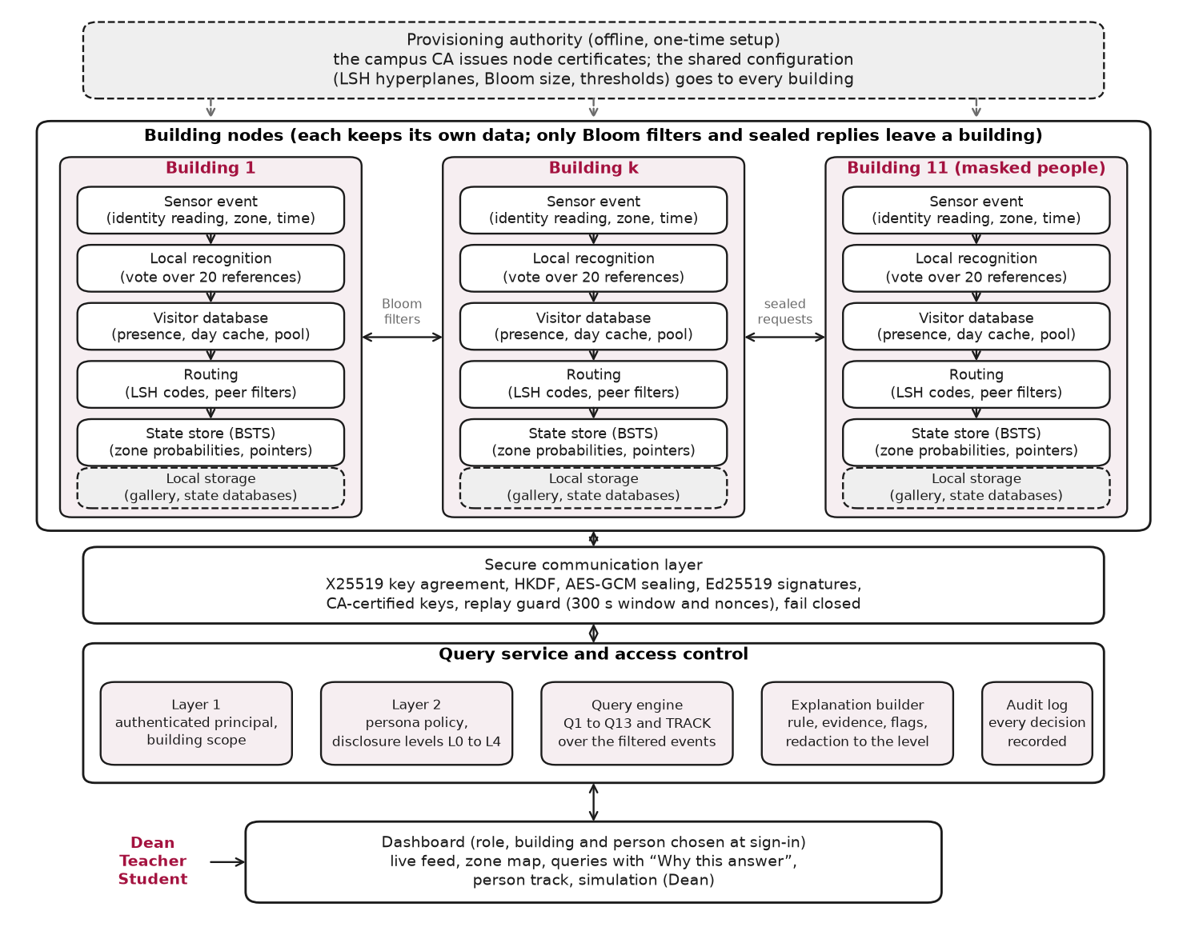
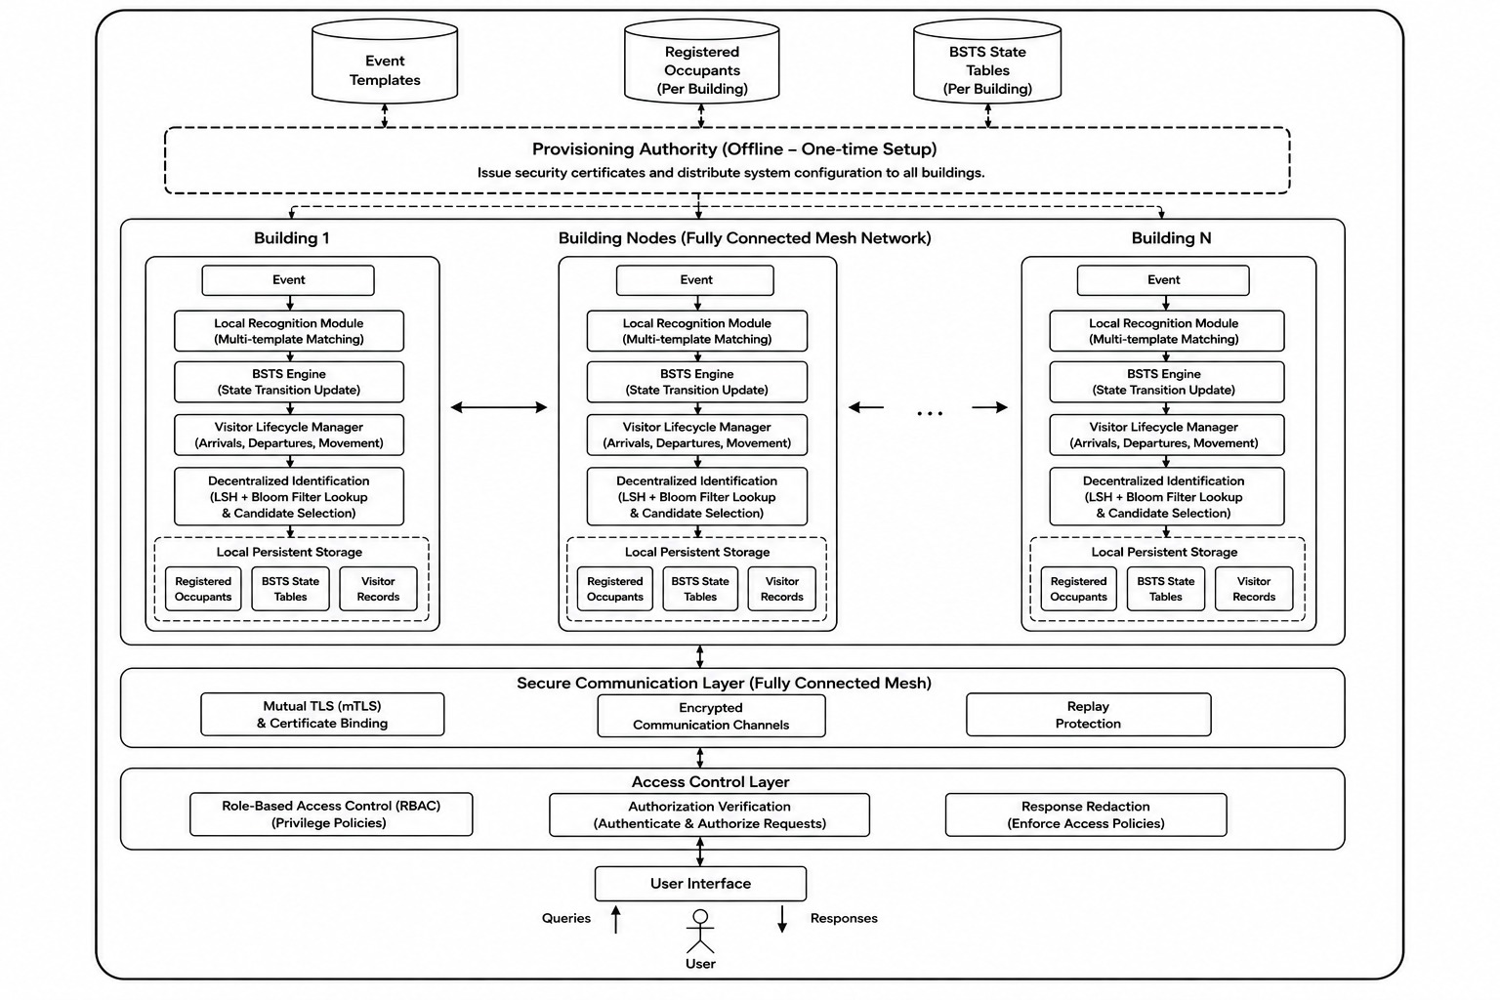

Proposed Methodology
Architecture and what is new
Novelty
LSH + Bloom routing: each building publishes only a compact Bloom filter (no ids or embeddings); a capture ranks the buildings without exposing any gallery.
Targeted peer verification: only the shortlisted buildings compare faces (vote of 12 of 20 references).
Dynamic visitor database: presence, a day cache, an entry counter and a permanent pool for frequent visitors.
Role-based access control: each role (Dean, Teacher, Student) sees only what its relationship to a person allows, at graded levels of detail.
Explainable answers: rule, evidence, uncertainty flags, redacted to the caller's level.
Sealed transfers: every cross-building message is encrypted, signed and replay-protected.
Architecture: every building holds its own gallery and state; only Bloom filters and sealed replies cross buildings.
Notes:
This is the architecture and what is new. Every building holds its own gallery and its own state. Only Bloom filters and sealed replies cross buildings.
The novelty is in six parts. LSH plus Bloom routing, where a building publishes only a compact Bloom filter, with no ids and no embeddings, so a capture can rank buildings without exposing any gallery. Targeted peer verification, where only the shortlisted buildings compare faces. A dynamic visitor database. Role-based access control with graded detail. Explainable answers. And sealed transfers, encrypted, signed and replay-protected.

Slide 10
Proposed Methodology
Dynamic visitor database and visit pointers
1. Presence
2. Day cache
3. Permanent pool
Who is inside a building and in which zone, until they leave or the day ends.
Every event updates the probabilities of the visitors who are inside.
The visitor's 20 references, kept for one simulated day.
Later sightings the same day are matched locally: no routing, no new request.
Every arrival is recorded.
After 3 entries in 7 days (or 8 in 30), the next entry stores the person permanently.
Rules that keep the state correct
Transition-zone rule: a visitor waiting in zT is left out of other people's updates until seen outside zT.
Visit pointers: the arrival mints a pointer at the person's home building (no biometrics); the second zT event closes it. A location query follows the open pointer instead of asking all buildings.
Notes:
Here is the visitor database. A visitor passes through three stages. Presence: who is inside a building and in which zone, with probabilities updated on every event. Day cache: the visitor's twenty references are kept for one simulated day, so later sightings are matched locally with no routing. Permanent pool: after three entries in seven days, or eight in thirty, the next entry stores the person permanently.
Two rules keep the state correct. The transition-zone rule: a visitor waiting in the transition zone is left out of other people's updates until seen outside it. And visit pointers: an arrival creates a pointer at the person's home building, with no biometrics, and the second transition-zone event closes it, so a location query follows the open pointer instead of asking every building.

Slide 11
Proposed Methodology
Security and access control
Between buildings (secure_transfer)
Who may see whom (access_control)
Sealed payloads: ephemeral X25519, HKDF-SHA256, AES-GCM with the header as associated data
Signed: Ed25519 signature over header, nonce and ciphertext; replies bound to their request
Certified keys: a campus CA signs a certificate binding both public keys; expiry, revocation and pinning are checked
Replay guard: 300 s window plus unique nonces, checked after the signature
Fail closed: any failed step means no reply and nothing admitted
Visitor data hygiene: private copies, cache zeroed at day rollover
Role | May follow | Cannot see
Dean | Own campus's teachers and students, and other Deans | Other campuses' people, visitors
Teacher | Only their assigned students, in any building | Unassigned students, peers, Dean
Student | Only their assigned teachers; self in full | Peers, other teachers, Dean
Layer 1: authenticated principal, building scope. Layer 2: persona policy, disclosure L0 to L4.
Also: signed 1-hour tokens, per-person credentials, login lockout, single-use WebSocket tickets, audit log.
Notes:
Security has two parts. Between buildings, every message is sealed with an ephemeral X25519 key, HKDF and AES-GCM, and signed with Ed25519. Keys are certified by a campus authority, a replay guard rejects old or repeated messages, and any failed step means no reply and nothing admitted.
Within a building, access control has two layers: the first checks the authenticated principal and building scope, and the second applies the persona policy with disclosure levels L0 to L4. The table shows what each role may follow: the Dean sees their own campus and other Deans, a Teacher sees only assigned students, and a Student sees only assigned teachers and themselves. Tokens, lockout and an audit log sit around this.

Slide 12
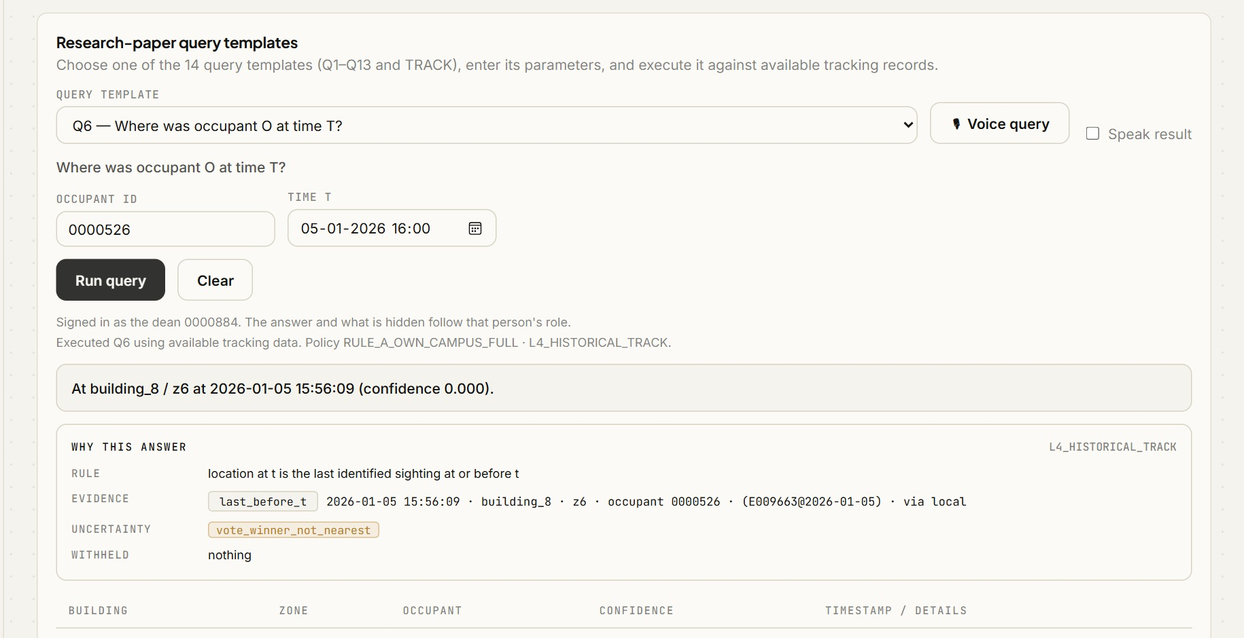
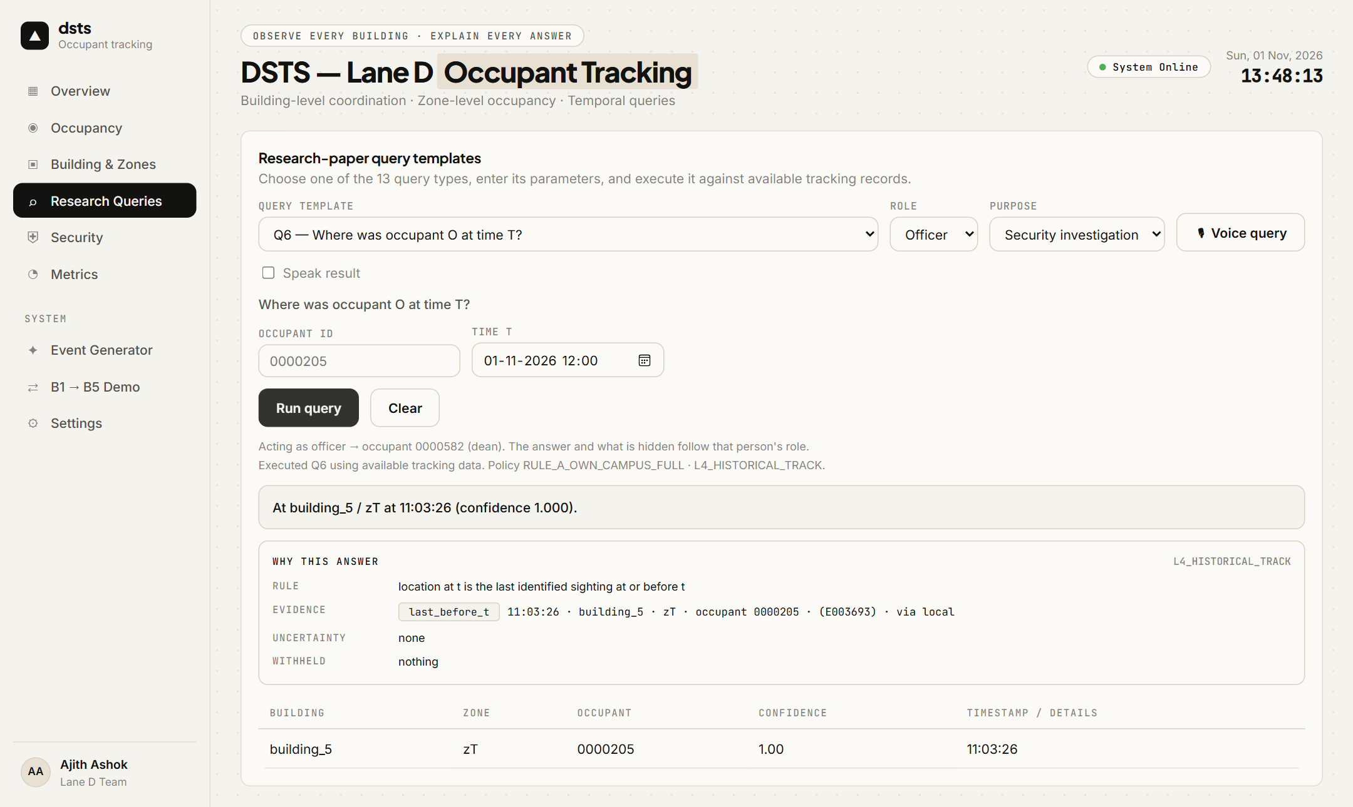
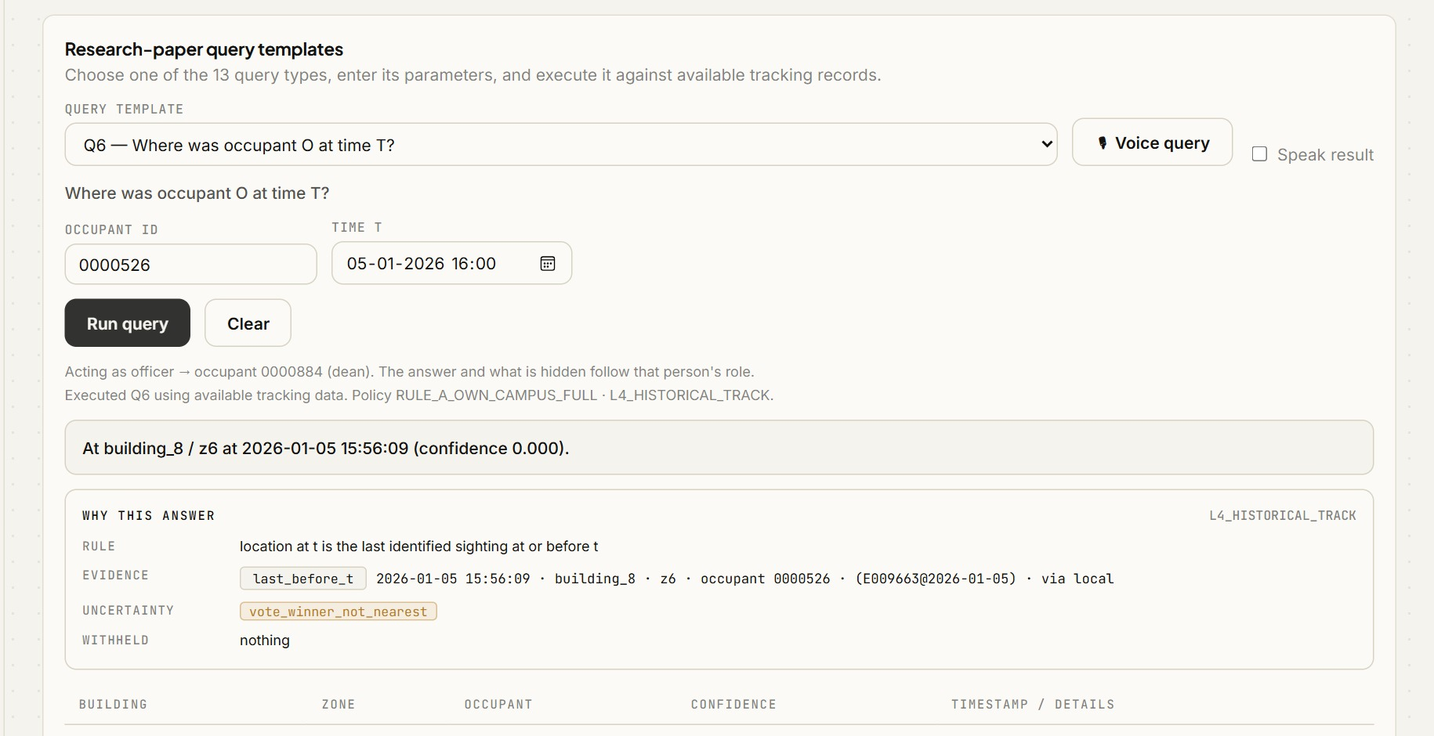
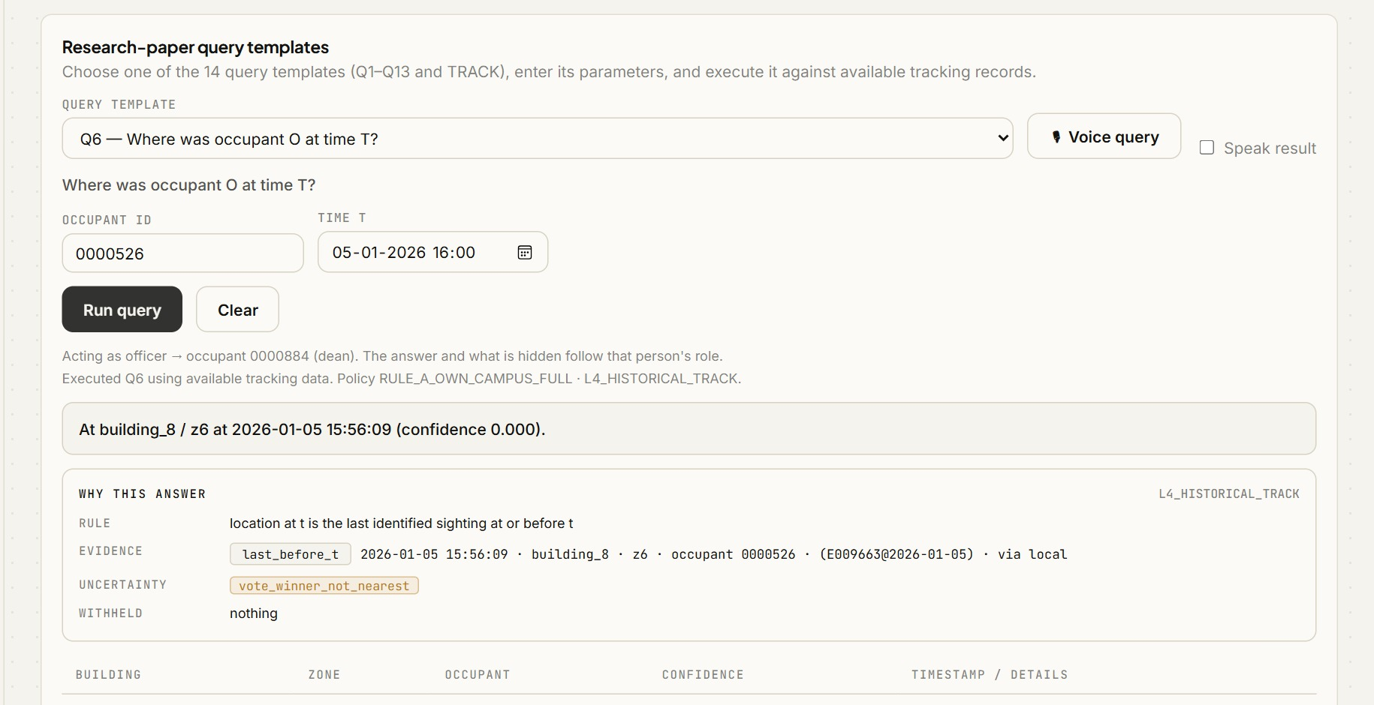
Proposed Methodology
Explainable responses: why this answer
Every answer carries:
Rule the decision rule applied
Evidence the events it rests on, with their role (decisive, last before t, carry-in...)
Absence what was looked for and not found
Uncertainty flags low votes, narrow routing margin, stale sighting, pointer-based, verified by a lower-ranked building, and the strongest, vote_winner_not_nearest (the accepted occupant was not the nearest candidate)
Withheld what the caller's level removed
The explanation is built from the same events as the answer, then redacted to the caller's level, so it never shows more than the answer does.
Notes:
Every answer carries five parts: the rule applied, the evidence it rests on, what was looked for and not found, uncertainty flags, and what the caller's level withheld. The flags include low votes, narrow routing margin, stale sighting, and the strongest one, vote_winner_not_nearest, which means the accepted person was not the nearest candidate.
The explanation is built from the same events as the answer and then redacted to the caller's level, so it can never show more than the answer does. The screenshot is a Dean's query with its Why-this-answer card.

Slide 13
Proposed Methodology
Masked occupants: building 11
50
20 + 20
800 / 200
people from the real-world masked-face dataset RMFRD form an 11th building
photos each: 20 unmasked for the gallery, 20 masked as the events
of the 1,000 masked probes are real photos / augmented copies
How it works
Faces are detected and aligned (SCRFD), then embedded with the same ArcFace model as everyone else.
Routing and verification are unchanged: a masked probe is matched against an unmasked gallery, so the system never knows a mask is present.
Augmented copies (flip, rotation, scale, shift, brightness, blur, noise, JPEG) fill the probes where a person has fewer than 20 real masked photos.
The masked people are not shuffled by the seed: building 11 is always the same 50 people.
Notes:
The eleventh building holds fifty people from a real masked-face dataset. Each has twenty unmasked photos for the gallery and twenty masked photos used as events; most are real, and a minority are augmented copies where fewer real photos exist.
The important point is that routing and verification are unchanged. A masked probe is matched against an unmasked gallery, so the system never knows a mask is present. The masked people are not shuffled by the seed, so building eleven is always the same fifty people.

Slide 14
Proposed Approach
Algorithm, training and testing, hyperparameters
Algorithm (per sensor event)
Training and testing
Hyperparameters
1
Read the event: identity reading, zone, time
No model is trained: pretrained SCRFD and ArcFace give the embeddings
Parameter | Value
LSH bits K / slots L | 11 / 122
Bloom target false-positive rate | 0.01
References per occupant | 20
Accept angle | 80.43°
Minimum votes (of 20) | 12
Shortlist size / probes | 5 / 3
Visitor promotion | 3 in 7 days or 8 in 30
2
Vote over the building's own 20 references
20 reference photos per person enrol the building
3
If not accepted: LSH codes, score peers' Bloom filters
The other 20 photos per person are the events; none is used twice
4
Verify in the top 5 buildings (sealed)
5
Update the zone probabilities (BSTS)
Five random populations, seeds 0 to 4
6
Open or close the visit pointer; cache the visitor
Test once: one simulated day, 11,000 events per run
7
Answer queries by role, with the explanation
Notes:
The Proposed Approach slide gives the algorithm, the training and testing procedure, and the hyperparameters. For each sensor event: read the identity, zone and time; vote over the building's own twenty references; if not accepted, compute LSH codes and score the peers' Bloom filters; verify in the top five buildings over sealed channels; update the zone probabilities; open or close the visit pointer and cache the visitor; and answer queries by role with the explanation.
No model is trained, because pretrained SCRFD and ArcFace give the embeddings. Twenty photos per person enrol the building, the other twenty are the test events, and none is used twice. We test once per population over five random populations. The table lists the settings.

Slide 15
Evaluation Setup and Criteria
Setup and baselines
Metrics (one-vs-rest)
500 people in 10 buildings plus 50 masked people in building_11 (550); populations are seeded (five random populations, seeds 0-4; all results are averages).
One simulated day: 11,000 events (8,800 local, 2,200 visitor).
Baseline: a centralised server holding every gallery, same preprocessing and vote rule, no LSH / Bloom.
State ground truth is recorded for every state, so location, building and zone accuracy are scored too.
TP predicted = true identity. FP a wrong identity was given. FN the true identity was not predicted (wrong or abstain). TN all other pairs.
Precision = TP / (TP + FP)
Recall = TP / (TP + FN)
F1 = 2PR / (P + R)
Identification accuracy = correct identities / events
Gallery touched = buildings searched / buildings (central = 100%).
Why these: accuracy alone hides abstentions and wrong answers (a wrong identity is both an FP and an FN), so precision, recall and F1 are reported with it, per cohort (local, visitor, masked, unmasked) and per state level.
Notes:
For the evaluation, we use five hundred people in ten buildings plus fifty masked people in building eleven, with five seeded populations, and all results are averages. One simulated day has eleven thousand events, of which eight thousand eight hundred are local and two thousand two hundred are visitor events.
The baseline is a centralised server holding every gallery, with the same preprocessing and vote rule but no LSH or Bloom filters. Metrics are one-vs-rest precision, recall and F1, identification accuracy, and gallery touched. We report them per cohort, because accuracy alone hides abstentions and wrong answers. State ground truth is recorded too, so building and zone accuracy are scored as well.

Slide 16
Results and Analysis
Identification and tracking: average of five random populations (seeds 0 to 4), 11,000 events per run
Cohort | Count | Precision | Recall | F1
All events | 11,000 | 0.976 | 0.915 | 0.945
Local (registered here) | 8,800 | 0.981 | 0.920 | 0.950
Visitor (registered elsewhere) | 2,200 | 0.956 | 0.896 | 0.925
Unmasked people | 10,000 | 0.982 | 0.948 | 0.965
Masked people | 1,000 | 0.892 | 0.591 | 0.711
Tracking state | Labels | Precision | Recall | F1
Building | 11 | 0.956 | 0.944 | 0.950
Zone | 9 | 0.921 | 0.910 | 0.916
Building and zone | 99 | 0.901 | 0.890 | 0.896
10.3%
Visitors: the right building is in the top 5 for 86.9% of lookups, and 65.9% of visitor events are served from the visitor database with no routing. Precision, recall and F1 are one-vs-rest scores.
of the galleries touched per lookup (central search: 100%); 91.5% identified correctly against 92.2%
Notes:
These are the results, averaged over five random populations. The chart compares the centralised search with our decentralised design on all events, local events and visitor events. The first table gives precision, recall and F1 per cohort, including masked and unmasked people. The second table scores the tracking state at building, zone, and building-and-zone level.
The card shows the share of galleries touched per lookup against the centralised 100 percent. For visitors, the table notes how often the right building is in the shortlist and how many visitor events are served from the visitor database with no routing.

Slide 17
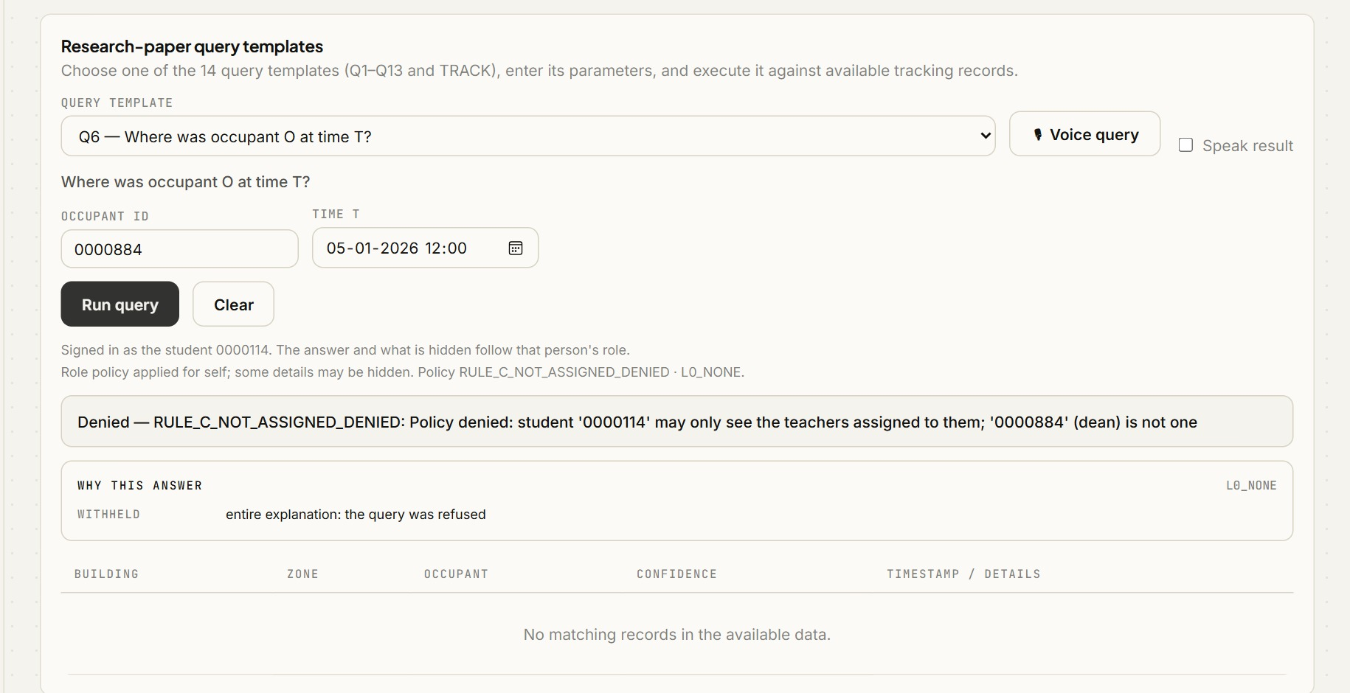
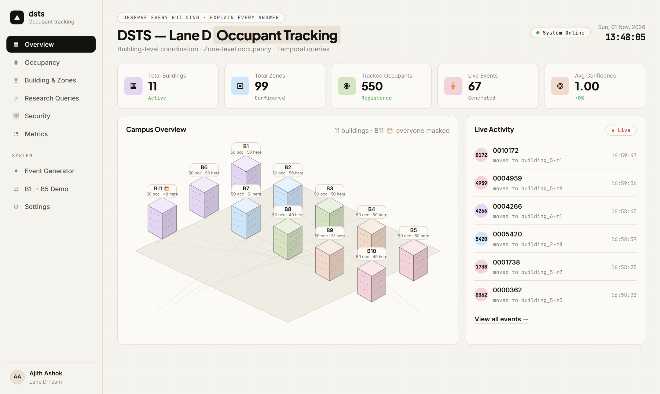
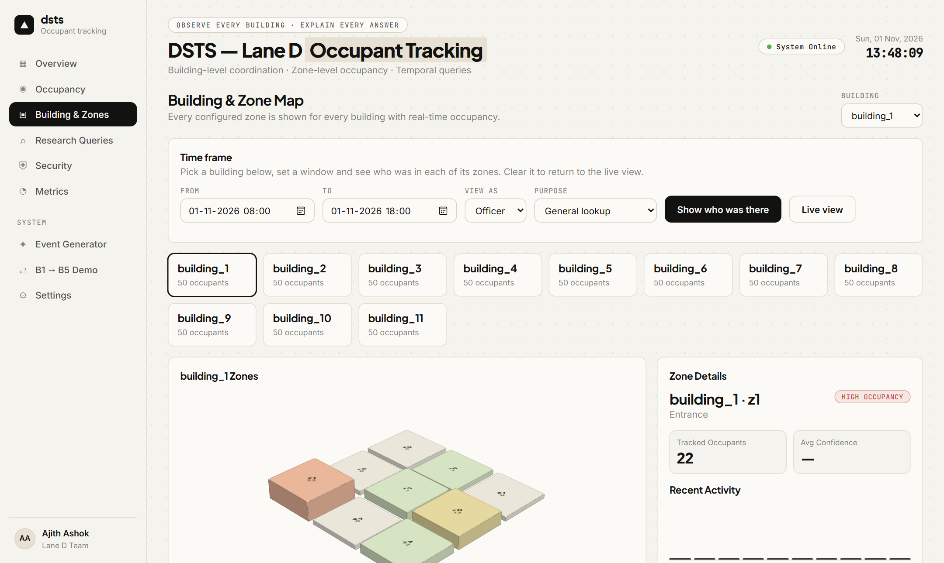
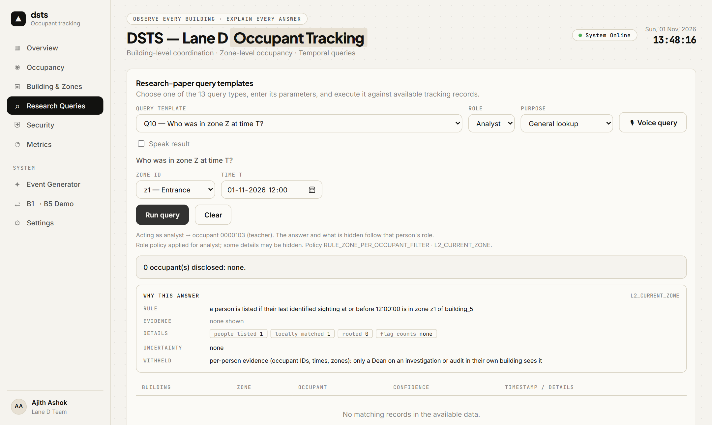
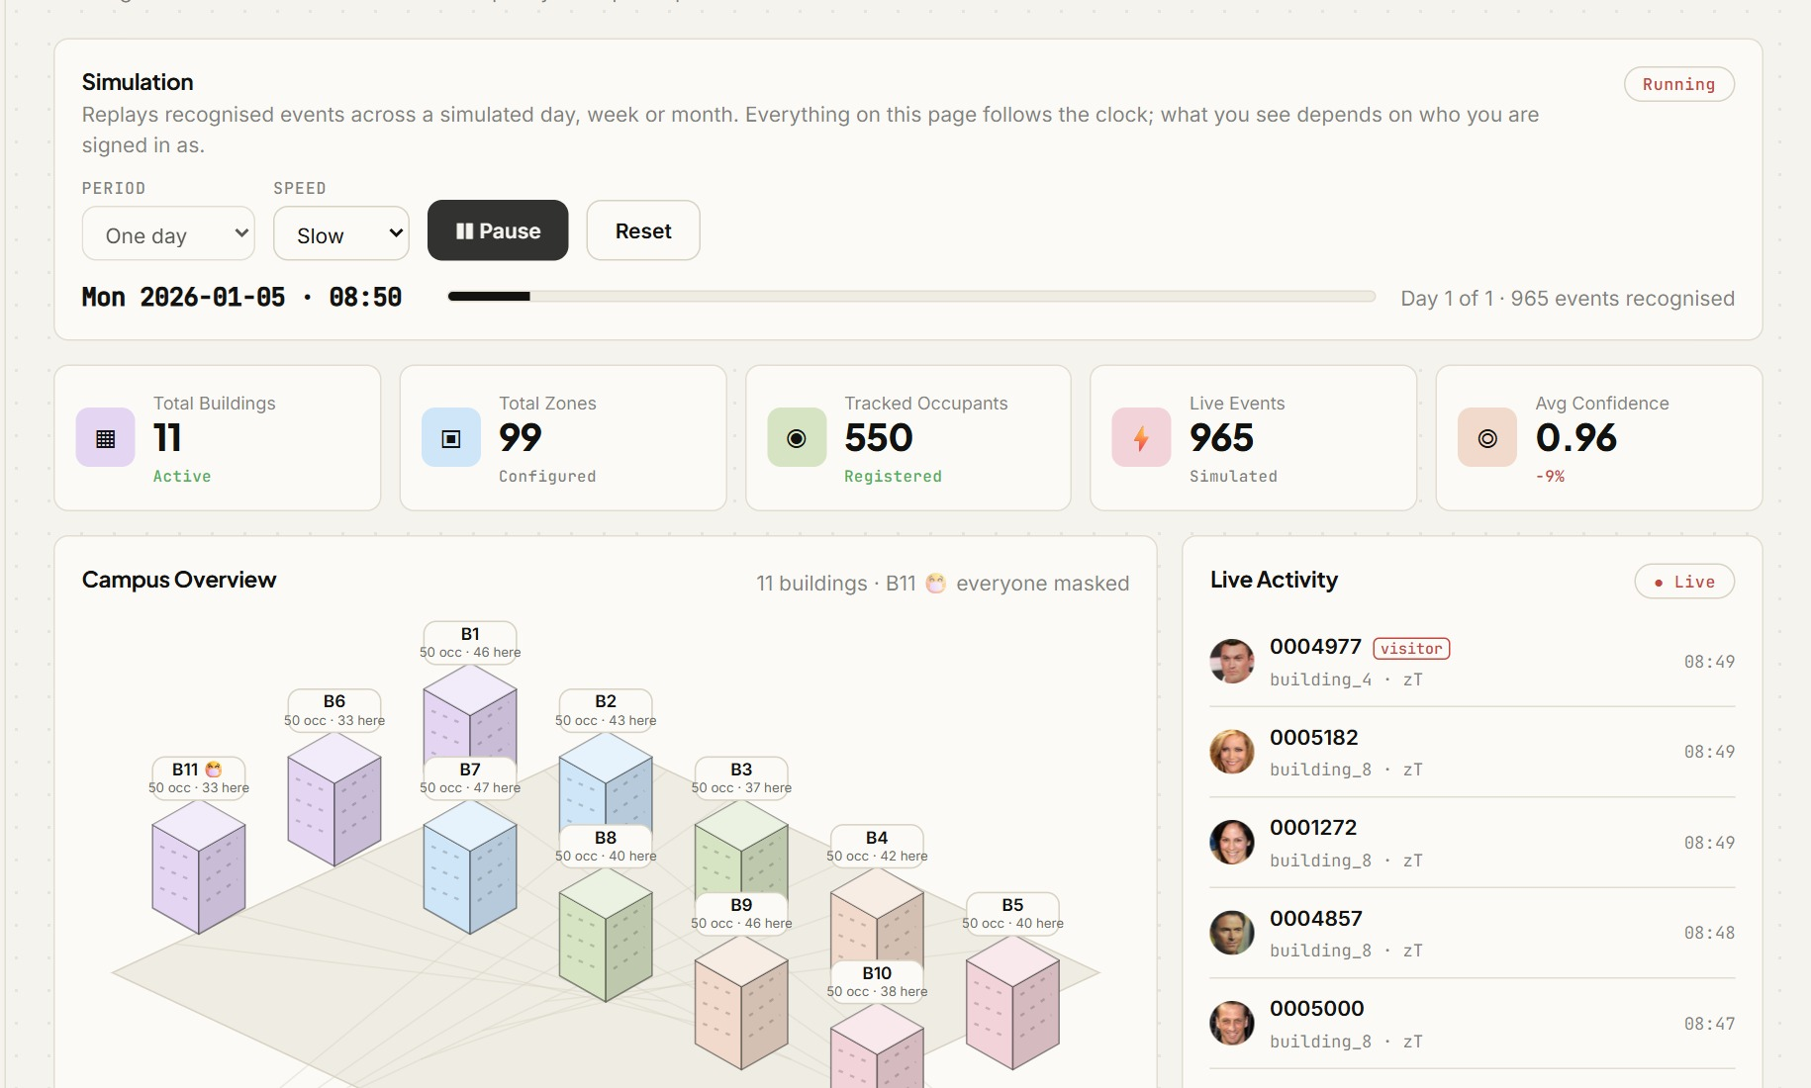
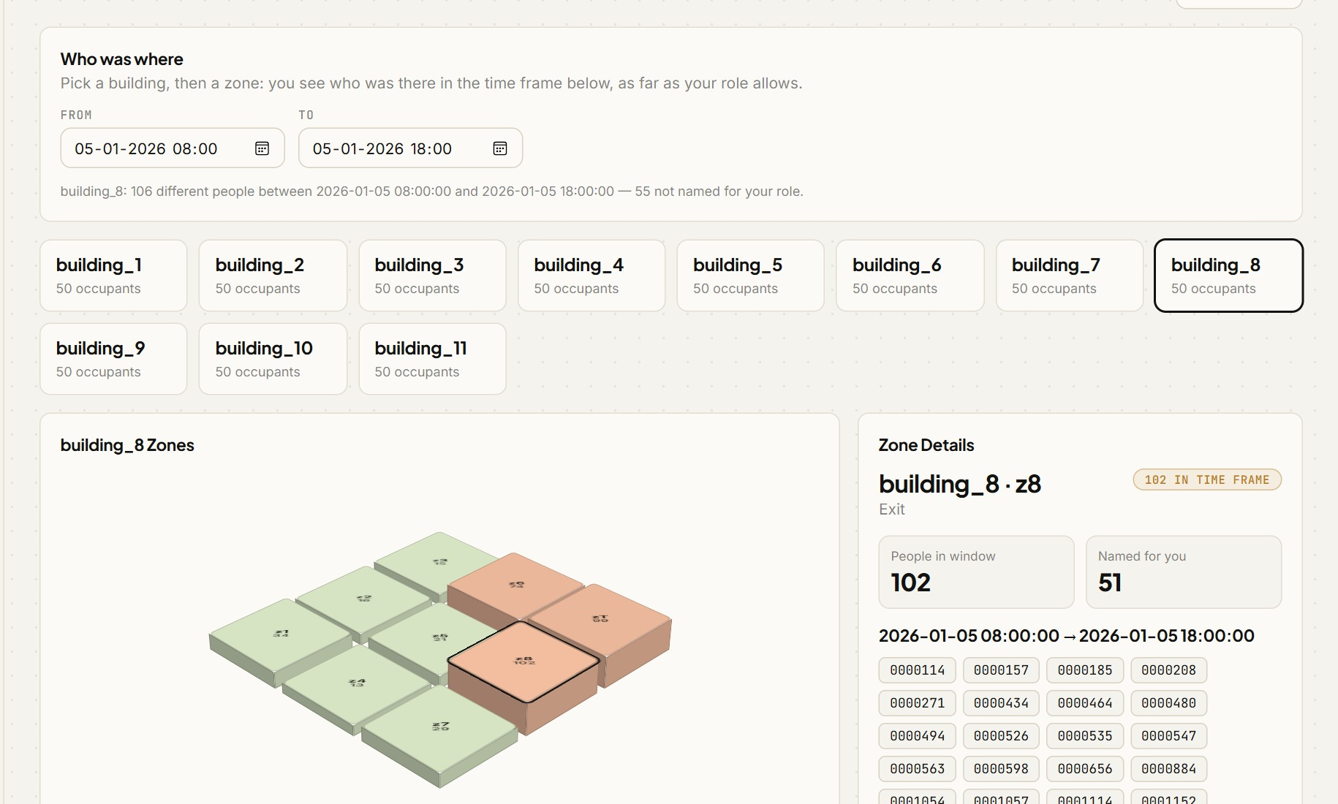
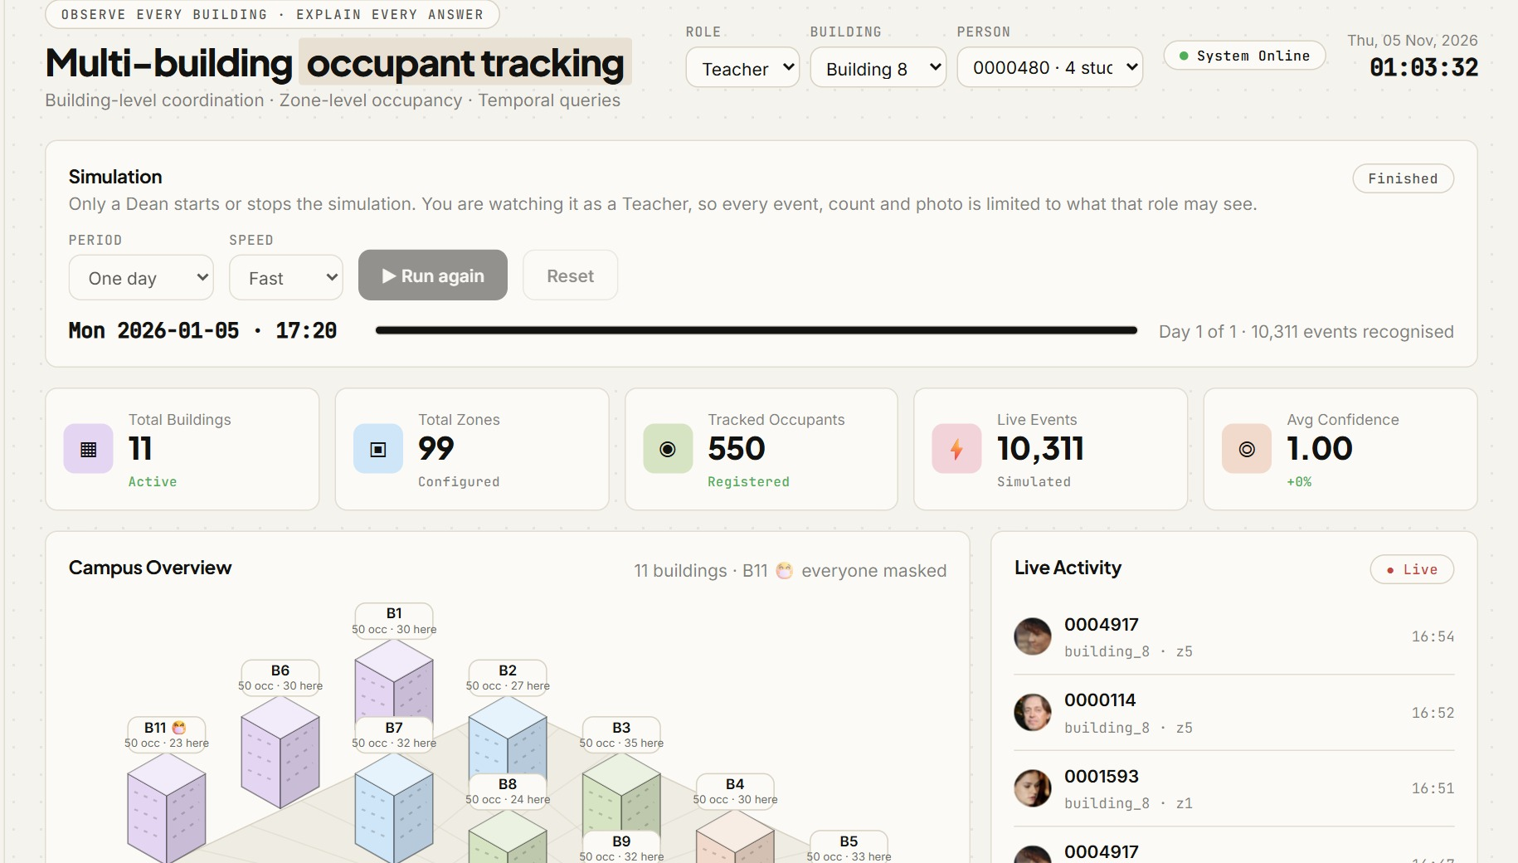
Results and Analysis
Access control and explainability: the same query from two roles
A Dean's query: the answer comes with its “Why this answer” card: rule, evidence, uncertainty flags and what was withheld.
The same query from a Student: refused with a rule code, and the explanation is withheld in full.
Every view follows the signed-in role: the live feed, zone lists, person tracks and photos show only what that role may see.
A Start-simulation control (one day, week or month) drives the live feed, the zone map and the per-person tracks.
Notes:
This slide shows access control and explainability working. On the left, a Dean's query returns the answer together with its Why-this-answer card: rule, evidence, flags and what was withheld. On the right, the same query from a Student is refused with a rule code, and the explanation is withheld in full.
Every view in the dashboard follows the signed-in role: the live feed, zone lists, person tracks and photos show only what that role may see. A Start-simulation control runs one day, week or month and drives the live feed, the zone map and per-person tracks.

Slide 18
Results and Analysis
Comparison with the baseline and prior work
Approach | Visitor lookup | Face data leaves a building? | Result (average of 5 seeds)
Centralised search over all galleries (baseline) | One global search | Yes, galleries pooled | 92.24% accuracy, 100% of gallery searched
This work: LSH + Bloom routing | Rank by Bloom score, verify top 5 | Only a Bloom filter (about 10 KB) is shared; references move only on a confirmed match | 91.54% accuracy, 10.3% of gallery
Related edge-camera tracking [1]-[5] | Within one site | n/a | No cross-building identity, RBAC or explanations
Other published systems use different data and cannot be compared number-for-number; the fair comparison is the same pipeline with a central search.
Routing costs 0.7 points of accuracy overall and 3.7 points on visitors, in exchange for ~90% less gallery touched.
Notes:
This slide compares with the baseline and prior work. The fair comparison is the same pipeline with a central search, shown in the first two rows: the centralised baseline against our routing, with accuracy and the share of gallery searched. In ours, only a Bloom filter is shared, and references move only on a confirmed match.
The related edge-camera systems work within one site and offer no cross-building identity, access control or explanations. They also use different data, so they cannot be compared number for number. The cost of routing is stated at the bottom: a small accuracy loss overall, and larger on visitors, in exchange for far less gallery touched.

Slide 19
Discussion and Limitations
What the results mean
Limitations
Decentralised routing comes within 0.7 points of a central search (91.5% against 92.2%) while touching about a tenth of the gallery.
Most visitor events need no routing: repeat sightings the same day come from the day cache.
Tracking is accurate at building level (F1 0.95) and weaker at zone level (0.92).
Uncertainty flags mark 74% of wrong identifications, and 3.8% of correct ones, for about 7% extra latency; errors from the visitor database are almost never flagged.
The Bloom filters report 3.5% false positives, not the configured 1%, so privacy rests on the one-way encoding and exact verification.
Masked people are the hard case (59% against 95%): the limit is the face model, and the existing mask handler does not help.
Network, sensors and face detector are simulated; the certificate authority is a stand-in, not a real PKI.
No TLS on the API unless a proxy adds it; no encryption on disk; no outside penetration test.
Masked data is web-crawled with some wrong labels; 20% of masked probes are augmented copies.
A wrong identity in the visitor cache persists for the rest of that day.
550 people in 11 buildings; larger scale is untested. Week and month simulations replay one recognised day.
Notes:
This is where we interpret the results. Decentralised routing comes within one point of a central search while touching about a tenth of the gallery. Most visitor events need no routing, since repeat sightings come from the day cache. Tracking is accurate at building level and weaker at zone level. Uncertainty flags mark about three quarters of wrong identifications for a small latency cost, though errors from the visitor database are almost never flagged. The Bloom filters show a higher false-positive rate than configured, so privacy rests on the one-way encoding and exact verification. Masked people are the hard case, and the limit is the face model.
The limitations are honest ones: the network, sensors and detector are simulated, the certificate authority is a stand-in, TLS is not part of the application itself, the masked data has some wrong labels, a wrong identity in the visitor cache persists for the day, and scale beyond eleven buildings is untested.

Slide 20
Conclusion
We built and evaluated an end-to-end system that identifies and tracks occupants across buildings without pooling face data, answers queries by role, and explains every answer. It matches a central search to within 1 point while touching about 10% of the gallery.
Objective | Planned | Status | Evidence
1 Multi-building DSTS extension | Mid review | Achieved | BSTS, 11 buildings, state F1 0.95 (building)
2 RBAC query interface | 24/9/26 | Achieved | Two layers of role-based access, all policy cells tested
3 Explainable responses | 26/9/26 | Achieved | Rule, evidence, flags, redaction; faithfulness tests
4 LSH + Bloom routing | Mid review | Achieved | 10.3% of gallery touched, 0.7-point accuracy cost
5 Security layer | 2/10/26 | Achieved* | Sealed transfers, tokens, lockout, audit (*simulated network)
6 Evaluation | Final review | Achieved | Event and state TP/FP/FN/TN, 5 seeds, centralised baseline
Notes:
To conclude, we built and evaluated an end-to-end system that identifies and tracks occupants across buildings without pooling face data, answers queries by role, and explains every answer. It matches a central search to within about a point while touching about a tenth of the gallery.
The table gives objective-wise status. All six are achieved; the security objective is marked with an asterisk because the network is simulated.

Slide 21
Future Work
1
Better masked recognition
A face model trained with masks, instead of one trained on unmasked faces.
A real mask detector, because the current heuristic flags the wrong people.
Enrol a few real masked photos per person (about +5 points in our tests) and use tracking context, such as who is already inside.
2
Unknown visitor re-identification
Today a visitor must be registered in some building; a face nobody knows is left unidentified.
Re-identify unknown visitors across buildings and days: keep one-way codes of unknown faces (LSH + Bloom) under a temporary id and link their sightings.
Needs retention and privacy rules, and a check that two different strangers are not merged.
Notes:
Two directions for future work. First, better masked recognition: a face model trained with masks, a real mask detector since the present heuristic flags the wrong people, and enrolling a few real masked photos per person together with tracking context.
Second, unknown visitor re-identification. Today a visitor must be registered in some building. We would keep one-way codes of unknown faces under a temporary id and link their sightings, which needs retention and privacy rules and a check that two strangers are not merged.

Slide 22
Team Contribution
Member | Main contributions
Ajith Ashok | The dashboard and its wiring (overview, occupancy, zones, queries, security views)
Arjun Rajesh | Query engine (Q1-Q13 and TRACK), RBAC and the secure-transfer layer, FastAPI server, monitoring, mobility simulation
D Aditya Kiran | Event recognition and retrieval, centralised baseline, explanation model, redaction and faithfulness tests
Yadhu Vipin M. M. | LSH + Bloom routing, pipeline, visitor database, seeded populations, ground truth and metrics, role-based access control, masked building, integration
Guide: Dr. Lakshmi Mohan. Contributions follow the repository history and hand-overs.
Notes:
This is the team contribution. Ajith built the dashboard and its wiring. Arjun built the query engine, the access control and secure-transfer layer, the server, monitoring and the mobility simulation. Aditya built event recognition and retrieval, the centralised baseline, and the explanation model with redaction and faithfulness tests. I built the LSH and Bloom routing, the pipeline, the visitor database, seeded populations, ground truth and metrics, role-based access, the masked building and the integration.

Slide 23

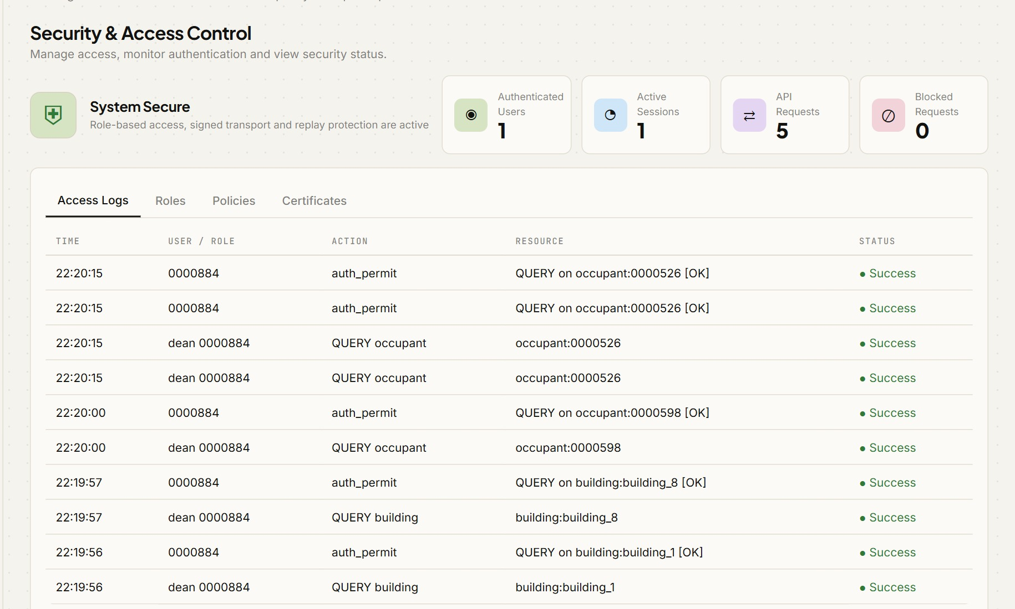
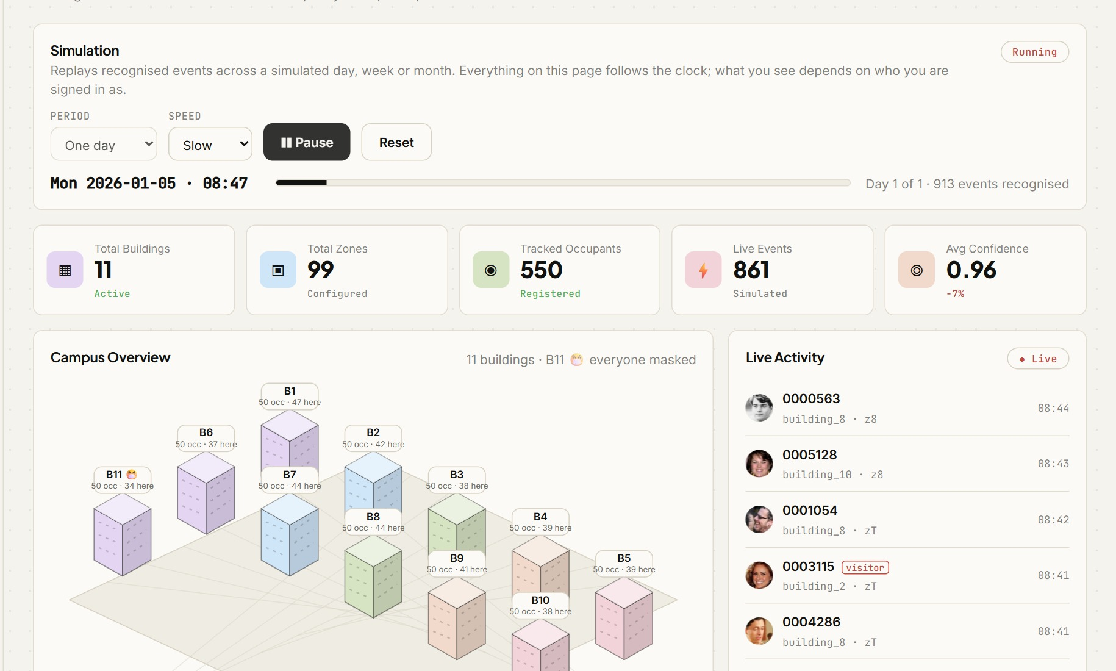
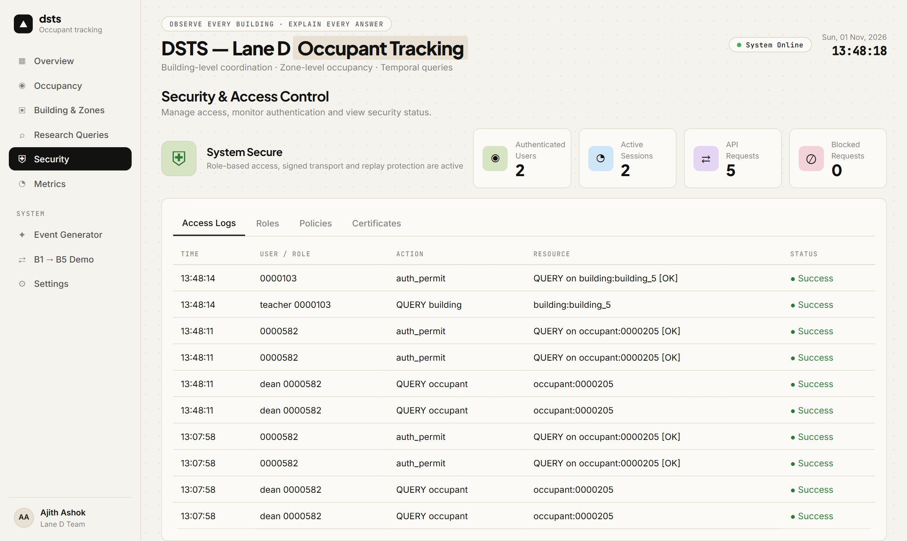
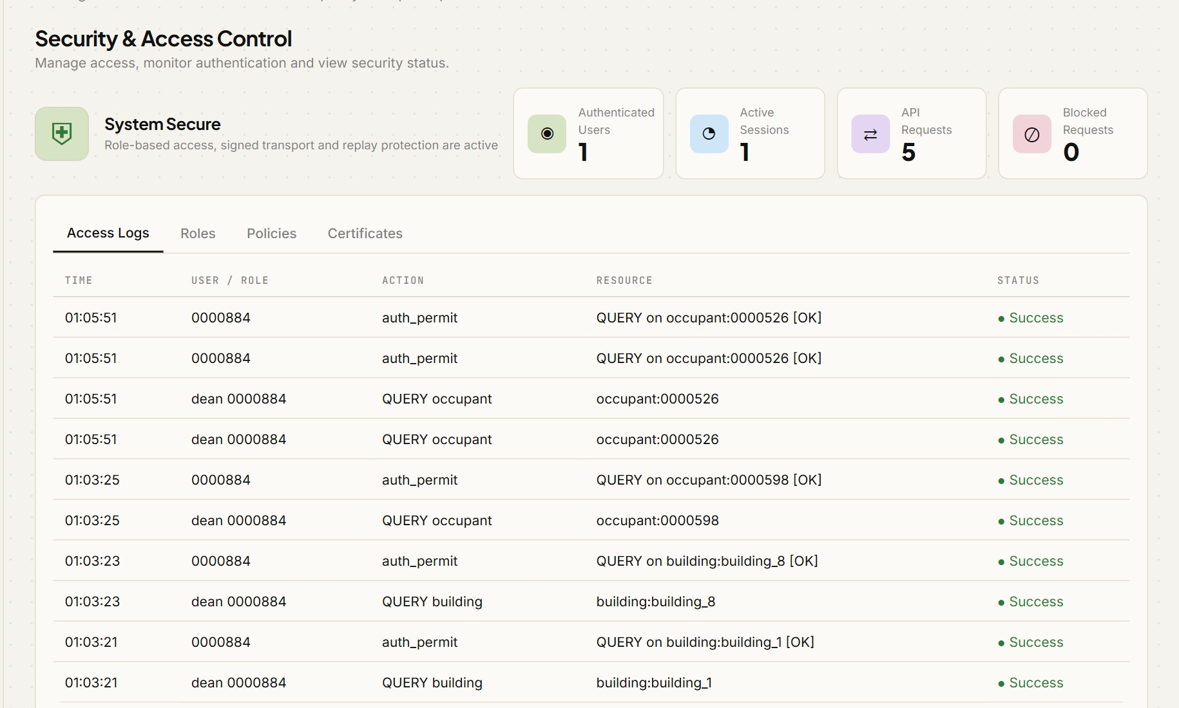
Appendix A: Code and Demo
Repository: github.com/yadhu-vipin/Occupant_Tracking_v2
Branch / commit: test_7
Run it: python manage.py run --seeds 0-4
Demo: DSTS_DEMO_MODE=1 python manage.py serve then open 127.0.0.1:8000
Tests: python manage.py test (575 pass)
Masked data: python manage.py masked (needs RMFRD in external/)
Scan for the repository
Notes:
Everything is in the repository, on branch test_7; the QR code opens it. One command runs the five-seed experiment, another starts the demo server, and the test suite passes in full. The masked data needs the RMFRD dataset placed in the external folder. The screenshots show the security view, the overview and a Dean's query.

Slide 24
Project Time Line
Component | Status | Completed
BSTS: local recognition, LSH + Bloom routing, remote verification, state | Implemented | Mid review (Sept 2026)
Centralised baseline and decentralised-vs-central comparison | Implemented | Sept 2026; rerun on 11 buildings Oct 2026
Point-in-time and Boolean queries (Q1 to Q13, and TRACK) | Implemented | Sept 2026
RBAC: two layers, per-role disclosure | Implemented | Sept to Oct 2026
Explainable responses with redaction | Implemented | 25 Oct 2026
Security: sealed transfers, tokens, lockout, audit | Implemented | Sept to Oct 2026
Visitor database, multi-day events, ground truth, seeded runs | Implemented | 25 Oct 2026
Masked building (RMFRD) and its evaluation | Implemented | 30 Oct 2026
Notes:
The time line shows each component, its status and when it was completed. The core pipeline and routing were done by the mid review; role-based access, security and the baseline comparison followed in September and October; the explanations, visitor database and ground truth were finished on 25 October, and the masked building on 30 October. All components are implemented.

Slide 25
Reference
[1] C. Hegde et al., “Indoor group identification and localization using privacy-preserving edge computing distributed camera network,” IEEE J. Indoor Seamless Position. Navig., vol. 2, pp. 51–60, 2024, doi: 10.1109/JISPIN.2024.3354248.
[2] H. Kwon et al., “A feasibility study on indoor localization and multiperson tracking using sparsely distributed camera network with edge computing,” IEEE J. Indoor Seamless Position. Navig., 2023, doi: 10.1109/JISPIN.2023.3337189.
[3] S. Yang, F. Ding, P. Li and S. Hu, “Distributed multi-camera multi-target association for real-time tracking,” Sci. Rep., vol. 12, art. 11052, 2022, doi: 10.1038/s41598-022-15000-4.
[4] S. Casao, A. Naya, A. C. Murillo and E. Montijano, “Distributed multi-target tracking in camera networks,” arXiv:2010.13701, 2021.
[5] B. Gaikwad and A. Karmakar, “Smart surveillance system for real-time multi-person multi-camera tracking at the edge,” J. Real-Time Image Process., 2021, doi: 10.1007/s11554-020-01066-8.
[6] L. Mohan and V. Menon, “Modelling large scale camera networks for identification and tracking: an abstract framework,” IET Comput. Vis., vol. 14, no. 7, pp. 426–433, 2020 (base paper).
[7] B. H. Bloom, “Space/time trade-offs in hash coding with allowable errors,” Commun. ACM, vol. 13, no. 7, pp. 422–426, 1970.
[8] M. S. Charikar, “Similarity estimation techniques from rounding algorithms,” in Proc. ACM STOC, 2002, pp. 380–388.
[9] Q. Lv et al., “Multi-probe LSH: efficient indexing for high-dimensional similarity search,” in Proc. VLDB, 2007, pp. 950–961.
[10] J. Deng, J. Guo, N. Xue and S. Zafeiriou, “ArcFace: additive angular margin loss for deep face recognition,” in Proc. IEEE/CVF CVPR, 2019, pp. 4690–4699.
[11] Z. Wang et al., “Masked face recognition dataset and application,” arXiv:2003.09093, 2020 (RMFRD).
Notes:
These are the references: papers one to five are the reviewed literature, six is the base paper, and seven to eleven are the techniques we build on, namely Bloom filters, random-hyperplane LSH, multi-probe LSH, ArcFace and the masked-face dataset. Thank you. We would be happy to take questions.

