Slide 1

Polar FEC chain development in software for 5G Final thesis presentation
Yadhunandana Kumaraiah (Yadhu)
yadhu.kumaraiah@tum.de
Supervisors:
Fabian Steiner, Peihong Yuan (TUM)
Dr. Moritz Harteneck, Alexander Heinz
(Rohde & Schwarz)

Slide 2
Agenda
Motivation
Background
Encoding FEC chain
Latency results : Encoding chain
Decoding FEC chain
Latency results : Decoding chain
Conclusion and Outlook

Slide 3
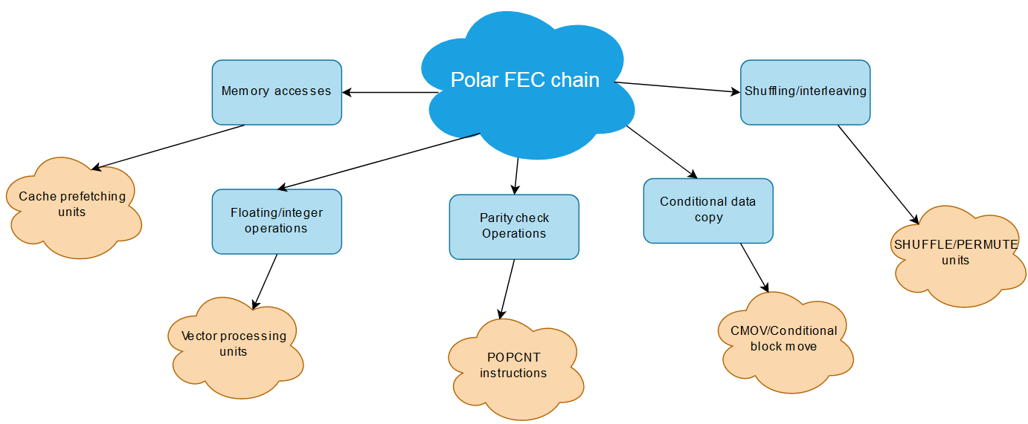
Motivation
Traditionally FEC chains are developed with FPGA’s or ASIC’s to achieve low latency and high throughput.
Development/maintenance in FPGA/ASIC requires more time and expensive.
With recent advances in General Purpose Processors, it is possible to achieve required latency and throughput with software implementations without custom hardware.
Software implementations require less development/maintenance effort and provide flexibility/ease of maintenance to device manufacturer.
However algorithms need to adopted/optimized to efficiently implement in software.

Slide 4
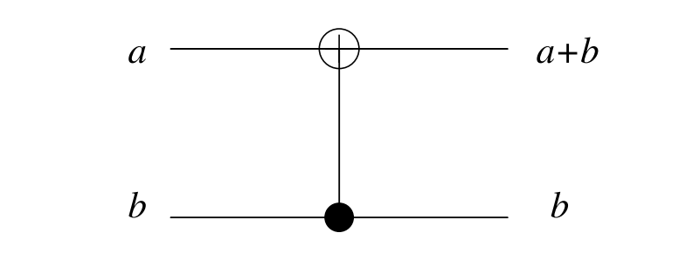


Background: Polar codes
Invented by Erdal Arıkan^{[1]} in 2009.
First codes to theoretically approach channel capacity for BMC channels with explicit construction.
Basic idea is synthesizing either completely noiseless or fully noisy channels based on SNR.
Information bits transmitted in noiseless and zeros in noisy channels .
Synthesizing channels for every SNR is complex. 5G adopted heuristic low complexity approach independent of SNR^{[2]} .
This construction performs sufficiently good over a large range of SNR^{[1]}
Butterfly circuit
Encoder circuit for $N=2$
$N→∞$,
Fraction of good channels $→C$

Slide 5
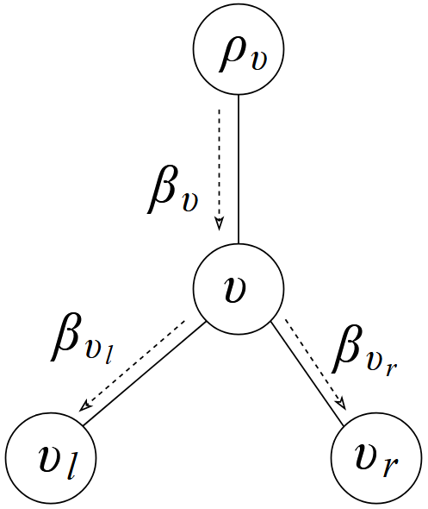
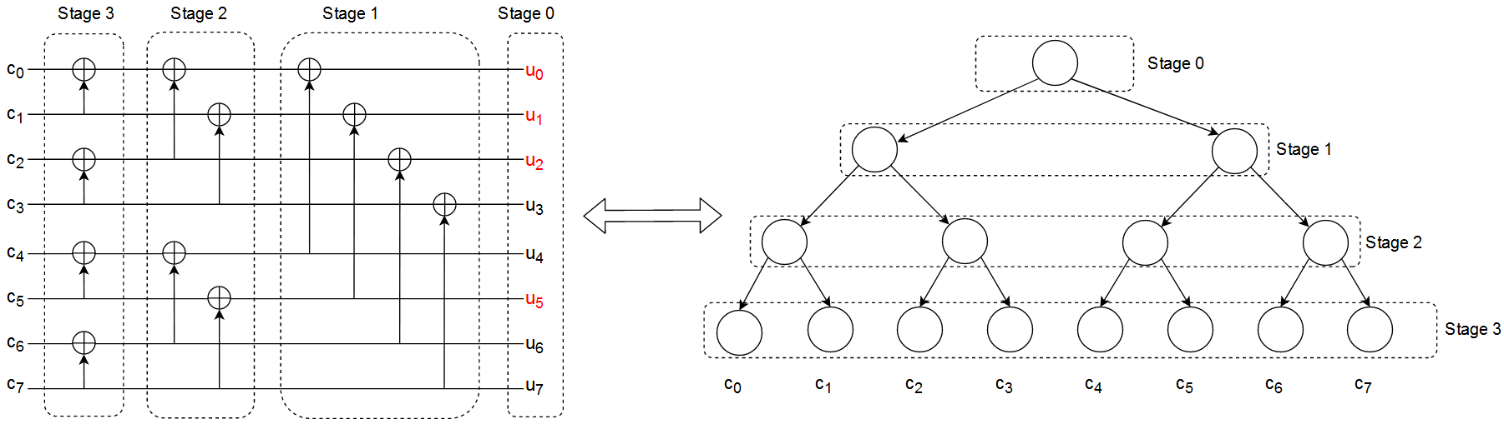



Polar Encoding (Polar Transform)
XOR introduces correlation between code word bits.
Bits shown in red are frozen bits (zeros).
Node operation in encoder with vector size $N_{v}$.
$β_{v_{l}}\left[i\right] =$ $β_{v}[i]⨁{β_{v}\left[i+{N_{v}}/2\right] 0≤i<{N_{v}}/2}$
$β_{v_{r}}\left[i\right] ={ β}_{v}\left[i+{N_{v}}/2\right] 0≤i<{N_{v}}/2$ $∕∕Superfluous copying$
XOR operation
$K=4, N = 8$.
Each stage contains vector of size $Nv = 2^{N−stage}$

Slide 6
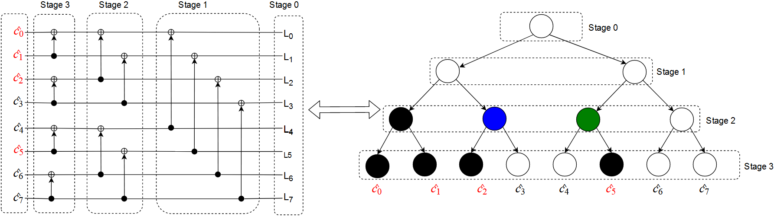

Decoding polar codes
Decoder estimates the code word by exploiting the correlation introduced by encoder.
Decoding involves Check Node (CN), Variable Node (VN) and bit combination operations.
Every node in the decoder tree performs these operations.
Decoding circuit can also be viewed as binary tree.
Each stage contains vector of size $Nv = 2^{N−stage}$

Slide 7
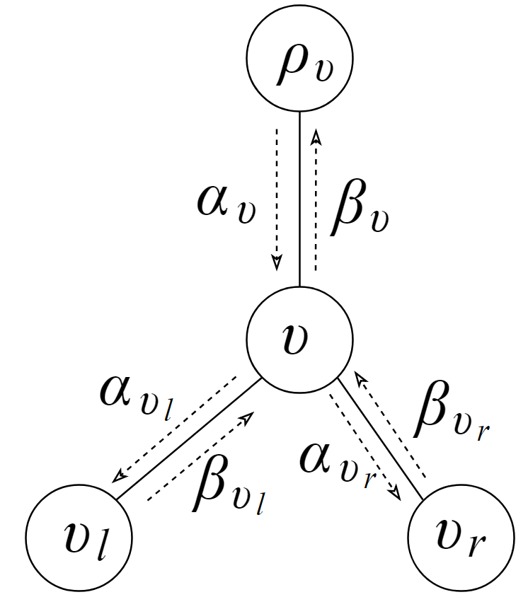

CN, VN and bit combination operations
For LLR vector size $N_{v}$
CN operation: ($⨁$)
$α_{v_{l}}\left[i\right]=sign\left(α_{v}\left[i\right]\right)∗sign(α_{v} \left[i+\frac{N_{v}}{2}\right])∗$
$min⁡({|α}_{v}\left[i\right]|,{|α}_{v}\left[i+\frac{N_{v}}{2}\right]|)$
VN operation: ( )
$α_{v_{r}}\left[i\right]$ = $\left(1−β_{v_{l}}\right)∗α_{v}\left[i\right]+α_{v} \left[i+\frac{N_{v}}{2}\right]$
Bit combination:
$β_{v}\left[i\right] = \left\{\begin{aligned}β_{v_{l}}[i]⨁{β_{v_{r}}\left[i\right] 0≤i<{N_{v}}/2} \\ β_{v_{r}}\left[i\right] ∕∕Just copying\end{aligned}\right.$
Local decoder with messages

Slide 8
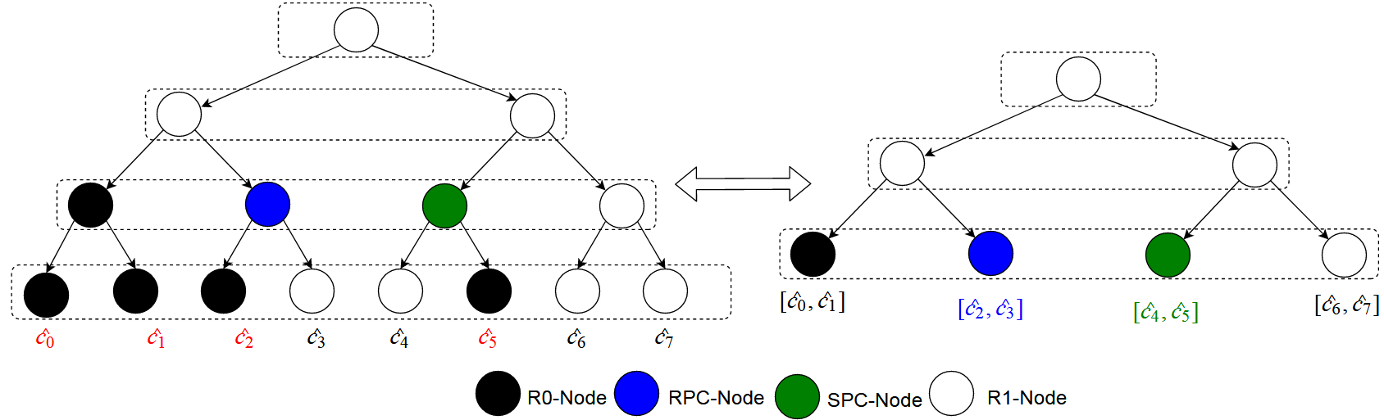

Fast-SSC algorithm
Fast-SSC algorithm^{[1]} identifies special component codes from polar code which allow immediate decoding avoiding full tree traversal.
Reduces number of CN and VN operations.
Parallelizes the decoding operation.
Example $frozen_pattern = \{1,1,1,0,0,1,0,0\}$
Original decoder tree
Reduced tree

Slide 9
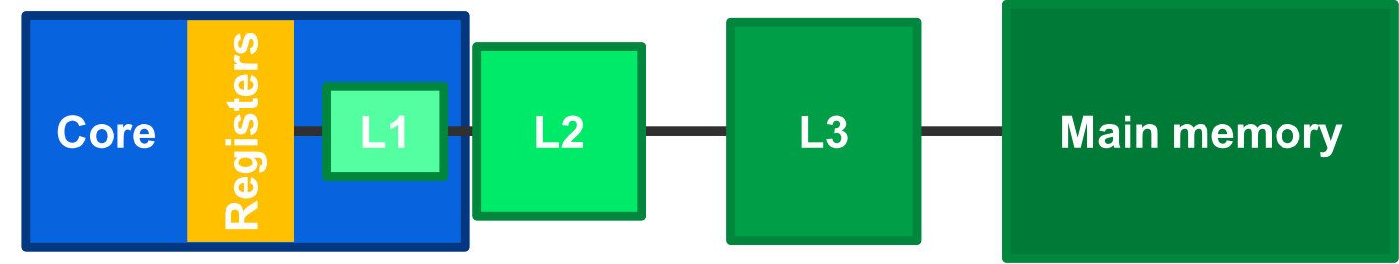
Processor architecture: Cache memory
Performance bottleneck in modern processors is accessing main memory.
Modern processors come with faster memory called cache.
Caches reduce the average memory access latency.
Copy of frequently accessed data is stored in cache.
Data access latency of cache is negligible comparatively.

Slide 10
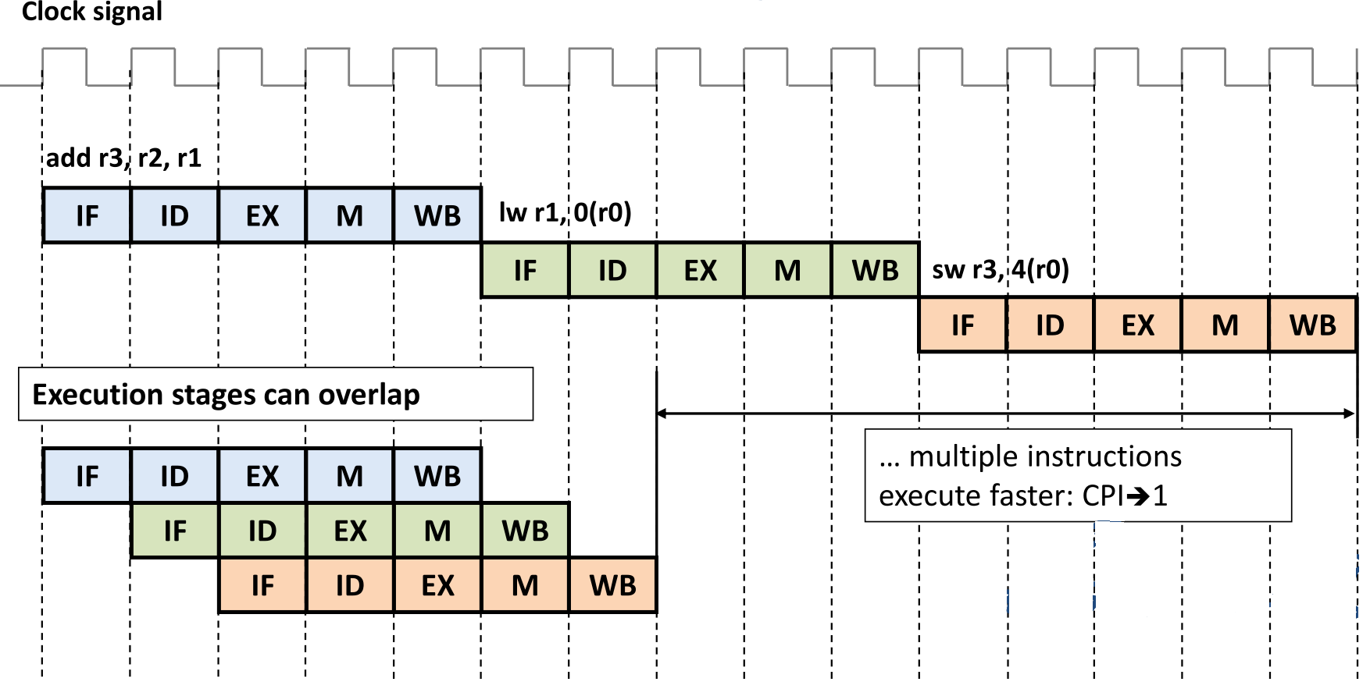
Instruction pipelining
Modern processors come with advanced pipelining.
Pipelining increases IPC (Instructions Per Cycle).
Branching and cache misses create stalls in pipelining which reduce IPC.
Branches and cache misses need to be reduced in code to achieve high performance.

Slide 11
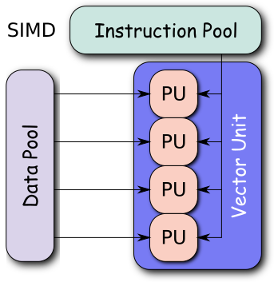
Vector processing units
Process multiple data elements (vectors) in a single instruction. Incorporated in modern processors.
Allow data parallelism, popular among video/image processing community.
Faster encoding/decoding in communication systems can be implemented using SIMD (Single instruction multiple data) instructions.
SIMD feature allows encoding/decoding with low latency due to vector.

Slide 12
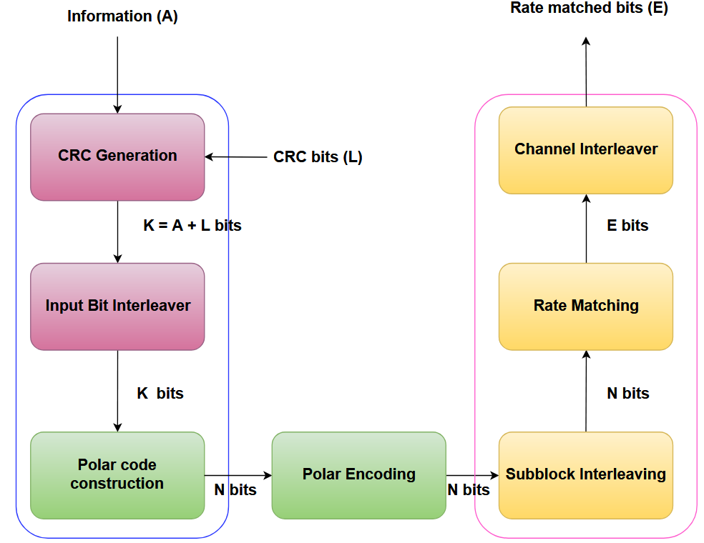
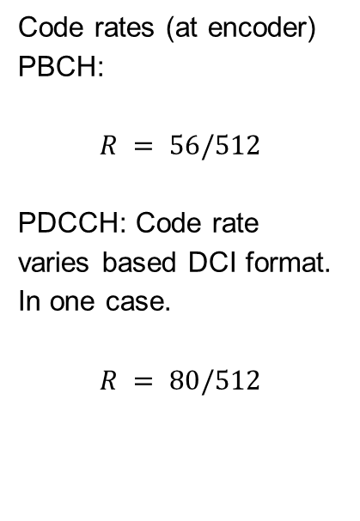
Encoding FEC chain in 5G
FEC chain of Physical Broadcast Channel (PBCH) and Physical Downlink Control Channel (PDCCH).
Code rates (at encoder)
PBCH:
$$R = 56/512$$
PDCCH: Code rate varies based DCI format. In one case.
$$R = 80/512$$

Slide 13
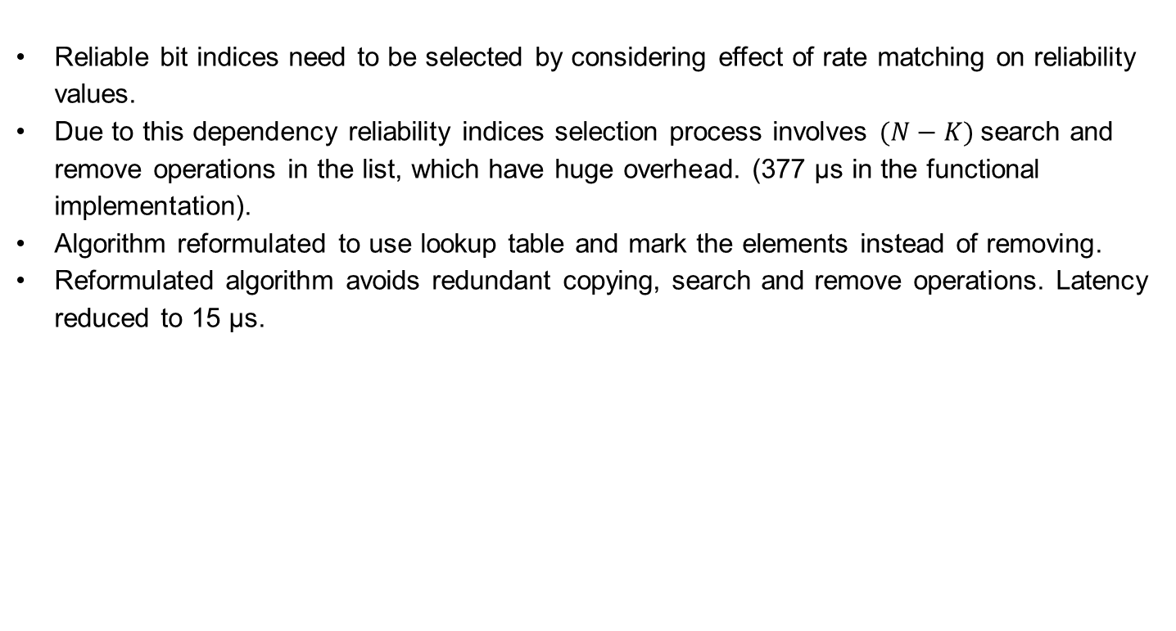
Polar code construction
Reliable bit indices need to be selected by considering effect of rate matching on reliability values.
Due to this dependency reliability indices selection process involves $(N−K)$search and remove operations in the list, which have huge overhead. (377 μs in the functional implementation).
Algorithm reformulated to use lookup table and mark the elements instead of removing.
Reformulated algorithm avoids redundant copying, search and remove operations. Latency reduced to 15 μs.

Slide 14
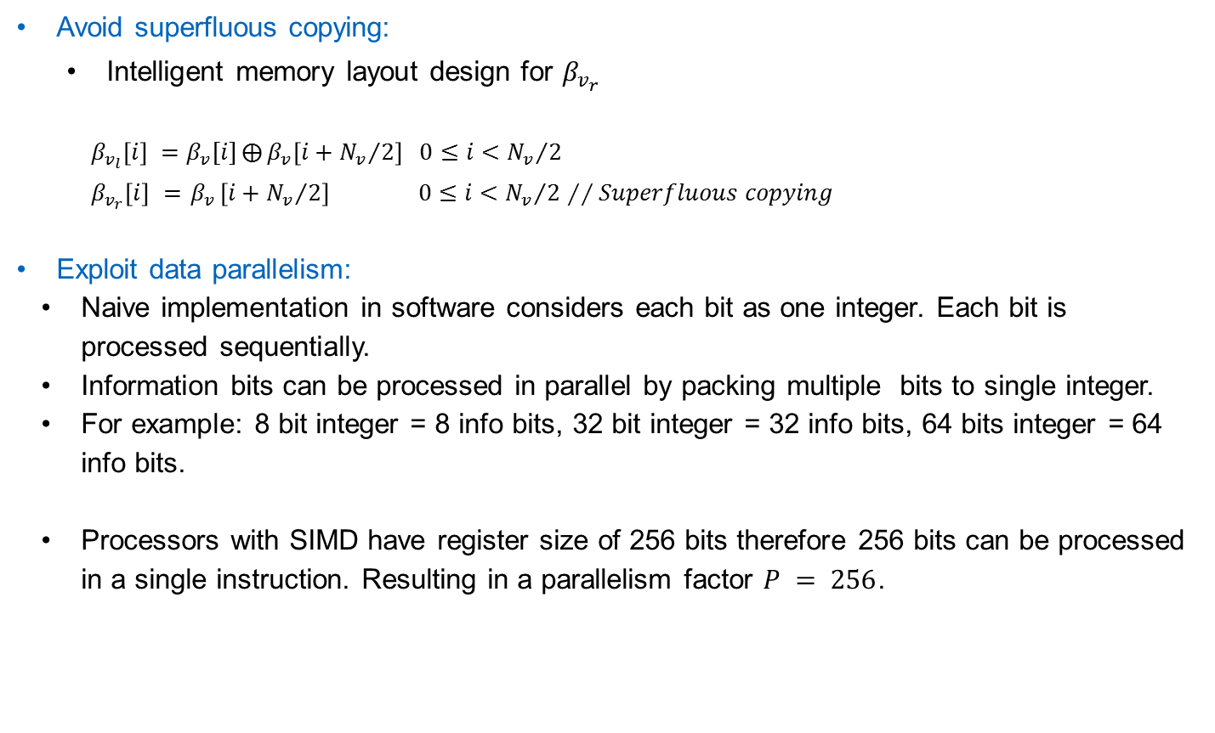
Optimization of Polar Encoder
Avoid superfluous copying:
Intelligent memory layout design for $β_{v_{r}}$
$β_{v_{l}}\left[i\right] =$ $β_{v}[i]⨁{β_{v}\left[i+{N_{v}}/2\right] 0≤i<{N_{v}}/2}$
$β_{v_{r}}\left[i\right] ={ β}_{v}\left[i+{N_{v}}/2\right] 0≤i<{N_{v}}/2$ $∕∕Superfluous copying$
Exploit data parallelism:
Naive implementation in software considers each bit as one integer. Each bit is processed sequentially.
Information bits can be processed in parallel by packing multiple bits to single integer.
For example: 8 bit integer = 8 info bits, 32 bit integer = 32 info bits, 64 bits integer = 64 info bits.
Processors with SIMD have register size of 256 bits therefore 256 bits can be processed in a single instruction. Resulting in a parallelism factor $P = 256$.

Slide 15
Information bits packing example
Each row represents 8 bit integer representing one info bit.
Only last column contains info bits
0 | 0 | 0 | 0 | 0 | 0 | 0 | 1
0 | 0 | 0 | 0 | 0 | 0 | 0 | 0
0 | 0 | 0 | 0 | 0 | 0 | 0 | 0
0 | 0 | 0 | 0 | 0 | 0 | 0 | 1
0 | 0 | 0 | 0 | 0 | 0 | 0 | 0
0 | 0 | 0 | 0 | 0 | 0 | 0 | 0
0 | 0 | 0 | 0 | 0 | 0 | 0 | 1
0 | 0 | 0 | 0 | 0 | 0 | 0 | 1
8 bits grouped as one integer.
1 | 0 | 0 | 1 | 0 | 0 | 1 | 1
Same idea can be extended to 256 bits packing for SIMD.
Packing/Unpacking need to be performed very efficiently.
SIMD extensions provide dedicated instructions to perform fast packing and unpacking.

Slide 16
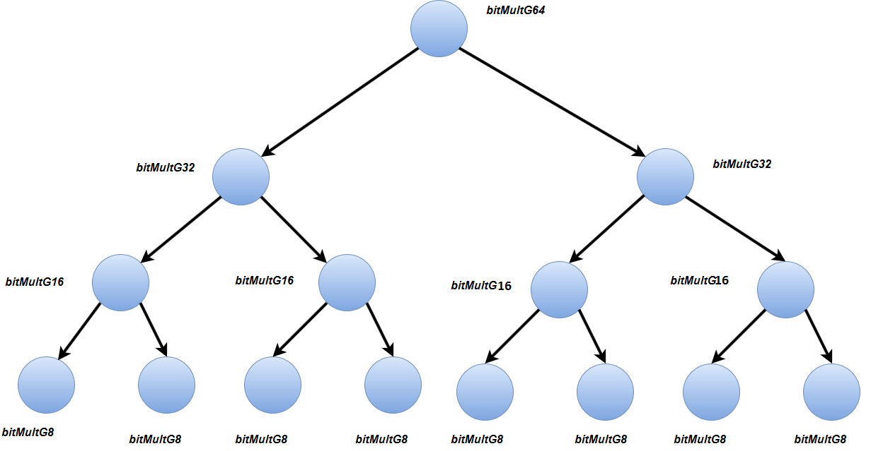

Tree pruning and Unrolling recursion
Plain implementation of encoding traverses till the end of tree, In other words for $N = 1024$, encoder needs to traverse $2047$ nodes of a tree.
Pruning of tree can be done by building a lookup table and stopping encoding when level is $\log_{2}{N −3}$, i.e. 7 in our example.
Reduces the number of nodes to be traversed to 255 from 2047 hence significantly reduces the latency.
This optimization can also be applied for hardware implementations.
Recursive function has overhead since every function call requires new stack allocation and branching. Both have huge overhead.

Slide 17

Encoding chain results
Comparison with open source encoder software implementation (in AMD EPYC processor at 1.6ghz) $N = 1024$
Worst case encoding FEC chain:
Functional | Current implementation
451 μs | 40 μs
Encoder Latency:
aff3ct^{[1]} (No SIMD) | Current implementation
5.6 μs | 0.24 μs
Notes:
Functional implementation done by colleague at R&S.
For FPGA implementation, value is scaled according to N value.

Slide 18
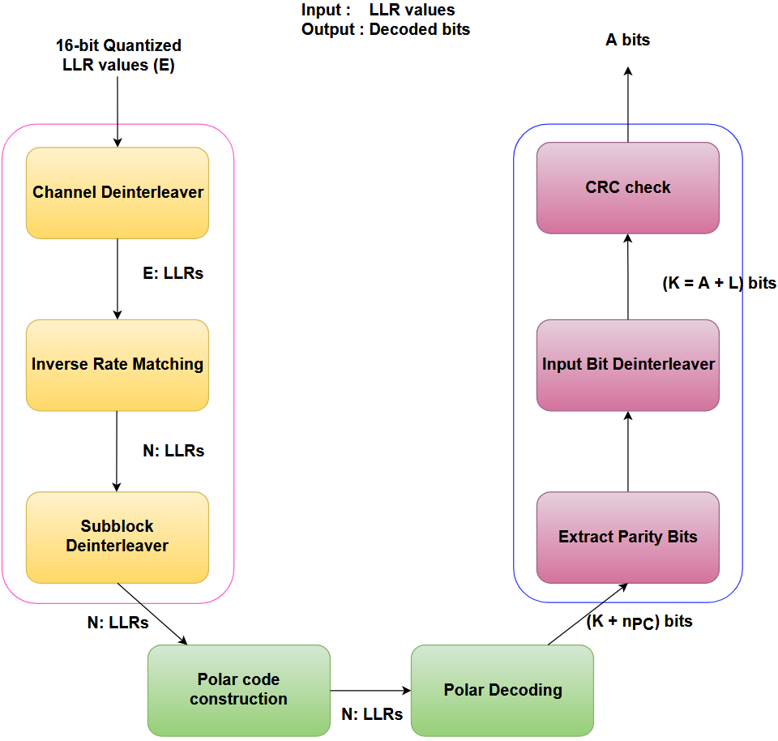
Decoding FEC chain
Decoding FEC chain for Physical Uplink Control Channel (PUCCH) and Physical uplink shared Channel (PUSCH).

Slide 19
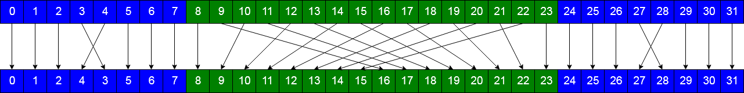

Subblock deinterleaver
Inverse of subblock interleaver operation performed at the transmitter.
Deinterleaving is performed as shown in the figure.
Expensive operation due to huge number of division, multiplication and modulus operations and it is also sequential.
This operation is broken down into three parts, each of them are implemented using permute and blend SIMD instructions.
Latency reduced from 19$μs$to 0.47$μs$.

Slide 20
Polar decoding: Packing frozen pattern
Packing multiple frozen bits allows efficient identification of component codes.
Frozen pattern is passed in packed bit format to decoder.
Identification component codes is performed at run time.
Packing of multiple bits together allows identification of component codes in a single comparison instruction.
Reduces the expensive branch instructions and exploits data parallelism.
For frozen pattern at child node = {1,1……..1,1} //256 values.
bool isRateZeroNode(int8_t frozenPattern[])
{
bool rateZeroNode = true;
for(auto i = 0; i < 256;i++) {
if(frozenPattern[i] != 1) {
rateZeroNode = false;
break;
}
}
return rateZeroNode;
}
Naive way
Efficient SIMD way
template<>
inline bool isRateZeroNode(uint64_t s[]) {
__m256i temp1 = _mm256_loadu_si256 ((__m256i*)s);
__m256i temp2;
temp2 = _mm256_set1_epi8 ((char)0xFF);
__m256i pcmp = _mm256_cmpeq_epi64 (temp1, temp2);
unsigned bitmask = _mm256_movemask_epi8(pcmp);
return (bitmask == 0xffffffffU);
}

Slide 21
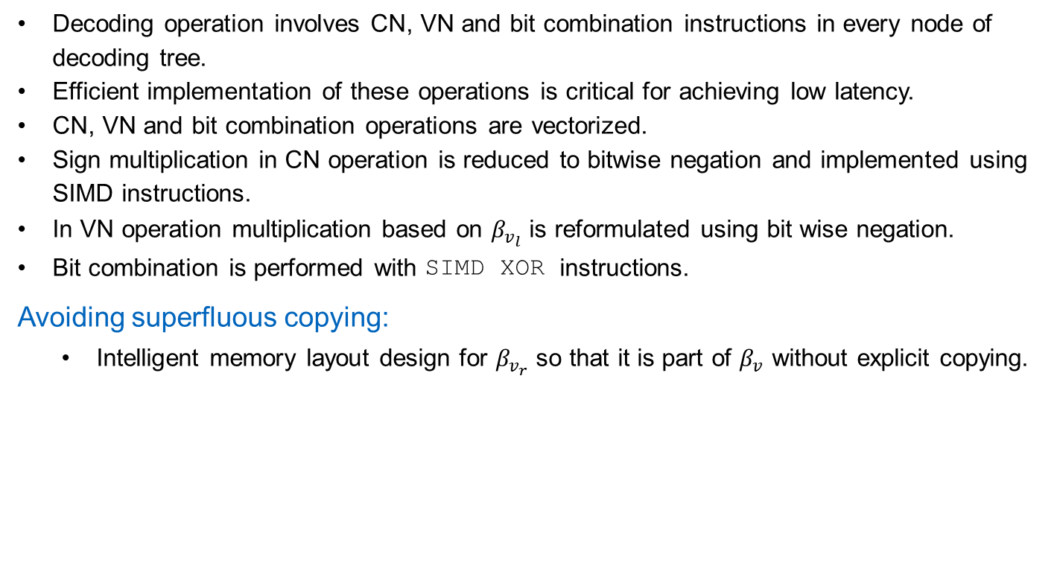
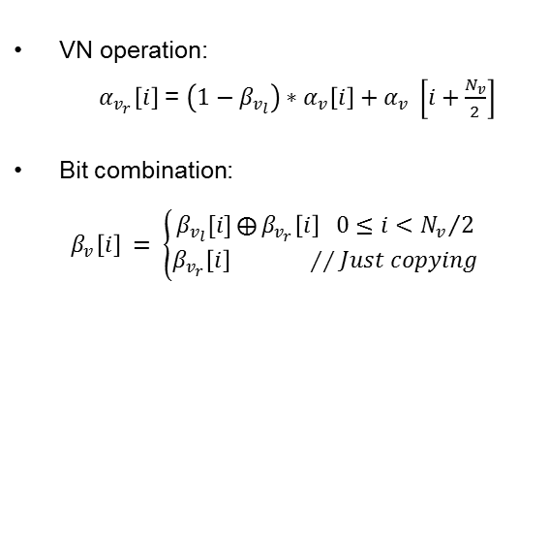

Optimized CN, VN and bit combination operations
Decoding operation involves CN, VN and bit combination instructions in every node of decoding tree.
Efficient implementation of these operations is critical for achieving low latency.
CN, VN and bit combination operations are vectorized.
Sign multiplication in CN operation is reduced to bitwise negation and implemented using SIMD instructions.
In VN operation multiplication based on $β_{v_{l}}$ is reformulated using bit wise negation.
Bit combination is performed with SIMD XOR instructions.
Avoiding superfluous copying:
Intelligent memory layout design for $β_{v_{r}}$ so that it is part of $β_{v}$ without explicit copying.
CN operation: ($⨁$)
$$α_{v_{l}}\left[i\right]=sign\left(α_{v}\left[i\right]\right)∗sign(α_{v} \left[i+\frac{N_{v}}{2}\right])∗$$
$min⁡({|α}_{v}\left[i\right]|,α_{v} \left[i+\frac{N_{v}}{2}\right])$
VN operation:
$α_{v_{r}}\left[i\right]$ = $\left(1−β_{v_{l}}\right)∗α_{v}\left[i\right]+α_{v} \left[i+\frac{N_{v}}{2}\right]$
Bit combination:
$β_{v}\left[i\right] = \left\{\begin{aligned}β_{v_{l}}[i]⨁{β_{v_{r}}\left[i\right] 0≤i<{N_{v}}/2} \\ β_{v_{r}}\left[i\right] ∕∕Just copying\end{aligned}\right.$

Slide 22
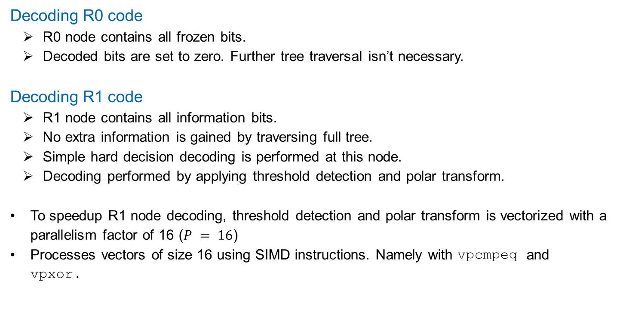
Decoding R0 and R1 codes
Decoding R0 code
R0 node contains all frozen bits.
Decoded bits are set to zero. Further tree traversal isn’t necessary.
Decoding R1 code
R1 node contains all information bits.
No extra information is gained by traversing full tree.
Simple hard decision decoding is performed at this node.
Decoding performed by applying threshold detection and polar transform.
To speedup R1 node decoding, threshold detection and polar transform is vectorized with a parallelism factor of 16 ($P = 16$)
Processes vectors of size 16 using SIMD instructions. Namely with vpcmpeq and vpxor.

Slide 23
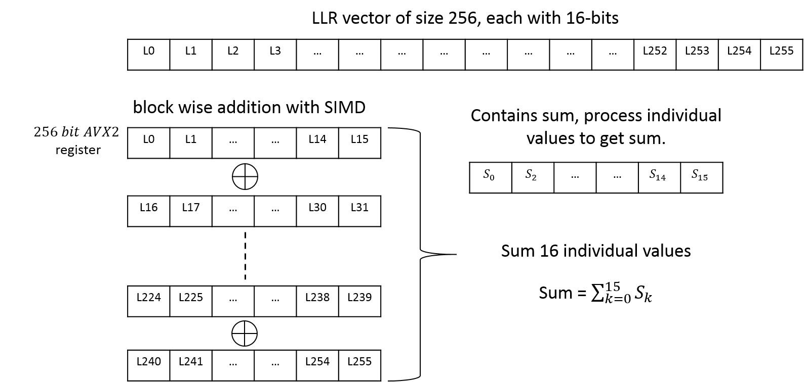

Decoding RPC Node
RPC node’s right most descendent contains information and all remaining bits are frozen.
Decoding operation involves summing of all the elements of LLR vector and deciding the bit based on the sum.
Result is stored at information bit position and zeros are stored in frozen bit positions.
Summation is calculated block wise with AVX2 vector instructions.
$$β_{v}\left[i\right] = \left\{\begin{aligned}0, \sum_{j}{α_{v}[j]}≥0 \\ 1, otherwise \end{aligned}\right.$$

Slide 24
Decoding SPC node
SPC node’s left most descendent is a frozen bit and remaining positions contain information bits.
Decoding involves threshold detection, parity calculation, searching minimum magnitude LLR and polar transform.
Block wise threshold detection with SIMD comparison instruction.
Parity calculation with bit packing and POPCNT instruction.
Searching is performed with another SIMD instruction phminpos.
Finally optimized polar transform function is called.
SPC decoding
Polar
Transform
Threshold detection
Searching
Parity
compute
SIMD Comparison
SIMD XOR operation
POPCNT instruction
PHMINPOS
Instruction
Notes:
position searching, polar transform
Parity calculation,

Slide 25
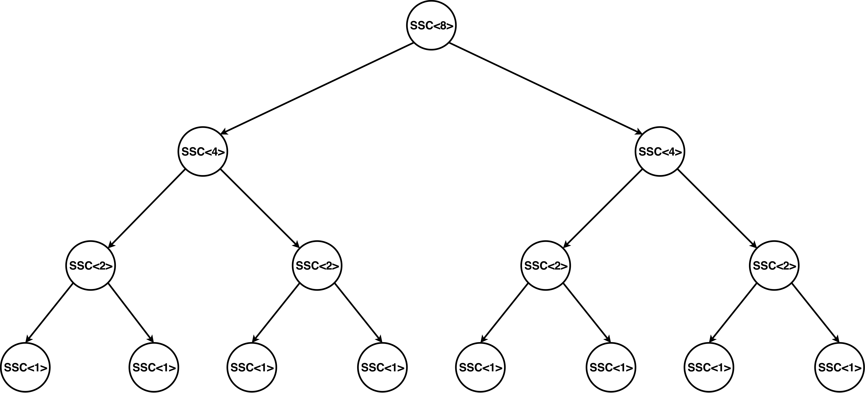
Unrolling the decoder
Recursive formulation is advantageous for hardware implementation. However in software recursive function calling causes a huge overhead.
To overcome this overhead decoder implementation is unrolled using templates concept of C++.
With templates, compiler automatically generates the code for different vector sizes.

Slide 26

Decoder tree pruning
Decoding latency can be further reduced by intelligently pruning the decoder tree.
Decoder tree is pruned irrespective of frozen pattern type.
Latency reduction comes at the cost of increased BLER.
At high SNR and low code rate scenarios this method can be used.
Pruning increases the BLER. Level of pruning and BLER can be dealt as a trade-off.

Slide 27
Cache prefetching
VN, CN and bit combination operations fetch a block of memory to perform vector operations.
Memory access pattern is predictable in advance.
Memory access latencies of future accesses can be reduced by fetching cache well in advance.
Cache line fetching is provided by non blocking PREFETCH instruction which is part of latest 3dnow extension of AMD EPYC processor.
Main memory
Prefetching request
L1-Cache
L2-Cache
L3-Cache
Data transfer
Processor

Slide 28
CRC calculation
PBCH and PDCCH channels need to calculate CRC24 for downlink control information transmission.
PUCCH and PUSCH channels calculate CRC6 or CRC11 for CRC check.
CRC calculation is one of the significant latency contributor to both encoding and decoding FEC chains.
Processing individual bits for CRC calculation is very inefficient.
Extended the popular CRC algorithm^{[1]} to calculate CRC24, CRC6 and CRC11 .
In this algorithm, 8 bits are processed in parallel rather than bit by bit,
Reduced CRC calculation latency from 8 μs to 0.8 μs in FEC chain.

Slide 29

Miscellaneous Optimizations
Replaced multiplication/division and modulus operations with bitwise operations which achieve the same result
Implemented approximate versions $\log_{2}{X}$ and exponential functions to reduce the number of floating point multiplications.
Reduced the usage of jump functions to avoid flushing of the instruction pipeline, instead latest instruction extension CMOV is used.
Used the compiler optimization primitives for better instruction scheduling.

Slide 30

Decoding chain results
Comparison with state of the art polar decoder software implementation (in AMD EPYC processor at 1.6 GHz) $N = 1024$
Decoder latency compared to state of the art
[1]* | This work
8 μs | 5 μs
*Scaled according to frequency
Decoder latency:
Functional | Current implementation
283.4 μs | 5 μs
Worst case latency decoding FEC chain:
Functional | Current implementation
391 μs | 40 μs

Slide 31
Conclusion
Both encoding and decoding FEC chains are efficiently implemented, achieved latency requirements through both algorithmic and software optimizations
Optimized implementation exploits modern features. Namely SIMD, Cache prefetching etc.
Achieved latency reduction of 10x.
Outlook
CRC aided Successive Cancellation List (CA-SCL) algorithm is also implemented. However it is not optimized.
CA-SCL algorithm has approximately 1.5dB gain over fast-SSC algorithm for N = 2048 and list size of 8^{[1]}.
Future work: Extend decoding FEC chain with optimized CA-SCL.
Interesting to see latency of CA-SCL which has expensive sort and copying operations.

Slide 32

Thank you
Questions

