Slide 1

Polar FEC chain development in software for 5G Final thesis presentation
Yadhunandana Rajathadripura Kumaraiah (Yadhu)
yadhu.kumaraiah@tum.de
Supervisors:
Fabian Steiner, Peihong Yuan (TUM)
Dr. Moritz Harteneck, Alexander Heinz
(Rohde & Schwarz)

Slide 2
Agenda
Introduction and Motivation
Background
Encoding FEC chain
Decoding FEC chain
Results
Future work

Slide 3
Motivation
Traditionally FEC chains are developed in hardware i.e. FPGA’s or ASIC’s to achieve low latency and high throughput.
Development/maintenance in FPGA/ASIC requires more time and expensive.
With recent advances in General Purpose Processors it is possible to achieve required latency and throughput with software implementations without custom hardware.
Software implementations require less development and maintenance effort and provide flexibility and ease of maintenance to device manufacturer.
However algorithms need to adopted/optimized to efficiently implement in software.

Slide 4
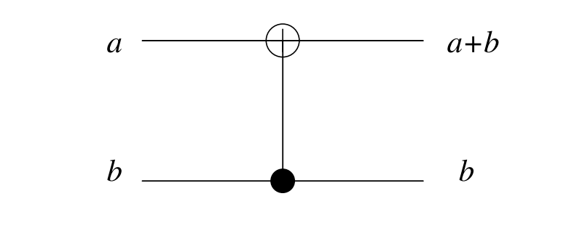
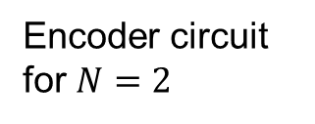
Background: Polar codes
Invented by Erdal Arıkan^{[1]} in 2009.
First codes to theoretically achieve channel capacity of binary memoryless channels with explicit construction.
Encoding a involves polarizing channels to either completely noiseless or fully noisy channels.
As N becomes large, fraction of reliable bit indices approach the capacity of the channel.
Encoder circuit for $N=2$

Slide 5
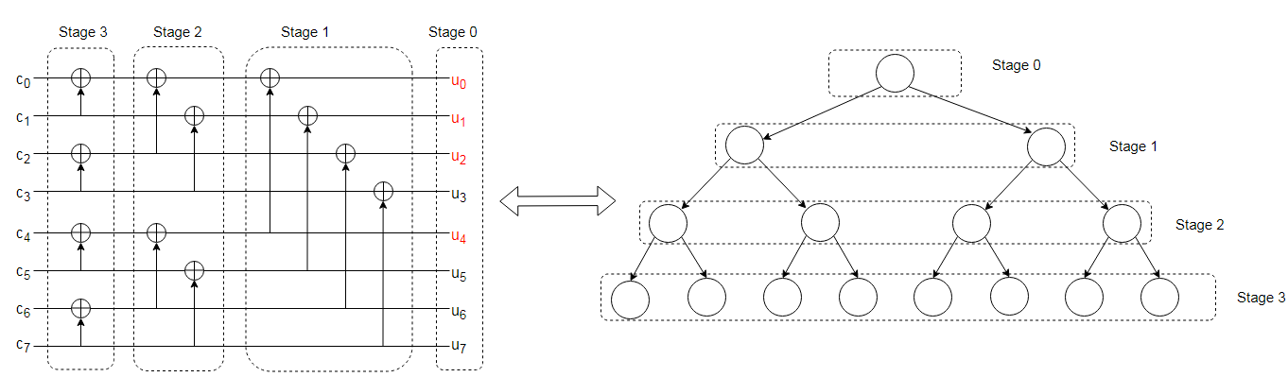

Polar Encoding
Sample encoding in circuit for $N = 8$.
$\# of info bits = 4$, $output bits (N) = 8$.
Each stage contains vector of size 2^{(N-stage)}
Encoding introduces correlation between code word bits through XOR operation.

Slide 6
Polar code construction in 5G
Reliability indices selection is done based on the channel condition(SNR)
Many construction methods are proposed such as density evolution (DE), Gaussian Approximation DE etc.
Still very complex to construct code on the fly.
5G standard (Huawei contribution) proposes a heuristic low complexity polar code construction independent of channel condition.
This construction performs sufficiently good over a large range of SNR^{[1]}

Slide 7
Decoding polar codes
In two slides explain polar decoding algorithms, Show decoder as tree diagram and explain fast SSC

Slide 8
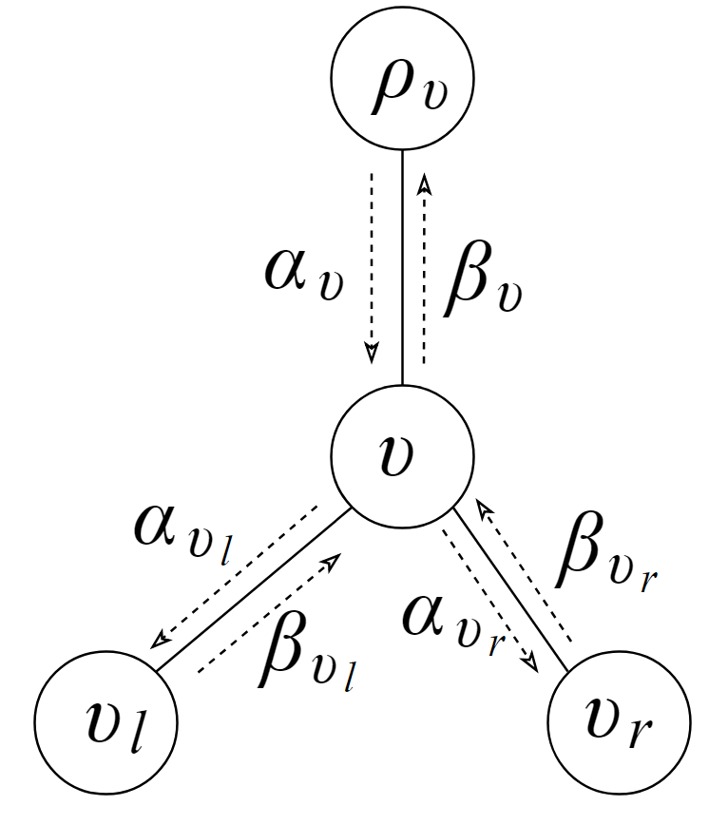
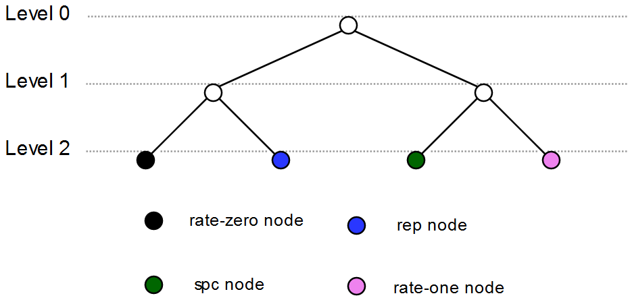
Decoding polar codes
Local decoder with messages

Slide 9
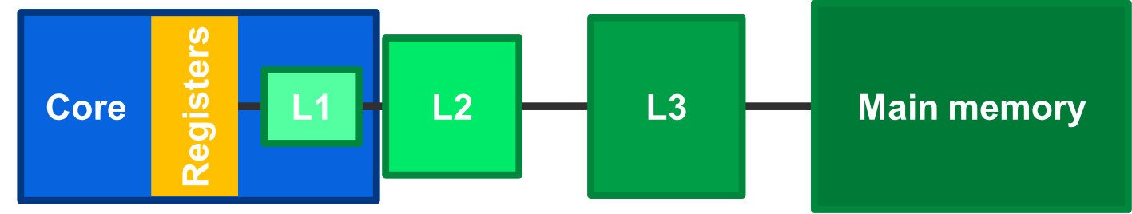
Processor architecture: Cache memory

Slide 10
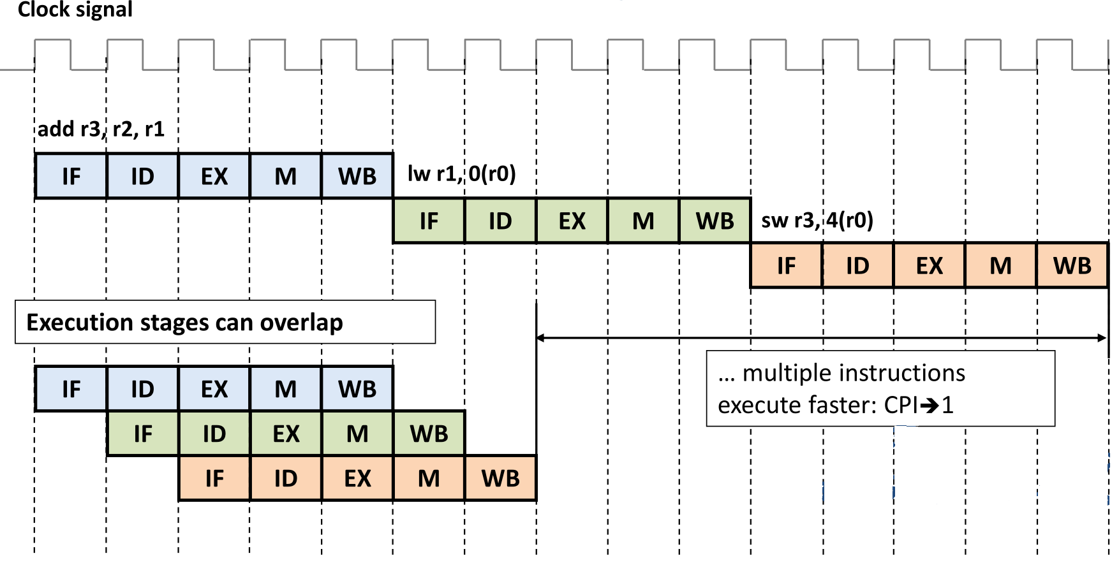
Processor architecture: Instruction pipelining

Slide 11
Vector processing units
Single instruction multiple data (SIMD) allows single instruction to operate on multiple data items (Vectors).
Modern processors incorporate these vector processing units.
Allows faster data processing, popular among video and image processing community.
Faster encoding/decoding in communication systems can be implemented in software in general purpose processors using SIMD instructions without specialized hardware.
SIMD feature allows encoding/decoding with low latency, due to processing of vectors rather than element by element processing.

Slide 12
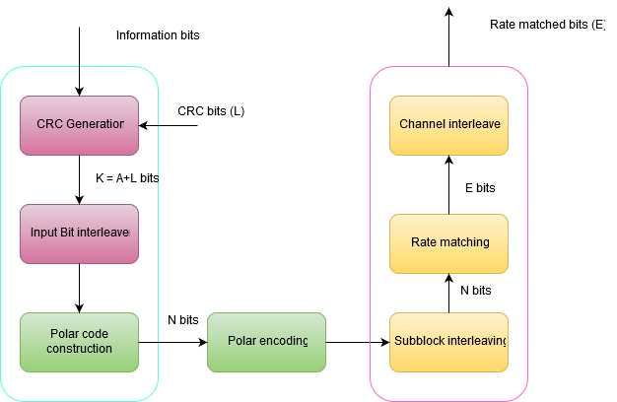
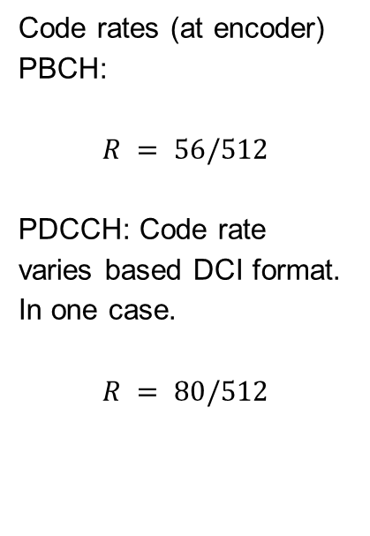
Encoding FEC chain in 5G
FEC chain of Physical Broadcast Channel (PBCH) and Physical Downlink Control Channel (PDCCH).
Code rates (at encoder)
PBCH:
$$R = 56/512$$
PDCCH: Code rate varies based DCI format. In one case.
$$R = 80/512$$

Slide 13
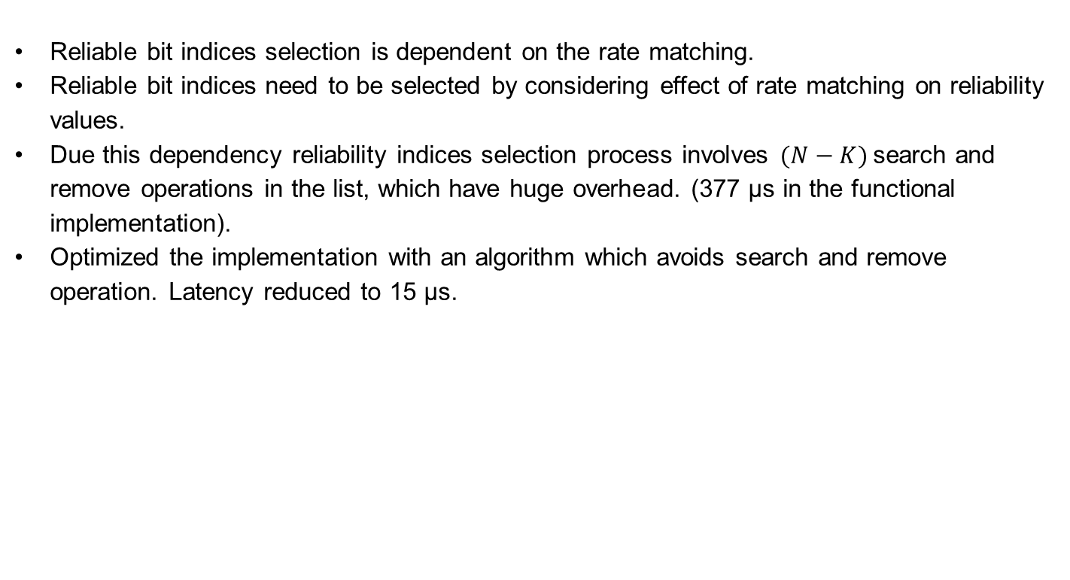
Information bit indices selection
Reliable bit indices selection is dependent on the rate matching.
Reliable bit indices need to be selected by considering effect of rate matching on reliability values.
Due this dependency reliability indices selection process involves $(N−K)$search and remove operations in the list, which have huge overhead. (377 μs in the functional implementation).
Optimized the implementation with an algorithm which avoids search and remove operation. Latency reduced to 15 μs.

Slide 14
Optimization of Polar Encoding
Plain implementation in software considers each bit as one integer.
No parallel processing, each bit processed separately.
Information bits can be processed in parallel by packing multiple information bits to single integer.
For example: 8 bit integer = 8 info bits, 16 bits integer = 16 bit, 32 bit integer = 32 info bits, 64 bits integer = 64 info bits.
SIMD processors have register size of 256 bits therefore 256 bits can be processed in a single instruction.

Slide 15
Information bits packing example
Each row represents 8 bit integer representing one info bit.
Only last column contains info bits
0 | 0 | 0 | 0 | 0 | 0 | 0 | 1
0 | 0 | 0 | 0 | 0 | 0 | 0 | 0
0 | 0 | 0 | 0 | 0 | 0 | 0 | 0
0 | 0 | 0 | 0 | 0 | 0 | 0 | 1
0 | 0 | 0 | 0 | 0 | 0 | 0 | 0
0 | 0 | 0 | 0 | 0 | 0 | 0 | 0
0 | 0 | 0 | 0 | 0 | 0 | 0 | 1
0 | 0 | 0 | 0 | 0 | 0 | 0 | 1
8 bits grouped as one integer.
1 | 0 | 0 | 1 | 0 | 0 | 1 | 1
Same idea can be extended to creating integers of 64 bits, so 64 info bits can processed concurrently.
Same idea can be extended to 256 bits packing for SIMD.

Slide 16
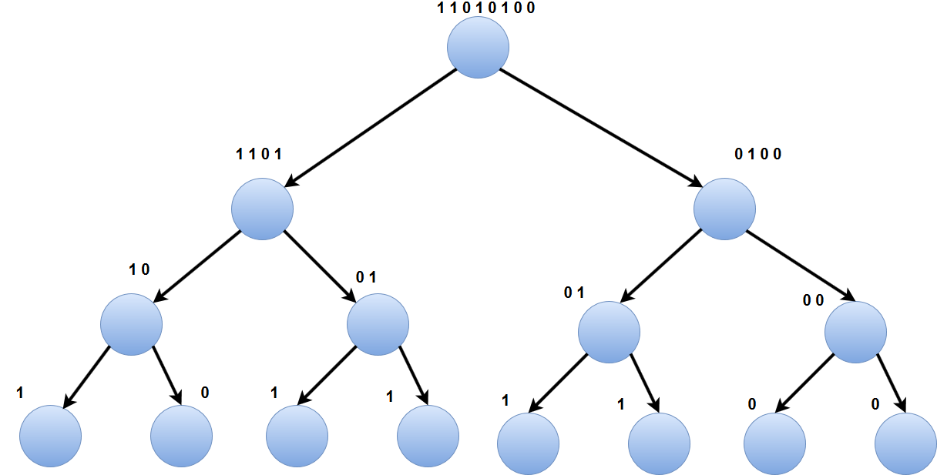

Polar Encoding in Tree Structure
Tree representation of polar encoding, For $N = 8$.

Slide 17

Encoder tree pruning
Plain implementation of encoding traverses till the end of tree, In other words for $N = 1024$, encoder needs to travel $2047$ nodes in a tree.
Number of nodes can be significantly reduced by pruning the tree.
Pruning of tree can be done by building a lookup table and stopping encoding when level is $\log_{2}{N −3}$, i.e 7 in our example.
This reduces the number of nodes to be traversed to 255 from 2047.
This significantly reduces the latency.
This optimization can also be applied for hardware implementations.

Slide 18
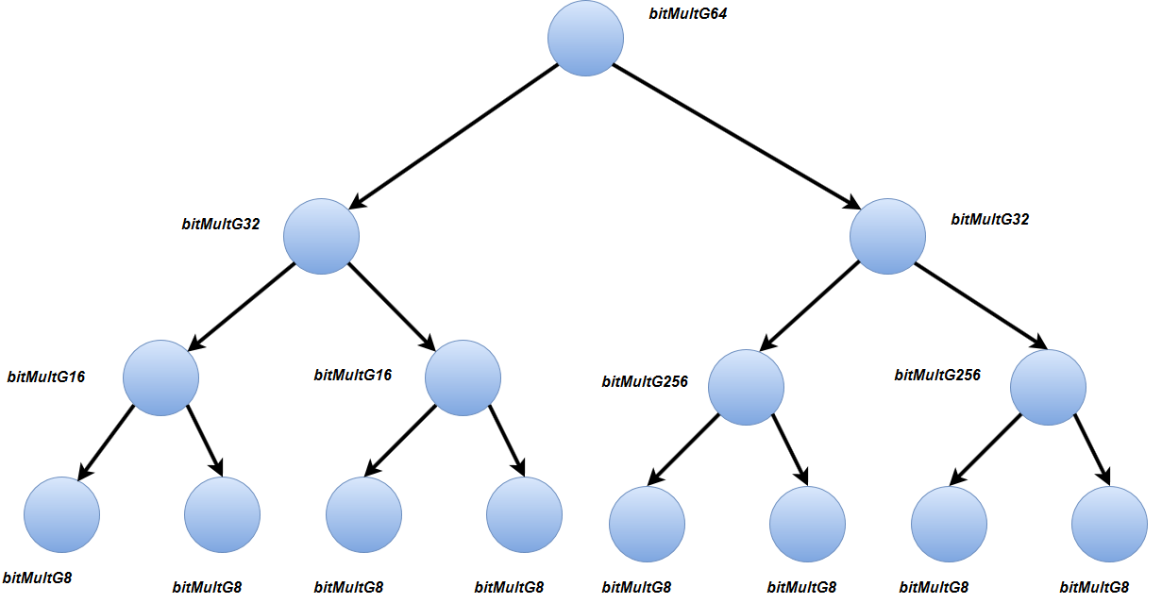
Unrolling the recursive implementation
Recursive function has overhead since every function call requires new stack allocation and jumping to function target address.
Avoiding branching(Jump instructions) which has significant overhead.

Slide 19
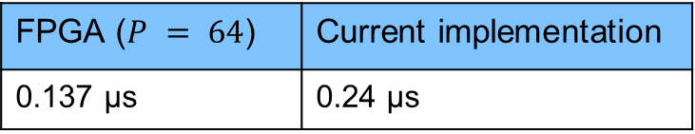

Results
Comparison with open source encoder software implementation (in AMD EPYC processor at 1.6ghz) $N = 1024$
FPGA^{[2]} v/s Software
Overall PDCCH FEC chain:
aff3ct^{[1]} (No SIMD) | Current implementation
5.6 μs | 0.24 μs
FPGA ($P = 64$) | Current implementation
0.137 μs | 0.24 μs
Functional | Current implementation
411 μs | 21 μs
Notes:
Functional implementation done by colleague at R&S.
For FPGA implementation, value is scaled according to N value.

Slide 20
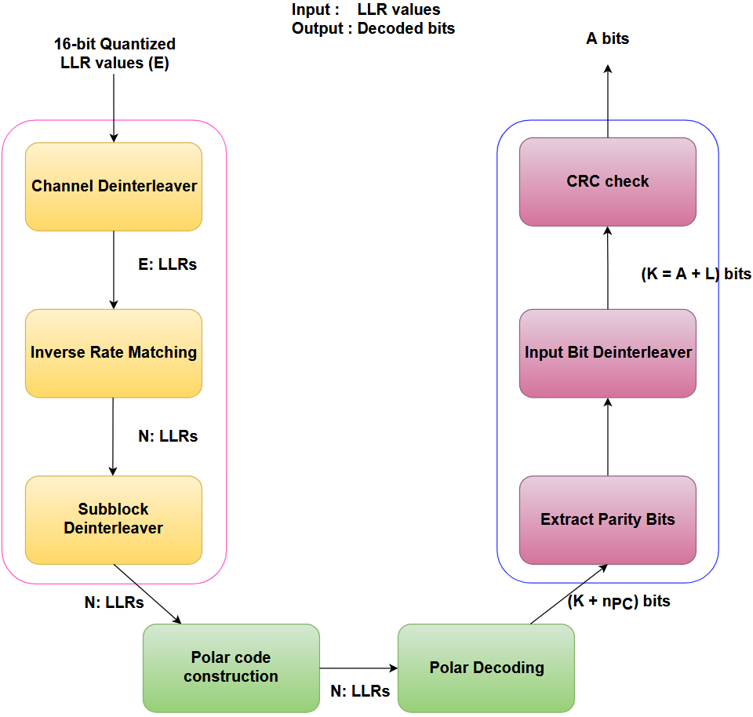
Decoding FEC chain

Slide 21
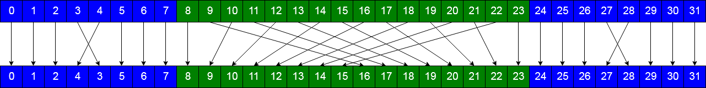
Subblock deinterleaver
Inverse of subblock interleaver operation performed at the transmitter.
Deinterleaving is performed as shown in the figure.
One of expensive operation due to huge number of division, multiplication and modulus operations and it is also sequential.
This operation is broken down into three parts, each of them are implemented using permute and blend SIMD instructions.
Latency reduced from 19us to 0.47us.

Slide 22
Polar decoding: Packing frozen bits
Packing multiple frozen bits efficient identification of component codes.
Frozen pattern is passed in packed bit format to decoder.
Identification component codes is performed at run time.
Packing of multiple bits together allows identification of component codes in a single comparison instruction.

Slide 23
Polar decoding: Avoiding superfluous copying

Slide 24
Polar decoding: Optimized CN and VN operations

Slide 25
Decoding R0 and R1 codes
Vector threshold detection and polar transform for R1 nodes.

Slide 26
Decoding RPC and SPC codes
Parity calculation, position searching, polar transform

Slide 27
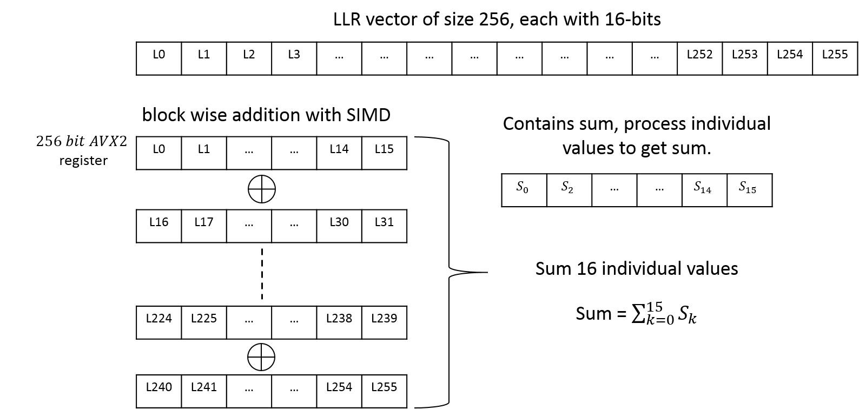
Block wise addition for RPC

Slide 28
Unrolling the decoder
Recursive formulation is advantageous for hardware implementation. However in software recursive function calling huge overhead.
To overcome this overhead decoder implementation is unrolled using templates concept of C++.
With templates compiler automatically generates the code for different vector sizes.
One can also explicitly specialize functions if different logic needs to be implemented for particular vector size.

Slide 29
Cache prefetching
Memory access in the decoder is regular.
Future memory which is going to be accessed is known in advance.
Memory access latency can be overcome by issuing non blocking cache line fetch instruction in advance.

Slide 30
Decoder tree pruning

Slide 31
CRC calculation
PBCH and PDCCH channel need to calculate CRC24 for downlink control information transmission.
PUCCH and PUSCH channel need calculate CRC6 or CRC11 for CRC check.
CRC calculation is one of the significant latency contributor to both in encoding and decoding FEC chains.
Extended popular CRC algorithm^{[1]} to calculate CRC24, CRC6 and CRC11 .
In this algorithm group of 8 bits are processed in parallel rather than bit by bit, Reduced CRC calculation latency from 8 μs to 0.8 μs in FEC chain.

Slide 32

Miscellaneous Optimizations
Avoiding multiplication/division and modulus operations and achieving the same using bitwise operations.
Implemented approximate versions $\log_{2}{X}$ and exponential functions to reduce the number of floating point multiplications.
Avoided jump functions to avoid flushing of the instruction pipeline.
Using the compiler optimization primitives to reduce the branches in the program.

Slide 33

Results: Decoding
Comparison with state of the art polar decoder software implementation (in AMD EPYC processor at 1.6ghz) $N = 1024$
Overall PUCCH FEC chain:
[1] | This work
8 μs | 5 μs
Functional | Current implementation
391 μs | 40 μs
Notes:
Functional implementation done by colleague at R&S.
For FPGA implementation, value is scaled according to N value.

Slide 34
Conclusion
Both encoding and decoding FEC chains are efficiently implemented through both algorithmic and software optimizations
Optimized implementation exploits the features provided by modern processors such SIMD, Cache prefetching et cetera.
This work achieved latency requirements encoding and decoding FEC chains of 5G through software implementation.
Efficient implementation and optimization reduced the latency by 10x.

Slide 35
Outlook
As part of this work another decoding algorithm, CRC aided Successive Cancellation List (CA-SCL) algorithm is also implemented. However it is not optimized.
CA-SCL algorithm has approximately 1.5dB gain over fast-SSC algorithm for N = 2048 and list size of 8.
Ideal continuation of this work would be to extend decoding FEC chain by incorporating CA-SCL.
It would be interesting to see latency values of CA-SCL which has expensive sort and copying operations.

Slide 36

Thank you
Questions

