Slide 1
Polar FEC development in software for NR(5G) Current status
Yadhu
yadhunandana.kumaraiah@rohde-schwarz.com

Slide 2
Contents
Polar Encoding Background
5G polar encoding chain
Latency measurement.
Polar encoder latency.
Polar code construction and optimization.
Polar transform optimization.
Optimal CRC calculation.
References.

Slide 3
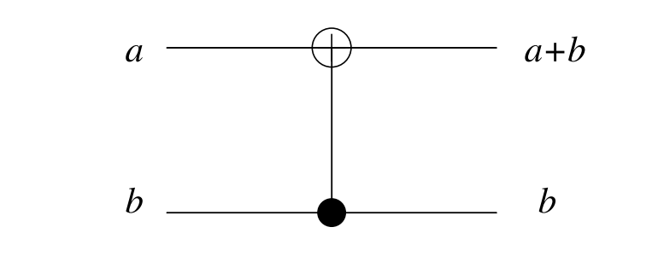
Polar Codes background.
Invented by Erdal Arıkan in 2009.
First codes to achieve channel capacity of binary memoryless channels with explicit construction.
Encoding a involves polarizing channels to either completely noiseless or fully noisy channels.
Encoder circuit for N=2

Slide 4
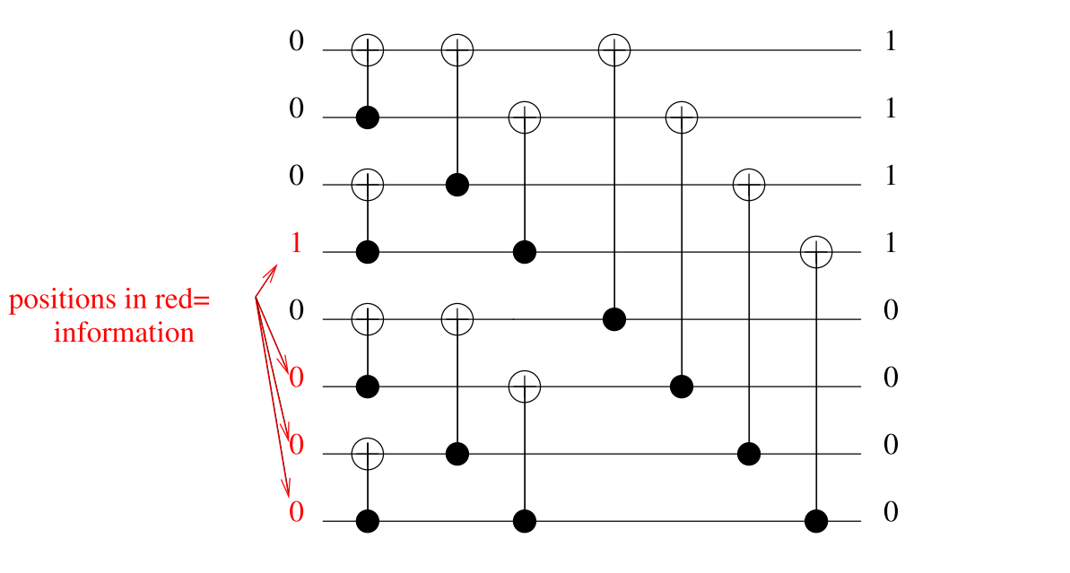
Polar Codes background. Sample encoding in circuit for N = 8
# of info bits=4, code word size(N) = 8.

Slide 5
Polar Codes background.
As N becomes large, fraction of reliable bit indices approach the capacity of the channel.
Reliability indices selection is done based on the channel condition(SNR)
Many construction methods proposed such density evolution etc.
Still very complex to construct code on the fly.
5G standard (Huwaei contribution) proposes a heuristic low complexity polar code construction independent of channel condition.
This construction performs sufficiently good over a large range of SNR.

Slide 6
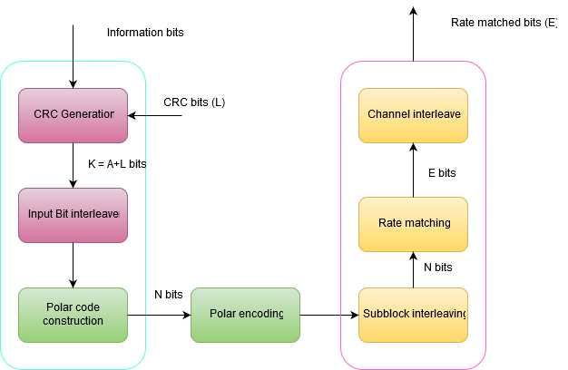
Polar Encoding Chain in 5G

Slide 7
Measuring the latency. First step in code optimization.
Aim is to reduce the latency of encoding and decoding.
Requires accurate measurement of latency.
C++ STL chrono library provides high resolution time measurement, accuracy in the order of Nano seconds.
Accuracy guaranteed only in Linux platform.
Sample latency measurement snippet.
high_resolution_clock::time_point start = high_resolution_clock::now();
encodedData = PbchFecModule.fastEncode(mib, sfn, n_hf, iSSB, k0);
high_resolution_clock::time_point end = high_resolution_clock::now();

Slide 8
Profiling the code. Second step in code optimization.
Helps to identify hotspots in the code.
Used open source profiler called perf.
Very low overhead and doesn’t require modification of binary file.
Data captured from hardware performance counters of the processor.
Accurately reflects the runtime behavior of the program.

Slide 9
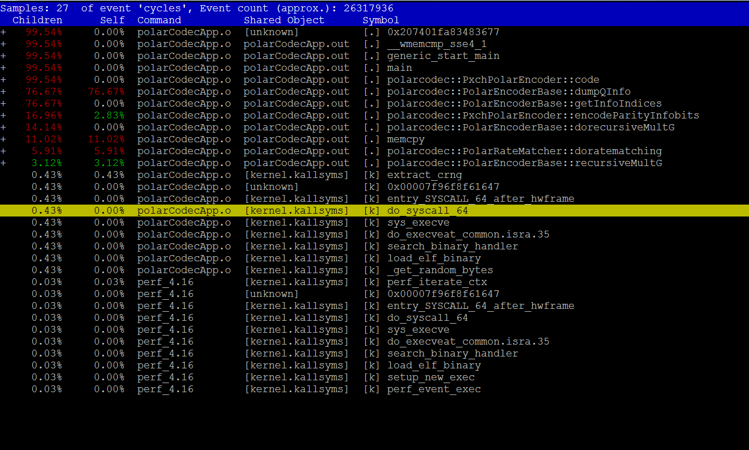
Perf report
latency slide

Slide 10
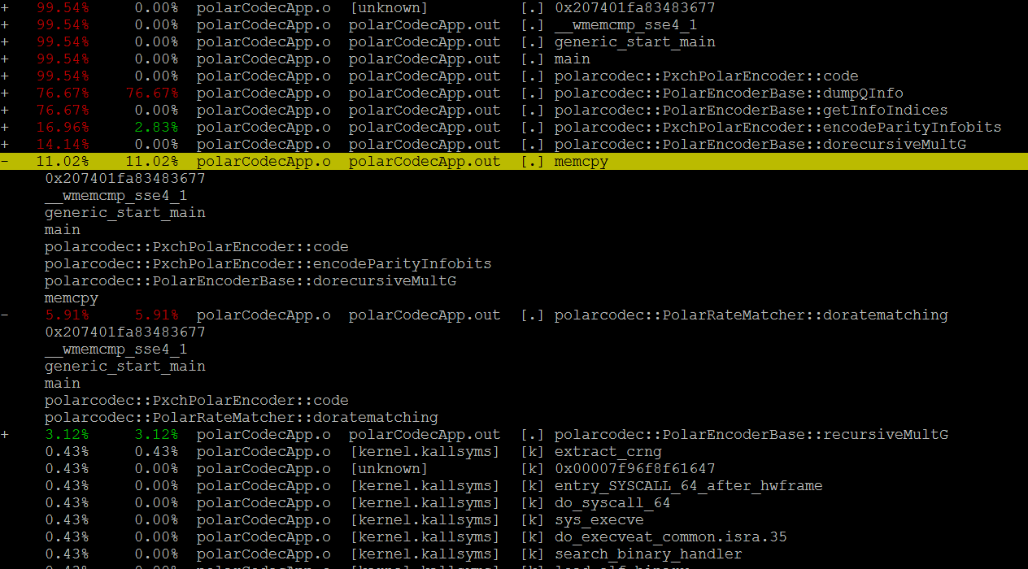
Perf call graph

Slide 11
Polar Encoder Latency
Latency measurement of first functional implementation(MATLAB like) of Polar encoder.
K is the number of information bits, N is the numbers of bits at the encoder output, E is the number of bits after rate matching.
For the case of K = 55, N = 1024 and E = 846. Latency was 411 us without any optimizations.
Code rate at the output of encoder is 55/1024. After rate matching it is 55/846.
Perf report

Slide 12
Optimization in selecting reliability indices
Before encoding data bits, K reliable positions out of N positions need to selected.
Interleaving pattern also need to be taken into account.
Process involves select K best positions out of N by searching through a list.
Low reliability indexes are removed from the list.
Searching, removing and erasing are very costly operations.
Use to take 176 us for just remove operations.
Costliest operation among all the operations in encoding.

Slide 13
Optimization of selection reliability indices
The aim is to avoid remove and erase operations.
Which involve costly memory deallocation and copy operations.
Efficient algorithm for selecting would be to find the element which needs to removed and mark it as removed, but don’t remove it.
This algorithm reduced the latency by 176 us.
Again the above algorithm can be further improved. since it involves many searching operations in an array of 1024 elements.
Total search time amounts to 40us. Which is highly undesirable.
Can we come up with a better method?

Slide 14
Optimization in selection reliability indices
Reliability index positions are constants. So why to search for them?
Why not build a lookup table whose value exactly gives position of the reliability index.
This method reduced the latency by 40 us which is good improvement.
Overall, latency improvement is by 216 us through efficient selection of reliability indices.

Slide 15
Selecting Reliability Indices.
When (E < N), either puncturing or shortening of reliability indices is carried out for selecting frozen indices.
Frozen bit indices are removed from reliability indices list, so remaining values indicate information bits positions.
Removing frozen bit positions involve (N – E) search operations through unsorted list and (N – E) remove operations. These operations are costly.
Selecting reliability indices was taking 209 us for N = 1024, K = 55 and E = 846.

Slide 16
Example For example take N = 32, E = 16 and K = 10.
N32POLARSEQRELIABILITY = { 0, 1, 2, 4, 8, 16, 3, 5, 9, 6, 17, 10, 18, 12, 20, 24, 7, 11, 19, 13, 14, 21, 26, 25, 22, 28, 15, 23, 27, 29, 30, 31};
These parameters require shortening according to the spec. (N - E) will be selected as frozen bit indices.
For the above example. 16 indices. These indices are calculated from the interleaving pattern table of the spec.
J32INTERLEAVED = { 0, 1, 2, 4, 3, 5, 6, 7,8,16,9,17,10,18,11,19,12,20,13,21,14,22,15,23,24,25,26,28,27,29,30,31}; last 16 indices from this list are chosen as frozen indices, they must be removed from the reliability indices list.
Requires searching and removing through the reliability list. From software perspective for searching one should go through every element in the list, Every removing operation requires copying the values present after index removed.

Slide 17
Example continued
Resulting reliability indices. {0, 1, 2, 4, 8, 16, 3, 5, 9, 6, 17, 10, 18, 7, 11, 19};
Can we avoid costly search and copy operations?

Slide 18
Avoiding costly search and remove operations
If we don’t remove from reliability positions, reliability position values don’t change.
So we can easily build a look up table which contains indexes of a reliability values.
Directly get a reliability value position from the table and mark it as removed.
Just marking it as removed has two advantages
It avoids costly remove operations which involve copying.
Positions of the reliability indexes won’t change hence their positions can be read from the look up table hence avoiding search operations.
This algorithm reduced the latency of this function from 209us to 3us.

Slide 19
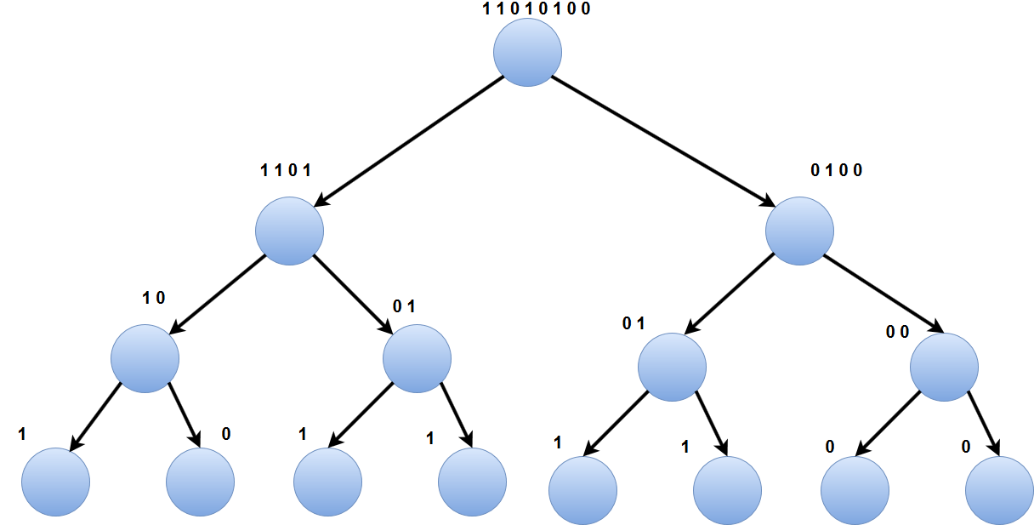
Polar encoding in tree structure.
Tree representation of polar encoding, For N = 8.

Slide 20
Optimization of Polar transform
Polar transform takes 55us for N = 1024 and K = 130.
Polar transform optimization.
Avoiding memcpy operations.
Using pointers to reduce memory allocation and deallocation.
Using XOR operation in place of addition and mod operation.
Latency reduced to 45us.

Slide 21
Polar transform function
Before
After
if (sizeIn==1)
{
dEncoded[m_index++] = *s;
}
else
{
UNS32 len = sizeIn/2;
UNS32 s1[len];
UNS32 s2[len];
std::copy(s, s+len, s1);
std::copy(s+len, s+sizeIn, s2);
for (UNS32 i = 0; i < len; ++i)
s1[i]= (s1[i] + s2[i]) % 2
recursiveMultG(s1,len,dEncoded);
recursiveMultG(s2,len,dEncoded);
}
if (sizeIn==1)
{
dEncoded[m_index++] = *s;
}
else
{
UNS32 len = sizeIn >> 1;
UNS32 *s1 = s;
UNS32 *s2 = s + len;
for (UNS32 i = 0; i < len; ++i)
s1[i]= (s1[i] ^ s2[i]);
recursiveMultG(s1,len,dEncoded);
recursiveMultG(s2,len,dEncoded);
}
Takes 55us
Takes 45us

Slide 22
SIMD implementation of Polar transform
Previous polar transform still takes 45us. Implementation can be further optimized using SIMD instructions.
In the previous implementation data is processed bit by bit.
Bits can be processed in parallel by making each set of 8/16/32/64 bits in to integers. This method improves the latency since multiple bits can be processed concurrently.
SIMD instructions support register size of 256 bits in AVX2 and 128 bits in AVX.
SIMD instructions allow processing of 256 bits in single instruction. Hence significantly improve the latency.
To get most out of SIMD, memory needs to be aligned.

Slide 23
Information bits grouping example
Each row represents 8 bit integer representing one info bit.
Last column only contains info bits
0 | 0 | 0 | 0 | 0 | 0 | 0 | 1
0 | 0 | 0 | 0 | 0 | 0 | 0 | 0
0 | 0 | 0 | 0 | 0 | 0 | 0 | 0
0 | 0 | 0 | 0 | 0 | 0 | 0 | 1
0 | 0 | 0 | 0 | 0 | 0 | 0 | 0
0 | 0 | 0 | 0 | 0 | 0 | 0 | 0
0 | 0 | 0 | 0 | 0 | 0 | 0 | 1
0 | 0 | 0 | 0 | 0 | 0 | 0 | 1
8 bits grouped as one integer.
1 | 0 | 0 | 1 | 0 | 0 | 1 | 1
Same idea can be extended to creating integers of 64 bits, so 64 info bits can processed concurrently.

Slide 24
SIMD processing of Information bits.
With previous method of grouping info bits, best case 64 bits info bits can be processed concurrently in 64 bit processor.
Still in case of 1024 bits, we have to do it 16 times in one node of polar encoding tree. Can we further reduce the number of operations?
SIMD instructions to rescue, with AVX2 256 bits and with AVX 128 bits can processed in a single operation.
For N=1024 bits, One stage can be processed with four AVX2 operations.

Slide 25
Sample SIMD code
C/C++ sample
Corresponding Assembly
inline void xor_256bit(void *operand1,void *operand2,void *destn)
{
__m256i result;
__m256i temp1 = _mm256_loadu_si256((__m256i*)operand1);
__m256i temp2 = _mm256_loadu_si256((__m256i*)operand2);
result = _mm256_xor_si256(temp1,temp2);
_mm256_storeu_si256((__m256i*)destn, result);
}
vmovdqu 0x40(%rdi),%ymm0
vpxor (%rdi),%ymm0,%ymm0
vmovdqu %ymm0,(%rdi)

Slide 26
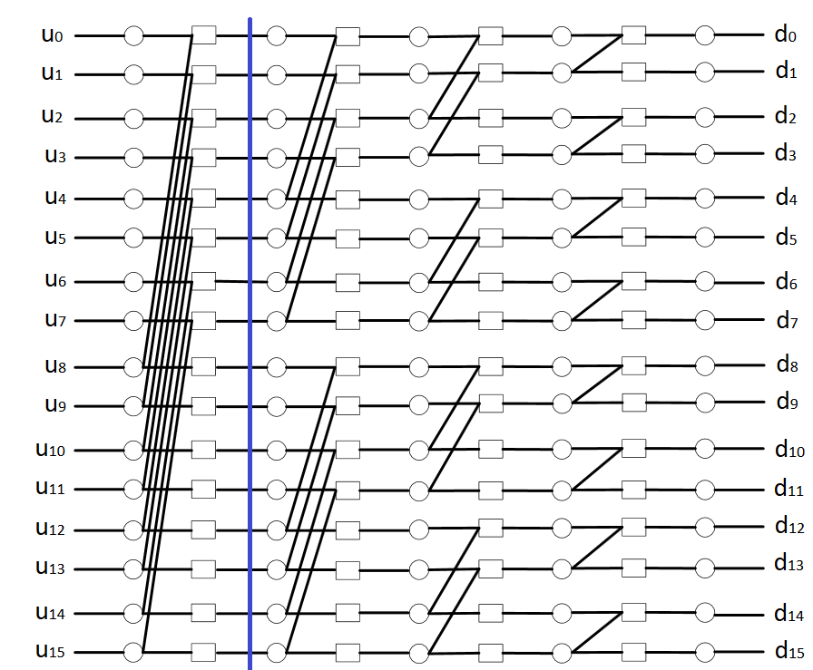
Sample polar encoder in circuit form, N = 16

Slide 27
Optimization of polar encoder.
One disadvantage of grouping information bits is that, when we need to perform polar transform in last 8 stages, Polar transform requires accessing 4,2 and 1 bits accessing these bits requires masking operation. Which further increase the latency.
These operations can be avoided by building a lookup table.
Building lookup table is equivalent to pruning encoder tree by grouping 8 leaf nodes to one.
Using lookup table reduces the latency in addition to avoiding masking operations.

Slide 28
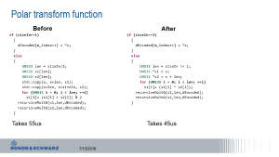
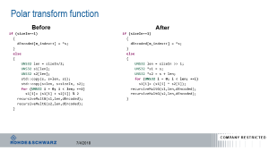
Unrolling the recursive function.
Recursive implementation looks pretty neat, however it has considerable overhead.
Every recursive call requires jump instruction and allocation of new stack frame.
This overhead can be avoided if encoder is implemented in non recursive way.
As maximum N specified in 5G spec is 1024, We can specialize the polar transform function for different values N. i.e 1024,512 etc. Correct function is chosen based on the value of N, which further calls N/2 specialized functions. All these functions are inline functions, Which makes encoder branch free non recursive implementation.

Slide 29
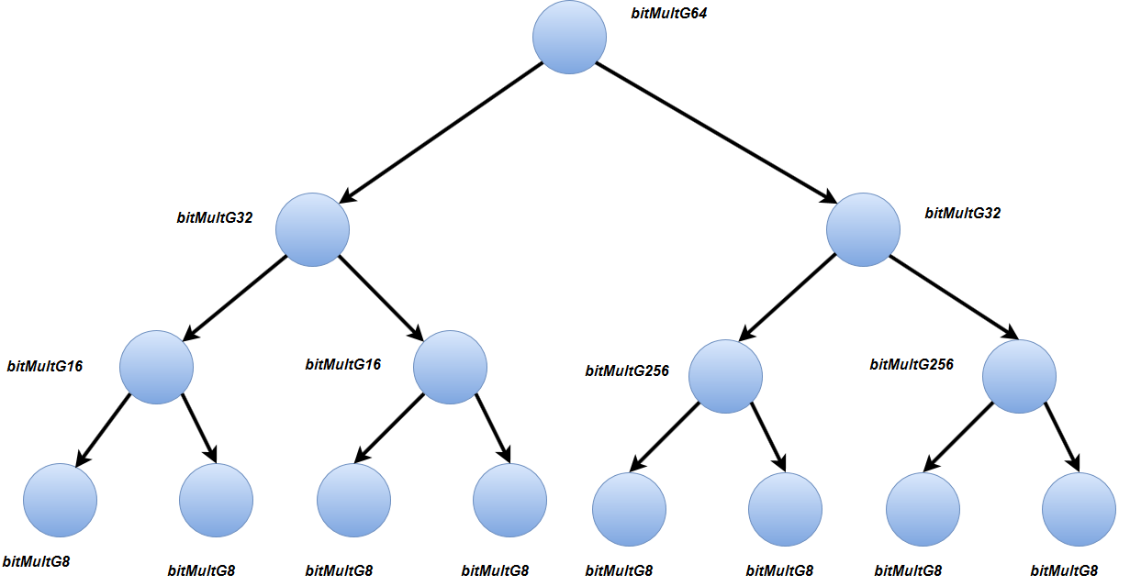
Pictorial representation of branch free encoder. For N = 64
Unrolled decoder in tree form
inline void bitMultG64(uint8_t *s, uint8_t *dEncoded)
{
//Here s is 64 bits, Divided to 32 bits each.
uint32_t *s1 = (uint32_t *) s + 1;
uint32_t *s2 = (uint32_t *) s;
*s1 = *s1 ^ *s2;
bitMultG32((uint8_t *) s1, dEncoded);
bitMultG32((uint8_t *) s2, dEncoded);
}
inline void bitMultG32(uint8_t *s, uint8_t *dEncoded) {
//Here s is 4 bytes, Divided to two bytes each.
uint16_t *s1 = (uint16_t *) s + 1;
uint16_t *s2 = (uint16_t *) s;
*s1 = *s1 ^ *s2;
bitMultG16((uint8_t *) s1, dEncoded);
bitMultG16((uint8_t *) s2, dEncoded);
}

Slide 30
Latency of optimized polar transform.
With all the above optimizations avoiding copy operations, bits grouping, SIMD instructions, Lookup table and unrolled branch free implementation. The latency of polar transform is reduced significantly from 55us to 1.5us for N = 1024.
In other words current implementation of polar transform can encode 1024 bits with in 1.5 us.

Slide 31
Efficient CRC calculation
Another significant latency contributor to PDCCH Encoding chain is CRC calculation. On the fly CRC calculation takes 8us with CRC24.
In optimized implementation, a lookup table is built. In which 24 bit CRC is calculated for all combinations 8bits and stored in a look up table.
For more than 8 bits info bits, CRC read from lookup table for chunks of 8 bits and is combined to generate CRC for the whole data block.
Optimized implementation takes 0.8us for 64 information bits.

Slide 32
Other optimizations to FEC chain
Using compiler primitives to help the branch predictor to reduce branches.
Aligning memory to 32 bytes so that compiler can generate SIMD code wherever it is possible.
Avoiding costly operations such as division and multiplications instead using right shift and left shift operations.
Avoiding dynamic memory allocations.
Manual loop unrolling to reduce the branches (Jumps) in the code.
Implementation log2 function using bit wise operations.
With all the above optimizations, Latency of the whole FEC chain is reduced from 411us to 20us.

Slide 33
TODO for Encoding
Optimizing the cache accesses. Probably prefetching the data from cache?
little difficult , Since it is hard to identify which part of the code is experiencing most cache misses.

Slide 34
Current work. Decoder implementation with SIMD.
Have done literature survey related to decoding algorithms.
Three different decoding algorithms are popular, Successive cancellation(SC), Simplified Successive Cancellation(SSC) and Fast SSC.
Among three, Fast-SSC is the fastest decoder.
Currently, implementing the Fast SSC decoding algorithm. SIMD instructions are useful for implementing check node(CN) and variable node(VN) operations.

Slide 35
Research directions
Fastest algorithm i.e Fast-SSC identifies repetition and SPC component codes in polar code. These codes are decoded immediately without traversing the remaining tree.
Investigate whether it is possible to identify any other type of component code which allows faster decoding.
Hard decision decoding is just performing polar transform on received bits after threshold detection. Try performing soft decision decoding for lower level nodes and hard decoding for higher level nodes, This reduces the decoding latency but increases the BER.
Investigate BER versus level of hard decision decoding in tree. Can we trade a BER for low latency?
Any other ideas and Suggestions for improvement are welcome.

Slide 36
References
E. Arıkan, “Channel polarization: A method for constructing capacity-achieving codes for symmetric binary-input memoryless channels,” IEEE Trans. Inform. Theory, vol. 55, pp. 3051–3073, July 2009.
Sarkis, G., & Gross, W. J. (2013). Increasing the throughput of polar decoders. IEEE Communications Letters, 17(4), 725–728.
Alamdar-Yazdi, A., & Kschischang, F. R. (2011). A simplified successive-cancellation decoder for polar codes. IEEE Communications Letters, 15(12).
Low-Latency Software Polar Decoders, Pascal Giard, Claude Thibeault, Warren J. Gross.
A Practical Introduction to Polar Codes (A very simple tutorial for beginners) Harish Vangala, Yi Hong, and Emanuele Viterbo, Monash University, Australia.
3rd Generation Partnership Project;
Technical Specification Group Radio Access Network; NR; Multiplexing and channel coding (Release 15).

Slide 37
Thanks

