Slide 1
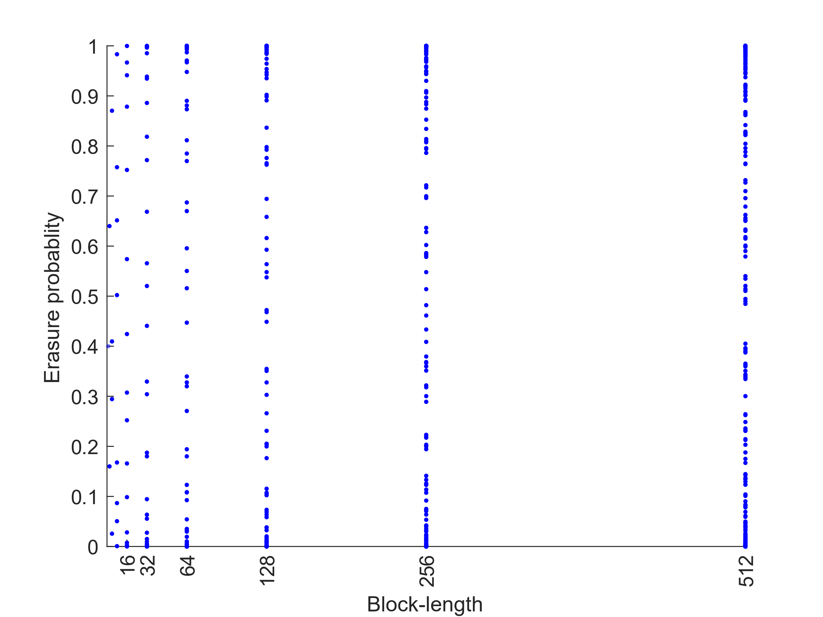
Fully unreliable channels
Fully reliable channels

