Slide 1

Polar FEC chain development in software for NR(5G) Final thesis presentation
Yadhunandana Rajathadripura Kumaraiah
yadhu.kumaraiah@tum.de
Supervisors:
Fabian Steiner and Peihong Yuan (TUM)
Dr. Moritz Harteneck and Alexander Heinz
(Rohde & Schwarz)

Slide 2
Agenda
Introduction and Motivation
Background
Encoding FEC chain
Decoding FEC chain
Results
Future work

Slide 3
Motivation
Traditionally FEC chains are developed in hardware i.e FPGA’s or ASIC’s to achieve low latency and high throughput.
Development/maintenance in FPGA/ASIC requires more time and expensive.
With recent advances in General Purpose Processors it is possible to achieve required latency and throughput with software implementations without custom hardware.
Software implementations are flexibility and ease of maintenance to device manufacturer.
However algorithms need to adopted/optimized to efficiently implement in software.

Slide 4
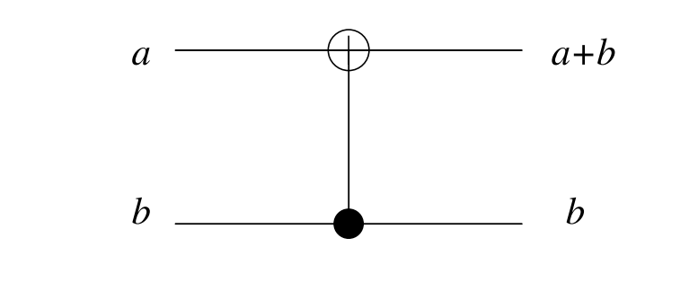
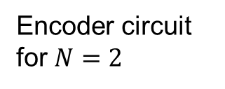
Polar Codes
Invented by Erdal Arıkan^{[1]} in 2009.
First codes to theoretically achieve channel capacity of binary memoryless channels with explicit construction.
Encoding a involves polarizing channels to either completely noiseless or fully noisy channels.
As N becomes large, fraction of reliable bit indices approach the capacity of the channel.
Encoder circuit for $N=2$

Slide 5
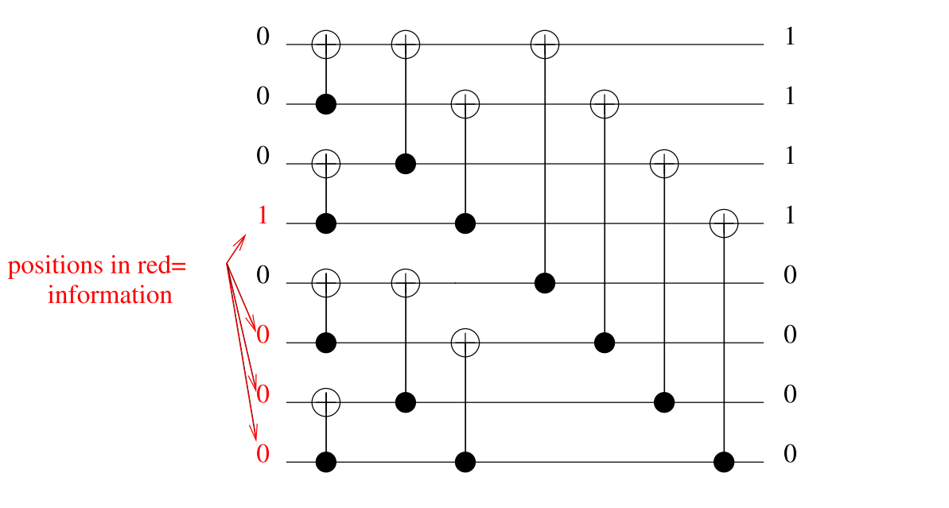

Polar Codes continued..
Sample encoding in circuit for $N = 8$.
$\# of info bits = 4$, $output bits (N) = 8$.

Slide 6
Polar codes for control channels in 5G
Reliability indices selection is done based on the channel condition(SNR)
Many construction methods are proposed such as density evolution (DE), Gaussian Approximation DE etc.
Still very complex to construct code on the fly.
5G standard (Huawei contribution) proposes a heuristic low complexity polar code construction independent of channel condition.
This construction performs sufficiently good over a large range of SNR^{[1]}

Slide 7
SIMD Technology Background
Single instruction multiple data (SIMD) allows single instruction to operate on multiple data items (Vectors).
Modern processors incorporate these vector processing units.
Allows faster data processing, popular among video and image processing community.
Faster encoding/decoding in communication systems can be implemented in software in general purpose processors using SIMD instructions without specialized hardware.
SIMD feature allows encoding/decoding with low latency, due to processing of vectors rather than element by element processing.

Slide 8
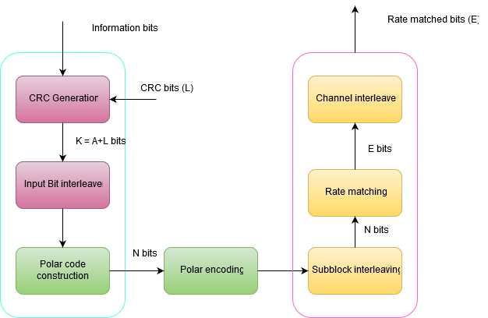
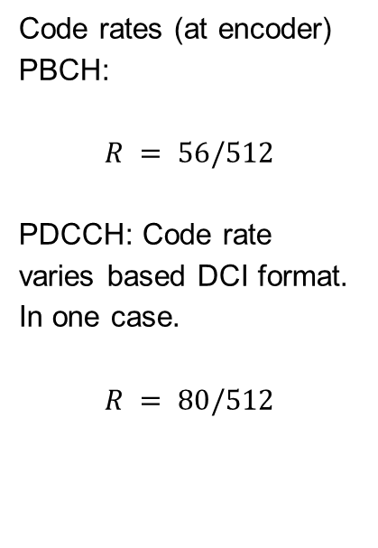
Polar FEC chain in 5G
Following diagram shows the FEC chain of Physical Broadcast Channel (PBCH) and Physical Downlink Control Channel (PDCCH).
Code rates (at encoder)
PBCH:
$$R = 56/512$$
PDCCH: Code rate varies based DCI format. In one case.
$$R = 80/512$$

Slide 9
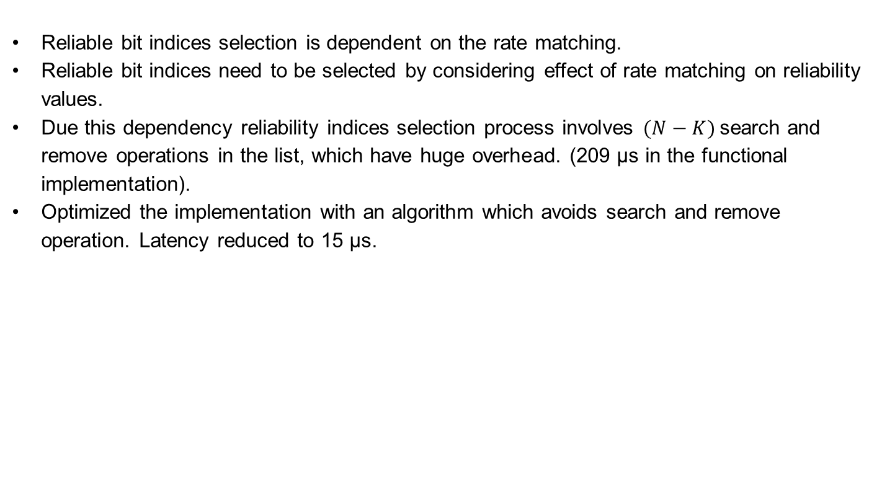
Optimization in reliability indices selection
Reliable bit indices selection is dependent on the rate matching.
Reliable bit indices need to be selected by considering effect of rate matching on reliability values.
Due this dependency reliability indices selection process involves $(N−K)$search and remove operations in the list, which have huge overhead. (209 μs in the functional implementation).
Optimized the implementation with an algorithm which avoids search and remove operation. Latency reduced to 15 μs.

Slide 10
Optimization of Polar Encoding
Plain implementation in software considers each bit as one integer.
No parallel processing, each bit processed separately.
Information bits can be processed in parallel by packing multiple information bits to single integer.
For example: 8 bit integer = 8 info bits, 16 bits integer = 16 bit, 32 bit integer = 32 info bits, 64 bits integer = 64 info bits.
SIMD processors have register size of 256 bits therefore 256 bits can be processed in a single instruction.

Slide 11
Information bits packing example
Each row represents 8 bit integer representing one info bit.
Only last column contains info bits
0 | 0 | 0 | 0 | 0 | 0 | 0 | 1
0 | 0 | 0 | 0 | 0 | 0 | 0 | 0
0 | 0 | 0 | 0 | 0 | 0 | 0 | 0
0 | 0 | 0 | 0 | 0 | 0 | 0 | 1
0 | 0 | 0 | 0 | 0 | 0 | 0 | 0
0 | 0 | 0 | 0 | 0 | 0 | 0 | 0
0 | 0 | 0 | 0 | 0 | 0 | 0 | 1
0 | 0 | 0 | 0 | 0 | 0 | 0 | 1
8 bits grouped as one integer.
1 | 0 | 0 | 1 | 0 | 0 | 1 | 1
Same idea can be extended to creating integers of 64 bits, so 64 info bits can processed concurrently.
Same idea can be extended to 256 bits packing for SIMD.

Slide 12
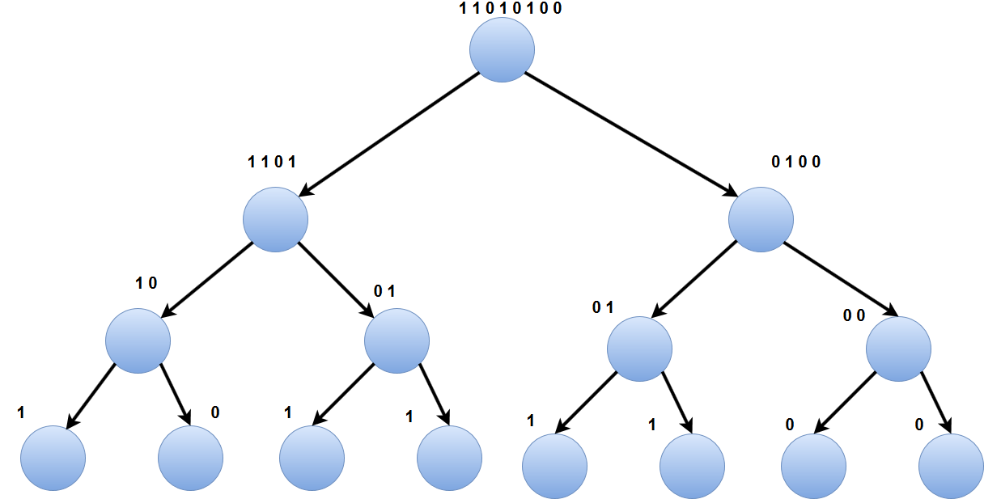

Polar Encoding in Tree Structure
Tree representation of polar encoding, For $N = 8$.

Slide 13

Encoder tree pruning
Plain implementation of encoding traverses till the end of tree, In other words for $N = 1024$, encoder needs to travel $2047$ nodes in a tree.
Number of nodes can be significantly reduced by pruning the tree.
Pruning of tree can be done by building a lookup table and stopping encoding when level is $\log_{2}{N −3}$, i.e 7 in our example.
This reduces the number of nodes to be traversed to 255 from 2047.
This significantly reduces the latency.
This optimization can also be applied for hardware implementations.

Slide 14
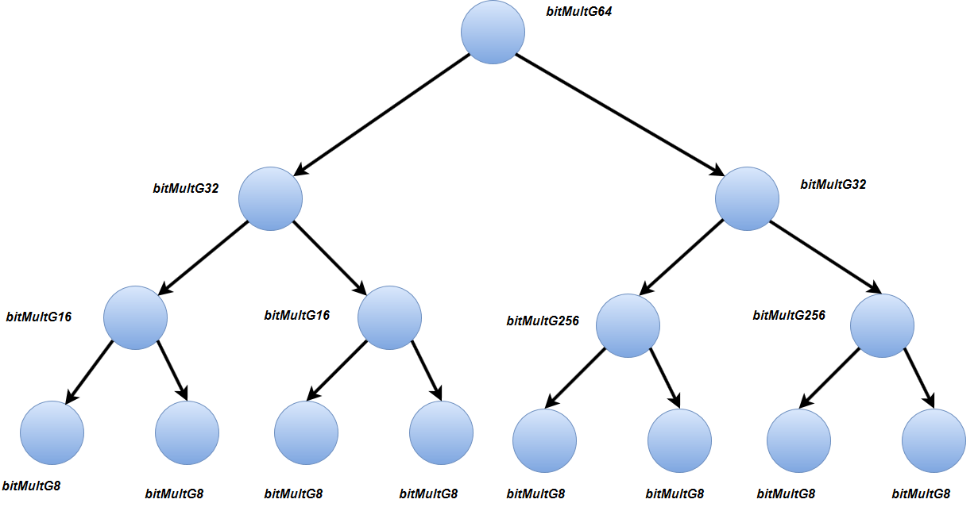
Unrolling the recursive implementation
Recursive function has overhead since every function call requires new stack allocation and jumping to function target address.
Avoiding branching(Jump instructions) which has significant overhead.

Slide 15
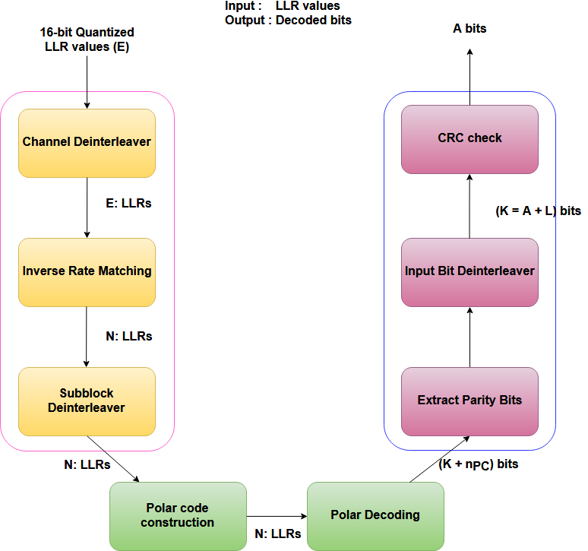
Decoding FEC chain

Slide 17
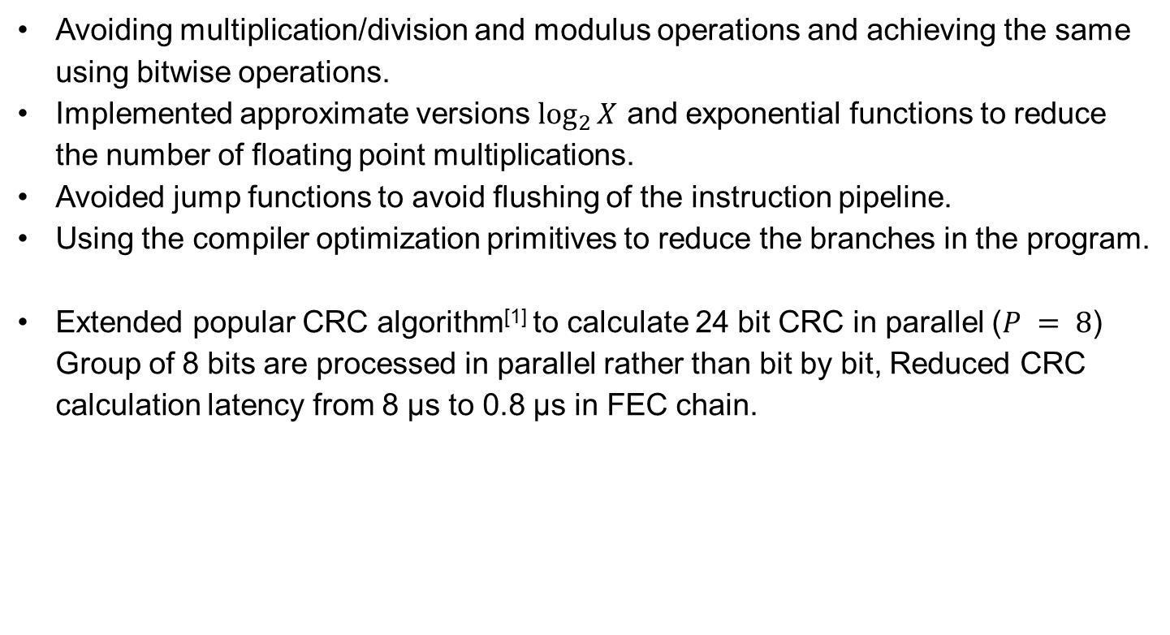
Miscellaneous Optimizations
Avoiding multiplication/division and modulus operations and achieving the same using bitwise operations.
Implemented approximate versions $\log_{2}{X}$ and exponential functions to reduce the number of floating point multiplications.
Avoided jump functions to avoid flushing of the instruction pipeline.
Using the compiler optimization primitives to reduce the branches in the program.
Extended popular CRC algorithm^{[1]} to calculate 24 bit CRC in parallel ($P = 8$) Group of 8 bits are processed in parallel rather than bit by bit, Reduced CRC calculation latency from 8 μs to 0.8 μs in FEC chain.

Slide 18
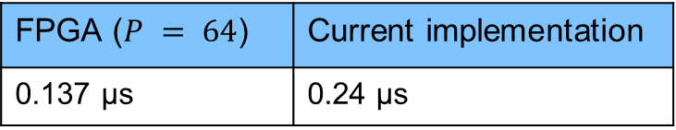

Results
Comparison with open source encoder software implementation (in AMD EPYC processor at 1.6ghz) $N = 1024$
FPGA^{[2]} v/s Software
Whole PDCCH FEC chain:
aff3ct^{[1]} (No SIMD) | Current implementation
5.6 μs | 0.24 μs
FPGA ($P = 64$) | Current implementation
0.137 μs | 0.24 μs
Functional | Current implementation
411 μs | 21 μs
Notes:
Functional implementation done by colleague at R&S.
For FPGA implementation, value is scaled according to N value.

Slide 19
Future work
Profile the encoder implementation to optimize the cache memory access.
Decoding FEC chain implementation and optimization with SIMD technology
Decoder algorithm improvement for low latency.
One such idea is
Pruning the decoder tree reduces the latency due to reduction in number of nodes. Analyze the BER versus latency tradeoff after pruning the tree.

Slide 20

Thank you
Questions

