Slide 1

Polar FEC chain development in software for 5G Final thesis presentation
Yadhunandana Rajathadripura Kumaraiah (Yadhu)
yadhu.kumaraiah@tum.de
Supervisors:
Fabian Steiner, Peihong Yuan (TUM)
Dr. Moritz Harteneck, Alexander Heinz
(Rohde & Schwarz)

Slide 2
Agenda
Motivation
Background
Encoding FEC chain
Decoding FEC chain
Results
Conclusion and Outlook

Slide 3
Motivation
Traditionally FEC chains are developed in hardware i.e. FPGA’s or ASIC’s to achieve low latency and high throughput.
Development/maintenance in FPGA/ASIC requires more time and expensive.
With recent advances in General Purpose Processors, it is possible to achieve required latency and throughput with software implementations without custom hardware.
Software implementations require less development/maintenance effort and provide flexibility and ease of maintenance to device manufacturer.
However algorithms need to adopted/optimized to efficiently implement in software.

Slide 4
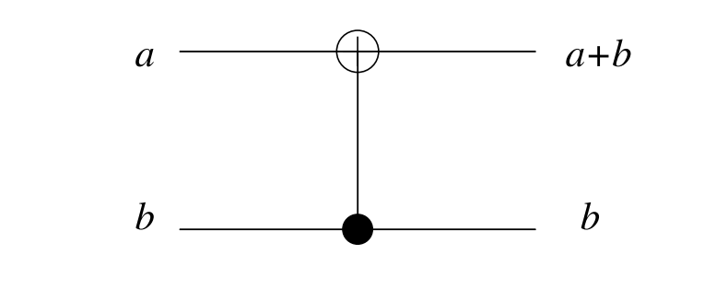
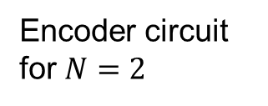
Background: Polar codes
Invented by Erdal Arıkan^{[1]} in 2009.
First codes to theoretically achieve channel capacity of binary memoryless channels with explicit construction.
Basic idea is synthesizing either completely noiseless or fully noisy channels.
As N becomes large, fraction of reliable bit indices approach the capacity of the channel.
Information bits are transmitted with noiseless channels, in noisy channels zeros are transmitted.
Encoder circuit for $N=2$

Slide 5
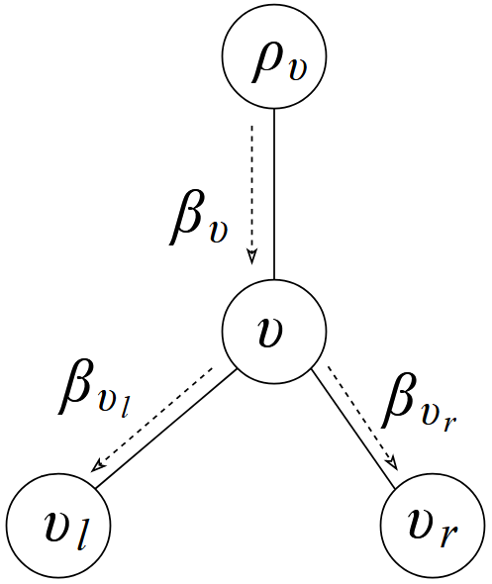
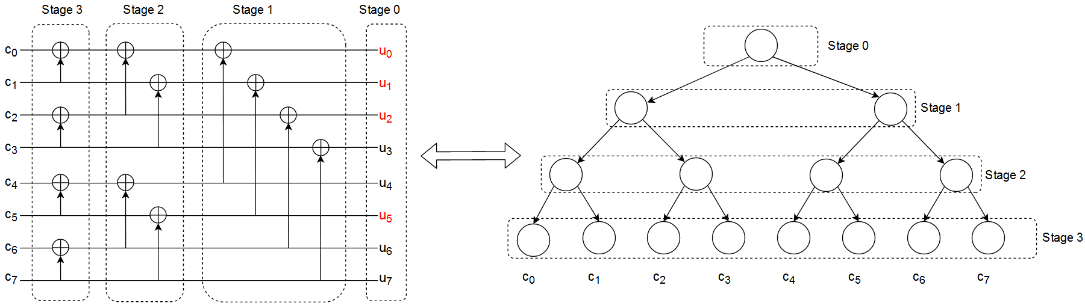

Polar Encoding (Polar Transform)
Sample encoding in circuit for $K=4, N = 8$.
Each stage contains vector of size 2^{(N-stage)}
XOR operation introduces correlation between code word bits.
Bits shown in red are frozen bits. superfluous
Node operation in encoder with vector size $N_{v}$.
$β_{v_{l}}\left[i\right] =$ $β_{v}[i]⨁{β_{v}\left[i+{N_{v}}/2\right] 0≤i<{N_{v}}/2}$
$β_{v_{r}}\left[i\right] ={ β}_{v}\left[i+{N_{v}}/2\right] 0≤i<{N_{v}}/2$ $∕∕Superfluous copying$
XOR operation

Slide 6
Polar code construction in 5G
Reliability indices selection is done based on the channel condition(SNR)
Many construction methods are proposed such as density evolution (DE), Gaussian Approximation DE etc.
Still very complex to construct code on the fly.
5G standard (Huawei contribution) proposes a heuristic low complexity polar code construction independent of channel condition.
This construction performs sufficiently good over a large range of SNR^{[1]}

Slide 7
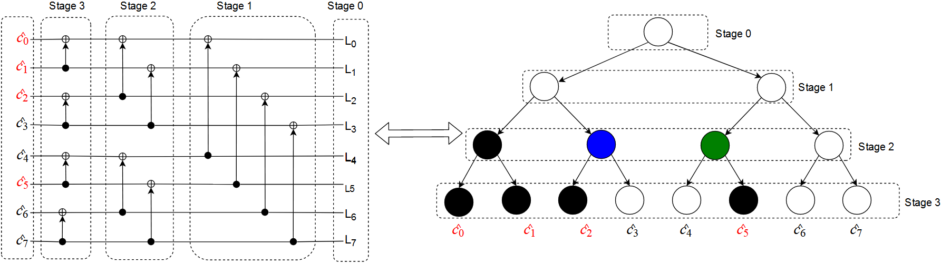
Decoding polar codes
Decoder estimates the code word by exploiting the correlation introduced by encoder.
Decoding involves Check Node (CN), Variable Node (VN) and bit combination operations.
Every node in the decoder tree performs these operations.

Slide 8
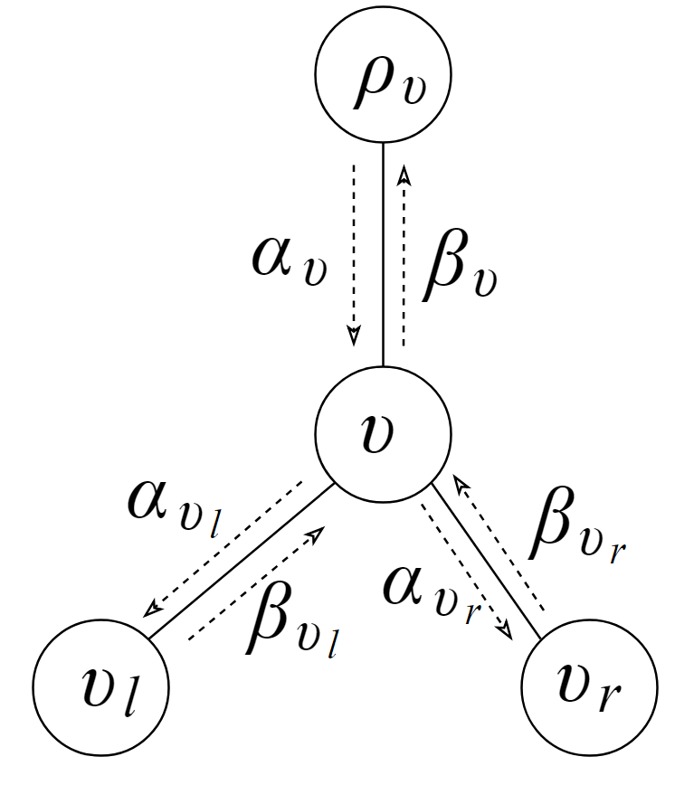

CN, VN and bit combination operations
For LLR vector size $N_{v}$
CN operation: ($⨁$)
$α_{v_{l}}\left[i\right]=sign\left(α_{v}\left[i\right]\right)∗sign(α_{v} \left[i+\frac{N_{v}}{2}\right])∗$
$min⁡({|α}_{v}\left[i\right]|,α_{v} \left[i+\frac{N_{v}}{2}\right])$
VN operation: ( )
$α_{v_{r}}\left[i\right]$ = $\left(1−β_{v_{l}}\right)∗α_{v}\left[i\right]+α_{v} \left[i+\frac{N_{v}}{2}\right]$
Bit combination:
$β_{v}\left[i\right] = \left\{\begin{aligned}β_{v_{l}}[i]⨁{β_{v_{r}}\left[i\right] 0≤i<{N_{v}}/2} \\ β_{v_{r}}\left[i\right] ∕∕Just copying\end{aligned}\right.$
Local decoder with messages

Slide 9
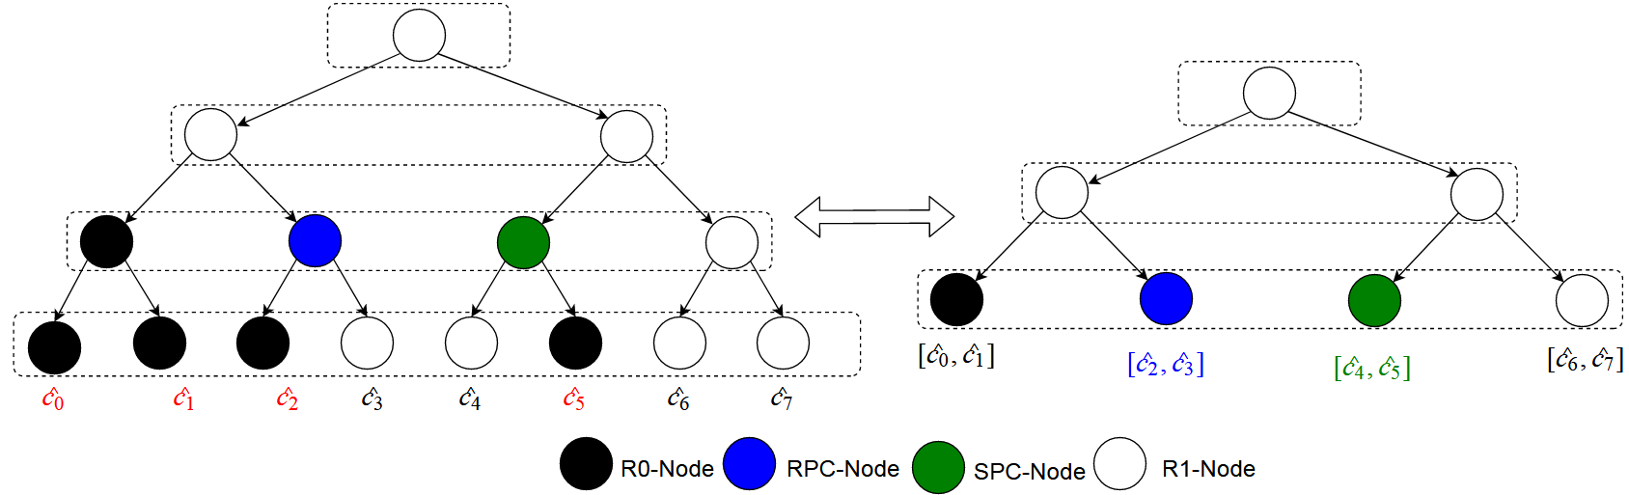

Fast-SSC algorithm
Fast-SSC algorithm identifies special component codes from polar code which allow immediate decoding avoiding full tree traversal.
Reduces number of CN and VN operations.
Parallelizes the decoding operation.
Example $frozen_pattern = \{1,1,1,0,0,1,0,0\}$
Original decoder tree
Reduced tree

Slide 10
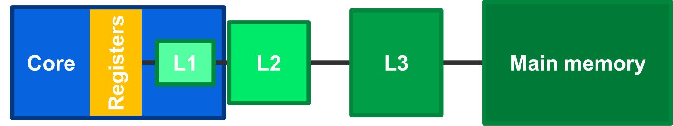
Processor architecture: Cache memory
Performance bottleneck in modern processors is accessing main memory.
Modern processors come with faster memory called cache.
Caches reduce the average memory access latency.
Copy of frequently accessed data is stored in cache.
Data access latency of cache is negligible comparatively.

Slide 11
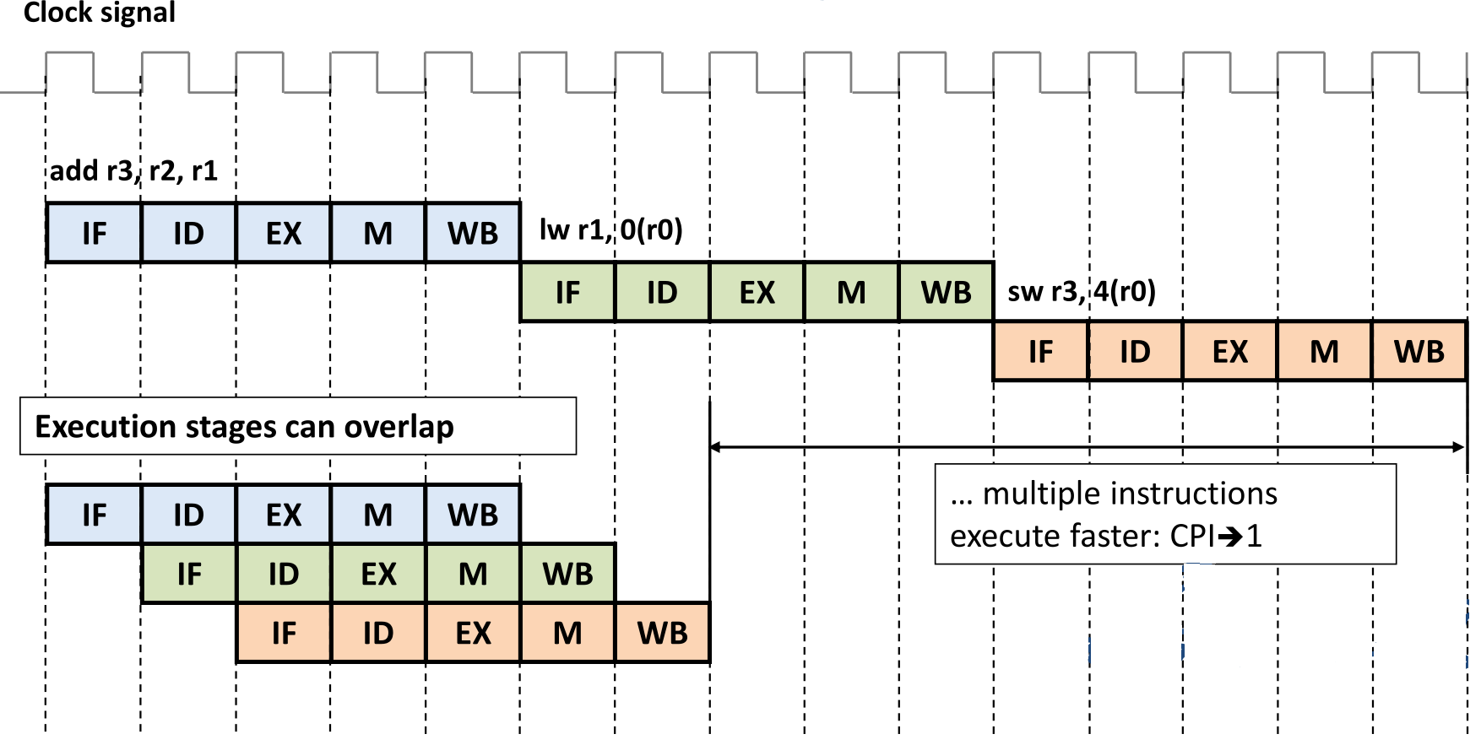
Instruction pipelining
Modern processors come with advanced pipelining.
Pipelining increases IPC (Instructions Per Cycle).
Branching and cache misses create stalls in pipelining which reduce IPC.
Branches and cache misses need to reduced in a code to achieve high performance.

Slide 12
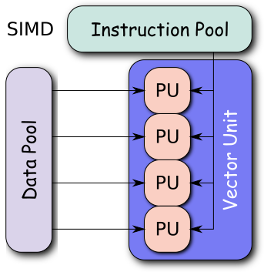
Vector processing units
Single instruction multiple data (SIMD) allows single instruction to operate on multiple data items (Vectors).
Modern processors incorporate these vector processing units.
Allows faster data processing, popular among video and image processing community.
Faster encoding/decoding in communication systems can be implemented in software in general purpose processors using SIMD instructions without specialized hardware.
SIMD feature allows encoding/decoding with low latency, due to processing of vectors rather than element by element processing.

Slide 13
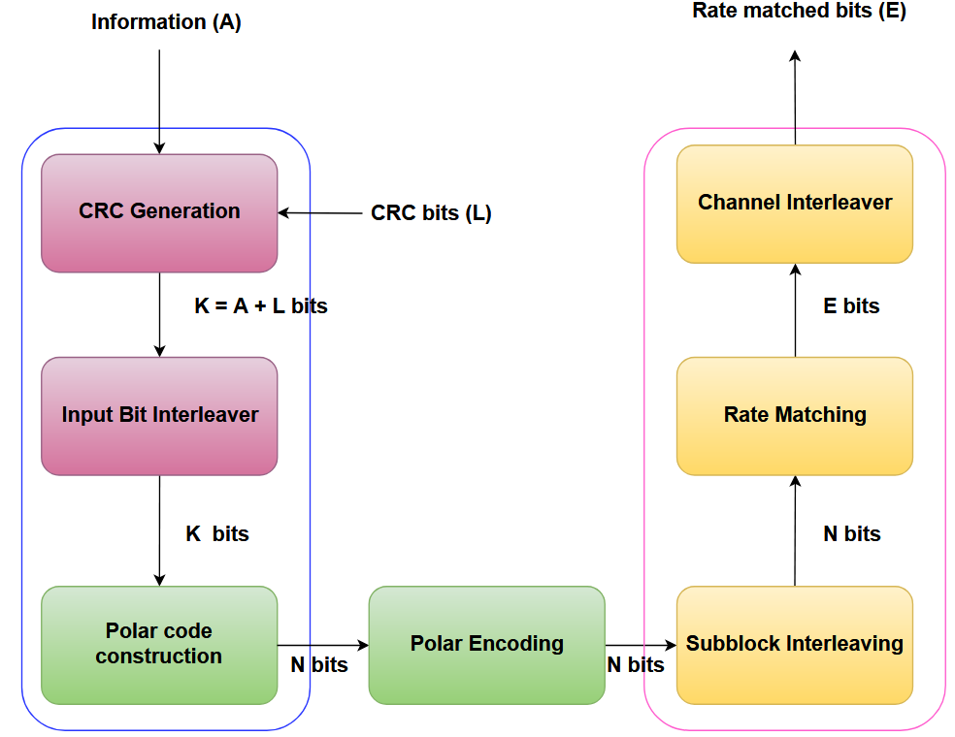
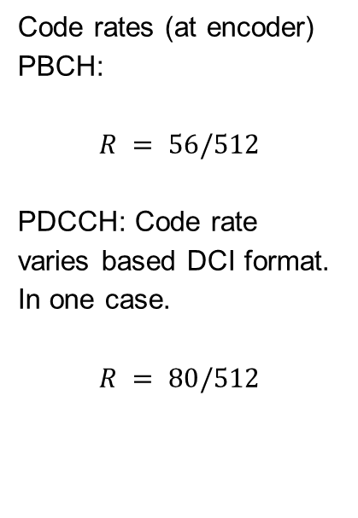
Encoding FEC chain in 5G
FEC chain of Physical Broadcast Channel (PBCH) and Physical Downlink Control Channel (PDCCH).
Code rates (at encoder)
PBCH:
$$R = 56/512$$
PDCCH: Code rate varies based DCI format. In one case.
$$R = 80/512$$

Slide 14
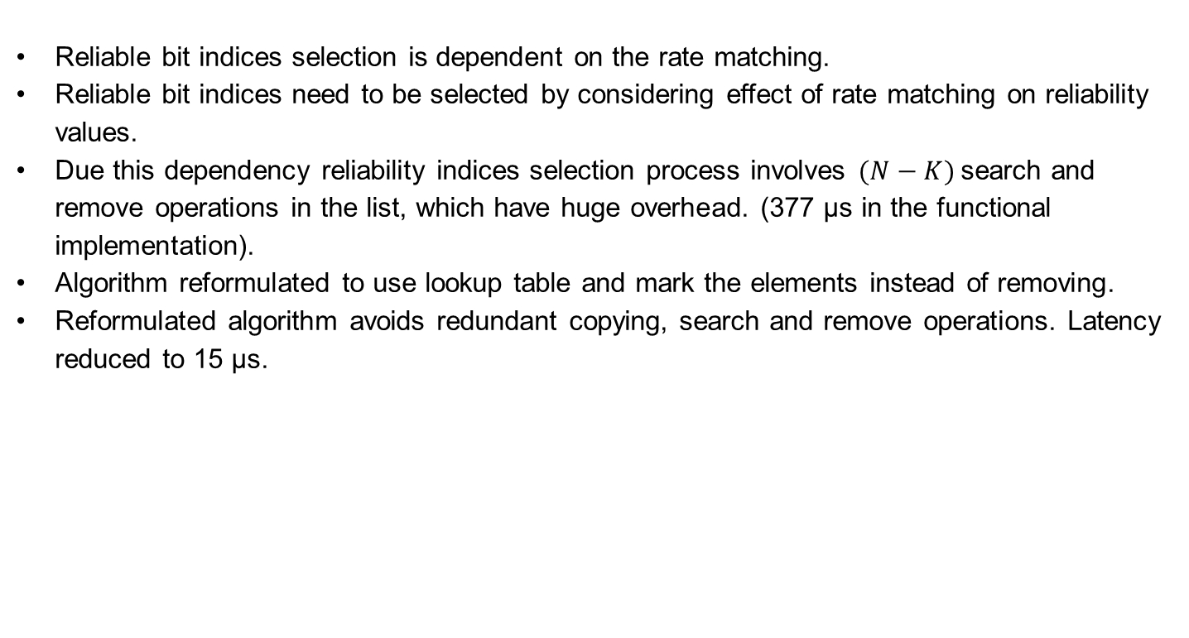
Information bit indices selection
Reliable bit indices selection is dependent on the rate matching.
Reliable bit indices need to be selected by considering effect of rate matching on reliability values.
Due this dependency reliability indices selection process involves $(N−K)$search and remove operations in the list, which have huge overhead. (377 μs in the functional implementation).
Algorithm reformulated to use lookup table and mark the elements instead of removing.
Reformulated algorithm avoids redundant copying, search and remove operations. Latency reduced to 15 μs.

Slide 15
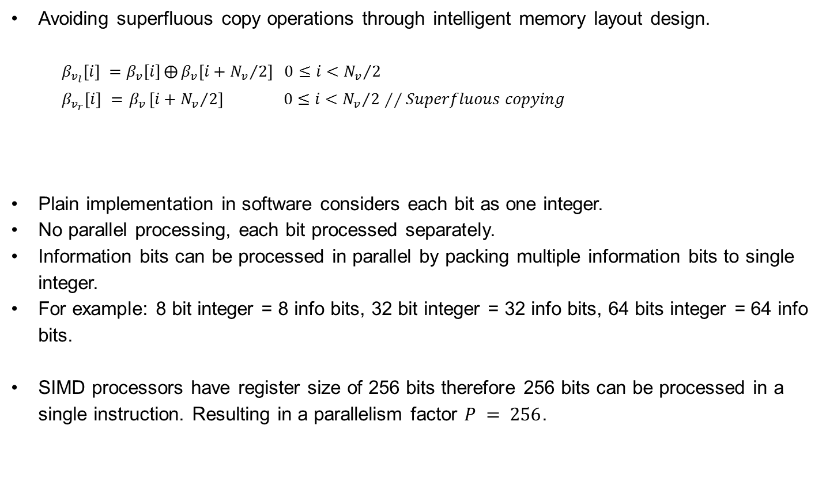
Optimization of Polar Encoding
Avoiding superfluous copy operations through intelligent memory layout design.
$β_{v_{l}}\left[i\right] =$ $β_{v}[i]⨁{β_{v}\left[i+{N_{v}}/2\right] 0≤i<{N_{v}}/2}$
$β_{v_{r}}\left[i\right] ={ β}_{v}\left[i+{N_{v}}/2\right] 0≤i<{N_{v}}/2$ $∕∕Superfluous copying$
Plain implementation in software considers each bit as one integer.
No parallel processing, each bit processed separately.
Information bits can be processed in parallel by packing multiple information bits to single integer.
For example: 8 bit integer = 8 info bits, 32 bit integer = 32 info bits, 64 bits integer = 64 info bits.
SIMD processors have register size of 256 bits therefore 256 bits can be processed in a single instruction. Resulting in a parallelism factor $P = 256$.

Slide 16
Information bits packing example
Each row represents 8 bit integer representing one info bit.
Only last column contains info bits
0 | 0 | 0 | 0 | 0 | 0 | 0 | 1
0 | 0 | 0 | 0 | 0 | 0 | 0 | 0
0 | 0 | 0 | 0 | 0 | 0 | 0 | 0
0 | 0 | 0 | 0 | 0 | 0 | 0 | 1
0 | 0 | 0 | 0 | 0 | 0 | 0 | 0
0 | 0 | 0 | 0 | 0 | 0 | 0 | 0
0 | 0 | 0 | 0 | 0 | 0 | 0 | 1
0 | 0 | 0 | 0 | 0 | 0 | 0 | 1
8 bits grouped as one integer.
1 | 0 | 0 | 1 | 0 | 0 | 1 | 1
Same idea can be extended to creating integers of 64 bits, so 64 info bits can processed concurrently.
Same idea can be extended to 256 bits packing for SIMD.
Packing/Unpacking needs to be performed very efficiently.
SIMD extensions provide dedicated instructions to perform fast packing and unpacking.

Slide 17
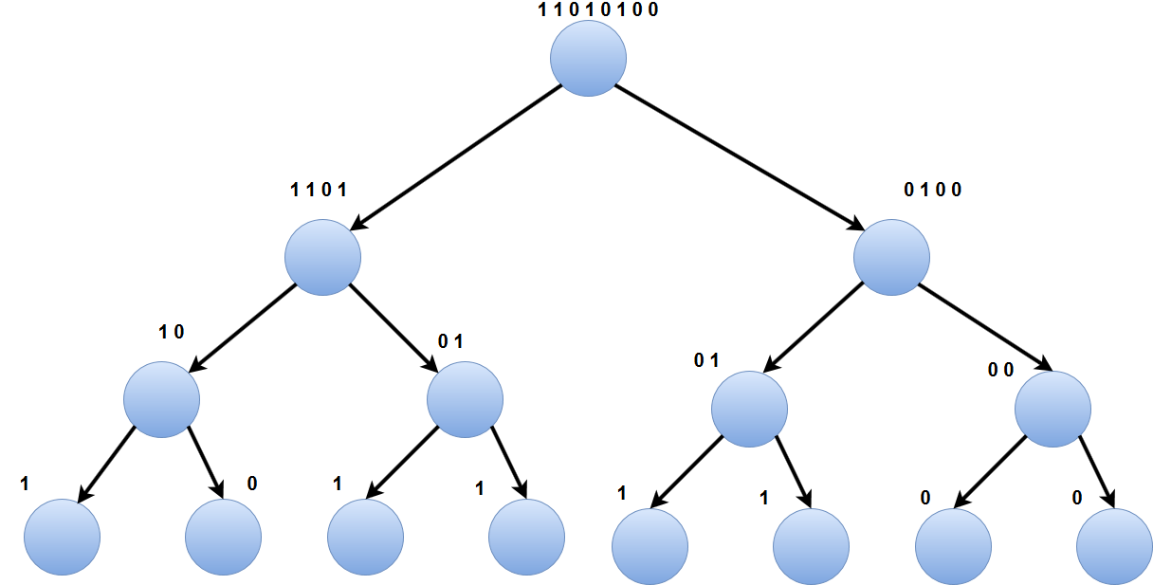

Polar Encoding in Tree Structure
Tree representation of polar encoding, For $N = 8$.
Notes:
This slide is not very important, Can be skipped.

Slide 18

Encoder tree pruning
Plain implementation of encoding traverses till the end of tree, In other words for $N = 1024$, encoder needs to traverse $2047$ nodes of a tree.
Number of nodes can be significantly reduced by pruning the tree.
Pruning of tree can be done by building a lookup table and stopping encoding when level is $\log_{2}{N −3}$, i.e 7 in our example.
Reduces the number of nodes to be traversed to 255 from 2047 hence significantly reduces the latency.
This optimization can also be applied for hardware implementations.

Slide 19
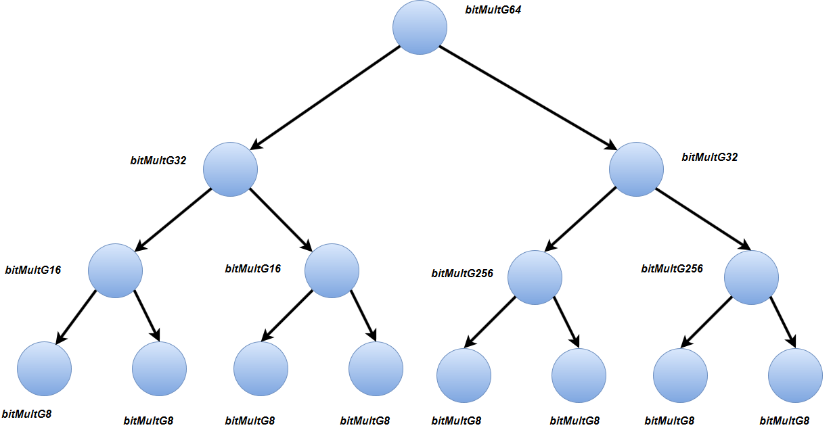
Unrolling the recursive implementation
Recursive function has overhead since every function call requires new stack allocation and jumping to function target address.
Avoiding branching(Jump instruction) which has significant overhead.

Slide 20
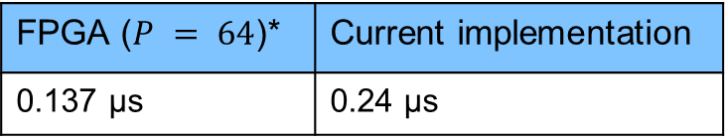

Encoding chain results
Comparison with open source encoder software implementation (in AMD EPYC processor at 1.6ghz) $N = 1024$
FPGA^{[2]} v/s Software
*P indicates parallelism factor
Worst case encoding FEC chain:
aff3ct^{[1]} (No SIMD) | Current implementation
5.6 μs | 0.24 μs
FPGA ($P = 64$)* | Current implementation
0.137 μs | 0.24 μs
Functional | Current implementation
451 μs | 40 μs
Notes:
Functional implementation done by colleague at R&S.
For FPGA implementation, value is scaled according to N value.

Slide 21

Encoding chain results
Comparison with open source encoder software implementation (in AMD EPYC processor at 1.6ghz) $N = 1024$
Worst case encoding FEC chain:
aff3ct^{[1]} (No SIMD) | Current implementation
5.6 μs | 0.24 μs
Functional | Current implementation
451 μs | 40 μs
Notes:
Functional implementation done by colleague at R&S.
For FPGA implementation, value is scaled according to N value.

Slide 22
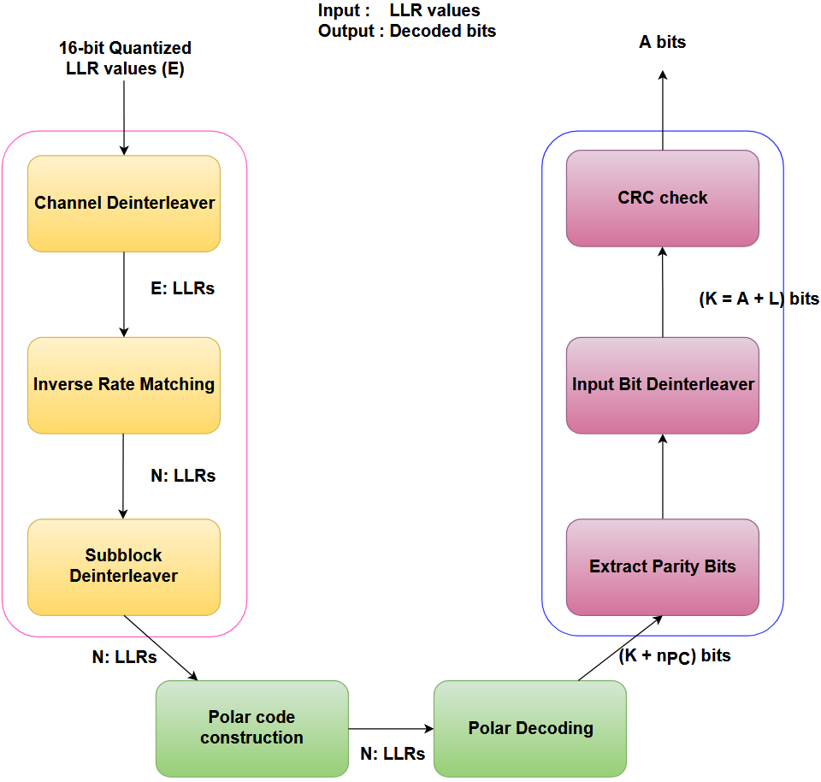
Decoding FEC chain
Decoding FEC chain for Physical Uplink Control Channel (PUCCH) and Physical uplink shared Channel (PUSCH).

Slide 23
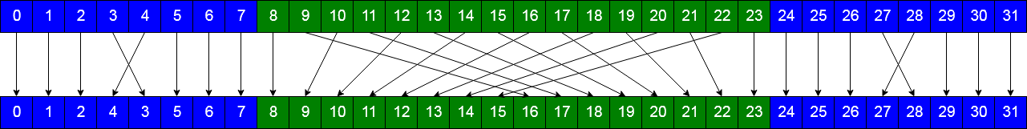

Subblock deinterleaver
Inverse of subblock interleaver operation performed at the transmitter.
Deinterleaving is performed as shown in the figure.
Expensive operation due to huge number of division, multiplication and modulus operations and it is also sequential.
This operation is broken down into three parts, each of them are implemented using permute and blend SIMD instructions.
Latency reduced from 19$μs$to 0.47$μs$.

Slide 24
Polar decoding: Packing frozen pattern
Packing multiple frozen bits allows efficient identification of component codes.
Frozen pattern is passed in packed bit format to decoder.
Identification component codes is performed at run time.
Packing of multiple bits together allows identification of component codes in a single comparison instruction.
Reduces the expensive branch instructions and exploits data parallelism.
For frozen pattern at child node = {1,1……..1,1} //256 values.
bool isRateZeroNode(int8_t frozenPattern[])
{
bool rateZeroNode = true;
for(auto i = 0; i < 256;i++) {
if(frozenPattern[i] != 1) {
rateZeroNode = false;
break;
}
}
return rateZeroNode;
}
Naive way
Efficient SIMD way
template<>
inline bool isRateZeroNode(uint64_t s[]) {
__m256i temp1 = _mm256_loadu_si256 ((__m256i*)s);
__m256i temp2;
temp2 = _mm256_set1_epi8 ((char)0xFF);
__m256i pcmp = _mm256_cmpeq_epi64 (temp1, temp2);
unsigned bitmask = _mm256_movemask_epi8(pcmp);
return (bitmask == 0xffffffffU);
}

Slide 25
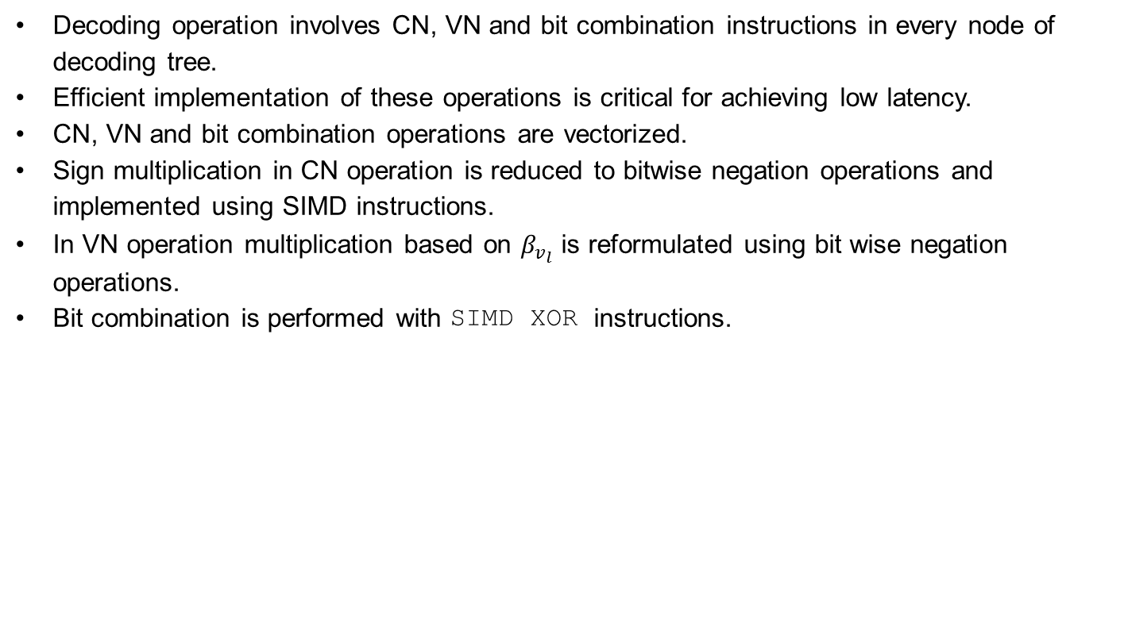
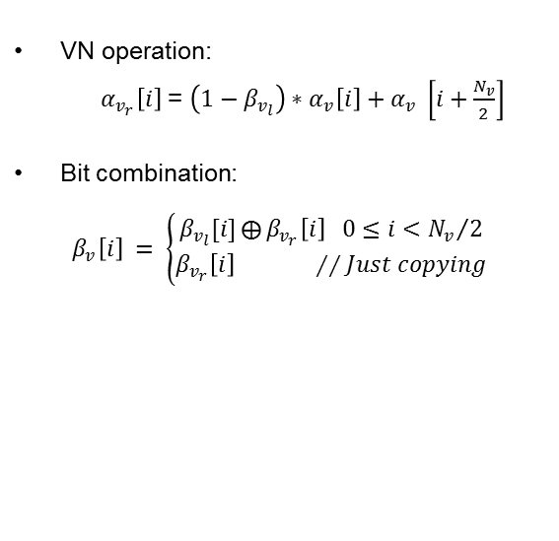

Optimized CN, VN and bit combination operations
Decoding operation involves CN, VN and bit combination instructions in every node of decoding tree.
Efficient implementation of these operations is critical for achieving low latency.
CN, VN and bit combination operations are vectorized.
Sign multiplication in CN operation is reduced to bitwise negation operations and implemented using SIMD instructions.
In VN operation multiplication based on $β_{v_{l}}$ is reformulated using bit wise negation operations.
Bit combination is performed with SIMD XOR instructions.
VN operation:
$α_{v_{r}}\left[i\right]$ = $\left(1−β_{v_{l}}\right)∗α_{v}\left[i\right]+α_{v} \left[i+\frac{N_{v}}{2}\right]$
Bit combination:
$β_{v}\left[i\right] = \left\{\begin{aligned}β_{v_{l}}[i]⨁{β_{v_{r}}\left[i\right] 0≤i<{N_{v}}/2} \\ β_{v_{r}}\left[i\right] ∕∕Just copying\end{aligned}\right.$
CN operation: ($⨁$)
$$α_{v_{l}}\left[i\right]=sign\left(α_{v}\left[i\right]\right)∗sign(α_{v} \left[i+\frac{N_{v}}{2}\right])∗$$
$min⁡({|α}_{v}\left[i\right]|,α_{v} \left[i+\frac{N_{v}}{2}\right])$

Slide 26
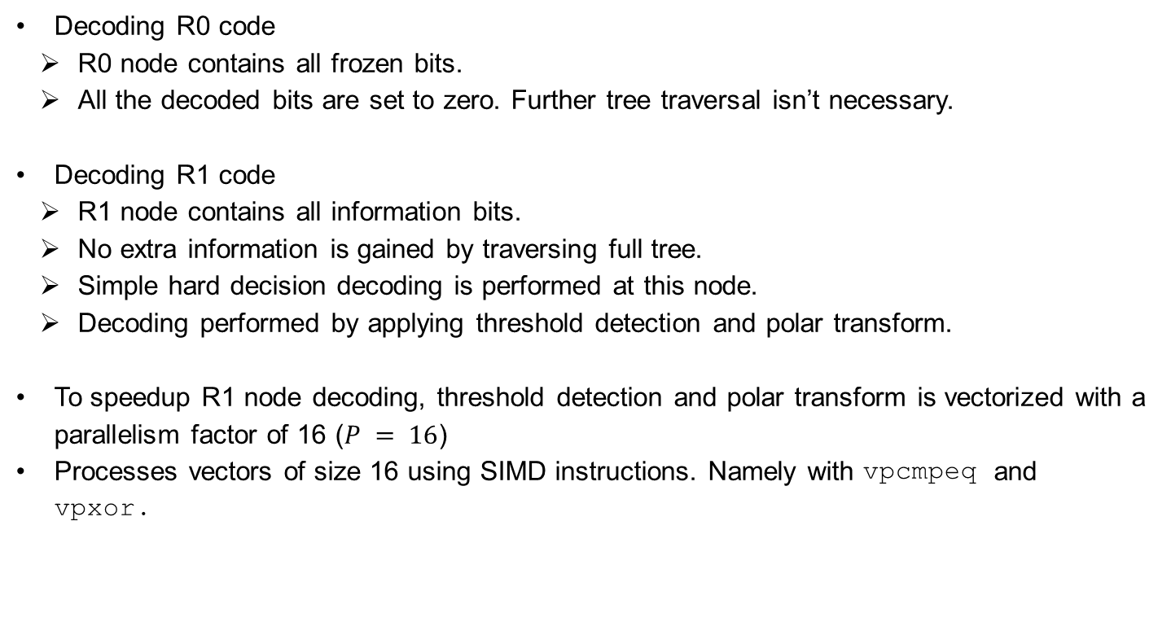
Decoding R0 and R1 codes
Decoding R0 code
R0 node contains all frozen bits.
All the decoded bits are set to zero. Further tree traversal isn’t necessary.
Decoding R1 code
R1 node contains all information bits.
No extra information is gained by traversing full tree.
Simple hard decision decoding is performed at this node.
Decoding performed by applying threshold detection and polar transform.
To speedup R1 node decoding, threshold detection and polar transform is vectorized with a parallelism factor of 16 ($P = 16$)
Processes vectors of size 16 using SIMD instructions. Namely with vpcmpeq and vpxor.

Slide 27
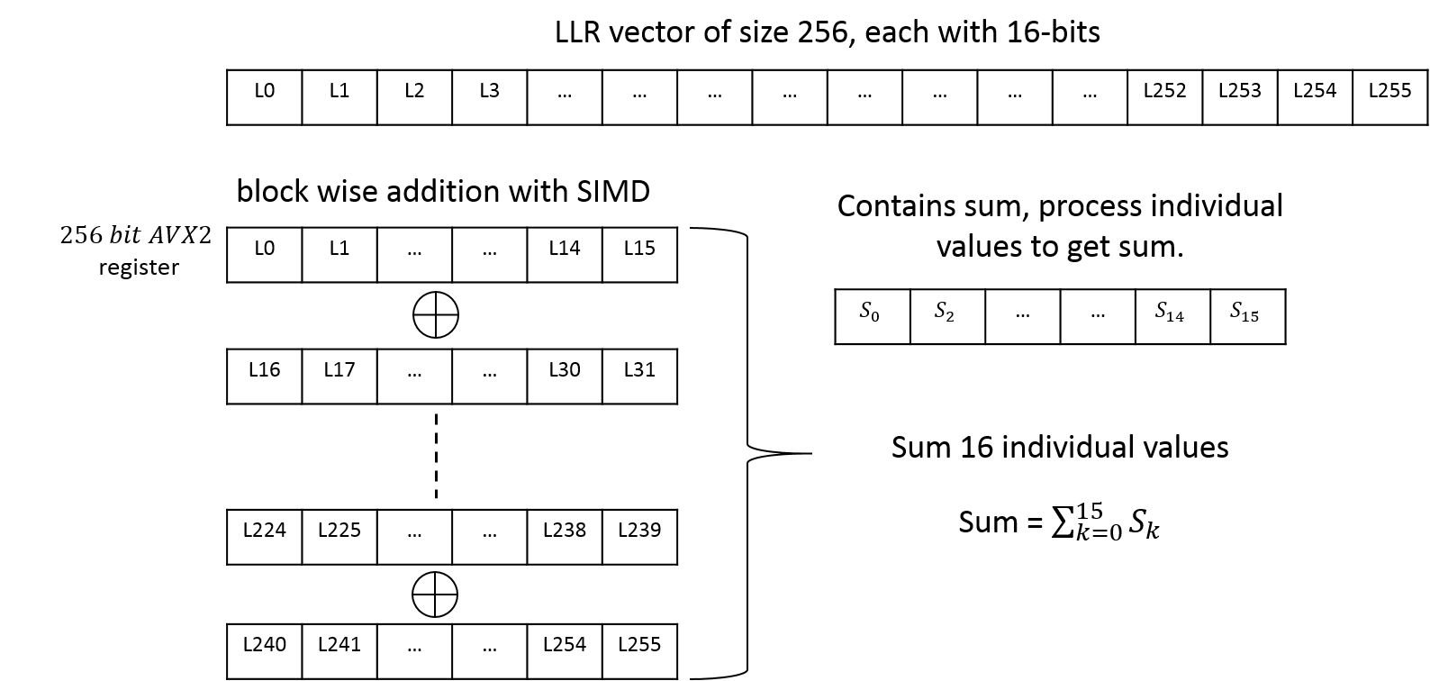

Decoding RPC Node
RPC node’s right most descendent contains information and all remaining bits are frozen.
Decoding operation involves summing of all the elements of LLR vector and deciding the bit based on the sum.
Result is stored at information bit position and zeros are stored in frozen bit positions.
Summation is calculated block wise with AVX2 vector instructions.
$$β_{v}\left[i\right] = \left\{\begin{aligned}0, \sum_{j}{α_{v}[j]}≥0 \\ 1, otherwise \end{aligned}\right.$$

Slide 28
Decoding SPC node
SPC node’s left most descendent is a frozen bit and remaining positions contain information bits.
Decoding involves threshold detection, parity calculation, searching minimum magnitude LLR and polar transform.
Block wise threshold detection with SIMD comparison instruction.
Parity calculation with bit packing and POPCNT instruction.
Searching is performed with another SIMD instruction phminpos.
Finally optimized polar transform function is called.
SPC decoding
Polar
Transform
Threshold detection
Searching
Parity
compute
SIMD Comparison
SIMD XOR operation
POPCNT instruction
PHMINPOS
Instruction
Notes:
position searching, polar transform
Parity calculation,

Slide 29
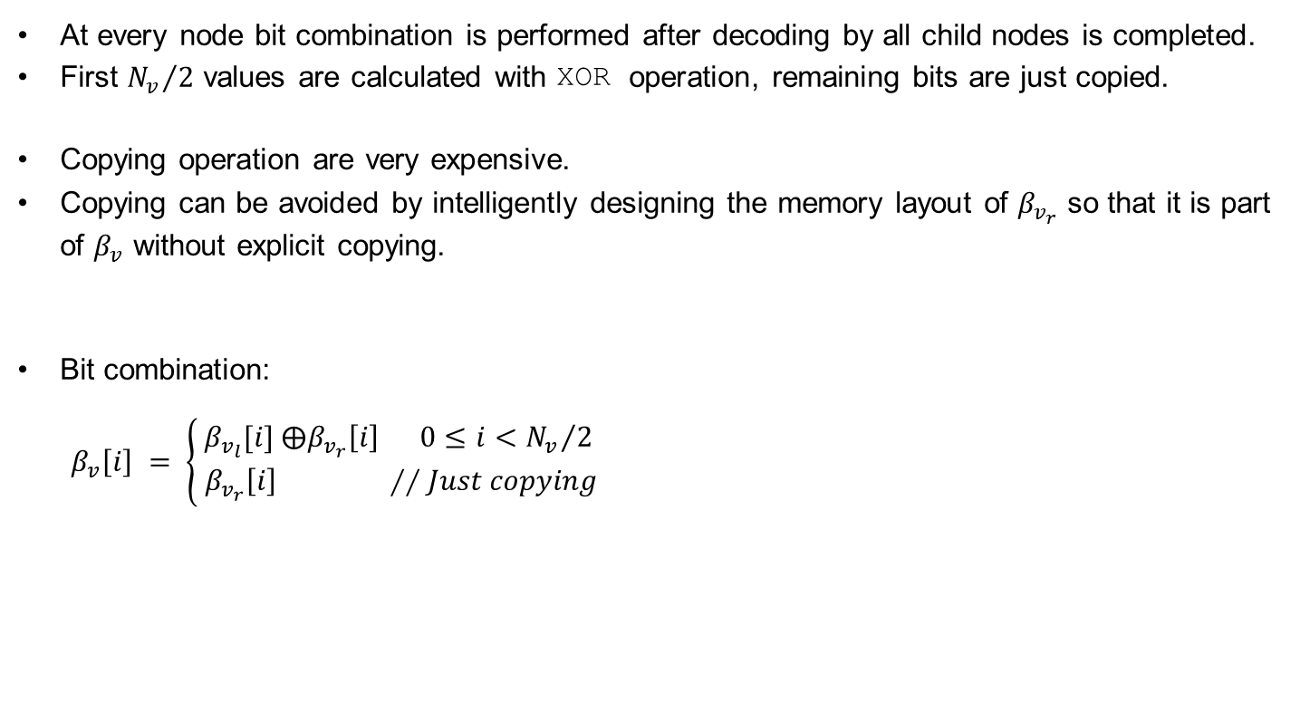
Avoiding superfluous copying
At every node bit combination is performed after decoding by all child nodes is completed.
First ${N_{v}}/2$ values are calculated with XOR operation, remaining bits are just copied.
Copying operation are very expensive.
Copying can be avoided by intelligently designing the memory layout of $β_{v_{r}}$ so that it is part of $β_{v}$ without explicit copying.
Bit combination:
$$β_{v}\left[i\right] = \left\{\begin{aligned}β_{v_{l}}[i] ⨁β_{v_{r}}\left[i\right] 0≤i<{N_{v}}/2 \\ { β}_{v_{r}}\left[i\right] ∕∕Just copying\end{aligned}\right.$$
Notes:
Low priority, can be removed if needed.

Slide 30
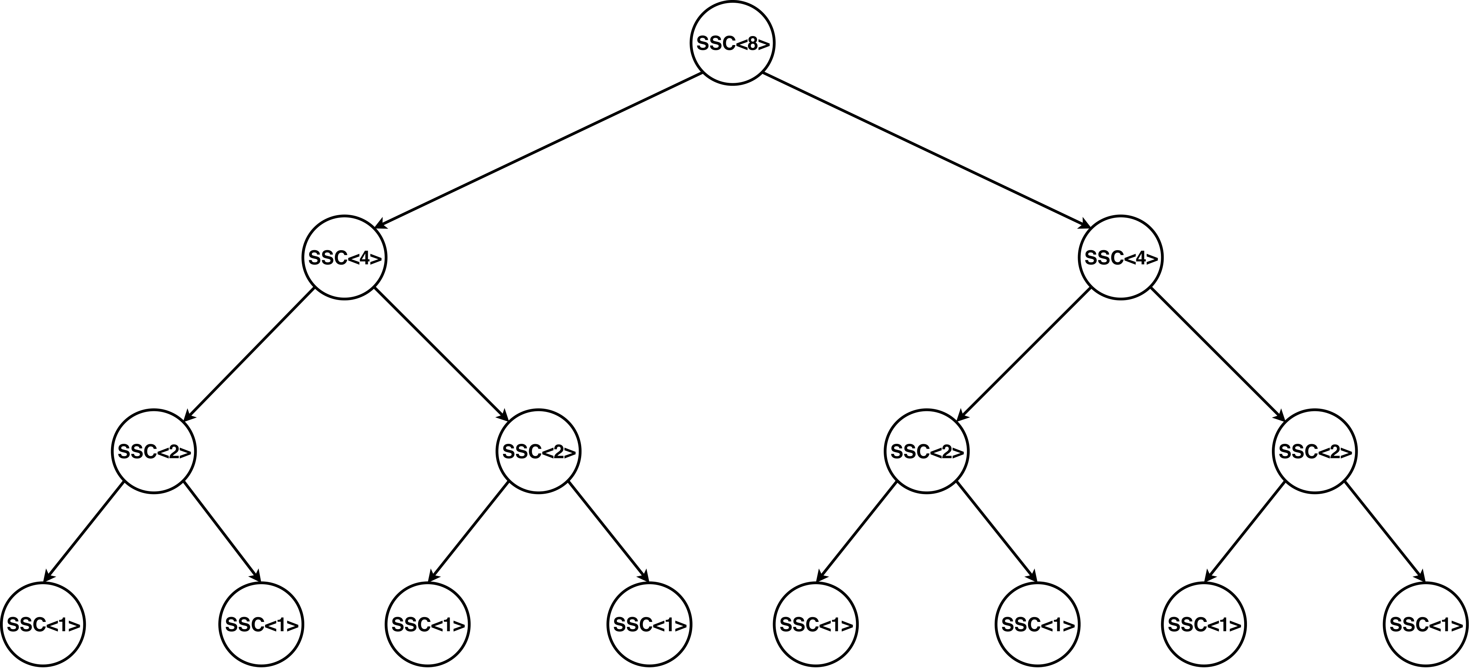
Unrolling the decoder
Recursive formulation is advantageous for hardware implementation. However in software recursive function calling huge overhead.
To overcome this overhead decoder implementation is unrolled using templates concept of C++.
With templates compiler automatically generates the code for different vector sizes.
One can also explicitly specialize functions, if different logic needs to be implemented for particular vector size.

Slide 31
Cache prefetching
VN, CN and bit combination operations fetch a block of memory to perform vector operations.
Memory access pattern in all these is regular and known in advance.
To avoid memory access latency future memory accesses can be fetched to cache well in advance.
Cache line fetching is done with non blocking PREFETCH instruction provided by latest 3dnow extension of AMD EPYC processor.
Main memory
Prefetching request
L1-Cache
L2-Cache
L3-Cache
Data transfer
Processor

Slide 32

Decoder tree pruning
Decoding latency can be further reduced by intelligently pruning the decoder tree.
Decoder tree is pruned irrespective frozen pattern type.
Latency reduction comes at the cost of increased BLER.
At high SNR and low code rate scenarios this method can be used.
Pruning increases the BLER. Level of pruning and BLER can be dealt as a trade-off.

Slide 33
CRC calculation
PBCH and PDCCH channels need to calculate CRC24 for downlink control information transmission.
PUCCH and PUSCH channels calculate CRC6 or CRC11 for CRC check.
CRC calculation is one of the significant latency contributor to both in encoding and decoding FEC chains.
Processing individual bits for CRC calculation is very inefficient.
Extended the popular CRC algorithm^{[1]} to calculate CRC24, CRC6 and CRC11 .
In this algorithm, 8 bits are processed in parallel rather than bit by bit, Reduced CRC calculation latency from 8 μs to 0.8 μs in FEC chain.

Slide 34
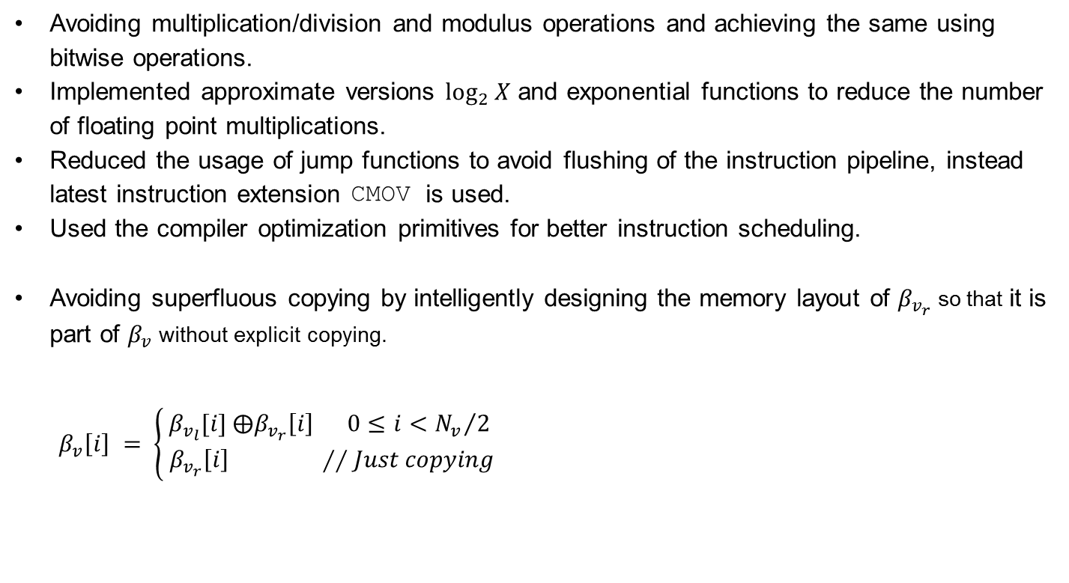
Miscellaneous Optimizations
Avoiding multiplication/division and modulus operations and achieving the same using bitwise operations.
Implemented approximate versions $\log_{2}{X}$ and exponential functions to reduce the number of floating point multiplications.
Reduced the usage of jump functions to avoid flushing of the instruction pipeline, instead latest instruction extension CMOV is used.
Used the compiler optimization primitives for better instruction scheduling.
Avoiding superfluous copying by intelligently designing the memory layout of $β_{v_{r}}$ so that it is part of $β_{v}$ without explicit copying.
$$β_{v}\left[i\right] = \left\{\begin{aligned}β_{v_{l}}[i] ⨁β_{v_{r}}\left[i\right] 0≤i<{N_{v}}/2 \\ { β}_{v_{r}}\left[i\right] ∕∕Just copying\end{aligned}\right.$$

Slide 35

Decoding chain results
Comparison with state of the art polar decoder software implementation (in AMD EPYC processor at 1.6 GHz) $N = 1024$
Decoder latency compared to state of the art
[1]* | This work
8 μs | 5 μs
*Scaled according to frequency
Decoder latency:
Functional | Current implementation
283.4 μs | 5 μs
Worst case decoding FEC chain:
Functional | Current implementation
391 μs | 40 μs

Slide 36
Conclusion
Both encoding and decoding FEC chains are efficiently implemented through both algorithmic and software optimizations
Optimized implementation exploits the features provided by modern processors. Namely SIMD, Cache prefetching et cetera.
This work achieved latency requirements encoding and decoding FEC chains of 5G through software implementation.
Efficient implementation and optimizations reduced the latency by 10x.

Slide 37
Outlook
As part of this work, another decoding algorithm, CRC aided Successive Cancellation List (CA-SCL) algorithm is also implemented. However it is not optimized.
CA-SCL algorithm has approximately 1.5dB gain over fast-SSC algorithm for N = 2048 and list size of 8 [1].
Ideal continuation of this work would be to extend decoding FEC chain by incorporating optimized CA-SCL.
It would be interesting to see latency values of CA-SCL which has expensive sort and copying operations.

Slide 38

Thank you
Questions

