Slide 1
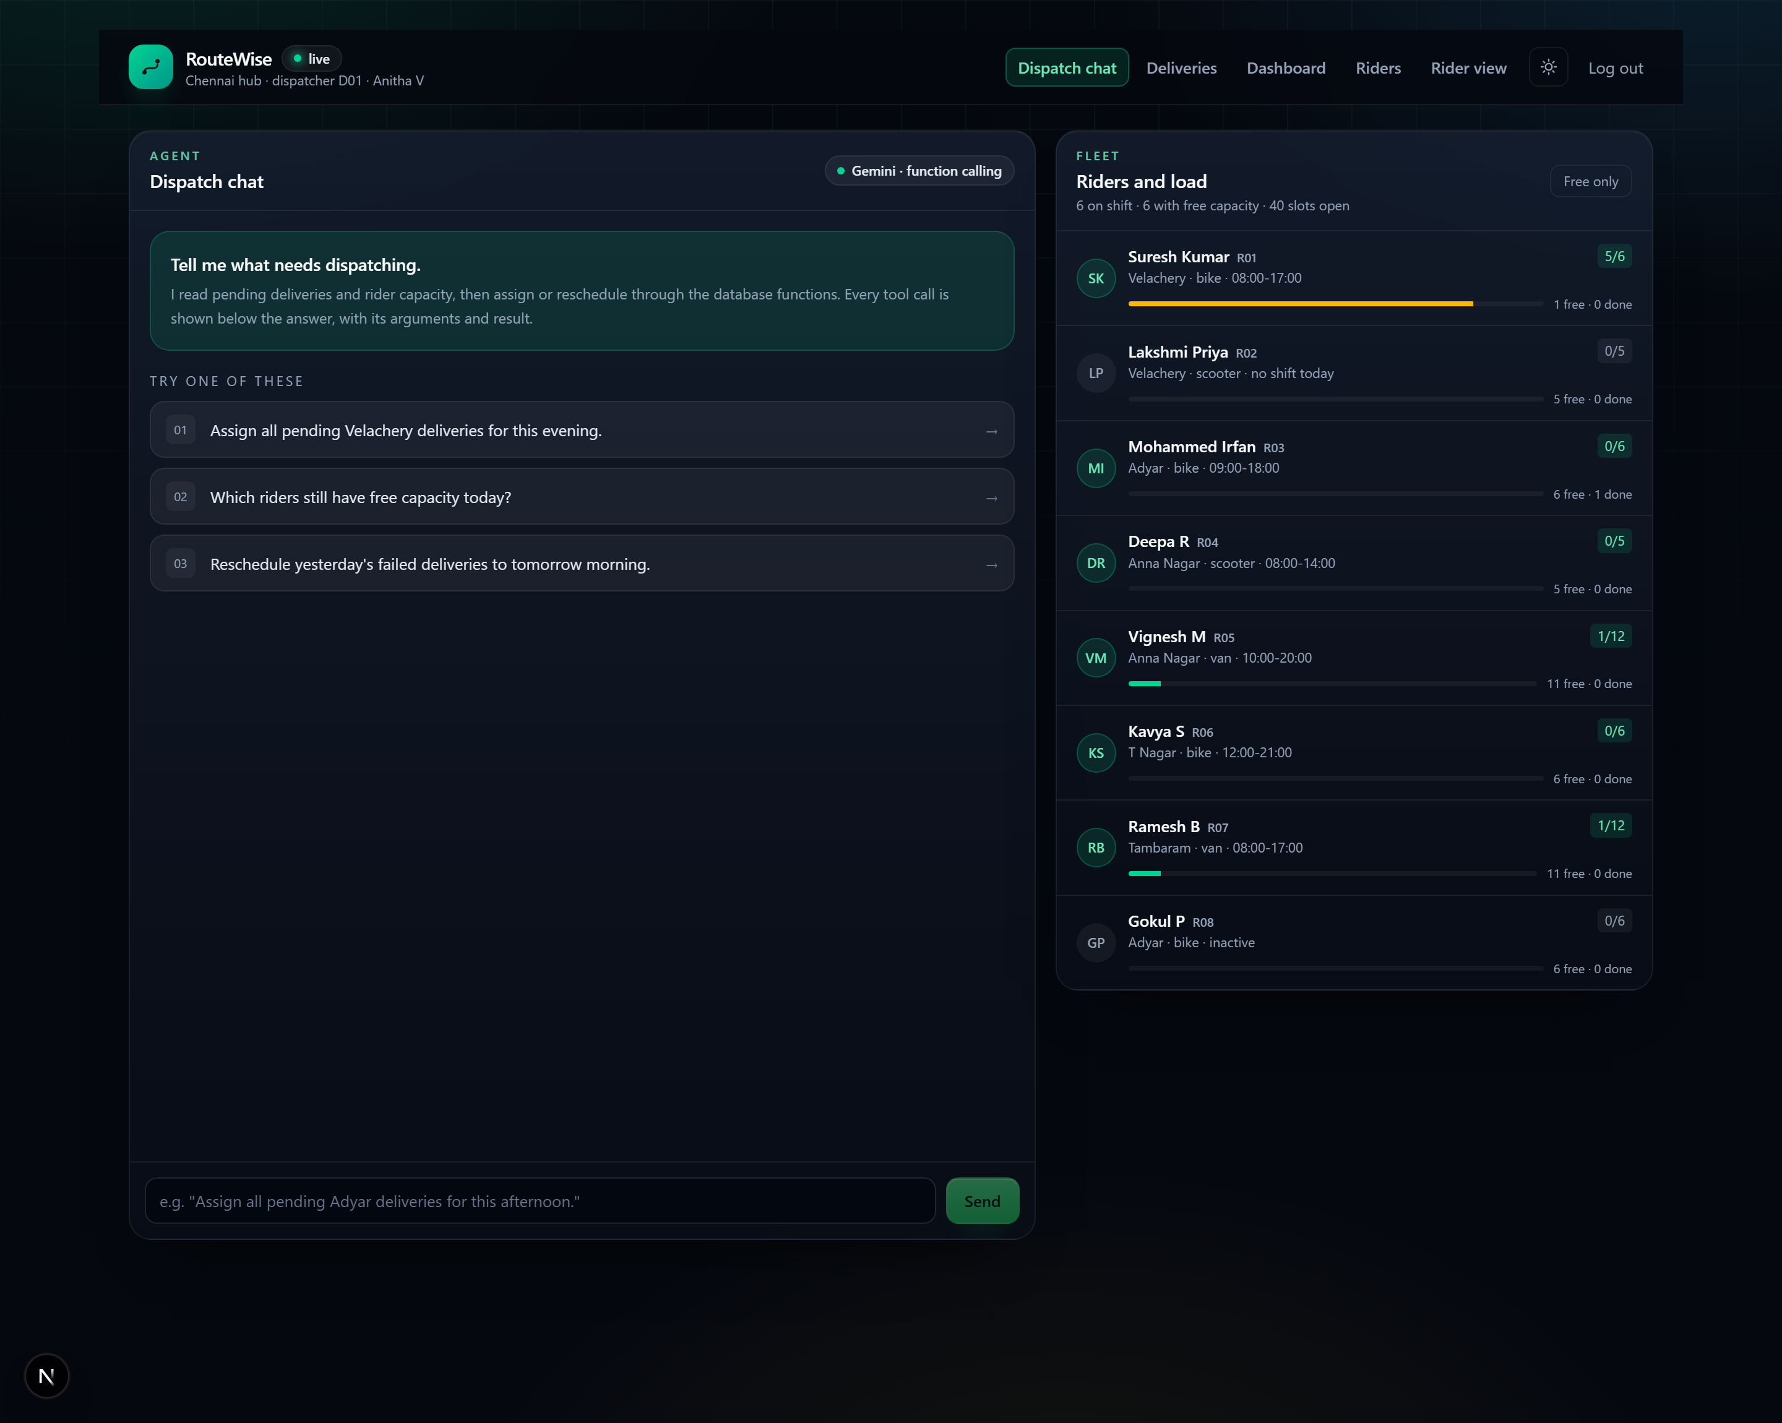
VISONX
SRM AGENTIC AI HACKATHON · TRACK 7
RouteWise
Delivery dispatch, in plain English.
An agent that assigns Chennai hub parcels to the right rider — and lets Postgres enforce every business rule.
Yadhunandh K
Abhishek S B
RA24110026010949
RA241100301243
Alok Ramteke
Nikhil Kumar Dev
Live dispatch chat with the agent and the rider fleet
RA2411003012526
RA2411003012594
routewise-ps7.vercel.app passcode routewise2026
Notes:
Open: RouteWise is our dispatch agent for the Chennai hub. One dispatcher, eight riders, one spreadsheet — we replaced the spreadsheet with an agent that does the dispatch and shows its work. Everything you see here is live at routewise-ps7.vercel.app with the passcode routewise2026.

Slide 2
THE PROBLEM
One dispatcher, eight riders, a spreadsheet.
Every morning the hub assigns parcels by hand. Three failures repeat daily, and none of them are visible in the sheet.
01
02
03
Load is blind
Zones are ignored
Failures vanish
One rider carries six parcels while another finishes at noon with four free slots. Nobody can see it until the day is lost.
Riders are sent into areas they do not cover, so addresses are found late or not at all — and the customer is told nothing.
A failed stop is marked and forgotten. The three-attempt limit is never tracked, so retries either never happen or go on forever.
22 parcels a day · 8 riders · 5 Chennai zones · 1 person deciding all of it
VisonX · Track 7 · PS7 Delivery Dispatch Agent
02
Notes:
The dispatcher is the bottleneck and the only integration point. Overload, wrong-zone trips and forgotten retries are not discipline problems — they are information problems. The spreadsheet has no capacity model, no zone constraint and no attempt counter.

Slide 3
THE SOLUTION AND DEMO
Ask in English. The agent dispatches.
The dispatcher states intent. RouteWise reads the real delivery list and the real fleet, performs the dispatch, and reports what it could not move and why.
DISPATCHER
“Assign all pending Velachery deliveries for this evening.”
AGENT
ORD-5006 → R01 Suresh Kumar (5 → 6 of 6)
ORD-5007 left pending — no rider in Z1 has a shift with free capacity.
Every write goes through assign_delivery() and reschedule_delivery(). The rules live in Postgres — not in the prompt.
VisonX · Track 7 · PS7 Delivery Dispatch Agent
03
Notes:
Demo line: type the prompt, let the agent work. It calls four tools and batch-assigns ORD-5006 to Suresh, then explains that ORD-5007 cannot move because every Velachery rider is full or off today. That explanation is the product: the dispatcher gets a reason, not a red cell in a spreadsheet.

Slide 4
HOW THE AGENT WORKS
A loop with seven tools and a hard rule floor.
Dispatcher
/api/agent
7 tools
Postgres
plain English
Gemini 3.5 Flash
function calling
4 read · 3 write
Zod validated
assign / reschedule
rule checks
Loop tool results — and any rule error from Postgres — are handed back to the model, which explains them in plain English. Nothing is retried blindly.
THE SEVEN TOOLS
RULES ENFORCED IN POSTGRES
reads getPendingDeliveries · getAvailableRiders · getRiderLoad · getFailedDeliveries
pending only · same home zone · on shift today
capacity limit · maximum 3 attempts
writes assignDelivery · batchAssignDeliveries · rescheduleDelivery
The model proposes. The database disposes.
Gemini 3.5 Flash · max 8 tool rounds per request · transient 503 / 429 responses retried
VisonX · Track 7 · PS7 Delivery Dispatch Agent
04
Notes:
Technically: Next.js route handler, Gemini with seven function declarations generated from Zod schemas, max eight rounds, retry on 503/429. Reads are plain queries; writes only ever call the two SQL functions, so an instruction-injection in the prompt cannot skip capacity or skip the attempt limit. Tool traces are returned to the UI.

Slide 5
RESULTS AND LINKS
It runs, and the rules hold under testing.
7
6
9
1
tools
screens
endpoints
request
4 read · 3 write, Zod-validated
chat · board · dashboard · fleet · rider · gate
agent, board, rider, dashboard, batch, auth
assigns a whole zone (was one call per parcel)
VERIFIED IN TESTING
LIVE NOW
—
Capacity stops the agent: second assign to a full rider returned “Rider Suresh Kumar is full (6 of 6)”.
routewise-ps7.vercel.app
—
Attempts stop the agent: the third reschedule was refused by the database function, not by the prompt.
passcode routewise2026
—
Batch assign previewed 1 of 2 parcels, then assigned it for real; state restored afterwards.
github.com/yadhu49/team-07-ps7
—
Rider flow moved COD to ₹899 collected on a delivered parcel; a foreign rider's mark returned 403.
Next.js · TypeScript · Supabase Postgres · Gemini · Vercel
Team 7 · VisonX
VisonX · Track 7 · PS7 Delivery Dispatch Agent
05
Notes:
If judges ask for proof: every claim on this slide was run against the live database. The capacity and attempt refusals came from the SQL functions, not from our own validation — that is the point. The batch endpoint and the agent share the same service, so the demo and the API cannot disagree.

Slide 6
BEYOND THE BRIEF
Six additions that make it field-ready.
Supervisor dashboard
Batch assign
Rider view
Today's delivered, open and failed counts, success rate, COD in hand, fleet load, seven-day trend, zone progress and rider performance.
One request assigns every pending parcel in a zone and window, capacity-aware, with a dry run that previews the plan before writing.
A rider marks stops delivered or failed with a reason, sees COD collected and pending, and the day's COD report exports as CSV.
Guarded writes
Light and dark themes
Built for the phone
A mark must belong to the rider, be active and stay under three attempts — a guarded update stops double taps from double counting.
The whole console switches palette from one token layer, remembered per browser and applied before first paint, without a flash.
Every screen holds at 360 px: columns stack, the header collapses and the rider's tap targets stay thumb-sized.
Live at routewise-ps7.vercel.app · passcode routewise2026
VisonX · Track 7 · PS7 Delivery Dispatch Agent
06
Notes:
Close on this: the brief asked for assign and reschedule. These six came from using the app as a dispatcher would — a supervisor needs numbers, a rider needs a phone screen, and the field has bad light and bad signal. All of it is live, none of it is a mock.

