Slide 1



Website for KVS Garments
PROJECT MEMBERS
ANOJ ROSHAN M (19ITR006)
HARI V (19ITR024)
LAKSHMANAN S (19ITR042)
PROJECT GUIDE
Dr. E.M.ROOPA DEVI
Associate Professor/Department of IT
Kongu Engineering College

Slide 2
Company Details
KEC-IT
Company name:
KVS Garments
Address:
No.16/2BA, Jawahar Nagar,
2nd street, Weavers Colony,
P.N.Road, Tirupur – 641 602
Contact:
Mobile: +91 94432-58681
2

Slide 3
Objective(s)
KEC-IT
The objective of the project is to display the products fabricated by the company and promote them online.
The fundamental focus is to facilitate clients to enquire the products’ availability and concurrently enable the admin to maintain a product database.
3

Slide 4
Hardware Requirements & Software/Tools used
KEC-IT
Hardware:
i3 Processor and 4GB RAM
Front End:
HTML – HTML for page layout
CSS – CSS UI design for page layout
Bootstrap – Mobile View Optimization
Back End:
NodeJS, ExpressJS – Backend Logic
MongoDB – For product/admin details and description
4

Slide 5
Module Description
KEC-IT
Index module:
It comprises of three elements such as Home, Description, Contact.
They provide a general description about the company and its reputation.
Client module:
It comprises of the products and products’ summary page.
It is denoted as the Client module as major client interactions occur here.
Admin module:
It comprises of the Admin login page and their dashboard where they can manipulate the products database as well as register new admin.
5

Slide 6
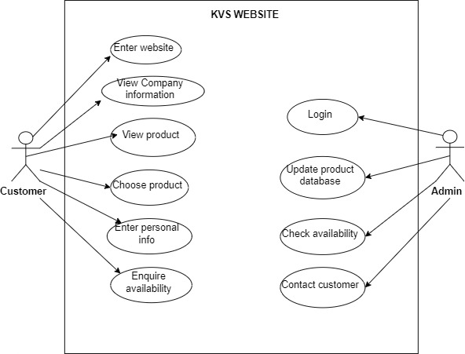
Use Case diagram
KEC-IT
6

Slide 7
Database Schema
S.No. | Field Name | Data type | Constraints
1. | admin_id | varchar(10) | Primary key
2. | admin_name | varchar(15) | NOT NULL
3. | admin_email | varchar(25) | NOT NULL
4. | admin_password | varchar(50) | NOT NULL
S.No. | Field Name | Data type | Constraints
1. | product_id | varchar(10) | Primary key
2. | product_image_url | varchar(30) | NOT NULL
3. | product_name | varchar(15) | NOT NULL
4. | product_size | varchar(5) | NOT NULL
5. | product_stock | int(20) | NOT NULL
6. | product_price | int(50) | NOT NULL
7. | product_sleev | varchar(15) | NOT NULL
8. | product_neck | varchar(15) | NOT NULL

Slide 8
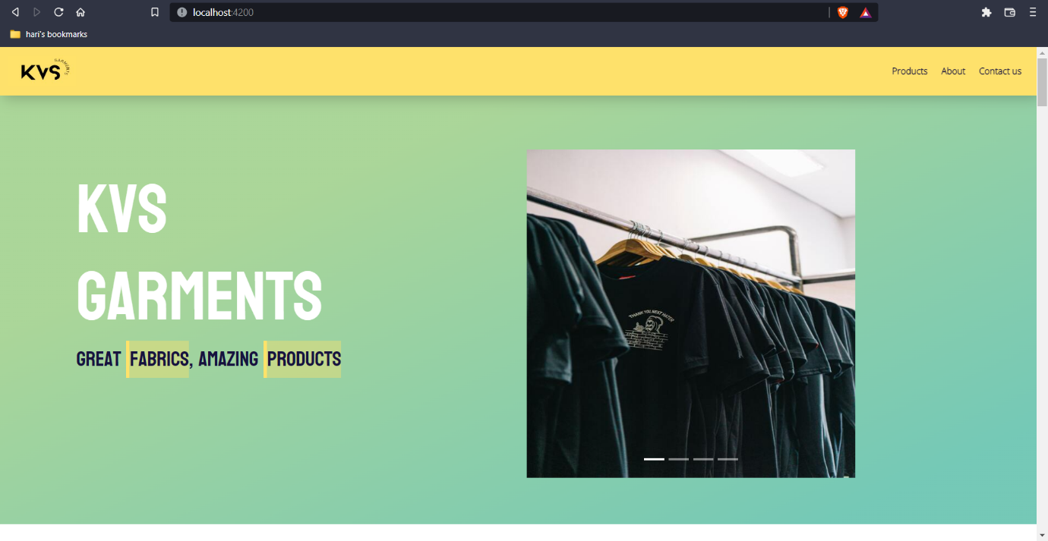
Index Module
KEC-IT
8

Slide 9
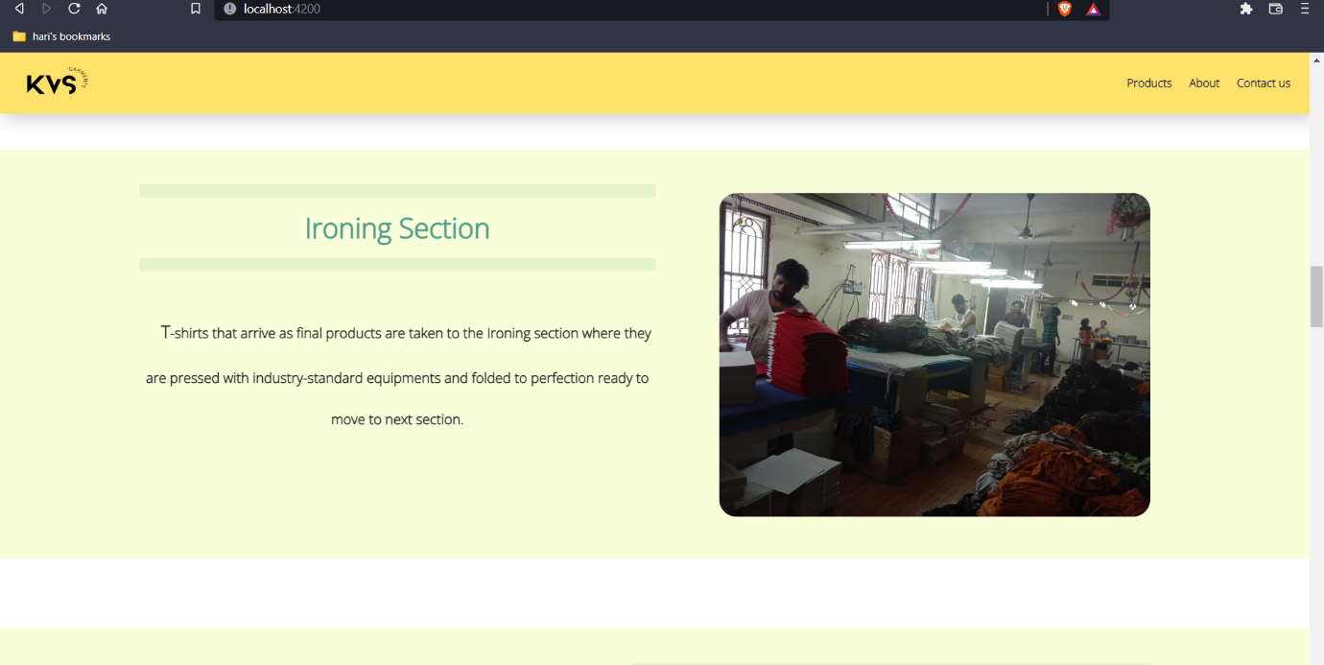
KEC-IT
9

Slide 10
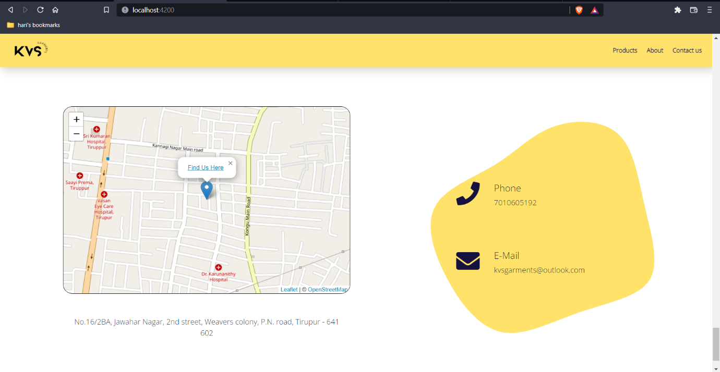

Slide 11
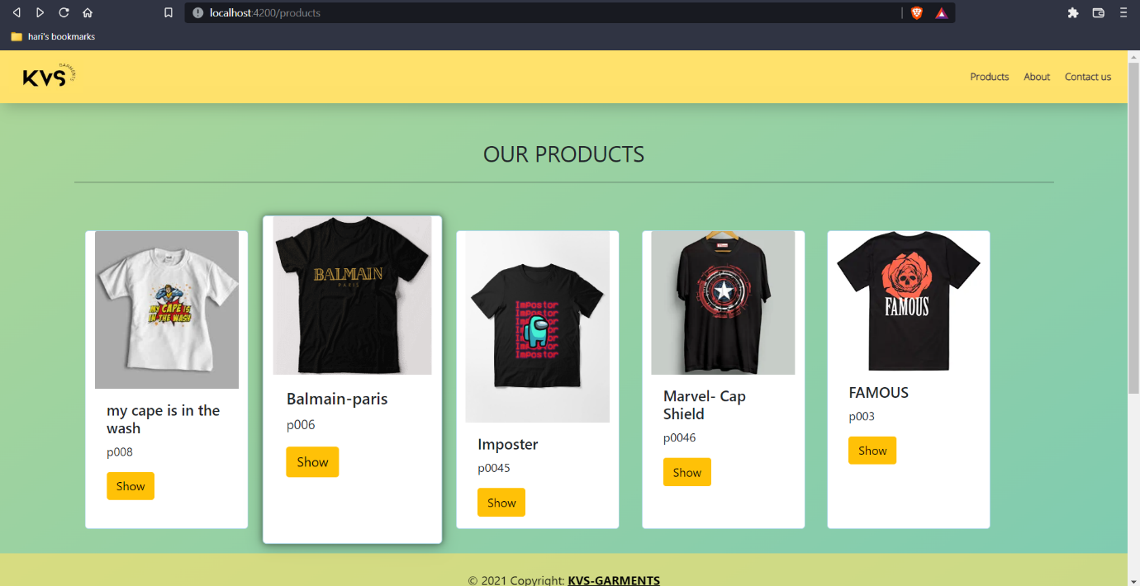
Products Module

Slide 12
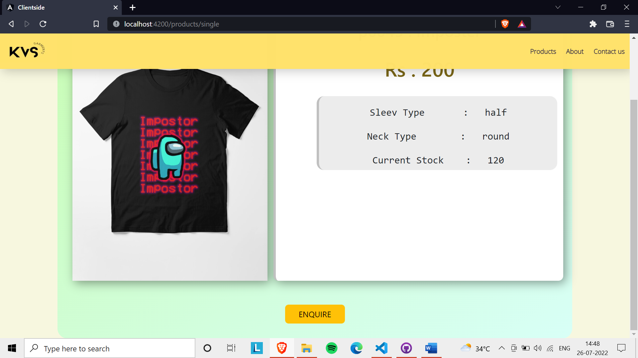

Slide 13
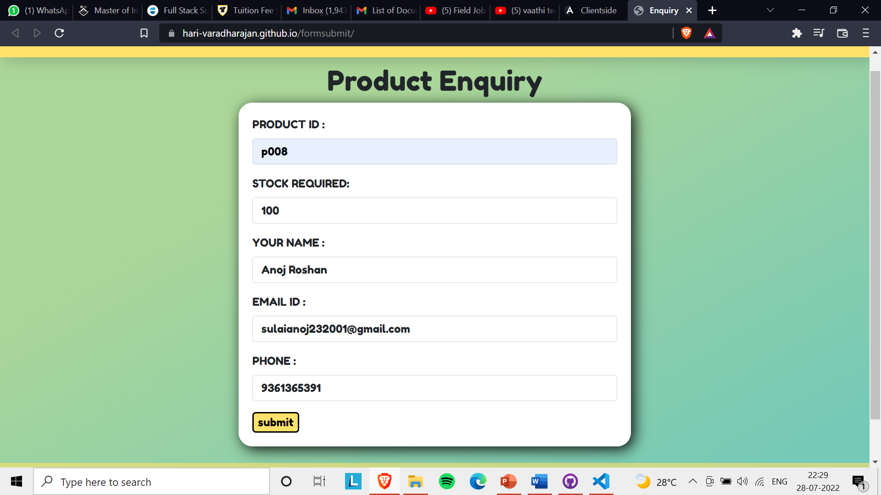
KEC-IT
13

Slide 14
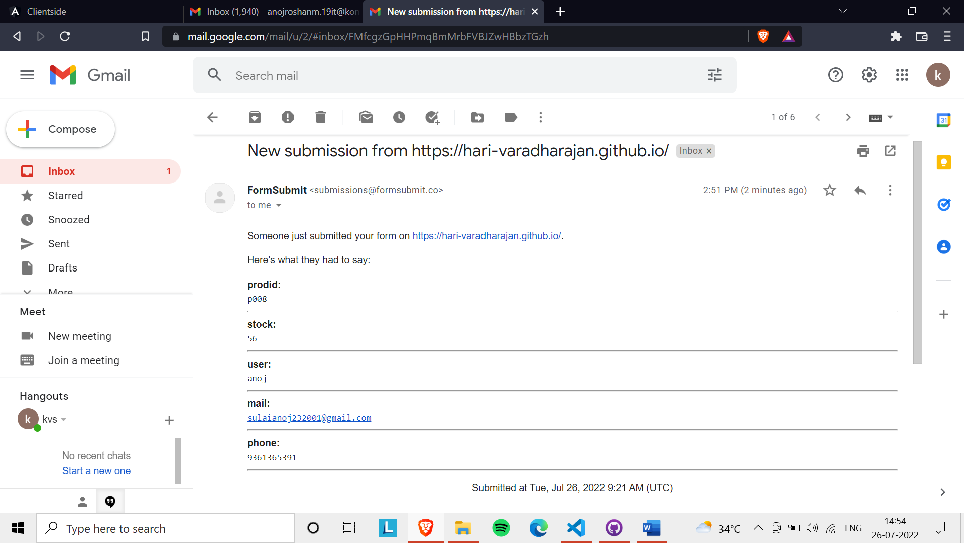

Slide 15
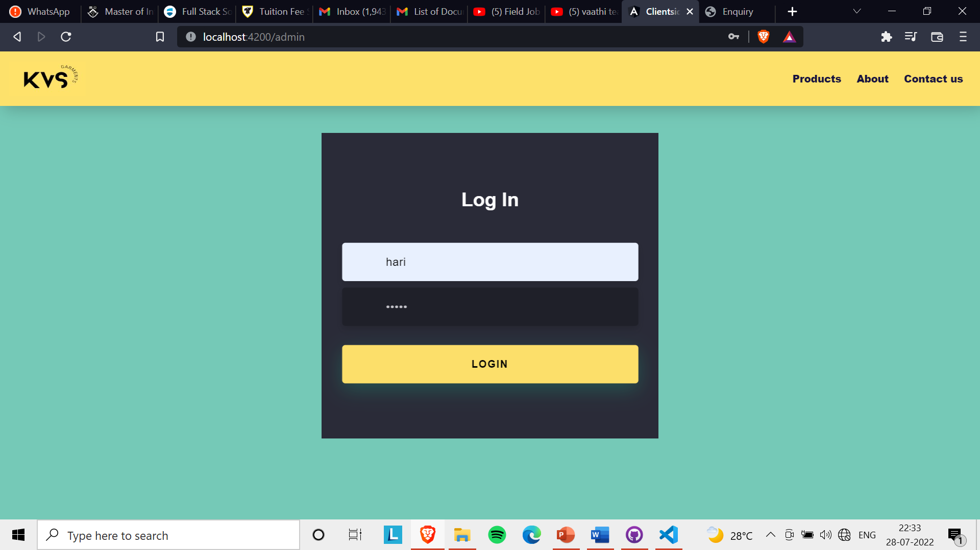

Slide 16
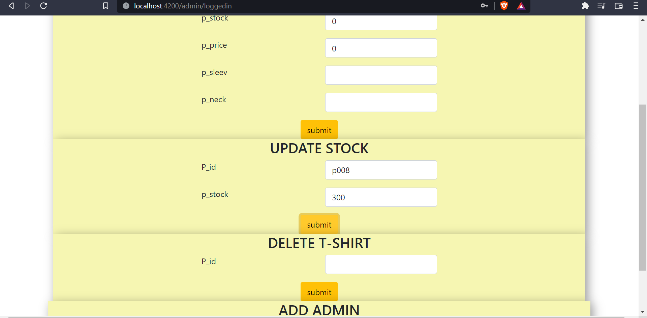

Slide 17
Conclusion
The project work titled “WEBSITE FOR KVS GARMENTS” has been implemented and documented completely. Through this project the company is enabled to showcase their products as well as present an overall idea of their operations to the possible clients.
The application is tested well and end users’ satisfaction is imminent. It is built in such a way that minimum internet knowledge is sufficient for the end users to use the website.

Slide 18
References
https://angular.io/
https://stackoverflow.com/questions/tagged/angular
https://nodemailer.com/about/
https://portswigger.net/web-security/cors

Slide 19
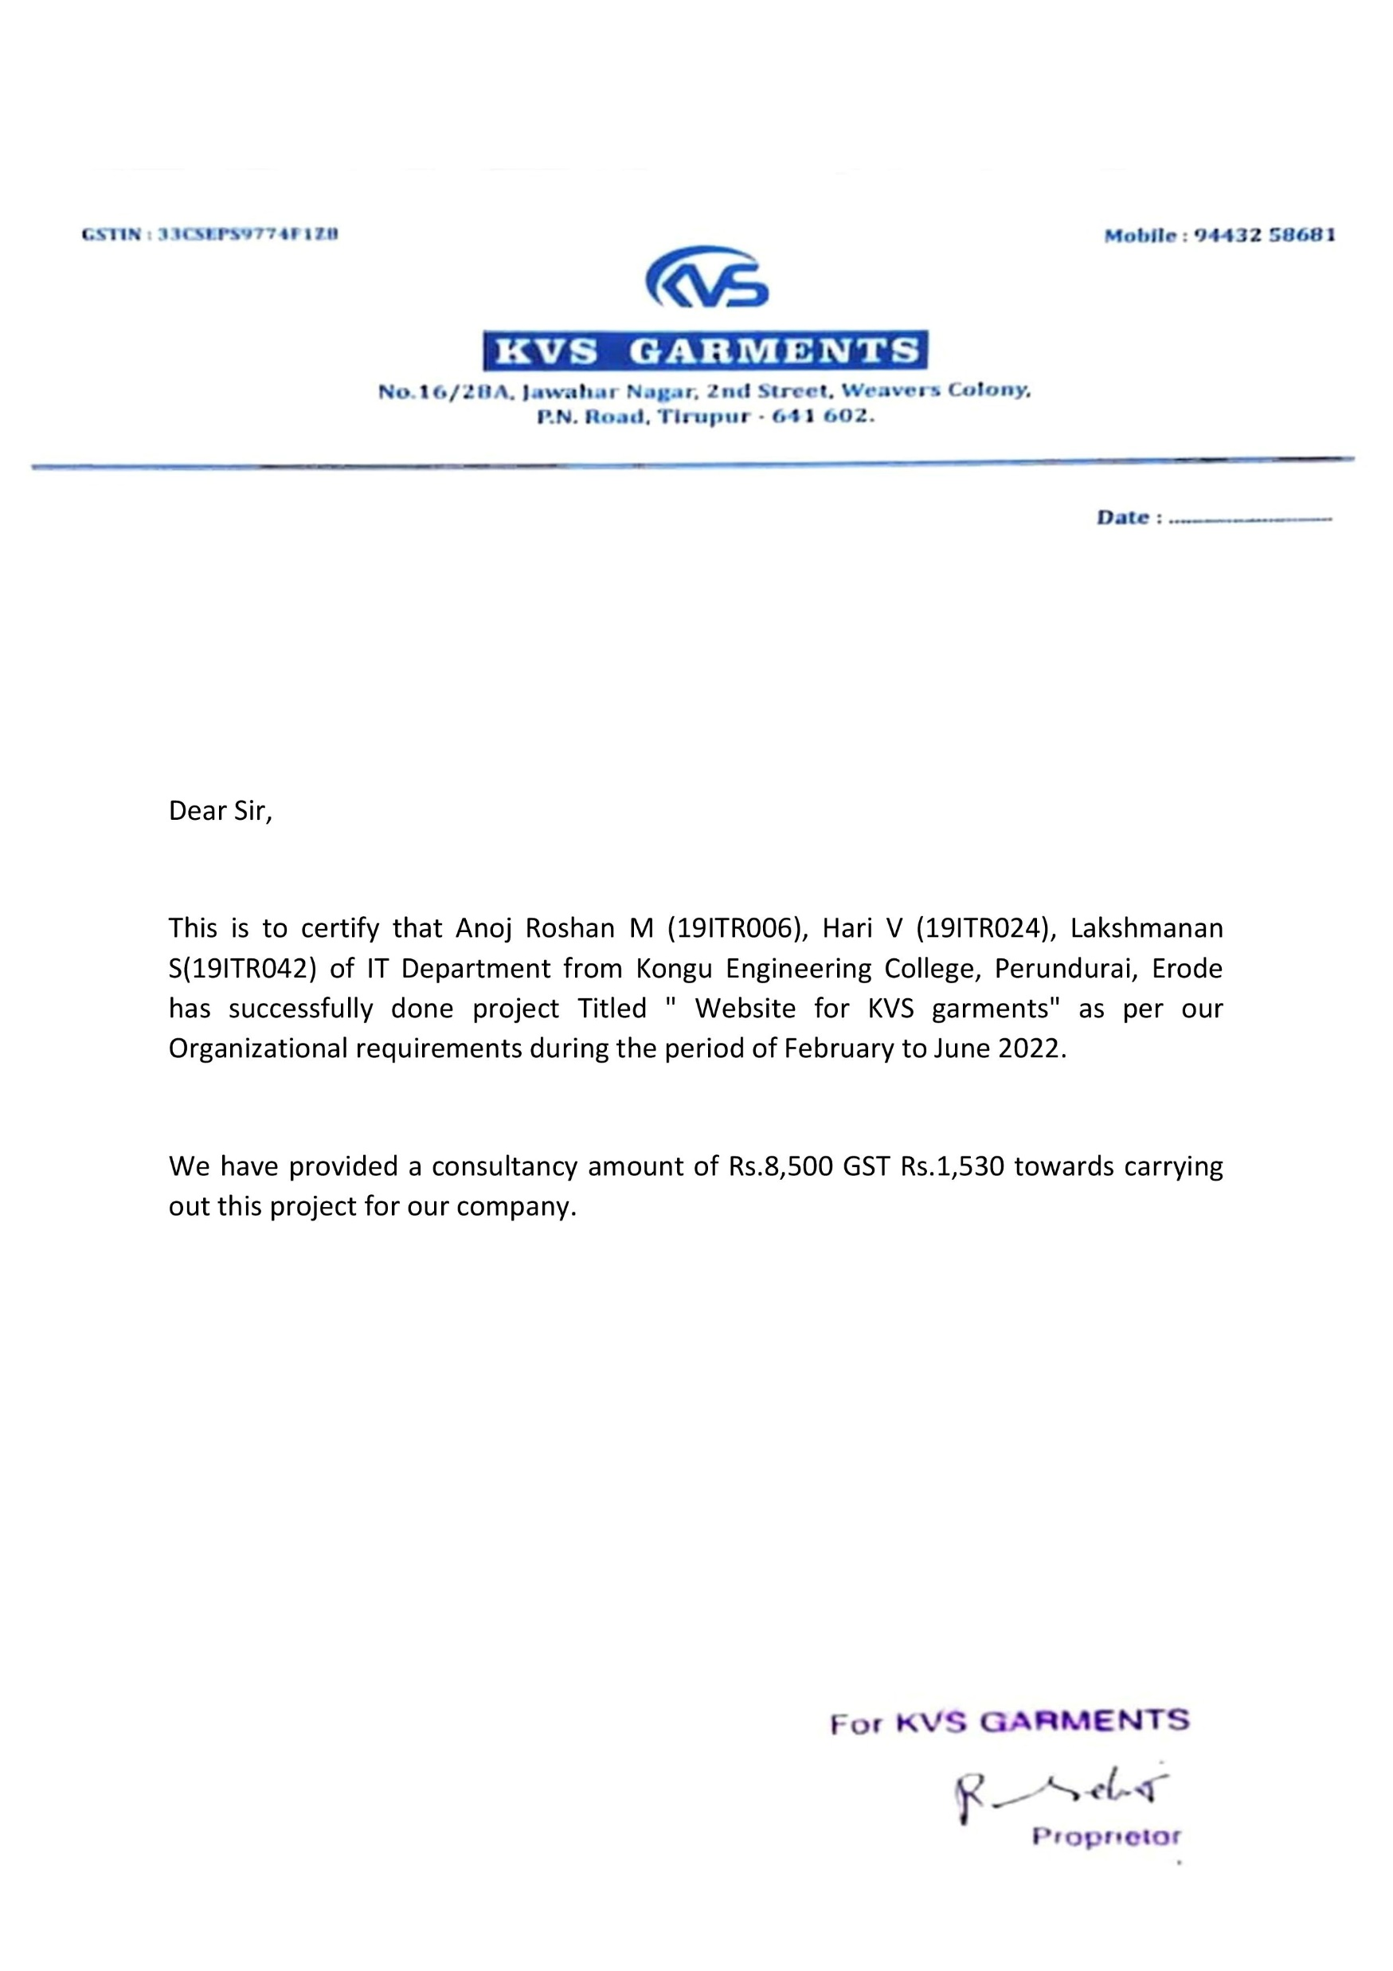
Letter from company

Slide 20
KEC-IT
THANK YOU
20

