Slide 1
The impact of physical exercise treatment on mental health
EDA Project
by Oren Ben Ami, Gilad Danin, Yadin Sapir

Slide 2
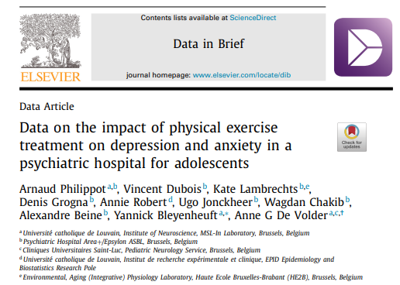
Background
The database at hand describes the effect of physical exercise as intervene treatment on clinical symptoms of depression, anxiety, and physical condition among adolescent patients who have been admitted to a psychiatric hospital.
The data gathered through a randomized controlled trial (RCT) design represents the most effective methodology for drawing meaningful inferences.

Slide 3
Data overview
The data contains the results of randomized clinical trial done on youngsters hospitalized due to anxiety and depression backgrounds
The trial examined the effect of physical exercise (‘sport’) on anxiety/depression scores (compared to the placebo effect of non-sport activity)

Slide 4
Data overview
The data contains:
Physiological data: weight, BMI, maximal oxygen uptake (VO2Max)
Scores of various mental health tests before and after the activity
40 adolescents were randomly assigned to either a physical exercise or a control program done 3-4 times per week over 6 weeks
These questionnaires and tests were filled at baseline and after intervention

Slide 5
Variables Overview:
Mental examinations:
The primary outcome was the Hospital Anxiety Depression Scale for evaluation of depression (HADS-D) and anxiety (HADS-A) symptoms.
SDS: Secondary outcomes were psychological self-assessments (The Zung Self-Assessment Depression Scale
BDI-13: Beck’s abbreviated Depression Inventory
CDI: The Child Depression Inventory
STAI: The State-Trait Anxiety Inventory
HAM-D: Depression Diagnostic interview score
Physical examinations:
VO2 max: physical effort Test (Indication to cardiorespiratory fitness - the higher the better)
BMI (Body Mass Index - the lower the better)
Weight (The lower the better)

Slide 6
Goals
Correlations between matched samples (within the group, before and after)
Correlations between unmatched samples (test group to control group)
Show differences
Visualisations

