Slide 1



Exploring various bootloader Projects based on uefi implementation for risc-v Architecture

Slide 2
team
Guided by : Mr. Rushikesh Jadhav
Names : Ashwini K. Darokar
Rohini Sagar Baviskar
Yadnesh Surendra Kayande
Aboli Kiran Ahirrao

Slide 3
bootloaders
A bootloader is a program that is executed when a computer is powered on. It is responsible for loading the operating system into memory and starting it.
Importance:
System Initialization: Initializes hardware components and prepares the system for running the OS.
OS Selection: Allows users to choose between multiple operating systems installed on the machine.
Kernel Loading: Loads the operating system kernel into memory and passes control to it.

Slide 4
U-boot (universal bootloader)
It is an open-source bootloader used in embedded devices to perform various low-level hardware initialization tasks.
It can also load the operating system’s kernel into the memory.
It supports multiple computer architectures including ARM, RISC-V, x86 etc
Opensbi (open source supervisor binary interface)
It initializes the processor and basic hardware.
It implements Supervisor Binary Interface (SBI) calls used by the OS to interact with the hardware.
It provides essential runtime services for operating systems running on RISC-V.

Slide 5
Coreboot
Coreboot is an open-source firmware project aimed at replacing proprietary BIOS/UEFI firmware found in most computers. It provides a lightweight, customizable firmware solution designed to initialize the hardware and bootstrap the operating system during the system startup process.
Key aspects:
Open Source
Fast and Lightweight
Customizable
Security
Payloads

Slide 6
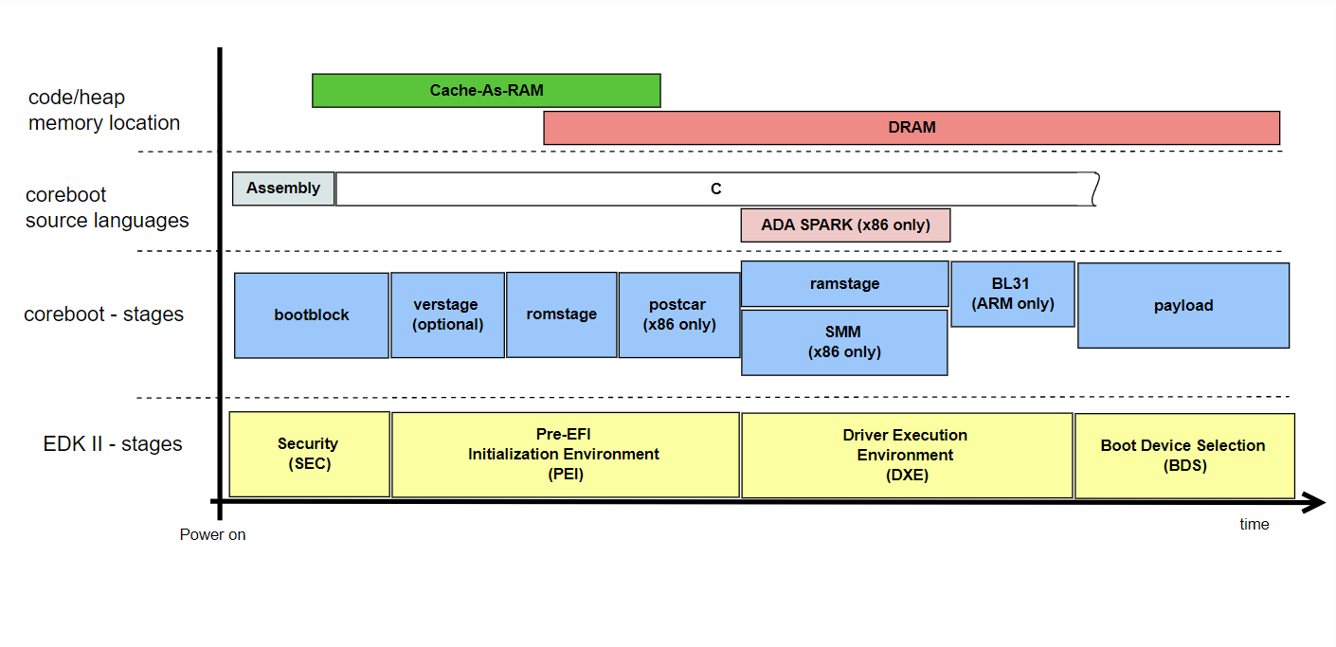
Coreboot boot stages

Slide 7
Booting sequence using coreboot
Coreboot
Payload (Grub2)
Kernel Loading and Initialization
Mounting Root Filesystem
Init Process
Login Prompt

Slide 8
Payloads for coreboot
SeaBIOS
GRUB 2
Depthcharge
Tianocore/EDK2
FILO
LinuxBoot
Open Firmware
OpenSBI
OpenBIOS
U-Boot

Slide 9
Potential payloads of coreboot for risc-v architecture
LinuxBoot (Linux Kernel + u-root (initramfs))
OpenSBI
GRUB 2

Slide 10
Why we used grub 2
1. Multi-Architecture Support
2. Modularity
3. Extensive Filesystem Support
4. Complex Boot Scenarios
5. Command Line Interface
6. Support for Advanced Features
7. Community and Documentation
8. U-Boot Integration
9. Future-Proofing

Slide 11
Compiling kernel and coreboot
Downloading the coreboot source tree.B
Build the coreboot toolchain
Build the payload- coreinfo
Configure build and mainboard
Select payload and build coreboot
Using the resulting ‘grub.cfg’ file as payload while compiling coreboot with the risc-v cross tools built.
Run QEMU

Slide 12
Compiling coreboot with a special risc-v cross toolchain comprising of all the patches and updates needed while compiling coreboot.
Packages used to build toolchain were: binutils, gmp, mpc, mpfr, gcc and iasl along with certain patches and updates for each package which are specifically used to compile coreboot.

Slide 13
Build grub for coreboot and booted
Booting into x86 image.
Downloading grub source code and building it specifically for coreboot platform.
Obtaining grub.cfg from it and trying to boot the x86 image with the coreboot.rom file in qemu.

Slide 14
BOOTING using coreboot
Using the compiled ‘coreboot.rom’ file to boot the os image i386
Encountered error while jumping to the boot code address

Slide 15
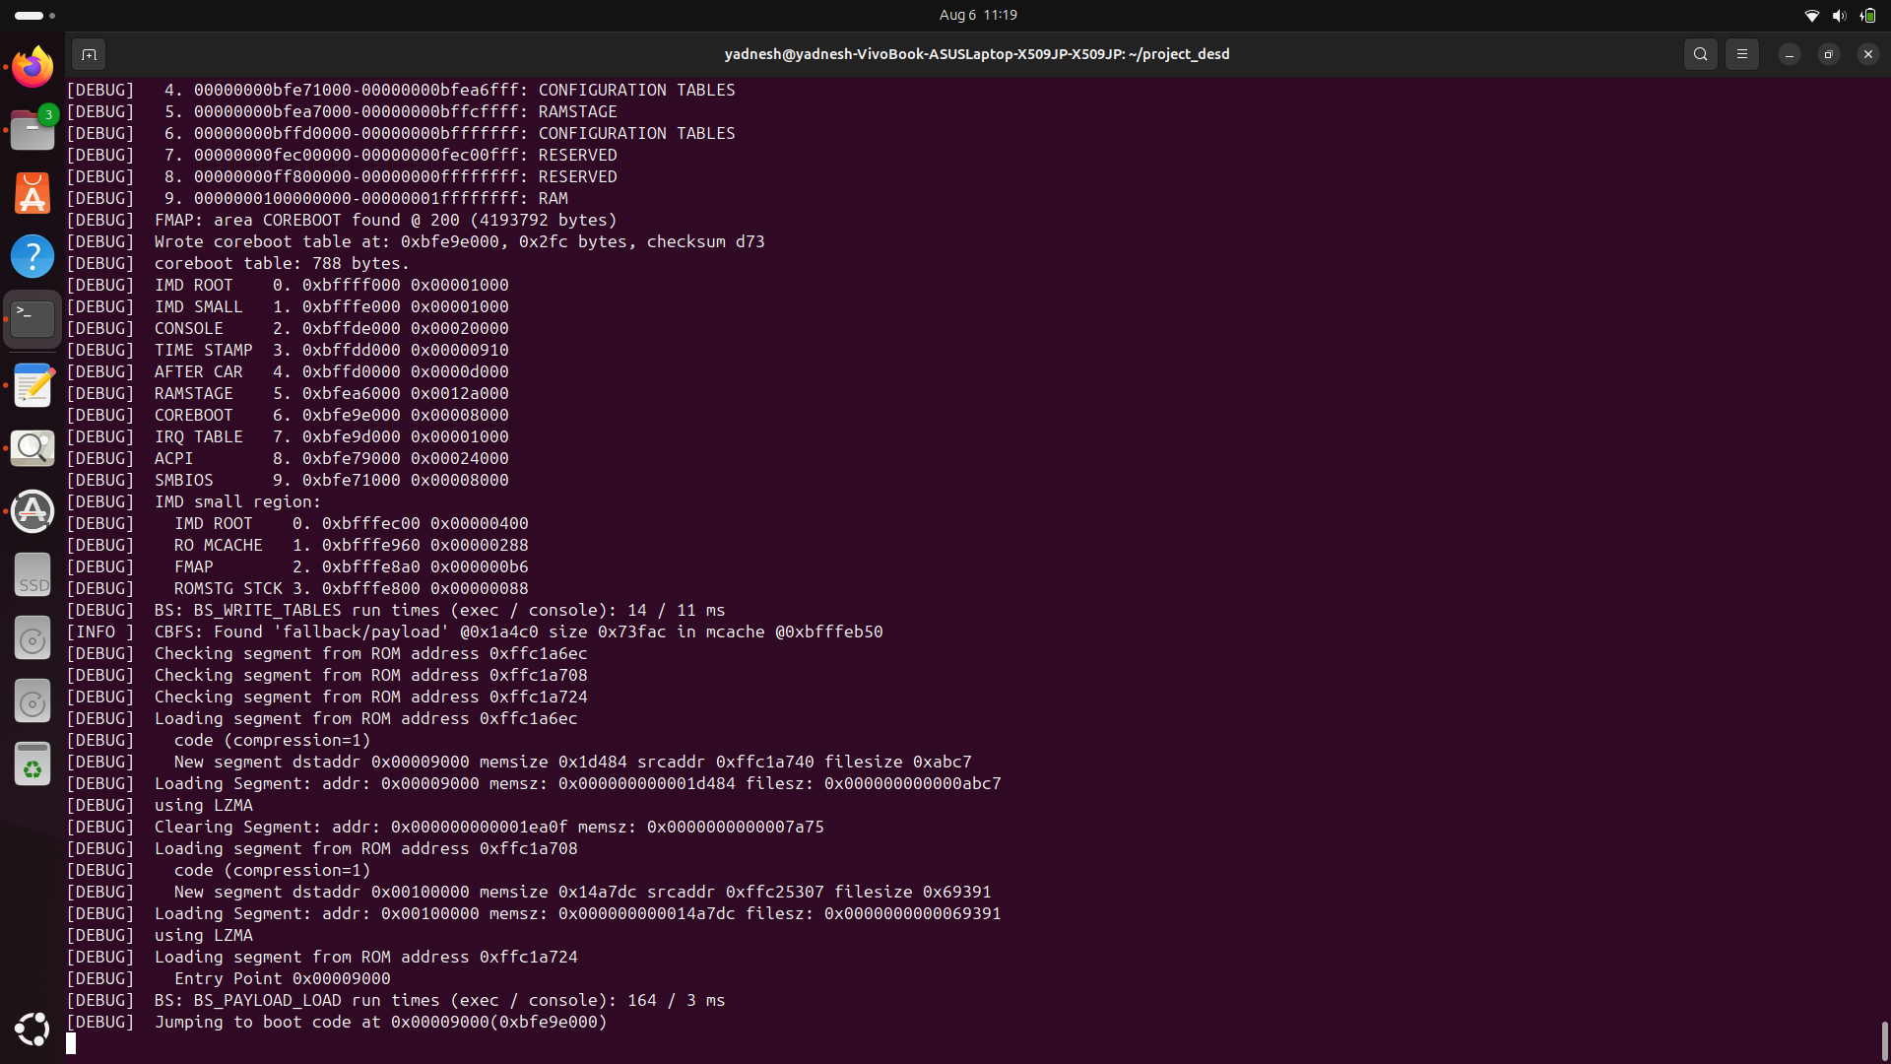

Slide 16
How we resolved
When we boot our fedora image through the core boot firmware package,
Core boot initializes the hardware
Then successfully hands over the control to GRUB2 payload
However the problem occurs because GRUB2 is unable to find UUID of the partition automatically
As a result, we have to manually add the UUID of the root and partition in the menu entry section of grub.cfg

Slide 17
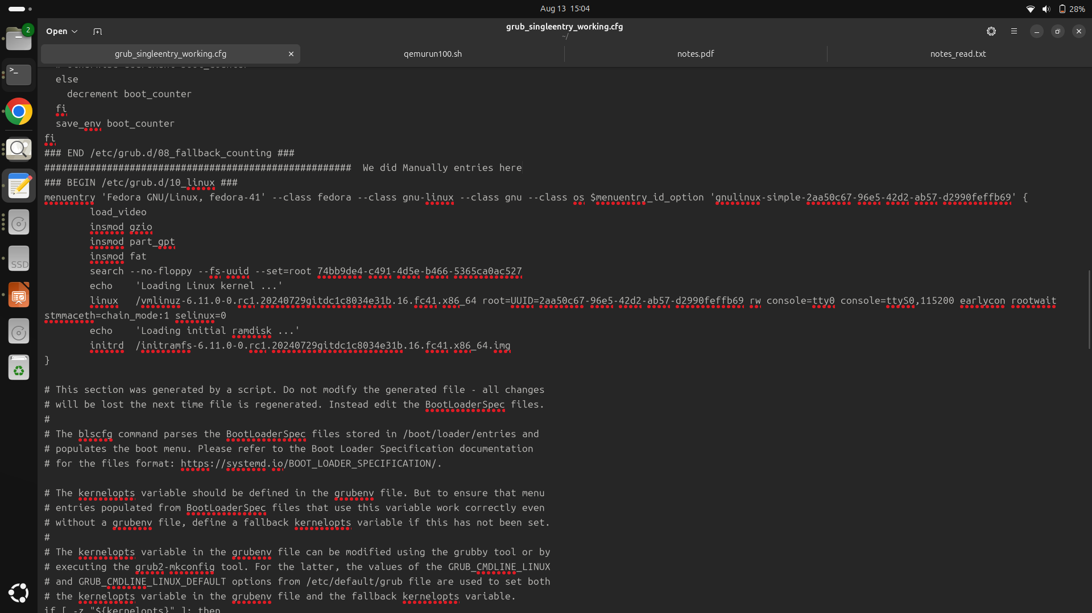

Slide 18
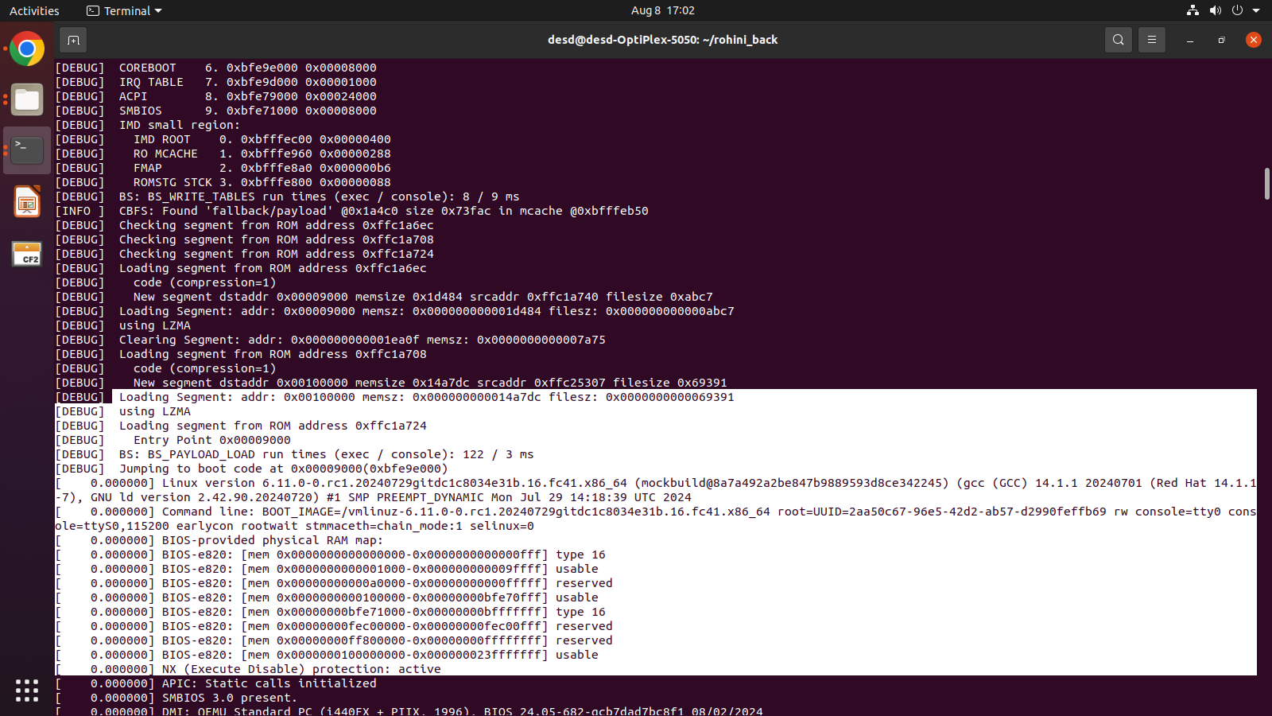
resolved…

Slide 19
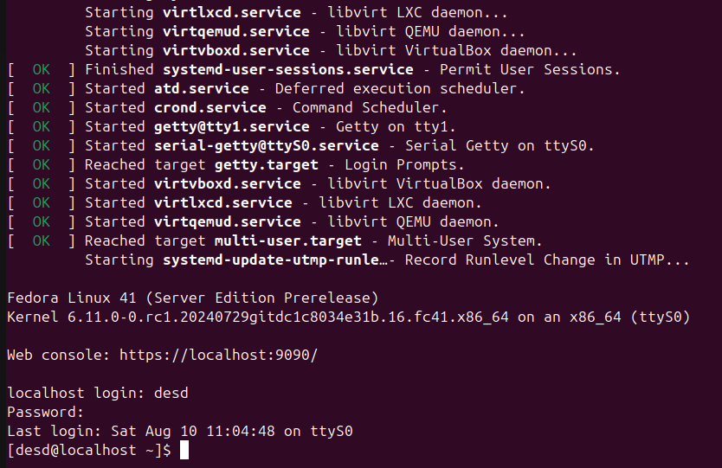
Successfully logged in…

Slide 20
Video…

Slide 21
We booted fedora image for risc –v 64 architecture and run it on qemu
Using following command …

Slide 22
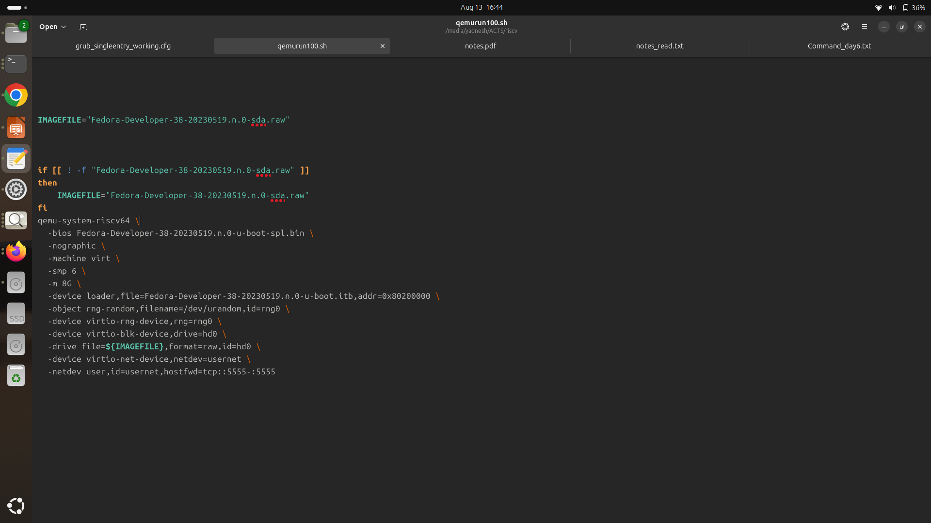

Slide 23
Successfully logged in…

Slide 24
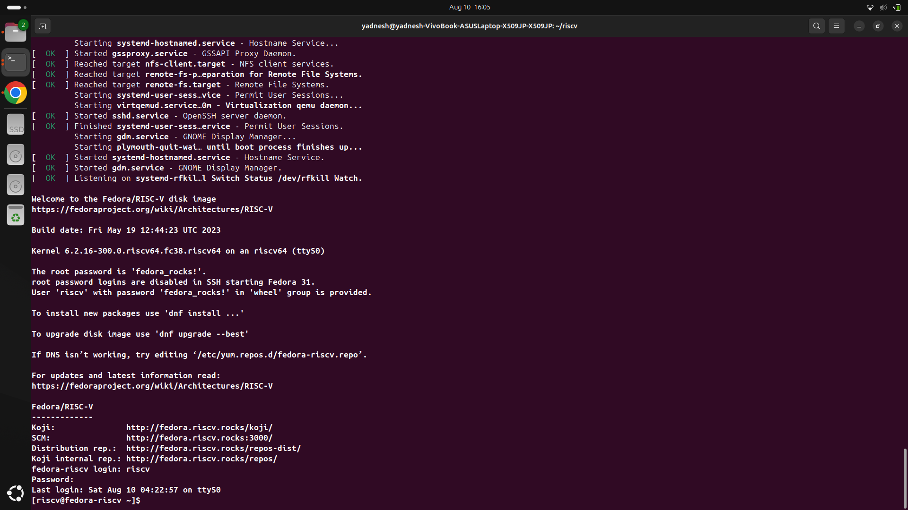

Slide 25
Coreboot incompatibility
We installed coreboot and GRUB2
While compiling GRUB2, getting error
The platform coreboot is not supported for target cpu RISC –V 64

Slide 26
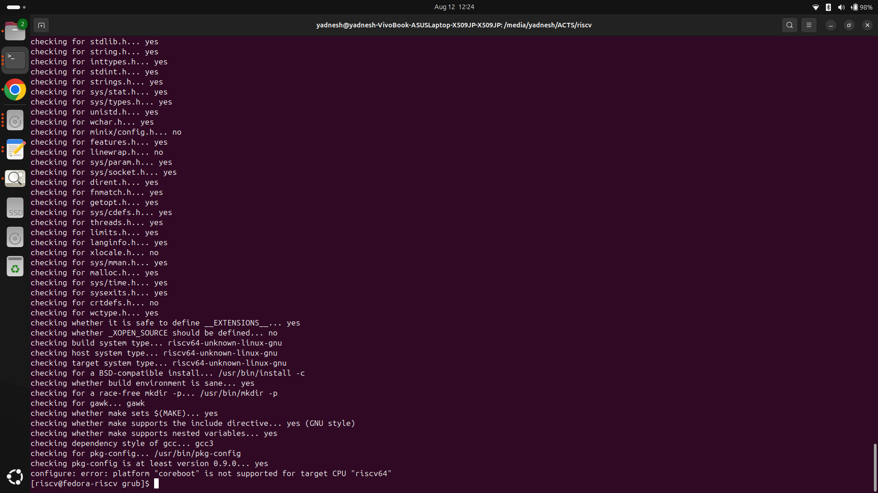

Slide 27
Thank you

