Slide 1
YouTube Prediction for the year 2024
Name:- Yadnesh Mankame
Student Id:- L00179080
Notes:
In this presentation, we will get to know which are the factors that will trend Youtube in the upcoming year of 2024.
Nowadays earnings on youtube is growing rapidly.

Slide 2
Introduction
YouTube has become a global stage for content creators, artists, startups, etc.
In this presentation we will get to know the popular video categories that have captured the attention of viewers in the year 2023.
YouTube has become the second-largest search engine.
Every category on YouTube tells a different tale of involvement, creativity and influence.
Notes:
1. Youtube has become an important platform to showcase talent for many of them like
1.1 Content Creators
1.2 Artists etc.
2. From this analysis we will get to know the top categories that acquired much more viewers in the year 2023.
3. Due to various types of video YouTube has become the second largest search engine.

Slide 3
Dataset description & Questions
Factors affecting trending videos on YouTube, that will help us to understand,
Ongoing YouTube trends
Marketing Strategy
The important features are comments disabled, ratings disabled, video error or removed, country, likes, label, dislikes, comment, num_tags, description length, title length & publish weekday
Questions:
Which are the top 5 trending video categories?
From which country videos are getting more views and what is the Entertainment category count in each country?
Notes:
Dataset contains features that will describe the youtube trends and for businesses the current marketing strategy.
Then 2 Question like: Q1) Top 5 trending video categories
Q2) From which country videos are getting more views, Count of entertainment categories in each country as it is the top trending category.

Slide 4
Categories Like, Dislikes & Views
Most trending is Entertainment Videos.
If one wants to start on YouTube then one can select from the top 5 trending categories.
Top 5 trending categories
Entertainment
Comedy
People & Blogs
Music
News & Politics
Notes:
The graph describes likes and dislikes views for each category, from those Entertainment acquires more count of views.
There can be various types of entertainment like shows or series.
Here are the top 5 trending Categories
Music is a way of entertainment that can get views even if the viewer is only listening.

Slide 5
Country-wise video trends
The graph shows how the Entertainment category growing in every country.
Notes:
USA has the top most Viewers as this is because of the Internet connection
The rest country has much less viewers the USA although the population is huge in India that is because the Internet is not available in every area.
As mentioned earlier Entertainment is the top category so count of Entertainment views in every country.

Slide 6
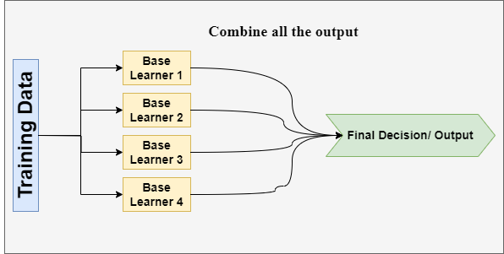
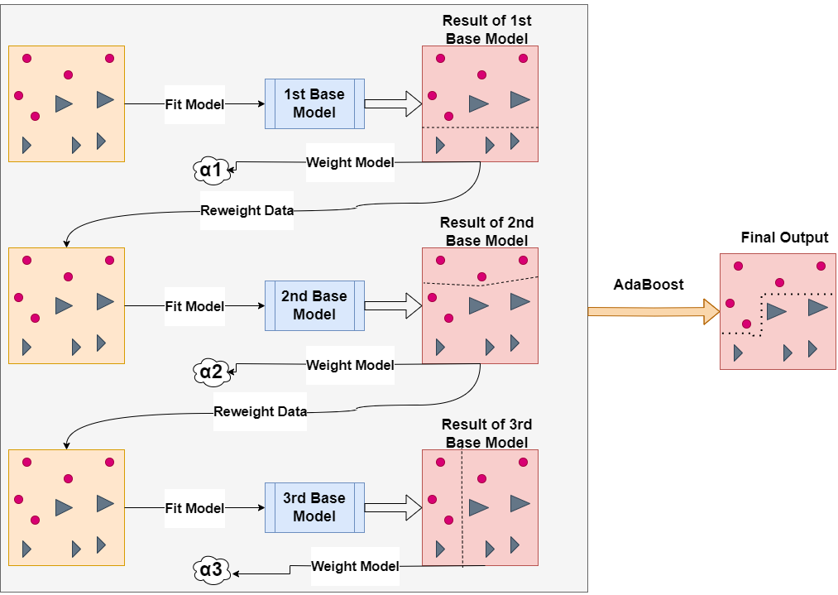
Adaptive Boosting OR AdaBoost Working
Ensemble Learning
Different Algorithms.
Different Training Dataset's
Training Dataset with circles & triangles.
The goal is to form decision boundaries between two classes.
Initially it will give sample weights to all training data instances.
Here we are using 3 n_estimators.
To overcome the decision tree overfitting problem we use a decision stump that only makes a single decision, which means resultant estimators only have two leaf nodes.
Notes:
In ML there is a technique called ensemble the word itself defines as a group of things.
Training data will get insert to different algorithms like DT, SVM, etc and from those outputs there will only a single prediction which will be more accurate.
Here I am using 2 different Ensemble models 1st is AdaBoost and the 2nd is Gradient Boost
First we will look after the AdaBoost Architecture.
In this example we will try to split triangles and circles With the 3 estimators means 3 models
Initially the training data instances are all given the same weight which is denoted by alpha
Here we use DT to overcome the overfitting issue we use the simplest version as a decision stump.
Only one decision so the resultant will have two leaf nodes.
Result of the first Base Model the dotted line creates a bountry.
However there are two triangles left with greater in size.
The contribustion of each model depends on the magnitude of errors It makes.
Once after evaluating the error of first base model, we can weight the model and assign it a value. As alpha 1
For the next stage we need to reweight the data give heigh weightage to larger triangles.
Again assign the weight as per the errors and fir the 3rd base model.
Finally after reaching n_estimators =3 the ada boost will get the final output by aggregating the output of 3 base models.

Slide 7
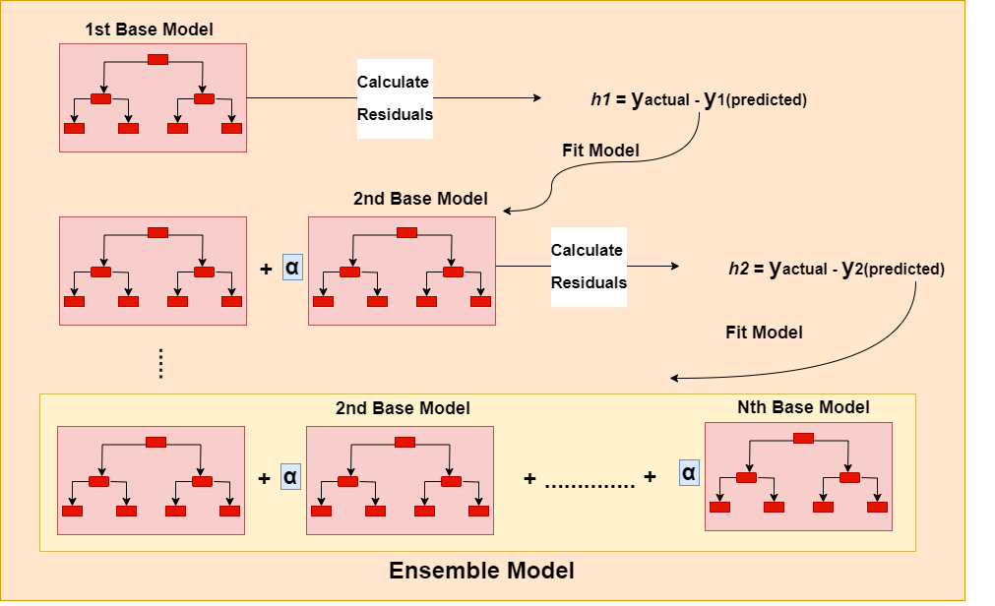
Gradient Boosting(GB)
The first step is to fit estimators for the Boosting Algorithm.
GB trees can include a few more decision branches than AdaBoost.
GB trees can have up to 32 leaf nodes or 5 levels of tree depth.
Current example we are restricting depth to 2 or 4 leaf nodes.
Calculate residual error means the difference between each training data instance’s actual and predicted values. With the below formula.
Implement the 2nd base model which will pick only the errors made by the 1st base model.
2nd base model multiply with constant learning rate α & adding o/p of 1st base model.
Repeat steps till the Nth stage until the residual error does not change.
Notes:
The first step is to fit a base estimator.
The base estimator tends to be simple and highly biased which will overcome the issue of over fitting.
Over the ada boost Gradien Boost tend to include few more decision Branches. It has often 32 leaf nodes upto 5 levels
Here we are restricting to depth of estimators to 2. Which means 4 leaf nodes.
After the model is train the residual error is calculated which is h1 for every instance with the formula ……
In the next stage in the sequential learning fit the 2nd Base model fit the model on the errors of the previous stage.
Here h1 the 2nd Base Model will learn from the mistakes of 1st Base model and multiply with constant learning rate α(0.01) and add to the result of 1st Base Model
Each time calculate residuals.
Repeat steps till the Nth stage until the residual error does not change. Till the defined number of estimators
And we will get the final ensemble output

Slide 8
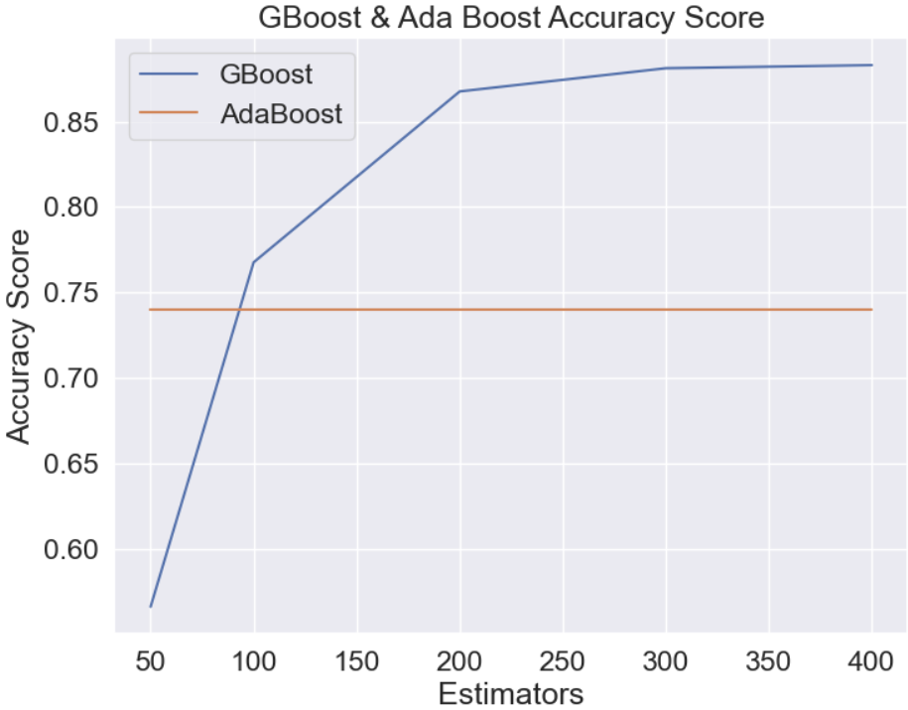
GBoost and AdaBoost comparison
Notes:
Accuracy of Gradient Boost is changing as per the increasing number of Estimators.
For AdaBoost Accuracy is constant.

Slide 9
Discussion
The Internet plays a vital role in growing YouTube trends.
Previously the growth was not more but after the Covid people are getting more engaged with the Internet.
There can also be various types of good and bad factors.
Notes:
Because of the Growing Internet youtube is getting more trend.
Covid is the main time period for growing internet access.
Good factors like:- Education, Entertainment, etc
Bad Factors like:- Much more time spent on youtube for childrens,

Slide 10
Conclusion
An analysis of 2023’s top 5 video categories offers insightful information about the tastes of internet users.
When it comes to content that is trending, Entertainment is the clear leader. There can be movies, viral videos, etc.
After Entertainment the most trending category is Music. Music is a universal language that knows no boundaries.
This analysis provides advertisers and content creators with strategic opportunities, and promotion tactics as per the taste of the audience.
Notes:
What is the top trending categories of youtube
One can start with Entertainment category if want to start on youtube.
Music is also much more popular.
4.

Slide 11
Thank You

