Slide 1
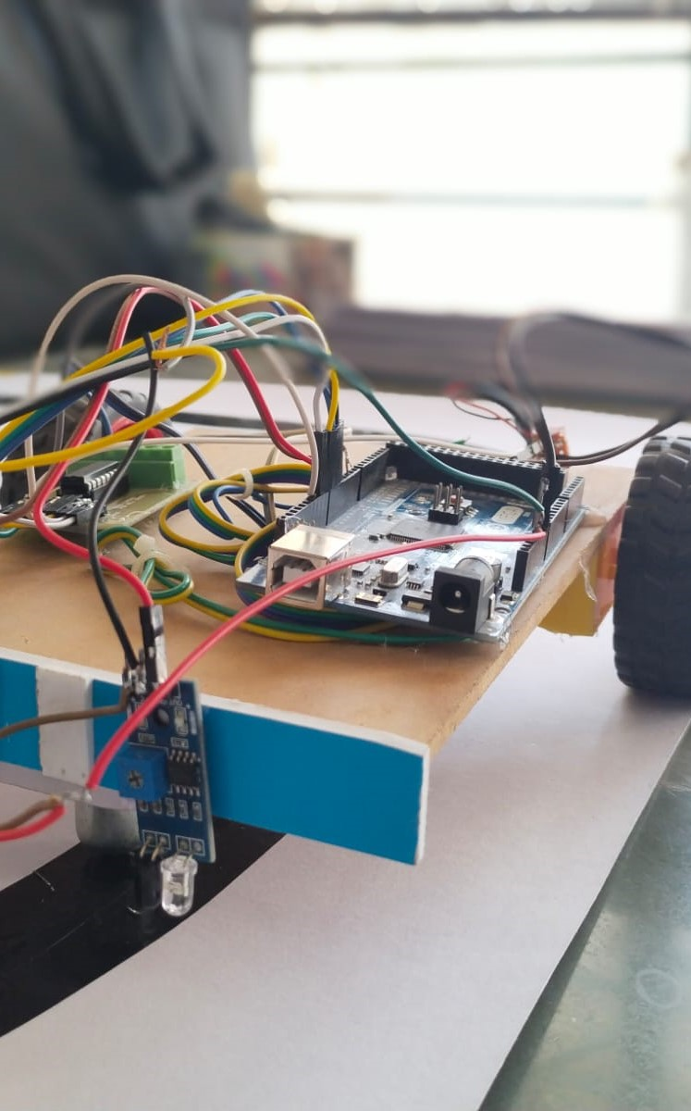



Line Following Robot
Guided By : Dr. A . K . Patil
Group Members
Yadnynesh Dhangar
Aniket Gudgal
Saurabh Japkar

Slide 2
Project Description
The model aims to develop a robot that can autonomously follow designated paths using sensor feedback and decision-making algorithms.
1
Sensor Integration
Integrating infrared sensors for line detection and obstacle avoidance.
2
Algorithm Implementation
Implementing a PID control system for accurate line tracking.
3
Test and Calibration
Conducting extensive testing and fine-tuning for optimal performance.

Slide 3
Line Following Algorithm
Explanation of the algorithm used to enable the robot to track and follow lines effectively.
A Line Follower Robot is an autonomous robot which is able to follow either a black or white line that is drawn on the surface consisting of a contrasting color. It is designed to move automatically and follow the made plot line.

Slide 4
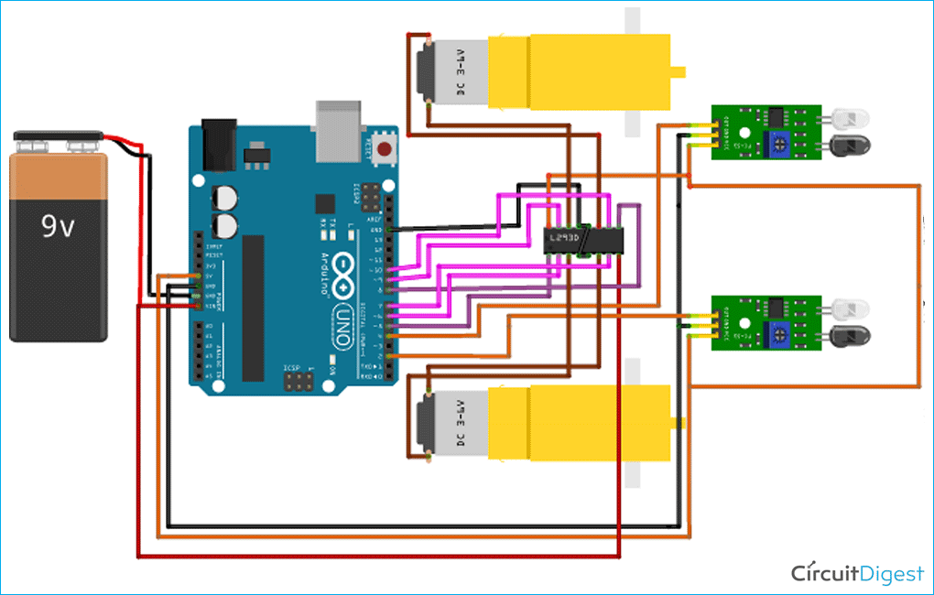
Circuit Diagram
Visual representation of the electronic connections and components in the line following robot's circuitry.
Circuit Diagram

Slide 5

Challenges Faced and Solutions
Addressing the challenges encountered during the project and the strategies used to overcome them.
1
Complex Path Geometry
2
Ambient Light Interference
3
Obstacle Navigation
Integrating collision avoidance mechanisms to ensure safe traversal even in complex environments.
Developing adaptive algorithms to handle intricate path designs effectively.
Implementing filters to minimize the impact of varying light conditions on sensor accuracy.

Slide 6
Results and Performance
Evaluating the performance and outcomes achieved by the line following robot model.
90%
5
Accuracy
Speed
High accuracy in line tracking and following capability.
Maximum speed achieved during line-following operations.

Slide 7
Components Used
A list of the components and specifications utilized in the development of the line following robot model, along with associated costs.
1. Sensor
Sr.No | Name Of the Component | Price / Coast
01. | Arduino Mega 2560
02. | L293D Motor Driver
03. | DC Motor
04. | IR Sensor
05. | Caster Ball
 | Price =

Slide 8
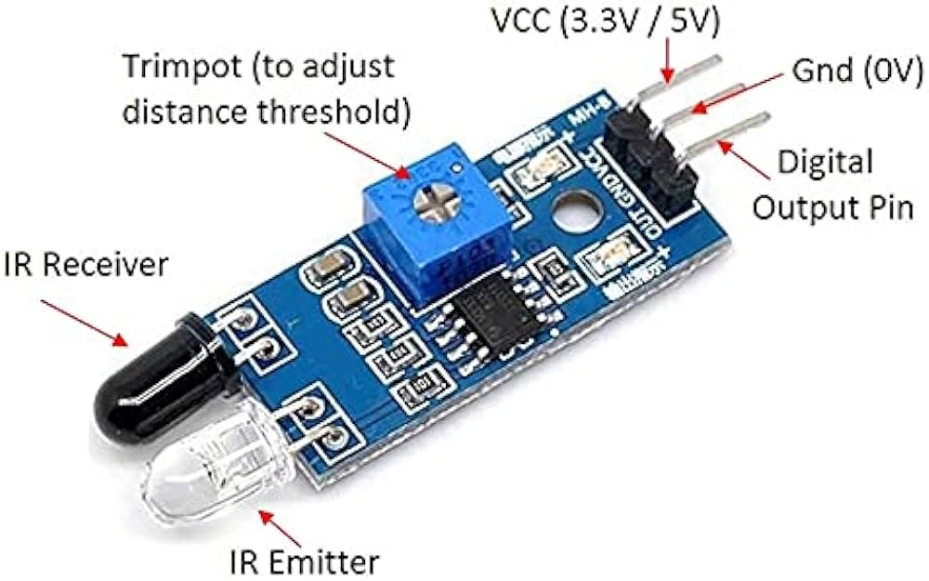
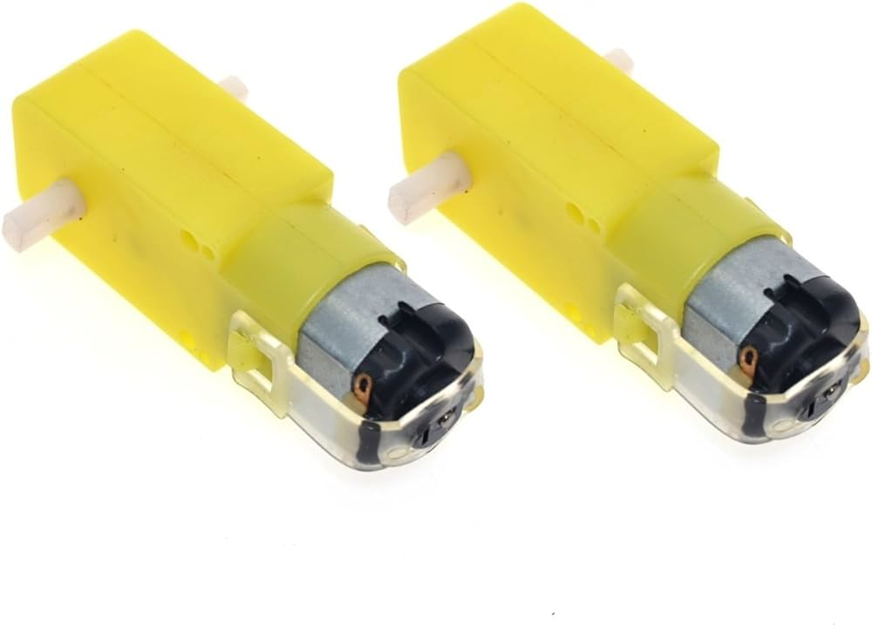
1.
IR - Sensor
The module consist of a IR emitter and IR receiver pair, The power consumption in this module is low
2.
BO DC Motors
DC motors are most easy for controlling. One dc motor has two signals for its operation. Reversing the polarity of the power supply across it can change the direction required. Speed can be varied by varying the voltage across motor

Slide 9
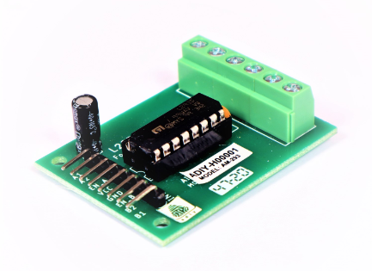
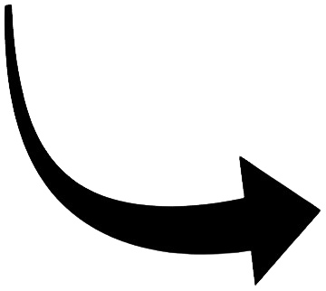
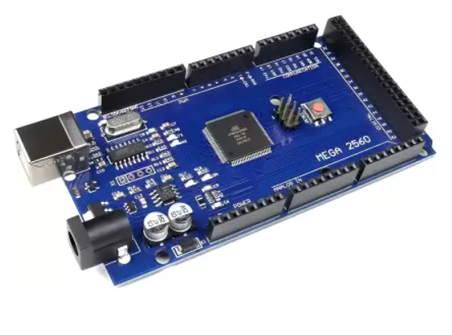
3.
L293D Motor Driver
motor driver IC that can drive two motor simultaneously, 2 Channels .One channel is used for one motor, if we set Logical Supply Voltage equals to +5V, then -0.3V to 1.5V will be considered as Input Low Voltage and 2.3 V to 5V is taken into consider as Input High Voltage
4.
Arduino Mega
microcontroller consists a central processing unit, random-access memory, read-only memory, electrically erasable programmable read-only memory, input/output (I/O) lines, serial and parallel parts, timers, and other built-in peripherals, such as analog-to-digital and digital-to-analog converters.

Slide 10


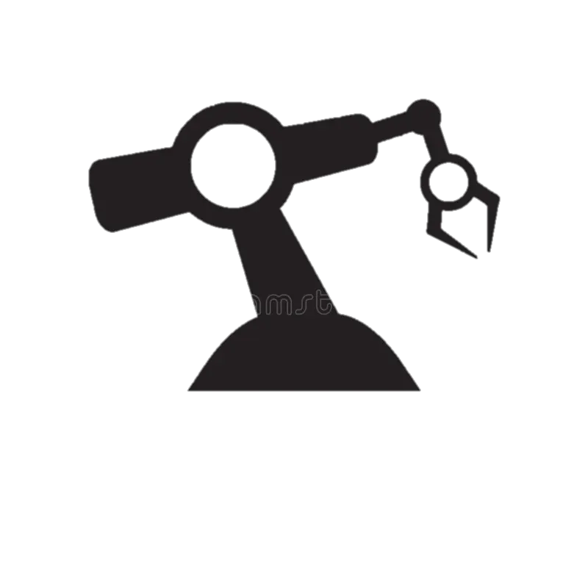




Advantages
Robot movement is automatic
It is used for long distance application
Fit and forget system
Used in home, industrial automation etc.

Slide 11



Use of Our Model
An overview of the potential applications and benefits of deploying the line following robot model in various real-world scenarios.
Industrial Automation
Automated material handling and assembly line processes.
Home Application
It helps to the Home cleaning and Floor Cleaner Automations
Guidance Systems
Monitoring applications in controlled environments.

Slide 12


