Slide 1


Stochastic grid variables generation
Reliability/risk assessment
Joint PDF approximation
MC sampling of grid variables
Joint PDF of load and wind power
Copula
Joint PDF approximation
SCUC solution
L₁
L₂
.
.
.
W₁
W₂
.
.
.
Reliability/risk assessment
Numerical SCUC solver
PDF
Marginal PDFs
PDF
PDF
Load
Load
Wind power
GNN prediction
Wind power
Reliability/risk assessment
GNN surrogates
PDF
Wind power
Wind speed
Wind speed

Slide 2




PG
model
$$\hat{PG}$$
Stochastic wind/load input
UC
model
$$\hat{UC}$$
$$\tilde{LF}$$
$$\hat{DL}$$
PG
model

Slide 3


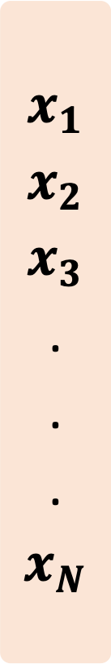


Input
Layer I
Layer II
Layer III
Output
$$x_{1}$$
$$x_{2}$$
$$x_{3}$$
.
.
.
$$x_{N}$$
$$\hat{UC}$$
$$\hat{PG}$$
$$\hat{DL}$$
UC model
PG model
DL model

Slide 4
ReLU
ReLU
……
……
……

Slide 5
(a)
(b)
(c)

Slide 6
(a)
ReLU
ReLU
ReLU
Input
Output
……
……
Encoder
Decoder
GNN layers
(b)
MILP solver
(reserve & non-reserve constraints)
Load shedding
(reserve + non-reserve related)
Stochastic
grid variables
Load shedding
(reserve related only)
UC
MILP solver
(non-reserve constraints only)
Load shedding
(non-reserve related only)

Slide 7
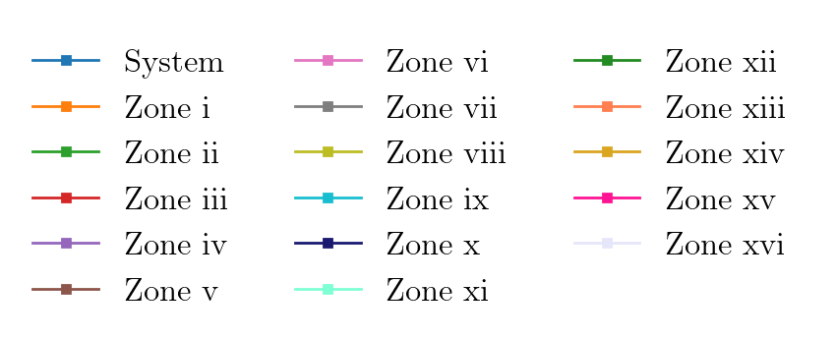
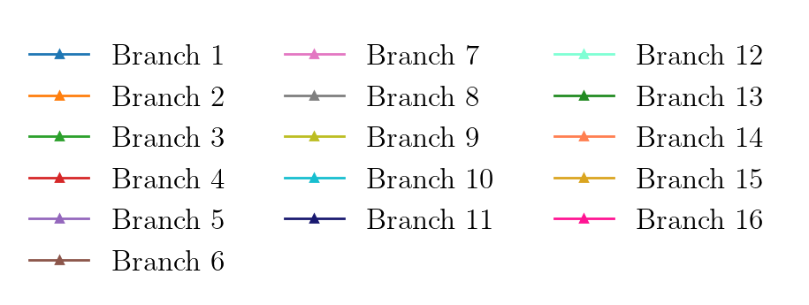

Slide 8
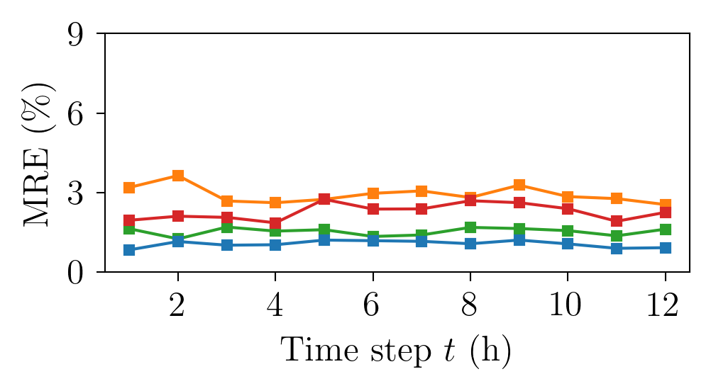
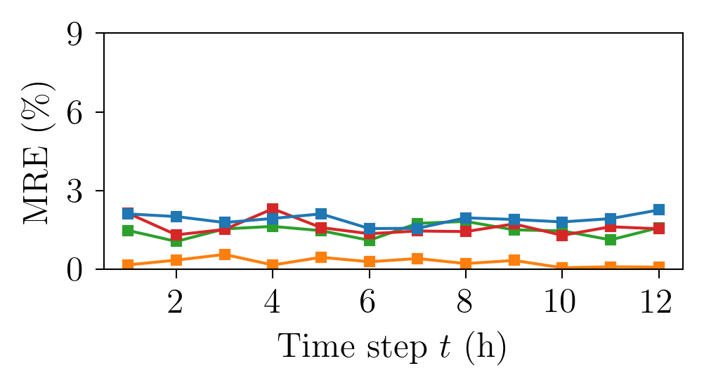
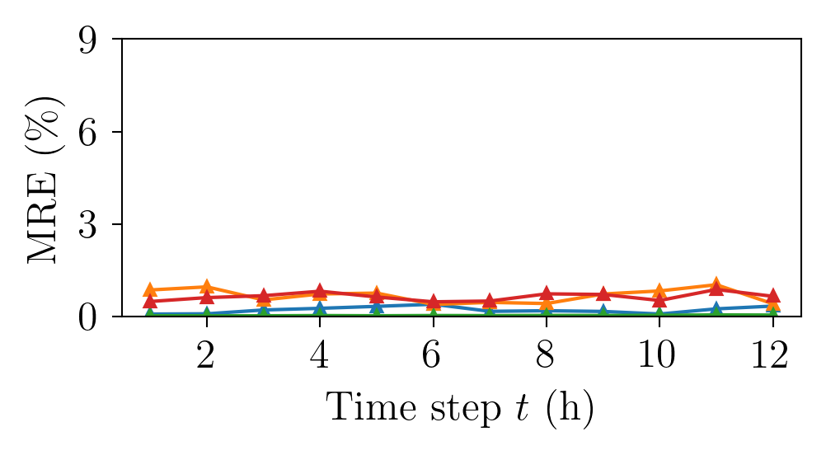
Thermal power generation
Load shedding
Power flow in significant branches

Slide 9

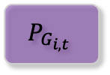
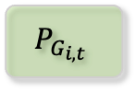
MILP solver
reserve &
non-reserve
constraints
Shedding
reserve &
non-reserve
related
$$P_{G_{i,t}}$$
$$UC$$
generation capacity
Shedding
reserve related
only
Grid
variable
samples
MILP solver
non-reserve
constraints only
Shedding
non-reserve
related only
$$P_{G_{i,t}}$$

Slide 10






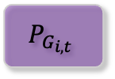
Grid variable
samples
MILP solver
all constraints
MILP solver
fixed UC
UC
(generation capacity)
$$P_{G_{i,t}}$$
$$P_{G_{i,t}}$$
Shedding
reserve &
non-reserve
related
Shedding
non-reserve
related only
Shedding
reserve related
only

Slide 11
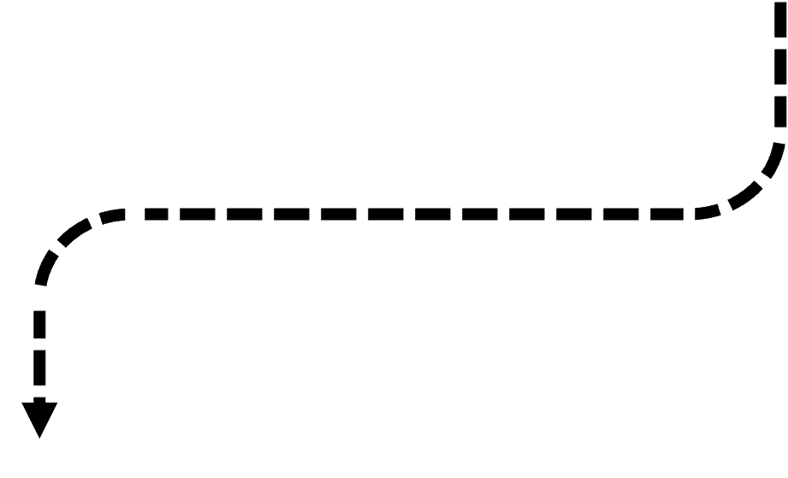


Security-constrained unit commitment
All constraints included
$$P_{G_{i,t}}$$
Shedding
Caused by all constraints
RES & Demand
One sample of grid variables
UC
(generator on/off)
SCUC
SCUC becomes (optimal) dispatch problem when UC is determined
Shedding
Non-reserve related
(Optimal) dispatch
Problem
UC is set, all other constraints included
Shedding
Reserve
related
$$P_{G_{i,t}}$$

Slide 12
Constraints
ReLU
ReLU
ReLU
Grid
variables
……
Grid topology

Slide 14
Encoder
GNN Layers
Decoder
ReLU
ReLU
ReLU
…
…

Slide 15
…
…

Slide 16
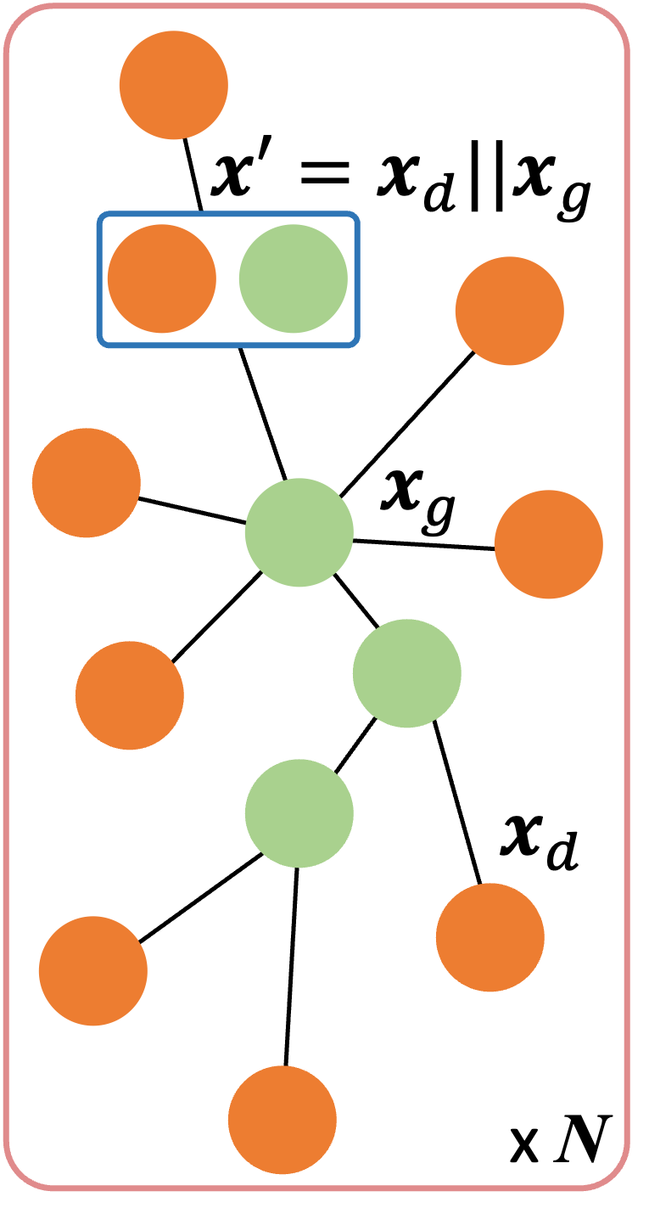
Input
Bus-level model
Output
GCN-I
(#, 120)
GCN-II
(120, 120)
GCN-III
(120, 1)
MLP
$$P^{L}$$
ReLU
ReLU
ReLU
Branch-level model
GCN-I
(#, 120)
GCN-II
(120, 120)
GCN-III
(120, 1)
MLP
$$l_{f}$$
ReLU
ReLU
ReLU
Zonal/system-level model
GCN-I
(#, 120)
GCN-II
(120, 120)
GCN-III
(120, 1)
MLP
$$Θ,Φ$$
ReLU
ReLU
ReLU

Slide 17













Graph-structured data of power grid
Adjacency matrix (topology)
x = u_{g}||v_{g}||u_{d}||v_{d}
x = u_{g}||v_{g}
... …
1
x = u_{d}||v_{d}
…
1
…
….
... …
1
$$x_{1}=[x_{1}^{1}, x_{1}^{2},…, x_{1}^{D_{I}}]$$
$$x_{2}=[x_{2}^{1}, x_{2}^{2},…, x_{2}^{D_{I}}]$$
…
…
$$x_{1}$$
$$x_{1}^{1}, x_{1}^{2},…, x_{1}^{D_{I}}$$
$$x_{N}=[x_{N}^{1}, x_{N}^{2},…, x_{N}^{D_{I}}]$$
$$x_{2}$$
$$x_{2}^{1}, x_{2}^{2},…, x_{2}^{D_{I}}$$
=
$$⋮$$
$$⋮$$
$$⋮$$
$$x_{N}$$
$$x_{N}^{1}, x_{N}^{2},…, x_{N}^{D_{I}}$$

Slide 18
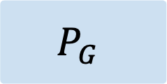


Encoder
GraphSAGE
Decoder
$$P_{G}$$
Encoder
GraphSAGE
Decoder
$$γ$$
Encoder
GraphSAGE
Decoder
$$ψ$$

Slide 19
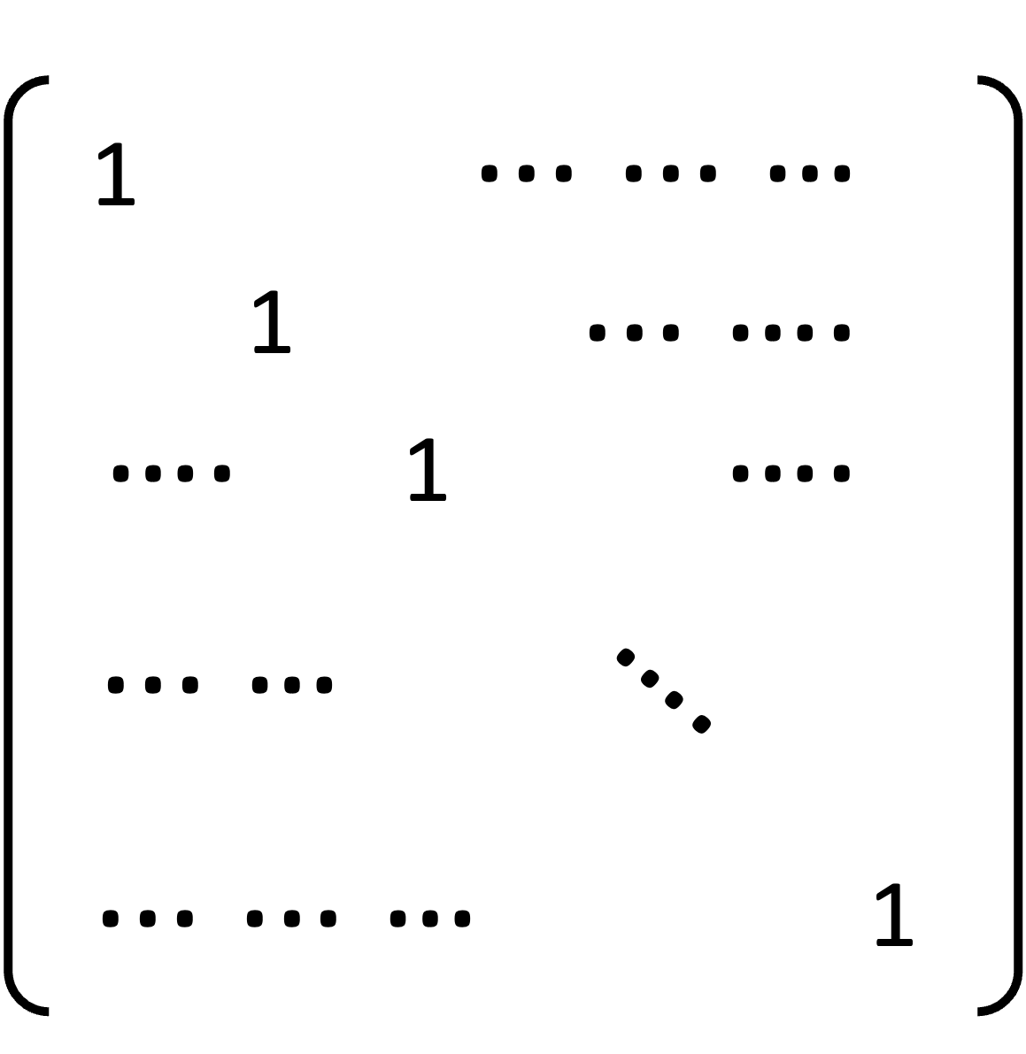
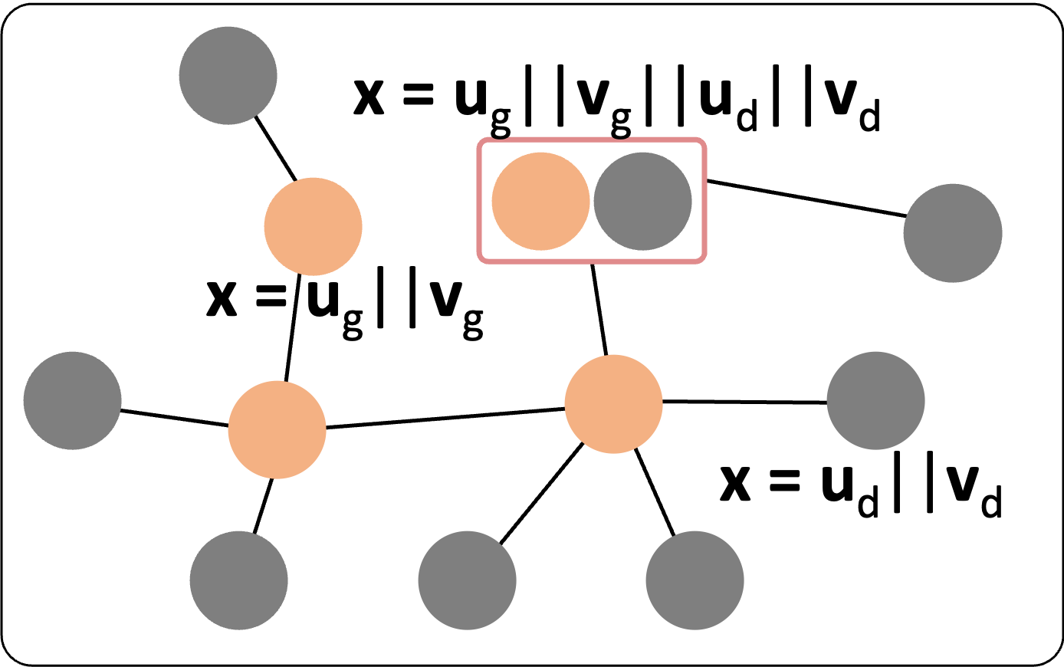
Input:
X = [x₁ x₂ x₃ … x_{N}]^{T}

Slide 20
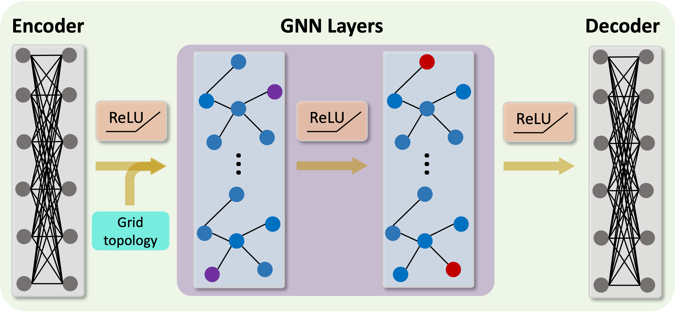
[x₁ x₂ x₃ … x_{N}]^{T}
[x₁ x₂ x₃ … x_{N}]^{T}

Slide 21
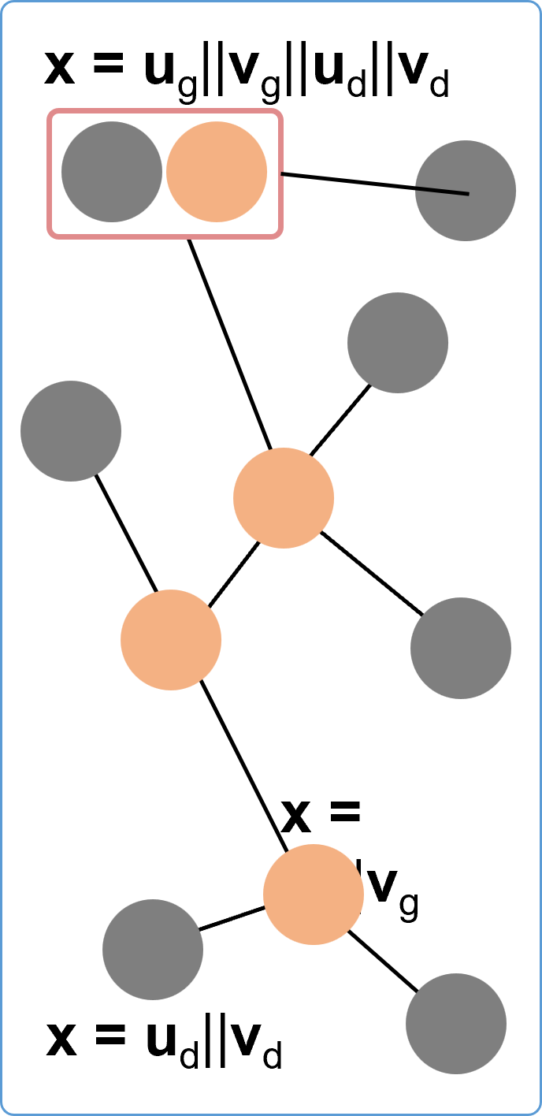
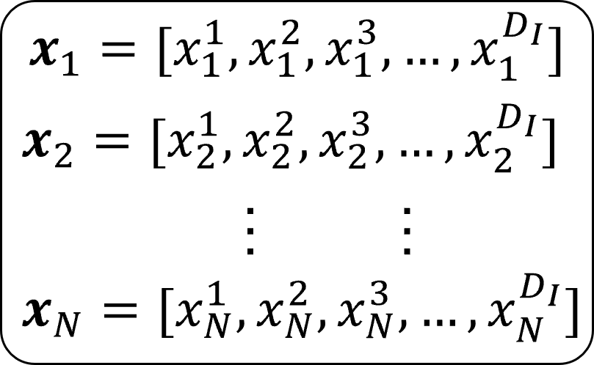
Inputs
Model architecture
Output
Power grid
Encoder
Model I
Zonal/system-level aggregated PG
Node vectors
MLP-1
MLP-2
GNN
Model I
Zonal/system-level aggregated PG
GraphSAGE-1
GraphSAGE-1
Adjacency matrix
(topology)
GNN
Model I
Zonal/system-level aggregated PG
GraphSAGE-1
GraphSAGE-1

Slide 22









Inputs
GNN architecture
Outputs
Power grid
Encoder
Node vectors
MLP-1
MLP-2
Model I
Zonal/system-level aggregated
thermal power generation
x = u_{g}||v_{g}||u_{d}||v_{d}
$$x_{1}$$
$$x_{1}^{1}, x_{1}^{2},…, x_{1}^{D_{I}}$$
$$x_{2}$$
$$x_{2}^{1}, x_{2}^{2},…, x_{2}^{D_{I}}$$
$$⋮$$
=
$$⋮$$
$$⋮$$
$$x_{N}$$
$$x_{N}^{1}, x_{N}^{2},…, x_{N}^{D_{I}}$$
GNN
Model II
Zonal/system-level aggregated
load shedding
x = u_{d}||v_{d}
GrapgSAGE-1
GrapgSAGE-2
Adjacency matrix
1
... …
1
…
Model III
Active power flow on critical branches
…
….
Decoder
x = u_{g}||v_{g}
... …
1
MLP-1
MLP-2

Slide 23
