Slide 1
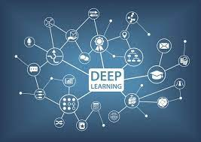
Duration: 100 min
Pretrained CNN
Lab 5
Dr. Harini S
Deep Learning : Principles and Practices

Slide 2
What is PyTorch?
PyTorch is a Python-based scientific computing package serving two broad purposes:
  A replacement for NumPy to use the power of GPUs and other accelerators.
  An automatic differentiation library that is useful to implement neural networks.

Slide 3
Basics of PyTorch
https://colab.research.google.com/drive/1cqaMNrVILqPtvkokwTyt-ZvHP0Er7LM2?usp=sharing

Slide 4
PyTorch and GPU
https://colab.research.google.com/drive/1WXVMGQ1N0k8SJlXw1tkYkKAsyjHOhGO_?usp=sharing

Slide 5
GoogLeNet
https://colab.research.google.com/drive/1jzBkbo_ds6iga3kKButMoh8bMwJ5CsGc?usp=sharing
(Vary the image and show the results)
Other Pre-Trained Models
  https://github.com/pytorch/vision/blob/main/torchvision/models/googlenet.py

Slide 6
Hot Questions
1. Implement VGG16 for image Recognition
2. Implement ResNet for image Recognition
3. Compare results of VGG16 and GoogLeNet

