Slide 1
CNN based Plastic Detection using Hyper-spectral Images by Spectral Band Reflectance Computation

Slide 2
Abstract
Hyper-spectral imaging has become increasingly popular for detecting plastic waste due to its ability to capture plastic reflectance using near-infrared sensors. This technology has shown promise in various fields, including cancer detection and agriculture, and could address environmental issues caused by plastic waste. Despite its potential, research into using hyper-spectral imaging (HSI) for plastic detection is still limited, and the technology is in its early stages. This proposal suggests a cutting-edge approach that combines HSI with deep learning for improved plastic detection and automated sorting, particularly for small and thin plastics.

Slide 3
Reference | Description
(Sivaram et.al) | When designing a CNN model for plastic type classification encompassing seven categories (HDPE, PET, LDPE, PVC, PP, PS, Other), the process involves collecting and renaming appropriate images, resizing them to balance computational load and identification accuracy (64x64 or 120x120 pixels), and determining the CNN layers. Various structures such as LeNet-5 and AlexNet are explored, leading to a simplified model. This model incorporates convolutional, max-pooling, activation, dropout, and SoftMax layers for feature extraction and classification. System analysis aims to comprehend the problem, identify key variables, and devise optimal solutions.
(Wen et al.) | The system utilizes an Intel RealSense D435 depth camera for information acquisition, coordinating with a robotic arm controlled by a computer for sorting actions. Equipped with an AUBO-i5 robotic arm and integrated vacuum sponge sucker, objects are picked up efficiently. Communication between modules occurs via USB and Ethernet. The conveyor module features a belt with an aluminum bracket for camera adjustment. For plastic classification, a dataset of 6247 images is collected, divided into categories such as wash supplies bottle, beverage bottle, Tetra Pak, express package, and tableware box. Object detection employs YOLOX, leveraging CSPDarknet as backbone and SimOTA for efficient assignment. YOLOX-m is chosen for its optimized speed and accuracy. Data augmentation techniques including mosaic and mixup strategies enhance training sample diversity, improving detection performance.
(Roslan et al.) | The paper employs the YOLOv5 model for real-time detection and recognition of plastic surface defects, utilizing its backbone, neck, and head components to optimize gradient flow and information hierarchy. Specifically, the CSP-Darknet backbone and PANet neck enhance feature extraction and information propagation, while the Yolo Layer outputs relevant vectors. YOLOv5s is chosen for its compatibility with time and hardware constraints. Performance evaluation involves precision, recall rate, and mean average precision (mAP) metrics, utilizing a custom dataset augmented for robustness. The YOLOv5 model is constructed using Python and PyTorch library, with subsequent evaluation based on precision, accuracy, Fmeasures, and recall post-training.

Slide 4
Reference | Description
(Bhanumathi et al.) | This paper explores the application of YOLOv4 and YOLOv5 algorithms for identifying ocean plastics in epipelagic layers. YOLO algorithms are prized for their speed, high accuracy, and learning capabilities. YOLOv4, an extension of YOLOv3, introduces significant enhancements, including BoF (bag of freebies) and BoS (bag of specials) techniques to boost accuracy without sacrificing inference time. Utilizing the CSPDarknet-53 backbone structure, YOLOv4 accommodates input images of any size and leverages GPU and CUDA library for enhanced computational power during training. YOLOv5, based on PyTorch, offers a smaller, faster, and lightweight alternative, although studies indicate trade-offs between accuracy and speed compared to YOLOv4 and YOLOv3. While YOLOv5 excels in real-time object detection, YOLOv4 may be preferable for custom configurations.
(Salim et al.) | The system comprises a Logitech C615 webcam and a 22-inch display monitor connected to a Jetson Nano Development Kit. The choice of Jetson Nano is due to its comprehensive features and affordability, making it suitable for deploying deep learning models widely. Mounted on an aluminum profile behind a trash can, the system detects individuals approaching with reusable bottles, displaying a bounding box around the bottle on the monitor along with persuasive text tailored to the context. The setup encourages plastic reuse and can display information in multiple languages.

Slide 5
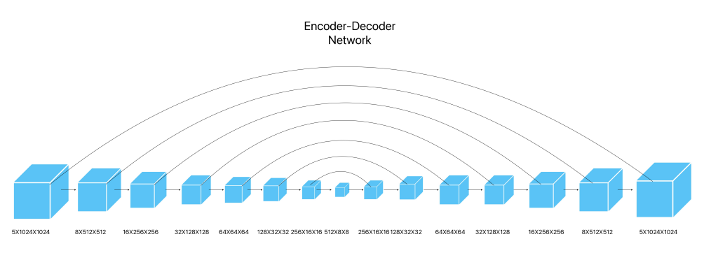
Convolutional Neural Network Model

Slide 6
THANK YOU
Yadukrishnan
21BAI1210
yadukrishnan.2021@vitstudent.ac.in

