Slide 1


ADVANCED RAILWAY
RESERVATION SYSTEM
PRITIKA KANNAPIRAN, 21BAI1172
YADU KRISHNAN, 21BAI1210
GAVRISH B, 21BAI1327

Slide 2



CONTENTs
1
2
3
4
INTRODUCTION
LITERATURE REVIEW
PROBLEM STATEMENT
PROPOSED SYSTEM
5
6
7
ARCHITECTURE
LIST OF MODULES
REFERENCES

Slide 3
INTRODUCTION
The purpose of a Railway Reservation System is to facilitate the efficient and organized booking of train tickets for passengers. The system aims to streamline the process of reserving seats or berths on trains, making it more convenient for travelers and improving overall railway management.

Slide 4
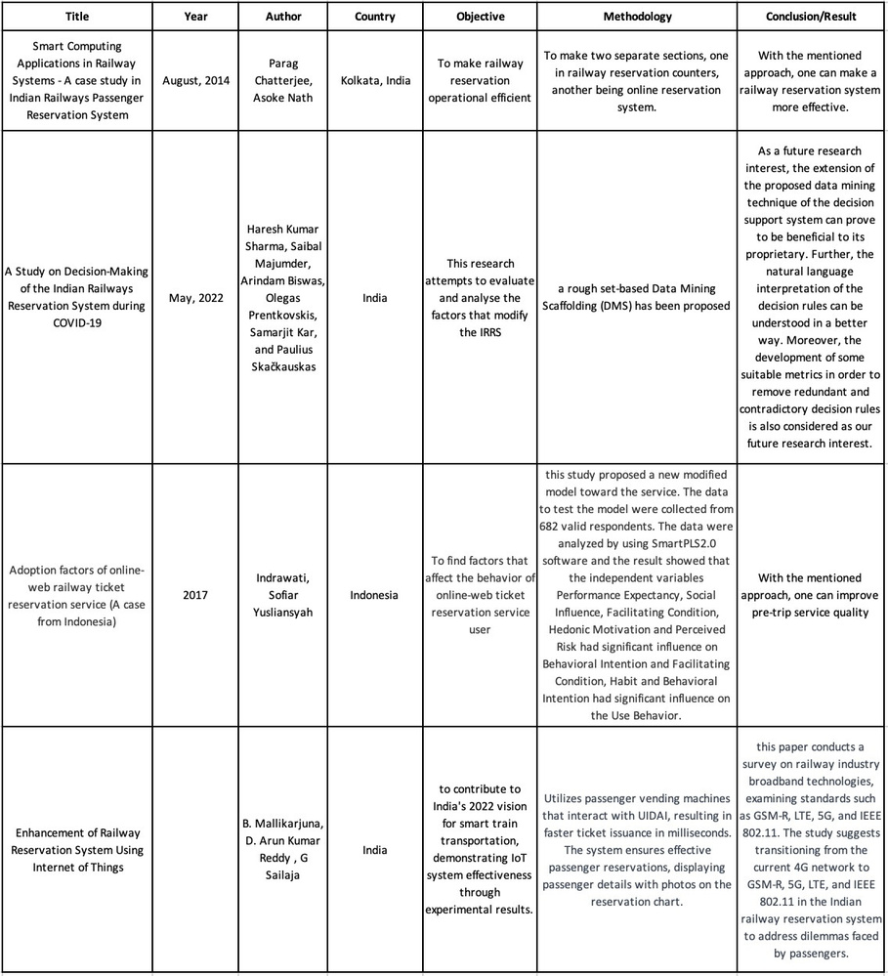
LITERATURE REVIEW

Slide 5
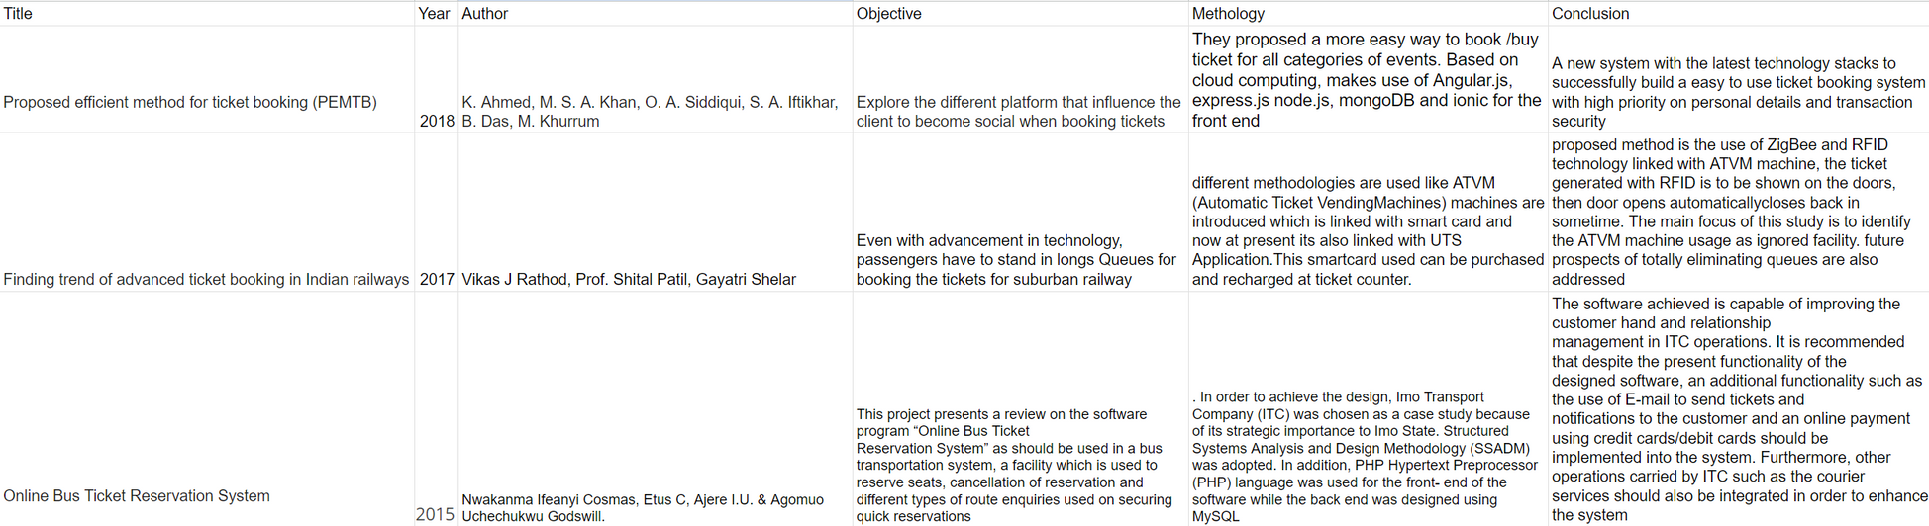
LITERATURE REVIEW

Slide 6
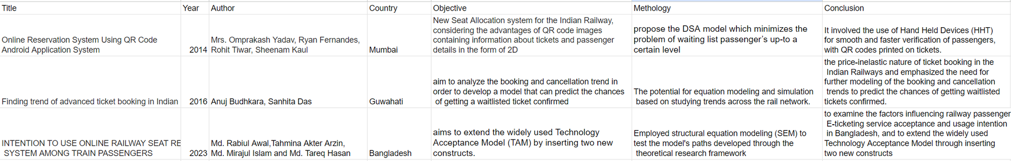
LITERATURE REVIEW

Slide 7
problem statement
The Railway Reservation System is a crucial component in managing railway services, offering a user-friendly interface for online booking and real-time seat availability information. Good User Interface also plays a crucial role in booking these tickets. However, technical issues may arise, causing difficulties in canceling or refunding train tickets, leading to dissatisfaction among passengers.

Slide 8
PROPOSED SOLUTION
The Railway Reservation System stands as a fundamental pillar in the contemporary management of railway services, revolutionizing the process of booking and reserving train tickets for passengers. With a user-friendly interface, it facilitates convenient online booking, providing real-time information on seat availability. Ensuring security through a robust payment gateway, the system seamlessly integrates with other railway management components, such as scheduling and inventory. Offering flexibility, it allows for cancellations and refunds while catering to users with varying technological proficiency.

Slide 9
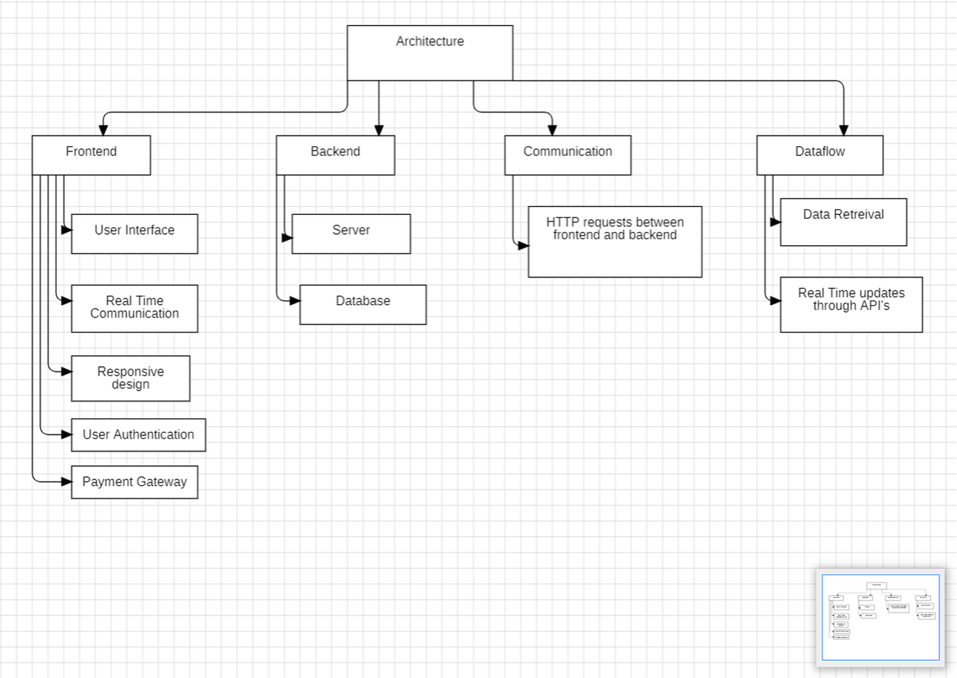
ARCHITECTURE

Slide 10
TECH STACK
REQUIREMENTS
Front-end: ReactJS, SCSS, Tailwind/AntD
Back-end: NodeJS, MongoDB
User authentication: JSON Web Tokens
Payment system: Stripe payment API for payments
Version control: Git, Github/Bitbucket

Slide 11
LIST OF MODULES
User login /sign up page
User profile
Ticket booking
Managing Tickets
Cancelling tickets
Reviewing schedule

Slide 12
REFERENCES
[1] Paul fraga- Lamas, Tiago etc. "Towards Internet of Smart Trains: A Review on Industrial IOT-connected Tailways", Sensors, mdpi Journal, DOI:10.3390/s 17061457, published 21 June 2017.
[2] Ohyun Jo etc. "IoT for Smart Railways feasibility and Applications", IEEE Internet of Things Journal, ISSN:2237-4662, DOI: 10.1109/JIOT.2017.2749401 ISSN:2237-4662,
[3] Daniel T Fokum and Victor S Frost. A survey on methods for broadband internet access on trains. Communications Surveys & Tutorials, IEEE, 12(2):171–185, 2010. Books & Book Ch [4] E Masson and M. Berbineau, " Chapter 2: Railway Applications required Broadband Wireless Applications" Studies in Systems, Decision and Control 82, DOI: 10.1007/978-3-319-47202-7-2. [
5] William Stallings, Chapter 17, "Data and Computer Communications", Eighth edition, Pearson Prentice Hall @2007, ISBN 0-13-24310-9. Technical Reports
[6] Rajnish Kumar, "IOT and Indian Railways" National Academy of Indian Railways, Vadodara, India.
[7] Sandeep Patalay "Railway Signaling Using Wireless Sensor Networks" from the desk of Sandeep Patlay CMC Systems Ltd., P.No 1-25. Online Sources

Slide 13
REFERENCES
[8] Ian Poole etc. Adrio Communication Ltd.,"Resources and Analysis of Electronics Engineers", c/o 1 paper mewsdorking surry, UK, ww.radio-electronics.com.
[9] Railway Telecommunications (RT); ER GSM Frequencies European Telecommunication standard Institute, 2011,www.etst.org, IPR@ copyrights reserved 2018
[10]Ahmed, K.A.A. & Kranthi, A.K. (2019). Determinants of m-ticketing adoption using smartphone app among ITemployees of Bengaluru city – an extended UTAUT2 approach. International Journal of Business Innovation adResearch, 19(1), 57-79.
[11]Alalwan, N.P., Kizgin(2017). Factors influencing adoption of mobile banking by Jordanian bank customers:
Extending UTAUT2 with trust. International Journal of Information Management, 37(3), 99-110.
[12] Baabdullah, A.M. (2018). Consumer adoption of Mobile Social Network Games (M-SNGs) in Saudi Arabia: The
role of social influence, hedonic motivation and Trust. Technology in Society, 53, 91-102.
[13]A.A., Rana, H. & Patil, P. (2019).Consumer use of mobile banking (M-Banking) in Saudi Arabia: Towards an
integrated model. International journal of information management, 44, 38-52.
[14]Business Line (2016). IRCTC hacking: Railways claims no leakage of ‘sensitive’ data. Access on 28 June 2020.
Retrieved from https://www.thehindubusinessline.com/economy/irctc-hacking-railways-claims-no-leakage-
ofsensitive-data/article8561744.ece

Slide 14

THANK YOU

