Slide 1
Perceptron
Neural Network from Scratch
By Yadav Dhakal

Slide 2
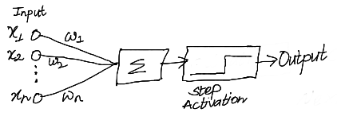
Mathematics
1. Notations
  x→ Input to the perceptron
  y →True label for the class (0 or 1), 0 represents a class and 1 represents another class
  prediction → The output of the perceptron network
  w → Weights of the perceptron
  n → Size of input including bias
2. Forward Step or Prediction
prediction = step(w1x1 + w2x2 + … + wnxn)
3. Backward Step or Learning
wi = wi + learning_rate * (y-prediction) * xi
Where,
  learning_rate is a constant factor usually less than 1.
  x1 = 1 for all the data, so that w1x1 acts as a bias term.
  step(k) = 0 if k <= 0 else 1
  i = 1 ... n
  There will be a bunch of inputs and for each of them x1, …, xn will be different.

Slide 3
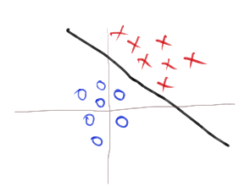
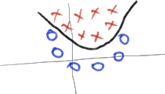
Working intuition
Line divides a plane into two parts
Plane divides a volume into two parts
A hyper plane divides a hyper volume into two parts
A perceptron represents a hyper plane in dimension equal to n
Perceptron only works for a linear boundary
Linear boundary
Non Linear boundary

