Slide 1
INTRODUCTION
Neural Network from Scratch
By Yadav Dhakal

Slide 2
Prerequisite
Working knowledge of python programming language
Mathematics:
  Linear Algebra: Matrix arithmetic, algebraic, trigonometric and exponential functions
  Basics of calculus: Derivatives of basic functions

Slide 3
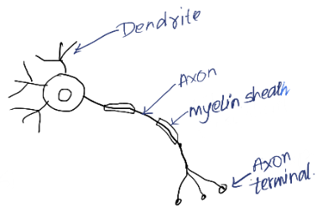
Biological neuron
Each neuron is a living cell with dendrites and single axon.
Communication is done via electrical signals.
Dendrites act as input while axon terminals act as output.
Myelin sheath acts as insulator to prevent leakage of signals.
Neuron becomes active according to the inputs received via dendrites and then passes signal via axon to dendrites of other neurons. The axon acts as activation function and becomes active only after a threshold is reached.
Learning process involves change in the chemical structure or creation of new dendrite links between neurons.

Slide 4
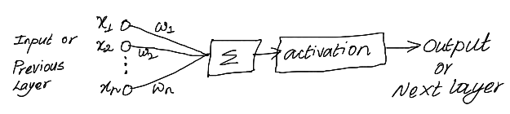
Artificial Neural Network(ANN)
Inspired from biological neurons and their grouping
Mostly mathematical models in software. While some are implemented in hardware
Approximates the behavior of real neurons
Learning occurs via weight adjustments which is mostly done via back propagation.
The end goal is to get accurate output for a given input

Slide 5
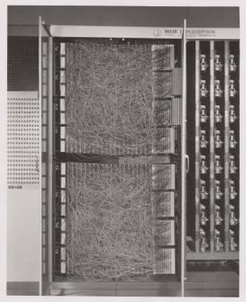
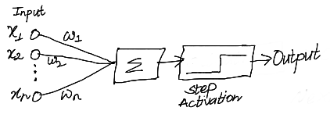
Perceptron
First network structure. Simplest to implement and train.
Theorized in 1943 and implemented as hardware in 1958.
Training occurs via perceptron algorithm.
Mathematics
f(x) = Step(w1x1 + w2x2 + … + wnxn)
= Step(w.x)
where, x = (x1,x2,...,xn) and w = (w1,w2,…,wn)
  Linear function followed by Step
  Step function acts as activation function, it squeezes output to be between 0 and 1
  Fix x1 = 1, so that it acts as bias
More on next chapter!

Slide 6
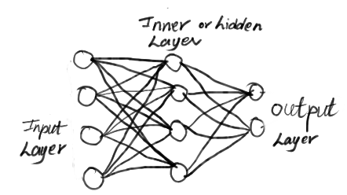
Feed forward networks
Layered structure.
All the neurons of a layer are connected to all other neurons of next layer.
Also called dense network due to large number of connections.
Used as last layer in ANN architectures.
Multi input-Multi output structure
At least two layers are required i.e.
input and output layers. Any number of
inner layers may be added.
Various activation functions can be used.
Training is done via back propagation.

Slide 7
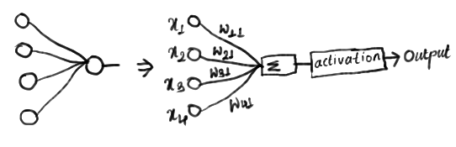
Feed forward networks vs Perceptron
A perceptron can be thought of as a special case of feed forward network.
Two layer feed forward network with single output resembles a perceptron.
Despite the resemblance in the structure, the training algorithm is different, back propagation for feed forward networks and perceptron algorithm for perceptron.

Slide 8
What will we be implementing?
Perceptron: We will implement classification of 20x20 image into male or female. Dataset is from kaggle: https://www.kaggle.com/datasets/cashutosh/gender-classification-dataset
Feed forward: Handwritten digit classification. MNIST dataset: https://www.kaggle.com/datasets/hojjatk/mnist-dataset
We will be using python for the implementation

Slide 9
Thank You

