Slide 1
Applied Data Science
Building a predictive model for New York City Taxi
drivers to maximise their revenue
Group 7
Xuanken Tay
Geng Yuxiang
Li Shangqian
Yin Zhou Zheng
Progress Report
Notes:
We are group 7, we are here to give a short presentation on building a predictive model for NY taxi drivers to maximise their earnings. I am….. and we will be taking turns to present to you in the next 10 minutes

Slide 2
Presentation Outline
Problem description
Workflow
Feature Engineering
Classification Model
Decision Making
Evaluation of models
Allocation of tasks
Notes:
Just a brief outline of the presentation itself,
I will first give an introductory problem description, along with the general workflow we will adopt in the next few weeks
Yuxiang will then talk about feature engineering focusing on what are some of the heuristics we can focus on maximising
Following up on that, we will have Shangqian to talk through the classification model, which is involved in the outputting the next best decision for taxi driver
Last but not least, Yin Zhou will talk briefly about evaluating all the models and the job allocation among the group members.
With that,

Slide 3

Problem Formulation
7am 8am 9am 10am
Bronx
Decision set 1
Decision set 2
Decision set 3
$13
For Hire
$25
Manhattan
$4
$17
$3
$35
$15
JFK Airport
Problem: What are the decisions that result in maximum revenue?
Aim: Given the current time and location of taxi driver, find the next best decision to maximise revenue
Notes:
If we are NY taxi drivers driving around the NYC and want to maximise our revenue, we can do so in several different ways.
We can choose to start our day looking for passenger in Bronx, Manhattan, airport or obviously other regions. We also have the freedom to set the status to for hire freely as we wish.
Now, the change in status from unavailable to for hire and the location to look for passengers form exactly the basis of the decision which will have a direct impact on the taxi revenue.
And our aim in this project is build and come up with a predictive model, such that, given the current time and location of taxi driver, inform him/her with the next best decision in order for him/her to maximise the revenue.

Slide 7
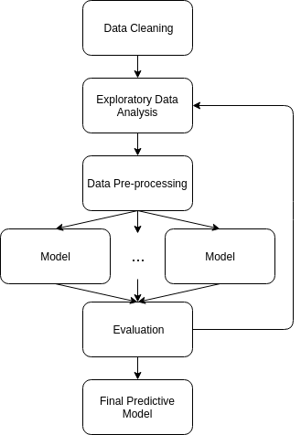
Workflow
Feedback
Notes:
Moving on, this is a flowchart showing the high-level workflow to address the problem.
Briefly, we will use the data provided to us and perform cleaning on it to remove bad observations.
Then, we will perform data analysis in order to extract useful insights before throwing everything into machine learning models.
We will of course pre-process the data accordingly as a step to prepare dataset for training our models.
Train different models from different ideas and put them into evaluation using the local game platform.
Iterate through this process, continue to improve on it and finally choosing the best model as our final decision predictive model for the NY taxi drivers

Slide 8
FEATURES
Profitability = ...
Notes:
Thank you xuanken.
So as taxi driver, we want to know when we arrive at that cell at a particular time, what is the profitability.

Slide 9

Average Total Earnings Rate [AVG(TER)]
Calculated as
Grouping Factors (Predictors)
Cell Id (e.g. “23:60”)
Day of the Week (e.g. Saturday)
Time of the day (e.g. 21:52:00)
Notes:
So firstly, we will compute a feature called as average total earnings rate.
This feature is calculated by dividing average total earnings by average trip duration.
This feature is calculated for all possible combination of particular cell, different days of week and different time.

Slide 10
Complementary Features (Penalized)
Driving Duration [DD]
Time taken for driving from origin cell to destination cell.
Determine Shortest Cell Path between current cell and destination cell using Breadth First Search
Average Waiting Time [AWT]
Average waiting time before next trip
Notes:
However, the average total earning rate itself is not sufficient to make the optimal decision. These features are not directly related to average total earning rate and may affect the profitability in different we, depending on how we penalize them.
The first feature is driving duration, which is basically the time it takes to drive from the current cell to any destination cell. The driving duration can be thought of as the opportunity cost for total earning rate.
To compute driving duration, we need the shortest path between current cell and destination cell. This can be done by any shortest path algorithm. Then we simply multiply the shortest path by game clock time which is 1 min/cell, which is equavelant to driving speed.
Another penalized feature is the average waiting time
Basically, if, for some reason, we are not awarded with a trip as expected, we want to know how much longer we have to wait for the next trip.
So these two features have to be taken into account.
The question is how much to penalize them.
Well, we can run some experiments with different penalizing terms and determine the combinations that maximize profitability.

Slide 11
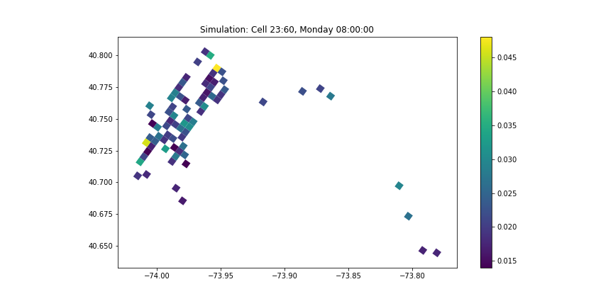
From 23:60
To 26:57
Notes:
This is visually how our model might work. We ran a small simulation. This simulation takes place on a Monday 8am and our taxi is at that moment cell 23:60, which is shown the red arrow. Our model predicted that the profitability is the highest for cell 26:57, which is shown by the blue arrow. And this cell will marked as our destination.
Next, shangqian will go into details into how machine learning models make predictions.

Slide 12
Method Implementation
Different models to predict features:
Linear Modelling:
Predicting Average Total Earnings
Generalised Linear Model (Poisson, Gamma, Negative-binomial)
Waiting Time (Trip Frequency)
Clustering Method
Average Trip Duration
Notes:
>Implementations regard the predicting method that Ricky has explained
>For continous values like total earning, we may adopt regression method such as regression tree and linear regression
>For the uncertainty factor trip frequency. We believe that glm with poisson or gamma link might be the best choice for estimating count data.
> In terms of the waiting time and trip duration, we suggest that clustering method like k_means is a good options to explore that similarities and dissimilarities between cells. For instance, ….

Slide 13
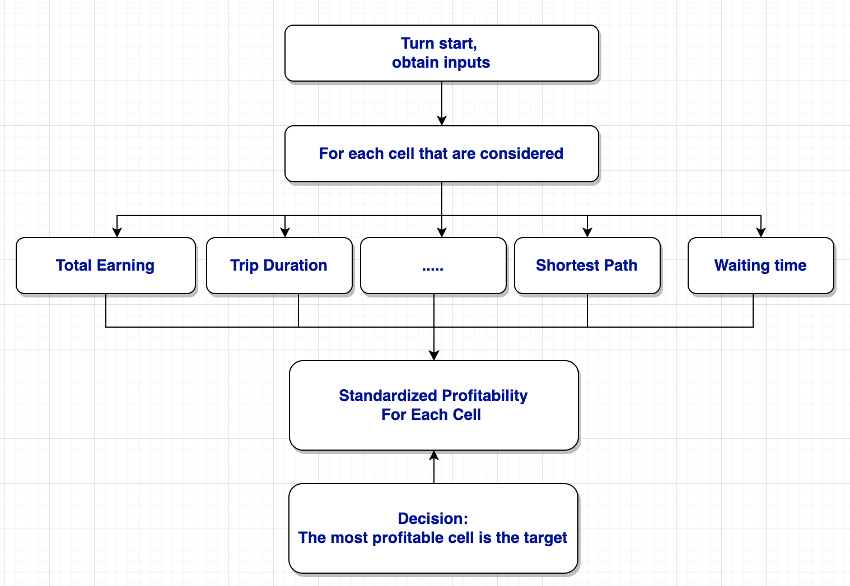
Classification
Process
Combine the predictions from the small models.
Calculate standardised profitability of each cell.
Choose cell with maximum as next cell.
Goal-driven algorithm to prevent deadlock.
Notes:
>Why need classification?
>We need combibne ```` to make decisions
>Introduce the graph.
>In terms of reaching the target zone, we set the goal area once for each trip. That is, our algorithm is goal-driven but not greedy. The purpose is to prevent deadlock, keep switchihng areas without setting avaliable and getting a trip.

Slide 14
Evaluation
Model Implementations:
Different combinations to produce players.
Running on local game platform.
Observe total earnings over simulated week.
Compute statistics.
Choose “best” player.
Review logs to address uncertainty.
Notes:
> Our model consists of smaller models with different functions. These models can be implemented in different ways. We take a combination of these model implementations to form a complete model which can be run on the local game platform.
> We run each model combination several times to generate statistics. A key statistic will be the total earnings over the simulated week. From multiple runs, we can obtain a mean and variance.
> We then choose the “best” combination of model implementations to be our final model. The “best” performing model should maximise the total earnings, but also do so consistently. There will be a tradeoff between the rank in terms of total earnings and consistency (measured by variance).
> For unexpected behaviour, for instance: performing worse than a random walker player, we can review the logs, possibly producing a visualisation to help identify the problem.

Slide 15
Job Allocation
Partition:
Avoid overlapping.
Covering all avenues.
Initial Ideas:
Models trained by different members.
Report sections split among members.
Tools:
Meeting Minutes.
GitLab issue assignments.
Notes:
> We haven’t gone into detail about how we wish to split up the work; but ideally, we want to form some kind of partition. No overlapping work, but also covering everything we initially intended to cover.
> Some initial ideas for job allocations include: model implementations trained by different members. And live editing for report writing; using software such as Google Docs.
> Tools for job allocation. Using meetings to discuss tasks between meetings. Recording tasks in the Meeting Minutes, and assigning the tasks as issues on GitLab.

Slide 16
Thank you for your time.
Questions.

