Slide 1

Detecting Fraud in BTC Blockchain
Yael Brown

Slide 2
Overview
- Identify wallets and transactions to or from those wallets that were used in fraudulent transactions
- Fraudulent transactions are classified as transactions from victims in ransomware attacks, black marketplace payments for illegal goods.
- Having a model trained and actively reviewing transactions on the blockchain, this could aid law enforcement and tip them off to possible fraudulent transactions.
- This would beneficial especially if the blockchain scales or technology evolves to handle more transactions.

Slide 3
Bitcoin Overview
1 BTC = 1,000,000 Satoshi’s. (Satoshi’s are the smallest unit of Bitcoin)
“Bc1qzyda53xqwkqruex3mzwvpja04x23r572mygpgfc90qckdw2cwwaqr2h70u” is an example wallet address. 62 letters and numbers.
Bitcoin is purchased on exchanges and can traded with exchanges and wallets.
All the transactions are transparent on the blockchain

Slide 4
Overview
- Collect transaction data, known fraudulent transaction data, and daily price (close) data.
- Combined to one data set.
- Train a Logistic Regression model on the data.
- Test it with possible transactions

Slide 5
Estimate of Impact of Solution
- To assist law enforcement in detecting fraudulent transactions
- Help trace bad actors to exchanges to help identify them when they try to cash out the fraudulent funds.
- Solution that is able to scale with the blockchain.

Slide 6
Intro to dataset
- Using transaction data, known fraud data, and coin price
- Combine the datasets and drop unnecessary columns from them.
- Normalize the date format. (a column for month, day, year)
- Transaction dataset is a lot (39 GB)
- Only 93k rows for fraud dataset

Slide 7
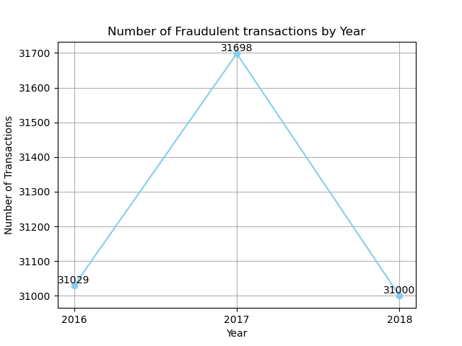
Number of Fraudulent Tx. in Dataset

Slide 8
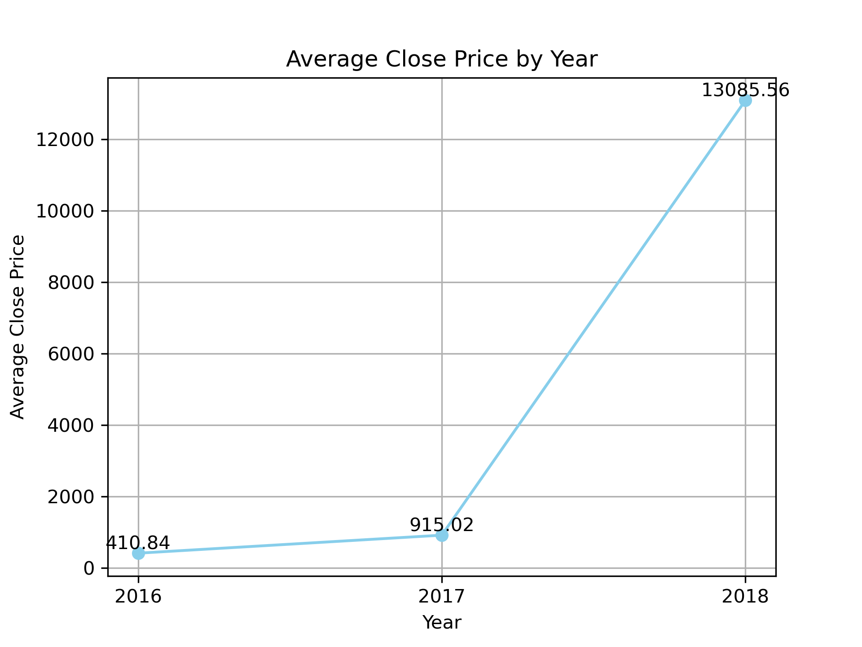
Average Closing Price by Year

Slide 9
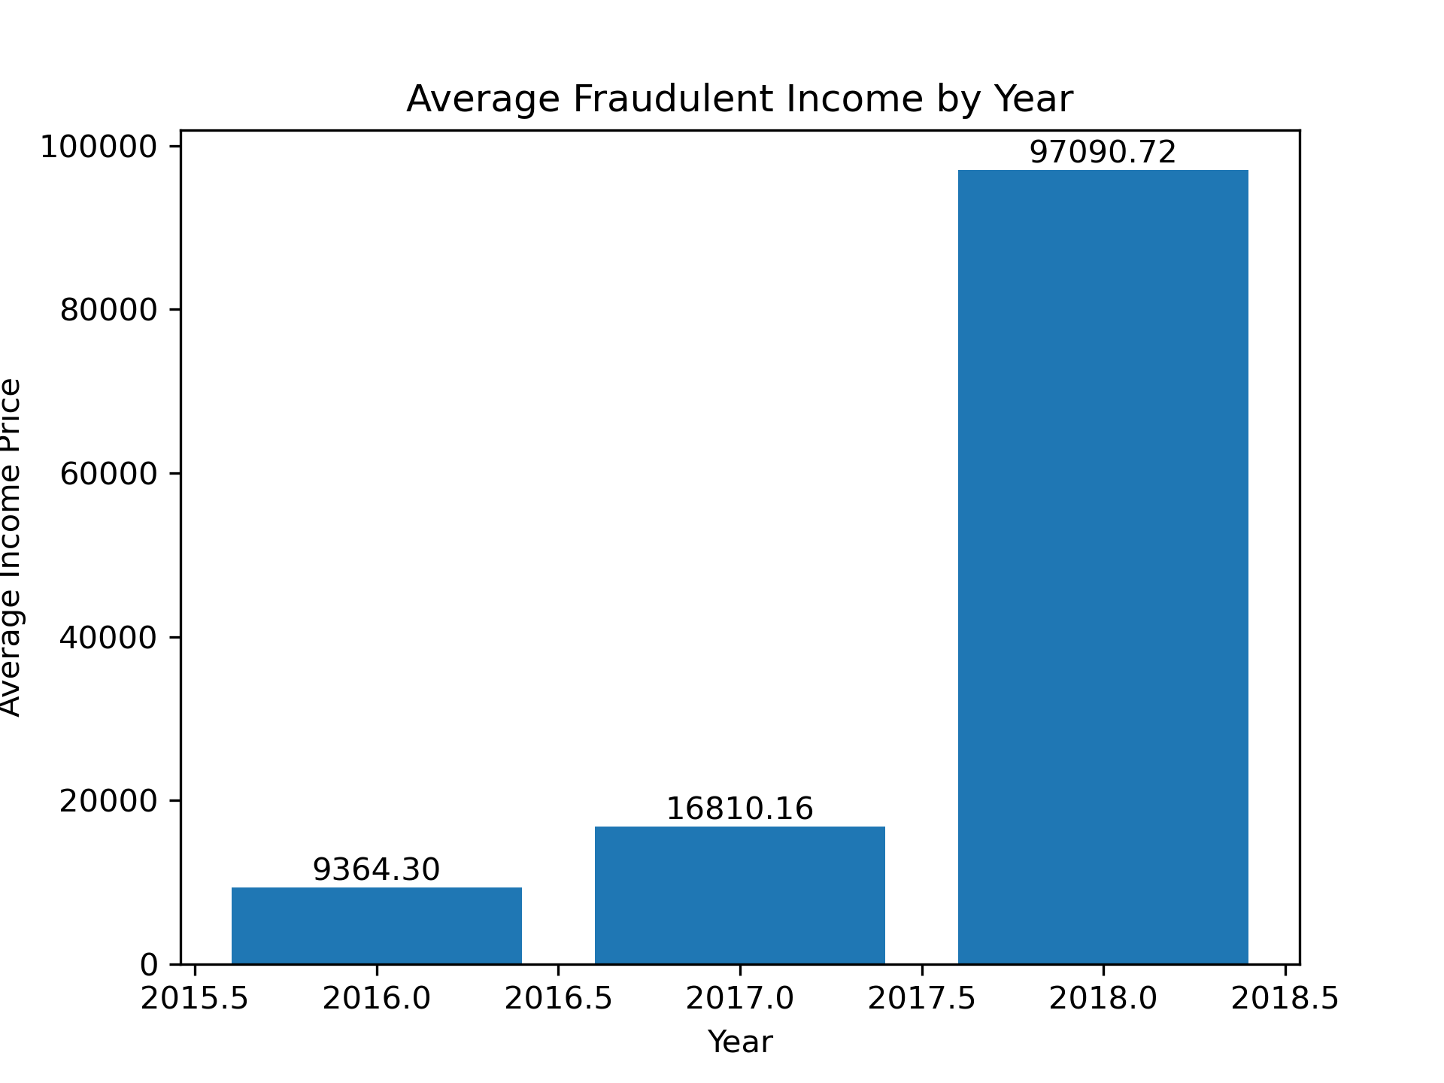
Average Fraudulent Income by Year

Slide 10
Next steps
Finish downloading datasets
Finish doing EDA and look for features
Begin modeling phase

Slide 11
End

