Slide 1
LIFE Matrix Project
Yafan Wang
Repo Linked here

Slide 2
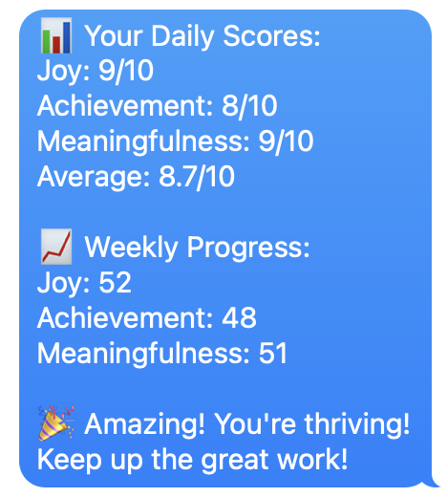
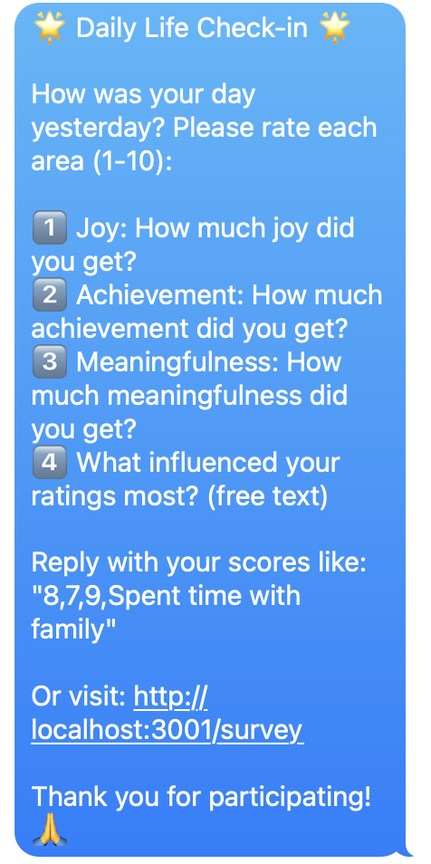
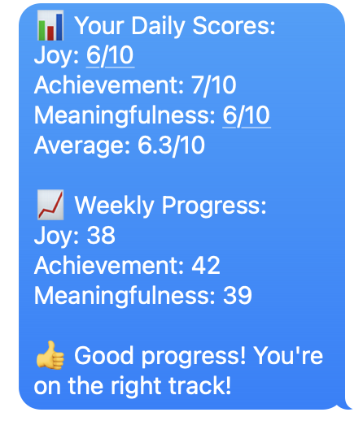
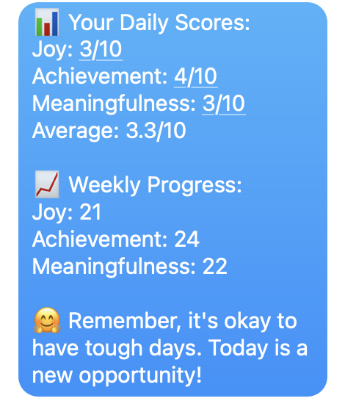
Daily SMS Daily at 7 a.m.
Daily SMS scheduled via Twilio
Two response channels implemented:
Text it back
Via a link
Three tiers of feedback given
Amazing
Good progress
It’s okay to have a rough day
Weekly progress stored and tracked for each user
Note: test the message, run node test-sms-messages.js. It is not sent deployed yet since Twilio free account has length limit.

Slide 3
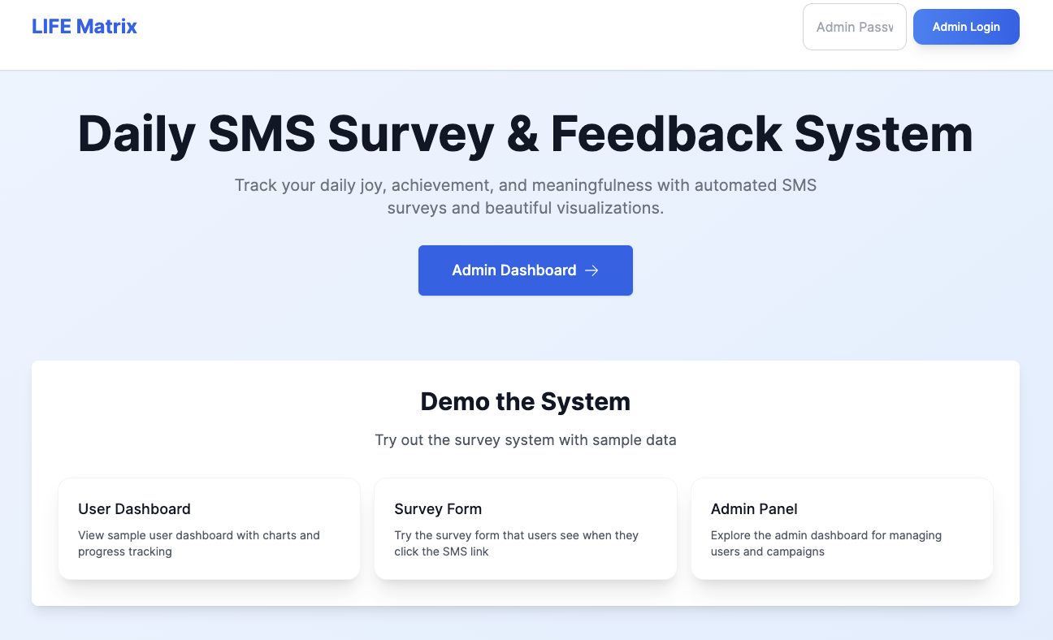
Dashboard Landing Page

Slide 4
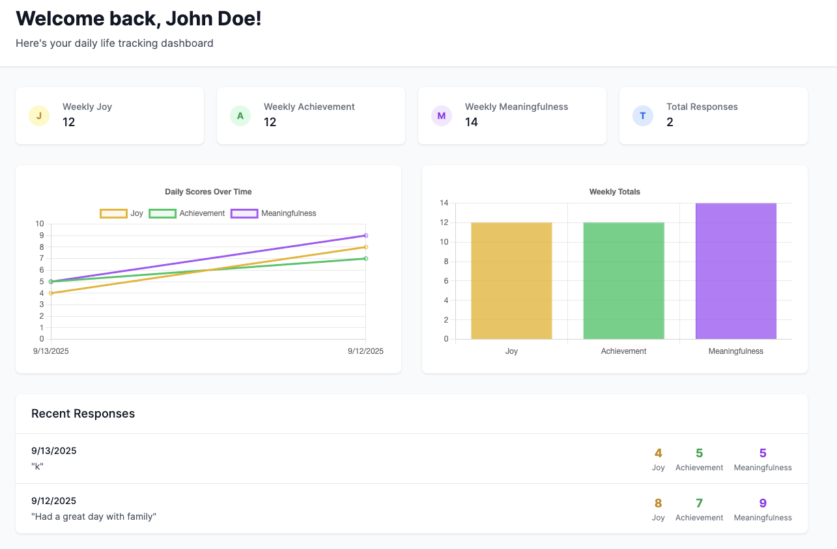
User Dashboard

Slide 5
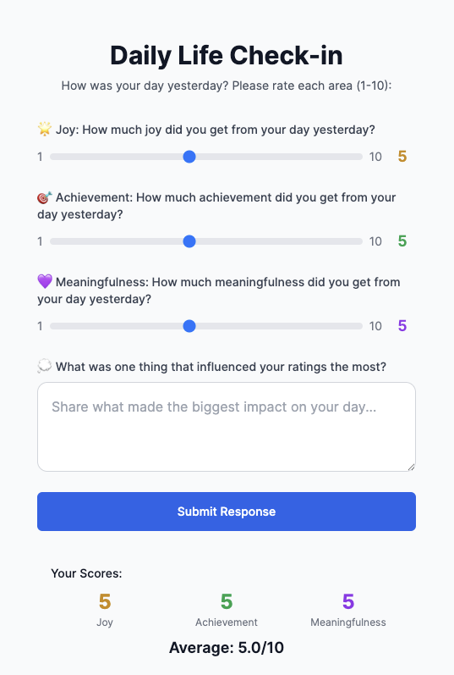
Survey Form

Slide 6
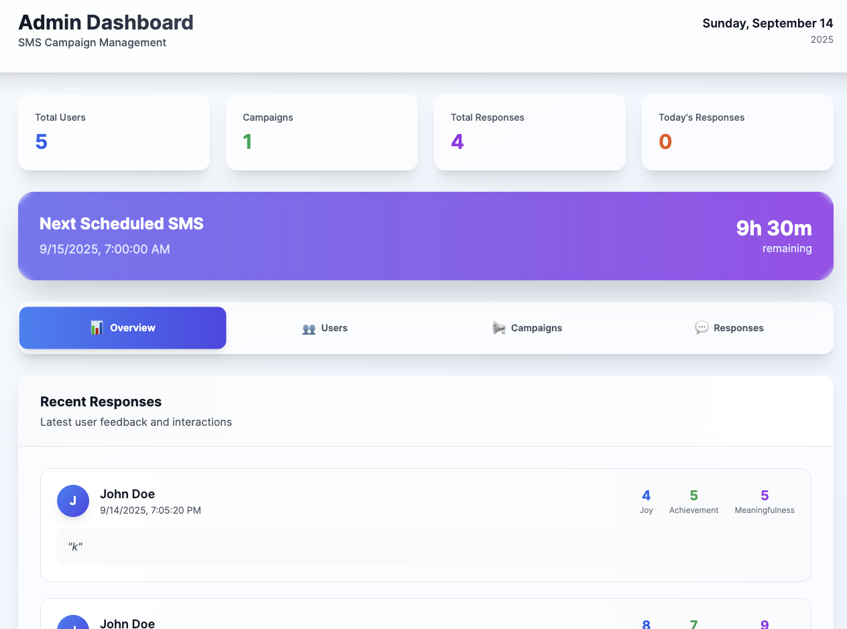
Admin Dashboard - Overview

Slide 7
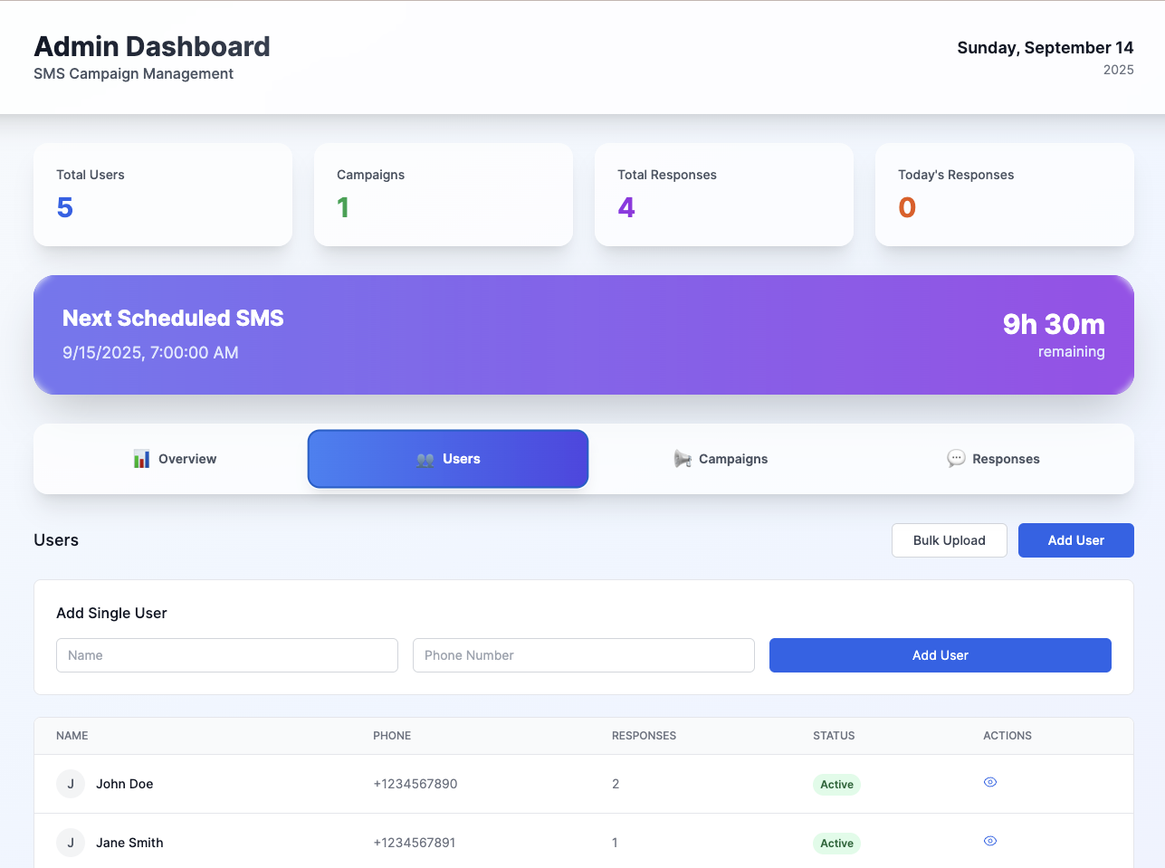
Admin Dashboard – User Management

Slide 8
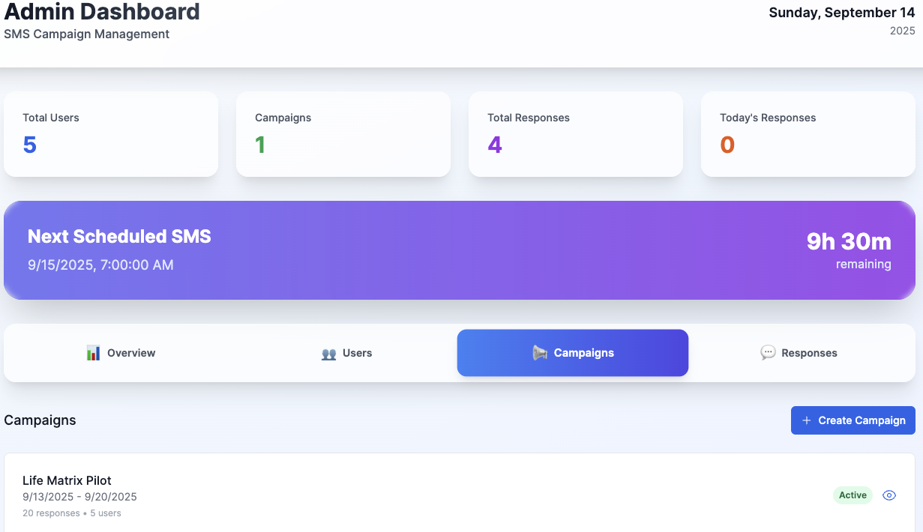
Admin Dashboard – Campaign Management

Slide 9
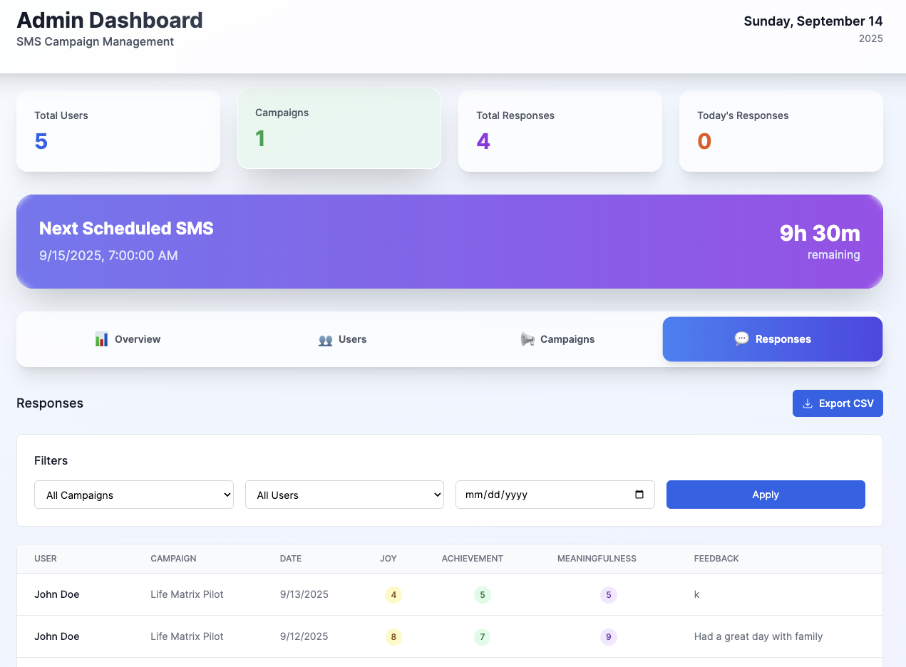
Admin Dashboard – Response Analytics

