Slide 1

AUTOMATIC RADIOGRAPHIC QUANTIFICATION OF JOINT SPACE NARROWING PROGRESSION IN RHEUMATOID ARTHRITIS USING POC
HOKKAIDO UNIVERSITY
Graduate School of Information Science and Technology
Division of Electronics for Informatics
Research Center for Integrates Quantum Electronics
Quantum Multimedia System Laboratory
Yafei Ou
Notes:
This work is about medical image processing, used to calculate the joint space narrowing in Rheumatoid Arthritis patient.

Slide 2
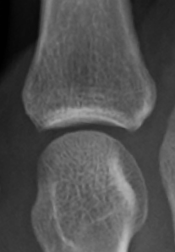
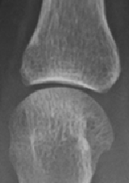
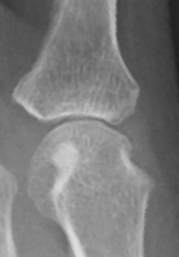
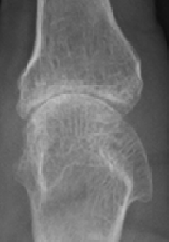
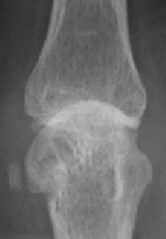
Rheumatoid Arthritis
Notes:
Rheumatoid Arthritis is a long-term autoimmune disorder, as the progression, the joint space will gradually narrow. As it is difficult to noticed by human eyes especially in the early stage, it cost doctors a lot of time to figure out the subtle change of the joint space. Also the joint space width is a very important indicator of prognosis, diagnosis and judging recovery. Therefore, we want to measure the joint space narrowing automatically.

Slide 3
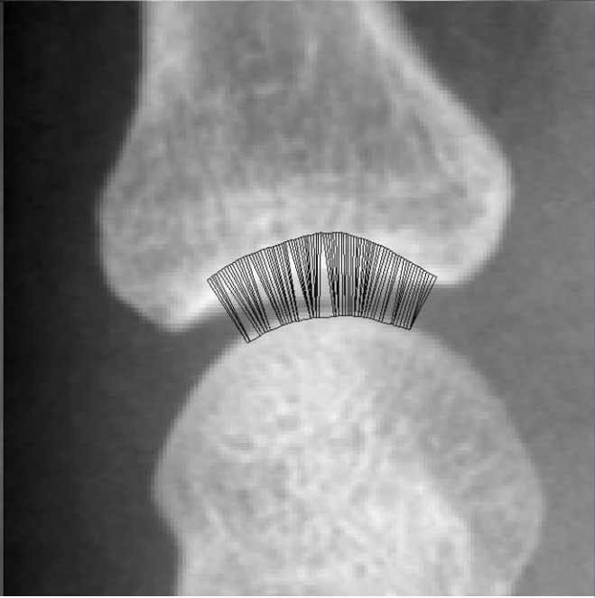
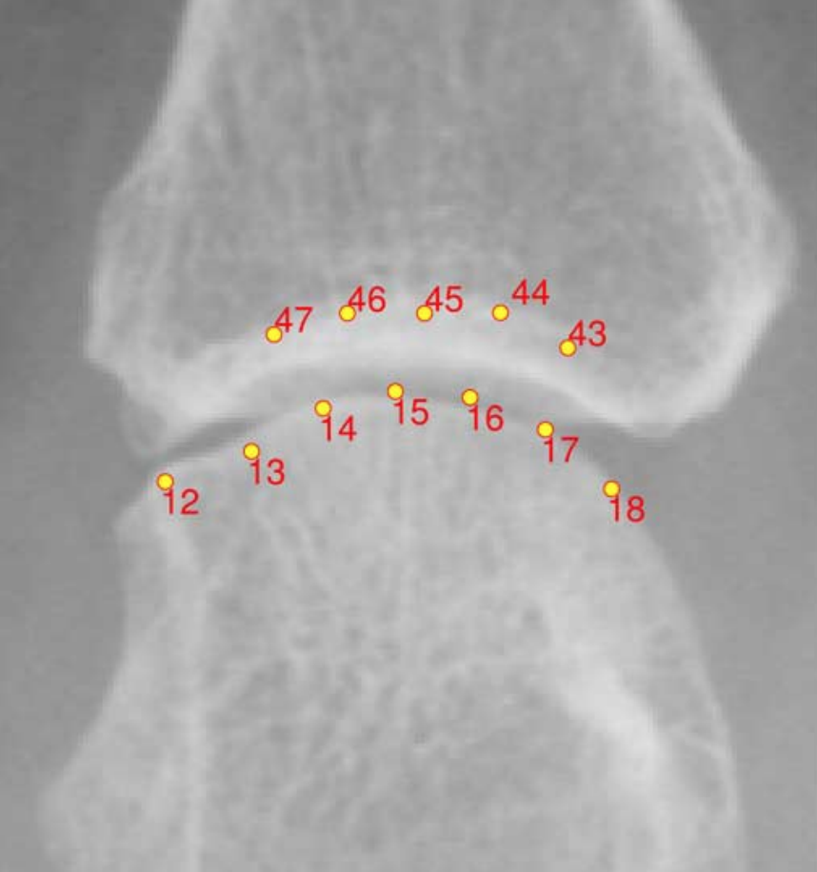
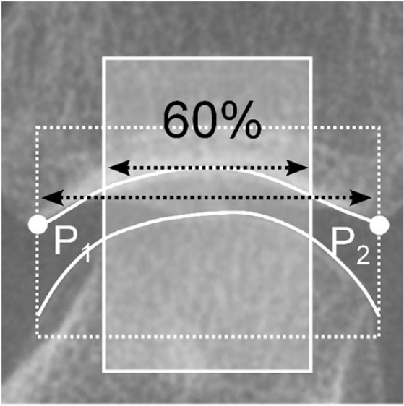
Previous Works
① Active Shape Model
② ASM-Driven Snakes
③ Edge Detection
Error: 3.06pix
Error: 2.36pix
Error: 1.20pix
[1] Peloschek P, Langs G, Weber M et al (2007) An automatic model-based system for joint space measurements on hand radiographs: initial experience. Radiology 245:855–862.
[2] Langs G, Peloschek P, Bischof H, et al. Automatic quantification of joint space narrowing and erosions in rheumatoid arthritis[J]. IEEE transactions on medical imaging, 2009, 28(1): 151-164.
[3] Huo Y H. Automated measurement of joint space width in early rheumatoid arthritis hand radiographs[D]. Utrecht University, 2017.
Notes:
There are some other previous works. They proposed some solutions to detect the joint space width. However, these researches have some certain limitations. All of them have pixel-level errors and it`s difficult to detect less than 1 pixel changes. But In the early stages, sometimes the joint space narrowing is less than one pixel per year. So, we want to propose a high accurately method to detect the subtle change of joint space.

Slide 4
Algorithm Flow
Previous works:
Joint images
Edge detection
Joint space width
Pixel-level error
This work:
Joint images
Movement calculate
Joint space narrowing
Sub-Pixel level error
Notes:
According to our discuss, the reason for the large error is bone edge detection.

Slide 5
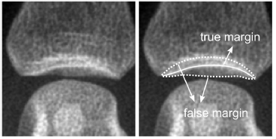
Bone margin
Hou Y et al. IEEE Trans Biomed Eng. 2016
Notes:
Because detecting the bone edge correctly is difficult, and the edge detection will also have pixel-level errors.

Slide 6
Algorithm Flow
Previous works:
Joint images
Edge detection
Joint space width
Pixel-level error
This work:
Joint images
Movement calculate
Joint space narrowing
Sub-Pixel level error
Notes:
So, we proposed a new method without edge detection. We use phase-only correction to calculate the above and the below bone movement. Then we calculate joint space narrowing. Phase-only correlation that we used have sub-pixel level accuracy because it computes the deviation between two images in the frequency domain. So this method can detect more subtle changes.

Slide 7
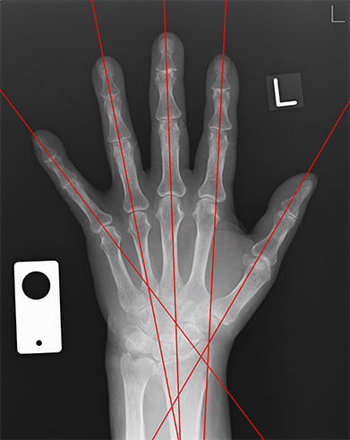
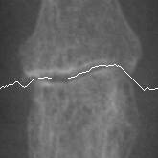

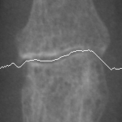

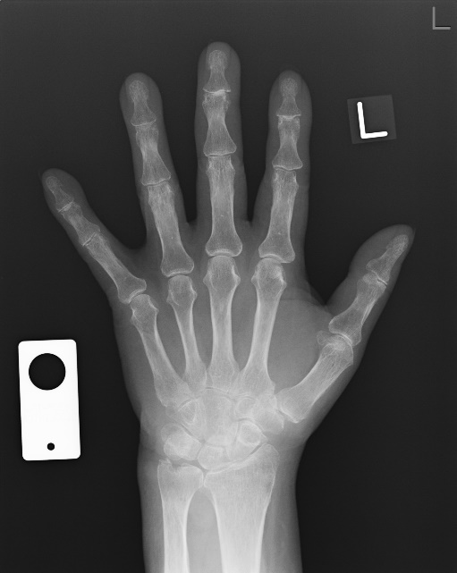

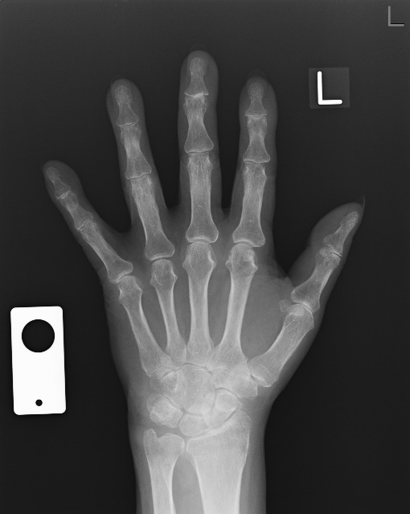

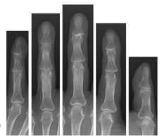
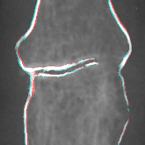


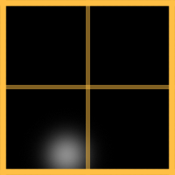
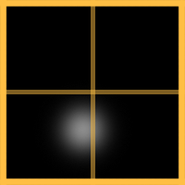
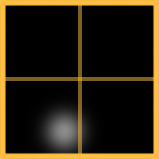
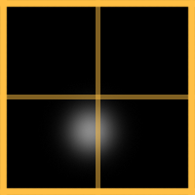
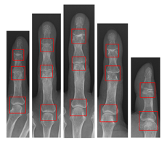
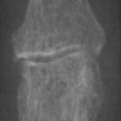
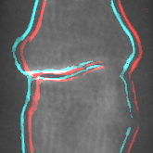
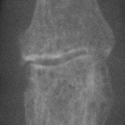





Methodology
P
1. Bones Detection
R
Previous
Recent
4. Joint Segmentation
5. POC
(Movement Measurement)
($∆x$₁, $∆$y₁)
($∆x0$, $∆$y₀)
2. AdaBoost
3. POC
(Position Calibration)
$$∆y_{1}=$$
$$−1.05pix$$
$$∆y_{0}=$$
$$−0.84pix$$
P
R
The progression of joint space narrowing =
$$∆y_{1}−∆y_{0}=−0.21pix$$
Notes:
Next I will briefly introduce our algorithm flow.

Slide 8
Methodology
P
1. Bones Detection
R
Previous
Recent
4. Joint Segmentation
5. POC
(Movement Measurement)
($∆x$₁, $∆$y₁)
($∆x0$, $∆$y₀)
2. AdaBoost
3. POC
(Position Calibration)
$$∆y_{1}=$$
$$−1.05pix$$
$$∆y_{0}=$$
$$−0.84pix$$
P
R
The progression of joint space narrowing =
$$∆y_{1}−∆y_{0}=−0.21pix$$
Notes:
Firstly, we use some image processing algorithms to detect fingers rapidly.

Slide 9
Methodology
P
1. Bones Detection
R
Previous
Recent
4. Joint Segmentation
5. POC
(Movement Measurement)
($∆x$₁, $∆$y₁)
($∆x0$, $∆$y₀)
2. AdaBoost
3. POC
(Position Calibration)
$$∆y_{1}=$$
$$−1.05pix$$
$$∆y_{0}=$$
$$−0.84pix$$
P
R
The progression of joint space narrowing =
$$∆y_{1}−∆y_{0}=−0.21pix$$
Notes:
Then we train a joint classifier by AdaBoost. In this step, the false negatives and false positives in our database are very low.

Slide 10
Methodology
P
1. Bones Detection
R
Previous
Recent
4. Joint Segmentation
5. POC
(Movement Measurement)
($∆x$₁, $∆$y₁)
($∆x0$, $∆$y₀)
2. AdaBoost
3. POC
(Position Calibration)
$$∆y_{1}=$$
$$−1.05pix$$
$$∆y_{0}=$$
$$−0.84pix$$
P
R
The progression of joint space narrowing =
$$∆y_{1}−∆y_{0}=−0.21pix$$
Notes:
Next, we use phase-only correlation to correct the position deviation between two joint windows.

Slide 11
Methodology
P
1. Bones Detection
R
Previous
Recent
4. Joint Segmentation
5. POC
(Movement Measurement)
($∆x$₁, $∆$y₁)
($∆x0$, $∆$y₀)
2. AdaBoost
3. POC
(Position Calibration)
$$∆y_{1}=$$
$$−1.05pix$$
$$∆y_{0}=$$
$$−0.84pix$$
P
R
The progression of joint space narrowing =
$$∆y_{1}−∆y_{0}=−0.21pix$$
Notes:
Continually, we segment the joint image, and the segmentation algorithm is like this. We calculate the depth of each point by a filter. Then calculate the depth-sum of each round, and select a line that have the largest depth-sum as the segmentation curve. According to the result, it passes between the two bones.

Slide 12


Methodology
P
1. Bones Detection
R
Previous
Recent
4. Joint Segmentation
5. POC
(Movement Measurement)
($∆x$₁, $∆$y₁)
($∆x0$, $∆$y₀)
2. AdaBoost
3. POC
(Position Calibration)
$$∆y_{1}=$$
$$−1.05pix$$
$$∆y_{0}=$$
$$−0.84pix$$
P
R
The progression of joint space narrowing =
$$∆y_{1}−∆y_{0}=−0.21pix$$
Notes:
Next, we calculate the movement of the above and the below bones by phase-only correlation.

Slide 13
Methodology
P
1. Bones Detection
R
Previous
Recent
4. Joint Segmentation
5. POC
(Movement Measurement)
($∆x$₁, $∆$y₁)
($∆x0$, $∆$y₀)
2. AdaBoost
3. POC
(Position Calibration)
$$∆y_{1}=$$
$$−1.05pix$$
$$∆y_{0}=$$
$$−0.84pix$$
P
R
The progression of joint space narrowing =
$$∆y_{1}−∆y_{0}=−0.21pix$$
Notes:
So, we can calculate the joint space narrowing by the bone movements.

Slide 14

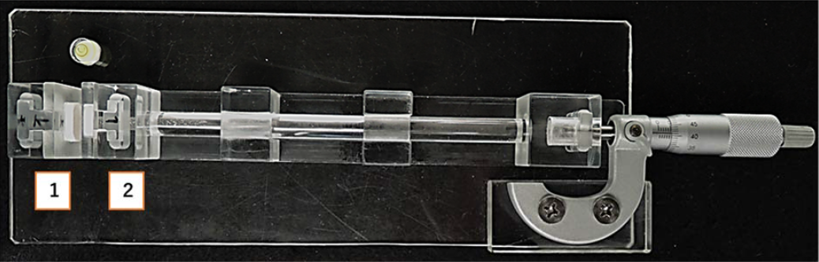
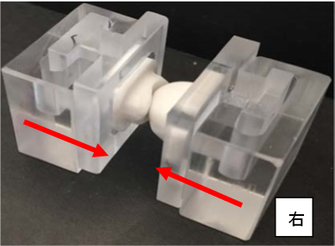
Materials
Level
Motion Part
Micrometer
Notes:
We tried to calculate the error in radiographic images. But it‘s difficult because the radiographic images don’t have ground truth. We made test images using imaging phantom. The phantom parameters and imaging parameters are in these two tables. The figure shows the device for image acquisition.

Slide 15
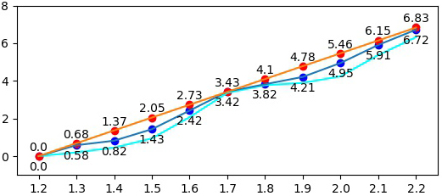
Experiments
Ideal situation
In this work
Without median filter
Differential image distance
With 1.2mm (in pixel)
Joint distance in the phantom (mm)
Notes:
This graph is the result of this work. We used the median filter to smooth the bone images before the phase-only correlation. And it also reduces the errors.

Slide 16
Comparison
 | Method | Mean Error | Smallest Detection Difference
Our Method (Phantom Images) | POC(Phase Only Correlation) | 0.208pix | <0.1pix
[1] Hou Y et al. Trans Bio Eng. 2016 | Edge Detection | ~1.2pixel (6.8% of JSW) | N/A
[2] Langs G, et al. T-MI, 2009 | ASMDS(ASM-Driven Snakes) | 2.36pix (0.20mm) | 0.95pix (0.08mm)
 | ASM(Active Shape Model) | 2.96pix (0.25mm)
[3] Peloschek P, et al. Radiology, 2007 | ASM(Active Shape Model) | 3.06pix (0.26mm) | 0.87pix (0.05mm)
[1] Huo Y H. Automated measurement of joint space width in early rheumatoid arthritis hand radiographs[D]. Utrecht University, 2017.
[2] Langs G, Peloschek P, Bischof H, et al. Automatic quantification of joint space narrowing and erosions in rheumatoid arthritis[J]. IEEE transactions on medical imaging, 2009, 28(1): 151-164.
[3] Peloschek P, Langs G, Weber M et al (2007) An automatic model-based system for joint space measurements on hand radiographs: initial experience. Radiology 245:855–862.
Notes:
In this work, the mean error in phantom images is only 0.2 pixel and the smallest detection difference is less than 0.1 pixel. Compared with other works, this work significantly reduces errors and can detect more subtle changes.

Slide 17
Conclusion
We propose a high-accuracy joint space narrowing (JSN) progression detection algorithm based on phase only correlation (POC) method.
Our method is automated, using a sequence of radiographic image we can detect JSN progression.
Our method can detect sub-pixel progression of JSN.
Propose an image segmentation algorithm to separate joint images in order to improve accuracy.

