Slide 1
GROUP 2 BOWEN ZHANG THOMAS VISSCHER YAFEI YE KRISTINA GONCHAROV
To what extent does your local supermarket indicate how expensive your area is to live in?

Slide 2
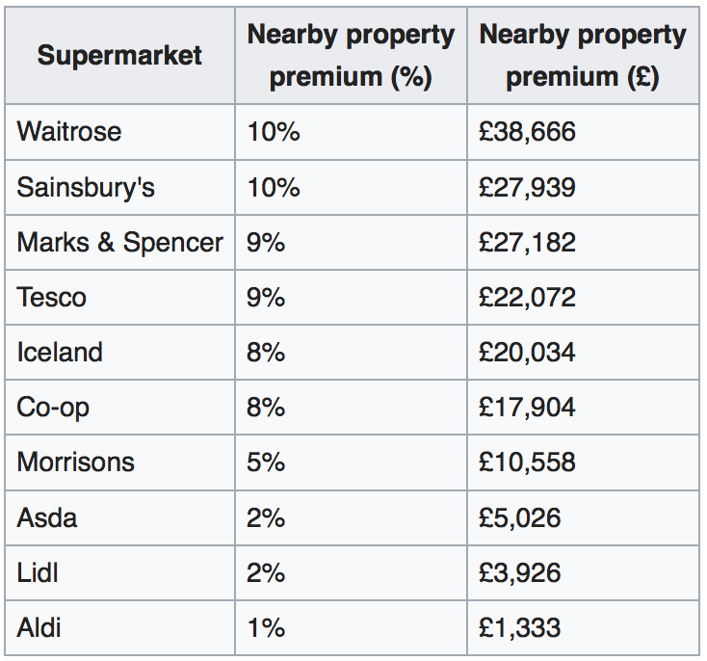
Introduction
Waitrose Effect
Proximity to a supermarket has been widely reported to be an amenity that can have a significant effect on residential property prices in Britain.
Choose these top 10 supermarkets as our target supermarkets.
https://en.wikipedia.org/wiki/List_of_supermarket_chains_in_the_United_Kingdom

Slide 3
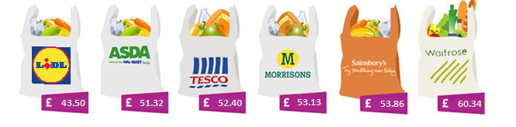
Introduction
There is a large difference in the price of the same items at different supermarkets, suggesting certain supermarkets target different demographics:
Which Magazine: Supermarket price comparison 2018 https://www.which.co.uk/reviews/supermarkets/article/supermarket-price-comparison

Slide 4
Hypothesis:
H₀: There is a significant correlation between house prices and how expensive the local supermarkets are in wards of London.
H₁: There is not a significant correlation between house prices and how expensive the local supermarkets are in wards of London.

Slide 5
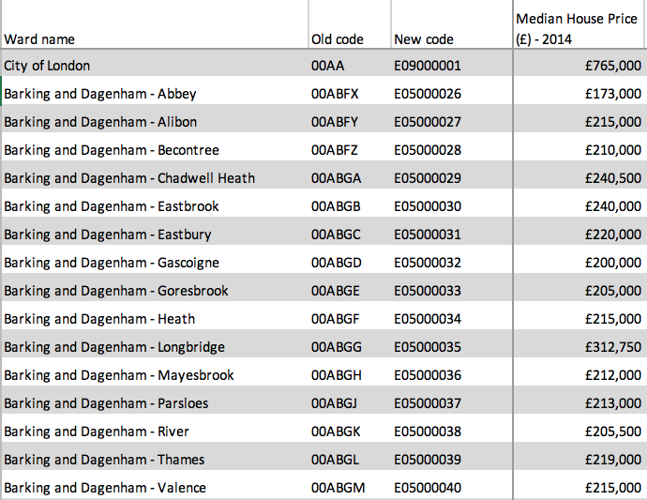
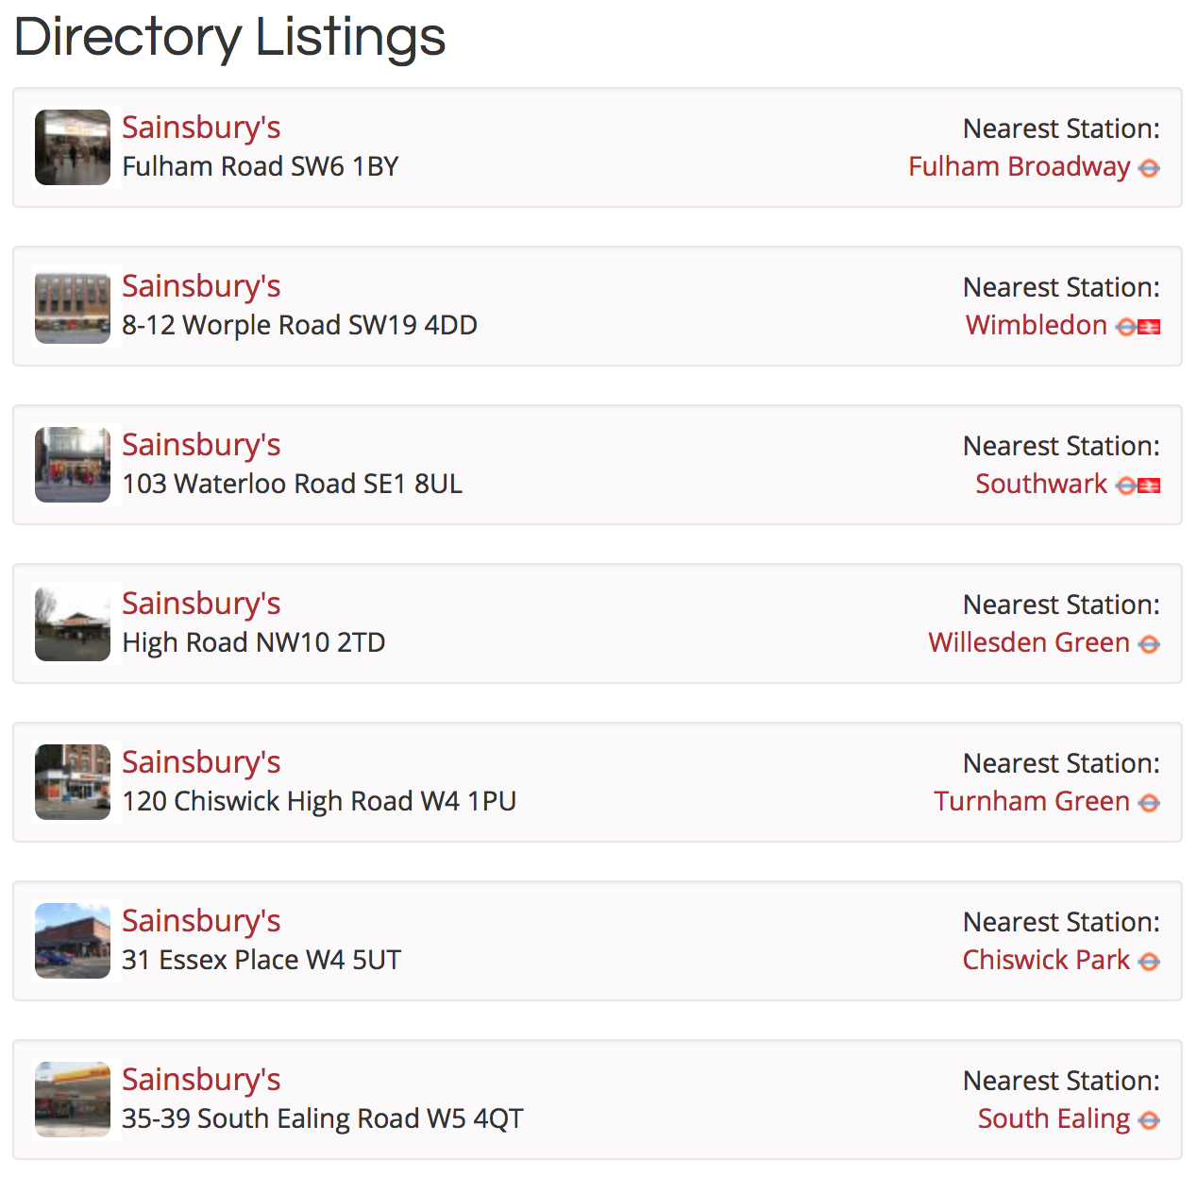
Data Collection
1. 2014 Median House Price of Wards in London from Ward Profiles and Atlas
Provided by Greater London Authority (GLA)
Available in London Datastore: https://data.london.gov.uk/dataset/ward-profiles-and-atlas
2. Listing of Supermarkets in London with Postcodes were Scraped from allinlondon.co.uk and Cleaned in Excel
Available in: https://www.allinlondon.co.uk/directory/1162.php
2014 Median House Price
Listing of Supermarkets in London

Slide 6
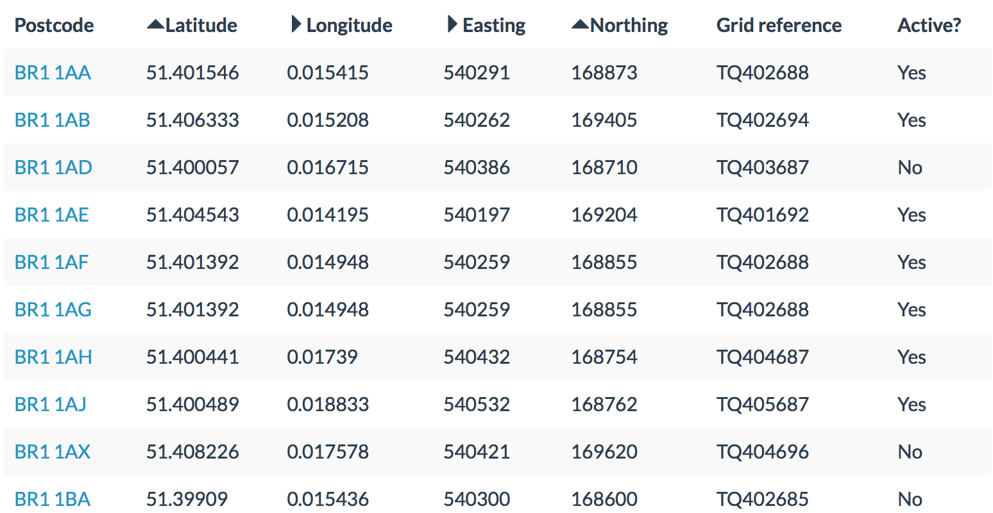
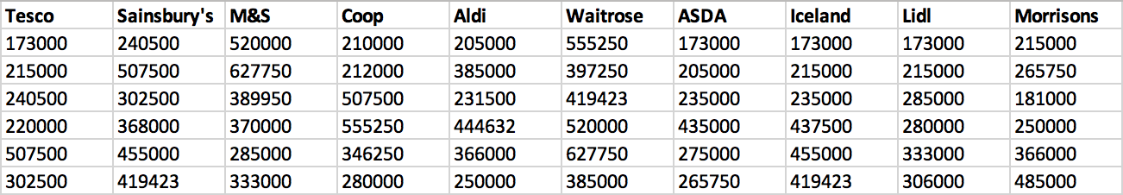
Data Collection
3. Greater London Postcodes from doogal.co.uk and ArcGIS was Used to Link the Postcodes of Sup ermarkets to Wards.
Available in: https://www.allinlondon.co.uk/directory/1162.php
4. A New Joined Database was exported which Has the Matched 2014 Median House Price of Wards in London to Every Supermarket in Different Kinds.
Greater London Postcodes
A New Joined Database

Slide 7
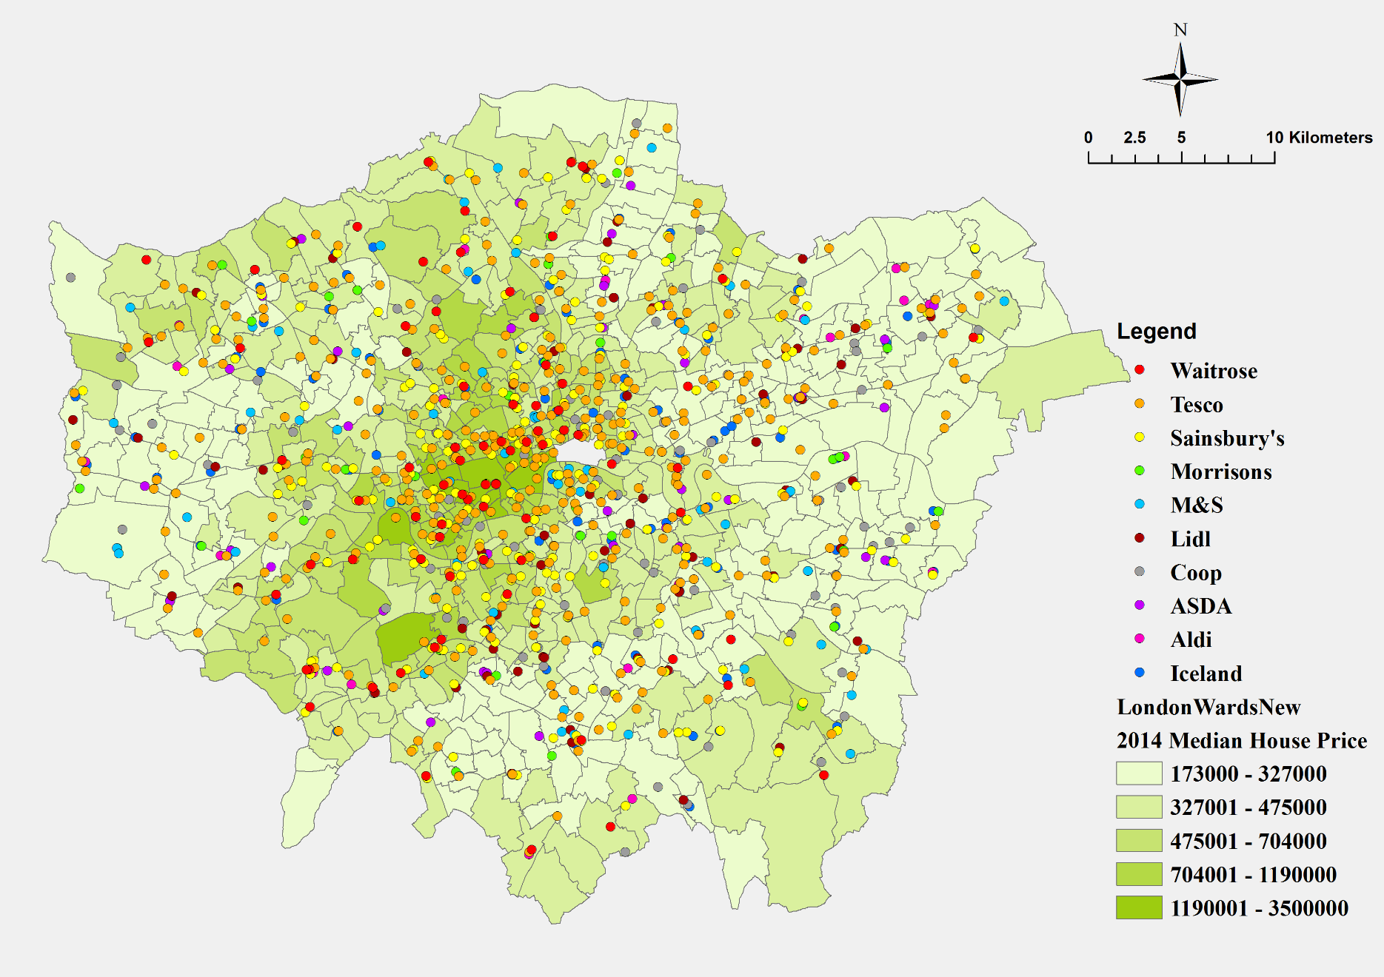
Data Collection
Distribution of Top 10 Supermarkets

Slide 8
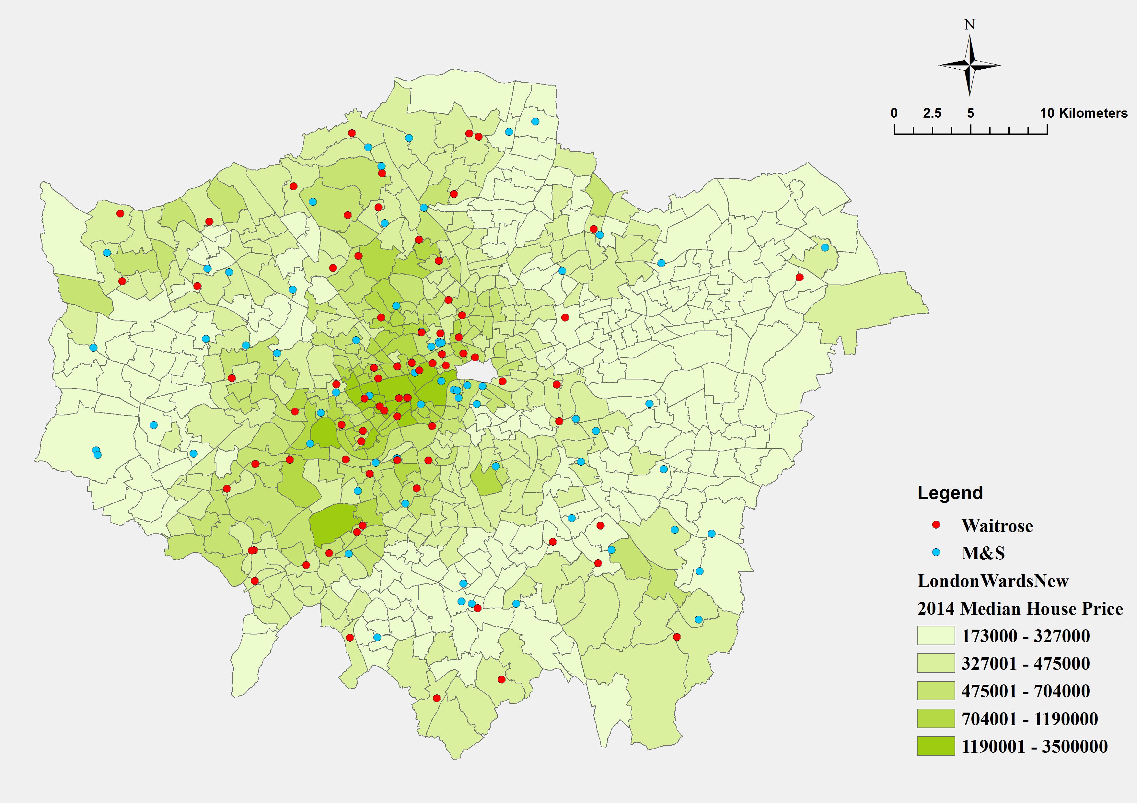
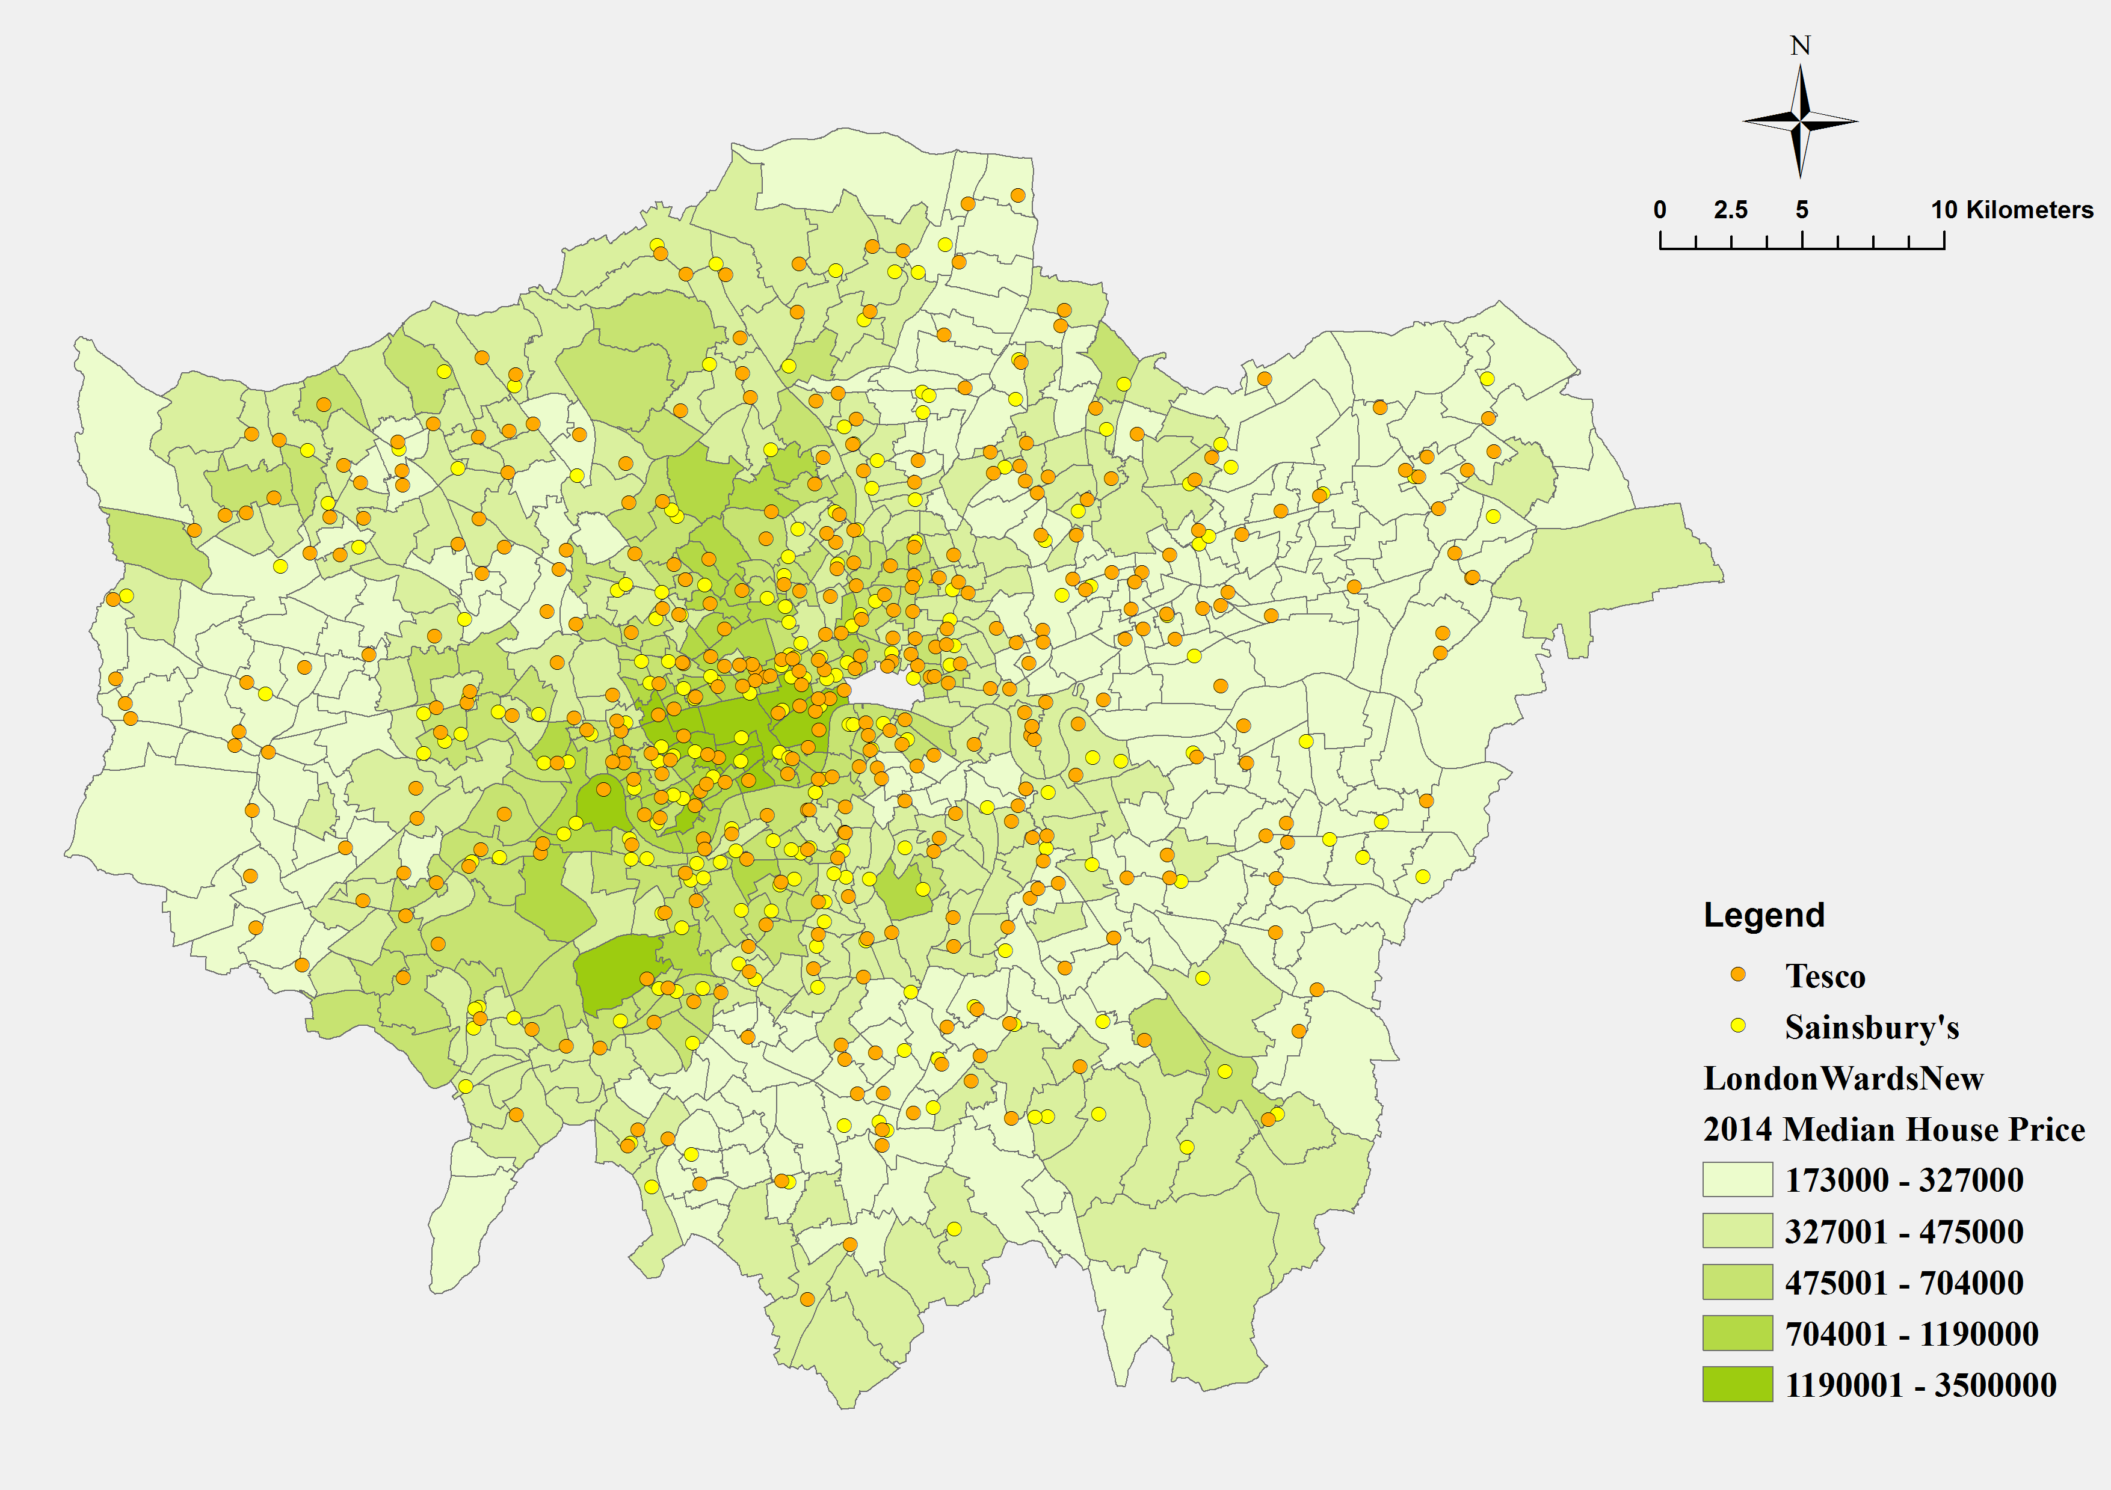
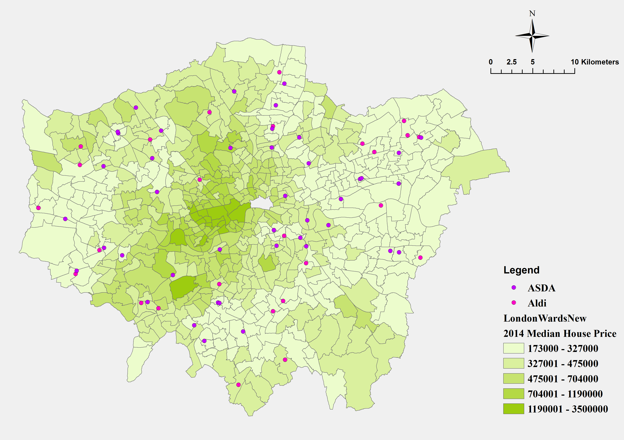
Data Collection
Distribution of Waitrose and M&S
Distribution of Tesco and Sainsbury’s
Distribution of ASDA and Aldi
Stereotype is True?
Different kinds of supermarkets can be classified into several categories, and have correlations in every category?

Slide 9
Data SUMMARY
Descriptive Statistics of Final Data
Supermarket | Mean | Median | Std. Deviation | Minimum | Maximum | Count
Waitrose | 653978.06 | 515250 | 479948.39 | 236000 | 3500000 | 71
Sainsbury's | 509369.39 | 440000 | 334375.60 | 193000 | 3500000 | 176
M&S | 492355.83 | 392750 | 280156.21 | 209000 | 1400000 | 60
Tesco | 461977.50 | 386250 | 268855.03 | 173000 | 1995000 | 290
Coop | 433186.23 | 357625 | 231683.41 | 207500 | 1487500 | 86
Morrisons | 363236.03 | 353500 | 136573.20 | 181000 | 813500 | 31
Iceland | 359420.53 | 340000 | 125967.03 | 173000 | 805000 | 119
Lidl | 342372.50 | 315000 | 110113.55 | 173000 | 732500 | 64
ASDA | 337897.50 | 305500 | 152477.04 | 173000 | 985000 | 40
Aldi | 306091.42 | 291997.5 | 80994.65 | 190000 | 500000 | 26

Slide 10
Analysis method
Group 1 | Group 2 | Group 3
Aldi | Tesco | Waitrose
Lidl | Coop
Iceland | Sainsbury's
Morrisons | M&S
ASDA
Assumption Group
According to mean
Two Sample T-test Assuming unequal variance
Hypothesis:
One-tail: Two-tail：
H₀: μ₁ ≥ μ₂
H_{a}: μ₁ < μ₂
H₀: μ₁ = μ₂
H_{a}: μ₁ ≠ μ₂

Slide 11
Analysis result
Inner groups
Group 1
 | Aldi | ASDA | Lidl | Iceland | Morrisons
Mean | 306091.423 | 337897.5 | 342372.5 | 359420.529 | 363236
P-value
 | Aldi | ASDA | Iceland | Morrisons | Lidl
Aldi | 1.00
ASDA | 0.27 | 1.00
Iceland | 0.01** | 0.42 | 1.00
Morrisons | 0.06* | 0.46 | 0.89 | 1.00
Lidl | 0.09* | 0.87 | 0.34 | 0.46 | 1.00
Significant level : *P < 0.1; **P < 0.05;

Slide 12
Analysis result
Inner groups
Group 2
 | Coop | Tesco | M&S | Sainsbury's
Mean | 433186 | 461977 | 492355 | 509369
P-value
 | Coop | Tesco | M&S | Sainsbury's
Coop | 1.00
Tesco | 0.33 | 1.00
M&S | 0.18 | 0.44 | 1.00
Sainsbury's | 0.06* | 0.11 | 0.70 | 1.00
Significant level : *P < 0.1; **P < 0.05;

Slide 13
Analysis result
Between groups
 | Morrisons | Coop
Mean | 363236.03 | 433186.23
 | Waitrose | Sainsbury's
Mean | 653978.06 | 509369.39
t Stat | -2.00
P(T<=t) one-tail | 0.02**
t Critical one-tail | 1.66
t Stat | 2.32
P(T<=t) one-tail | 0.01**
t Critical one-tail | 1.66
Significant level : *P < 0.1; **P < 0.05;

Slide 14
Analysis result
Amended new groups
There are four price groups for wards:
Group 1 £306,091 | Group 2 £336,335 | Group 3 £460,977 | Group 4 £653,978
Aldi | Lidl | Tesco | Waitrose
 | Iceland | Coop
 | Morrisons | Sainsbury's
 | ASDA | M&S
House Price：Group1 < Group2 < Group3 < Group 4

Slide 15
CONCLUSION
H₀: There is a significant correlation between house prices and how expensive the local supermarkets are in any given ward in London.

Slide 16
Further research
We could apply the same test to urban agglomerations other than London.
We might use supermarket data as a proxy measure of gentrification.
We could analyze the impact of supermarket proximity to homes, rather than density per ward for more accurate results.
Weaknesses: House prices don’t always reflect wealth of underlying population. Rental prices would also be interesting to test.

Slide 17

Inside a Waitrose…
https://metro.co.uk/2016/09/15/waitrose-is-putting-more-wine-bars-in-stores-so-you-can-try-before-you-buy-6130461/

