Slide 1
Flink从入门到入土
2020.12 张敏坷
深圳市名通科技股份有限公司

Slide 2
内容提纲
01
简介
目录
02
WordCount
CONTENTS
03
Spark对比
04
总结

Slide 3
简介
起源
2010年，柏林工业大学、柏林洪堡大学和哈索·普拉特纳研究所（Hasso Plattner Institute）启动Stratosphere项目
2014年3月，Stratosphere的一个分支以Flink之名成为Apache基金会的孵化器项目
2014年12月，Flink从Apache孵化器毕业，成为顶级项目
于此同时，Flink创始团队成立Data Artisans GmbH公司，开启chuFlink商业化之路

Slide 4
简介
起源
2015年，阿里巴巴调研后选择Flink作为下一代大数据计算引擎，并进行深度开发
2016年，Flink正式在阿里巴巴上线使用
2017年，Flink在阿里巴巴所有子公司中上线使用
2018年，Flink Forward China举办，Flink广泛进入中国IT从业人员的视野
2019年，阿里巴巴Flink内部版Blink正式开源，并宣称会将Blink逐步合并入Flink
同年，阿里巴巴收购Data Artisans GmbH公司

Slide 5

简介/特性
聚焦运维
正确性保证
灵活部署
高可用
保存点
Exactly-once状态一致性
事件时间处理
成熟的迟到数据处理
所有流式场景
大规模计算
事件驱动
流批分析
数据管道&ETL
水平扩展架构
支持超大状态
增量检查点机制
分层api
卓越性能
sql on batch & stream
DataStream & DataSet
ProcessFunction
低延迟
高吞吐
内存计算

Slide 6
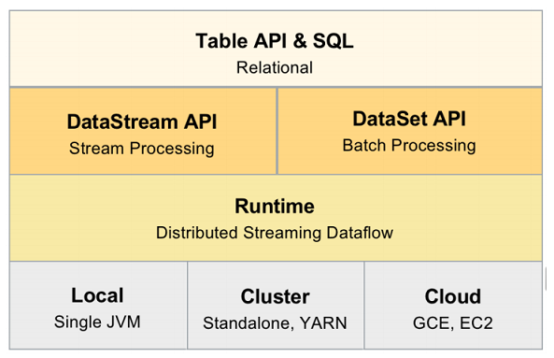
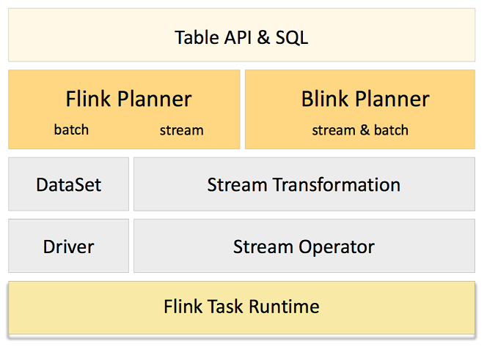
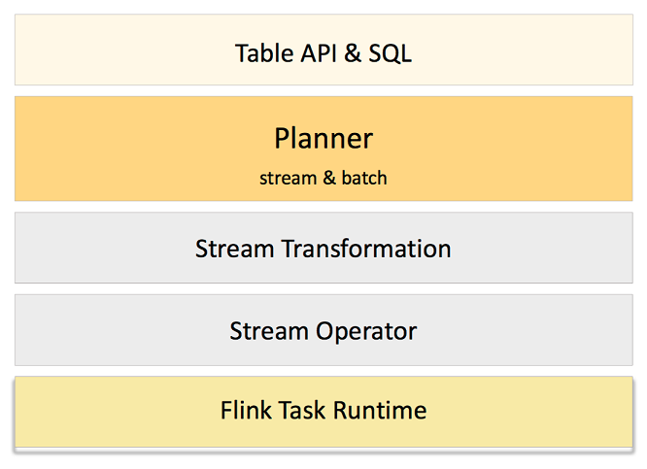
简介/功能模块

Slide 7
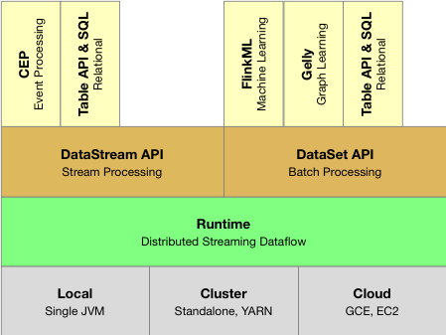
简介/整体架构

Slide 8
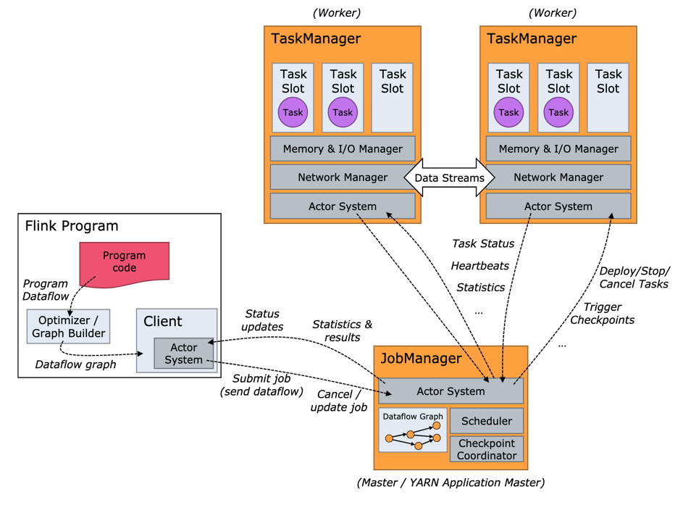
简介/整体架构

Slide 9
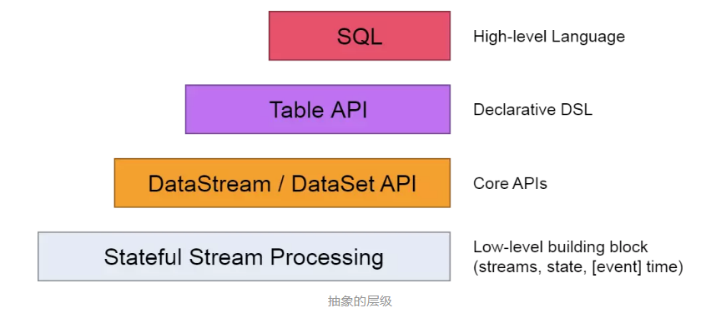
简介/编程模型

Slide 10
内容提纲
01
简介
目录
02
WordCount
CONTENTS
03
Spark对比
04
总结

Slide 11
WordCount/准备工作
下载源码
https://flink.apache.org/zh/downloads.html
编译源码
mvn clean package -DskipTests

Slide 12
WordCount/运行模式
本地模式
java -jar <jar-file> <arguments>
StandAlone模式
bin/flink run [OPTIONS] <jar-file> <arguments>
Yarn模式
单个Yarn session模式
多个Yarn session模式
bin/flink run -m yarn-cluster -yn 2 -yjm 1024 -ytm 1024 <jar-file> <arguments>
Notes:
-m 哪种模式
-yn yarn container的数量
-yjm yarn jobManager 内存
-ytm yarn taskManager内存

Slide 13
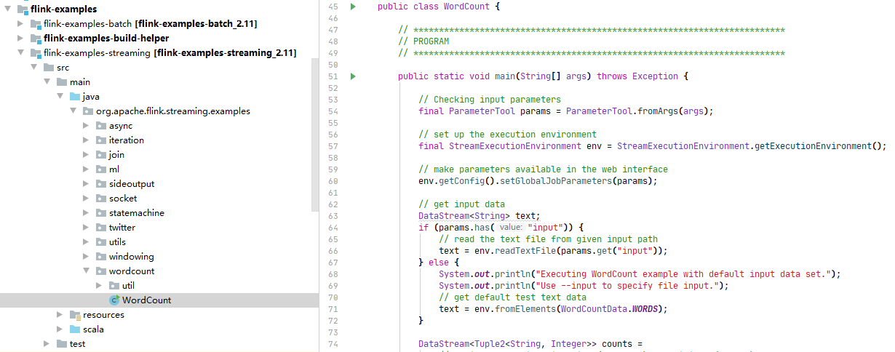
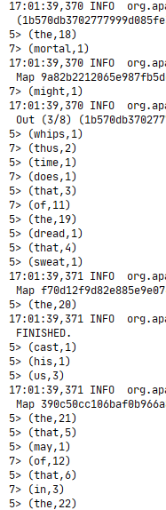
WordCount/example
打开Flink官方的例子，直接运行

Slide 14
WordCount/代码讲解
public static void main(String[] args) throws Exception {
// 检查输入参数
final ParameterTool params = ParameterTool.fromArgs(args);
// 启动执行环境
final StreamExecutionEnvironment env = StreamExecutionEnvironment.getExecutionEnvironment();
// 设置参数
env.getConfig().setGlobalJobParameters(params);
// 获取输入数据
DataStream<String> text;
if (params.has("input")) {
// 从参数中获取输入数据的路径
text = env.readTextFile(params.get("input"));
} else {
System.out.println("Executing WordCount example with default input data set.");
System.out.println("Use --input to specify file input.");
// 使用默认的数据
text = env.fromElements(WordCountData.WORDS);
}
DataStream<Tuple2<String, Integer>> counts =
// 将行切分成二元组 例如: (word,1)
text.flatMap(new Tokenizer())
// 按二元组的第1位进行分组，并且按第2位进行求和
.keyBy(0).sum(1);
// 输出结果
if (params.has("output")) {
counts.writeAsText(params.get("output"));
} else {
System.out.println("Printing result to stdout. Use --output to specify output path.");
counts.print();
}
// 执行程序
env.execute("Streaming WordCount");
}

Slide 15
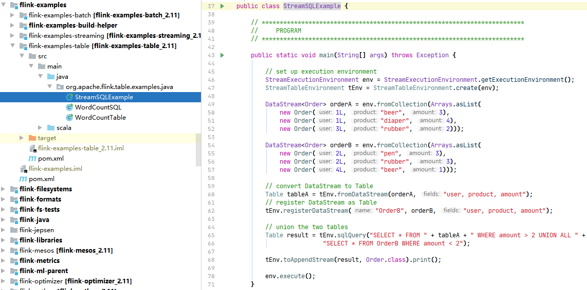
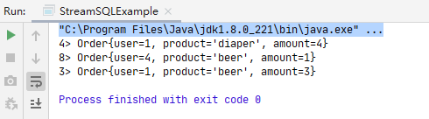
WordCount/Stream Sql Example
打开Flink官方的例子，直接运行

Slide 16
WordCount/代码讲解
public static void main(String[] args) throws Exception {
// set up execution environment
StreamExecutionEnvironment env = StreamExecutionEnvironment.getExecutionEnvironment();
StreamTableEnvironment tEnv = StreamTableEnvironment.create(env);
DataStream<Order> orderA = env.fromCollection(Arrays.asList(
new Order(1L, "beer", 3),
new Order(1L, "diaper", 4),
new Order(3L, "rubber", 2)));
DataStream<Order> orderB = env.fromCollection(Arrays.asList(
new Order(2L, "pen", 3),
new Order(2L, "rubber", 3),
new Order(4L, "beer", 1)));
// convert DataStream to Table
Table tableA = tEnv.fromDataStream(orderA, "user, product, amount");
// register DataStream as Table
tEnv.registerDataStream("OrderB", orderB, "user, product, amount");
// union the two tables
Table result = tEnv.sqlQuery("SELECT * FROM " + tableA + " WHERE amount > 2 UNION ALL " + "SELECT * FROM OrderB WHERE amount < 2");
tEnv.toAppendStream(result, Order.class).print();
env.execute();
}

Slide 17
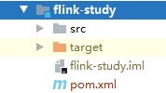
WordCount/进一步学习
flink-parent中建立子项目flink-study
引入依赖
<dependency>
<groupId>org.apache.flink</groupId>
<artifactId>flink-core</artifactId>
<version>1.9.0</version>
</dependency>
<dependency>
<groupId>org.apache.flink</groupId>
<artifactId>flink-streaming-java_2.11</artifactId>
<version>1.9.0</version>
</dependency>

Slide 18
WordCount/第一个demo
自己动手写
public static void main(String[] args) throws Exception {
final StreamExecutionEnvironment env = StreamExecutionEnvironment.getExecutionEnvironment();
DataStream<String> text = env.fromElements(WORDS);
text.flatMap((FlatMapFunction<String, Tuple2<String, Integer>>) (line, out) -> {
String[] tokens = line.split("\\W+");
for (String token : tokens) {
out.collect(new Tuple2<>(token, 1));
}
}).returns(Types.TUPLE(Types.STRING, Types.INT))
.keyBy(0)
.sum(1)
.print()
.setParallelism(1);
env.execute("My Word Count");
}

Slide 19
WordCount/自定义输入源 & sql操作
引入依赖
<dependency>
<groupId>org.apache.flink</groupId>
<artifactId>flink-table-planner_2.11</artifactId>
<version>1.9.0</version>
</dependency>
<dependency>
<groupId>org.apache.flink</groupId>
<artifactId>flink-table-planner-blink_2.11</artifactId>
<version>1.9.0</version>
</dependency>
<dependency>
<groupId>org.apache.flink</groupId>
<artifactId>flink-table-common</artifactId>
<version>1.9.0</version>
</dependency>
<dependency>
<groupId>org.apache.flink</groupId>
<artifactId>flink-table-api-java-bridge_2.11</artifactId>
<version>1.9.0</version>
</dependency>

Slide 20
WordCount/自定义输入源 & sql操作
自己动手写
public static void main(String[] args) throws Exception {
StreamExecutionEnvironment env = StreamExecutionEnvironment.getExecutionEnvironment();
StreamTableEnvironment tEnv = StreamTableEnvironment.create(env);
tEnv.registerTableSource("t", new WordCountTableSource(WORDS));
Table res = tEnv.sqlQuery("SELECT key, SUM(num) FROM t GROUP BY key");
tEnv.toRetractStream(res, Row.class)
.print().setParallelism(1);
env.execute();
}

Slide 21
WordCount/自定义输入源 & sql操作
自己动手写
private static class WordCountTableSource implements StreamTableSource<Row> {
private final String[] data;
private final TableSchema schema;
private WordCountTableSource(String... data) {
this.data = data;
this.schema = TableSchema.builder()
.field("key", DataTypes.STRING())
.field("num", DataTypes.INT())
.build();
}
@Override public boolean isBounded() {return true;}
@Override public DataStream<Row> getDataStream(StreamExecutionEnvironment env) {
String[] filedNames = { "key", "num" };
return env.fromElements(data)
.flatMap((FlatMapFunction<String, Row>) (value, out) -> {
final String[] tokens = value.split("\\W+");
for (String token : tokens) {
out.collect(Row.of(token, 1));
}
}).returns(Types.ROW_NAMED(filedNames, Types.STRING, Types.INT));
}
@Override public TableSchema getTableSchema() {return schema;}
@Override public DataType getProducedDataType() {return schema.toRowDataType();}
}

Slide 22
WordCount/connector - source & sink
connector
connector是Flink中用户连接第三方存储引擎的组件
包括读取组件（source）和写入组件（sink）
Flink官方为我们提供了很多connector，例如
FlinkKafkaConsumer（source）
FlinkKafkaProducer（sink）

Slide 23
WordCount/connector - source & sink
需求
Kakfa中有如下的数据
{"user_id": "543462", "item_id":"1715", "category_id": "1464116", "behavior": "pv", "ts": "2017-11-26T01:00:00Z"}
{"user_id": "662867", "item_id":"2244074", "category_id": "1575622", "behavior": "pv", "ts": "2017-11-26T01:00:00Z"}
{"user_id": "561558", "item_id":"3611281", "category_id": "965809", "behavior": "pv", "ts": "2017-11-26T01:00:00Z"}
{"user_id": "894923", "item_id":"3076029", "category_id": "1879194", "behavior": "pv", "ts": "2017-11-26T01:00:00Z"}
{"user_id": "834377", "item_id":"4541270", "category_id": "3738615", "behavior": "pv", "ts": "2017-11-26T01:00:00Z"}
{"user_id": "315321", "item_id":"942195", "category_id": "4339722", "behavior": "pv", "ts": "2017-11-26T01:00:00Z"}
user_id | item_id | category_id | behavior | ts
543462 | 1715 | 1464116 | pv | 2017-11-26T01:00:00Z
662867 | 2244074 | 1575622 | pv | 2017-11-26T01:00:00Z
561558 | 3611281 | 965809 | pv | 2017-11-26T01:00:00Z

Slide 24
WordCount/connector - source & sink
需求
统计出每小时的pv和uv，并保存到MySQL中
SELECT
DATE_FORMAT(ts, 'yyyy-MM-dd HH:00') dt,
COUNT(*) AS pv,
COUNT(DISTINCT user_id) AS uv
FROM user_log
GROUP BY DATE_FORMAT(ts, 'yyyy-MM-dd HH:00')
user_id | item_id | category_id | behavior | ts
543462 | 1715 | 1464116 | pv | 2017-11-26T01:00:00Z
662867 | 2244074 | 1575622 | pv | 2017-11-26T01:00:00Z
561558 | 3611281 | 965809 | pv | 2017-11-26T01:00:00Z

Slide 25
WordCount/connector - source & sink
引入依赖
<!-- json -->
<dependency>
<groupId>org.apache.flink</groupId>
<artifactId>flink-json</artifactId>
<version>1.9.0</version>
</dependency>
<!-- jdbc & MySQL -->
<dependency>
<groupId>org.apache.flink</groupId>
<artifactId>flink-jdbc_2.11</artifactId>
<version>1.9.0</version>
</dependency>
<dependency>
<groupId>mysql</groupId>
<artifactId>mysql-connector-java</artifactId>
<version>5.1.48</version>
</dependency>
<!-- Kafka -->
<dependency>
<groupId>org.apache.flink</groupId>
<artifactId>flink-connector-kafka-0.10_2.11</artifactId>
<version>1.9.0</version>
</dependency>
<dependency>
<groupId>org.apache.flink</groupId>
<artifactId>flink-sql-connector-kafka-0.10_2.11</artifactId>
<version>1.9.0</version>
</dependency><dependency>
<groupId>org.apache.kafka</groupId>
<artifactId>kafka-clients</artifactId>
<version>1.1.0</version>
</dependency>

Slide 26
WordCount/connector - source & sink
自己动手写
public static void main(String[] args) throws Exception {
EnvironmentSettings settings = EnvironmentSettings.newInstance()
.useBlinkPlanner()
.inStreamingMode()
.build();
TableEnvironment tEnv = TableEnvironment.create(settings);
Kafka010TableSource source = createKafka010TableSource();
tEnv.registerTableSource("user_log", source);
JDBCUpsertTableSink tableSink = createJdbcUpsertTableSink();
tEnv.registerTableSink("t_pvuv", tableSink);
String sql = "" +
"INSERT INTO t_pvuv " +
"SELECT" +
" DATE_FORMAT(ts, 'yyyy-MM-dd HH:00') dt," +
" COUNT(*) AS pv," +
" COUNT(DISTINCT user_id) AS uv " +
"FROM user_log " +
"GROUP BY DATE_FORMAT(ts, 'yyyy-MM-dd HH:00')";
tEnv.sqlUpdate(sql);
tEnv.execute("consume kafka and save to mysql");
}

Slide 27
WordCount/connector - source & sink
自己动手写
private static Kafka010TableSource createKafka010TableSource() {
Properties props = new Properties();
props.setProperty("bootstrap.servers", "node00:9092,node01:9092,node02:9092");
props.setProperty("group.id", "test");
props.setProperty("auto.offset.reset", "earliest");
props.setProperty("enable.auto.commit", "false");
props.setProperty("key.deserializer", "org.apache.kafka.common.serialization.StringDeserializer");
props.setProperty("value.deserializer", "org.apache.kafka.common.serialization.StringDeserializer");
String[] filedNames = { "user_id", "item_id", "category_id", "behavior", "ts" };
TypeInformation<?>[] physicalType = { INT, INT, INT, STRING, SQL_TIMESTAMP };
DataType[] logicalType = { INT(), INT(), INT(), STRING(),
new AtomicDataType(new TimestampType(true, TimestampKind.ROWTIME, 3))
.bridgedTo(java.sql.Timestamp.class) };
JsonRowDeserializationSchema deserializationSchema = new JsonRowDeserializationSchema.Builder(
Types.ROW_NAMED(filedNames, physicalType)).build();
TableSchema schema = TableSchema.builder()
.fields(filedNames, logicalType)
.build();
return new Kafka010TableSource(schema, "user_behavior", props, deserializationSchema);
}

Slide 28
WordCount/connector - source & sink
自己动手写
private static JDBCUpsertTableSink createJdbcUpsertTableSink() {
return new JDBCUpsertTableSink.Builder()
.setOptions(JDBCOptions.builder()
.setDBUrl("jdbc:mysql://192.168.1.71:3306/test2?useSSL=false")
.setUsername("dtauser")
.setPassword("dtauser")
.setDriverName("com.mysql.jdbc.Driver")
.setTableName("t_pvuv")
.build())
.setTableSchema(TableSchema.builder()
.field("dt", DataTypes.STRING())
.field("pv", DataTypes.BIGINT())
.field("uv", DataTypes.BIGINT())
.build())
.build();
}

Slide 29
WordCount/旁路输出
旁路输出
旁路输出能够将一个数据流分割成两个流
例如，在进行数据清洗的时候，需要把正确的数据输出到一个流，异常的数据输出到一个流
传统方式的话，输出这两个流需要遍历两次，而旁路输出就不用

Slide 30
WordCount/旁路输出
需求
现有一批订单
要求从中找出合法的支付完成订单和支付超时订单
订单id=1就是合法的支付完成订单
订单id=2就是支付超时的订单
id | status | createTime | price
1 | 创建订单,等待支付 | 2016-07-28 00:00:15 | 295
1 | 支付订单完成 | 2016-07-28 00:00:16 | 165
2 | 创建订单,等待支付 | 2016-07-29 00:00:11 | 132

Slide 31
WordCount/旁路输出
自己动手写
准备数据
StreamExecutionEnvironment env = StreamExecutionEnvironment.getExecutionEnvironment();
env.setStreamTimeCharacteristic(TimeCharacteristic.EventTime);
KeyedStream<Order, String> keyedStream = env.fromElements(
new Order("20160728001511050311389390", "创建订单,等待支付", "2016-07-28 00:15:11", 295.0),
new Order("20160801000227050311955990", "创建订单,等待支付", "2016-07-28 00:16:12", 165.0),
new Order("20160728001511050311389390", "支付订单完成", "2016-07-28 00:18:11", 295.0),
new Order("20160801000227050311955990", "支付订单完成", "2016-07-28 00:18:12", 165.0),
new Order("20160728001511050311389390", "取消订单，申请退款", "2016-07-29 08:06:11", 295.0),
new Order("20160801000227050311955990", "已发货", "2016-07-29 12:21:12", 165.0),
new Order("20160804114043050311618457", "创建订单,等待支付", "2016-07-30 00:16:15", 132.0),
new Order("20160801000227050311955990", "确认收货，已经完成", "2016-07-30 18:13:24", 165.0))
.assignTimestampsAndWatermarks(new BoundedOutOfOrdernessTimestampExtractor<Order>(Time.seconds(5)) {
@Override
public long extractTimestamp(Order element) {
return element.createTime;
}
})
.filter(o -> o.status.equals("创建订单,等待支付") || o.status.equals("支付订单完成"))
.keyBy(o -> o.id);

Slide 32
WordCount/旁路输出
自己动手写
业务逻辑
OutputTag<Order> orderTimeoutTag = new OutputTag<>("orderTimeout", Types.POJO(Order.class));
SingleOutputStreamOperator<Order> res = keyedStream.timeWindow(Time.minutes(15))
.process(new ProcessWindowFunction<Order, Order, String, TimeWindow>() {
@Override
public void process(String key, Context ctx, Iterable<Order> orders, Collector<Order> out) {
Iterator<Order> itr = orders.iterator();
Order a = itr.hasNext() ? itr.next() : null;
Order b = itr.hasNext() ? itr.next() : null;
// 如果没有【支付完成】的订单，就输出到【旁路输出】
if (b == null) {
ctx.output(orderTimeoutTag, a);
} else if (Math.abs(a.createTime - b.createTime) <= 15 * 60 * 1000) {
if (a.status.equals("支付订单完成")) out.collect(a);
else out.collect(b);
}
}
});
res.print("支付完成").setParallelism(1);
res.getSideOutput(orderTimeoutTag).print("支付超时").setParallelism(1);
env.execute();

Slide 33
WordCount/CEP
Complex Event Processing
复杂事件处理是一种新兴的基于事件流的技术，它将系统数据看作不同类型的事件，通过分析事件间的关系，建立不同的事件关系序列库，利用过滤、关联、聚合等技术，最终由简单事件产生高级事件或商业流程。
简单来说，就是我们可以定义一个类似正则表达式的规则，应用到数据流上，筛选出我们需要的数据
CEP适合的场景包括实时风险管理、实时交易分析、网络诈欺、网络攻击、市场趋势分析等等。

Slide 34
WordCount/CEP
引入依赖
<dependency>
<groupId>org.apache.flink</groupId>
<artifactId>flink-cep_2.11</artifactId>
<version>1.9.0</version>
</dependency>

Slide 35
WordCount/CEP
自己动手写（还是以之前的例子为例）
准备数据
StreamExecutionEnvironment env = StreamExecutionEnvironment.getExecutionEnvironment();
env.setStreamTimeCharacteristic(TimeCharacteristic.EventTime);
KeyedStream<Order, String> keyedStream = env.fromElements(
new Order("20160728001511050311389390", "创建订单,等待支付", "2016-07-28 00:15:11", 295.0),
new Order("20160801000227050311955990", "创建订单,等待支付", "2016-07-28 00:16:12", 165.0),
new Order("20160728001511050311389390", "支付订单完成", "2016-07-28 00:18:11", 295.0),
new Order("20160801000227050311955990", "支付订单完成", "2016-07-28 00:18:12", 165.0),
new Order("20160728001511050311389390", "取消订单，申请退款", "2016-07-29 08:06:11", 295.0),
new Order("20160801000227050311955990", "已发货", "2016-07-29 12:21:12", 165.0),
new Order("20160804114043050311618457", "创建订单,等待支付", "2016-07-30 00:16:15", 132.0),
new Order("20160801000227050311955990", "确认收货，已经完成", "2016-07-30 18:13:24", 165.0))
.assignTimestampsAndWatermarks(new BoundedOutOfOrdernessTimestampExtractor<Order>(Time.seconds(5)) {
@Override
public long extractTimestamp(Order element) {
return element.createTime;
}
})
.filter(o -> o.status.equals("创建订单,等待支付") || o.status.equals("支付订单完成"))
.keyBy(o -> o.id);

Slide 36
WordCount/CEP
自己动手写（还是以之前的例子为例）
业务逻辑
Pattern<Order, Order> start = Pattern.begin("start");
Pattern<Order, Order> paySuccessWithin15Min = start.where(new IterativeCondition<Order>(){
@Override public boolean filter(Order value, Context<Order> ctx) {
return value.status.equals("创建订单,等待支付");
}
})
.followedBy("second")
.where(new IterativeCondition<Order>() {
@Override public boolean filter(Order value, Context<Order> ctx) {
return value.status.equals("支付订单完成");
}
})
.within(Time.minutes(15));
PatternStream<Order> patternStream = CEP.pattern(keyedStream, paySuccessWithin15Min);
OutputTag<Order> orderTimeoutOutputTag = new OutputTag<>("orderTimeout", Types.POJO(Order.class));
SingleOutputStreamOperator<Order> selectResultStream = patternStream.select(
orderTimeoutOutputTag,
(PatternTimeoutFunction<Order, Order>) (pattern, timestamp) -> pattern.get("start").iterator().next(),
(PatternSelectFunction<Order, Order>) pattern -> pattern.get("second").iterator().next());
selectResultStream.print("支付成功").setParallelism(1);
selectResultStream.getSideOutput(orderTimeoutOutputTag).print("支付超时").setParallelism(1);
env.execute();

Slide 37
WordCount/State Backend
状态后端
流处理过程中，会产生庞大的中间状态，如何保存、快速读写这巨大的中间状态数据？
Flink提供State Backend（状态后端）来支撑中间状态的保存和读写
Flink内置了三种State Backend
MemoryStateBackend
FsStateBackend
RocksDBStateBackend

Slide 38
WordCount/State Backend
同样以上面的例子为例，引入依赖
<dependency>
<groupId>org.apache.flink</groupId>
<artifactId>flink-statebackend-rocksdb_2.11</artifactId>
<version>1.9.0</version>
</dependency>

Slide 39
WordCount/State Backend
自己动手写
public static void main(String[] args) throws Exception {
StreamExecutionEnvironment env = StreamExecutionEnvironment.getExecutionEnvironment();
env.setStreamTimeCharacteristic(TimeCharacteristic.EventTime);
env.setStateBackend(new RocksDBStateBackend(checkpointDataUri));
env.fromElements(
new Order("20160728001511050311389390", "创建订单,等待支付", "2016-07-28 00:15:11", 295.0),
new Order("20160801000227050311955990", "创建订单,等待支付", "2016-07-28 00:16:12", 165.0),
new Order("20160728001511050311389390", "支付订单完成", "2016-07-28 00:18:11", 295.0),
new Order("20160801000227050311955990", "支付订单完成", "2016-07-28 00:18:12", 165.0),
new Order("20160728001511050311389390", "取消订单，申请退款", "2016-07-29 08:06:11", 295.0),
new Order("20160801000227050311955990", "已发货", "2016-07-29 12:21:12", 165.0),
new Order("20160804114043050311618457", "创建订单,等待支付", "2016-07-30 00:16:15", 132.0),
new Order("20160801000227050311955990", "确认收货，已经完成", "2016-07-30 18:13:24", 165.0))
.assignTimestampsAndWatermarks(new BoundedOutOfOrdernessTimestampExtractor<Order>(Time.seconds(5)) {
@Override public long extractTimestamp(Order element) {
return element.createTime;
}
})
.filter(o -> o.status.equals("创建订单,等待支付") || o.status.equals("支付订单完成"))
.timeWindowAll(Time.minutes(15))
.process(new MyFunction())
.print()
.setParallelism(1);
env.execute();
}

Slide 40
WordCount/State Backend
自己动手写
private static class MyFunction extends ProcessAllWindowFunction<Order, Tuple2<String, Order>, TimeWindow> {
private static final String CREATED_ORDERS = UUID.randomUUID().toString();
private static final String PAID_ORDERS = UUID.randomUUID().toString();
@Override public void process(Context ctx, Iterable<Order> elements, Collector<Tuple2<String, Order>> out) throws Exception {
// 获取 state 对象
MapState<String, Order> createdOrders = getRuntimeContext().getMapState(
new MapStateDescriptor<>(CREATED_ORDERS, String.class, Order.class));
MapState<String, Order> paidOrders = getRuntimeContext().getMapState(
new MapStateDescriptor<>(PAID_ORDERS, String.class, Order.class));
// 更新 state
for (Order elem : elements) {
if (elem.status.equals("创建订单,等待支付")) { createdOrders.put(elem.id, elem); }
else { paidOrders.put(elem.id, elem); }
}
for (Iterator<Map.Entry<String, Order>> itr = createdOrders.entries().iterator(); itr.hasNext();) {
Map.Entry<String, Order> e = itr.next();
String key = e.getKey();
Order createdOrder = e.getValue();
Order paidOrder = paidOrders.get(key);
// 支付成功的订单
if (paidOrder != null && (paidOrder.createTime - createdOrder.createTime) <= 15 * 60 * 1000) {
out.collect(new Tuple2<>("支付成功", paidOrder));
itr.remove();
paidOrders.remove(key);
}
// 支付超时的订单
else {
out.collect(new Tuple2<>("支付超时", createdOrder));
itr.remove();
}
}
}
}

Slide 41
内容提纲
01
简介
目录
02
WordCount
CONTENTS
03
Spark对比
04
总结

Slide 42
Spark VS. Flink
数据处理场景
 | Spark | Flink
批处理 | Spark core | Flink
流处理 | Spark-streaming/ Structured Streaming
交互式查询 | SparkSQL | FlinkSQL/Blink
图计算 | Spark GraphX | Flink Gelly
机器学习 | Spark MLlib | Flink ML/Alink

Slide 43
Spark VS. Flink
编程模型
 | Spark | Flink
底层api | Rdd | ProcessFunction
核心api | DataFrame/DataSet/ Structured Streaming | DataSet/DataStream/Table
高阶api | sql | sql

Slide 44
Spark VS. Flink
支持语言
 | Spark | Flink
Java | ✔ | ✔
Scala | ✔ | ✔
Python | ✔ | ✔
R | ✔ | ✔（第三方）
SQL | ✔ | ✔

Slide 45
Spark VS. Flink
部署模式
 | Spark | Flink
独立程序 | ✔ | ✔
独立集群 | ✔ | ✔
Yarn | ✔ | ✔
Mesos | ✔ | ✔
Kubernetes | ✔ | ✔

Slide 46
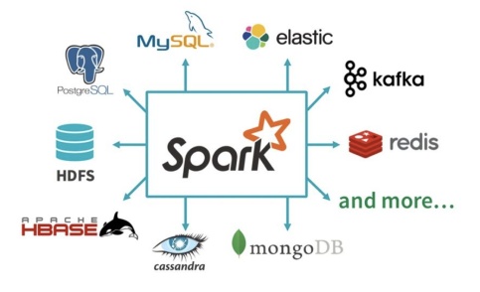
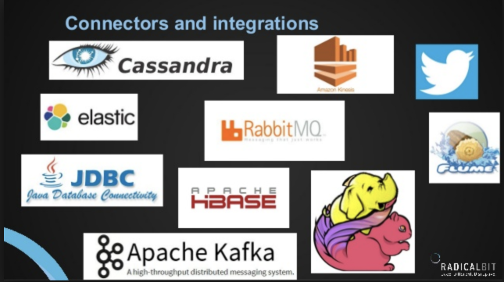
Spark VS. Flink
与第三方的集成

Slide 47
Spark VS. Flink
其他特性
 | Spark | Flink
内存计算 | ✔ | ✔
流批统一api | ✔ | ✔
window | 仅支持TimeWindow | Time、Count、Session及自定义窗口
Exactly once语义 | 实现复杂 | ✔
DAG | ✔ | ✔（还支持有向有环图）
错误恢复机制 | ✔ | ✔
状态管理 | ✔（简单） | ✔（支持超大规模状态）
CEP |  | ✔

Slide 48
Spark VS. Flink
总结
Spark 社区在规模和活跃程度上都是领先的。
两者都有相对比较成熟的生态系统，Spark 的生态总体更完善一些。
Flink 在流计算上有明显优势，核心架构和模型也更透彻和灵活一些。

Slide 49
内容提纲
01
简介
目录
02
WordCount
CONTENTS
03
Spark对比
04
总结

Slide 50
总结
介绍Flink的历史
介绍了Flink的基本使用
StreamWordCount
SQL on Flink
自定义输入源
Kafka Sources & MySql Sink
CEP
State Backend
Spark和Flink各自的优缺点

Slide 51


