Slide 1
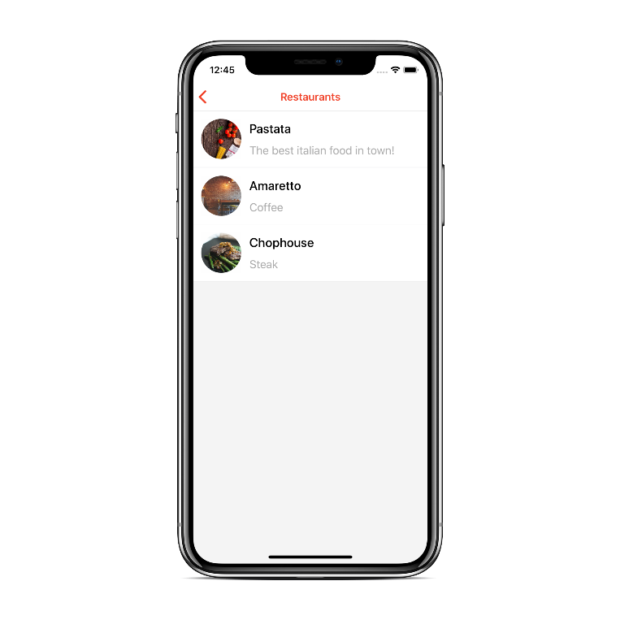

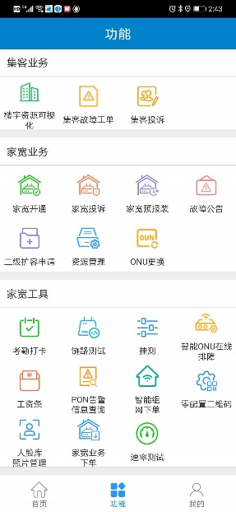
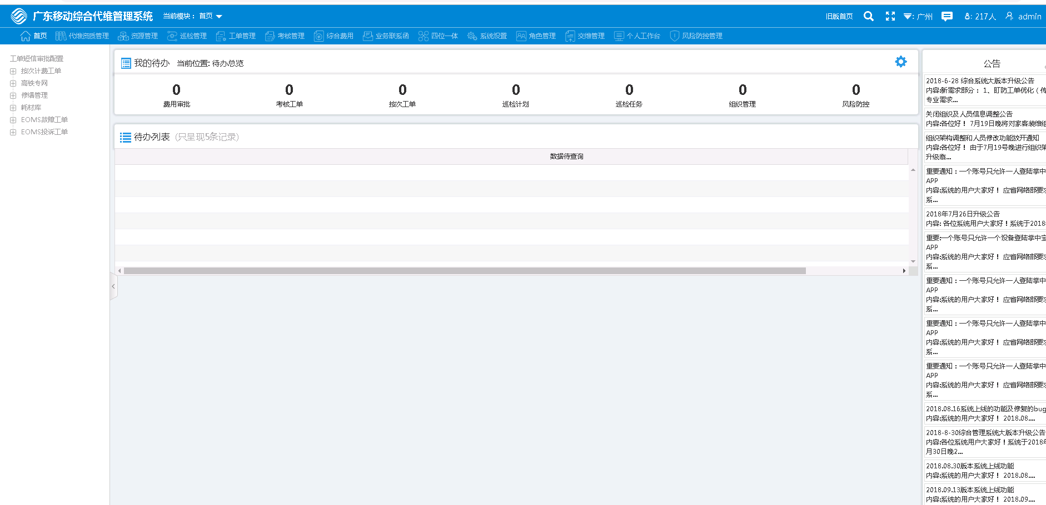
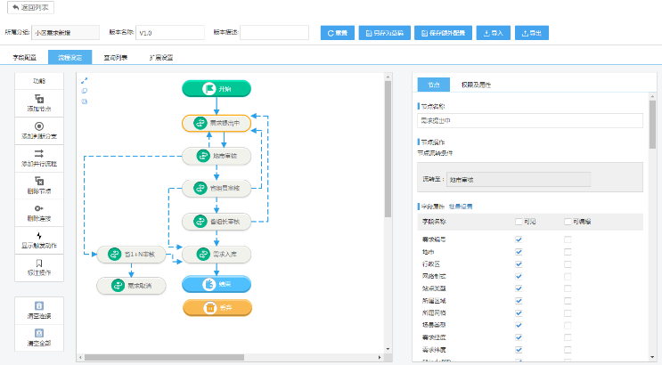

OLAP数据库的黑马
Clickhouse
深圳市名通科技股份有限公司

Slide 2
目录
第一部分
Clickhouse的诞生
第二部分
初识Clickhouse
第三部分
应用场景介绍
即席查询
用户留存分析
用户画像分析
地理索引应用

Slide 3
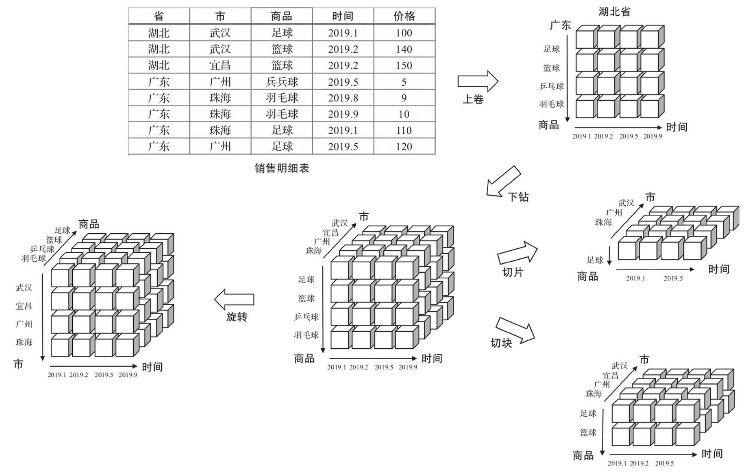
OLAP
OLAP(on-Line Analysis Processing)是使分析人员、管理人员或执行人员能够从多角度对信息进行快速、一致、交互地存取，从而获得对数据的更深入了解的一类软件技术。
OLAP的基本多维分析操作：
上卷
下钻
切片
切块
旋转
关系型
数据立方体

Slide 4
OLAP类型
ROLAP
(Relational OLAP)
HOLAP
(Hybrid OLAP)
MOLAP
(Multidimensional OLAP)
类型
关系数据库的OLAP
多维数据组织的OLAP
混合数据组织的OLAP
特点
sql查询，简单易用
实时汇聚，维度灵活
环境简单
预统计
海量数据快速查询
ROLAP与MOLAP的混合
问题
数据承载能力小
数据膨胀(2^{n}-1)
查询滞后
无法查询明细
维度固定
代表
oracle、mysql
greenplum、vertica
kylin、Druid

Slide 5
“喀秋莎”数据库Clickhouse的诞生
ClickHouse出自俄罗斯的Yandex搜索引擎公司，世界上最大的俄语搜索引擎。为了更好得帮助自身及用户分析网络流量，推出一款叫Yandex.Metrica的在线流量分析产品。
ROLAP
(Relational OLAP)
HOLAP
(Hybrid OLAP)
MOLAP
(Multidimensional OLAP)
阶段
mysql(MyISAM)
Metrage
Metrage + OLAPServer
性能
5800亿行，90%<=26秒
3万亿行，90%<=1秒
问题
数据量瓶颈
维度固定，无法自定义分析
阶段
Clickhouse
性能
每天200亿，总计20万亿行，集群400台，90%<=1秒

Slide 6
目录
第一部分
Clickhouse的诞生
第二部分
初识Clickhouse
第三部分
应用场景介绍
即席查询
用户留存分析
用户画像分析
地理索引应用

Slide 7

Clickhouse的特点
卓越性能
列式存储与数据压缩
写入快（50~200MB/S）
查询快
压缩比高(支持LZ4, ZSTD)
极大地节约了IO带宽
数据存储
完备的DBMS功能
自管理存储，不依赖其他组件
主键索引/二级索引
数据集分片(sharding)
数据分区(partition)
数据容灾和TTL支持
DDL(数据定义语言)
DML(数据操作语言）
权限控制
数据备份与恢复
分布式管理
向量化执行引擎
SQL支持
分布式计算
多核并行计算
向量化执行与SIMD
动态代码生成
对用户友好的SQL语法
内置功能齐全的分析统计函数
丰富的数据结构，字典、json、array、bitmap等

Slide 8
Clickhouse的列式存储
IO
CPU
减少IO。行式存储需要读整行，列式存储只读需要的列。
压缩比高。同一列数据类型相同，压缩效果显著。
更好的缓存效果。数据压缩带来更多系统缓存，跟高的缓存命中率。
降低CPU等待。执行一个查询需要处理大量行，按向量执行操作比按行执行操作更高效。

Slide 9
Clickhouse的存储引擎
合并树系列
日志系列
集成
特殊
MergeTree
SummingMergeTree
AggregatingMergeTree
ReplacingMergeTree
CollapsingMergeTree
VersionedCollapsingMergetree
ReplicatedMergeTree
……
Log
StripeLog
TinyLog
JDBC
ODBC
MySql
Kafka
HDFS
Distributed
Dictionary
Memory
Buffer
View
MaterializedView
Merge
File
……
手动挡的赛车

Slide 10
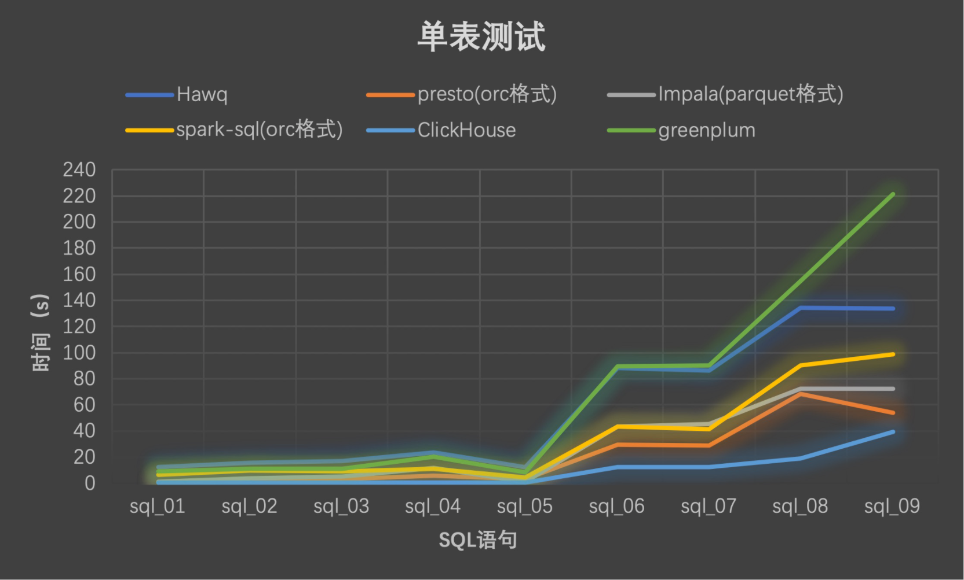
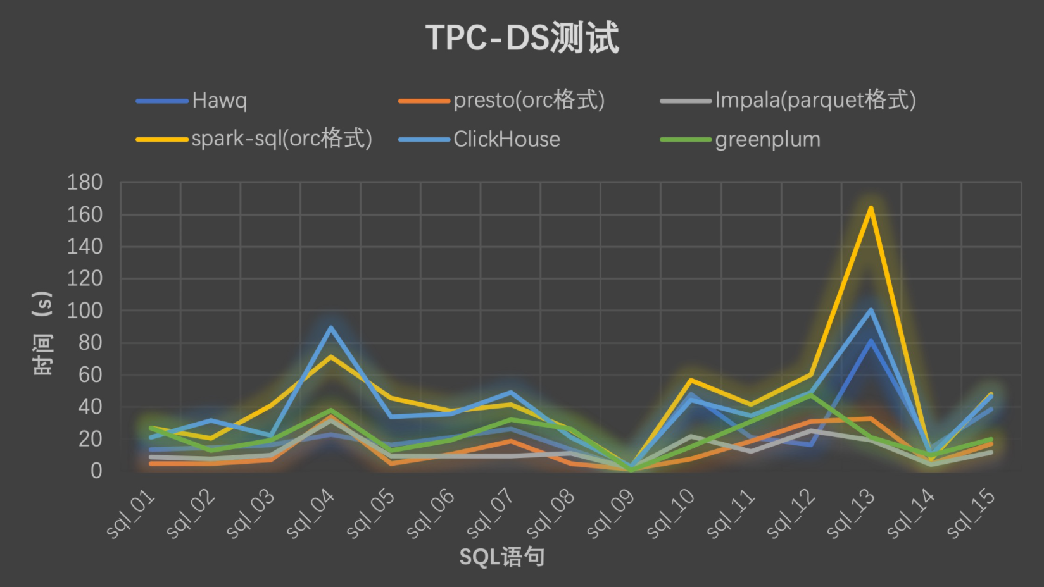
Clickhouse的优缺点
优点
缺点
ROLAP
在线实时查询
完整的DBMS
列式存储
不需要任何数据预处理
支持批量更新
具有非常完善的SQL支持和函数
支持高可用
不依赖Hadoop复杂生态
开箱即用
不支持事务
不支持高并发，官方建议qps为100
缺少高频率，低延迟的修改或删除已存在数据的能力
关联查询不是特别快
稀疏索引使得ClickHouse不适合通过key做单行点查询
简单易用
维护简单
省钱
快

Slide 11
目录
第一部分
Clickhouse的诞生
第二部分
初识Clickhouse
第三部分
应用场景介绍
即席查询
用户留存分析
用户画像分析
地理索引应用

Slide 12
Clickhouse的即席查询
模拟(性能)：
50W小区1个月所有小时Counter
875个字段，3.5亿条数据
select toDate(time), country ,
(sum(ifnull(ltehb11_erab_nbrreqrelenb_qci1,0)) -sum(ifnull(ltehb11_erab_nbrreqrelenb_normal_qci1,0)) +sum(ifnull(ltehb12_erab_hofail_qci1,0)))/sum(ifnull(ltehb06_erab_nbrsuccestab_qci1,0)) as `volte指标_e-rab掉线率(qci=1)`,
(sum(ifnull(ltehb11_erab_nbrreqrelenb_qci2,0)) -sum(ifnull(ltehb11_erab_nbrreqrelenb_normal_qci2,0)) +sum(ifnull(ltehb12_erab_hofail_qci2,0)))/(sum(ifnull(ltehb15_erab_nbrleft_qci2,0))+sum(ifnull(ltehb06_erab_nbrsuccestab_qci2,0)) +sum(ifnull(ltehb04_erab_nbrhoinc_qci2,0))) as `volte指标_e-rab掉线率(qci=2)`,
sum(ltehb06_erab_nbrsuccestab_qci1)/sum(ltehb05_erab_nbrattestab_qci1) as `volte指标_e-rab建立成功率(qci=1)`,
sum(ltehb06_erab_nbrsuccestab_qci2)/sum(ltehb05_erab_nbrattestab_qci2) as `volte指标_e-rab建立成功率(qci=2)`,
sum(ltehe04_iratho_succoutgeran)/sum(ltehe01_iratho_attoutgeran) as `volte指标_esrvcc切换成功率`,
sum(ltehe05_iratho_avgtimeoutgeran) as `volte指标_esrvcc切换中断时延-控制面`,
(sum(ltehd04_ho_succoutinterenbs1_2)+sum(ltehd10_ho_succoutinterenbx2_2)+sum(ltehd14_ho_succoutintraenb_2))/(sum(ltehd01_ho_attoutinterenbs1_2)+sum(ltehd07_ho_attoutinterenbx2_2)+sum(ltehd13_ho_attoutintraenb_2)) as `volte指标_qci2承载切换成功率`,
sum(greater(ltehb17_erab_activemaxnbrdl_qci2,ltehb19_erab_activemaxnbrul_qci2)) as `volte指标_volte视频峰值用户数`,
sum(ltehb01_erab_nbrmeanestab_qci2) as `volte指标_volte视频话务量`,
(sum(ltehh01_pdcp_upoctul_qci2)+sum(ltehh02_pdcp_upoctdl_qci2))/1000 as `volte指标_volte视频总流量`,
sum(ltehh09_pdcp_uppktdelaydl_qci1)/(sum(ltehh07_pdcp_nbrpktdl_qci1)-sum(ltehh08_pdcp_nbrpktlossdl_qci1)) as `volte指标_volte下行平均时延`,
1-sum(ltehm03_mac_nbrsuccinittbul)/sum(ltehm02_mac_nbrinittbul) as `volte指标_volte业务上行ibler`,
1-sum(ltehm07_mac_nbrsuccinittbdl)/sum(ltehm06_mac_nbrinittbdl) as `volte指标_volte业务下行ibler`,
(sum(ifnull(ltehd04_ho_succoutinterenbs1_1,0))+sum(ifnull(ltehd10_ho_succoutinterenbx2_1,0))+sum(ifnull(ltehd14_ho_succoutintraenb_1,0)))/(sum(ifnull(ltehd01_ho_attoutinterenbs1_1,0))+sum(ifnull(ltehd07_ho_attoutinterenbx2_1,0))+sum(ifnull(ltehd13_ho_attoutintraenb_1,0))) as `volte指标_volte用户切换成功率`,
sum(greater(ltehb17_erab_activemaxnbrdl_qci1,ltehb19_erab_activemaxnbrul_qci1)) as `volte指标_volte语音峰值用户数`,
sum(ltehb01_erab_nbrmeanestab_qci1) as `volte指标_volte语音话务量`,
sum(ltehh01_pdcp_upoctul_qci1)*8/sum(ltehi13_rru_dtchprbassntotalul_1) as `volte指标_volte语音上行每prb平均吞吐量`,
sum(ltehi13_rru_dtchprbassntotalul_1)/sum(ltehi09_rru_ttitotul) as `volte指标_volte语音上行每tti占用rb数`,
sum(ltehh02_pdcp_upoctdl_qci1)*8/sum(ltehi14_rru_dtchprbassntotaldl_1) as `volte指标_volte语音下行每prb平均吞吐量`,
sum(ltehi14_rru_dtchprbassntotaldl_1)/sum(ltehi10_rru_ttitotdl) as `volte指标_volte语音下行每tti占用rb数`,
(sum(ltehh01_pdcp_upoctul_qci1)+sum(ltehh02_pdcp_upoctdl_qci1))/1000 as `volte指标_volte语音总流量`,
sum(ltehm09_mac_nbrspstbul_1)/sum(ltehm01_mac_nbrtbul_1) as `volte指标_上行半持续调度次数占比`,
sum(ltehb06_erab_nbrsuccestab_qci1)/sum(ltehb05_erab_nbrattestab_qci1)*(sum(lteha06_rrc_succconnestab)/sum(lteha05_rrc_attconnestab)) as `volte指标_无线接通率(qci=1)`,
sum(ltehb06_erab_nbrsuccestab_qci2)/sum(ltehb05_erab_nbrattestab_qci2)*(sum(lteha06_rrc_succconnestab)/sum(lteha05_rrc_attconnestab)) as `volte指标_无线接通率(qci=2)`,
sum(ltehm10_mac_nbrspstbdl_1)/sum(ltehm05_mac_nbrtbdl_1) as `volte指标_下行半持续调度次数占比`
from default.tb_aaa_test_all_counter tatac
WHERE time >= '2017-05-11 00:00:00' and time < '2017-05-12 00:00:00'
group by toDate(time), country
order by toDate(time), country;
入库速度
字段数 | 行数 | 总大小 | 时间
875 | 47W | 1.4G | 20秒
875 | 1100W | 34G | 9分30秒
875 | 11000W | 340G | 8112秒
存储
原始大小 | 存储大小 | 压缩比
1055 | 39 | 3.70%
7.25 | 1.2 | 16.55%
2.47 | 0.5 | 20.24%
查询速度
字段数 | 总行数 | 读取行数 | 统计指标数 | 结果行数 | 查询类型 | 时间
875 | 3.5Y | 1128W | 25 | 47W | 天小区指标汇聚 | 1.3s
875 | 3.5Y | 1128W | 25 | 3 | 天地市指标汇聚 | 1.1s
875 | 3.5Y | 1128W | 25 | 16 | 天区县指标汇聚 | 1.1s
875 | 3.5Y | 47W | 7 | 47W | 按时间查询1小时 | 22~100ms
875 | 3.5Y | 265 | 7 | 265 | 按小区查询 | 21~300ms

Slide 13
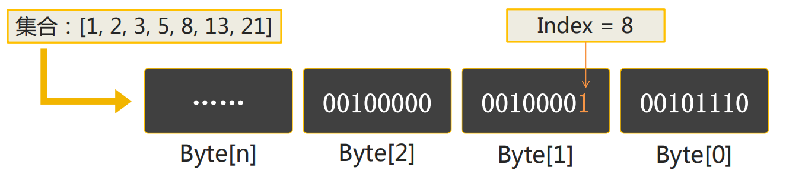
Clickhouse的位存储与位计算
原理
40亿个用户id正常存储需要14.9GB，使用bit存储，每个bit位表示一个数字id，40亿个的用户id，只需要40亿bit位，约477m大小 = （4 * 10⁹ / 8 / 1024 / 1024），约为正常存储的3%。
优化
使用这种存储结构存在一个问题，如果只有一个第40亿用户，也需要477M的存储。通常会使用bitmap压缩算法进行优化，业界普遍使用RoaringBitmap压缩算法，clickhouse也是使用的这种算法。
场景
通过单个bitmap可以完成精确去重操作，通过多个bitmap的and、or、xor、andnot等位操作完成留存分析、漏斗分析、用户画像分析等场景的计算。

Slide 14
Clickhouse的位存储与位计算
bitmapBuild
Integer
bitmapToArray
Array
运算类
bitmapAnd、bitmapOr
bitmapXor、bitmapAndnot
bitmapSubsetInRange
bitmapSubsetLimit
groupBitmapState
聚合类
groupBitmapAnd
groupBitmapOr
groupBitmapXor
Bitmap
Integer
求值类
bitmapCardinality
bitmapAndCardinality
bitmapOrCardinality
bitmapXorCardinality
bitmapAndnotCardinality
bitmapContains
bitmapHasAny、bitmapHasAll
bitmapMin、bitmapMax

Slide 15
用户留存分析示例
1、创建表
2、插入数据
3、查询
CREATE TABLE users_online
(
date Date,
uid UInt64,
page_id UInt64
)
ENGINE = MergeTree()
PARTITION BY toYear(date)
ORDER BY uid;
INSERT INTO users_online
SELECT
'2020-07-29' AS date,
number AS uid,
(number % 10) + 1 AS page_id
FROM numbers(1, 100000000);
SELECT countDistinct(a.uid) AS users
FROM
(
SELECT DISTINCT uid
FROM users_online
WHERE date = '2020-07-29'
) AS a
INNER JOIN
(
SELECT DISTINCT uid
FROM users_online
WHERE date = '2020-07-30'
) AS b ON a.uid = b.uid;
INSERT INTO users_online
SELECT
'2020-07-30' AS date,
number AS uid,
(number % 10) + 1 AS page_id
FROM numbers(10000000, 100000000);

Slide 16
用户留存分析示例-bitmap
1、创建表
2、插入数据
3、查询
CREATE TABLE users_online_agg
(
date Date,
uv AggregateFunction(groupBitmap, UInt64)
)
ENGINE = AggregatingMergeTree()
PARTITION BY toYear(date)
ORDER BY date;
INSERT INTO users_online_agg
SELECT
date,
groupBitmapState(toUInt64(uid)) AS uv
FROM users_online
GROUP BY date;
WITH
(
SELECT uv
FROM users_online_agg
WHERE date = '2020-07-29'
) AS a,
(
SELECT uv
FROM users_online_agg
WHERE date = '2020-07-30'
) AS b
SELECT bitmapAndCardinality(a, b) AS users;
2.1、动态插入
CREATE MATERIALIZED VIEW mv_users_online_agg_daily TO users_online_agg AS
SELECT
date,
groupBitmapState(uid) AS uv
FROM users_online
GROUP BY date;
留存：day1 AND day2
总数：day1 OR day2
流失：day1 ANDNOT day2
新增：day2 ANDNOT day1

Slide 17
用户画像分析示例
用户画像的典型应用场景：圈定一批人发放优惠券。
评估人数（圈选）
人群画像
用户清单
女的
学生
年龄在18-21之间
年龄分布是怎样的
VIP等级分布是怎样的
标签不定
条件不定
二次筛选

Slide 18
用户画像分析示例
1、创建用户标签表
2、创建标签表
3、创建物化视图
CREATE TABLE user_properties_string
(
uid UInt64,
label String,
value String
)
ENGINE = MergeTree()
ORDER BY uid;
CREATE TABLE labels_string
(
label String,
value String,
uv AggregateFunction(groupBitmap, UInt64)
)
ENGINE = AggregatingMergeTree()
PARTITION BY label
ORDER BY (label, value);
CREATE MATERIALIZED VIEW mv_labels_string TO labels_string AS
SELECT
label,
value,
groupBitmapState(uid) AS uv
FROM user_properties_string
GROUP BY label, value;
CREATE TABLE user_properties_integer
(
uid UInt64,
label String,
value UInt64
)
ENGINE = MergeTree()
ORDER BY uid;
CREATE TABLE labels_integer
(
label String,
value UInt64,
uv AggregateFunction(groupBitmap, UInt64)
)
ENGINE = AggregatingMergeTree()
PARTITION BY label
ORDER BY (label, value);
CREATE MATERIALIZED VIEW mv_labels_integer TO labels_integer AS
SELECT
label,
value,
groupBitmapState(uid) AS uv
FROM user_properties_integer
GROUP BY label, value;
CREATE TABLE user_properties_float
(
uid UInt64,
label String,
value Float64
)
ENGINE = MergeTree()
ORDER BY uid;
CREATE TABLE labels_float
(
label String,
value Float64,
uv AggregateFunction(groupBitmap, UInt64)
)
ENGINE = AggregatingMergeTree()
PARTITION BY label
ORDER BY (label, value);
CREATE MATERIALIZED VIEW mv_labels_float TO labels_float AS
SELECT
label,
value,
groupBitmapState(uid) AS uv
FROM user_properties_float
GROUP BY label, value;

Slide 19
用户画像分析示例
4、插入数据
4、插入数据
5、查看标签表
INSERT INTO user_properties_string
SELECT
number AS uid,
'gender' AS label,
multiIf((number % 3) = 0, 'F', 'M') AS value
FROM numbers(40000000);
INSERT INTO user_properties_integer
SELECT
number AS uid,
'age' AS label,
multiIf((number % 9) = 0, (number % 30) + 1, (number % 4) = 0, (number % 10) + 30, number % 60) AS value
FROM numbers(40000000);
SELECT
label,
value,
groupBitmapMerge(uv)
FROM labels_string
GROUP BY
label,
value;
INSERT INTO user_properties_string
SELECT
number AS uid,
'career' AS label,
multiIf((number < 10000000) = 0, 'Student', 'Engineer') AS value
FROM numbers(40000000);
INSERT INTO user_properties_integer
SELECT
number AS uid,
'level' AS label,
rand() % 10 AS value
FROM numbers(40000000);
SELECT
label,
value,
groupBitmapMerge(uv)
FROM labels_integer
GROUP BY
label,
value
LIMIT 10;

Slide 20
用户画像分析示例
6、圈选
7、人群画像
8、用户清单
SELECT bitmapAndCardinality(bitmapAnd(a, b), c) AS users
FROM
(
SELECT
1 AS j1,
groupBitmapMergeState(uv) AS a
FROM labels_string
WHERE label = 'gender' AND value = 'F'
) A
INNER JOIN
(
SELECT
1 AS j2,
groupBitmapMergeState(uv) AS b
FROM labels_string
WHERE label = 'career' AND value = 'Student'
) B ON j1 = j2
INNER JOIN
(
SELECT
1 AS j3,
groupBitmapMergeState(uv) AS c
FROM labels_integer
WHERE label = 'age' AND value > 17 AND value < 22
) C ON j2 = j3;
SELECT label, value, bitmapAndCardinality(users, checkout_users) AS users
FROM (
SELECT 1 AS joinId,
label,
value,
groupBitmapMergeState(uv) AS users
FROM labels_string
GROUP BY
label,
value
UNION ALL
SELECT 1 AS joinId,
label,
toString(value) AS value,
groupBitmapMergeState(uv) AS users
FROM labels_integer
GROUP BY
label,
value
) aaa
INNER JOIN
(
SELECT 1 AS joinId, bitmapAnd(bitmapAnd(a, b), c) AS checkout_users
FROM
(
SELECT
1 AS j1,
groupBitmapMergeState(uv) AS a
FROM labels_string
WHERE label = 'gender' AND value = 'F'
) aa
INNER JOIN
(
SELECT
1 AS j2,
groupBitmapMergeState(uv) AS b
FROM labels_string
WHERE label = 'career' AND value = 'Student'
) bb ON j1 = j2
INNER JOIN
(
SELECT
1 AS j3,
groupBitmapMergeState(uv) AS c
FROM labels_integer
WHERE label = 'age' AND value > 17 AND value < 22
) cc ON j2 = j3
) bbb ON aaa.joinId = bbb.joinId
WHERE users > 0
ORDER BY label, value;
SELECT arrayJoin(bitmapToArray(bitmapAnd(bitmapAnd(a, b), c))) AS users_list
FROM
(
SELECT
1 AS j1,
groupBitmapMergeState(uv) AS a
FROM labels_string
WHERE label = 'gender' AND value = 'F'
) aa
INNER JOIN
(
SELECT
1 AS j2,
groupBitmapMergeState(uv) AS b
FROM labels_string
WHERE label = 'career' AND value = 'Student'
) bb ON j1 = j2
INNER JOIN
(
SELECT
1 AS j3,
groupBitmapMergeState(uv) AS c
FROM labels_integer
WHERE label = 'age' AND value > 17 AND value < 22
) cc ON j2 = j3;

Slide 21

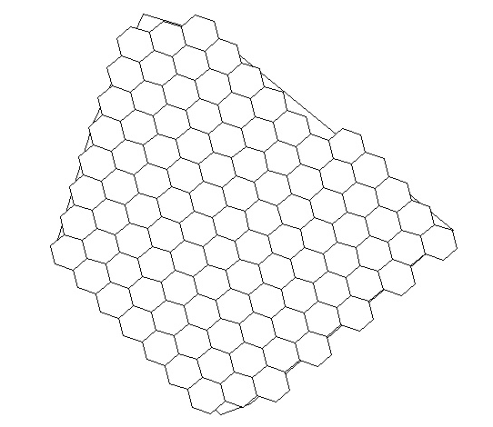

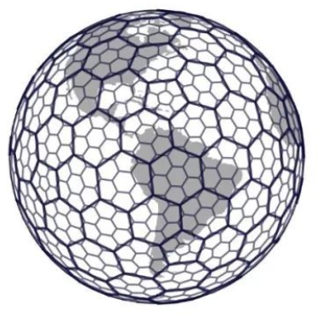
地理索引示例
栅格
GeoHash算法
Google S2算法
Uber H3算法
概况
基于矩形
简单易懂
未用于索引
基于Z介曲线
12级精度[1,12]
Clickhouse天然支持
基于希尔伯特曲线
31级精度[0,30]
基于蜂窝六边形
16级精度[0,15]
Clickhouse天然支持
样例
(x, y)
wtw37qw
3958611028950762963
636149024387050623
问题
两个维度两个字段
突变太厉害
精度跨度大，不好确定
存在突变
开源代码老旧
区域索引兼容性差
无法直接生成指定等级索引
索引生成速度比H3慢
海域不支持
区域索引会留边
y
5
4
3
2
1
x
1
2
3
4
5

Slide 22
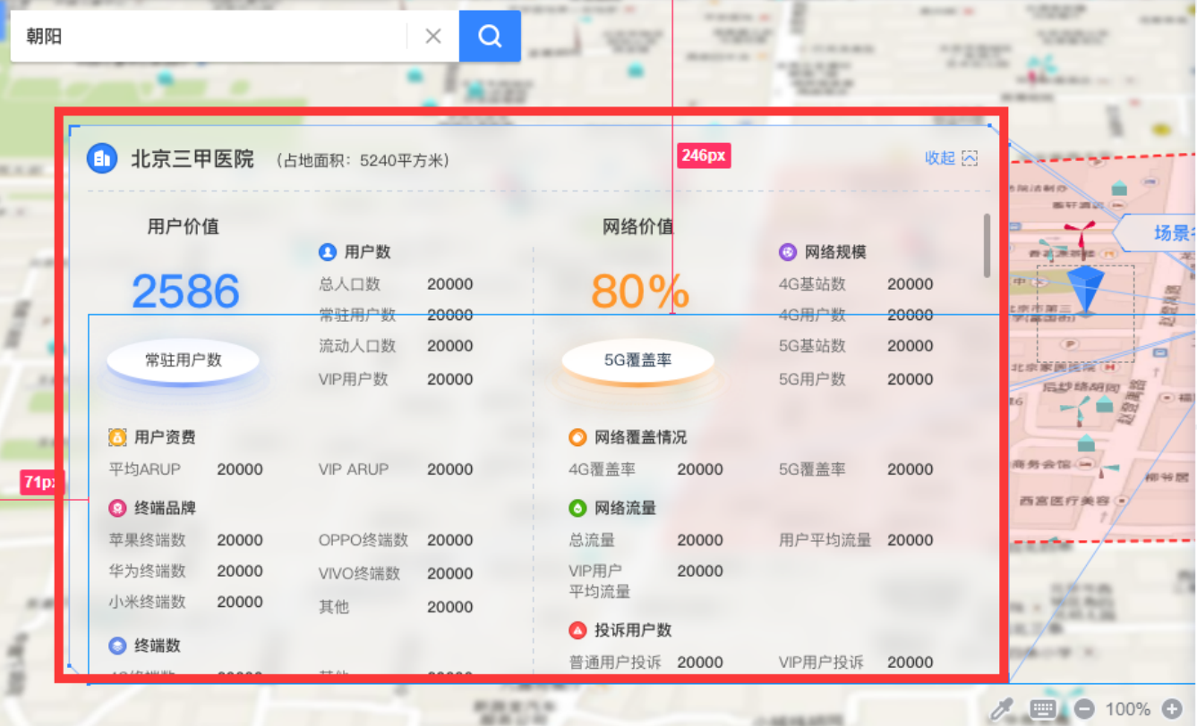
地理索引实战-价值区域
场景一：统计查询AOI采样点、用户、终端、POI等相关指标
表 | 数据量
tb_cfg_arealist_point_area_aoi_h3 | 380,225,552
tb_mr_outsample_low_yd_dd_201122 | 1,143,685,681
tb_mr_insample_mid_yd_dd_201122 | 1,312,555,120
tb_user_resident_location_dd_201118 | 37,468,986
tb_user_boss_myd | 15,062,649
tb_cfg_arealist_point_building | 33,0078
tb_cfg_poi | 4,017,103
地理索引等级：13
查询AOI的索引数量：137277
场景二：统计成都区县级采样点相关指标
表 | 数据量
tb_cfg_arealist_point_area_country_h3 | 6,310,403
tb_mr_outsample_low_yd_dd_201122 | 1,143,685,681
需求样例：根据指定AOI获取AOI各类指标统计
地理索引等级：11

Slide 23










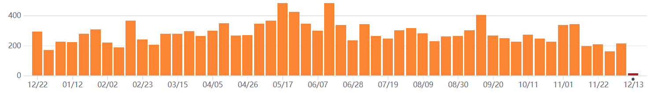
应用情况
国内使用
使用场景
实时查询
多维分析
即席查询
用户行为分析
用户留存分析
用户画像分析
图计算
运维监控
线性回归
CatBoost
社区活跃
国外使用
Yandex, CloudFlare, Spotify等

Slide 24


欢迎垂询指教：
深圳市名通科技股份有限公司
www.mastercom.cn
0755-86004500

