Slide 1
Indian startup case study analysis
By Yagay Khatri

Slide 2
Table of Contents
01
02
03
04
A complete overview of the dataset, what it is about and what data does it contain.
Insights extracted from the dataset which would help new startups in setting up and growing their company.
A five-step hypothetical scenario that will give us more insights from the data.
Plots and graphs to visualize the findings.

Slide 3
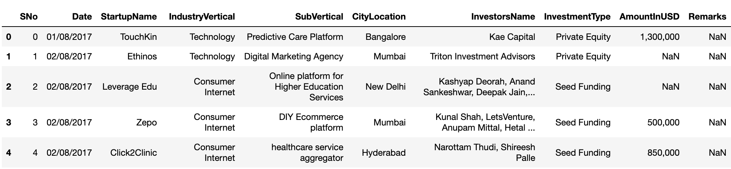
Dataset details
Feature Details :
SNo - Serial number.
Date - Date of funding in format DD/MM/YYYY from January 2015 to August 2017.
StartupName - Name of the startup which got funded.
IndustryVertical - Industry to which the startup belongs.
SubVertical - Sub-category of the industry type.
CityLocation - City which the startup is based out of.
InvestorsName - Name of the investors involved in the funding round.
InvestmentType - Either Private Equity or Seed Funding.
AmountInUSD - Funding Amount in USD.
Remarks - Other information, if any.
Dataset has 2372 rows and 10 columns.

Slide 4
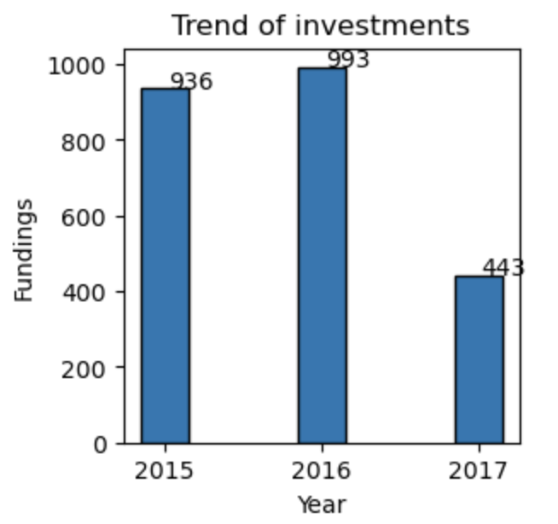
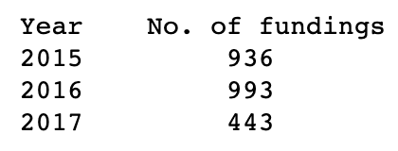
Trend of investments over the years
Result
From the analysis, we can see the comparison of Number of fundings per year – trend of investments over the years.

Slide 5
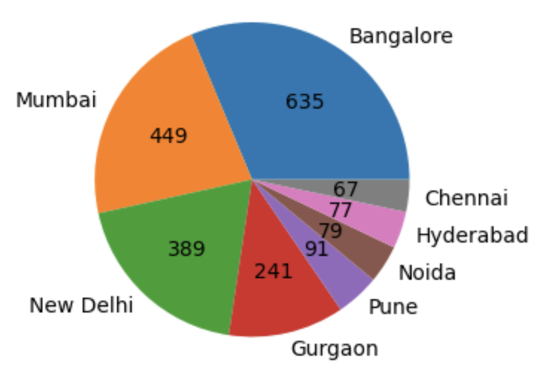
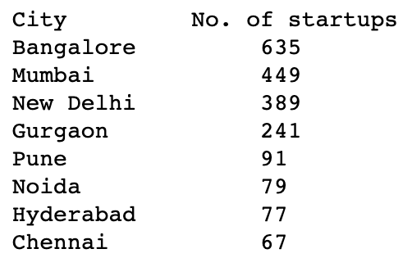
Cities vs Startups
Result
Here are the top 8 cities that are home to startups, with Bangalore on top with 635 startups.

Slide 6
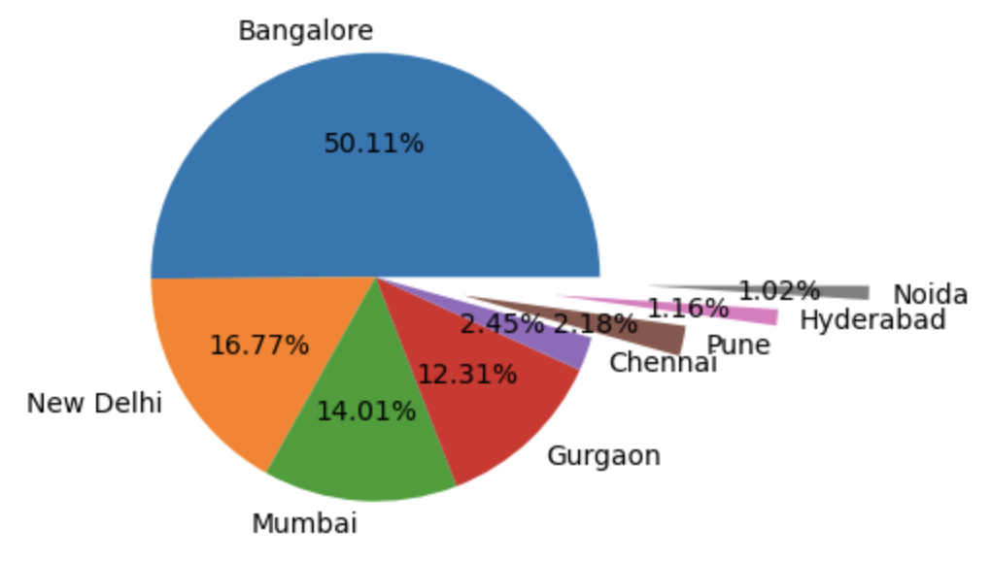
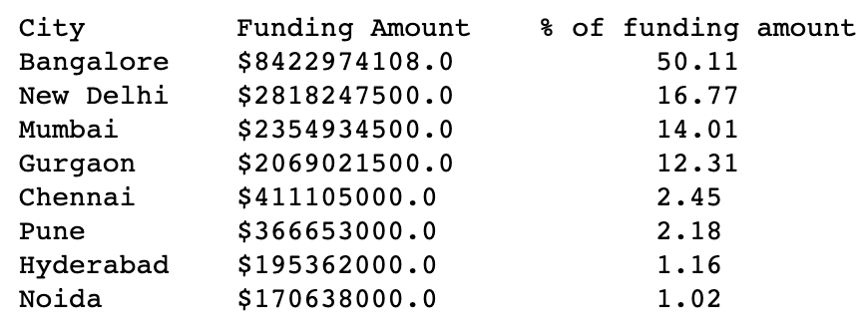
Cities vs Funding amounts
Here are the top 8 cities along with their funding amount in USD, and the % of funding amount.
We can see that Bangalore received the most funding amount with over 50% among these 8 cities.

Slide 7
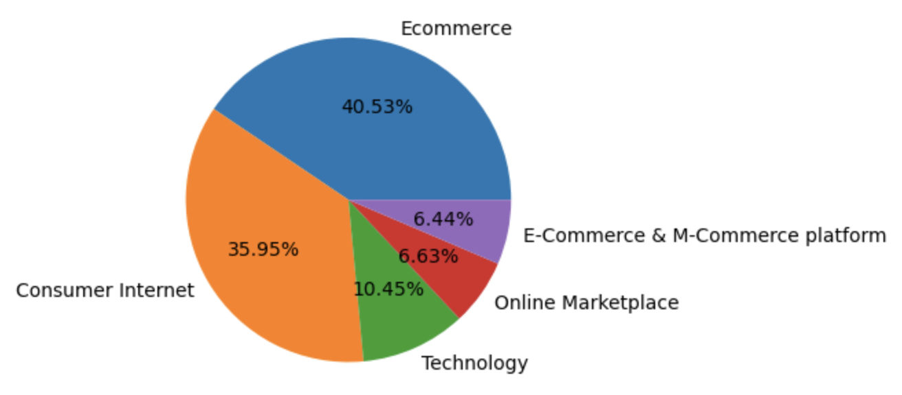
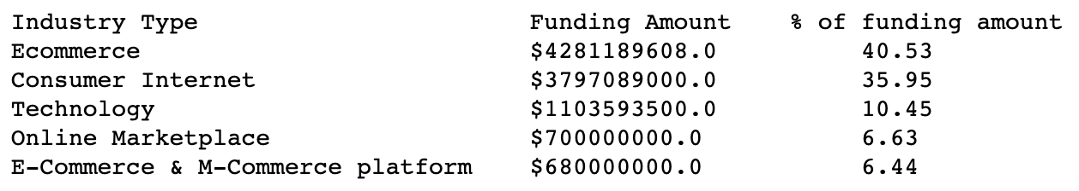
Industry vs Funding
Here are the top 8 cities along with their funding amount in USD, and the % of funding amount.
We can see that the startups in Ecommerce and Consumer internet industry vertical received the most funding.

Slide 8
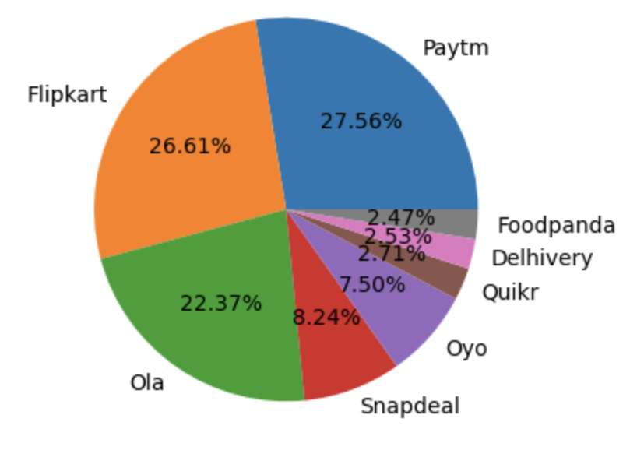
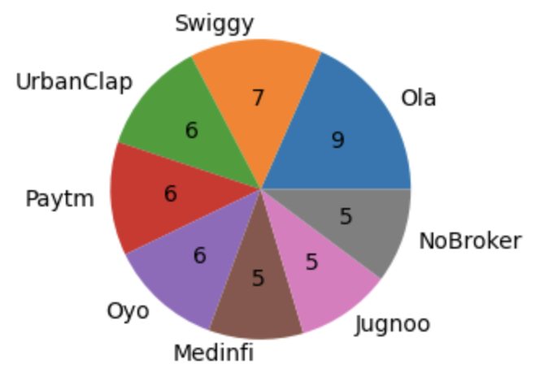
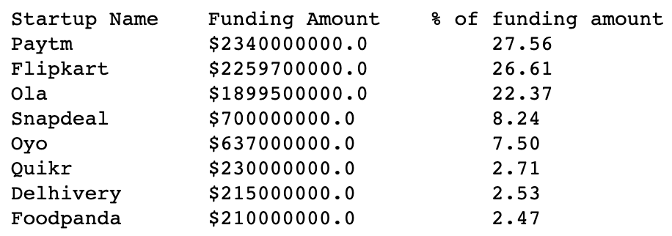
Startups vs Funding
Startups vs Funding amount
Startups vs Funding rounds
Here are the startups that received the most funding amount and rounds in the past 2.5 years.

Slide 9
Time
For a hypothetical scenario now

Slide 10
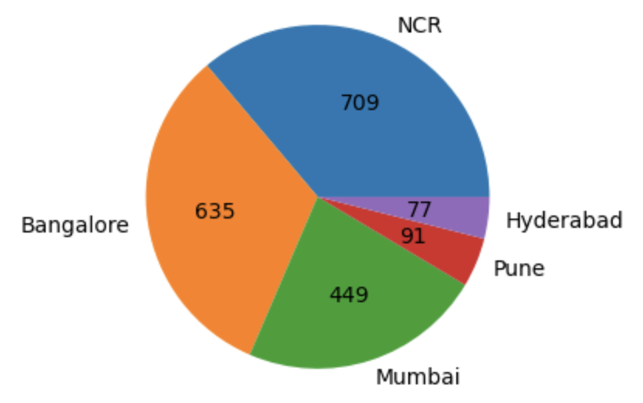
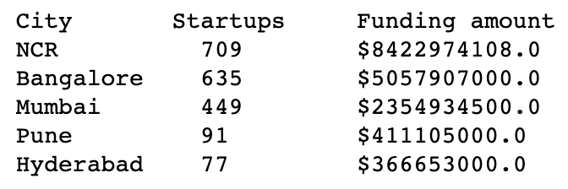
Lets say that you are launching a product startup and need help in some areas. Starting with, if you wish to launch a product startup, which will be the most suitable city.
We saw that Bangalore is the city which has the most number of startups as well as the most funding amount. But what if we club New Delhi, Gurgaon, and Noida as NCR, and then look at the number of fundings.
If we club New Delhi, Gurgaon, and Noida as NCR, then we get to know that NCR has received more fundings altogether.

Slide 11
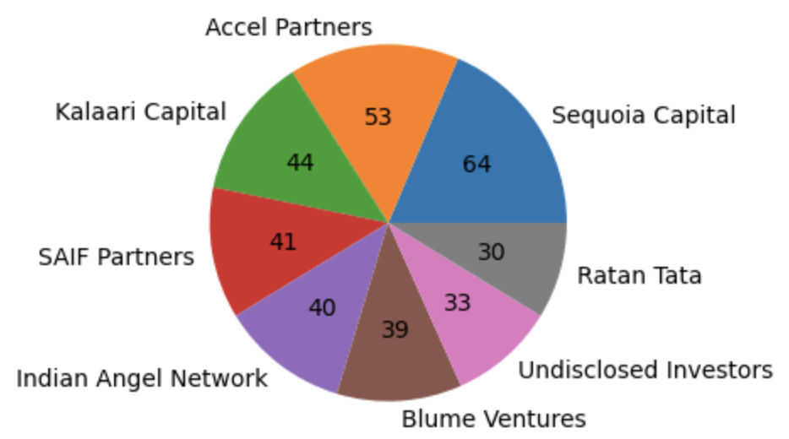
After you have chose a suitable city for establishing your product startup, now you will have to seek investment opportunities. To help you with it, let me help you find the top investors who have invested maximum number of times.
This may help your startup in getting the right investment, but this insight has a slight problem, that is some investors have invested in the same startup at different number of funding rounds.

Slide 12
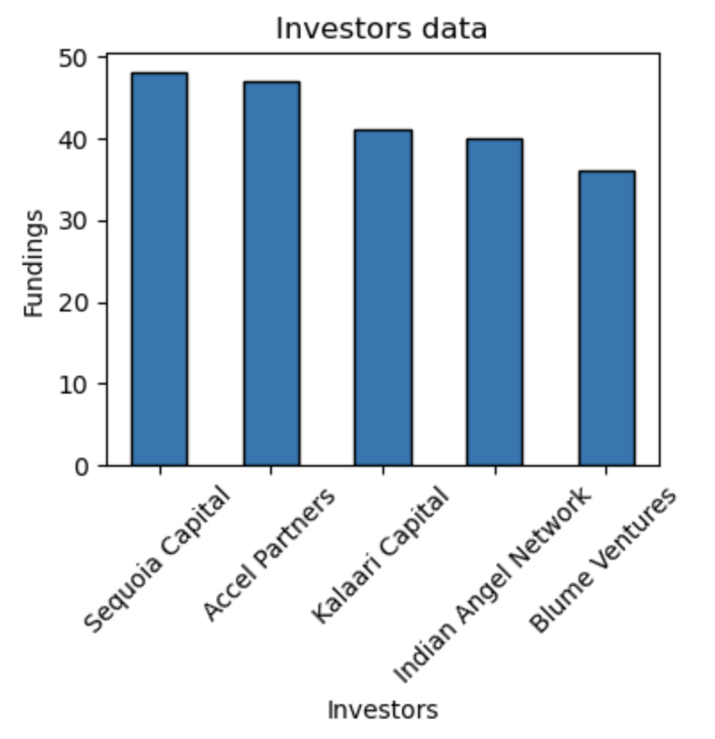
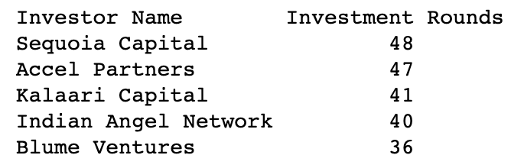
Let me now help you find top investors who have invested maximum number of times in different companies.
Now you have a more chance in getting an investment from the right investors

Slide 13
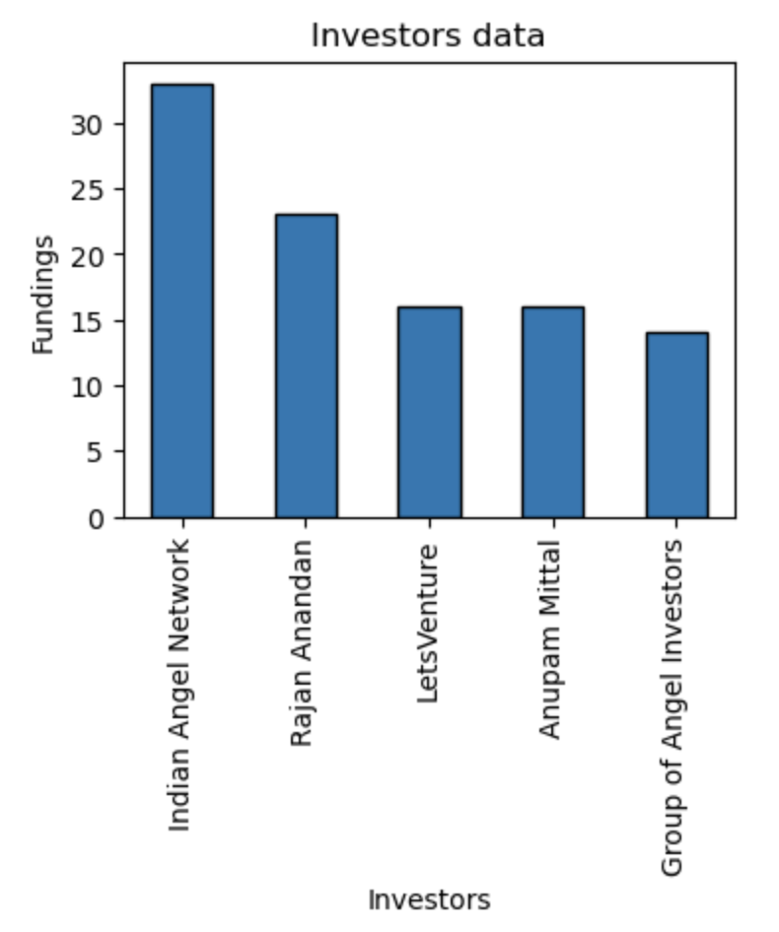
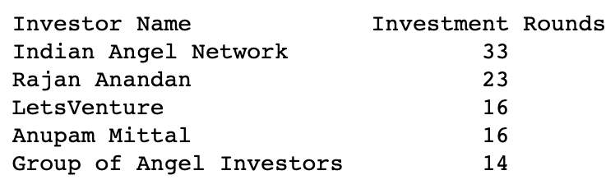
In order to select the right investor, it is important to choose the right investment. Since your startup is at an early stage startup, the best-suited investment type would be - Seed Funding and Crowdfunding. Let me help you find the top investors who have invested in a different number of startups and their investment type is Crowdfunding or Seed Funding.
After all these insights, your startup would have successfully got funding and will be on operational mode.

Slide 14
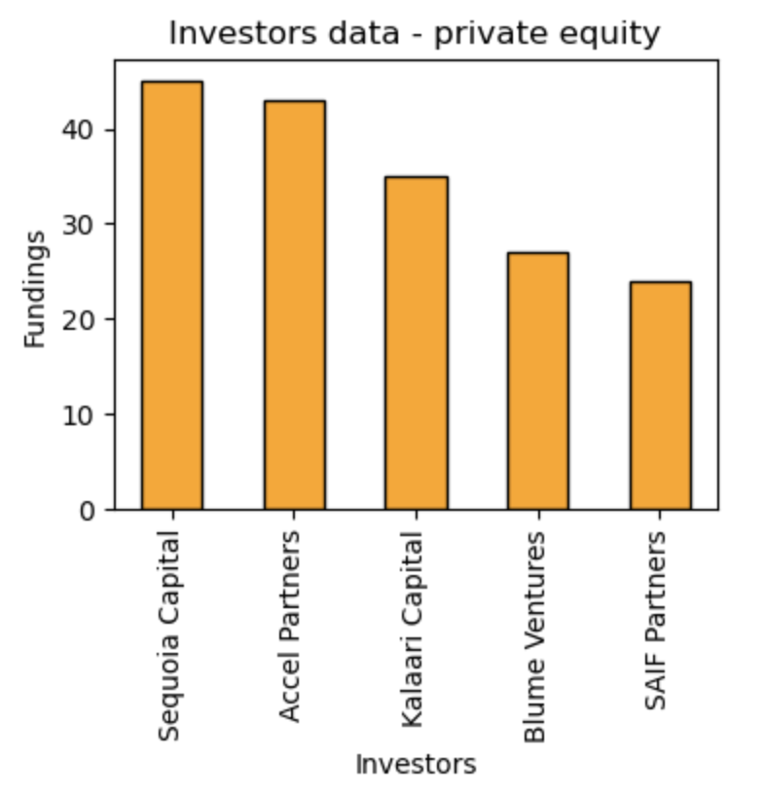
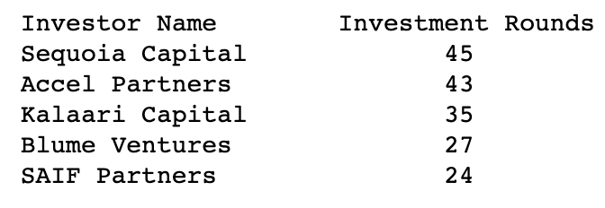
Now that your startup is in growth stage, lets me help you find private equity investment opportunities. With this information, you can look for best suited investment opportunity for your startup.
After all these insights, I hope your startup is growing and nurturing.

Slide 15
Thanks!
Contact:
Email
GitHub
LinkedIn
Case study analysis by Yagay Khatri
Language used: Python
Libraries used: csv, NumPy, pandas, matplotlib
Notebook: Jupyter
Software: Anaconda

