Slide 1
How to Install JSindo
Kiyoshi Yagi
Theoretical Molecular Science Lab.
RIKEN

Slide 2

1. Download Java
https://www.java.com/en/
click here and follow the instruction to install Java

Slide 3
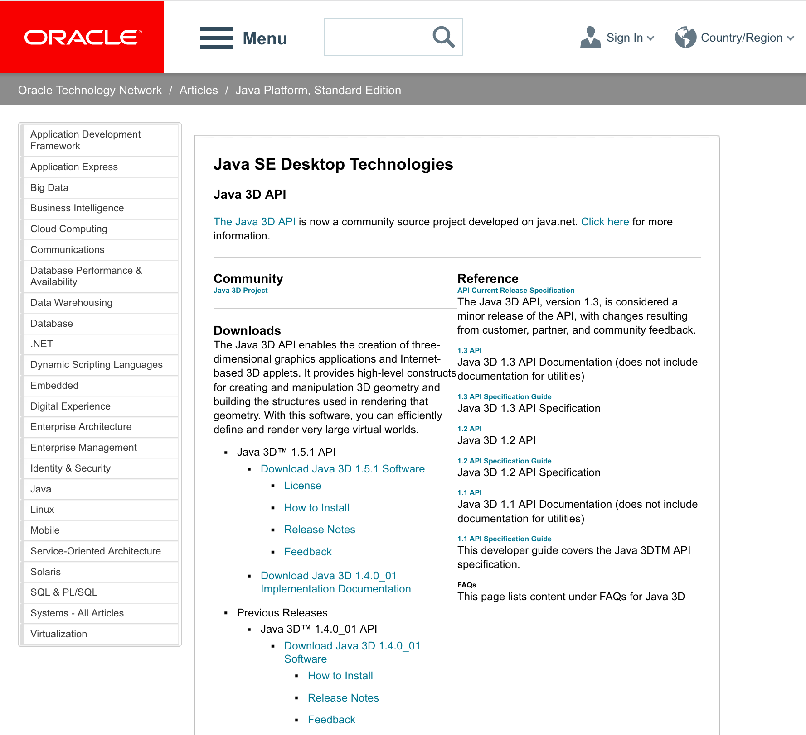
2. Setting up Java3D
2.1. Windows
Search for “java3d” in the web to find Java3D API of ORACLE,
http://www.oracle.com/technetwork/articles/javase/index-jsp-138252.html
click here

Slide 4
Before we proceed, let’s check if your Java is 32- or 64-bit. In the DOS prompt, type “java -version” and you will see a message like this:
This is an example of 64-bit. If “64-Bit” is absent, then it’s 32-bit. (It doesn’t explicitly state “32-Bit”, unfortunately.)
Alternatively, you may check these folders,
c:\Program Files\Java
c:\Program Files(x86)\Java
If you find ”jreX.X.X_XXX” in the former, your java is 64-bit, and vice versa.
>java –version
java version "1.8.0_45”
Java(TM) SE Runtime Environment (build 1.8.0_45-b14)
Java HotSpot(TM) 64-Bit Server VM (build 25.45-b02, mixed mode)

Slide 5
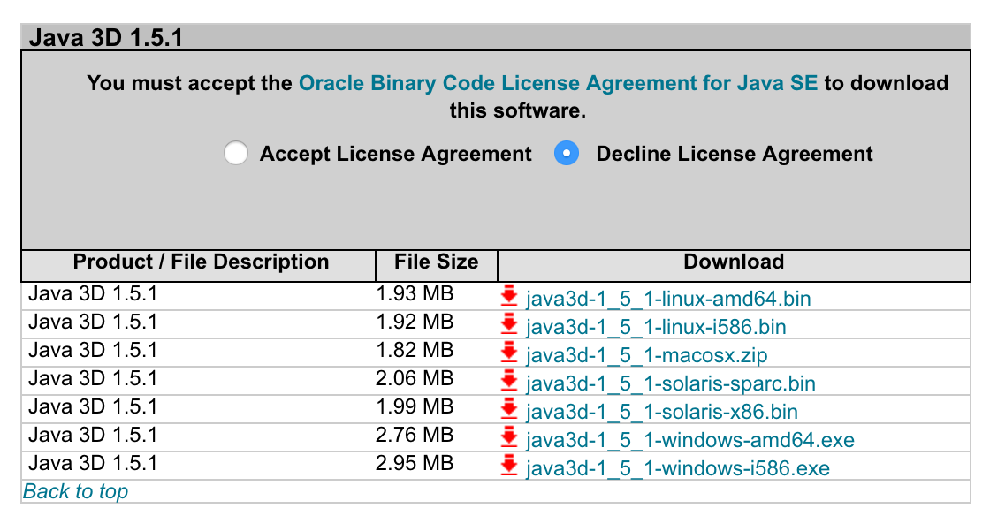
Now, we are ready to download the installer,
click accept
Click here to download
amd64 for 64-bit.
i586 for 32-bit (x86).
Double click the installer and follow the instruction. The installer creats a new folder, Java3D, in a Java folder,
64-bit c:\Program Files(x86)\Java\Java3D
32-bit c:\Program Files\Java\Java3D
In this folder, you will find three jarfiles,
Java3D\1.5.1\lib\ext\
j3dcore.jar
j3dutil.jar
vecmath.jar
Copy these three jarfiles to an extension folder of JRE,
Java\jre1.x.x_xxx\lib\ext

Slide 6
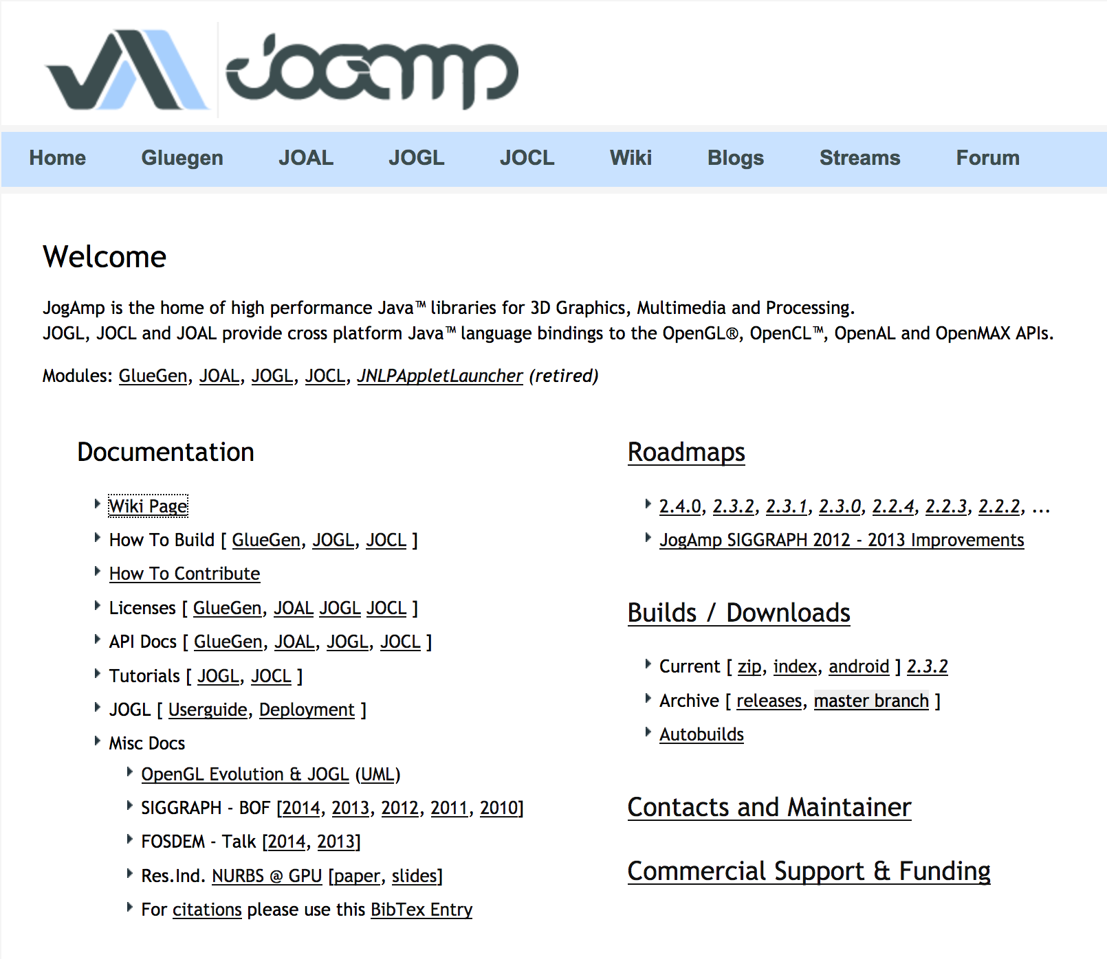
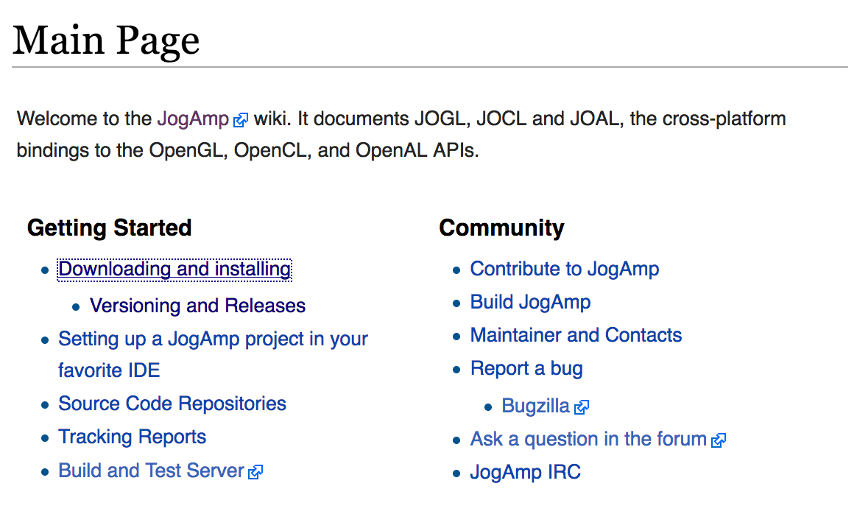
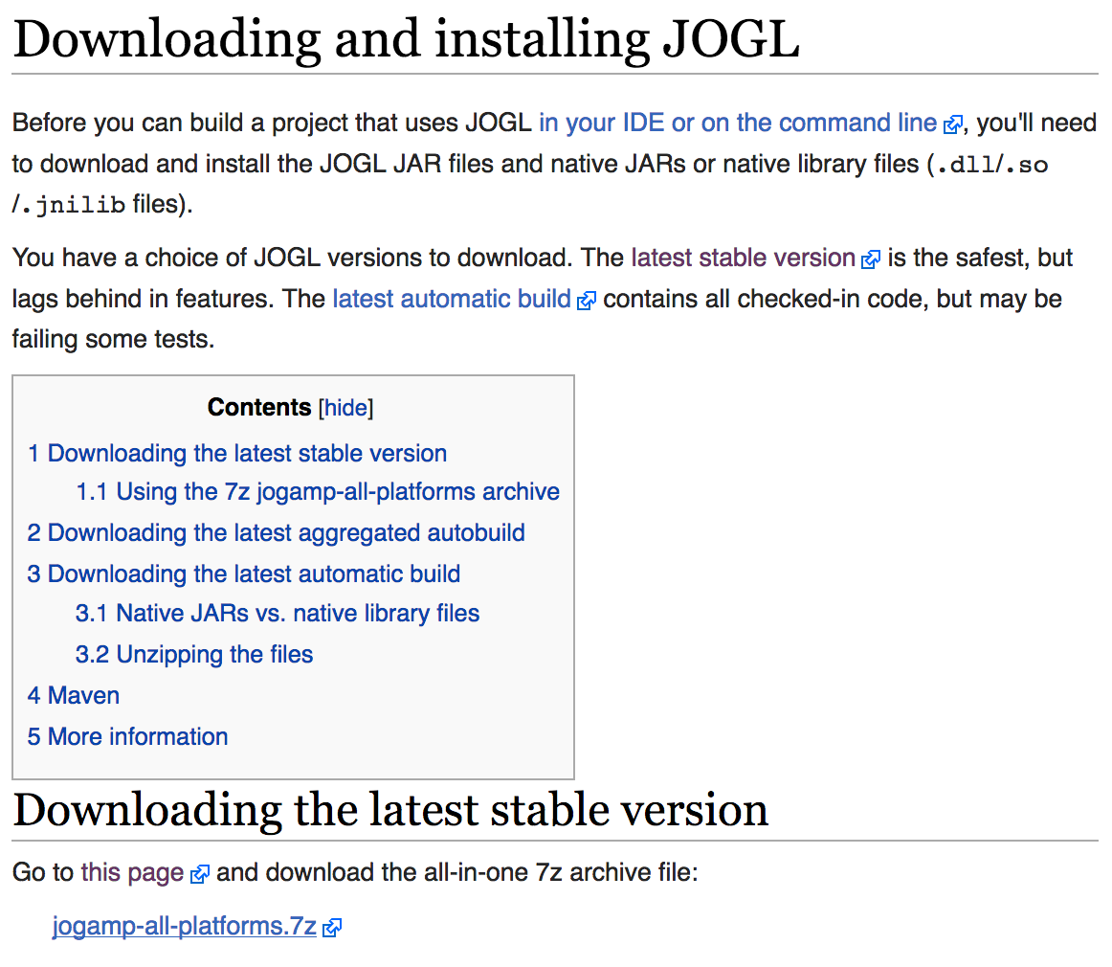
2.2. Mac OSX
Unfortunately, Java3D of ORACLE doesn’t work for Max OSX. Instead, we use Java3D wrapper of JogAmp. Goto http://jogamp.org,
click here
click here
click here and download
jogamp-all-platforms.7z

Slide 7
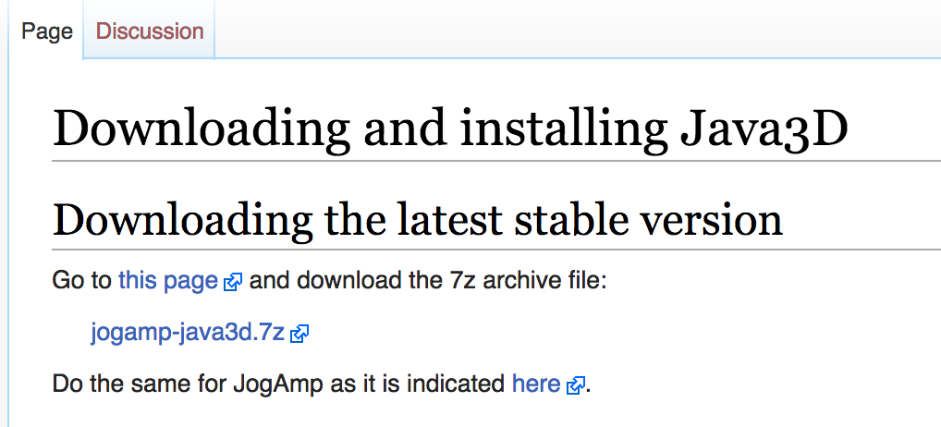
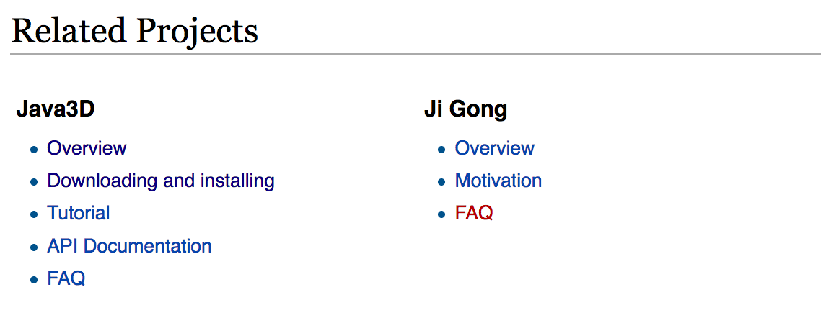

Go back to the Main page and scroll down
…
Scroll down
click here and download
jogamp-java3d.7z
click here
Unarchive the two files you just downloaded. 7z files can be unarchived using, for example, “The Unarchiver”. It’s a free program.
The Unarchiver
MacPaw Inc.
Then, copy the jar files to an extension folder:
>sudo cp jogamp-all-platforms/jar/*jar /Library/Java/Extensions/
>sudo cp jogamp-java3d/*jar /Library/Java/Extensions/

Slide 8
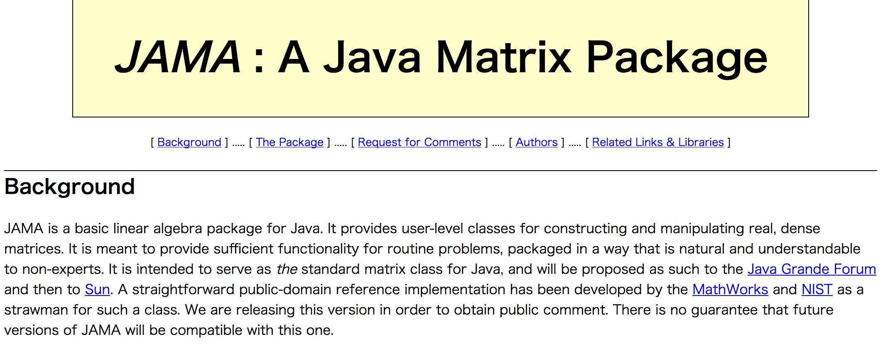
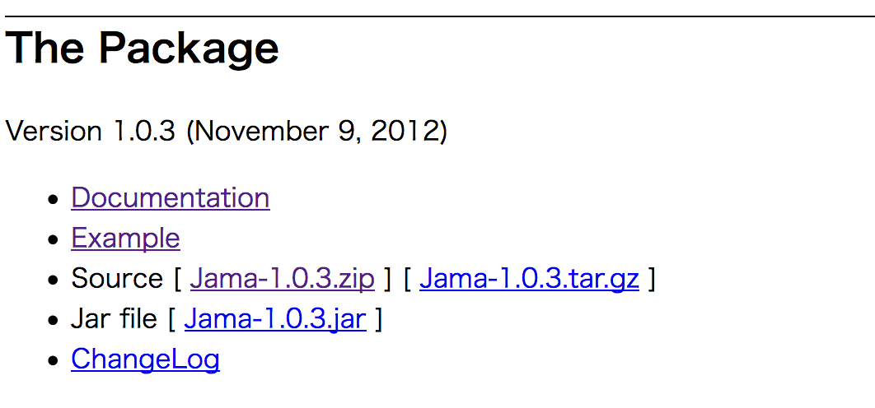
3. Download JAMA
JAMA is a linear algebra library for JAVA. We use it for matrix maltiplications, diagonalization, and so on. It can be downloaded from,
https://math.nist.gov/javanumerics/jama/
…
Scroll down
click here and download a jarfile.
Then, copy the jarfile to the extension folder as before.

Slide 9
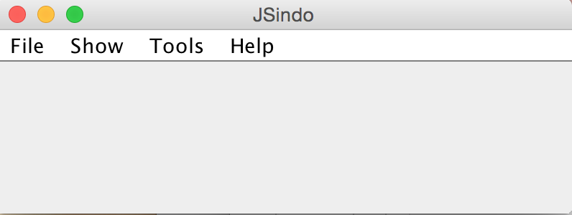
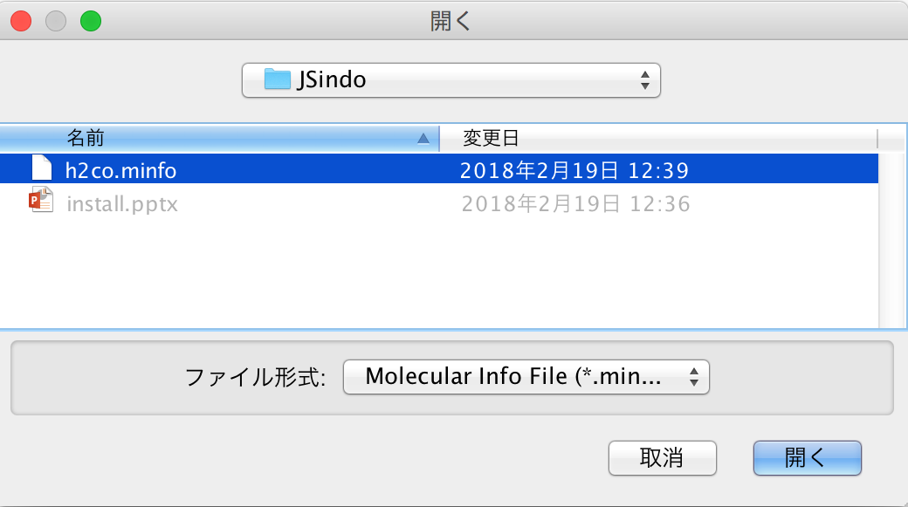
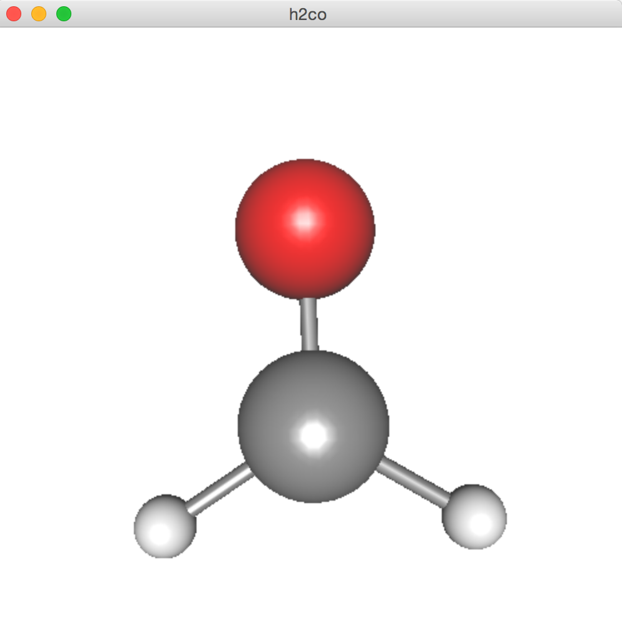
4. Test JSindo
Now, double click JSindo-4.0_xxxxxx.jar. You should see a control panel of JSindo.
If you don’t see the panel, review the installation of Java.
Let’s open “h2co.minfo”, which comes with this document. It contains data of formaldehyde.
Click, File -> Open, choose “h2co.minfo”, and click Open. If you see formaldehyde, you’re done with the first step!
If this step fails, it is highly likely that Java3D has a problem. Double check if the jarfiles are copied to the extension folder.
Open
click to choose

Slide 10
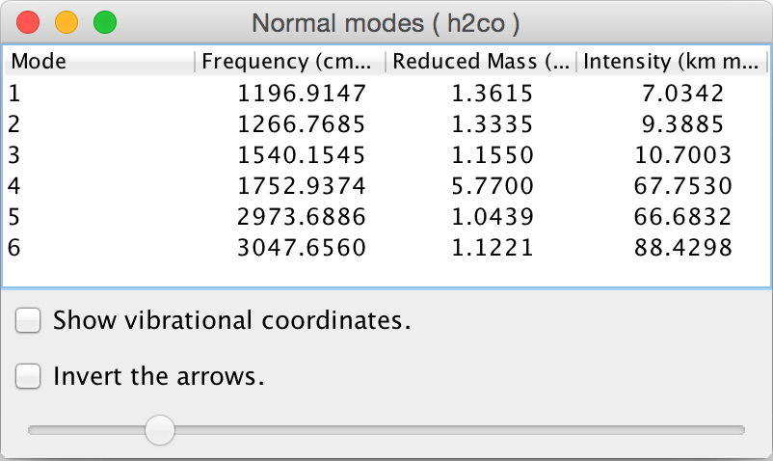
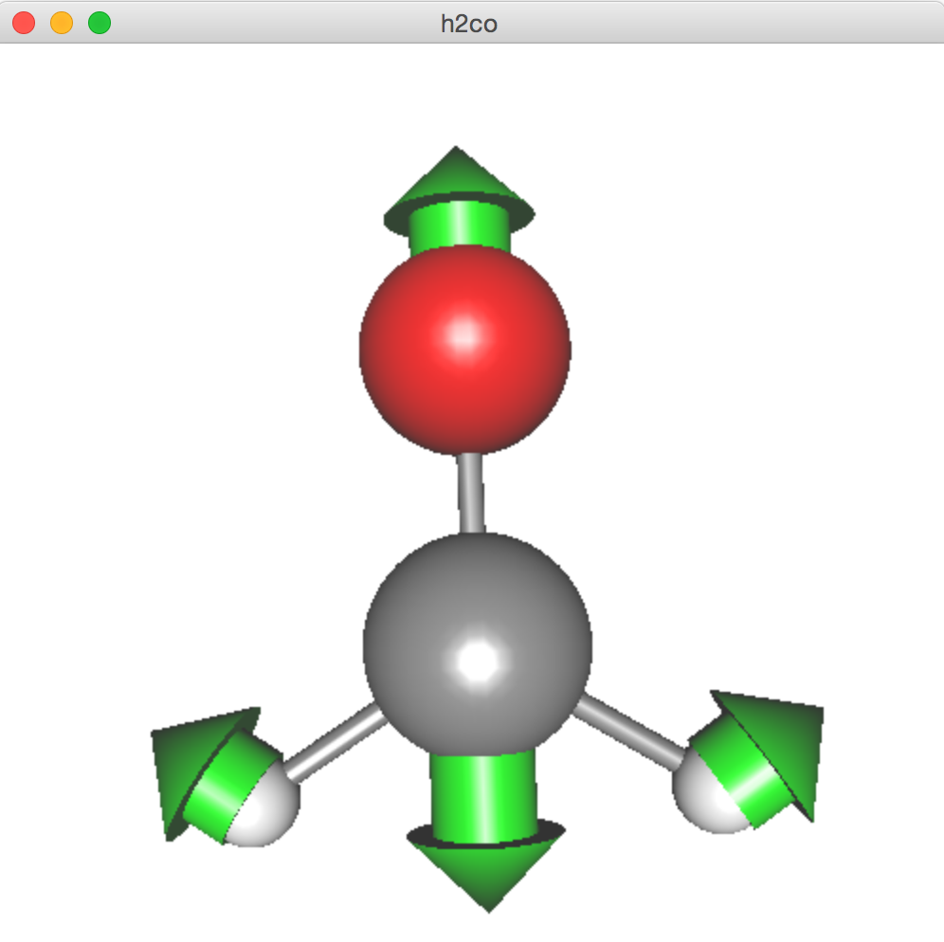
Finally, goto Tools -> Harmonic Analysis. This should create a “Normal modes” panel.
If you don’t see this panel, JAMA isn’t working. Check if the jarfile of JAMA is placed in the right folder.
If the panel appears, you’re all set! Congradulations!
Check on ”show vibrational coordinates”, and choose a mode you want to see. Vibrational motion will be indicated by arrows. You can “Invert the arrows” by a check box, and change the magnitude using a slider.
Thanks for using JSindo!
Enjoy!
Harmonic Analysis

Slide 11
FAQ
I want to use JSindo from a command line.
You may use the following command:
Alternatively, you may set an environment variable, CLASSPATH
in bash or csh/tcsh. Then, you can start JSindo simply by,
I cannot or don’t want to copy jarfiles into a system extension folder.
In principle, you can specify all jarfiles using “:” as a separator,
However, you don’t want to type all jarfiles everytime. So, I would set the CLASSPATH for all jarfiles in ~/.bashrc, for example,
There are so many jarfiles (JogAmp, in particular), but I suppose it’s still doable.
>java –cp /path/to/JSindo-4.0_xxxxxx.jar JSindo
> export CLASSPATH=${CLASSPATH}:/path/to/JSindo-4.0_xxxxxx.jar
> setenv CLASSPATH ${CLASSPATH}:/path/to/JSindo-4.0_xxxxxx.jar
> java JSindo
>java –cp JSindo-4.0_xxxxxx.jar:Jama-1.0.3.jar:... JSindo
> export CLASSPATH=${CLASSPATH}:/path/to/JSindo-4.0_xxxxxx.jar
> export CLASSPATH=${CLASSPATH}:/path/to/Jama-1.0.3.jar
...

Slide 12
What about Linux?
As far as I know, Java3D of ORACLE works for most distribution. Check your java architecture (32-bit or 64-bit), and download the installer from ORACLE.
Then, follow the same procedure as in Windows.
click accept
Click here to download
amd64 for 64-bit.
i586 for 32-bit (x86).

