Slide 1
User’s guide of JSindo
Kiyoshi Yagi
Theoretical Molecular Science Lab.
RIKEN

Slide 2
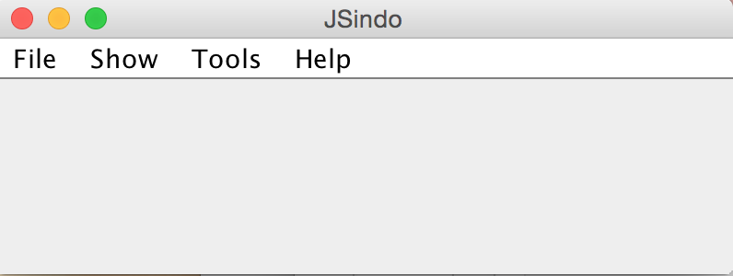
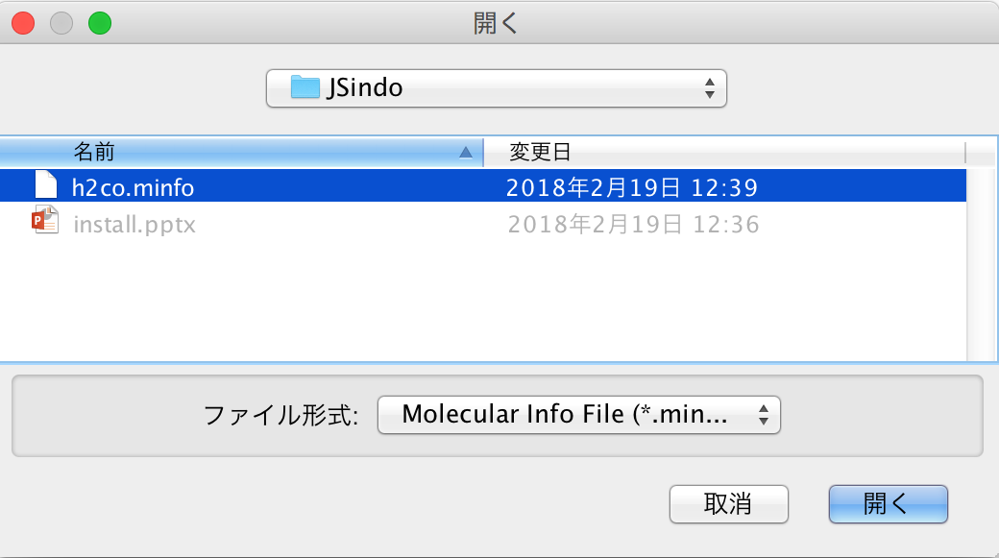
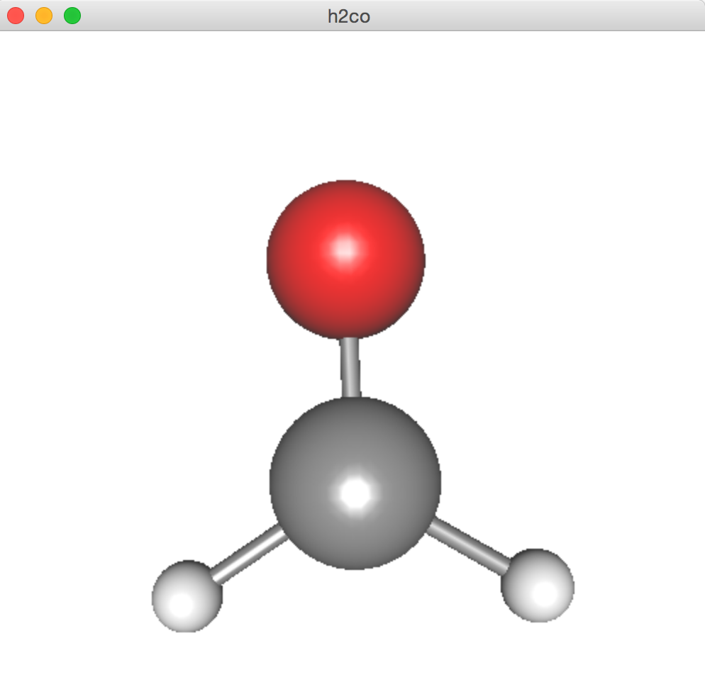
1. File
Open
Open
Save, Save as
click to choose
Import

Slide 3
2. Show
2.1. Label, Number
2.2. Vibraional Data

Slide 4
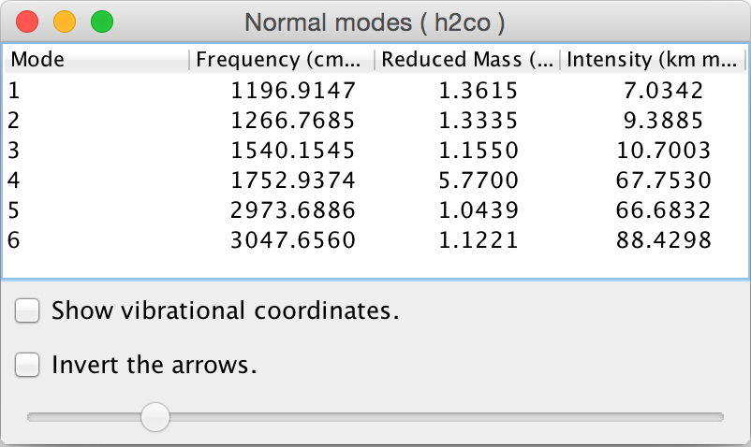
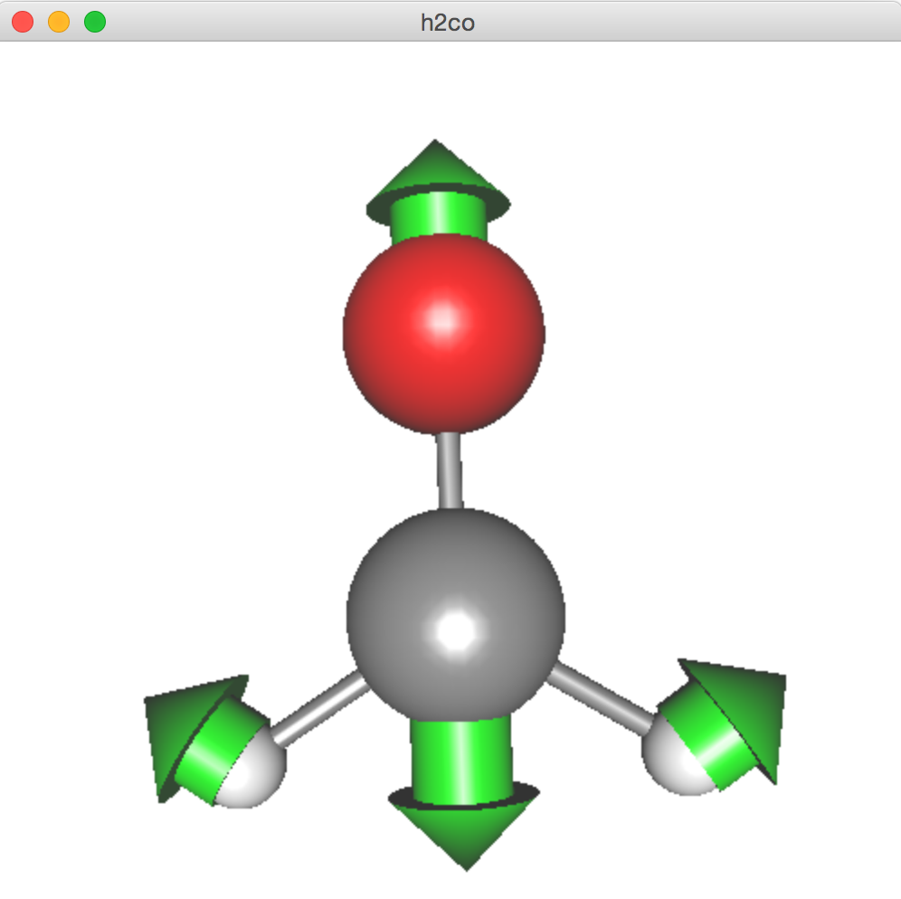
3. Tools
Harmonic Analysis
3.1. Harmonic Analysis
3.2. Create Local Modes

Slide 5
Appendix. minfo file
minfo形式の説明

Slide 6
FAQ
How can I change the color?
Commons.math

