Slide 1
Users’ guide of MakePES
Kiyoshi Yagi
kiyoshi.yagi@riken.jp
Theoretical Molecular Science Laboratory
RIKEN Cluster for Pioneering Research
2019/05/14

Slide 2
Contents of Sample Files
Sample files are found in sindo-4.0/doc/MakePES/sample_MakePES
0.harmonic_h2co
1.qff_h2co: Quartic force field for H₂CO
1-1.single
1-2.parallel
1-3.dryrun
1-4.generic
2.grid_h2co: Grid PES for H₂CO
2-1.1MR
2-2.2MR
2-3.3MR
2-4.1MR_generic
3.mrpes_h2co: Multi-resolution PES for H₂CO
4.water-hexamer

Slide 3
NOTE
MakePES is a command line based program. This manual assumes that you are familiar with basic commands in UNIX. Shell scripts are given for Bourne Shell (bash).
This manual also assumes that an alias is set to invoke RunMakePES,
Thus, the command “RunMakePES” in this document is the same as the java command above.
For a theoretical background on PES generation, see Lecture Notes #2 (kougi2.pdf).
sindo_jar=/path/to/sindo-4.0/jar
alias RunMakePES=‘java –cp “$sindo_jar/*” RunMakePES’

Slide 4
0.harmonic_h2co
Proceed to 0.harmoic_h2co and find an input file to perform harmonic vibrational analysis for formaldehyde using Gaussian.
> cd 0.harmonic_h2co
> ls
h2co-b3lyp-dz.inp log/
“log” folder contains sample output files.
h2co-b3lyp-dz.inp is the input file. Run Gaussian by the following command:
> runGaussian.sh ./ h2co-b3lyp-dz.inp
review the installation if you cannot run Gaussian with this command.
the two arguments are (working folder) and (input file), respectively.
You will obtain the following output files when the job ends.
> ls h2co-b3lyp-dz.*
h2co-b3lyp-dz.chk h2co-b3lyp-dz.fchk h2co-b3lyp-dz.inp h2co-b3lyp-dz.out

Slide 5
.fchk is a formatted check point file, which archives the result of quantum chemistry calculations. Let us convert the fchk file to a minfo file,
> java -cp "/path/to/sindo-4.0/jar/*" Fchk2Minfo h2co-b3lyp-dz
The argument after Fchk2Minfo is the basename of output files.
You will find a minfo file,
> ls h2co-b3lyp-dz.*
h2co-b3lyp-dz.chk h2co-b3lyp-dz.fchk h2co-b3lyp-dz.inp h2co-b3lyp-dz.out h2co-b3lyp-dz.minfo
Minfo file includes the equilibrium geometry, harmonic frequencies, and vibrational displacement vectors.
The same result can be obatined by JSindo; refer to the usage manual of JSindo. You can find details about the format of minfo file therein, too.

Slide 6
1.qff_h2co
1-1.single
Proceed to 1.qff_h2co/1-1.single to find input files to generate quartic force field (QFF) for formaldehyde,
> cd 1.qff_h2co/1-1.single
> ls
GaussianTemplate makePES.xml resources.info log/
makePES.xml is the main file, which is structured using tags in xml format. It is divided into sections by, <makePES> … </makePES>, <qchem> … </qchem>, and <qff> … </qff>. The options are specified in each section by <key value=“value” />. The value is case insensitive except for filenames. Comment out is possible as usual by <!-- … -->.
makePES
<makePES>
<minfoFile value="../../0.harmonic_h2co/h2co-b3lyp-dz.minfo" />
<MR value="3" />
read a minfo file of H₂CO
the order of the mode coupling expansion.

Slide 7
makePES
<qchem>
<program value="gaussian" />
<dryrun value="false"/>
<removefiles value="true" />
<title value="B3LYP/cc-pVDZ" />
<template value="GaussianTemplate" />
</qchem>
use Gaussian
run Gaussian
remove the output of Gauusian
set the title
the name of template file to generate Gaussian input
<qff>
<stepsize value="0.5" />
<ndifftype value="hess"/>
<mopfile value="prop_no_1.mop" />
</qff>
step size of numerical differentiations
numerical differentiations using Hessian
name of a mop file
</makePES>
resources.info provides hostname of nodes to run Gaussian. When we run on a single node, it is not important (but still, it should exist). We will later discuss this file in detail for parallel calculations in 1.2-parallel.

Slide 8
GaussianTemplate is a template file to generate input files for Gaussian specified by <template> in <qchem> section. It is the same as the usual input file for Gaussian, except for the red colored text.
GaussianTemplate
%chk=#basename#.chk
%NprocShared=2
%mem=1GB
#P B3LYP/CC-PVDZ FREQ NOSYMMETRY MAXDISK=240GB
Frequency at B3LYP/cc-pVDZ
0 1
#coordinate#
MakePES replaces #basename# and #coordinate# by the filename and the coordinates, respectively, to create input files.
”FREQ” keyword is necessary because we use numerical differentiations of the Hessian matrix (i.e., ndifftype = hess).

Slide 9
MakePES is invoked by the following command
> RunMakePES >& makePES.out
The main input file is set to makePES.xml by default. You can specify a different input file with –f option,
> RunMakePES -f makePES.xml >& makePES.out
In the output file, the options are first printed, and then the status of electronic structure calculations is printed,
makePES.out
Execute electronic structure calculations.
Thread0> Running minfo.files/mkqff-eq.inp on kyagi-mac3.local at …
Thread0> Running minfo.files/mkqff0-0.inp on kyagi-mac3.local at …
Thread0> Running minfo.files/mkqff0-1.inp on kyagi-mac3.local at …
During this step, Gaussian jobs are carried out in a folder minfo.files. Because we‘ve set <removefiles> to true, the input and output files are removed leaving only minfo files in the folder.

Slide 10
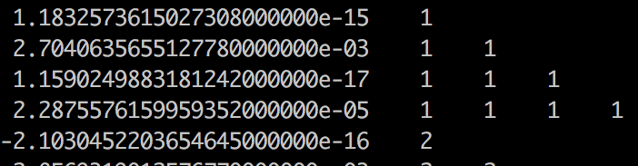
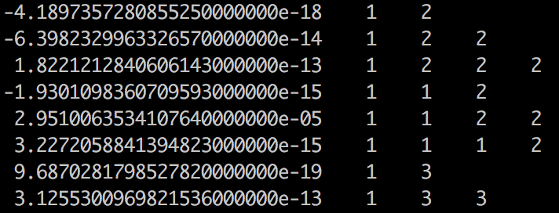
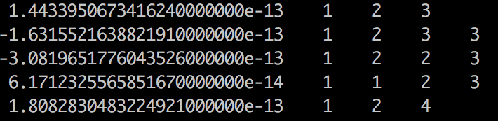
When this step is done, you will see an output like this,
makePES.out
End of electronic structure calculations.
Storing electronic structure data in tempfile ... Done!
Generating prop_no_1.mop... Done!
Removing the tempfiles ... Done!
End of QFF generation.
The QFF coefficients are written to <mopfile>, i.e., prop_no_1.mop.
one-body terms:
ci, cii, ciii, ciiii
…
two-body terms:
cij, cijj, cijjj, ciij, ciijj, ciiij
…
three-body terms:
cijk, cijkk, cijjk, ciijk
Note that four-body terms (cijkl) are missing because <MR> was set to 3.

Slide 11
1-2.parallel
The electronic structure calculations are an exclusive bottleneck for generating the PES. In the case of H₂CO, FREQ calculations at 13 grid points are required and they were carried out one by one in one node in the previous section.
MakePES can distribute the grid points to multiple nodes, and process the FREQ calculations in parallel. This function substantially speeds up the calculation. It requires that the nodes have shared disks (via NFS), where the input files as well as sindo/gaussian are located, and are inter-connectable with SSH without being asked for a password.
Proceed to 1-2.parallel to find the same set of input files.
Assuming that we use 16 core x 2 nodes, we make the following modification to resources.info and GaussianTemplate
> cd 1.qff_h2co/1-1.parallel
> ls
GaussianTemplate makePES.xml resources.info log/

Slide 12
resources.info
beluga01
beluga01
beluga02
beluga02
The hostname of 2 nodes.
We will run 2 processes in each nodes.
GaussianTemplate
%chk=#basename#.chk
%NprocShared=8
%mem=1GB
…
Each Gaussian process uses 8 cores
makePES.xml is the same as before. Set an environment variable SINDO_RSH =ssh, and then invoke MakePES as before,
> export SINDO_RSH=ssh
> RunMakePES >& makePES.out
You can see in the output that the grid points are distributed to beluga01 and 02, each in 2 processes.

Slide 13
makePES.out
Execute electronic structure calculations.
Thread2@beluga02> Running minfo.files/mkqff0-1.inp on beluga02 at …
Thread3@beluga02> Running minfo.files/mkqff1-0.inp on beluga02 at …
Thread0@beluga01> Running minfo.files/mkqff-eq.inp on beluga01 at …
Thread1@beluga01> Running minfo.files/mkqff0-0.inp on beluga01 at …
When you want to stop the job, a safe way to terminate all Gaussian jobs is to create a file with a name “terminate”.
> touch terminate
Then, the job stops after Gaussian jobs that are currently running are all finished.
If you want to immediately stop the job, you have to kill the main process, i.e., the java process responsible for RunMakePES. In that case, however, check carefully that all Gaussian child processes are killed as well.

Slide 14
1-3.dryrun
The <dryrun> option generates input files for grid points, and then stops the program without executing Gaussian. Proceed to 1-3.dryrun,
> cd 1.qff_h2co/1-3.dryrun
> ls
GaussianTemplate log1_dryrun_true/ log2_dryrun_false/ makePES.xml resources.info
The only difference is the value of <dryrun> in makePES.xml
makePES.xml
<qchem>
<program value="gaussian" />
<dryrun value=”true"/>
stop after generating the input files
Running the program creates the input files for Gaussian in the minfo.files folder,
> RunMakePES >& makePES.out
> ls minfo.files/
mkqff-eq.inp mkqff0-1.inp mkqff1-1.inp mkqff2-1.inp
mkqff3-1.inp mkqff4-1.inp …

Slide 15
You may transfer these input files to other computer systems and carry out Gaussian there. Then, convert the formatted checkpoint files to minfo format using Fchk2Minfo.
> java -cp "/path/to/sindo-4.0/jar/*" Fchk2Minfo mkqffx-x
Bring back the minfo files and locate them in the minfo.files folder,
> ls minfo.files/
mkqff-eq.inp mkqff-eq.minfo mkqff0-0.inp mkqff0-0.minfo mkqff0-1.inp mkqff0-1.minfo …
Change dryrun to false and run the program again.
makePES.xml
<qchem>
<program value="gaussian" />
<dryrun value=”false"/>
don’t stop after generating the input files
> RunMakePES >& makePES.out
> ls
GaussianTemplate makePES.out makePES.xml minfo.files/ prop_no_1.mop resources.info

Slide 16
You will see that the program immideately produces the mopfile.
The two log folders contains the files for the first step (log1_dryrun_true), and the files for the second step (log2_dryrun_false).
Note that, in general, MakePES looks into minfo.files folder for minfo files before starting Gaussian jobs. The job is skipped if a minfo file is found, and starts from the grid point where it ended before. In this example, we provided all minfo files, and thus the electronic structure calculations were all skipped.

Slide 17
1-4.generic
Setting <program> to generic prints the coordinates to a file in xyz format. You have to generate the input files, carry out the electronic structure calculations, and return the information in minfo format by yourself. Nevertheless, this may be useful for users who wish to use programs other than Gaussian.
Proceed to 1-4.generic to find makePES.xml.
The file is different only in <qchem> section,
> cd 1.qff_h2co/1-4.generic
> ls
log1_genxyz/ log2_genmop/ makePES.xml
makePES
<qchem>
<program value=”generic" />
<title value="B3LYP/cc-pVDZ" />
<xyzfile value="makeQFF" />
</qchem>
“generic” means no specific program
set the name of xyz file

Slide 18
Running the program creates makeQFF.xyz,
> RunMakePES >& makePES.out
> ls
makePES.out makePES.xml makeQFF.xyz
makeQFF.xyz is written in the usual xyz format,
makeQFF
The number of atoms
4
mkqff-eq
C 0.0000000000 0.0000000000 -0.6014736819
O 0.0000000000 -0.0000000000 0.6027247362
H 0.0000000000 0.9459644267 -1.2020174143
H -0.0000000000 -0.9459644267 -1.2020174143
4
mkqff0-0
C -0.0125897498 -0.0000000000 -0.6014736819
O 0.0031430124 0.0000000000 0.6027247362
name of the first point
xyz coordinates
name of the second point
xyz coordinates
The name, colored in red, is the ID of each grid points. We assume you carry out the electronic structure calculations by yourself, and collect the data in a minfo file with a name, ID.minfo.

Slide 19
Locate the minfo files in a minfo.files folder,
> ls minfo.files/
mkqff-eq.minfo mkqff0-1.minfo mkqff1-1.minfo mkqff2-1.minfo mkqff3-1.minfo mkqff4-1.minfo mkqff5-1.minfo mkqff0-0.minfo mkqff1-0.minfo mkqff2-0.minfo mkqff3-0.minfo mkqff4-0.minfo mkqff5-0.minfo
Run the program again (no need to change anything in makePES.xml).
> RunMakePES >& makePES.out
> ls
makePES.out makePES.xml makeQFF.xyz minfo.files/ prop_no_1.mop
The program produces the mopfile.
The two log folders contains the files for the first step (log1_genxyz), and the files for the second step (log2_genmop).

Slide 20
2.grid_h2co
2-1.1MR
Proceed to 2.grid_h2co/2-1.1MR to find input files to generate grid PES for formaldehyde,
> cd 2.grid_h2co/2-1.1MR
> ls
GaussianTemplate makePES.xml resources.info log/
makePES.xml has the same <qchem> section as before. A new section <grid> replaces <qff>.
makePES
<makePES>
<minfoFile value="../../0.harmonic_h2co/h2co-b3lyp-dz.minfo" />
<MR value=”1" />
<dipole value="true" />
…
<grid>
<ngrid value="11" />
<fullmc value="true"/>
</grid>
</makePES>
MR=1 for 1MR-PES
calculate dipole moment surface
number of grid points for each coordinates
calculate all modes

Slide 21
The generation of a gridPES requires only the energy at grid points, so that FREQ is no longer needed in GaussianTemplate. Don’t forget to remove FREQ if you copy the file from QFF. Note that MakePES still works as long as the energy is printed in the output; however, it would be an enormous waste of time! SCF=TIGHT is recommended for HF/DFT calculations.
GaussianTemplate
%chk=#basename#.chk
%NprocShared=8
%mem=1GB
#P B3LYP/CC-PVDZ SCF=TIGHT NOSYMMETRY MAXDISK=240GB
…
Each Gaussian process uses 8 cores
Don’t put a FREQ keyword!
Modify resource.info and %NprocShared for your system. In this sample, we run 8 processes of Gaussian with 8 cores (64 cores in total).
resources.info
beluga01
beluga01
…
beluga04
beluga04
4 nodes x 2 = 8 processes

Slide 22
Set an environment variable SINDO_RSH =ssh, and then run MakePES,
> export SINDO_RSH=ssh
> RunMakePES >& makePES.out
You will find in the output,
makePES.out
Setup MakeGrid module
o ngrid = 11
o 1MR Grid:
1 2 3 4 5 6
Enter GridPES generation:
Execute electronic structure calculations.
Thread2@beluga02.local> Running minfo.files/mkg-q1-11-1.inp on beluga02 at …
Thread3@beluga02.local> Running minfo.files/mkg-q1-11-2.inp on beluga02 at …
Thread0@beluga03.local> Running minfo.files/mkg-eq.inp on beluga03 at …
6 modes x 11 grid = 66 grid points
After the energy calculations are done, pot/dipole files are created.

Slide 23
makePES.out
Generating pot files.
o q1.pot [OK]
o q1.dipole [OK]
…
o q6.dipole [OK]
End of GridPES generation:
pot and dipole files are created.
> ls q*
q1.dipole q2.dipole q3.dipole q4.dipole q5.dipole q6.dipole
q1.pot q2.pot q3.pot q4.pot q5.pot q6.pot
qN.pot and qN.dipole contain the change of the potential energy and dipole moment, respectively, with respect to the equlibrium geomety along mode N. The values at the equilibrium geometry are written in eq.pot and eq.dipole.

Slide 24
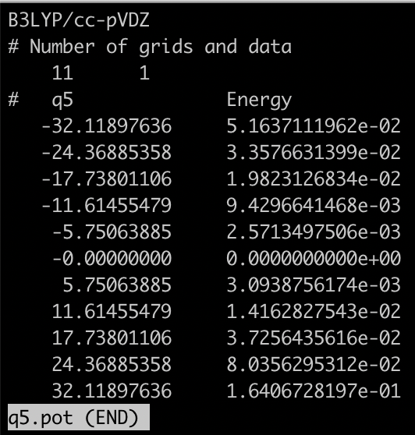
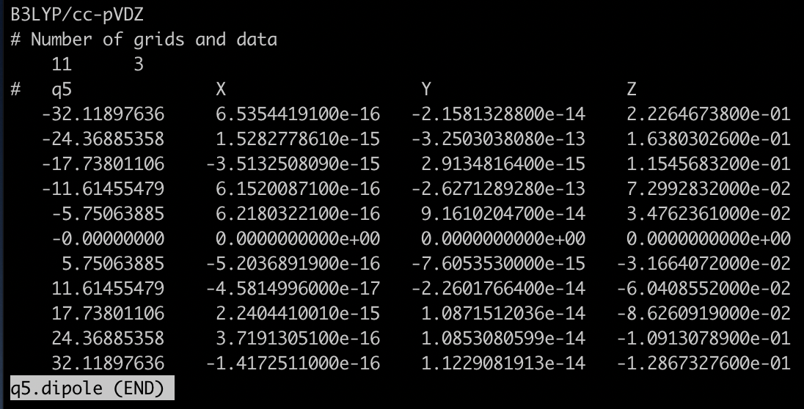
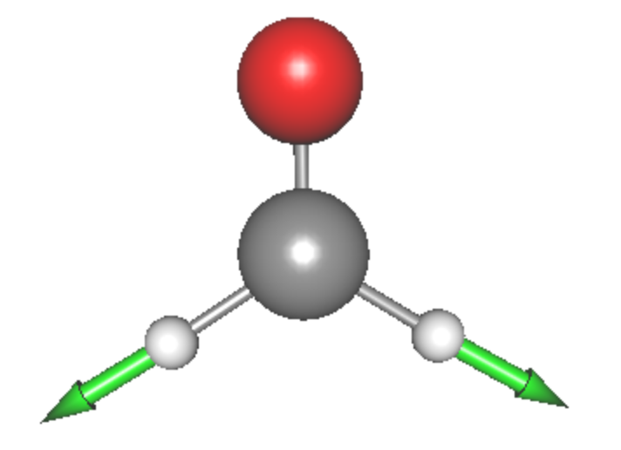
grid points along Q₅
V₅
dx
dy
dz
Plots of V₅ at grid points of Q₅. Q₅ (symmetic CH stretching mode) is visualized in the inset. Note that the arrow corresponds to the negative direction of Q₅, that is, the potential becomes flat as the CH bond extends.

Slide 25
2-2.2MR
In this section, we generate 2MR-grid PES for (Q1, Q2) and (Q5, Q6). Proceed to 2.grid_h2co/2-2.2MR,
> cd 2.grid_h2co/2-2.2MR
> ls *pot *dipole
eq.dipole q1.dipole q2.dipole q5.dipole q6.dipole
eq.pot q1.pot q2.pot q5.pot q6.pot
The pot and dipole files obtained in Sec. 2-1 for the equilibrium geometry and along Q1, Q2, Q5, Q6 are placed in the same folder. These files provide the information along the coordinates, and thus reduce the cost.
makePES
<makePES>
<minfoFile value="../../0.harmonic_h2co/h2co-b3lyp-dz.minfo" />
<MR value=”2" />
…
<grid>
<ngrid value=”9" />
<mc2 value="1,2, 5,6"/>
</grid>
</makePES>
MR=2 for 2MR-PES
number of grid points is reduced to 9
(Q1, Q2) and (Q5, Q6)

Slide 26
The two-mode terms are specified by <mc2> to (Q1,Q2) and (Q5,Q6). See the appendix on the details of format of mc2.
Calculating these terms with ngrid = 9 would require 9 x 9 x 2 = 162 grid points. In this case, the information along the axis is provided by the files, so that the number of grid points is reduced to 8 x 8 x 2 = 128.
GaussianTemplate and resources.info are the same as before. Run MakePES,
> export SINDO_RSH=ssh
> RunMakePES >& makePES.out
You may check the settings in the output,
makePES.out
Setup MakeGrid module
o ngrid = 9
o 1MR Grid:
1 2 5 6
o 2MR Grid:
(1,2) (5,6)
Enter GridPES generation:
number of grid points
1-mode terms
2-mode terms

Slide 27
pot/dipole files are created at the end of the calculation.
makePES.out
Generating pot files.
o q2q1.pot [OK]
o q2q1.dipole [OK]
o q6q5.pot [OK]
o q6q5.dipole [OK]
End of GridPES generation:
2-mode terms (9x9 grid points) are created.
In addition to the original files with 11 grid points (q[1-6].pot/dipole), new files for 2MR-PES with 9 grid points (q2q1.pot/dipole and q6q5.pot/dipole) are created.
> ls q*
q1.dipole q2.pot q5.dipole q6.pot
q1.pot q2q1.dipole q5.pot q6q5.dipole
q2.dipole q2q1.pot q6.dipole q6q5.pot

Slide 28
2-3.3MR
In this section, we generate 3MR-grid PES for (Q4, Q5, Q6). Proceed to 2.grid_h2co/2-3.3MR,
> cd 2.grid_h2co/2-3.3MR
> ls *pot *dipole
eq.dipole q4.dipole q5.dipole q6.dipole q6q5.dipole
eq.pot q4.pot q5.pot q6.pot q6q5.pot
Again, we use the exisiting information (q4, q5, q6, and q6q5) to reduce the cost. By placing these files in the same folder, the grid points are reduced from 729 (=9 x 9 x 9) points to 640 points.
makePES
<makePES>
<minfoFile value="../../0.harmonic_h2co/h2co-b3lyp-dz.minfo" />
<MR value=”3" />
…
<grid>
<ngrid value=”9" />
<mc3 value=”4,5,6"/>
</grid>
</makePES>
MR=3 for 3MR-PES
(Q4, Q5, Q6)

Slide 29
GaussianTemplate and resources.info are the same as before. Run MakePES,
> export SINDO_RSH=ssh
> RunMakePES >& makePES.out
You will find in the output that the 2-mode terms, (Q4, Q5) and (Q4, Q6), are automatically added,
makePES.out
Setup MakeGrid module
o ngrid = 9
o 1MR Grid:
4 5 6
o 2MR Grid:
(4,5) (4,6) (5,6)
o 3MR Grid:
(4,5,6)
Enter GridPES generation:
1- and 2-mode terms that are subsets of the 3-mode terms are automatically added by the program.
the 3-mode term specified in the input

Slide 30
After iteration over the grid points, we obtain pot and dipole files for (Q4, Q5), (Q4, Q6), and (Q4, Q5, Q6).
makePES.out
Generating pot files.
o q5q4.pot [OK]
o q5q4.dipole [OK]
o q6q4.pot [OK]
o q6q4.dipole [OK]
o q6q5q4.pot [OK]
o q6q5q4.dipole [OK]
End of GridPES generation:
Automatically added 2-mode terms
The target 3-mode term
> ls q*
q4.dipole q5q4.dipole q6q4.dipole q6q5q4.dipole
q4.pot q5q4.pot q6q4.pot q6q5q4.pot
q5.dipole q6.dipole q6q5.dipole
q5.pot q6.pot q6q5.pot

Slide 31
2-4.1MR_generic
In this section, we illustrate the generic mode for grid PES. Proceed to 2-4. 1MR_generic,
> cd 2.grid_h2co/2-4.1MR_generic
> ls
log1_genxyz/ log2_genpot/ makePES.xml
makePES.xml has <qchem> section as follow,
makePES
<makePES>
…
<qchem>
<program value="generic" />
<title value="B3LYP/cc-pVDZ" />
<xyzfile value="makeGrid" />
</qchem>
</makePES>
“generic” means no specific program
set the name of xyz file
Running the program creates makeGrid.xyz,
> RunMakePES >& makePES.out
> ls
makePES.out makePES.xml makeGrid.xyz

Slide 32
makeGrid.xyz has the same format as in QFF (see Sec. 1.4). For the grid points written in the file, calculate the energy and dipole moments of formaldehyde using your favorate program. Then, compile the information to a file, makeGrid.dat, in a format as follow,
makeGrid.dat
mkg-eq, -114.507640, 0.686660E-15, -0.112327E-13, -0.814248E+00
mkg-q1-11-0, -114.468383, -0.536891E-01, 0.321103E-13, -0.696204E+00
mkg-q1-11-1, -114.485563, -0.396727E-01, -0.420800E-14, -0.744696E+00
mkg-q1-11-2, -114.496189, -0.278582E-01, -0.494537E-13, -0.776962E+00
ID
Energy
Dipole moment (dx, dy, dz)
The column must be separated by comma. The length / digit is arbitrary. The order of grid points (i.e., the order of the raw) is also arbitrary. A sample is found in log2_genpot/makeGrid.dat.
Then, run the program again to obtain the pot/dipole files.
> RunMakePES >& makePES.out
> ls *pot
eq.pot q1.pot q2.pot q3.pot q4.pot q5.pot q6.pot

Slide 33
3.mrpes_h2co
In this section, we calculate a multi-resolution PES, which is a combination of QFF and grid PES. All 1-mode terms are obtained by the grid method using 11 points. Mode coupling strength (MCS) is derived from QFF coefficients, and coupling terms with MCS > 10.0 are generated by the grid method using 9 points.
Proceed to 3.mrpes_h2co to find input files,
> cd 3.mrpes_h2co
> ls
GaussianTemplate1 GaussianTemplate2 log/ makePES.xml resources.info
GaussianTemplate1 and GaussianTemplate2 are the template files to calculate a Hessian matrix (FREQ) and only the energy, respectively.
In makePES.xml, two <qchem> sections are given which specifies GaussianTemplate1 and GaussianTemplate2 attributed to id = “freq” and “ene”, respectively. The ID is associated with QCID of <qff> and <grid>.

Slide 34
makePES.xml
<qchem id="freq">
<program value="gaussian" />
…
<template value="GaussianTemplate1" />
</qchem>
<qchem id="ene">
<program value="gaussian" />
…
<template value="GaussianTemplate2" />
</qchem>
<qff>
<QCID value="freq" />
<mopfile value="prop_no_1.mop" / >
…
</qff>
<grid>
<QCID value="ene" />
<ngrid value="11" />
<mc1 value="1-6"/>
</grid>
<grid>
<QCID value="ene" />
<ngrid value=”9" />
<mcsstrength value="10"/>
<mopfile value="prop_no_1.mop"/>
</grid>

Slide 35
<qchem> sections are followed by one <qff> and two <grid> sections. MakePES processes these sections in the order they appear in the input file. In the present example,
Generate QFF
prop_no_1.mop is created.
Generate 1MR-grid PES with ngrid = 11
q1 - q6.pot / dipole files are created.
Generate 3MR-grid PES with ngrid = 9
pot/dipole files with MCS > 10 are created.
Step 1 (QFF) must precede Step 3, because prop_no.1.mop is needed to calculate MCS. Step 2 generates 1MR-grid PES, q1 - q6.pot. These files are used in Step 3.
Run the program by typing,
> export SINDO_RSH=ssh
> RunMakePES >& makePES.out
Find in the makePES.out that the calculation is performed in the above order.

Slide 36
makePES.out
…
Enter QFF generation:
…
Generating prop_no_1.mop... Done!
Removing the tempfiles ... Done!
End of QFF generation.
Setup MakeGrid module
o ngrid = 11
o 1MR Grid:
1 2 3 4 5 6
Enter GridPES generation:
…
Generating pot files.
o q1.pot [OK]
o q1.dipole [OK]
…
o q6.pot [OK]
o q6.dipole [OK]…
End of GridPES generation:
QFF generation
1MR-grid PES generation

Slide 37
makePES.out
Setup MakeGrid module
o Setup MCS: Read QFF Data via prop_no_1.mop ... [OK]
o ngrid = 9
o 1MR Grid:
5 1 2 3 6 4
o 2MR Grid:
(1,5) (2,5) (3,5) (1,6) (2,6) (3,6) (5,6) (2,3) (2,4) (4,6)
o 3MR Grid:
(2,3,6) (2,4,6)
Enter GridPES generation:
…
Generating pot files.
o q5q1.pot [OK]
o q5q1.dipole [OK]
…
o q6q4q2.pot [OK]
o q6q4q2.dipole [OK]
End of 3MR-GridPES generation:
Reads the output of QFF calc.
Coupling terms with MCS > 10.0
2, 3MR-grid PES generation

Slide 38
The program detects 10 two-mode terms and 2 three-mode terms where MCS > 10.0. When the calculation is done, you will find the following pot files in the working directory.
> ls *pot
eq.pot q2.pot q3q2.pot q4q2.pot q5q1.pot q5q3.pot q6q1.pot q6q3.pot q6q4.pot q6q5.pot
q1.pot q3.pot q4.pot q5.pot q5q2.pot q6.pot q6q2.pot q6q3q2.pot q6q4q2.pot

Slide 39
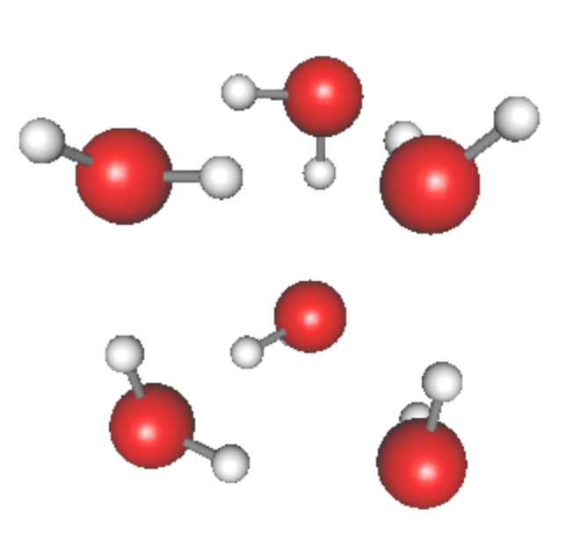
4.water-hexamer
4-1.intra
In this section, we generate the PES of water hexamer using the intramolecular modes, i.e., OH stretching and HOH bending modes. There are 18 such modes, and corresponds to mode 31 – 48.
water hexamer
(prism)
Proceed to 4.water-haxamer/4-1.intra to find input files,
> cd 4.water-hexamer/4-1.intra
> ls
GaussianTemplate h2o_6-mp2dz.minfo log/ makePES.xml resources.info
h2o_6-mp2dz.minfo is a minfo file that contains the equlibrium geometry and vibrational modes of water hexamer (prism shape) obtained at the MP2/c—pVDZ level of theory.
GaussianTemplate is a template file to perform FREQ calculations at the MP2/cc-pVDZ level of theory.

Slide 40
In makePES.xml, the active modes are specified by <activemode> to modes 31 – 48. Other sections, <qchem> and <qff>, are the same as before.
makePES.xml
<makePES>
<minfoFile value="h2o_6-mp2dz.minfo" />
<MR value="3" />
<activemode value="31-48" />
<qchem>
<program value="gaussian" />
<dryrun value="false"/>
<removefiles value="true" />
<title value="MP2/cc-pVDZ" />
<template value="GaussianTemplate" />
</qchem>
…
active modes are set to the intramolecular modes, mode 31 – 48.
Run the program by,
> export SINDO_RSH=ssh
> RunMakePES >& makePES.out

Slide 41
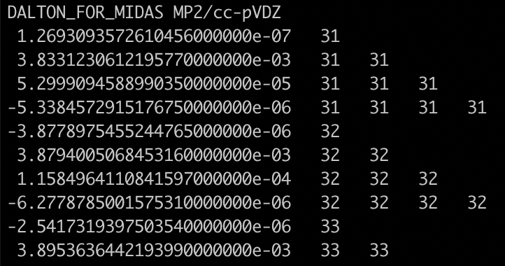
Find in the output that mode 31-48 are active ,
makePES.out
o Input options read via makePES.xml ... [OK]
- Molecular info via h2o_6-mp2dz.minfo ... [OK]
- InterDomain = false
- ActiveModes:
* Domain 1
31 32 33 34 35 36 37 38 39 40
41 42 43 44 45 46 47 48
- MR = 3
- Dipole = false
31 – 48 are active, and 1 – 30 are inactive.
When the calculation ends, you will find that prop_no_1.mop has entry only for modes 31 – 48.

Slide 42
Note that it is not easy to tell which modes should be set to active or inactive. The modes can be set to inactive later in the vibrational calculations using sindo. Therefore, I recommend to include as many modes as possible during the PES generation step.
Nevertheless, there are increasing demand to select vibrational modes as the size of system becomes large. For example, a solute in solvent, ligands in a protein, etc. A model that separates the inter- and intra-molecular modes, illustrated in this example, is often used for cluster systems. <activemode> is made to achieve such purposes.

Slide 43
Appendix: List of all keys
General keys
minfoFile: file name
The name of minfo file containing the vibrational data. The value is case sensitive.
MR: 1/2/3
The order of mode coupling expansion. Can take 1, 2, or 3. (default = 3)
activemode: string of mode index
Specifies active modes for PES generation. All modes are active by default. The mode numbers should be separated by camma or space. A hyphen can be used for a sequence of mode number. For example,
<entry key="activemode"> 1,2,3,5 </entry>
is equivalnet to,
<entry key="activemode"> 1-3 5 </entry>
which means Q₁,Q₂,Q₃, and Q₅ are active, and Q₄ isn’t.
dipole: true/false
Generates the dipole moment surface in addition to the PES, when true. (default = false)

Slide 44
interdomain: true / false
Calculates inter-domain coupling terms, when true. (default = false)
QFF計算では、実行された量子化学計算の情報から、Gradientで数値微分の場合はtiij, uiiij、Hessianで数値微分の場合は3MRまでドメイン間カップリングが計算可能だが、interdomain = falseではこれらは出力されない。出力したい場合は、interdomain=trueで再計算する。
Hessianの場合、minfo.filesからデータを読み込めば、追加の量子化学計算なく3MRまで計算できため、実は計算負荷の軽減にはならない。4MRは追加計算が必要となる。

Slide 45
QCHEM section
ID: string
program: string
gaussian … Interface with Gaussian
generic … Print the coordinates to a xyz file
title: string
A title line that will be printed to PES files.
options for non-generic (=Gaussian)
removefiles: true/false
Removes the input/output files of the quantum chemistry program, when true. (default = false)
dryrun: true/false
Generates the input files for the quantum chemistry program and exits without execution, when true. (default = false)
template: file name
The name of a template file to generate the input files for quantum chemisty jobs.
options for generic
xyzfile: filename
Name of a xyz file, where the coordinates are written. (default = makeQFF for QFF and makeGrid for GRID)

Slide 46
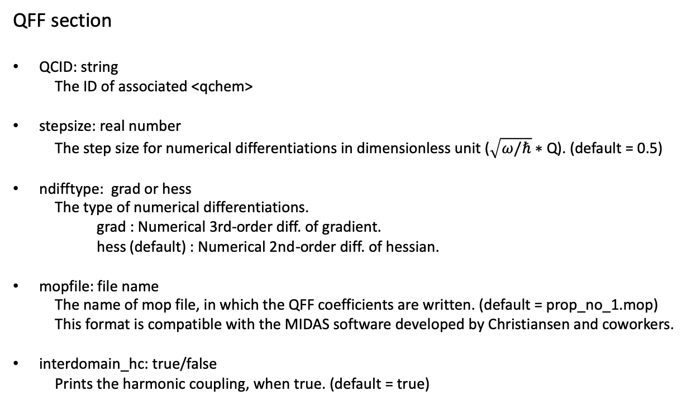
QFF section
QCID: string
The ID of associated <qchem>
stepsize: real number
The step size for numerical differentiations in dimensionless unit ($\sqrt{ω/ℏ}$ ∗ Q). (default = 0.5)
ndifftype: grad or hess
The type of numerical differentiations.
grad : Numerical 3rd-order diff. of gradient.
hess (default) : Numerical 2nd-order diff. of hessian.
mopfile: file name
The name of mop file, in which the QFF coefficients are written. (default = prop_no_1.mop) This format is compatible with the MIDAS software developed by Christiansen and coworkers.
interdomain_hc: true/false
Prints the harmonic coupling, when true. (default = true)

Slide 47
gradient and hessian: input/current
Specifies where the gradient and Hessian are retrieved.
input (default) : From the input minfo file. current : From the current calculation. (mkqff-eq.minfo)
“input” is useful for combining accurate geometry, gradient, and Hessian, read from the input minfo file, with lower-level cubic and quartic terms, which are calculated by MakePES module.
On the other hand, one might think of another strategy, where the geometry and coordinates are derived from a low-level of theory, and the QFF at a higher-level of theory. In that case, this option should be set to “current”, which incorporates the gradient and Hessian obtained from the current calculation.
genhs: true/false
Generate the 001.hs file, when true. (default = false) 001.hs is a file which contains the QFF coefficients in the old format; however, this format is deprecated and not recommended to use unless for a debugging purpose to compare the result with the previous version of SINDO.

Slide 48
GRID section
QCID: string
The ID of associated <qchem>
ngrid: integer number
The number of grid points along each coordinates. (default = 11)
fullmc: true/false
All the mode coupling up to the MR-th order is generated, when true. (default = false)
mc1, mc2, mc3: string of mode index
The 1, 2, or 3MR terms separated by camma or space.
Examples:
<mc1 value="1,2,3,5” /> or <mc1 value="1-3 5” />
generates grid points for Q1,Q2,Q3, and Q5.
<mc2 value="1,2, 1,4, 2,4, 3,4” /> or <mc2 value="1,2, 1-3,4” />
generates the grid points for (Q2, Q1),(Q4, Q1),(Q4, Q2), and (Q4, Q3).
<mc3 value="1,2,3, 1,2,4” />
generates the grid points for (Q3, Q2, Q1) and (Q4, Q2, Q1).

Slide 49
mcsstrength: real number
The threshold value (in cm⁻¹) to select the mode coupling term for generating the grid potential. The coupling terms with MCS larger than this value are generated.
mopfile: file name
The name of mop file to obtain MCS.
NOTE: One of fullmc, mc1, mc2, mc3, or mcsstrength must be present to specify the coupling terms.

