Slide 1
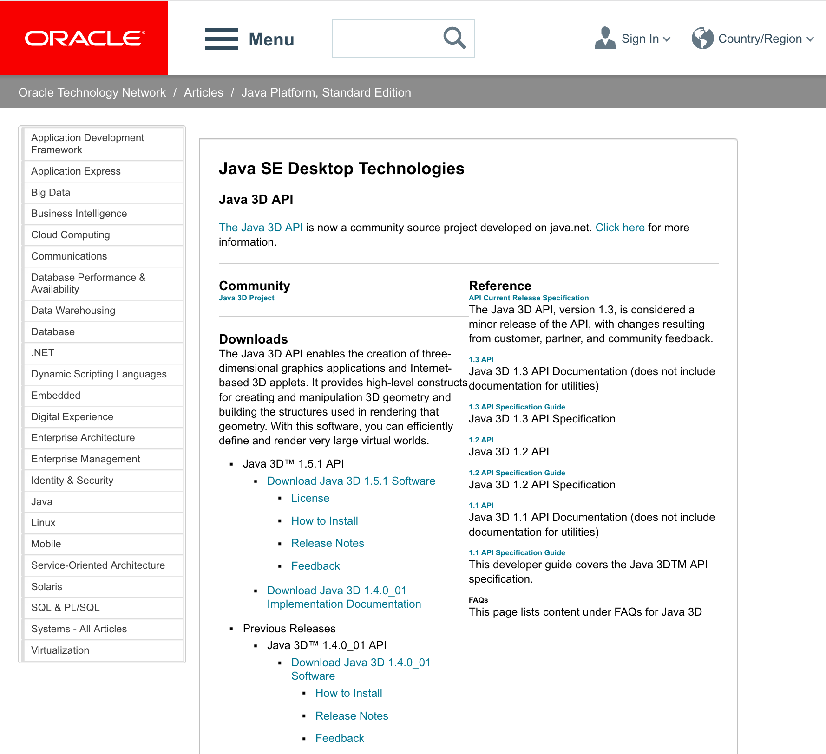
ORACLE Java3D (1.5.1)
Search for “java3d” in the web to find Java3D API of ORACLE,
http://www.oracle.com/technetwork/articles/javase/index-jsp-138252.html
click here

Slide 2
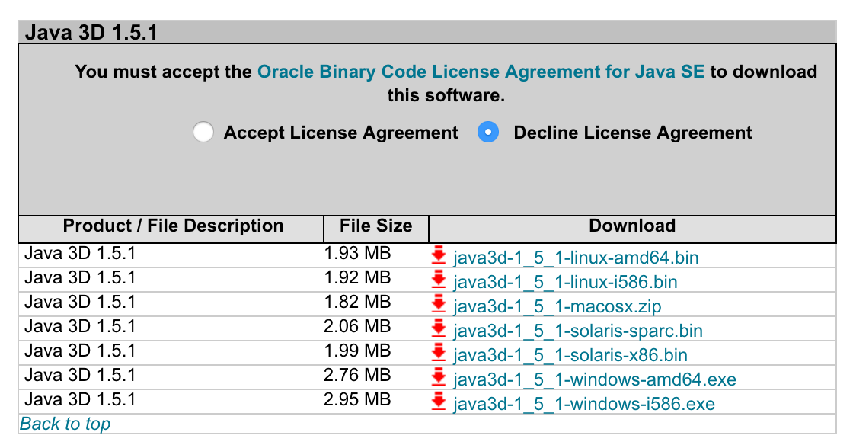
Now, download the installer,
click accept
Click here to download
amd64 for 64-bit.
i586 for 32-bit (x86).
Double click the installer and follow the instruction. The installer creats a new folder, Java3D, in a Java folder,
32-bit c:\Program Files(x86)\Java\Java3D
64-bit c:\Program Files\Java\Java3D
In this folder, you will find three jarfiles,
Java3D\1.5.1\lib\ext\
j3dcore.jar
j3dutil.jar
vecmath.jar
Copy these three jarfiles to an extension folder of JRE,
Java\jre1.x.x_xxx\lib\ext

Slide 3
OS | Java | Java3D | Result | Note
MacOSX(Mountain Lion) 10.8.5 | Oracle 1.8.0_161-b12 | JogAmp2.3.2 | OK | Mori MacBook Pro
MacOSX (Yosemite) 10.10.5 | Oracle 1.8.0_45 64-bit | Oracle 1.5.1_macosx | NO | Yagi, MacBook Pro (13 inch, mid2014)
MacOSX (Yosemite) 10.10.5 | Oracle 1.8.0_45 64-bit | JogAmp2.3.2 1.6.0-pre12 | OK | Yagi, MacBook Pro (13 inch, mid2014)
MacOSX (El Capitan) 10.11.6 | Oracle 1.8.0_40 64-bit | JogAmp2.3.2 1.6.0-pre12 | OK | yamada mac
MacOSX (High Sierra) | Oracle | JogAmp2.3.2 1.6.0-pre12 | OK | yagi mac
Mac OSX (Yosemite) | Oracle 1.8.0_172 64-bit | JogAmp2.3.2 1.6.0-pre12 | OK | Mizukami MacBook Pro (15 inch, 2014 late)
Mac OSX (High Sierra) | Oracle 1.8.0_172 64-bit | JogAmp2.3.2 1.6.0-pre12 | OK | Mizukami iMac 5k, 2014 late GPU (Radeon R9)
MacOSX(High Sierra) 10.13.4 | Oracle 9.0.4.0.11 | JogAmp2.3.2 | NO | Matsunaga MacBook Pro (15 inch, 2016)

Slide 4
OS | Java | Java3D | Result | Note
Windows10 Pro | Oracle 1.8.0_161 32-bit | Oracle 1.5.1 (i586) | OK | yagi PC vaio
Windows10 Pro | Oracle 1.8.0_161 32-bit | JogAmp2.3.2 1.6.0-pre12 (i586) | OK | yagi PC vaio
Windows10 Pro | Oracle 1.8.0_172 32/64-bit | JogAmp2.3.2 1.6.0-pre12 (i586) | OK | yagi PC vaio
Windows10 Pro | Oracle 1.8.0_171-b11 (32-bit) | jogamp v2.3.2 1.6.0-final (i586) | OK | Matsuoka notePC
Windows10 Pro for Workstations | Oracle 1.8.0_171-b12 (32-bit) | jogamp v2.3.2 java3d/1.6.0-final (windows i586) | OK | Win workstation
Fedora release 26 | Oracle 1.8.0_51-b16 | Jogamp 2.3.2 (amd64) | OK | Kobayashi PC
Fedora release 28 | Open JDK | Jogamp 2.3.2 (amd64) | OK | Yagi Workstation (HP Z)

