Slide 1
Users’ guide to MakePES
Kiyoshi Yagi
kiyoshi.yagi@riken.jp
Theoretical Molecular Science Laboratory
RIKEN Cluster for Pioneering Research
2019/11/12

Slide 2
In this guide, I will illustrate how to use MakePES to generate QFF, GridPES, and Multiresolution PES. Formaldehyde (H₂CO) is used as an example, but the method is applicable to any molecule.
MakePES is a command line based program. This guide assumes that you are familiar with basic commands in UNIX. Shell scripts are given for Bourne Shell (bash).
This guide also assumes that you have installed the program. Change “/path/to” to your installation directory when you see a command like this,
In this guide, we will use Gaussian for the electronic structure calculations. Make sure that you have configured “runGaussian.sh” and the path to it.
If you don’t use Gaussian, you may still use MakePES in generic mode; see 1.4 and 2.4.
sindo_jar=/path/to/sindo-4.0/jar
java –cp ‘$sindo_jar/*' RunMakePES
> export PATH=${PATH}:/path/to/sindo-4.0/script
> runGaussian.sh
USAGE: runGaussian.sh arg[1] arg[2]
arg[1] : current directory
arg[2] : input file

Slide 3
Contents
0. Harmonic analysis and generation of a minfo file
(0.harmonic_h2co)
1. Quartic force field (1.qff_h2co)
1.1. Using single node (1-1.single)
1.2. Using parallel computers (1-2.parallel)
1.3. Generate input files and exit (1-3.dryrun)
1.4. Generic mode (1-4.generic)
2. Grid potential (2.grid_h2co)
2.1. 1MR-grid PES (2-1.1MR)
2.2. 2MR-grid PES (2-2.2MR)
2.3. 3MR-grid PES (2-3.3MR)
2.4. Generic mode (2-4.1MR_generic)
3. Multiresolution PES (3.mrpes_h2co)
4. TIP and FAQ
5. References
Appendix: List of all keys
Sample files are found in sindo-4.0/doc/MakePES/sample_MakePES

Slide 4
0.Harmonic analysis and generation of a minfo file
Proceed to 0.harmoic_h2co and find an input file to perform harmonic vibrational analysis for formaldehyde using Gaussian.
> cd 0.harmonic_h2co
> ls
h2co-b3lyp-dz.inp log/ run.sh
“log” folder contains sample output files.
h2co-b3lyp-dz.inp is the input file. Run Gaussian by the following command:
> runGaussian.sh ./ h2co-b3lyp-dz.inp
review the installation if you cannot run Gaussian with this command.
the two arguments are (working folder) and (input file), respectively.
You will obtain the following output files when the job ends.
> ls h2co-b3lyp-dz.*
h2co-b3lyp-dz.chk h2co-b3lyp-dz.fchk h2co-b3lyp-dz.inp h2co-b3lyp-dz.out run.sh

Slide 5
.fchk is a formatted check point file, which archives the result of quantum chemistry calculations. Let us convert the fchk file to a minfo file,
> java -cp "/path/to/sindo-4.0/jar/*" Fchk2Minfo h2co-b3lyp-dz
The argument after Fchk2Minfo is the basename of output files.
You will find a minfo file,
> ls h2co-b3lyp-dz.*
h2co-b3lyp-dz.chk h2co-b3lyp-dz.fchk h2co-b3lyp-dz.inp h2co-b3lyp-dz.out h2co-b3lyp-dz.minfo run.sh
Minfo file includes the equilibrium geometry, harmonic frequencies, and vibrational displacement vectors.
The same result can be obatined by JSindo; refer to the Users’ guide to JSindo. You can find details about the format of minfo file therein, too.

Slide 6
“run.sh” is a script to do this work at once. Change ”/path/to” to your installation directory using an editor,
> vi run.sh
#!/bin/bash
sindo_dir=/path/to/sindo-4.0
sindo_jar=$sindo_dir/jar
PATH=$PATH:$sindo_dir/script
runGaussian.sh ./ h2co-b3lyp-dz.inp
java -cp "$sindo_jar/*" Fchk2Minfo h2co-b3lyp-dz
Then, run the script.
> ./run.sh
> ls
h2co-b3lyp-dz.chk h2co-b3lyp-dz.fchk h2co-b3lyp-dz.inp
h2co-b3lyp-dz.minfo h2co-b3lyp-dz.out run.sh

Slide 7
1.qff_h2co
1-1.single
In this section, we generate a quartic force field (QFF) for formaldehyde [1]. Proceed to 1.qff_h2co/1-1.single to find input files,
> cd 1.qff_h2co/1-1.single
> ls
GaussianTemplate log/ makePES.xml resources.info run.sh
makePES.xml is the main file, which is structured using tags in xml format. It is divided into sections by, <makePES> … </makePES>, <qchem> … </qchem>, and <qff> … </qff>. The options are specified in each section by <key value=“value” />. The value is case insensitive except for filenames. Comment out is possible as usual by <!-- … -->.
makePES
<makePES>
<minfoFile value="../../0.harmonic_h2co/h2co-b3lyp-dz.minfo" />
<MR value="3" />
read a minfo file of H₂CO
the order of the mode coupling expansion.

Slide 8
makePES
<qchem>
<program value="gaussian" />
<dryrun value="false"/>
<removefiles value="true" />
<title value="B3LYP/cc-pVDZ" />
<template value="GaussianTemplate" />
</qchem>
use Gaussian
run Gaussian
remove the output of Gaussian
set the title
the name of template file to generate Gaussian input
<qff>
<stepsize value="0.5" />
<ndifftype value="hess"/>
<mopfile value="prop_no_1.mop" />
</qff>
step size of numerical differentiations
numerical differentiations using Hessian
name of a mop file
</makePES>
resources.info provides hostname of nodes to run Gaussian. When we run on a single node, it is not important (but still, it should exist). We will later discuss this file in detail for parallel calculations in 1.2-parallel.

Slide 9
GaussianTemplate is a template file to generate input files for Gaussian specified by <template> in <qchem> section. It is the same as the usual input file for Gaussian, except for the red colored text.
GaussianTemplate
%chk=#basename#.chk
%NprocShared=2
%mem=1GB
#P B3LYP/CC-PVDZ FREQ NOSYMMETRY MAXDISK=240GB
Frequency at B3LYP/cc-pVDZ
0 1
#coordinate#
MakePES replaces #basename# and #coordinate# by the filename and the coordinates, respectively, to create input files.
”FREQ” keyword is necessary because we use numerical differentiations of the Hessian matrix (i.e., ndifftype = hess).

Slide 10
MakePES is invoked by the following command
> sindo_jar=/path/to/sindo-4.0/jar
> java -cp ”$sindo_jar/*" RunMakePES >& makePES.out
The main input file is set to makePES.xml by default. You can specify a different input file with –f option,
> sindo_jar=/path/to/sindo-4.0/jar
> java -cp $sindo_jar/*" RunMakePES -f makePES.xml >& makePES.out
In the output file, the options are first printed, and then the status of electronic structure calculations is printed,
makePES.out
Execute electronic structure calculations.
Thread0> Running minfo.files/mkqff-eq.inp on kyagi-mac3.local at …
Thread0> Running minfo.files/mkqff0-0.inp on kyagi-mac3.local at …
Thread0> Running minfo.files/mkqff0-1.inp on kyagi-mac3.local at …
During this step, Gaussian jobs are carried out in a folder minfo.files. Because we‘ve set <removefiles> to true, the input and output files are removed leaving only minfo files in the folder.

Slide 11
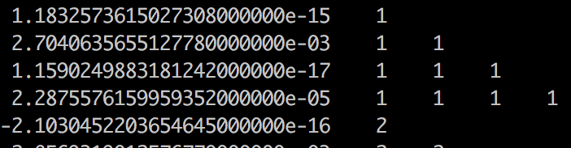
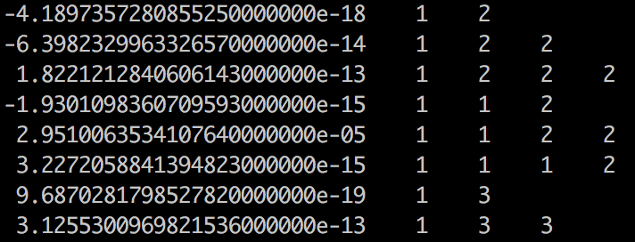
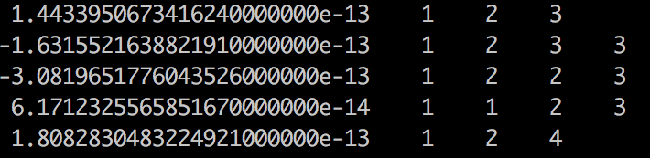
When this step is done, you will see an output like this,
makePES.out
End of electronic structure calculations.
Storing electronic structure data in tempfile ... Done!
Generating prop_no_1.mop... Done!
Removing the tempfiles ... Done!
End of QFF generation.
The QFF coefficients are written to <mopfile>, i.e., prop_no_1.mop.
one-body terms:
ci, cii, ciii, ciiii
…
two-body terms:
cij, cijj, cijjj, ciij, ciijj, ciiij
…
three-body terms:
cijk, cijkk, cijjk, ciijk
Note that four-body terms (cijkl) are missing because <MR> was set to 3.

Slide 12
1-2.parallel
The electronic structure calculations are an intensive bottleneck for generating the PES. In the case of H₂CO, FREQ calculations at 13 grid points are required. They were carried out one by one in the previous section using one node.
MakePES can distribute the grid points to multiple nodes, and process the FREQ calculations in parallel. This function substantially speeds up the calculation. It requires that the nodes have shared disks (via NFS), where the input files as well as sindo/gaussian are located, and are inter-connectable with SSH without being asked for a password.
Proceed to 1-2.parallel to find the same set of input files.
Assuming that we use 16 core x 2 nodes, we make the following modification to resources.info and GaussianTemplate
> cd 1.qff_h2co/1-2.parallel
> ls
GaussianTemplate log/ makePES.xml resources.info run.sh

Slide 13
resources.info
beluga01
beluga01
beluga02
beluga02
The hostname of 2 nodes.
We will run 2 processes in each nodes.
GaussianTemplate
%chk=#basename#.chk
%NprocShared=8
%mem=1GB
…
Each Gaussian process uses 8 cores
makePES.xml is the same as before. Set an environment variable SINDO_RSH =ssh, and then invoke MakePES as before,
> export SINDO_RSH=ssh
> sindo_jar=/path/to/sindo-4.0/jar
> java -cp "$sindo_jar/*" RunMakePES >& makePES.out
You can see in the output that the grid points are distributed to beluga01 and 02, each in 2 processes.

Slide 14
makePES.out
Execute electronic structure calculations.
Thread2@beluga02> Running minfo.files/mkqff0-1.inp on beluga02 at …
Thread3@beluga02> Running minfo.files/mkqff1-0.inp on beluga02 at …
Thread0@beluga01> Running minfo.files/mkqff-eq.inp on beluga01 at …
Thread1@beluga01> Running minfo.files/mkqff0-0.inp on beluga01 at …
When the job is done, you will obtain the same mop file as before, but in a much faster computational time.

Slide 15
1-3.dryrun
The <dryrun> option generates input files for grid points, and then stops the program without executing Gaussian. Proceed to 1-3.dryrun,
> cd 1.qff_h2co/1-3.dryrun
> ls
GaussianTemplate log1_dryrun_true/ log2_dryrun_false/ makePES.xml resources.info run.sh
The only difference is the value of <dryrun> in makePES.xml
makePES.xml
<qchem>
<program value="gaussian" />
<dryrun value=”true"/>
stop after generating the input files
Running the program creates input files for Gaussian in “minfo.files”,
> sindo_jar=/path/to/sindo-4.0/jar
> java -cp "$sindo_jar/*" RunMakePES >& makePES.out
> ls minfo.files/
mkqff-eq.inp mkqff0-1.inp mkqff1-1.inp mkqff2-1.inp
mkqff3-1.inp mkqff4-1.inp …

Slide 16
You may transfer these input files to other computer systems and carry out Gaussian there. Then, convert the formatted checkpoint files to minfo format using Fchk2Minfo.
> java -cp "/path/to/sindo-4.0/jar/*" Fchk2Minfo mkqffx-x
Bring back the minfo files and locate them in the minfo.files folder,
> ls minfo.files/
mkqff-eq.inp mkqff-eq.minfo mkqff0-0.inp mkqff0-0.minfo mkqff0-1.inp mkqff0-1.minfo …
Change dryrun to false and run the program again.
makePES.xml
<qchem>
<program value="gaussian" />
<dryrun value=”false"/>
don’t stop after generating the input files
> sindo_jar=/path/to/sindo-4.0/jar
> java -cp "$sindo_jar/*" RunMakePES >& makePES.out
> ls
GaussianTemplate makePES.out makePES.xml minfo.files/ prop_no_1.mop resources.info

Slide 17
You will see that the program immideately produces the mopfile.
The two log folders contains the files for the first step (log1_dryrun_true), and the files for the second step (log2_dryrun_false).
Note that, in general, MakePES looks into minfo.files folder for minfo files before starting Gaussian jobs. The job is skipped if a minfo file is found, and starts from the grid point where it ended before. In this example, we provided all minfo files, and thus the electronic structure calculations were all skipped. See the TIPS in 4.2 for more detail.

Slide 18
1-4.generic
Setting <program> to generic prints the coordinates to a file in xyz format. You have to generate the input files, carry out the electronic structure calculations, and return the information in minfo format by yourself. Nevertheless, this may be useful for users who wish to use programs other than Gaussian.
Proceed to 1-4.generic to find makePES.xml.
The file is different only in <qchem> section,
> cd 1.qff_h2co/1-4.generic
> ls
log1_genxyz/ log2_genmop/ makePES.xml
makePES
<qchem>
<program value=”generic" />
<title value="B3LYP/cc-pVDZ" />
<xyzfile value="makeQFF" />
</qchem>
“generic” means no specific program
set the name of xyz file

Slide 19
Running the program creates makeQFF.xyz,
> sindo_jar=/path/to/sindo-4.0/jar
> java -cp "$sindo_jar/*" RunMakePES >& makePES.out
> ls
makePES.out makePES.xml makeQFF.xyz
makeQFF.xyz is written in the usual xyz format,
makeQFF
The number of atoms
4
mkqff-eq
C 0.0000000000 0.0000000000 -0.6014736819
O 0.0000000000 -0.0000000000 0.6027247362
H 0.0000000000 0.9459644267 -1.2020174143
H -0.0000000000 -0.9459644267 -1.2020174143
4
mkqff0-0
C -0.0125897498 -0.0000000000 -0.6014736819
O 0.0031430124 0.0000000000 0.6027247362
name of the first point
xyz coordinates
name of the second point
xyz coordinates
The name, colored in red, is the ID of each grid points. We assume you carry out the electronic structure calculations by yourself, and collect the data in a minfo file with a name, ID.minfo.

Slide 20
Run the electronic structure calculations and generete minfo files by yourself. Locate the minfo files in a minfo.files folder,
> ls minfo.files/
mkqff-eq.minfo mkqff0-1.minfo mkqff1-1.minfo mkqff2-1.minfo mkqff3-1.minfo mkqff4-1.minfo mkqff5-1.minfo mkqff0-0.minfo mkqff1-0.minfo mkqff2-0.minfo mkqff3-0.minfo mkqff4-0.minfo mkqff5-0.minfo
Run the program again (no need to change anything in makePES.xml).
> sindo_jar=/path/to/sindo-4.0/jar
> java -cp "$sindo_jar/*" RunMakePES >& makePES.out
> ls
makePES.out makePES.xml makeQFF.xyz minfo.files/ prop_no_1.mop
The program produces the mopfile.
The two log folders contains the files for the first step (log1_genxyz), and the files for the second step (log2_genmop).

Slide 21
2. Grid potential
2.1. 1MR-grid PES
In this section, we generate a grid potential [2]. Proceed to 2.grid_h2co/2-1.1MR to find input files,
> cd 2.grid_h2co/2-1.1MR
> ls
GaussianTemplate log/ makePES.xml resources.info run.sh
makePES.xml has the same <qchem> section as before. A new section <grid> replaces <qff>. We also set <dipole> to true to generate dipole memoent surfaces.
makePES
<makePES>
<minfoFile value="../../0.harmonic_h2co/h2co-b3lyp-dz.minfo" />
<MR value=”1" />
<dipole value="true" />
…
<grid>
<ngrid value="11" />
<fullmc value="true"/>
</grid>
</makePES>
MR=1 for 1MR-PES
calculate dipole moment surface
number of grid points for each coordinates
calculate all modes

Slide 22
The generation of a gridPES requires only the energy at grid points, so that FREQ is no longer needed in GaussianTemplate. Don’t forget to remove FREQ if you copy the file from QFF. Note that MakePES still works as long as the energy is printed in the output; however, it would be an enormous waste of time! SCF=TIGHT is recommended for HF/DFT calculations.
GaussianTemplate
%chk=#basename#.chk
%NprocShared=8
%mem=1GB
#P B3LYP/CC-PVDZ SCF=TIGHT NOSYMMETRY MAXDISK=240GB
…
Each Gaussian process uses 8 cores
Don’t put a FREQ keyword!
Modify resource.info and %NprocShared for your system. In this sample, we run 8 processes of Gaussian with 8 cores (64 cores in total).
resources.info
beluga01
beluga01
…
beluga04
beluga04
4 nodes x 2 = 8 processes

Slide 23
Set an environment variable SINDO_RSH=ssh, and then run MakePES,
> export SINDO_RSH=ssh
> sindo_jar=/path/to/sindo-4.0/jar
> java -cp "$sindo_jar/*" RunMakePES >& makePES.out
You will find in the output,
makePES.out
Setup MakeGrid module
o ngrid = 11
o 1MR Grid:
1 2 3 4 5 6
Enter GridPES generation:
Execute electronic structure calculations.
Thread2@beluga02.local> Running minfo.files/mkg-q1-11-1.inp on beluga02 at …
Thread3@beluga02.local> Running minfo.files/mkg-q1-11-2.inp on beluga02 at …
Thread0@beluga03.local> Running minfo.files/mkg-eq.inp on beluga03 at …
6 modes x 11 grid = 66 grid points
After the energy calculations are done, pot/dipole files are created.

Slide 24
makePES.out
Generating pot files.
o q1.pot [OK]
o q1.dipole [OK]
…
o q6.dipole [OK]
End of GridPES generation:
pot and dipole files are created.
> ls q*
q1.dipole q2.dipole q3.dipole q4.dipole q5.dipole q6.dipole
q1.pot q2.pot q3.pot q4.pot q5.pot q6.pot
qN.pot and qN.dipole contain the change of the potential energy and dipole moment, respectively, with respect to the equlibrium geomety along mode N. The values at the equilibrium geometry are written in eq.pot and eq.dipole.

Slide 25
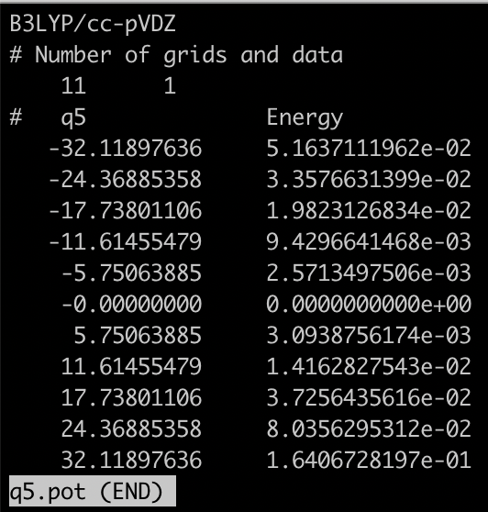
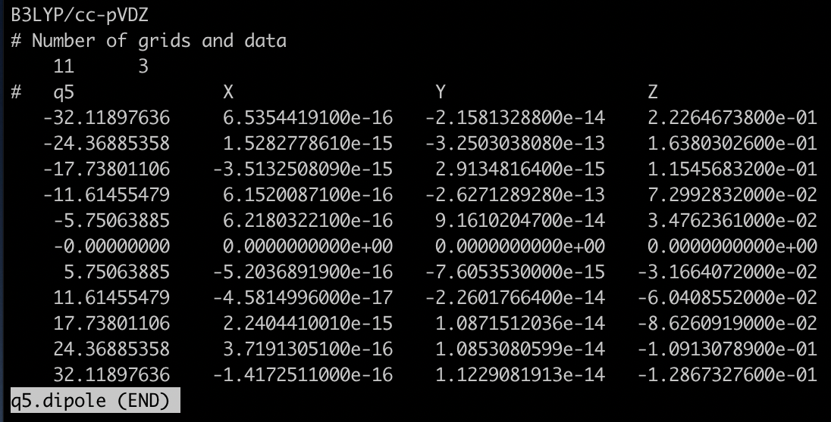
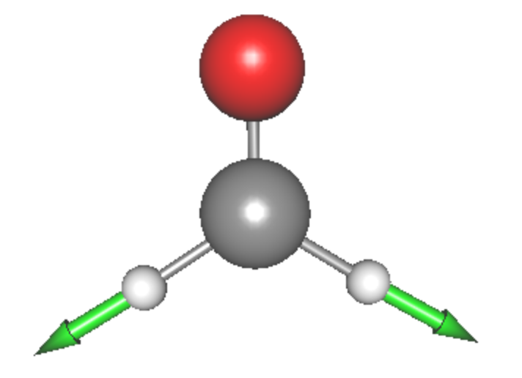
grid points along Q₅
V₅
dx
dy
dz
Plots of V₅ at grid points of Q₅. Q₅ (symmetic CH stretching mode) is visualized in the inset. Note that the arrow corresponds to the negative direction of Q₅, that is, the potential becomes flat as the CH bond extends.

Slide 26
2.2. 2MR-grid PES
In this section, we generate 2MR-grid PES for (Q1, Q2) and (Q5, Q6). Proceed to 2.grid_h2co/2-2.2MR,
> cd 2.grid_h2co/2-2.2MR
> ls
GaussianTemplate makePES.xml ...
makePES
<makePES>
<minfoFile value="../../0.harmonic_h2co/h2co-b3lyp-dz.minfo" />
<MR value=”2" />
…
<grid>
<ngrid value=”9" />
<mc2 value="1,2, 5,6"/>
</grid>
</makePES>
MR=2 for 2MR-PES
number of grid points is reduced to 9
(Q1, Q2) and (Q5, Q6)
The two-mode terms are specified by <mc2> to (Q1,Q2) and (Q5,Q6). See the appendix on the details of format of mc2.

Slide 27
Calculating two 2MR-terms with ngrid = 9 requires 9 x 9 x 2 = 162 grid points. However, we have already calculated the grid points along the axis. In order to re-use them, the pot and dipole files obtained in Sec. 2-1 are placed in the same directory:
> ls *pot *dipole
eq.dipole q1.dipole q2.dipole q5.dipole q6.dipole
eq.pot q1.pot q2.pot q5.pot q6.pot
MakePES make use of the previous calculation whenever possible. In this example, the information along the Q1, Q2, Q5, Q6 axis is provided by the files. Therefore, the number of grid points is reduced from 162 to to 8 x 8 x 2 = 128.
GaussianTemplate and resources.info are the same as before. Run MakePES,
> export SINDO_RSH=ssh
> sindo_jar=/path/to/sindo-4.0/jar
> java -cp "$sindo_jar/*" RunMakePES >& makePES.out

Slide 28
You may check the settings in the output,
makePES.out
Setup MakeGrid module
o ngrid = 9
o 1MR Grid:
1 2 5 6
o 2MR Grid:
(1,2) (5,6)
Enter GridPES generation:
number of grid points
1-mode terms
2-mode terms
and that pot/dipole files are created at the end of the calculation.
makePES.out
Generating pot files.
o q2q1.pot [OK]
o q2q1.dipole [OK]
o q6q5.pot [OK]
o q6q5.dipole [OK]
End of GridPES generation:
2-mode terms (9x9 grid points) are created.

Slide 29
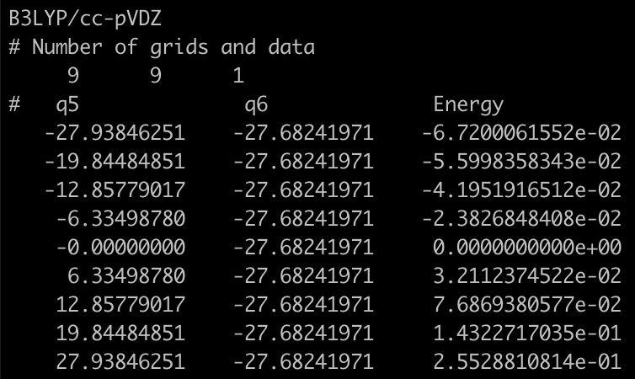
In addition to the original files with 11 grid points (q[1-6].pot/dipole), new files for 2MR-PES with 9 grid points (q2q1.pot/dipole and q6q5.pot/dipole) are created.
> ls q*
q1.dipole q2.pot q5.dipole q6.pot
q1.pot q2q1.dipole q5.pot q6q5.dipole
q2.dipole q2q1.pot q6.dipole q6q5.pot
grid points along Q₅ and Q₆
Note that the coupling term V₆₅ is
V₆₅
V₆₅ = V – V₆ – V₅
where V is the total energy, and V₅ and V₆ are the 1MR potential along Q₅ and Q₆, respectively. V₆₅ is often called an “intrinsic” coupling term.

Slide 30
2.3. 3MR-grid PES
In this section, we generate 3MR-grid PES for (Q4, Q5, Q6). Proceed to 2.grid_h2co/2-3.3MR,
> cd 2.grid_h2co/2-3.3MR
> ls *pot *dipole
eq.dipole q4.dipole q5.dipole q6.dipole q6q5.dipole
eq.pot q4.pot q5.pot q6.pot q6q5.pot
Again, we use the exisiting information (q4, q5, q6, and q6q5) to reduce the cost. By placing these files in the same folder, the grid points are reduced from 729 (=9 x 9 x 9) points to 640 points.
makePES
<makePES>
<minfoFile value="../../0.harmonic_h2co/h2co-b3lyp-dz.minfo" />
<MR value=”3" />
…
<grid>
<ngrid value=”9" />
<mc3 value=”4,5,6"/>
</grid>
</makePES>
MR=3 for 3MR-PES
(Q4, Q5, Q6)

Slide 31
GaussianTemplate and resources.info are the same as before. Run MakePES,
> export SINDO_RSH=ssh
> sindo_jar=/path/to/sindo-4.0/jar
> java -cp "$sindo_jar/*" RunMakePES >& makePES.out
You will find in the output that the 2-mode terms, (Q4, Q5) and (Q4, Q6), are automatically added,
makePES.out
Setup MakeGrid module
o ngrid = 9
o 1MR Grid:
4 5 6
o 2MR Grid:
(4,5) (4,6) (5,6)
o 3MR Grid:
(4,5,6)
Enter GridPES generation:
1- and 2-mode terms that are subsets of the 3-mode terms are automatically added by the program.
the 3-mode term specified in the input

Slide 32
After iteration over the grid points, we obtain pot and dipole files for (Q4, Q5), (Q4, Q6), and (Q4, Q5, Q6).
makePES.out
Generating pot files.
o q5q4.pot [OK]
o q5q4.dipole [OK]
o q6q4.pot [OK]
o q6q4.dipole [OK]
o q6q5q4.pot [OK]
o q6q5q4.dipole [OK]
End of GridPES generation:
Automatically added 2-mode terms
The target 3-mode term
> ls q*
q4.dipole q5q4.dipole q6q4.dipole q6q5q4.dipole
q4.pot q5q4.pot q6q4.pot q6q5q4.pot
q5.dipole q6.dipole q6q5.dipole
q5.pot q6.pot q6q5.pot

Slide 33
2.4. Generic mode
In this section, we illustrate the generic mode for grid PES. Proceed to 2-4. 1MR_generic,
> cd 2.grid_h2co/2-4.1MR_generic
makePES.xml has <qchem> section as follow,
makePES
<makePES>
…
<qchem>
<program value="generic" />
<title value="B3LYP/cc-pVDZ" />
<xyzfile value="makeGrid" />
</qchem>
</makePES>
“generic” means no specific program
set the name of xyz file
Running the program creates makeGrid.xyz,
> sindo_jar=/path/to/sindo-4.0/jar
> java -cp "$sindo_jar/*" RunMakePES >& makePES.out
> ls
makePES.out makePES.xml makeGrid.xyz

Slide 34
makeGrid.xyz has the same format as in QFF (see Sec. 1.4). For the grid points written in the file, calculate the energy and dipole moments of formaldehyde using your favorate program. Then, compile the information to a file, makeGrid.dat, in a format as follow,
makeGrid.dat
mkg-eq, -114.507640, 0.686660E-15, -0.112327E-13, -0.814248E+00
mkg-q1-11-0, -114.468383, -0.536891E-01, 0.321103E-13, -0.696204E+00
mkg-q1-11-1, -114.485563, -0.396727E-01, -0.420800E-14, -0.744696E+00
mkg-q1-11-2, -114.496189, -0.278582E-01, -0.494537E-13, -0.776962E+00
ID
Energy
Dipole moment (dx, dy, dz)
The column must be separated by comma. The length / digit is arbitrary. The order of grid points (i.e., the order of the raw) is also arbitrary. A sample is found in log2_genpot/makeGrid.dat.
Then, run the program again to obtain the pot/dipole files.
> sindo_jar=/path/to/sindo-4.0/jar
> java -cp "$sindo_jar/*" RunMakePES >& makePES.out
> ls *pot
eq.pot q1.pot q2.pot q3.pot q4.pot q5.pot q6.pot

Slide 35
3. Multiresolution PES
In this section, we generate a multi-resolution PES [3], which combines different levels of electronic structure and functional forms. Here, we will use the following combination:
 | Electronic Structure | Functional Form
1MR | CCSD(T)/cc-pVTZ | Grid-PES (11 points)
Strongly coupled terms (MCS>10) | CCSD(T)/cc-pVTZ | Grid-PES (9 points)
Weakly coupled terms (MCS>1) | B3LYP/cc-pVDZ | Grid-PES (7 points)
Other terms | B3LYP/cc-pVDZ | QFF
Mode coupling strength (MCS) is calculated from QFF coefficients [4].
Proceed to 3.mrpes_h2co to find input files,
> cd 3.mrpes_h2co
> ls
GaussianTemplate1 GaussianTemplate2 GaussianTemplate3 log/ makePES1.xml makePES2.xml resources.info run.sh

Slide 36
GaussianTemplate1 and GaussianTemplate2 are the template files for Gaussian to calculate the Hessian matrix (FREQ) and only the energy, respectively, at the B3LYP/cc-pVDZ level. In makePES1.xml, these files are associated with <qchem> sections with id=“freq” and “ene”, and the ID is associated with QCID of <qff> and <grid>.
makePES1.xml
<qchem id="freq">
…
<template value="GaussianTemplate1" />
</qchem>
<qchem id="ene">
…
<template value="GaussianTemplate2" />
</qchem>
<qff>
<QCID value="freq" />
…
</qff>
<grid>
<QCID value="ene" />
…
</grid>
…

Slide 37
makePES1.xml
<qff>
<QCID value="freq" />
<mopfile value="prop_no_1.mop" / >
…
</qff>
<grid>
<QCID value="ene" />
<ngrid value="11" />
<mc1 value="1-6"/>
</grid>
<grid>
<QCID value="ene" />
<ngrid value=”9" />
<mcstrength value="10"/>
<mopfile value="prop_no_1.mop"/>
</grid>
<grid>
<QCID value="ene" />
<ngrid value="7" />
<mcstrength value="1"/>
<mopfile value="prop_no_1.mop"/>
</grid>
1MR-grid PES
Grid PES with MCS > 10
Grid PES with MCS > 1

Slide 38
<qchem> sections are followed by one <qff> and three <grid> sections. MakePES processes these sections in the order they appear in the input file. In the present example,
Generate QFF
prop_no_1.mop is created.
Generate 1MR-grid PES with ngrid = 11
q1 - q6.pot / dipole files are created.
Generate 3MR-grid PES with ngrid = 9
pot/dipole files with MCS > 10 are created.
Generate 3MR-grid PES with ngrid = 7
pot/dipole files with MCS > 1 are created.
Step 1 (QFF) must precede Step 3 and 4, because prop_no.1.mop is needed to calculate MCS. Note that we only need step4 for the final mrpes; however, we carry out step2 and 3 for a reference.

Slide 39
Modify resource.info and %NprocShared in GaussianTemplate1/2 for your system. In this sample, we run 8 processes of Gaussian with 8 cores (64 cores in total).
GaussianTemplate1/2
%chk=#basename#.chk
%NprocShared=8
%mem=1GB
resources.info
beluga01
beluga01
…
beluga04
beluga04
4 nodes x 2 = 8 processes
Run the program by typing,
> sindo_jar=/path/to/sindo-4.0/jar
> java -cp "$sindo_jar/*" RunMakePES –f makePES1.xml >& makePES1.out

Slide 40
Find in the makePES1.out that the calculation is performed in the above order.
makePES1.out
…
Enter QFF generation:
…
Generating prop_no_1.mop... Done!
Setup MakeGrid module
…
Generating pot files.
o q1.pot [OK]
…
Setup MakeGrid module
o Setup MCS: Read QFF Data via prop_no_1.mop ... [OK]
o ngrid = 9
o 1MR Grid:
5 1 2 3 6 4
o 2MR Grid:
(1,5) (2,5) (3,5) (1,6) (2,6) (3,6) (5,6) (2,3) (2,4) (4,6)
o 3MR Grid:
(2,3,6) (2,4,6)
QFF generation
1MR-grid PES generation
Reads the output of QFF calc.
Coupling terms with MCS > 10.0

Slide 41
When the calculation is done, you will find the following pot files in the current directory.
> ls *pot
eq.pot q3q2.pot q5q1.pot q6.pot q6q4.pot
q1.pot q4.pot q5q2.pot q6q1.pot q6q4q2.pot
q2.pot q4q2.pot q5q3.pot q6q2.pot q6q5.pot
q2q1.pot q4q3.pot q5q4.pot q6q3.pot
q3.pot q5.pot q5q4q3.pot q6q3q2.pot
Note that the red ones are strongly coupled terms (MCS > 10) generated by 9 grid points, and the blue ones are weakly coupled terms (MCS > 1) generated by 7 grid points.
Before moving on to generate the PES at the CCSD(T)/cc-pVTZ level, we must save the PES@B3LYP data and clean up the current directory,
> mkdir pes_b3lyp
> mv minfo.files *pot *dipole pes_b3lyp
This is because MakePES looks for pot/dipole files and minfo files in the current directory to restart the job.

Slide 42
The input file for MakePES looks as follow:
makePES2.xml
<makePES>
...
<dipole value="false" />
<qchem id="ene">
...
<title value="CCSD(T)/cc-pVTZ" />
<template value="GaussianTemplate3" />
</qchem>
<grid>
<QCID value="ene" />
<ngrid value="11" />
<mc1 value="1-6"/>
</grid>
<grid>
<QCID value="ene" />
<ngrid value="9" />
<mcstrength value="10"/>
<mopfile value="prop_no_1.mop"/>
</grid>
</makePES>
Dipole is turned off because CCSD(T) does not provide a dipole moment.
1MR-grid PES
Grid PES with MCS > 10
use the mop file generated in the last step.

Slide 43
The template input file for CCSD(T)/cc-pVTZ is as follow
GaussianTemplate3
…
#P CCSD(T)/CC-PVTZ NOSYMMETRY MAXDISK=240GB
Run the program by typing,
> sindo_jar=/path/to/sindo-4.0/jar
> java -cp "$sindo_jar/*" RunMakePES –f makePES2.xml >& makePES2.out
When the calculation is done, you will find the following pot files in the current directory.
> ls *pot
eq.pot q3q2.pot q5q1.pot q6q1.pot q6q4.pot
q1.pot q4.pot q5q2.pot q6q2.pot q6q4q2.pot
q2.pot q4q2.pot q5q3.pot q6q3.pot q6q5.pot
q3.pot q5.pot q6.pot q6q3q2.pot
Again, we will save all the CCSD(T) data to a directory,
> mkdir pes_ccsdt
> mv minfo.files *pot pes_ccsdt

Slide 44
We now compile the PES data in one directory,
> mkdir pes_mrpes
> mv prop_no_1.mop pes_mrpes
> cp $b3lypdir/*pot pes_mrpes
> cp $ccsdtdir/*pot pes_mrpes
> cp $b3lypdir/*dipole pes_mrpes
QFF
2MR-, 3MR-Grid PES (MCS > 1)
1MR-grid and 2MR-, 3MR-grid PES (MCS > 10)
Dipole moment surface
We will use this PES for vibrational calculations. See the Users’ guide to FSindo.

Slide 45
4. TIP and FAQ
4.1. How to terminate jobs.
When you want to stop the job, a safe way to terminate all Gaussian jobs is to create a file with a name “terminate”.
> touch terminate
Then, the job stops after the electronic structure jobs that are currently running are all finished.
If you want to immediately stop the job, you have to kill the main process, i.e., the java process responsible for RunMakePES. In that case, however, you may have to kill all child processes (= electronic structure jobs) manually.

Slide 46
4.2. How to restart a job.
MakePES looks for PES data (pot files and mopfile) and minfo files in a “minfo.files” directory before starting electronic structure jobs. The job is skipped if a minfo file is found, and starts from a point where it ended before.
The same logic applies to a generic mode. MakePES looks for PES data, minfo files, and a grid data file (e.g., makeGrid.dat), and writes to a xyz file the coordinates of grid points that still need to calculate the energy, gradient, etc. Note that the xyz file, if exists, will be saved with an extension of xyz_0. In a generic mode, the PES data (mop/pot files) are generated only when the information of all grid points are provided.
Note that, for this reason, you have to remove the PES data to start a fresh new job.

Slide 47
5. References
QFF
[1] Ab initio vibrational state caluclations with a quartic force field: Applications to H₂CO, C₂H₄, CH₃OH, CH₃CCH, and C₆H₆, K. Yagi, K. Hirao, T. Taketsugu, M. W. Schmidt, and M. S. Gordon, J. Chem. Phys. 121, 1383 (2004).
Grid-PES
[2] Direct vibrational self-consistent field method: Applications to H₂O and H₂CO, K. Yagi, T. Taketsugu, K. Hirao, and M. S. Gordon, J. Chem. Phys. 113, 1005 (2000).
Multiresolution PES
[3] Multiresolution potential energy surfaces for vibrational state calculations, K. Yagi, S. Hirata, and K. Hirao, Theor. Chem. Acc. 118, 681 (2007).
[4] On the coupling strength in potential energy surfaces for vibrational calculations, P. Seidler, T. Kaga, K. Yagi, O. Christianse, and K. Hirao, Chem. Phys. Lett. 483, 138 (2009).

Slide 48
Appendix: List of all keys
General keys
minfoFile: file name
The name of minfo file containing the vibrational data. The value is case sensitive.
minfo_folder: folder name
The name of a folder where generated minfo files will be stored. The value is case sensitive. (default = minfo.files)
MR:
The order of mode coupling expansion. Each PES type can take its own MR, which precedes the MR here. (default = 3)
dipole: true/false
Generates the dipole moment surface in addition to the PES, when true. (default = false)

Slide 49
activemode: string of mode index
Specifies active modes for PES generation. All modes are active by default. The mode numbers should be separated by camma or space. A hyphen can be used for a sequence of mode number. For example,
<activemode value="1,2,3,5”>
is equivalnet to,
<activemode value=“1-3 5”>
which means Q₁,Q₂,Q₃, and Q₅ are active, and Q₄ isn’t.
Note that the modes can be set to inactive later in the vibrational calculations. Therefore, it is recommended to include as many modes as possible during the PES generation step.
Nevertheless, there are obvious cases where we want to select vibrational modes. For example, a solute in solvent, ligands in a protein, etc. A model that separates the inter- and intra-molecular modes is often used for cluster systems. <activemode> is useful for such purposes.

Slide 50
interdomain: true / false
Calculates inter-domain coupling terms, when true. (default = false)
QFF計算では、実行された量子化学計算の情報から、Gradientで数値微分の場合はtiij, uiiij、Hessianで数値微分の場合は3MRまでドメイン間カップリングが計算可能だが、interdomain = falseではこれらは出力されない。出力したい場合は、interdomain=trueで再計算する。
Hessianの場合、minfo.filesからデータを読み込めば、追加の量子化学計算なく3MRまで計算できため、実は計算負荷の軽減にはならない。4MRは追加計算が必要となる。

Slide 51
QCHEM section
ID: string
program: string
gaussian … Interface with Gaussian
generic … Print the coordinates to a xyz file
title: string
A title line that will be printed to PES files.
options for non-generic (=Gaussian)
removefiles: true/false
Removes the input/output files of the quantum chemistry program, when true. (default = false)
dryrun: true/false
Generates the input files for the quantum chemistry program and exits without execution, when true. (default = false)
template: file name
The name of a template file to generate the input files for quantum chemisty jobs.
options for generic
xyzfile: filename
Basename of a xyz file, where the coordinates of grid points are written. “.xyz” is automatically added. The PES data is read from minfo files in QFF and from a dat file, filename.dat, in GRID. (default = makeQFF for QFF and makeGrid for GRID)

Slide 52
QFF section
QCID: string
The ID of associated <qchem>
MR:
The order of mode coupling expansion. Maximum is 4. (default = 3)
stepsize: real number
The step size for numerical differentiations in dimensionless unit. (default = 0.5)
ndifftype: grad or hess
The type of numerical differentiations.
grad : Numerical 3rd-order diff. of gradient.
hess (default) : Numerical 2nd-order diff. of hessian.
mopfile: file name
The name of mop file, in which the QFF coefficients are written. (default = prop_no_1.mop) This format is compatible with the MIDAS software developed by Christiansen and coworkers.
interdomain_hc: true/false
Prints the harmonic coupling, when true. (default = true)

Slide 53
gradient and hessian: input/current
Specifies where the gradient and Hessian are retrieved.
input (default) : From the input minfo file. current : From the current calculation. (mkqff-eq.minfo)
“input” is useful for combining accurate geometry, gradient, and Hessian, read from the input minfo file, with lower-level cubic and quartic terms, which are calculated by MakePES module.
On the other hand, one might think of another strategy, where the geometry and coordinates are derived from a low-level of theory, and the QFF at a higher-level of theory. In that case, this option should be set to “current”, which incorporates the gradient and Hessian obtained from the current calculation.
genhs: true/false
Generate the 001.hs file, when true. (default = false) 001.hs is a file which contains the QFF coefficients in the old format; however, this format is deprecated and not recommended to use unless for a debugging purpose to compare the result with the previous version of SINDO.

Slide 54
GRID section
QCID: string
The ID of associated <qchem>
ngrid: integer number
The number of grid points along each coordinates. (default = 11)
fullmc: true/false
All the mode coupling up to the MR-th order is generated, when true. (default = false)
mc1, mc2, mc3: string of mode index
The 1, 2, or 3MR terms separated by camma or space.
Examples:
<mc1 value="1,2,3,5” /> or <mc1 value="1-3 5” />
generates grid points for Q1,Q2,Q3, and Q5.
<mc2 value="1,2, 1,4, 2,4, 3,4” /> or <mc2 value="1,2, 1-3,4” />
generates the grid points for (Q2, Q1),(Q4, Q1),(Q4, Q2), and (Q4, Q3).
<mc3 value="1,2,3, 1,2,4” />
generates the grid points for (Q3, Q2, Q1) and (Q4, Q2, Q1).

Slide 55
mcstrength: real number
The threshold value (in cm⁻¹) to select the mode coupling term for generating the grid potential. The coupling terms with MCS larger than this value are generated.
mopfile: file name
The name of mop file to obtain MCS.
NOTE: One of fullmc, mc1, mc2, mc3, or mcstrength must be present to specify the coupling terms.

