Slide 1
User’s guide of JSindo
Kiyoshi Yagi
Theoretical Molecular Science Lab.
RIKEN

Slide 2

1. Download Java
https://www.java.com/en/
click here and follow the instruction to install Java

Slide 3
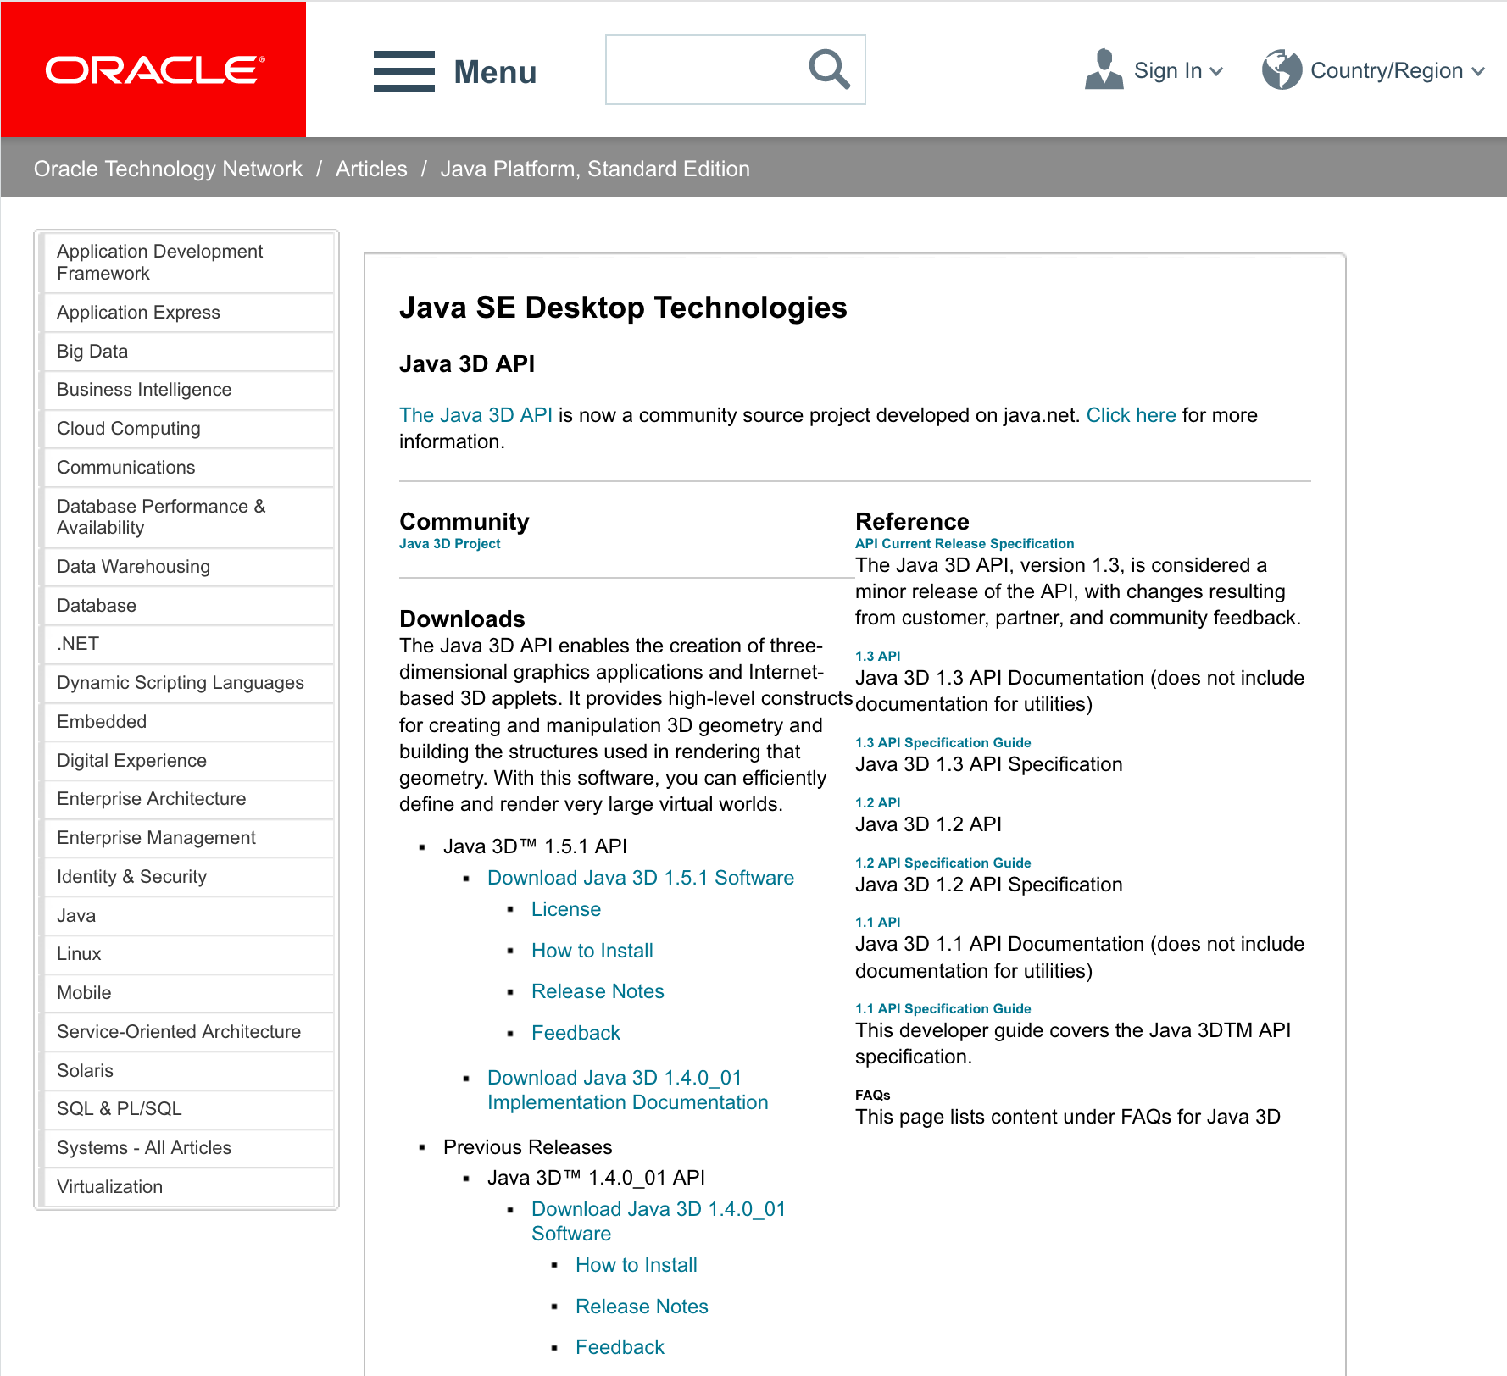
2. Setting up Java3D
2.1. Windows
Search for “java3d” in the web to find Java3D API of ORACLE,
http://www.oracle.com/technetwork/articles/javase/index-jsp-138252.html
click here

Slide 4
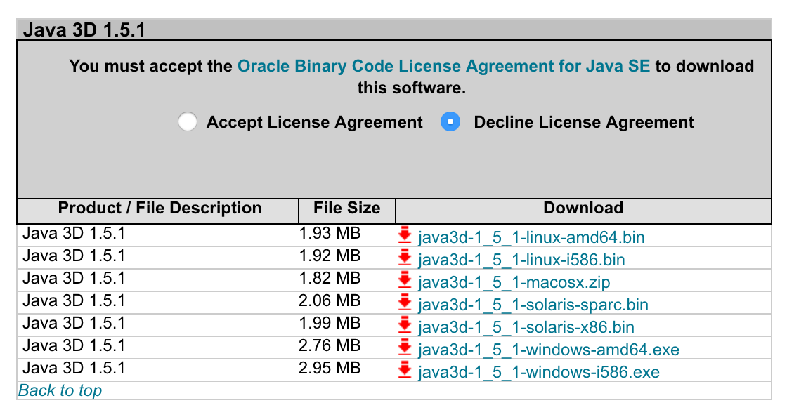
click accept
Choose one and download the installer.
amd64 is for 64-bit.
i586 is for 32-bit (x86).
If you are unsure, check the following folders,
c:\Program Files\Java
c:\Program Files(x86)\Java
and look for ”jrex.x.x_xxx”. If you find it in the former, your Java is 64-bit. If you find it in the latter, it’s 32-bit. If you find in both or multiple jre folders, please check which one is the default.
Double click the installer and follow the instruction. It will create a folder,
c:\Program Files\Java\Java3D (for 64-bit)
or
c:\Program Files(x86)\Java\Java3D (for 32-bit)
In this folder, you will find three jarfiles,
Java3D\1.5.1\lib\ext\j3dcore.jar, j3dutil.jar, vecmath.jar
Copy these jarfiles to an extension folder of JRE,
c:\Program Files\Java\jre1.x.x_xxx\lib\ext (for 64-bit)
or
c:\Program Files(x86)\Java\jre1.x.x_xxx\lib\ext (for 32-bit)

Slide 5
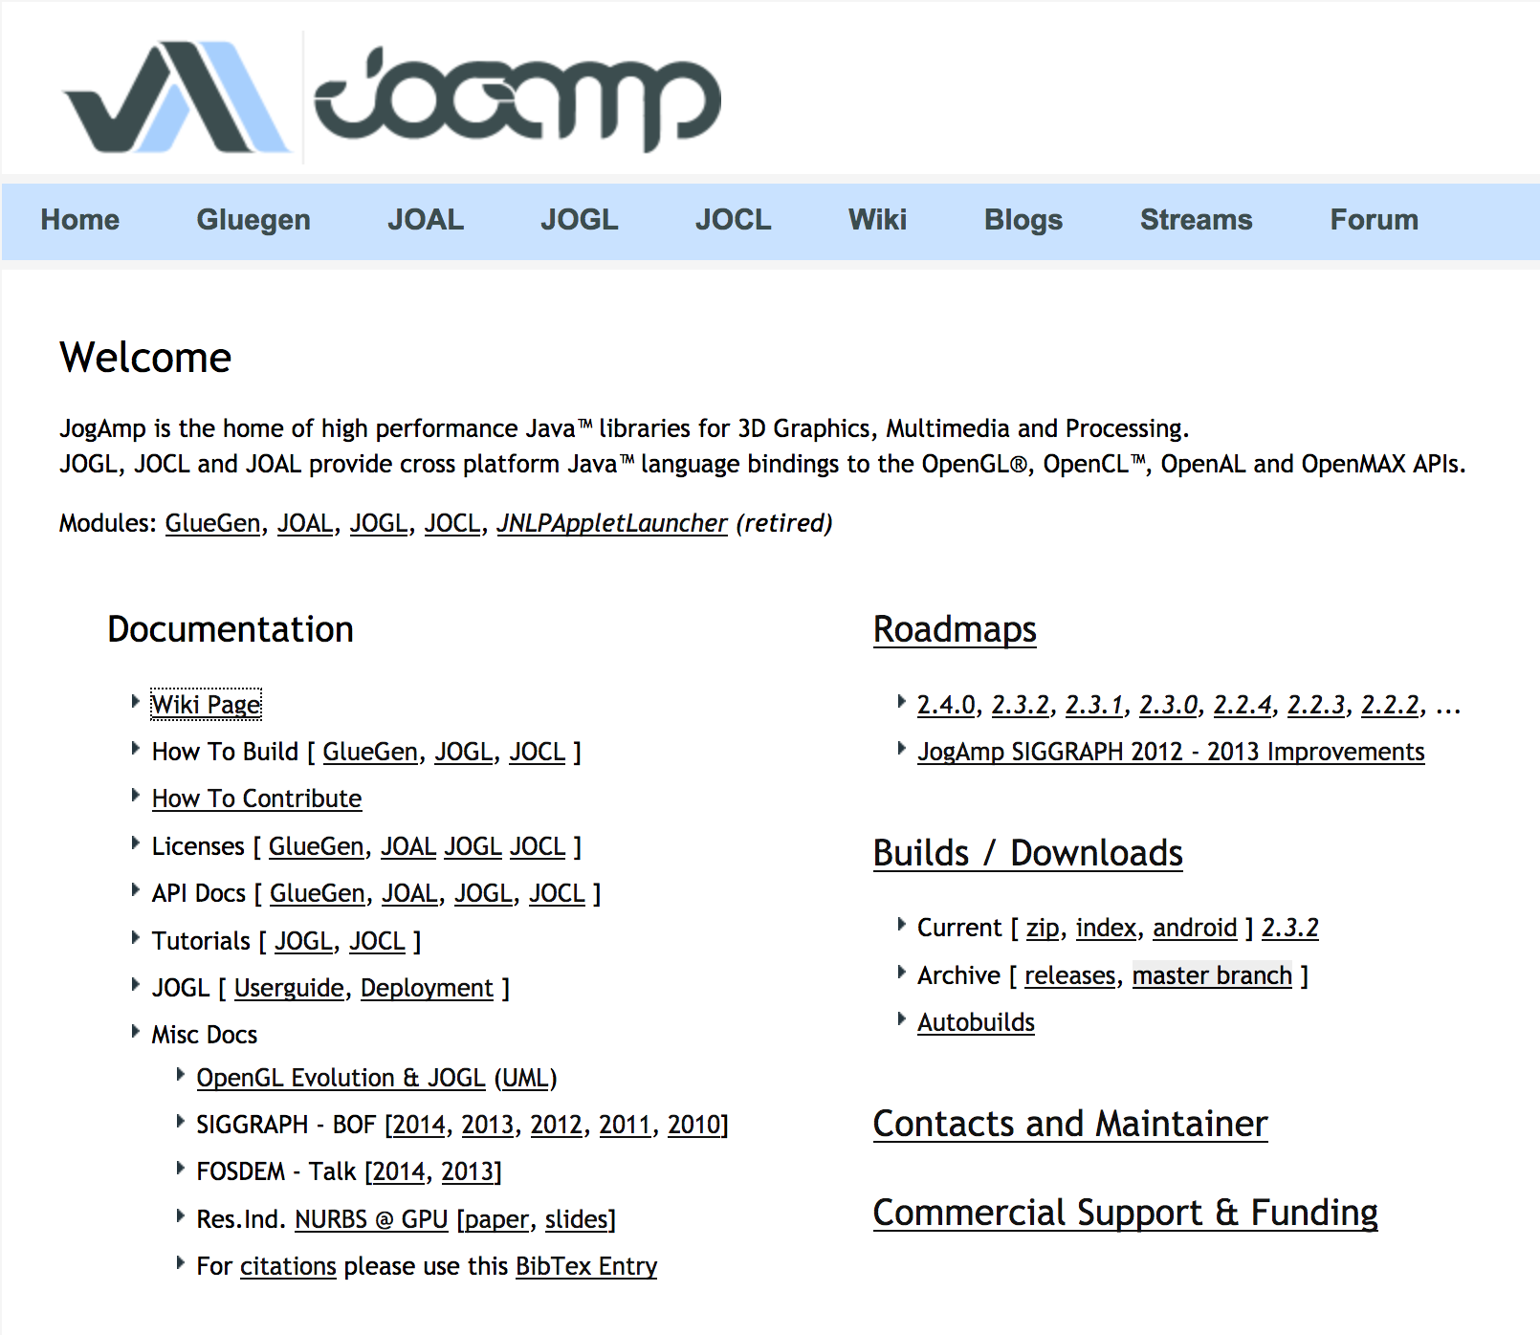
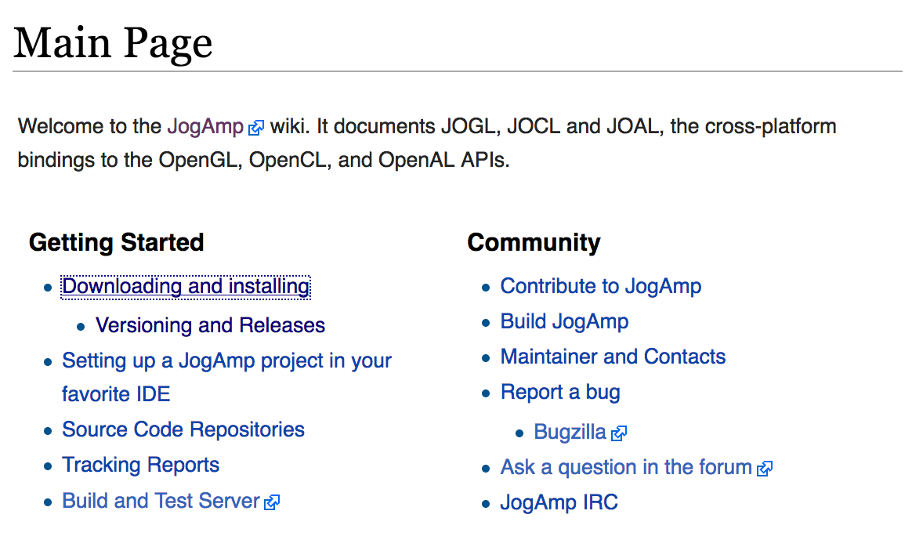
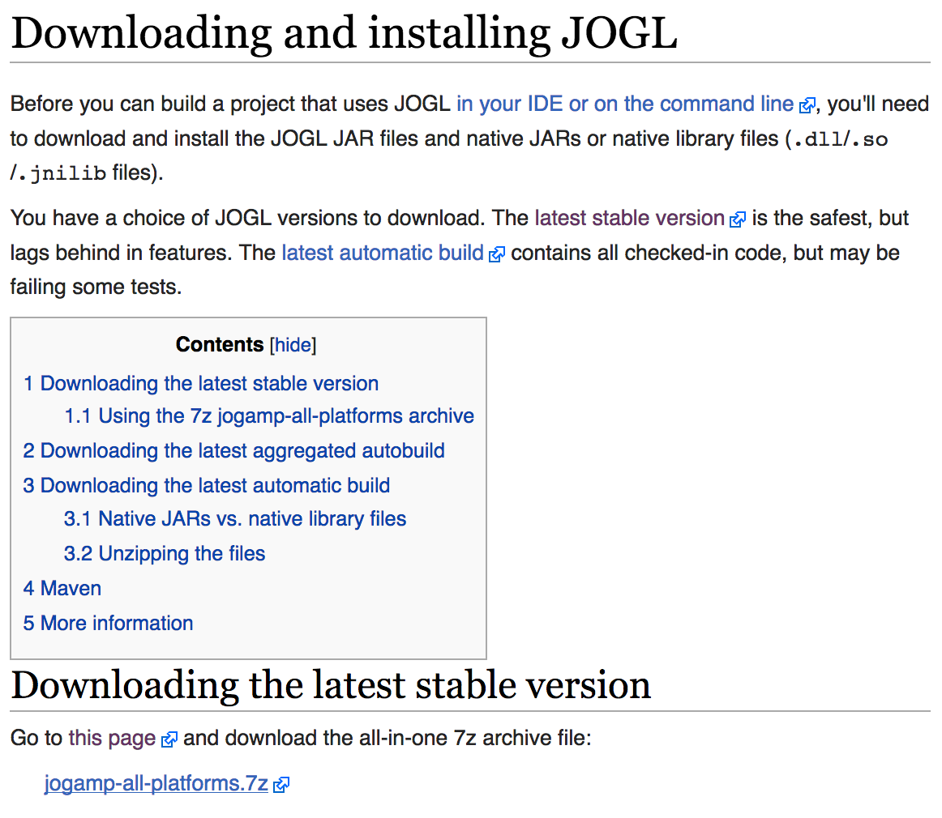
2.2. Mac OSX
Unfortunately, Java3D of ORACLE doesn’t work for Max OSX. Instead, we use Java3D wrapper of JogAmp. Goto http://jogamp.org,
click here
click here
click here and download
jogamp-all-platforms.7z

Slide 6
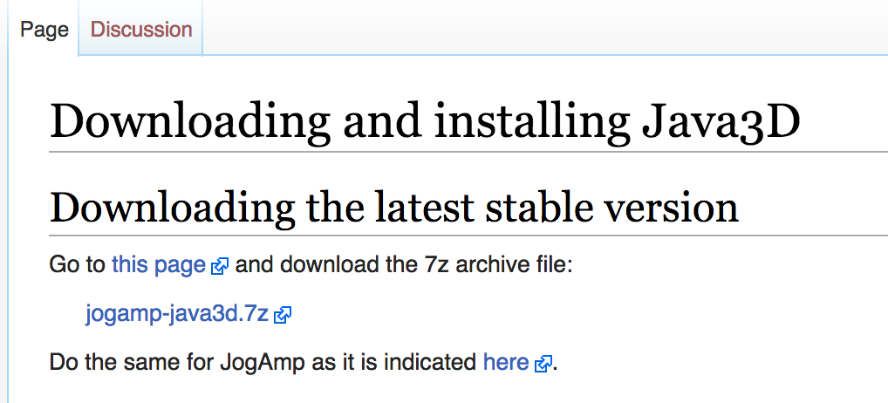
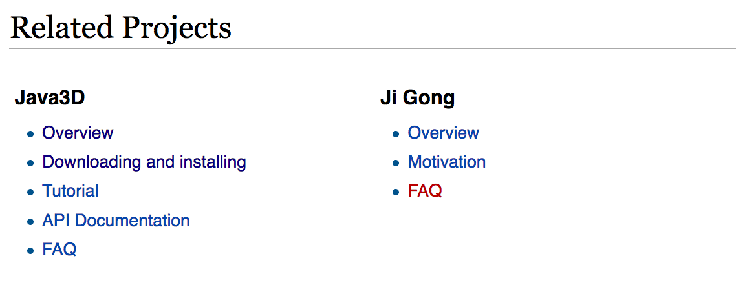

Go back to the Main page and scroll down
…
Scroll down
click here and download
jogamp-java3d.7z
click here
Unarchive the two files you just downloaded. 7z files can be unarchived using, for example, “The Unarchiver”. It’s a free program.
The Unarchiver
MacPaw Inc.
Then, copy the jar files to an extension folder:
>sudo cp jogamp-all-platforms/jar/*jar /Library/Java/Extensions/
>sudo cp jogamp-java3d/*jar /Library/Java/Extensions/

Slide 7
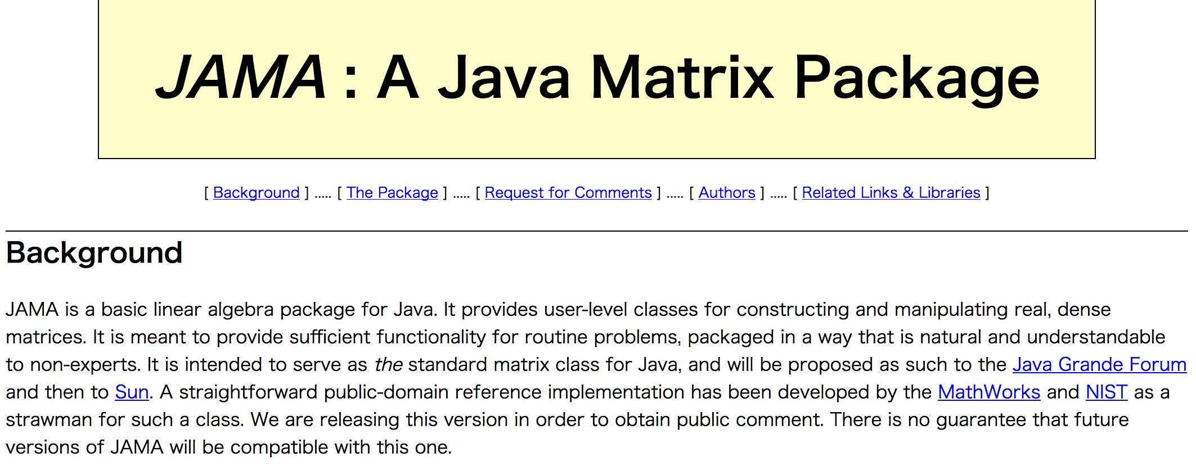
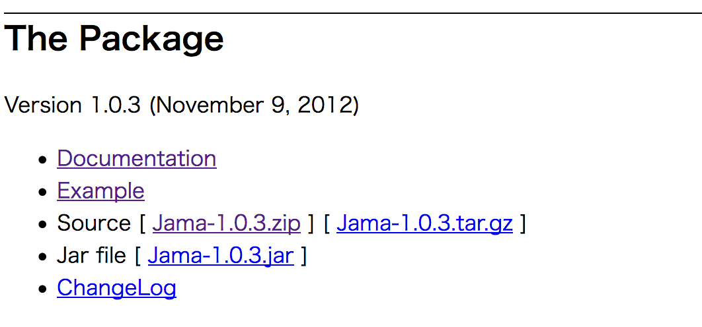
3. Download JAMA
JAMA is a linear algebra library for JAVA. We use it for matrix maltiplications, diagonalization, and so on. It can be downloaded from,
https://math.nist.gov/javanumerics/jama/
…
Scroll down
click here and download a jarfile.
Then, copy the jarfile to the extension folder as before.

Slide 8
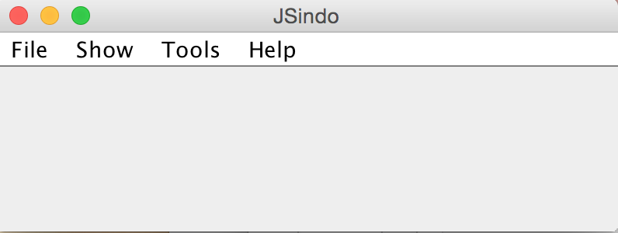
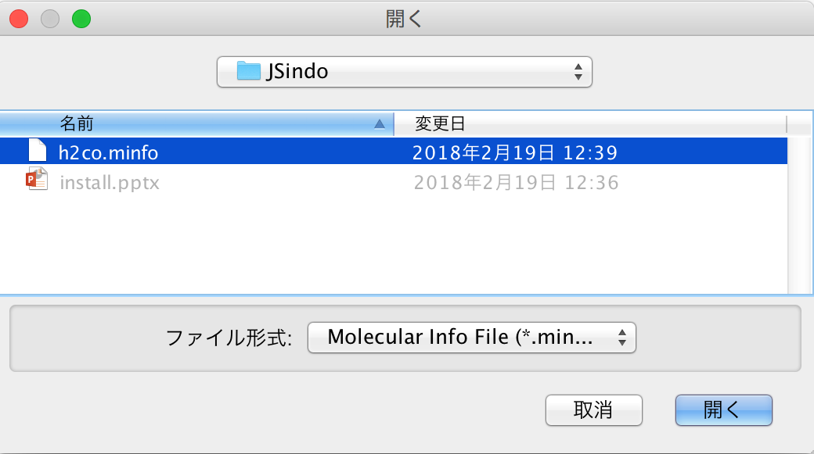
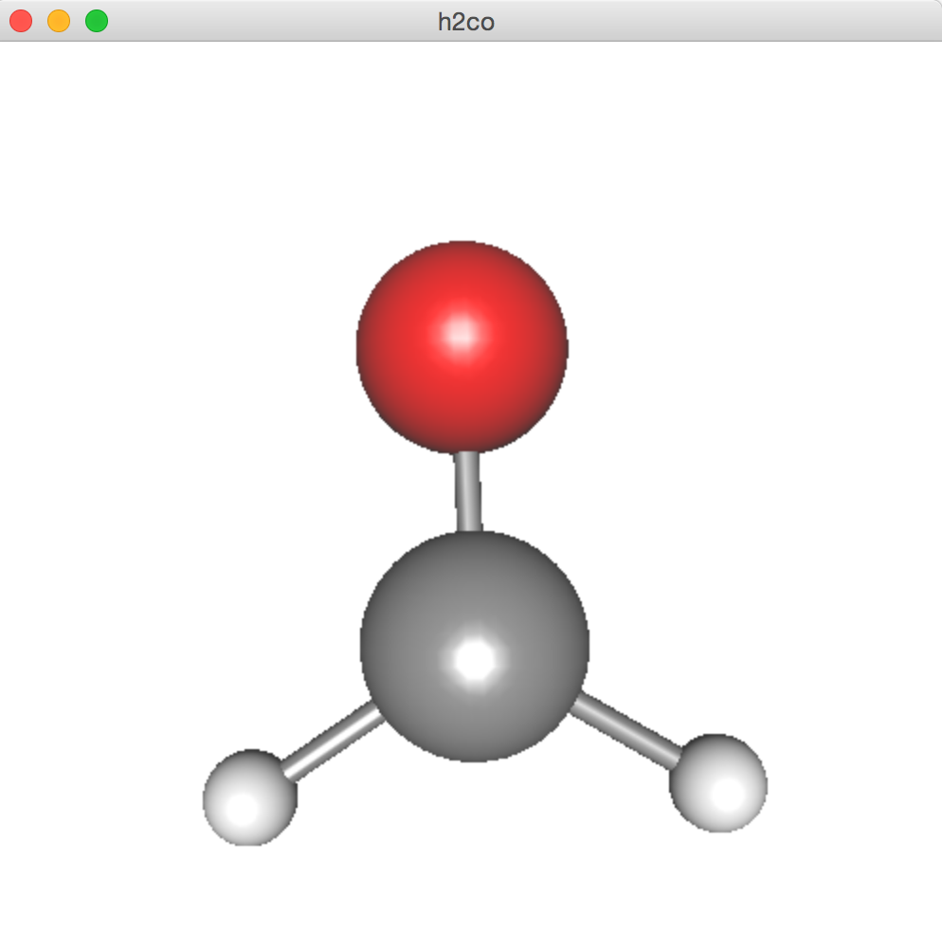
4. Setting up JSindo
Now, double click JSindo-4.0_xxxxxx.jar. You should see a control panel of JSindo.
If you don’t see the panel, review the installation of Java.
Let’s open “h2co.minfo”, which comes with this document. It contains data of formaldehyde.
Click, File -> Open, choose “h2co.minfo”, and click Open. If you see formaldehyde, you’re done with the first step!
If this step fails, it is highly likely that Java3D has a problem. Check that jarfiles are copied to the right extension folder.
Open
click to choose

Slide 9
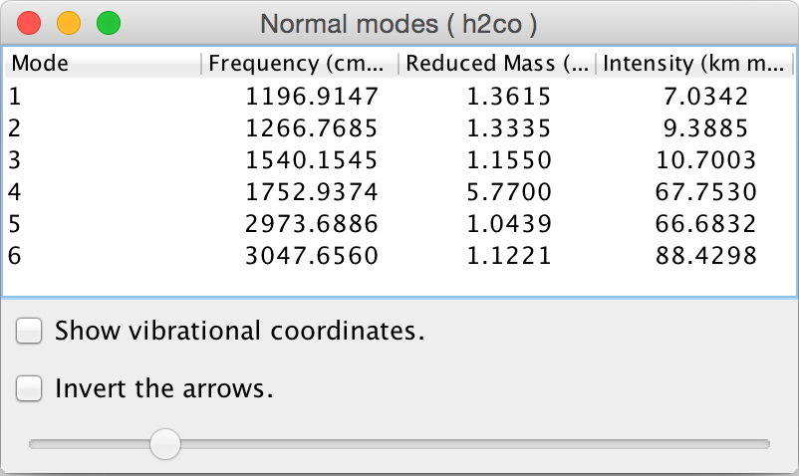
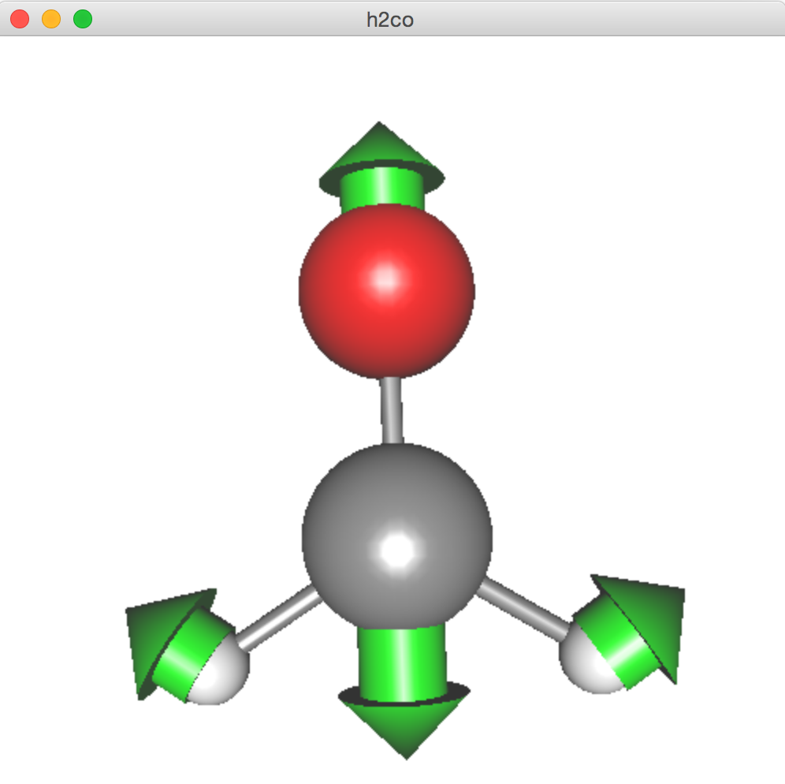
Finally, goto Tools -> Harmonic Analysis. This will create a “Normal modes” panel.
If you don’t see this panel, JAMA isn’t working. Check if the jarfile of JAMA is placed in the right folder.
If you see this panel, you’re all set! Congradulations!
Check on ”show vibrational coordinates”, and choose a mode you want to see. Vibrational motion will be indicated by arrows. You can “Invert the arrows” by a check box, and change the magnitude using a slider.
Enjoy! Thanks for using JSindo!
Harmonic Analysis

Slide 10
FAQ
I want to use JSindo from a command line.
You can use the following command:
Alternatively, you may set an environment valuable, CLASSPATH
in bash, or
in csh/tcsh. Then, it is simple to start JSindo,
How can I change the color?
Sorry, you can’t.
Commons.math
>java –cp /path/to/JSindo-4.0_xxxxxx.jar JSindo
> export CLASSPATH=${CLASSPATH}:/path/to/JSindo-4.0_xxxxxx.jar
> setenv CLASSPATH ${CLASSPATH}:/path/to/JSindo-4.0_xxxxxx.jar
> java JSindo

