Slide 1
FAQ: Install JSindo
Kiyoshi Yagi
kiyoshi.yagi@riken.jp
Theoretical Molecular Science Laboratory
RIKEN Pioneering Research Cluster
2018/06/18

Slide 2
General
I can not get JSindo start up with the following error:
Could not find or load main class JSindo
You probably don’t have JSindo-4.0.jar in the right folder. Review the jar folder.
Fonts and Icons are too tiny.
Although we are aware of this problem that happens with a high DPI diplay, we don’t know the solution at this moment. This seems to be a general issue of Java/Swing applications, which some people says it is fixed in JRE9. However, JRE9 is currently incompatible with JogAmp/Java3D.
I get JSindo start up, but cannot open minfo file with the following error:
Exception in thread "AWT-EventQueue-0" java.lang.NoClassDefFoundError: com/jogamp/opengl/GL
…
You probably downloaded an older version of JogAmp. Read the install manual again and get the right version. Alternatively, the direct link (as of 2018.6.13) is,
http://jogamp.org/deployment/jogamp-current/archive/jogamp-all-platforms.7z

Slide 3
LINUX
How do I make the start up command shorter?
I recommend to create an alias. Edit your ~/.bashrc and add the following two lines,
> vi ~/.bashrc
jsindo_jar=${HOME}/JSindo/jar
alias jsindo=‘java –cp “$jsindo_jar/*” JSindo’
After source, you can invoke the program by typing “jsindo” in the command.
> . .basrc
> jsindo
Alternately, you may want to set CLASSPATH,
> export CLASSPATH=${HOME}/JSindo/jar/*
> java JSindo
Note, however, that the use of CLASSPATH is discouraged, because it can easily mess things up (the library version, for example).

Slide 4
I can not get JSindo start up with the following error:
Exception in thread "main" java.awt.HeadlessException
at java.awt.GraphicsEnvironment.checkHeadless(GraphicsEnvironment.java:204)
…
Some distrubutions have a headless version of Java by default. Try the following command to install a standard Java:
> yum install java-1.8.0-openjdk
(Fedora)
> apt-get install openjdk-8-jre
(Debian, Ubuntu)
I get JSindo start up, but cannot open minfo file with the following error:
Exception in thread "AWT-EventQueue-0" java.lang.NoClassDefFoundError: javax/media/j3d/Bounds
…
You probably don’t have JogAmp/Java3D jarfiles in the jar folder. Review the jar folder.

Slide 5
I get JSindo start up, but cannot open minfo file with the following error:
Exception in thread "AWT-EventQueue-0" java.lang.InternalError: XXX0 profile[1]: GL3bc -> profileImpl GL4bc !!! not mapped
…
This error happened to me when I didn’t have the right driver installed for my GPU card (Quadro K600). It was solved after installing a nVidia driver. The following website was useful for me to install a driver in my Fedora Core,
https://www.if-not-true-then-false.com/2015/fedora-nvidia-guide

Slide 6
Mac
Is it possible NOT to use the extension folder?
Create a new folder (${HOME}/JSindo/jar in the example below), and copy all jar files in there,
> jsindo_jar=${HOME}/JSindo/jar
> mkdir -p $jarfiles
> cp /path/to/jogamp-all-platforms/jar/gluegen.jar $jsindo_jar
> cp /path/to/jogamp-all-platforms/jar/gluegen-rt.jar $jsindo_jar
> cp /path/to/jogamp-all-platforms/jar/jogl-all.jar $jsindo_jar
> cp /path/to/jogamp-all-platforms/jar/gluegen-rt-natives-macosx-universal.jar $jsindo_jar
> cp /path/to/jogamp-all-platforms/jar/jogl-all-natives-macosx-universal.jar $jsindo_jar
> cp /path/to/jogamp-java3d/j3dutils.jar $jsindo_jar
> cp /path/to/jogamp-java3d/j3dcore.jar $jsindo_jar
> cp /path/to/jogamp-java3d/vecmath.jar $jsindo_jar
> cp /path/to/Jama-1.0.3.jar $jsindo_jar
> cp /path/to/JSindo-4.0.jar $jsindo_jar
Then, type the following command to invoke JSindo:
>java –cp “$jsindo_jar/*” JSindo

Slide 7
Is it possible to retain the installed Java, and use Java8 only for JSindo?
Probably, yes. You need to invoke java8 directly from a command line. (See FAQ #1)
I could run JSindo with Java8 executable by the following command:
> /Library/Java/JavaVirtualMachines/jdk1.8.0_172.jdk/Contents/Home/bin/java \
–cp /path/to/JSindo-4.0.jar JSindo
Note that the folder name may be different, and check carefuly the location of the Java8 executable.

Slide 8
Windows

Slide 9
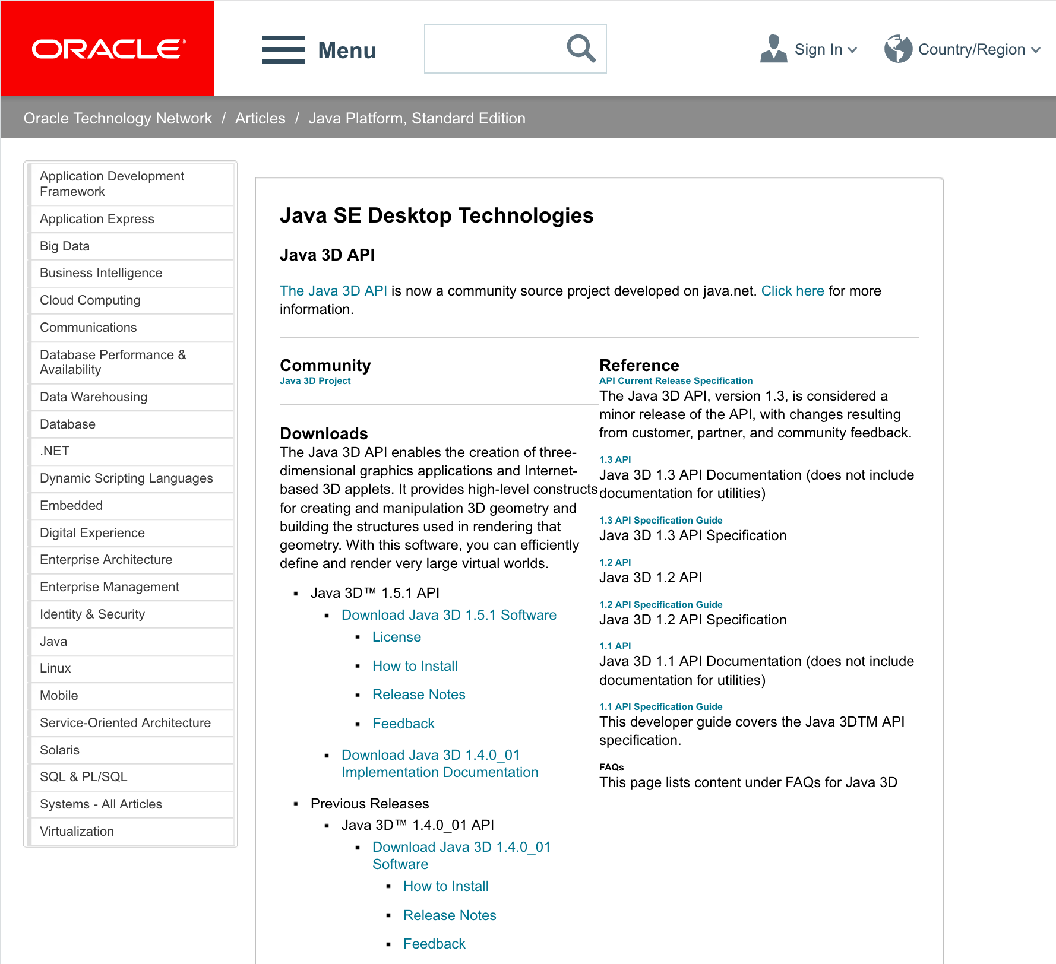
ORACLE Java3D (1.5.1)
Search for “java3d” in the web to find Java3D API of ORACLE,
http://www.oracle.com/technetwork/articles/javase/index-jsp-138252.html
click here

Slide 10
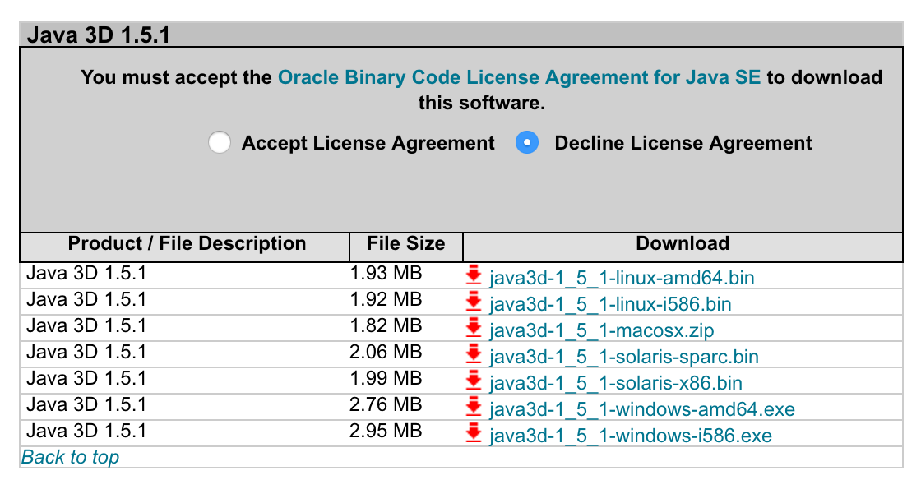
Now, download the installer,
click accept
Click here to download
amd64 for 64-bit.
i586 for 32-bit (x86).
Double click the installer and follow the instruction. The installer creats a new folder, Java3D, in a Java folder,
32-bit c:\Program Files(x86)\Java\Java3D
64-bit c:\Program Files\Java\Java3D
In this folder, you will find three jarfiles,
Java3D\1.5.1\lib\ext\
j3dcore.jar
j3dutil.jar
vecmath.jar
Copy these three jarfiles to an extension folder of JRE,
Java\jre1.x.x_xxx\lib\ext

Slide 11
OS | Java | Java3D | Result | Note
MacOSX(Mountain Lion) 10.8.5 | Oracle 1.8.0_161-b12 | JogAmp2.3.2 | OK | Mori MacBook Pro
MacOSX (Yosemite) 10.10.5 | Oracle 1.8.0_45 64-bit | Oracle 1.5.1_macosx | NO | Yagi, MacBook Pro (13 inch, mid2014)
MacOSX (Yosemite) 10.10.5 | Oracle 1.8.0_45 64-bit | JogAmp2.3.2 1.6.0-pre12 | OK | Yagi, MacBook Pro (13 inch, mid2014)
MacOSX (El Capitan) 10.11.6 | Oracle 1.8.0_40 64-bit | JogAmp2.3.2 1.6.0-pre12 | OK | yamada mac
MacOSX (High Sierra) | Oracle | JogAmp2.3.2 1.6.0-pre12 | OK | yagi mac
Mac OSX (Yosemite) | Oracle 1.8.0_172 64-bit | JogAmp2.3.2 1.6.0-pre12 | OK | Mizukami MacBook Pro (15 inch, 2014 late)
Mac OSX (High Sierra) | Oracle 1.8.0_172 64-bit | JogAmp2.3.2 1.6.0-pre12 | OK | Mizukami iMac 5k, 2014 late GPU (Radeon R9)
MacOSX(High Sierra) 10.13.4 | Oracle 9.0.4.0.11 | JogAmp2.3.2 | NO | Matsunaga MacBook Pro (15 inch, 2016)

Slide 12
OS | Java | Java3D | Result | Note
Windows10 Pro | Oracle 1.8.0_161 32-bit | Oracle 1.5.1 (i586) | OK | yagi PC vaio
Windows10 Pro | Oracle 1.8.0_161 32-bit | JogAmp2.3.2 1.6.0-pre12 (i586) | OK | yagi PC vaio
Windows10 Pro | Oracle 1.8.0_172 32/64-bit | JogAmp2.3.2 1.6.0-pre12 (i586) | OK | yagi PC vaio
Windows10 Pro | Oracle 1.8.0_171-b11 (32-bit) | jogamp v2.3.2 1.6.0-final (i586) | OK | Matsuoka notePC
Windows10 Pro for Workstations | Oracle 1.8.0_171-b12 (32-bit) | jogamp v2.3.2 java3d/1.6.0-final (windows i586) | OK | Win workstation
Fedora release 26 | Oracle 1.8.0_51-b16 | Jogamp 2.3.2 (amd64) | OK | Kobayashi PC
Fedora release 28 | Open JDK | Jogamp 2.3.2 (amd64) | OK | Yagi Workstation (HP Z)

