Slide 1
How to Install JSindo
for LINUX
Kiyoshi Yagi
kiyoshi.yagi@riken.jp
Theoretical Molecular Science Laboratory
RIKEN Pioneering Research Cluster
2018/06/04

Slide 2

1. Install Java
Let’s check if you have Java installed or not, and the version of Java if you have.
In the terminal, type “java -version” and you will see a message like this:
>java –version
openjdk version "1.8.0_121”
OpenJDK Runtime Environment (build 1.8.0_121-b13)
OpenJDK 64-Bit Server VM (build 25.121-b13, mixed mode)
If your Java is 1.8.xxx (=JDK8), then you can skip the installation and go to Chap. 2.
If your Java is a newer one, 1.9.xxx (=JDK9) and later, it is unfortunately NOT compatible with Java3D library, which JSindo use for visualization. You may either uninstall or switch to JDK8 keeping the current ones. Ask google for details.
To install JDK8, type in the terminal,
> yum install java-1.8.0-openjdk
(Fedora)
> apt-get install openjdk-8-jre
(Debian, Ubuntu)
http://openjdk.java.net/
See the OpenJDK website for further details.

Slide 3
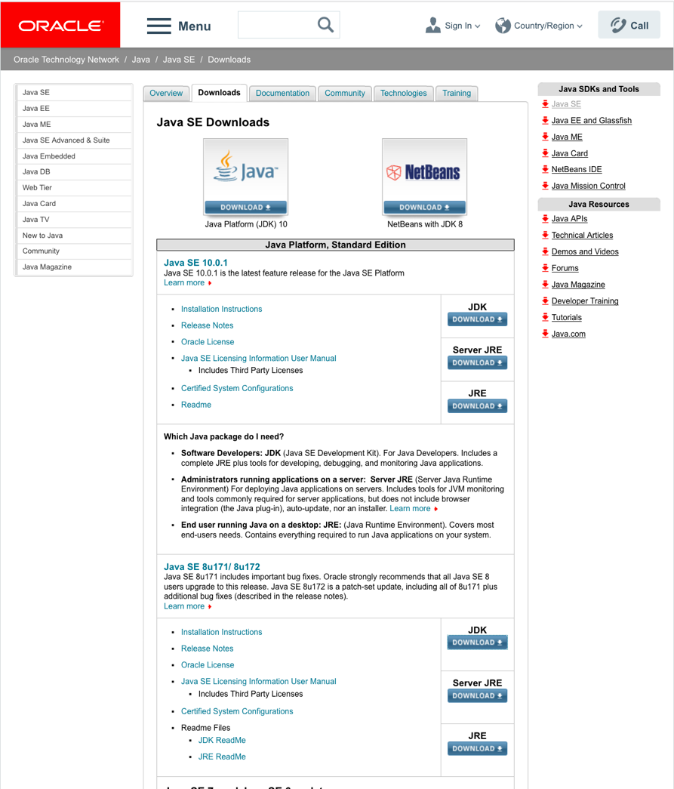
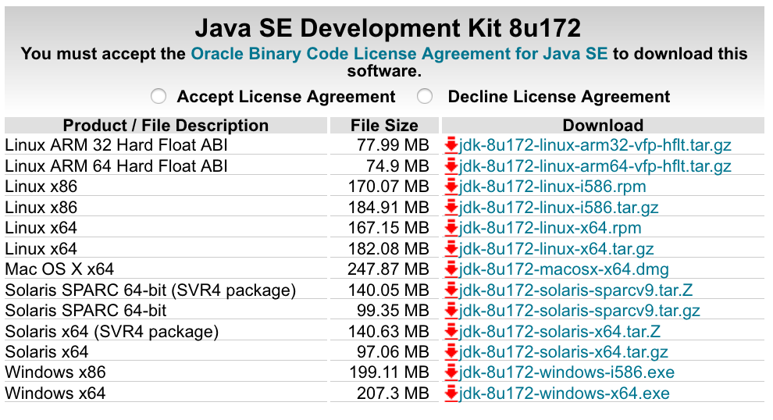
Alternately, you may use Oracle Java 1.8.x. It is available from here.
Search “Java SE download” in Google and goto the following website.
http://www.oracle.com/technetwork/java/javase/downloads/index.html
accept
Not this!
i586 and x64 is 32- and 64-bit, respectively. I think you will normally choose 64-bit.
Java SE 8u

Slide 4
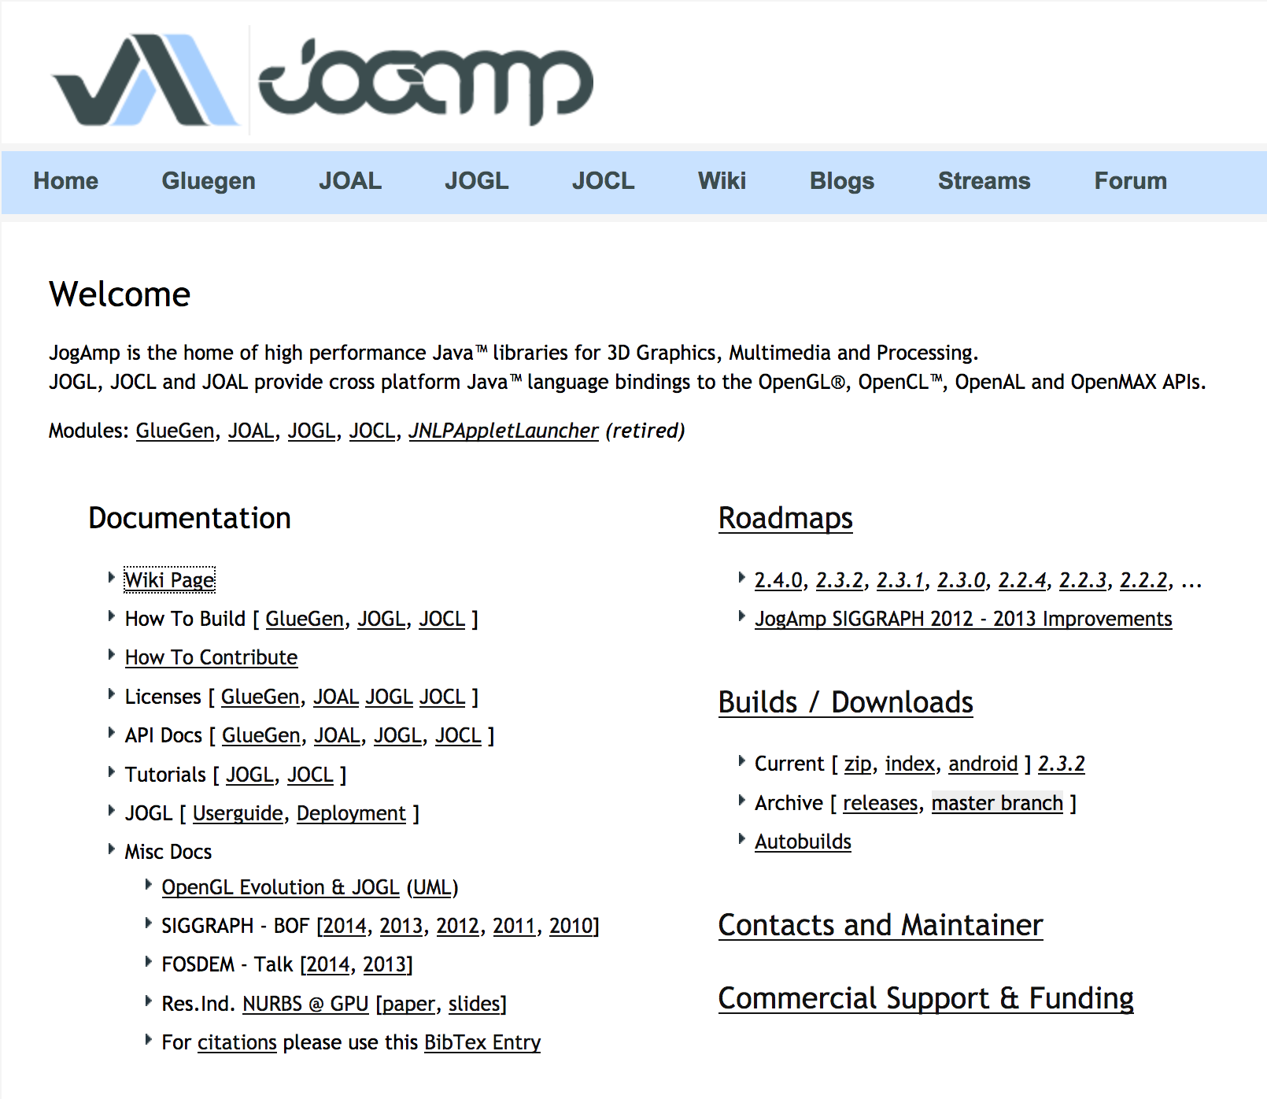
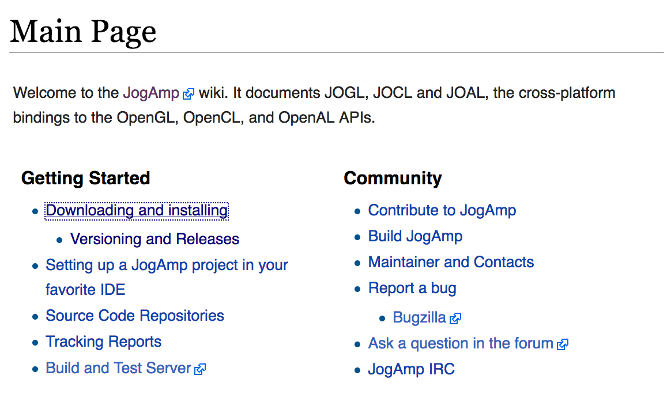
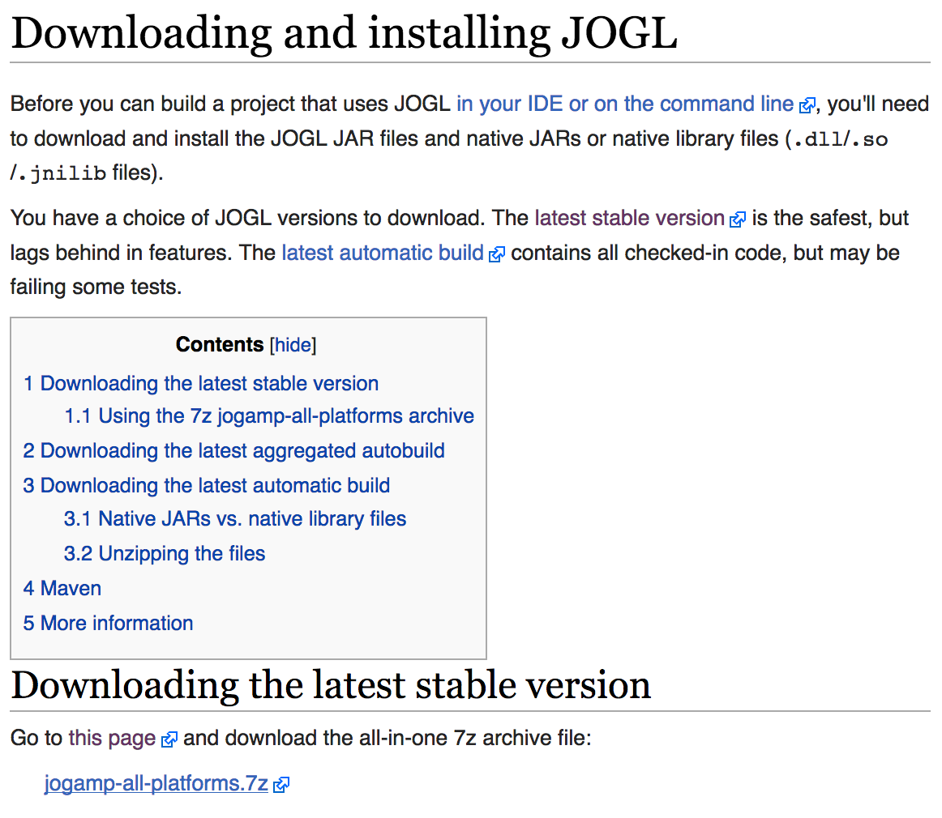
2. Download Java3D
JSindo uses Java3D for visualization. A stable version, 1.6.0, is available from JogAmp. Goto http://jogamp.org
click here
click here
click here and download
jogamp-all-platforms.7z

Slide 5
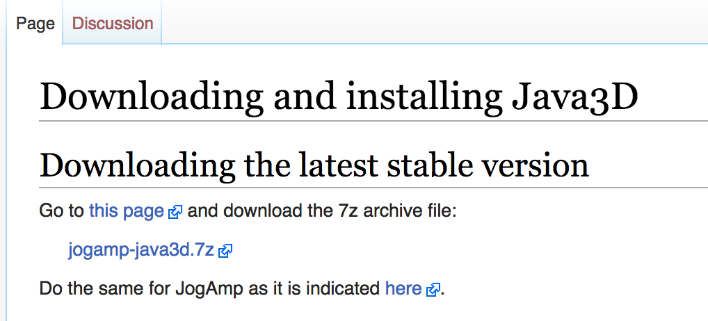
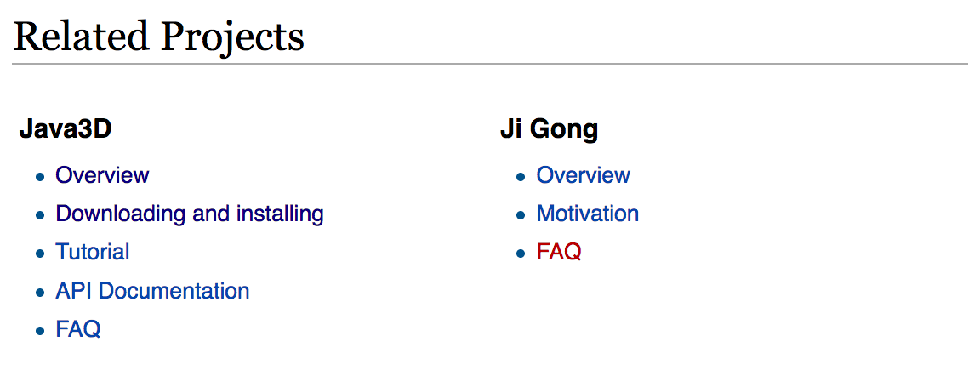
Go back to the Main page and scroll down
…
Scroll down
click here and download
jogamp-java3d.7z
click here
Unarchive the two files you’ve just downloaded. 7z files can be unarchived by,
> 7za x jogamp-all-platforms.7z
> 7za x jogamp-java3d.7z
If you don’t have the command, install p7zip package,
> yum install p7zip
(Fedora)
> apt-get install p7zip
(Debian and Ubuntu)

Slide 6
You will find jar files in jogamp-all-platforms/jar and in jogamp-java3d. The following jar files are needed for JSindo:
jogamp-all-platforms/jar/
gluegen-rt.jar
gluegen.jar
gluegen-rt-natives-linux-XXX.jar
jogl-all.jar
jogl-all-natives-linux-XXX.jar
jogamp-java3d/
j3dcore.jar
j3dutils.jar
vecmath.jar
where XXX = amd64 or i586 for 64 or 32-bit, respectively. You can check if your Java is 32- or 64-bit. In the terminal, type “java -version” and you will see a message like this:
This is an example of 64-bit. If “64-Bit” is absent, then it’s 32-bit.
>java –version
openjdk version "1.8.0_121”
OpenJDK Runtime Environment (build 1.8.0_121-b13)
OpenJDK 64-Bit Server VM (build 25.121-b13, mixed mode)
(* XXX = armv6 and armv6hf are for ARM cpus, which are used for phones.)

Slide 7
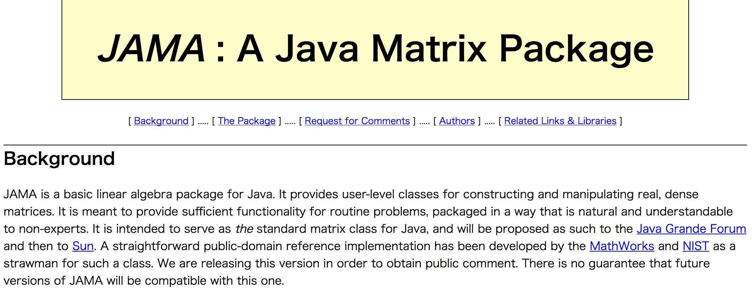
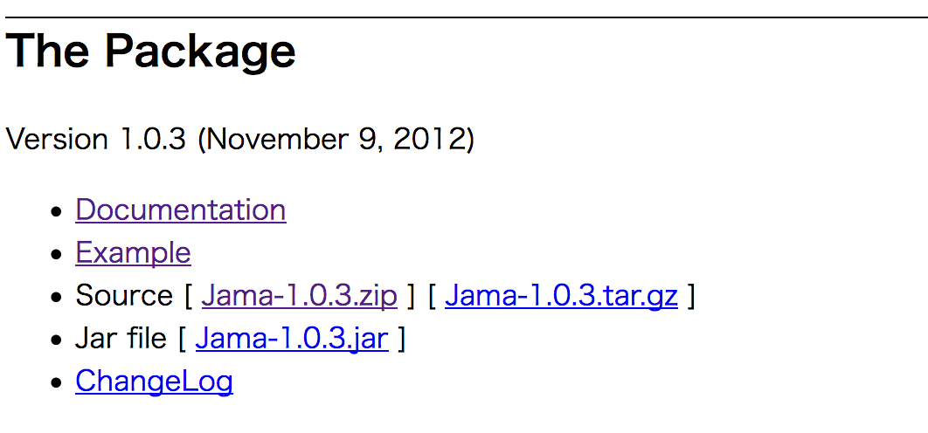
3. Download JAMA
JAMA is a linear algebra library for JAVA. We use it for matrix multiplications, diagonalization, and so on. It can be downloaded from,
https://math.nist.gov/javanumerics/jama/
…
Scroll down
click here and download a jarfile.

Slide 8
4. Download and test JSindo
Download JSindo-4.x.jar and sample.tar.gz (or sample.zip) from our website:
http://www.riken.jp/TMS2012/tms/en/research/software/sindo/index.html
Now, create a new folder (${HOME}/JSindo/jar in the example below), and copy all jar files in there,
> jsindo_jar=${HOME}/JSindo/jar
> mkdir -p $jarfiles
> cp /path/to/jogamp-all-platforms/jar/gluegen.jar $jsindo_jar
> cp /path/to/jogamp-all-platforms/jar/gluegen-rt.jar $jsindo_jar
> cp /path/to/jogamp-all-platforms/jar/jogl-all.jar $jsindo_jar
> cp /path/to/jogamp-all-platforms/jar/gluegen-rt-natives-linux-xxx.jar $jsindo_jar
> cp /path/to/jogamp-all-platforms/jar/jogl-all-natives-linux-xxx.jar $jsindo_jar
> cp /path/to/jogamp-java3d/j3dutils.jar $jsindo_jar
> cp /path/to/jogamp-java3d/j3dcore.jar $jsindo_jar
> cp /path/to/jogamp-java3d/vecmath.jar $jsindo_jar
> cp /path/to/Jama-1.0.3.jar $jsindo_jar
> cp /path/to/JSindo-4.0.jar $jsindo_jar
where xxx = amd64 or i586 for 64-bit or 32-bit, respectively.

Slide 9
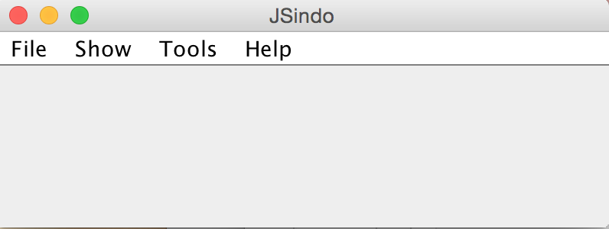
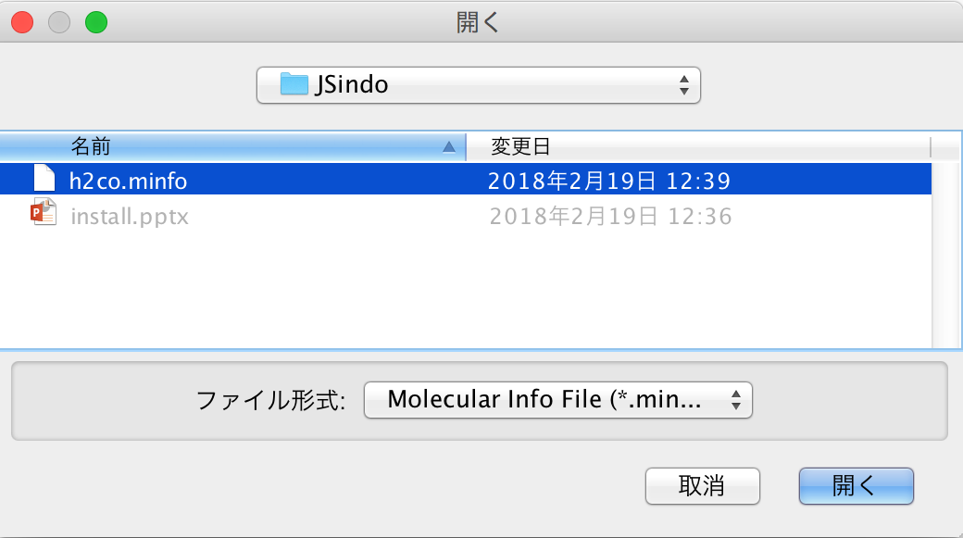
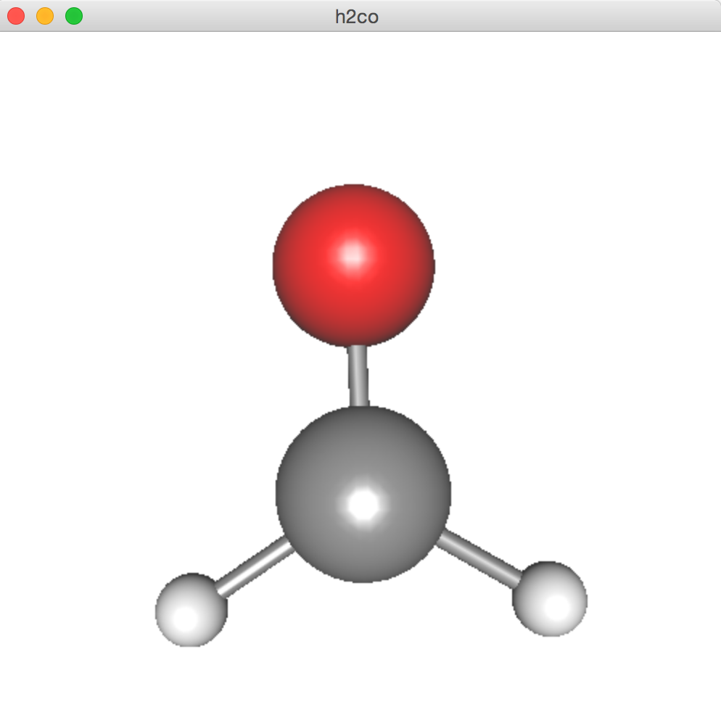
Then, type the following command to invoke JSindo:
>java –cp “$jsindo_jar/*” JSindo
With this command, you should see a control panel of JSindo. If you don’t see the panel, you might try to reinstall or update Java. See FAQ for some tips.
Let’s open “sample/h2co.minfo”, which is included in sample.tar.gz. You can extract the file by,
In JSindo control panel, click File -> Open, choose “h2co.minfo”, and click Open. If you see formaldehyde, you’re done with the first step!
If this step fails, it is highly likely that JogAmp/Java3D has a problem. Double check if the right jarfiles (xxx = amd64 or i586) are located in the folder.
Open
click to choose
>tar –zxvf sample.tar.gz

Slide 10
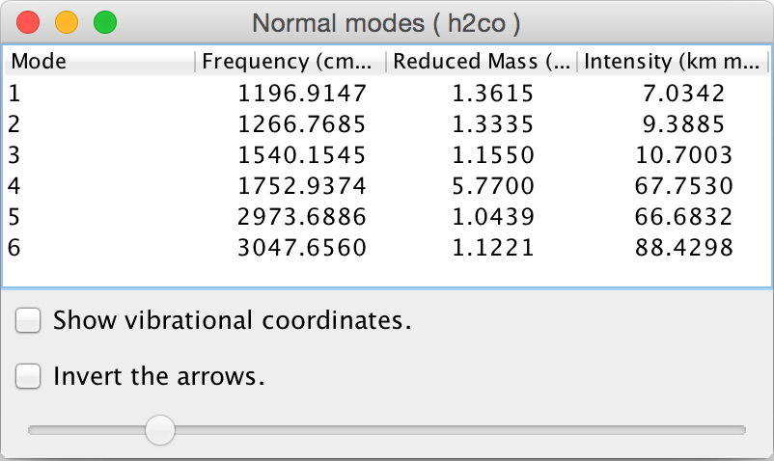
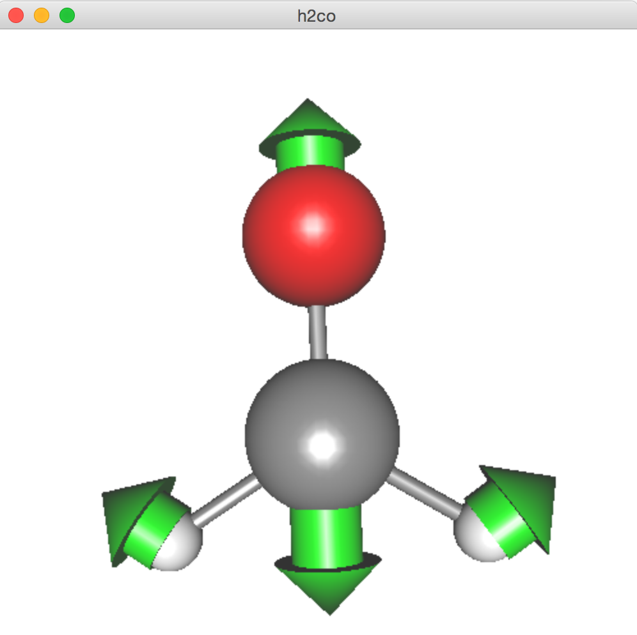
Finally, goto Tools -> Harmonic Analysis. This should create a panel of “Normal modes”.
If you don’t see this panel, JAMA isn’t working. Check if the jarfile of JAMA is located in the folder.
If the panel appears, you’re all set! Congratulations!
Check on ”show vibrational coordinates”, and choose a mode you want to see. Vibrational motion will be indicated by arrows. You can “Invert the arrows” by a check box, and change the magnitude using a slider.
Thanks for using JSindo!
Enjoy!
Harmonic Analysis

