Slide 1
How to Install JSindo
for Mac
Kiyoshi Yagi
kiyoshi.yagi@riken.jp
Theoretical Molecular Science Laboratory
RIKEN Pioneering Research Cluster
2018/06/01

Slide 2
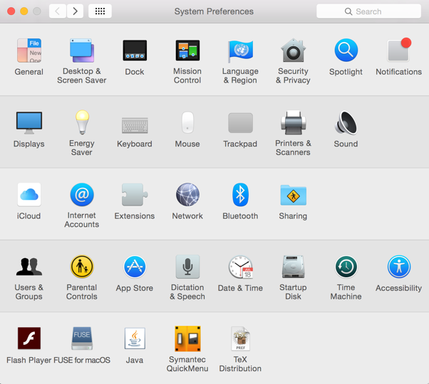
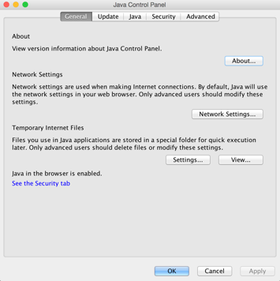
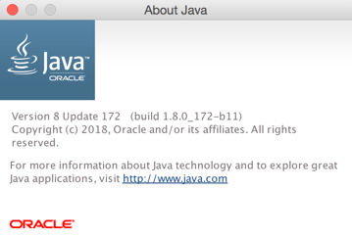
1. Install Java
STEP1: Let’s check if your Mac has Java installed or not, and the version of Java if you have.
Open the “System Preference”.
If you don’t find an icon of Java, your Mac doesn’t have a Java yet. In this case, goto STEP2.
If you find the icon, click the icon to open Java Control Panel, where you can check the version of Java.
If your Java is Version 8, then you can skip the installation and go to Chap. 2.
Your Java is Version 8 Update 172!

Slide 3

If your Java is a newer one (version 9 and later), it is unfortunately NOT compatible with Java3D library, which JSindo use for visualization. In this case, uninstall Java and re-install version 8.
Unfortunately, your Java is Version 10.0.1…
To uninstall Java (version 10), type the following commands to remove the folders. You will be prompted to enter an adimistrator password.
> sudo rm -rf /Library/Internet\ Plug-Ins/JavaAppletPlugin.plugin
> sudo rm -rf /Library/PreferencePanes/JavaControlPanel.prefPane
> sudo rm -rf /Library/Java/JavaVirtualMachines/jdk-10.0.1.jdk
WARNING!
Be sure to type the right folders. You cannot redo this command!

Slide 4
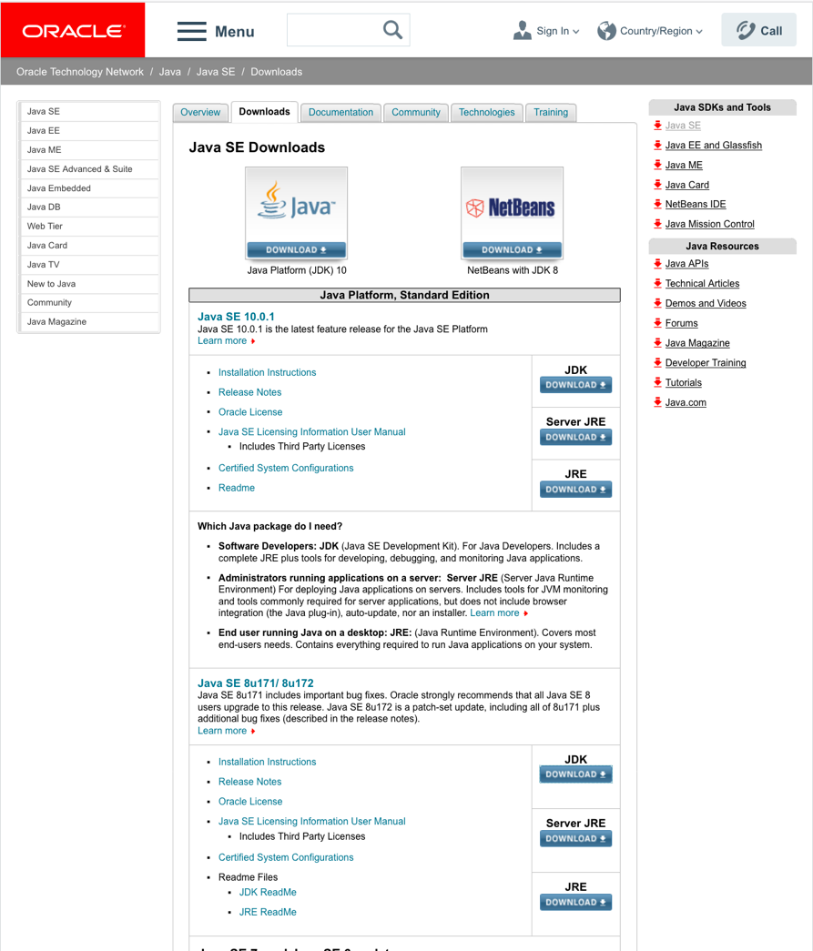
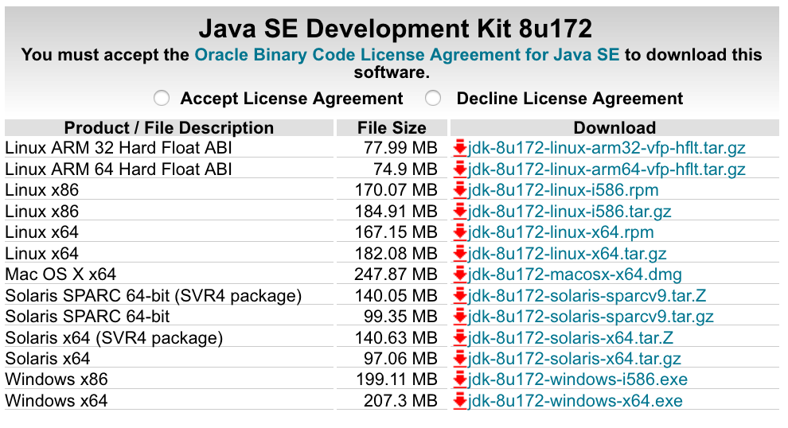
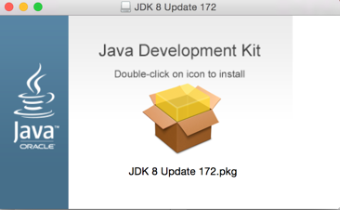
STEP2: Install Java8.
Search “Java SE download” in Google and goto the following website.
http://www.oracle.com/technetwork/java/javase/downloads/index.html
accept
Not this!
download and double click the dmg file
Click here, follow the instruction, and you’re done.
You may do STEP1 to double check you’ve got the right Java installed.
Java SE 8u
*) If you don’t have enough space, JRE is also OK. But, JDK is recommended since it let you use Java from a command line.

Slide 5
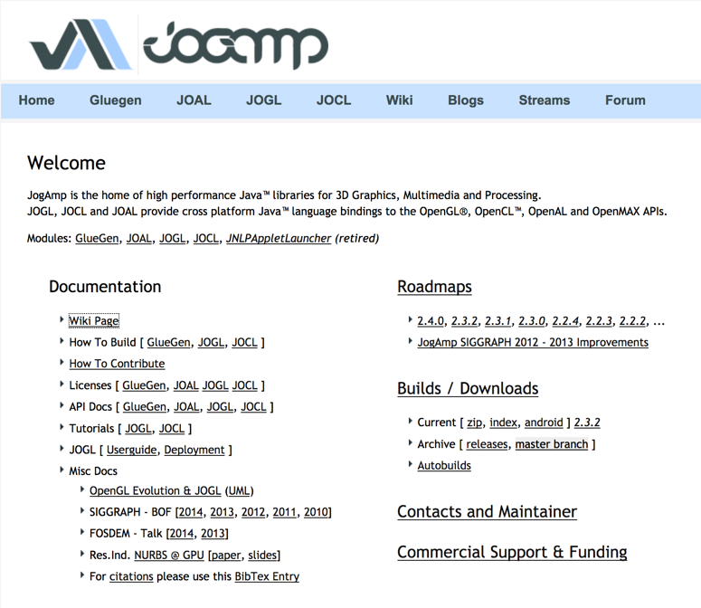
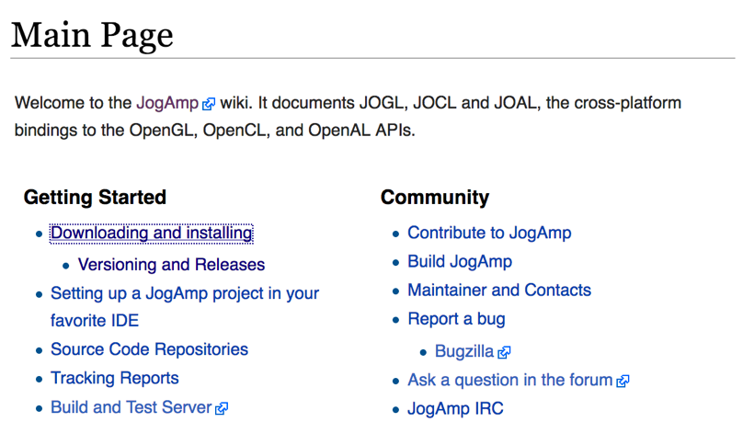
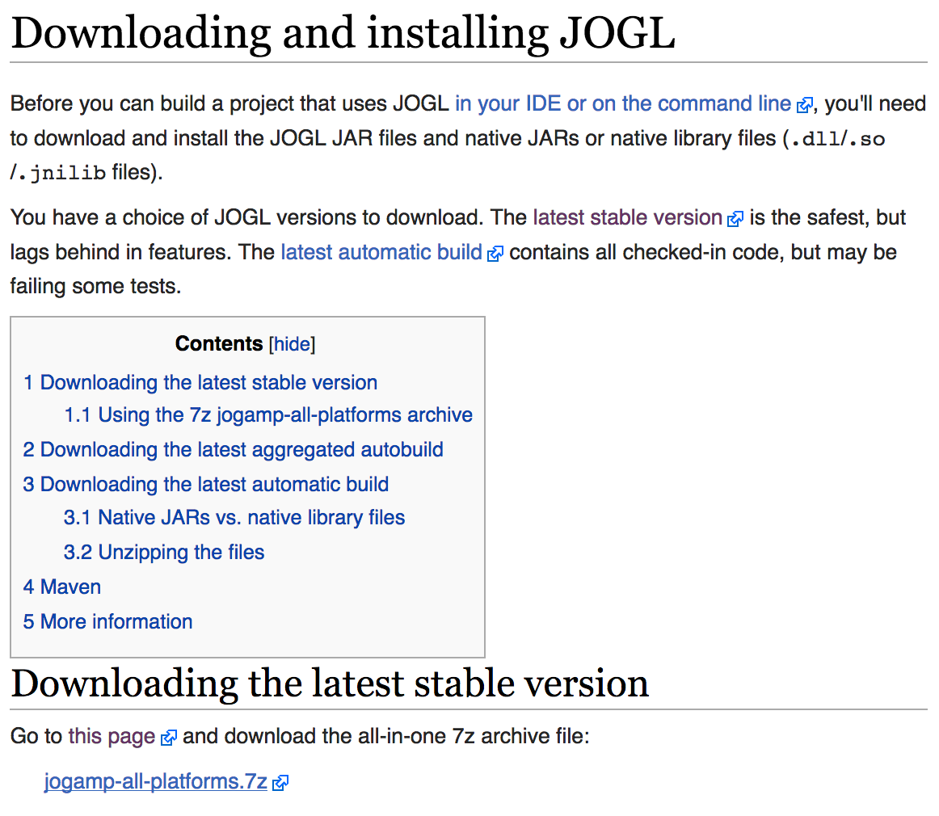
2. Download Java3D
JSindo uses Java3D for visualization. A stable version, 1.6.0, is available from JogAmp. Goto http://jogamp.org
click here
click here
click here and download
jogamp-all-platforms.7z

Slide 6

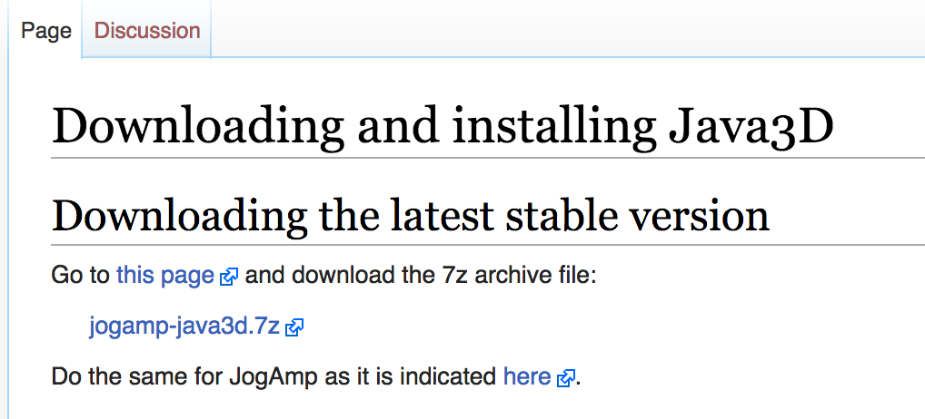
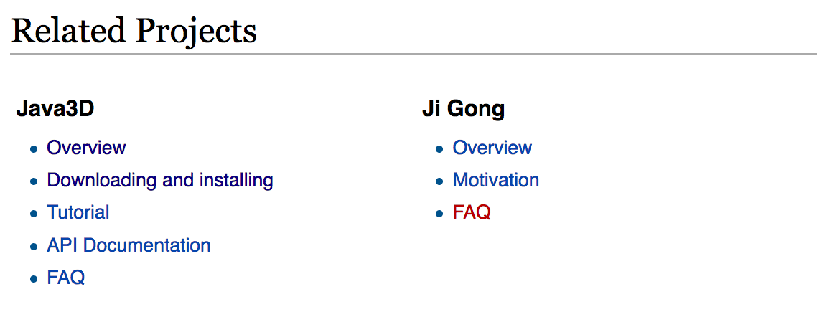

Go back to the Main page and scroll down
…
Scroll down
click here and download
jogamp-java3d.7z
click here
Unarchive the two files you’ve just downloaded. 7z files can be unarchived using, for example, “The Unarchiver”,
The Unarchiver
MacPaw Inc.

Slide 7
You will find jar files in jogamp-all-platforms/jar and in jogamp-java3d. The following jar files are needed for JSindo:
jogamp-all-platforms/jar/
gluegen-rt.jar
gluegen.jar
gluegen-rt-natives-macosx-universal.jar
jogl-all.jar
jogl-all-natives-macosx-universal.jar
jogamp-java3d/
j3dcore.jar
j3dutils.jar
vecmath.jar

Slide 8
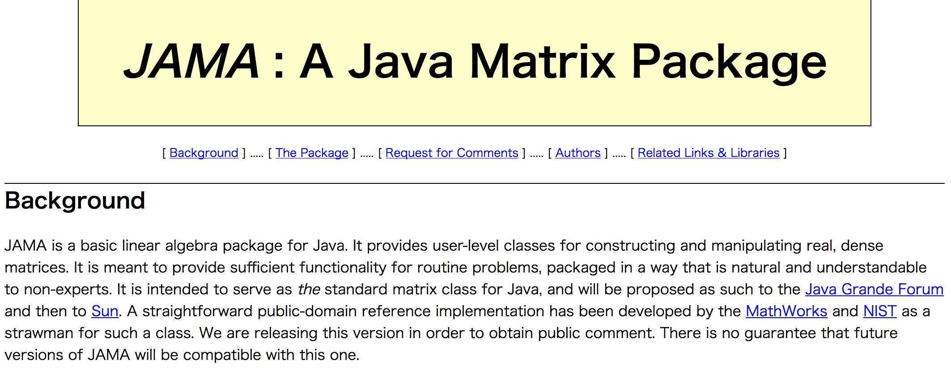
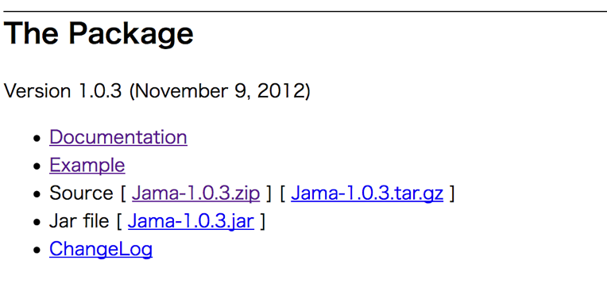
3. Download JAMA
JAMA is a linear algebra library for JAVA. We use it for matrix multiplications, diagonalization, and so on. It can be downloaded from,
https://math.nist.gov/javanumerics/jama/
…
Scroll down
click here and download a jarfile.

Slide 9
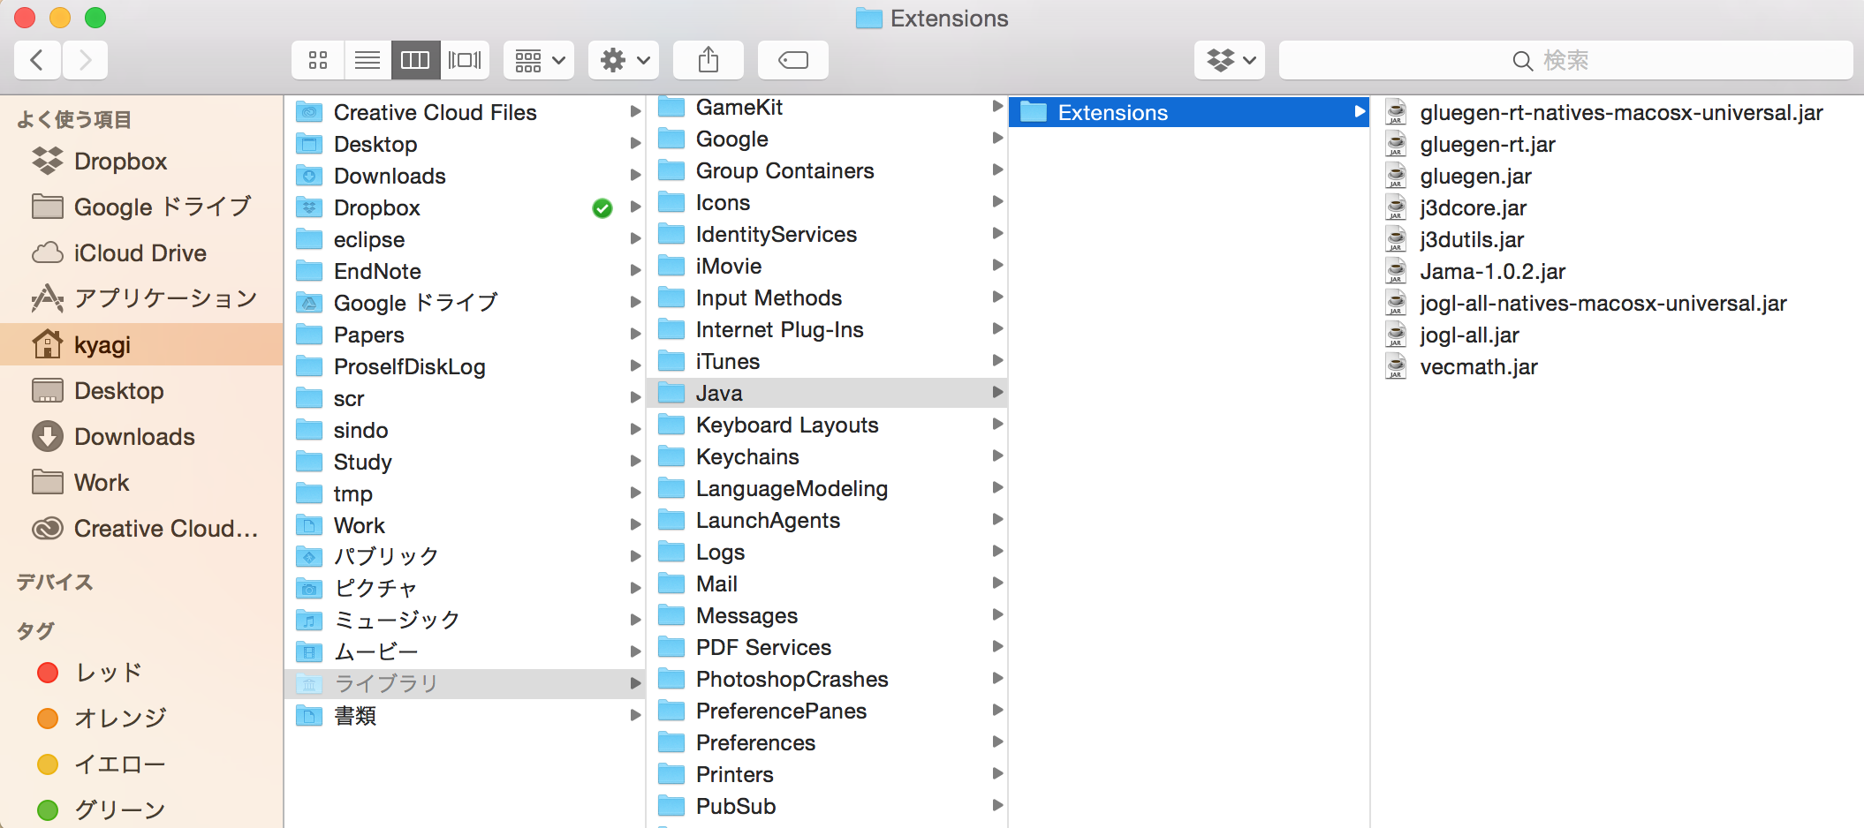
4. Copy jar files
Copy the jar files to an extension folder, which is set to ~/Library/Java/Extensions. Click Go menu of finder with option key pressed (~/Library is hidden) and choose Library. Create the folder if you don‘t have it yet, then copy the jar files in this folder.
Library

Slide 10
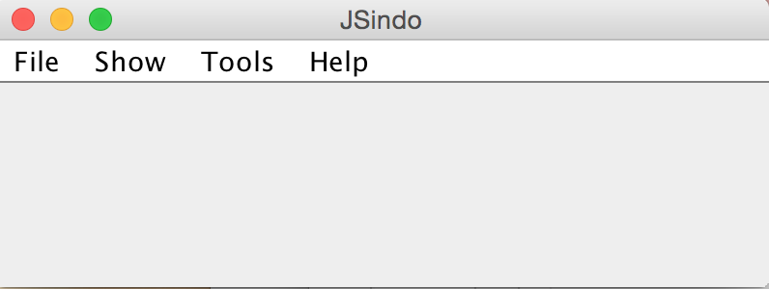
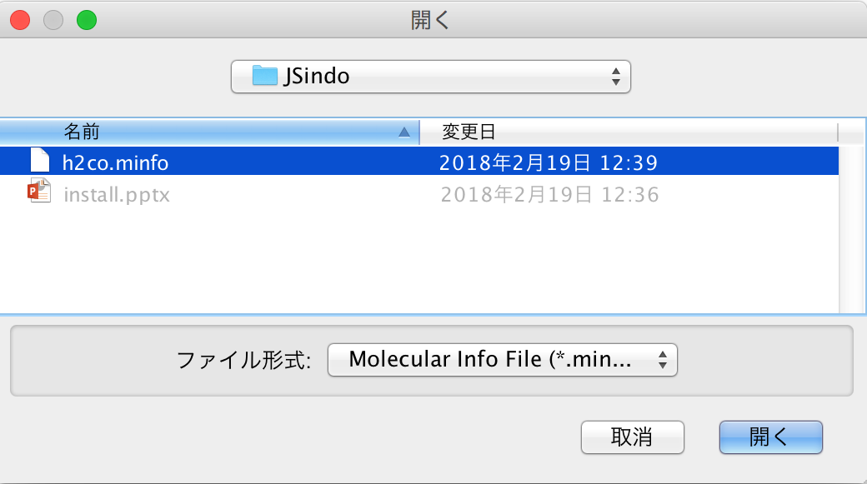
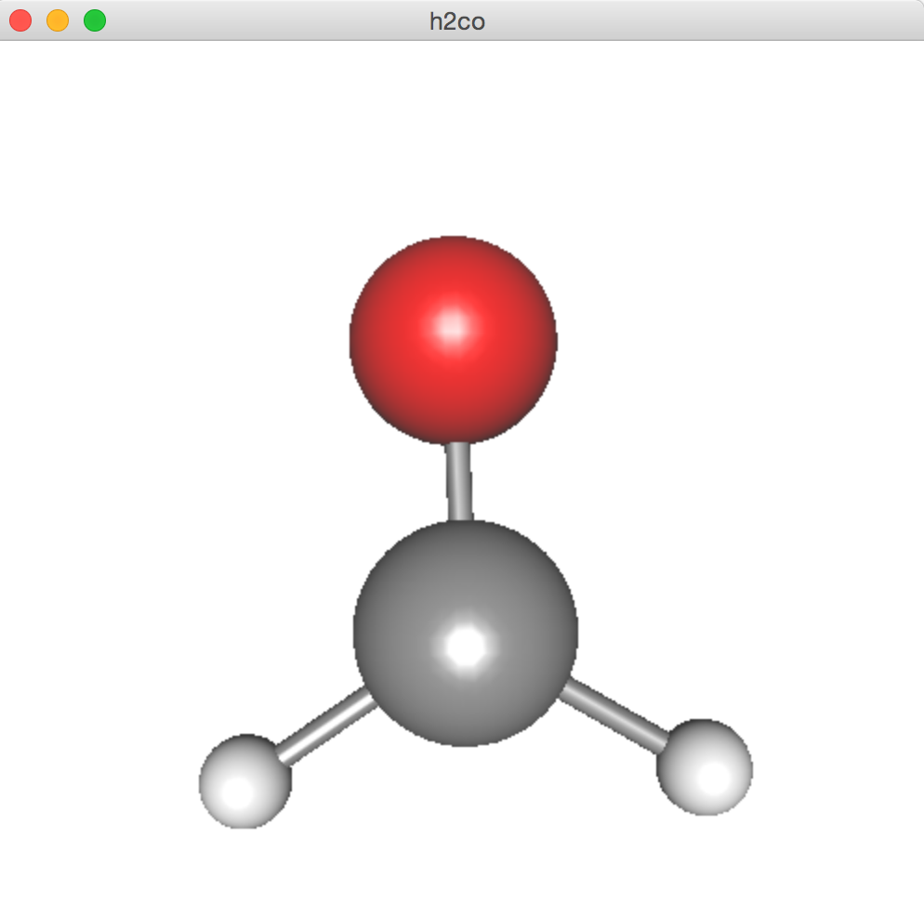
5. Download and test JSindo
Download JSindo-4.x.jar and sample.zip (or sample.tar.gz) from our website:
http://www.riken.jp/TMS2012/tms/en/research/software/sindo/index.html
Now, double click JSindo-4.0.jar. You should see a control panel of JSindo. If you don’t see the panel, review the installation of Java.
Let’s open “sample/h2co.minfo” included in sample.zip. Double click sample.zip to unzip the file.
In JSindo control panel, click File -> Open, choose “h2co.minfo”, and click Open. If you see formaldehyde, you’re done with the first step!
If this step fails, it is highly likely that JogAmp/ Java3D has a problem. Double check if the right jarfiles are located in the folder.
Open
click to choose

Slide 11
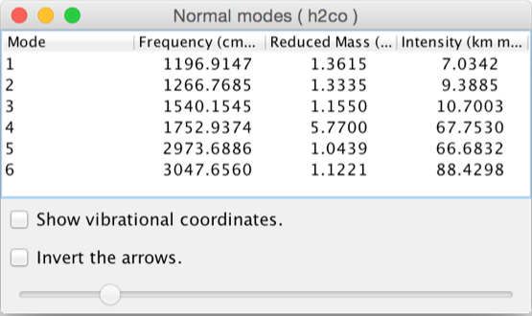
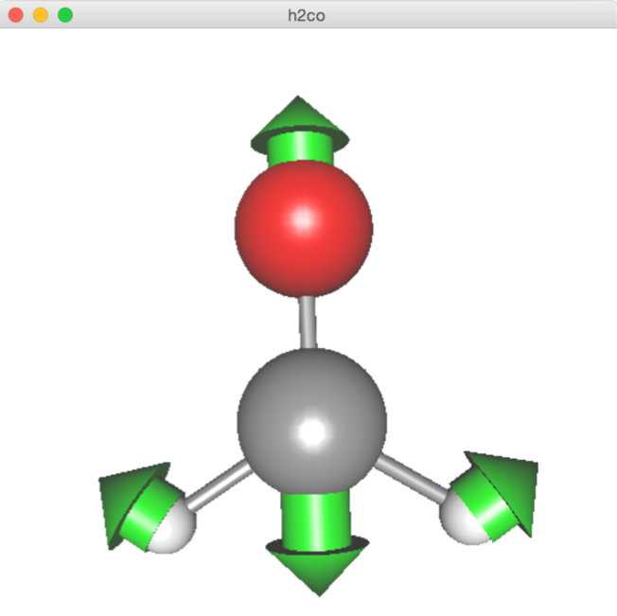
Finally, goto Tools -> Harmonic Analysis. This should create a panel of “Normal modes”.
If you don’t see this panel, JAMA isn’t working. Check if the jarfile of JAMA is set correctly.
If the panel appears, you’re all set! Congratulations!
Check on ”show vibrational coordinates”, and choose a mode you want to see. Vibrational motion will be indicated by arrows. You can “Invert the arrows” by a check box, and change the magnitude using a slider.
Thanks for using JSindo!
Enjoy!
Harmonic Analysis

Slide 12
Appendix
How to use JSindo from a command line.
Make sure you have installed JDK, not JRE, which let you use java from a command line. Type “java –version” in the terminal. If you get a version info, then you’re OK. If not, install JDK (see Chap. 1).
Then, you can start JSindo by
>java –cp /path/to/JSindo-4.0.jar JSindo
You may add the following line in your ~/.bashrc,
alias jsindo=‘java –cp /path/to/JSindo-4.0.jar JSindo’
After source, you can invoke the program by typing “jsindo” in the command.
> . ~/.bashrc
> jsindo

