Slide 1
How to Install JSindo
for Windows
Kiyoshi Yagi
kiyoshi.yagi@riken.jp
Theoretical Molecular Science Laboratory
RIKEN Cluster for Pioneering Research
2019/05/14

Slide 2
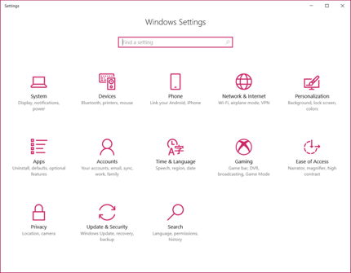
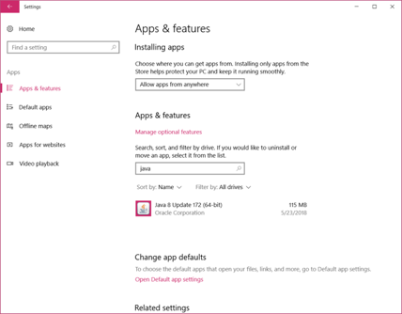
1. Install Java
STEP1: Let’s check if your PC has Java installed or not, and the version of Java if you have.
Open the “Windows Settings”, click “Apps”, and search for “java” in Apps & features.
If you don’t find anything, it means you don’t have java in your PC. Goto STEP2 to install.
If your Java is Version 8, then you can skip the installation and go to Chap. 2.
Enter “java”.
Version 8 Update 172!

Slide 3
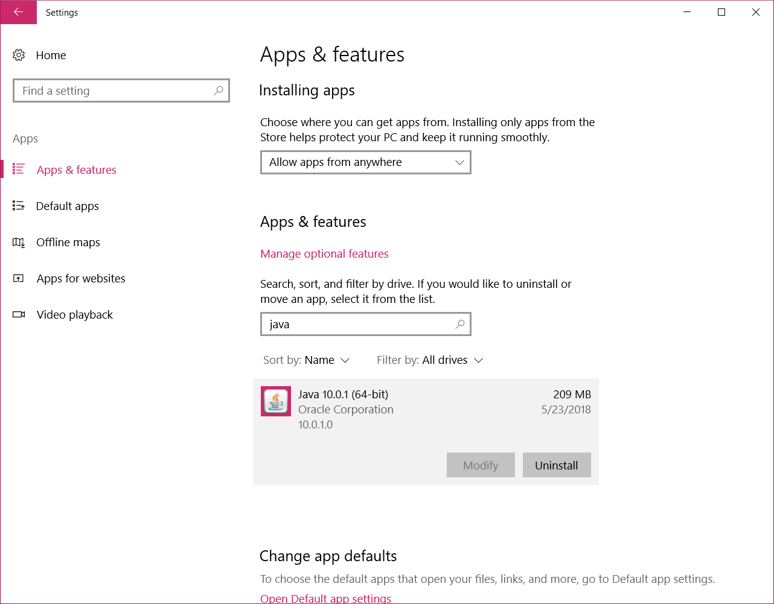
If your Java is a newer one (version 9 and later), it is unfortunately NOT compatible with Java3D library, which JSindo use for visualization. In this case, uninstall Java and re-install version 8.
To uninstall java, click the program and then click a “uninstall” button.
click here to uninstall.
Unfortunately, your Java is Version 10.0.1…

Slide 4

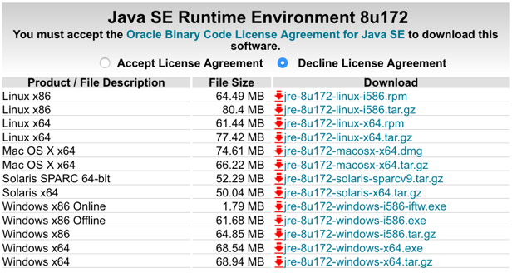
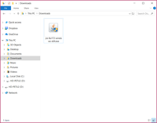
STEP2: Install Java8.
Search “Java SE download” in Google and goto the following website.
http://www.oracle.com/technetwork/java/javase/downloads/index.html
accept
Not this!
download “i586” (32-bit) or “x64” (64-bit).
Double click, follow the instruction, and you’re done.
You may do STEP1 to double check you’ve got the right version installed.
Java SE 8u

Slide 5
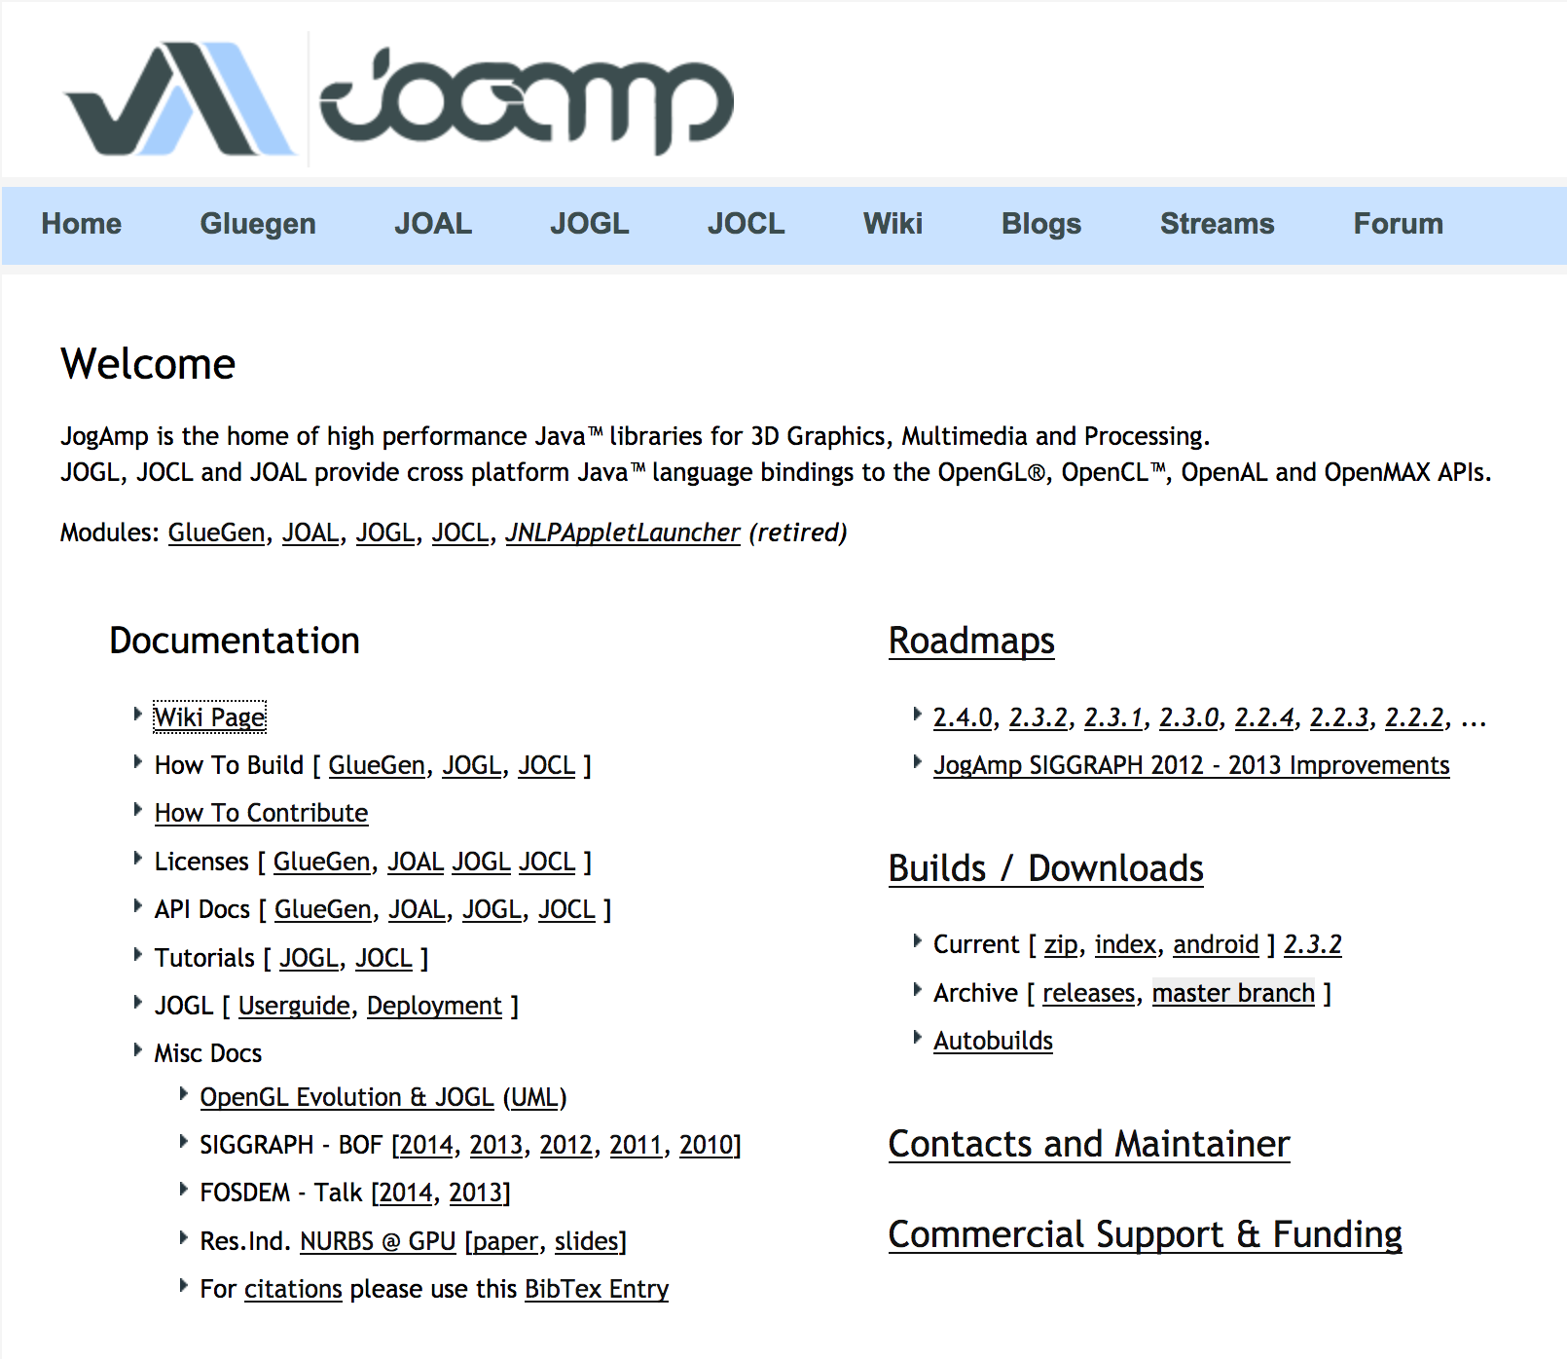
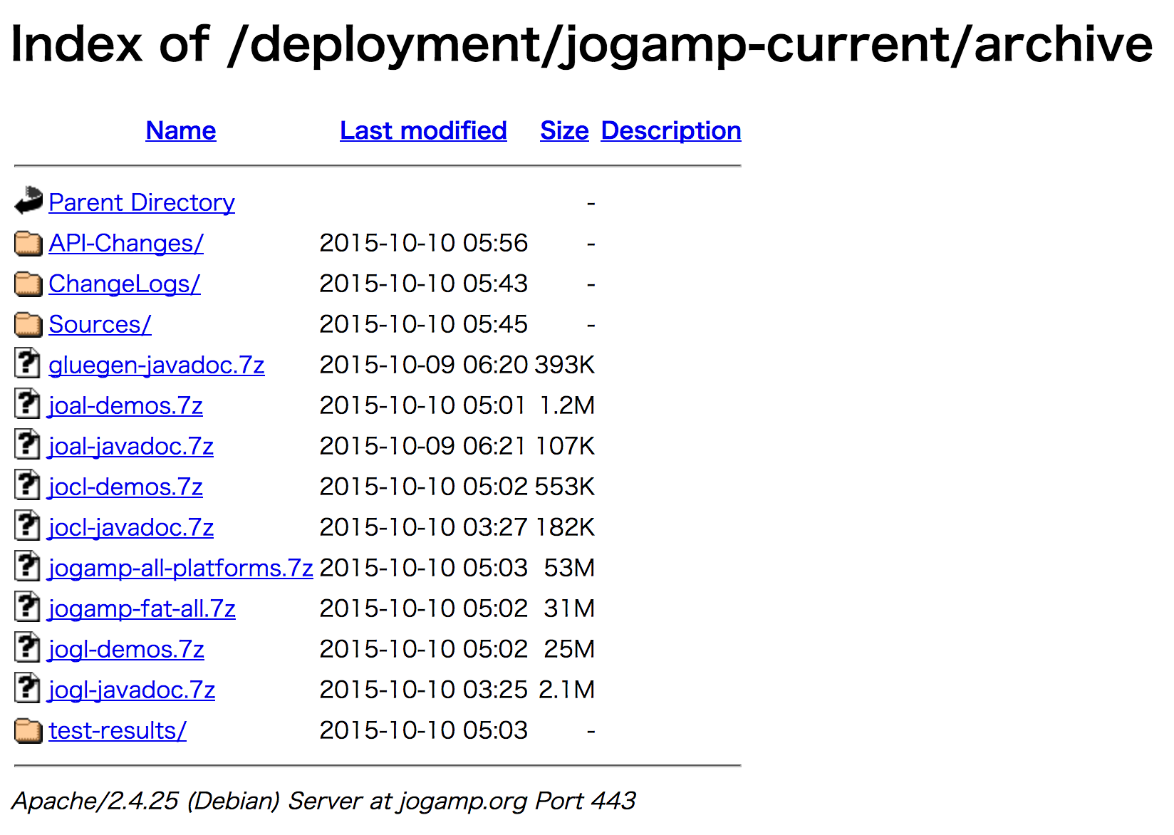
2. Download Java3D
JSindo uses Java3D for visualization. A stable version, 1.6.0, is available from JogAmp. Goto http://jogamp.org
click here
click here and download
jogamp-all-platforms.7z
Go back to the main page, then go to Wiki page,

Slide 6

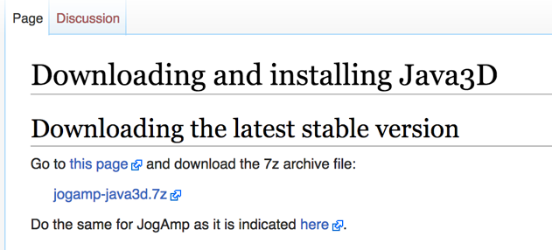
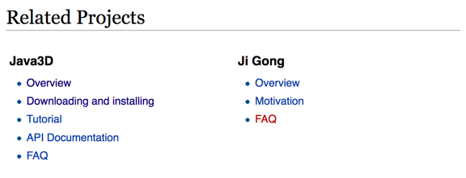

Scroll down the Wiki page,
…
Scroll down
click here and download
jogamp-java3d.7z
click here
Unarchive the two files you’ve just downloaded. 7z files can be unarchived using, for example, “7Z Opener”
7Z Opener
Tiny Opener

Slide 7
You will find jar files in jogamp-all-platforms/jar and in jogamp-java3d. The following jar files are needed for JSindo:
jogamp-all-platforms/jar/
gluegen-rt.jar
gluegen.jar
gluegen-rt-natives-windows-xxx.jar
jogl-all.jar
jogl-all-natives-windows-xxx.jar
jogamp-java3d/
j3dcore.jar
j3dutils.jar
vecmath.jar
where xxx = i586 (32-bit) or amd64 (64-bit).

Slide 8
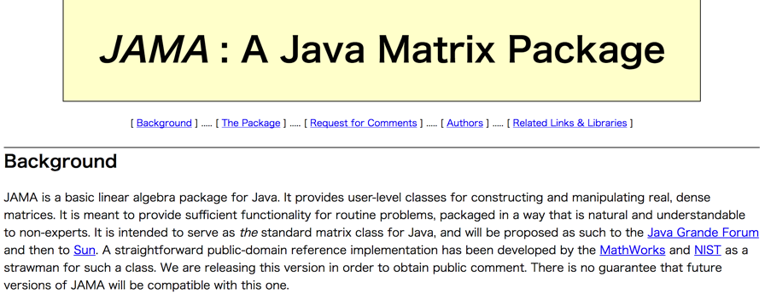
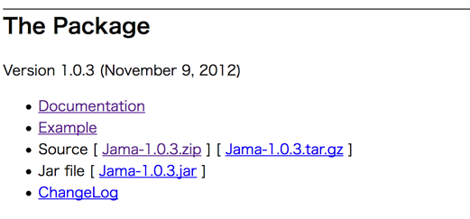
3. Download JAMA
JAMA is a linear algebra library for JAVA. We use it for matrix multiplications, diagonalization, and so on. It can be downloaded from,
https://math.nist.gov/javanumerics/jama/
…
Scroll down
click here and download a jarfile.

Slide 9
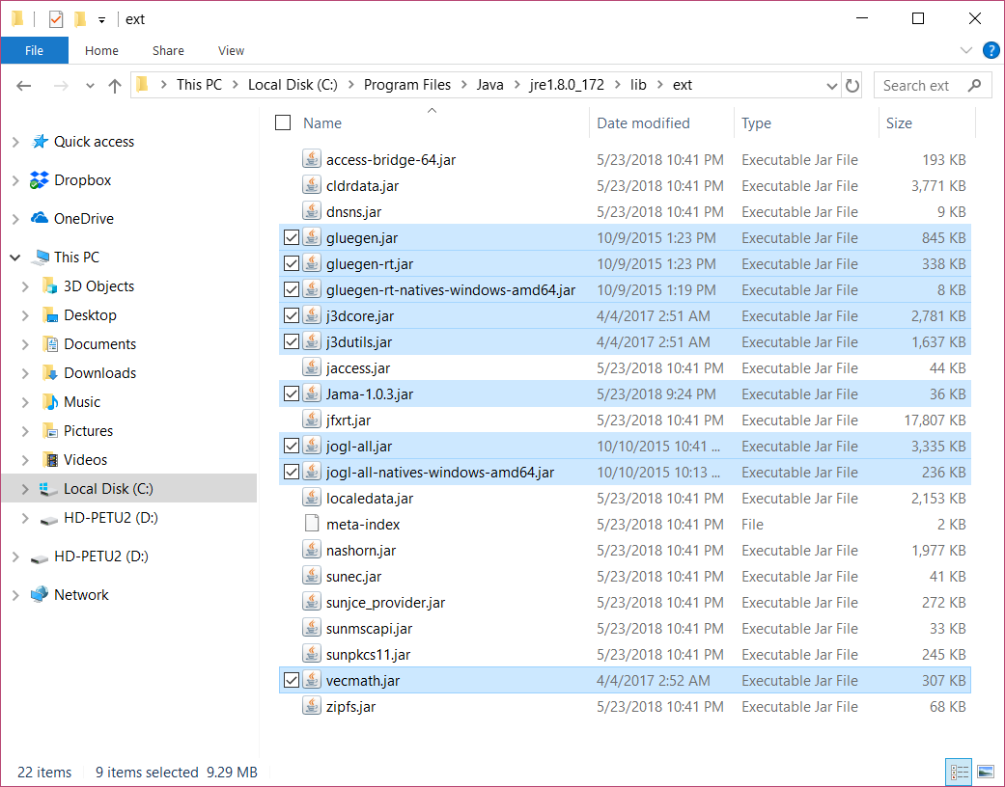
4. Copy jar files
Check whether your java is 32-bit or 64-bit. In Apps & features (see Chap. 1), you will find “Java8 Update xxx (64-bit)” for 64-bit, and just “Java8 Update xxx” for 32-bit. [It doesn’t explicitly write 32-bit.]
Now, we will copy the jar files to an extension folder, which is located at
32-bit: c:\Program Files (x86)\Java\jre1.8.x_xxx\lib\ext
64-bit: c:\Program Files\Java\jre1.8.x_xxx\lib\ext
Copy the following jar files in this folder,
gluegen-rt.jar
gluegen.jar
gluegen-rt-natives-windows-xxx.jar
jogl-all.jar
jogl-all-natives-windows-xxx.jar
j3dcore.jar
j3dutils.jar
vecmath.jar
Jama-1.0.3.jar
where xxx = i586 (32-bit) or amd64 (64-bit).

Slide 10
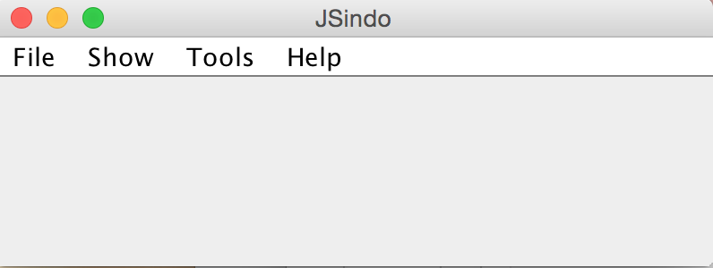
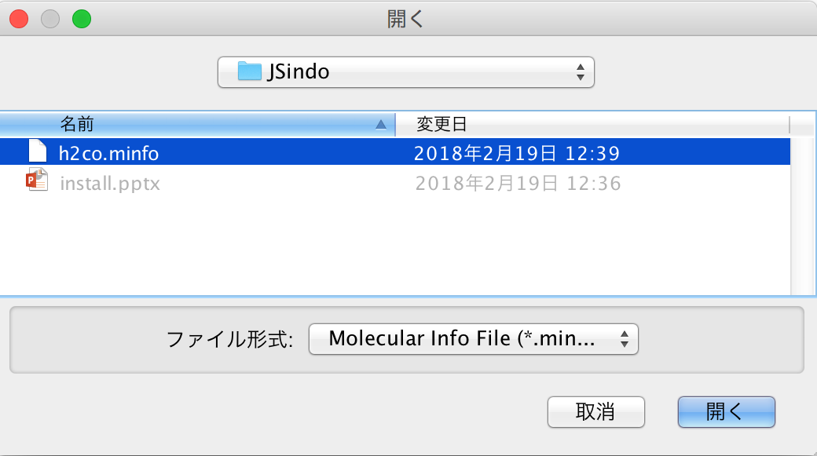
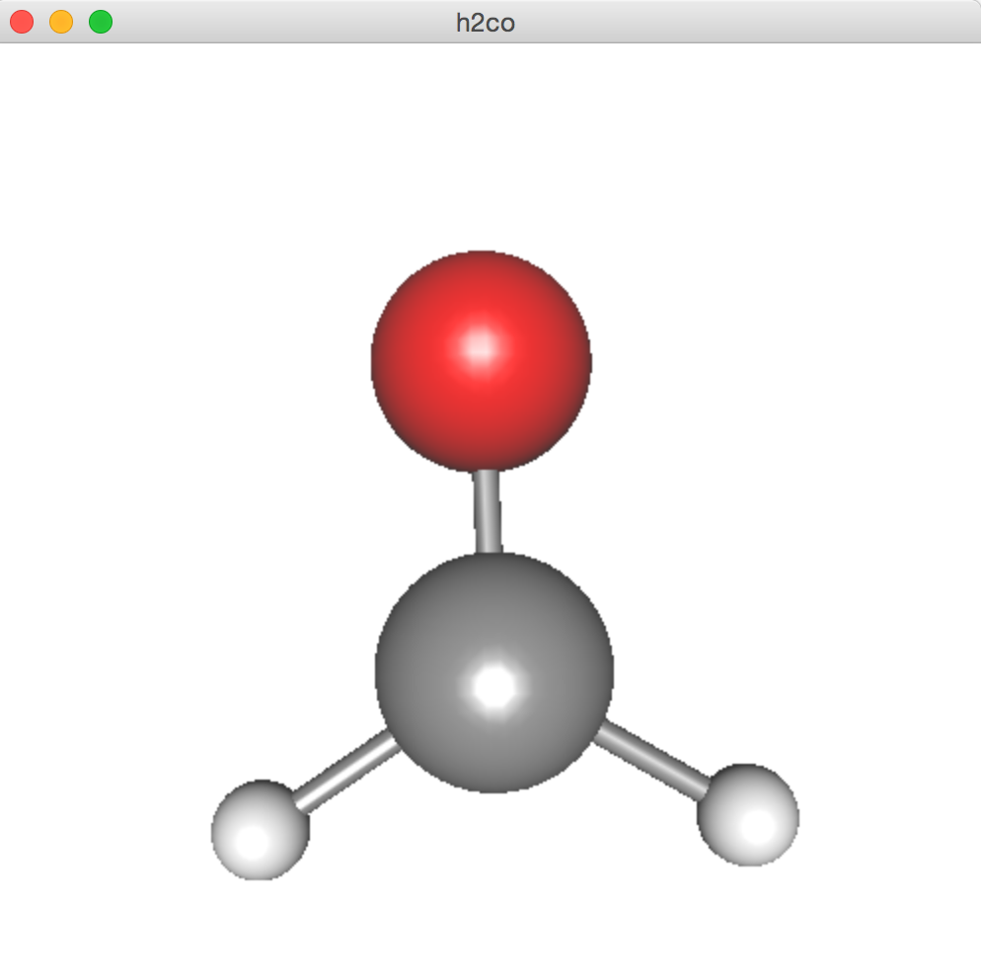
5. Download and test JSindo
Download sindo-4.0.zip from our website:
http://www.riken.jp/TMS2012/tms/en/research/software/sindo/index.html
Double click to unzip the file. Then, find sindo-4.0/jar/JSindo-4.0.jar. Double click the jar file, and you should see a control panel of JSindo. If you don’t see the panel, review the installation of Java.
Let’s test the program. Sample files are included in sindo-4.0/doc/JSindo/sample_JSindo.
In JSindo control panel, click File -> Open, choose “h2co.minfo”, and click Open. If you see formaldehyde, you’re done with the first step!
If this step fails, it is highly likely that JogAmp/ Java3D has a problem. Double check if the right jarfiles (xxx = amd64 or i586) are located in the folder.
Open
click to choose

Slide 11
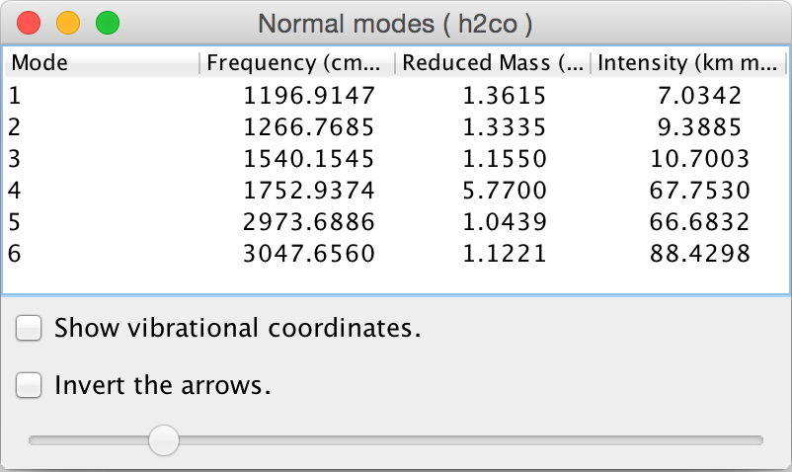
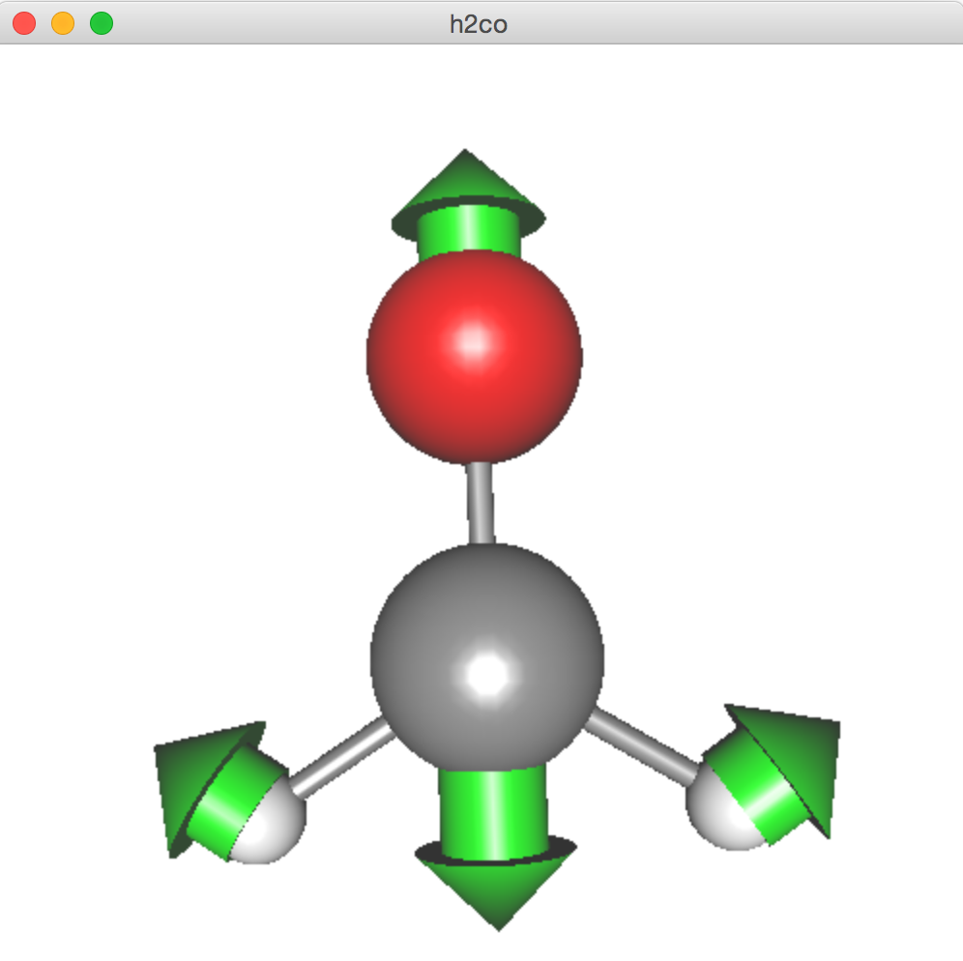
Finally, goto Tools -> Harmonic Analysis. This should create a panel of “Normal modes”.
If you don’t see this panel, JAMA isn’t working. Make sure the jarfile of JAMA is copied to the extension folder.
If the panel appears, you’re all set! Congratulations!
Check on ”show vibrational coordinates”, and choose a mode you want to see. Vibrational motion will be indicated by arrows. You can “Invert the arrows” by a check box, and change the magnitude using a slider.
Thanks for using JSindo!
Enjoy!
Harmonic Analysis

