Slide 1
User’s guide of FSindo
Kiyoshi Yagi
kiyoshi.yagi@riken.jp
Theoretical Molecular Science Laboratory
RIKEN Pioneering Research Cluster
2018/10/14

Slide 2
Contents of Sample Files
1.water/
VSCF, VCI[3]-(8), VMP2-(4), VQDPT2-(4)
2.ethylene/
VCI[3]-(6), VMP2-(4), VQDPT2-(4)
3.water-hexamer/
nc-VCI[3]-(6), nc-VQDPT2-(4)
3.water-hexamer_oc/
oc-VSCF, oc-VCI[3]-(6), oc-VQDPT2-(4)
How to run SINDO
$ sindo < xxx.inp > xxx.out

Slide 3
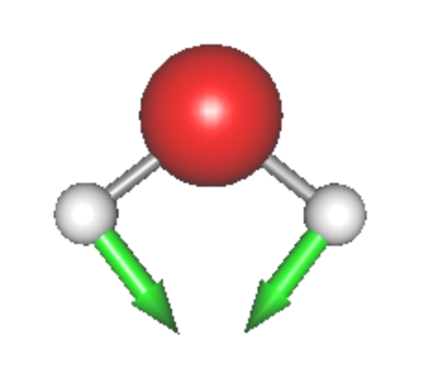
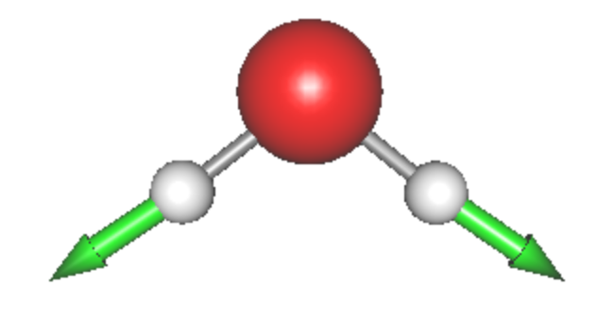
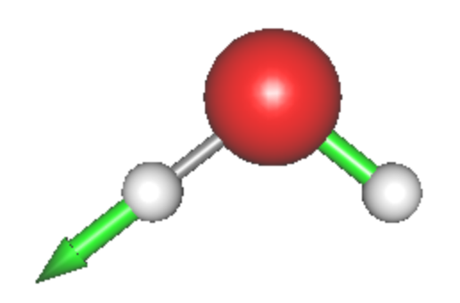
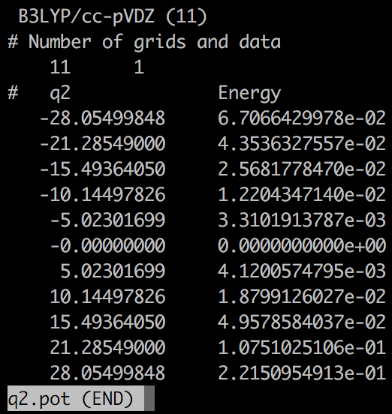
1. Water
h2o.minfo
平衡構造、調和振動数、振動ベクトルを含む。JSindoで可視化できる。
Q1
HOH bending
Q2
Sym. OH stretching
Q3
Asym. OH stretching
*.pot
グリッドポテンシャルの情報を含む。
eq. q0.pot
1MR q1.pot, q2.pot, q3.pot
2MR q2q1.pot, q3q1.pot, q3q2.pot
3MR q3q2q1.pot

Slide 4
vscf.inp
#--- [ INPUT PARAMETER ]
&mol minfofile='h2o.minfo' /
&sys maxmem=10 /
#--- [ VIB ]
&vib MR=3 vmaxAll=10 vscf=.t. /
#--- [ TARGET STATES ]
&states fund=.t. /
#--- [ VSCF ]
&vscf Maxitr=20 Ethresh=1.D-03 /
input minfo file
max memory in MB
MR : Mode coupling order of the PES
vmaxAll : Max num of quanta of HO basis sets for all modes.
vscf : true invokes VSCF.
Targets all fundamental levels.
Maxitr : Max iteration for VSCF
Ethresh : Threshold of convergence in cm⁻¹.

Slide 5
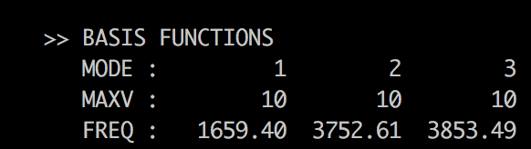
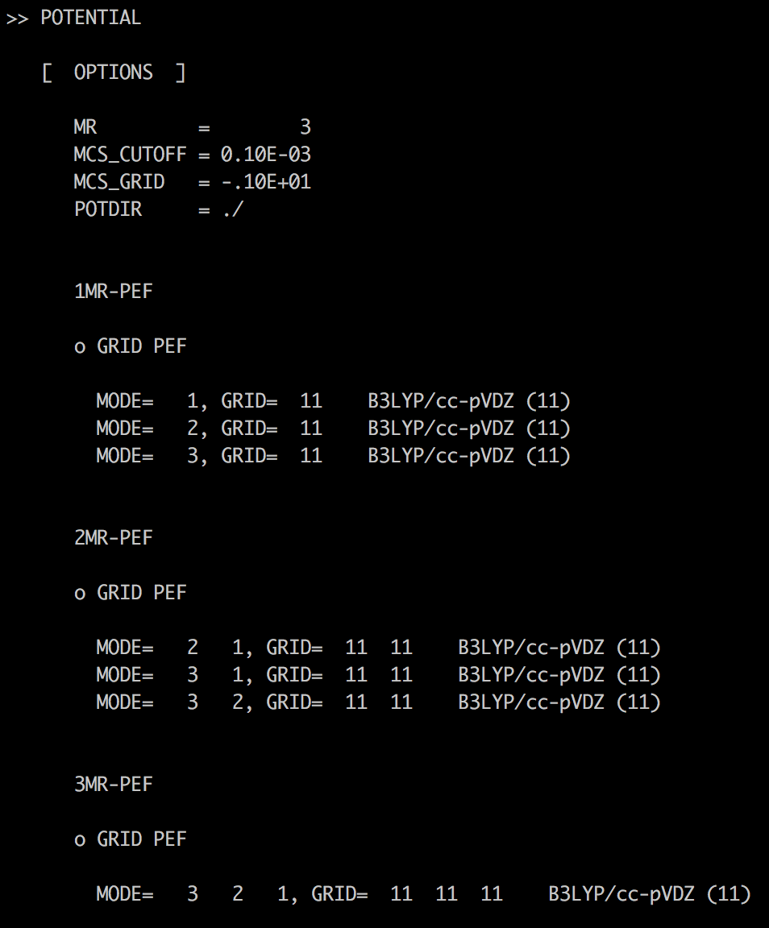
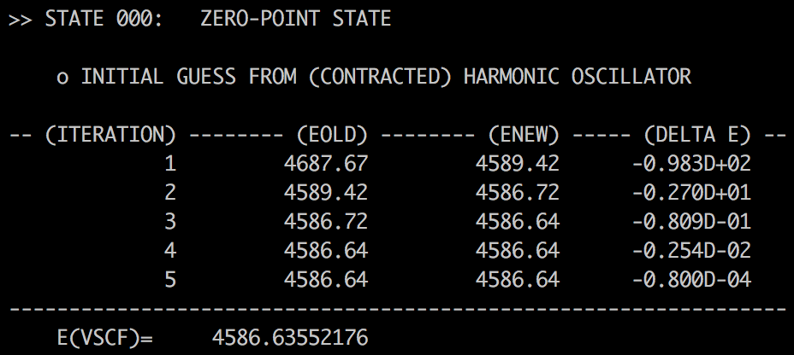
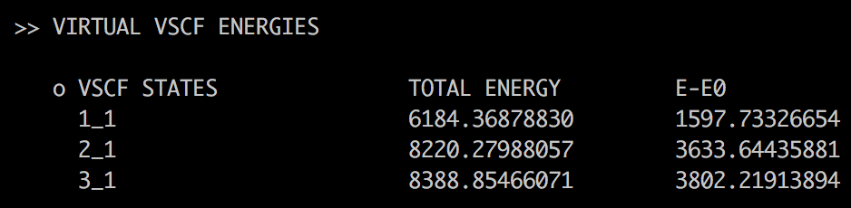
log/vscf.out
Setting of HO basis sets. Frequencies are taken from the minfo file.
1MR
VSCF iteration
Zero-point Energy
2MR
3MR
It’s a good practice to check if the PES is specified in the way you intended.
Virtual VSCF energies for the fundamental levels.

Slide 6
vci.inp
#--- [ VIB ]
&vib MR=3 vmaxAll=10 vscf=.t. vci=.t. /
#--- [ VCI ]
&vci nstate=20 nCUP=3 maxSum=8 /
vscf = .t. and vci = .t. invokes VSCF/VCI.
nstate : Number of states to obtain.
nCUP : Max number of modes to excite.
maxSum : Max sum of quantum numbers to excite.
* nCUP=3 and maxSum=8 means VCI[3]-(8).

Slide 7
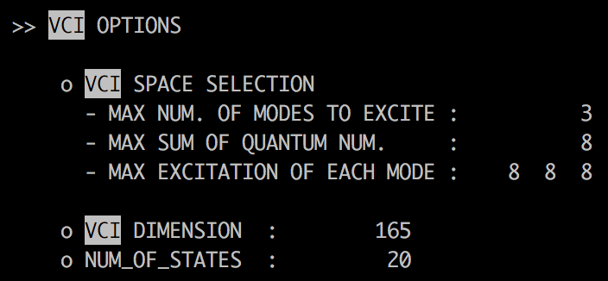
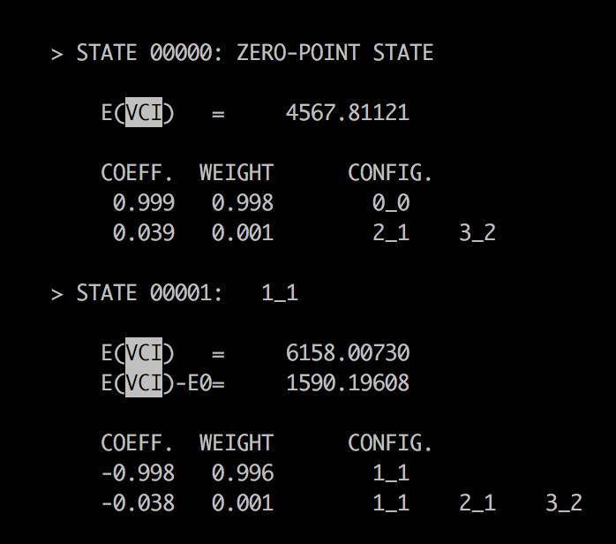
log/vci.out
VCI[3]-(8)
Dimension of VCI matrix
Zero-point energy
CI coeff.
1st excitation of the 1st mode
Total energy and excitation energy
CI coeff.

Slide 8
vmp2.inp
#--- [ VIB ]
&vib MR=3 vmaxAll=10 vscf=.t. vpt=.t. /
#--- [ VPT ]
&vpt maxSum=4 /
vscf = .t. and vpt = .t. invokes VMP2.
maxSum : Max sum of quantum numbers to excite.
* maxSum=4 means VMP2-(4).

Slide 9
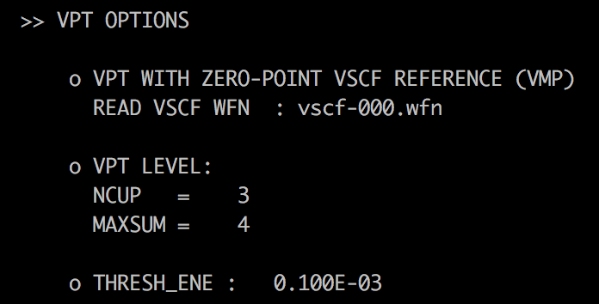
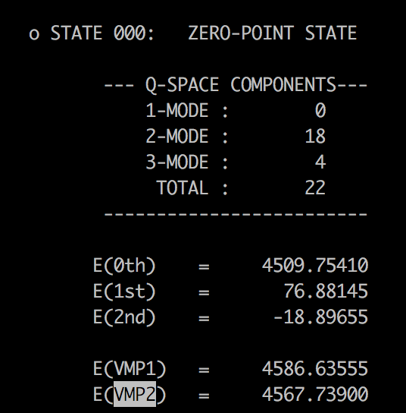
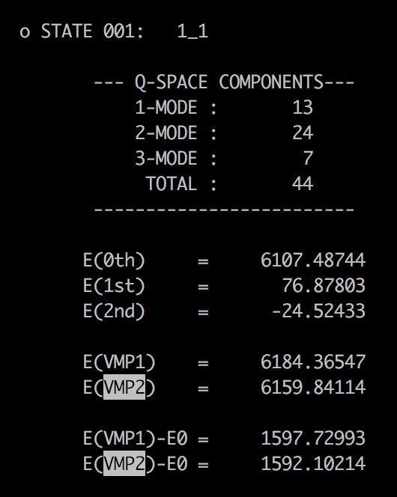
log/vmp2.out
VMP2-(4)
1st excitation of the 1st mode
1st and 2nd order energy
1st and 2nd order energy
1st and 2nd order excitation energy

Slide 10
vqdpt2.inp
#--- [ VIB ]
&vib MR=3 vmaxAll=10 vscf=.t. vqdpt=.t. /
&states
fund=.t.
nstate=3
target_state(2,1)=2
target_state(2,2)=1
target_state(3,2)=1
target_state(3,3)=2
/
#--- [ VPT ]
&vqdpt nGen=3 maxSum=4 /
vscf = .t. and vqdpt = .t. invokes VQDPT2.
All fundamental levels.
add (020), (011), (002)
nGen : Max number of iteration for generating the P space.
maxSum : Max sum of quantum numbers to excite.

Slide 11
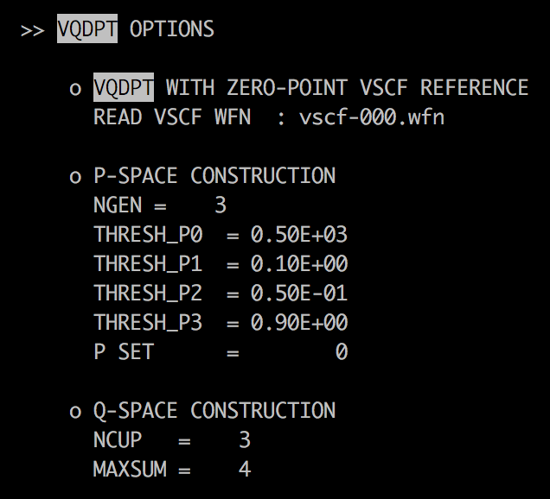
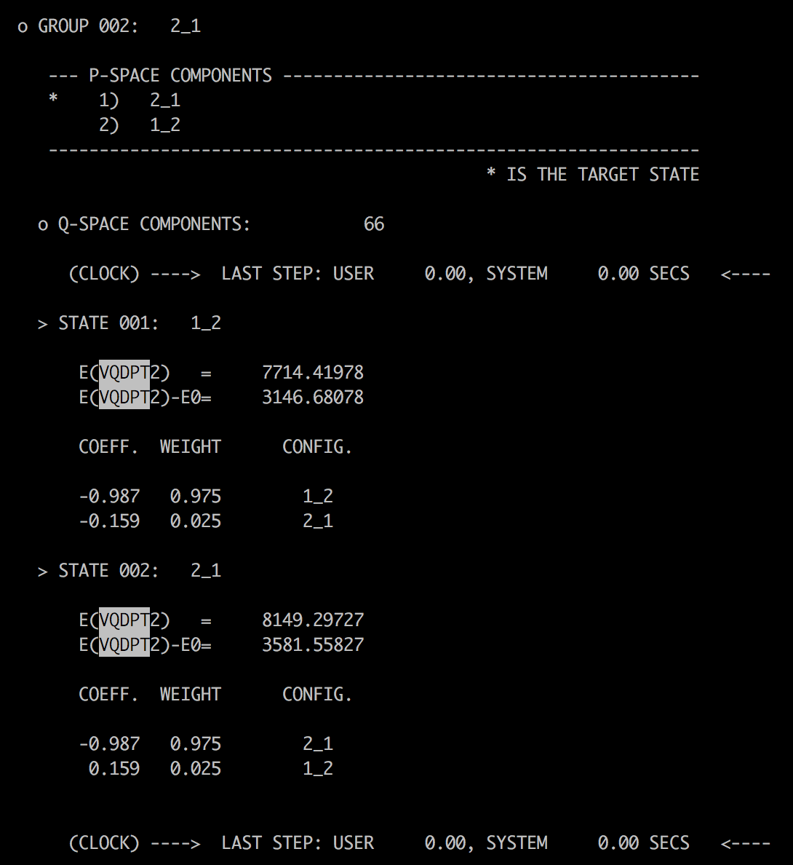
log/vqdpt2.out
P space components.
Parameters for the P space.
Parameters for the Q space.
VCI-like output for the P space.
1st and 2nd order correction
1st and 2nd order energy

Slide 12
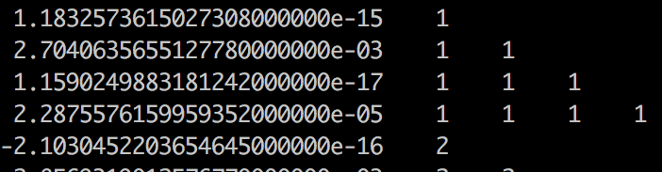
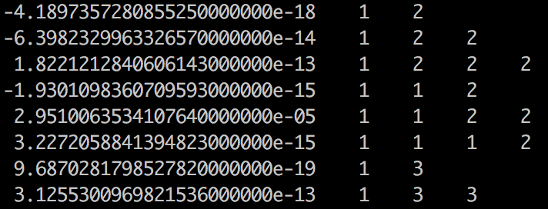
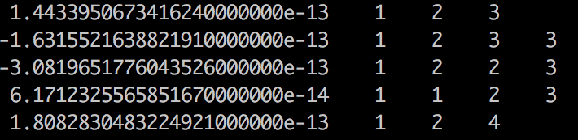
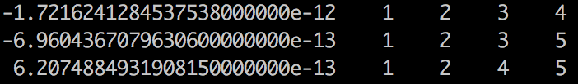
2. Ethylene
eq-mp2dz.minfo
平衡構造、調和振動数、振動ベクトルを含む。JSindoで可視化できる。
prop_no_1.mop
QFF情報を含む。
1体項 ci, cii, ciii, ciiii
…
2体項 cij, cijj, cijjj, ciij,
ciijj, ciiij
…
3体項 cijk, cijkk, cijjk, ciijk
…
4体項 cijkl

Slide 13
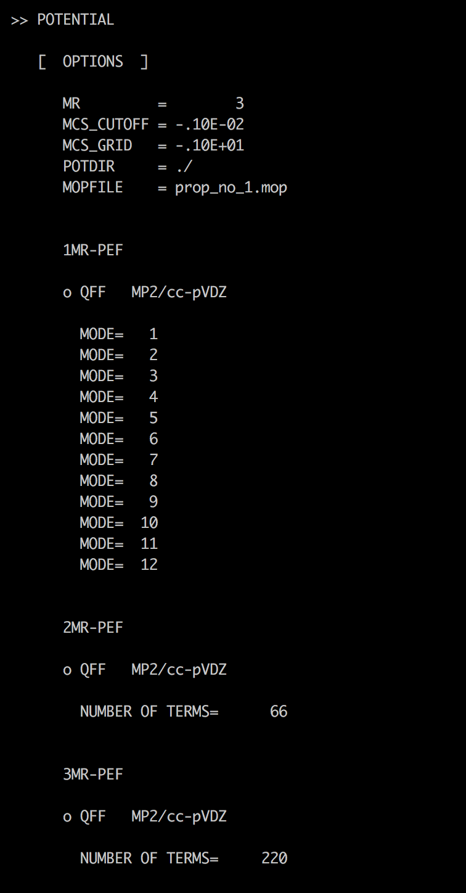
vci.inp, vmp2.inp, vqdpt2.inp
#--- [ MRPES ]
&mrpes mopFile='prop_no_1.mop' mcs_cutoff=-1.0D-03 /
mopFile : Name of a QFF file.
mcs_cutoff : Cut-off threshold for coupling terms based on MCS.
VCI, VMP2, VQDPT2計算のインプットはQFFのエントリーを除き、waterと同様。
アウトプットもQFF以外は同様。
1MR
2MR
3MR

Slide 14
3. Water Hexamer
1.ocvscf
h2o_6-mp2dz.minfo
平衡構造、調和振動数、振動ベクトルを含む。JSindoで可視化できる。
今回は、水の内部振動（OH伸縮、HOH変角）のみを扱い、分子間振動は無視する。Mode 31-48の18モードはactive, それ以外はinactiveとする。
prop_no_1.mop
QFF情報を含む。48モードの4MR-QFF。
（実はこれを計算するのは大変です。）

Slide 15
ocvscf.inp
#--- [ VIB ]
&vib MR=4 ocvscf=.t. vscf=.f. vci=.f. vpt=.f.
vmaxAll = -1
vmax(31) = 10
vmax(32) = 10
…
vmax(48) = 10
/
#--- [ OCVSCF ]
&ocvscf mopfile='prop_no_1.mop' /
ocvscf = .t. invokes oc-VSCF.
Make all modes inactive.
Make 31-48 active.
mopFile : Name of a QFF file.
* For oc-VSCF, QFF needs to be full 4MR-QFF.

Slide 16
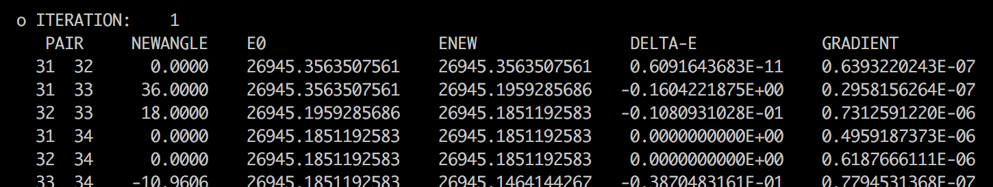
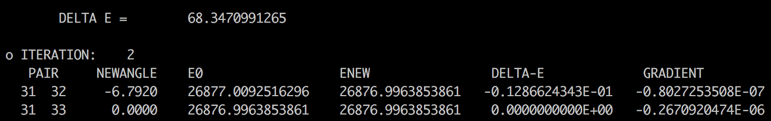
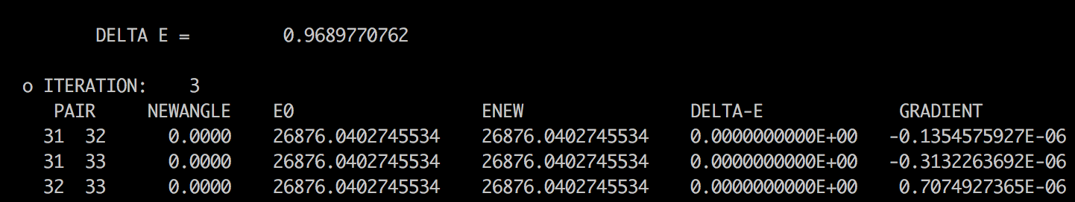
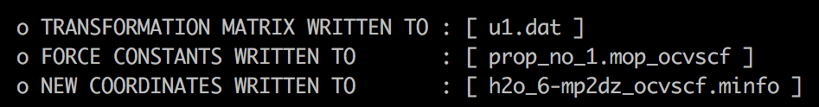
log/ocvscf.out
iteration over mode pairs
..
..
iteration over Jacobi sweep
These files are used in subsequent VSCF calculations.

Slide 17
2.vib
ncvci.inp, ncvqdpt2.inp
基準座標ベースのVCIとVQDPT2計算
h2o_6-mp2dz.minfo, prop_no_1.mopに基づく計算。
ocvci.inp, ocvqdpt2.inp
最適化座標ベースのVCIとVQDPT2計算
h2o_6-mp2dz_ocvscf.minfo, prop_no_1.mop_ocvscfに基づく計算。

Slide 18
問題
sindoのアウトプットファイルから、H₂Oの振動数の値を読み、以下の表を完成させよ。
 | Harm | VCI[3]-(8) | VMP2-(4) | VQDPT2-(4) | Exp.
1 |  |  |  |  | 1595
2 |  |  |  |  | 3652
3 |  |  |  |  | 3756

Slide 19
問題
sindoのアウトプットファイルから、C₂H₄の振動数の値を読み、以下の表を完成させよ。
 | Harm | VCI[3]-(8) | VMP2-(4) | VQDPT2-(4) | Exp.
1 |  |  |  |  | 826
2 |  |  |  |  | 940
3 |  |  |  |  | 949
4 |  |  |  |  | 1026
5 |  |  |  |  | 1222
6 |  |  |  |  | 1344
7 |  |  |  |  | 1442
8 |  |  |  |  | 1625
 |  |  |  |  | 1662
9 |  |  |  |  | 2989
10 |  |  |  |  | 3022
11 |  |  |  |  | 3083
12 |  |  |  |  | 3105

Slide 20
問題
水６量体の基準座標と最適化座標を可視化し、どのような違いがあるか、比較せよ。

Slide 21
問題
その他、自由な考察。
例えば、ポテンシャルのカップリング次数(MR)、励起ランク（nCUP, maxSum)に対する依存や、計算負荷の変化など。

Slide 22
List of all Options
&mol
Character(80) :: minfoFile
The name of the .minfo file, in which the information of molecule is written.
Integer :: Nat
The number of atoms
Real(8), dimension(Nat) :: Mass
The mass of each atoms (in atomic mass unit)
Real(8), dimension(3,Nat) :: x
The reference (equilibrium) geometry (in Angstrom)
Real(8), dimension(Nfree) :: omega
The frequencies for the HO basis sets (in cm−1)
Real(8), dimension(Nat*3,Nfree) :: L
The vibrational displacement vectors
[Note] ’minfoFile’ is mutually exclusive from others.
&sys
Integer(8) :: Maxmem
Maximum size of memory (MB)

Slide 23
&mrpes
Integer :: MR
Mode representation (MR=1-4)
Real(8) :: mcs_cutoff
Cutoff of QFF based on MCS in cm-1 (default = 1.d-04)
Logical :: au
The grid data in atomic unit (default = true)
Character(80) :: mopFile
The name of the mop file.
&vib
Integer :: Nfree
Number of degrees of freedom (default = 3Nat - 6)
Integer :: MR
Mode representation (MR=1-4)
Integer, dimension(Nfree) :: vmax
Number of basis functions for each mode (default=10)
Integer :: vmaxALL
Number of basis functions for all modes (default=10)
Integer :: vmax base
same as vmaxALL
Logical :: vscf, ocvscf, vci, vpt, vqdpt
invoke vscf/ocvscf/vci/vpt/vqdpt
Logical :: prpt
invoke property calculation
Logical :: readBasis
read the basis functions from cho.basis

Slide 24
&states
Integer :: Nstate
Number of states to calculate
Integer, dimension(Nfree,Nstate) :: target state
Labels of the target states
Logical :: fund
Compute fundamentals
&vscf
Logical :: state specific
State specific VSCF if true (default = .false.)
Logical :: restart
Restart from vscf xxx.wfn (default = .false.)
Integer :: Maxitr
Maximum number of iteration (default = 10)
Real(8) :: Ethresh
Threshold of convergence (default = 1e-03 cm−1)

Slide 25
&ocvscf
Integer :: maxOptIter
Maximum number of iteration (default = 30)
Real(8) :: ethresh
Threshold of the energy (default = 1e-06 cm−1)
Real(8) :: gthresh
Threshold of the gradient (default = 1e-06 cm−1 rad−1)
Integer :: pfit
Order of the Fourier fitting (default = 2)
Character(80) :: mopFile
The name of the mopfile
Character(80) :: u1File
The name of the file to write the transformation matrix (default = u1.dat)
Integer :: icff
Switch on CFF when icff = 1 and QFF when icff = 0 (default = 0)
Integer :: iscreen
Switch off/on pair selection when iscreen=0/1 (default = 1)
Real(8) :: eta12thresh
Threshold value for the pair screening (default = 500 cm−1)

Slide 26
&vci
Integer :: Nstate
Number of states to calculate
Integer :: nCI
Max CI dimension (cutoff based on the energy)
Integer(Nfree) :: maxEx
Max quantum number to excite for each mode
Integer :: maxExALL
Max quantum number to excite for all the modes
Integer :: maxSum
Max sum of quantum number
Integer :: nCUP
Max number of modes to excite
Logical :: geomAv
If true, calculate vibrationally averaged geometry
Logical :: dump
If true, dump the vci wavefunction to vci-w.wfn
Real(8) :: printWeight
Print the configuration with the weight larger than this threshold
Logical :: readCIbasis
If true, read CI basis from vci-w.wfn
Logical :: dumpHmat
If true, write the VCI hamiltonian matrix
Logical :: noDiag
If true, the diagonalization is skipped

Slide 27
&vpt
Integer :: maxSum
Max sum of quantum number to excite (default = -1)
Integer :: maxEx
Max quantum number to excite (default = -1)
Integer :: nCUP
Max number of modes to excite (default = MR)
Real(8) :: thresh ene
Threshold energy to avoid divergence (default=1e-04 Hartree)
Logical :: dump
Dump the information to vmp-w.wfn
&vqdpt
Integer :: nGen
The generation of P space (default=3)
Real(8) :: thresh p0
E0 pruning (default=500 cm−1)
Real(8) :: thresh p1
VPT based pruning (default=0.1)
Real(8) :: thresh p2
VCI pruning (default=0.05)
Real(8) :: thresh p3
VCI pruning (default=0.9)
Integer :: pset
Combine the p-space generated from several target states
=0 when the target states have an overlap (default)
=1 when the p-space components have an overlap

Slide 28
Integer :: maxSum
Max sum of quantum number to excite (default = -1)
Integer :: nCUP
Max number of modes to excite (default = MR)
Integer :: pqSum
P/Q interaction scheme
> 0 prune the interaction when λpq > maxSum (default)
< 0 full interaction
Integer :: vqdpt2 loop
=0 loop over q, then p, p’ (default)
=1 loop over p, then p’, q
Real(8) :: thresh ene
Threshold energy to avoid divergence (default=1e-04 Hartree)
Real(8) :: printWeight
Print the configuration with the weight larger than this threshold (default=0.001)
Logical :: dump
Dump the information to vqdpt-w.wfn (default=true)
&prpt
Logical :: vscfprpt, vciprpt, vptprpt, vqdptprpt
Invoke property calculation for vscf, vci, vpt, vqpdt wavefuncion
Integer :: MR
Mode representation (default = 3)
Character :: extn(*)
The extension of the property files
Integer :: matrix(*)
= 0 calculate only the average
> 0 calculate the matrix
Logical :: infrared
If true, calculate the IR intensity.

Slide 29
&prptvci
Integer :: Nstate
The number of states
&IRspectrum
Real(8) :: minOmega, maxOmega
Min/Max value of the spectrum (default = 100 - 4000 cm−1)
Real(8) :: delOmega
Interval of the data (default = 1 cm−1)
Real(8) :: fwhm
Full-width half maximum of the Lorentz function for convolutions (default = 20 cm−1)
Real(8) :: cutoff
Cutoff of the band (default = -1 km mol−1)

