Slide 1
Applications to Molecular Clusters
Water hexamer: (H₂O)₆
Kiyoshi Yagi
kiyoshi.yagi@riken.jp
Theoretical Molecular Science Laboratory
RIKEN Cluster for Pioneering Research
2019/11/12

Slide 2
In this guide, I will illustrate how to use MakePES to generate QFF, GridPES, and Multiresolution PES. Formaldehyde (H₂CO) is used as an example, but the method is applicable to any molecule.
MakePES is a command line based program. This guide assumes that you are familiar with basic commands in UNIX. Shell scripts are given for Bourne Shell (bash).
This guide also assumes that you have installed the program. Change “/path/to” to your installation directory when you see a command like this,
In this guide, we will use Gaussian for the electronic structure calculations. Make sure that you have configured “runGaussian.sh” and the path to it.
If you don’t use Gaussian, you may still use MakePES in generic mode; see 1.4 and 2.4.
sindo_jar=/path/to/sindo-4.0/jar
java –cp ‘$sindo_jar/*' RunMakePES
> export PATH=${PATH}:/path/to/sindo-4.0/script
> runGaussian.sh
USAGE: runGaussian.sh arg[1] arg[2]
arg[1] : current directory
arg[2] : input file

Slide 3
Contents of Sample Files
Sample files are found in sindo-4.0/doc/MakePES/sample_MakePES
0.harmonic_h2co
1.qff_h2co: Quartic force field for H₂CO
1-1.single
1-2.parallel
1-3.dryrun
1-4.generic
2.grid_h2co: Grid PES for H₂CO
2-1.1MR
2-2.2MR
2-3.3MR
2-4.1MR_generic
3.mrpes_h2co: Multi-resolution PES for H₂CO

Slide 4
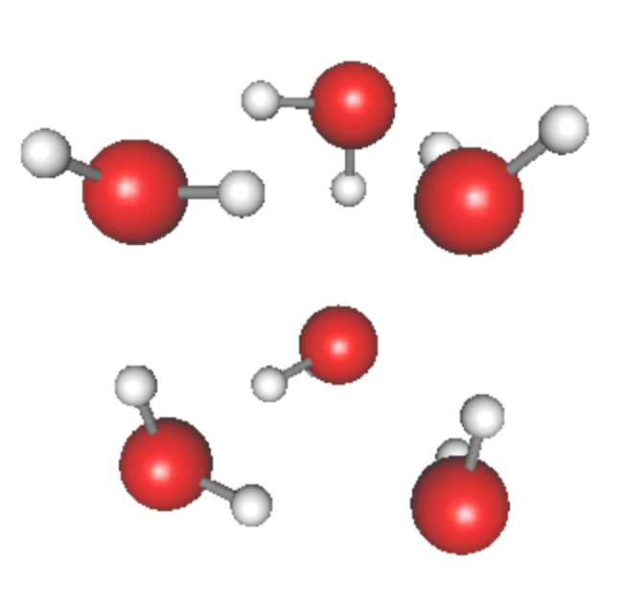
4.water-hexamer
4-1.intra
In this section, we generate the PES of water hexamer using the intramolecular modes, i.e., OH stretching and HOH bending modes. There are 18 such modes, and corresponds to mode 31 – 48.
water hexamer
(prism)
Proceed to 4.water-haxamer/4-1.intra to find input files,
> cd 4.water-hexamer/4-1.intra
> ls
GaussianTemplate h2o_6-mp2dz.minfo log/ makePES.xml resources.info
h2o_6-mp2dz.minfo is a minfo file that contains the equlibrium geometry and vibrational modes of water hexamer (prism shape) obtained at the MP2/c—pVDZ level of theory.
GaussianTemplate is a template file to perform FREQ calculations at the MP2/cc-pVDZ level of theory.

Slide 5
In makePES.xml, the active modes are specified by <activemode> to modes 31 – 48. Other sections, <qchem> and <qff>, are the same as before.
makePES.xml
<makePES>
<minfoFile value="h2o_6-mp2dz.minfo" />
<MR value="3" />
<activemode value="31-48" />
<qchem>
<program value="gaussian" />
<dryrun value="false"/>
<removefiles value="true" />
<title value="MP2/cc-pVDZ" />
<template value="GaussianTemplate" />
</qchem>
…
active modes are set to the intramolecular modes, mode 31 – 48.
Run the program by,
> export SINDO_RSH=ssh
> RunMakePES >& makePES.out

Slide 6
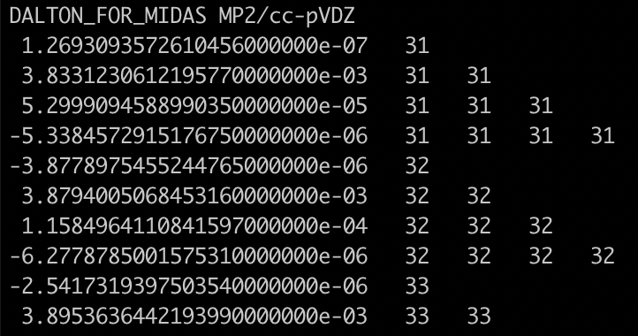
Find in the output that mode 31-48 are active ,
makePES.out
o Input options read via makePES.xml ... [OK]
- Molecular info via h2o_6-mp2dz.minfo ... [OK]
- InterDomain = false
- ActiveModes:
* Domain 1
31 32 33 34 35 36 37 38 39 40
41 42 43 44 45 46 47 48
- MR = 3
- Dipole = false
31 – 48 are active, and 1 – 30 are inactive.
When the calculation ends, you will find that prop_no_1.mop has entry only for modes 31 – 48.

Slide 7
3. Water Hexamer
h2o_6-mp2dz.minfo
Includes the equilibrium geometry, harmonic frequencies, and vibrational displacement vectors. They can be visualized by JSindo. In this example, we only treat internal vibration of water molecules (i.e., OH stretching and HOH bending modes) neglecting intermolecular modes. We set modes 31 – 40 to active, and others to inactive.
prop_no_1.mop
Includes the information of QFF. This is 4MR-QFF for all 48 modes. (In fact, it is costly to get this QFF.)

Slide 8
ocvscf.inp
#--- [ VIB ]
&vib MR=4 ocvscf=.t. vscf=.f. vci=.f. vpt=.f.
vmaxAll = -1
vmax(31) = 10
vmax(32) = 10
…
vmax(48) = 10
/
#--- [ OCVSCF ]
&ocvscf mopfile='prop_no_1.mop' /
ocvscf = .t. invokes oc-VSCF.
Make all modes inactive.
Make 31-48 active.
mopFile : Name of a QFF file.
* For oc-VSCF, QFF needs to be full 4MR-QFF.

Slide 9
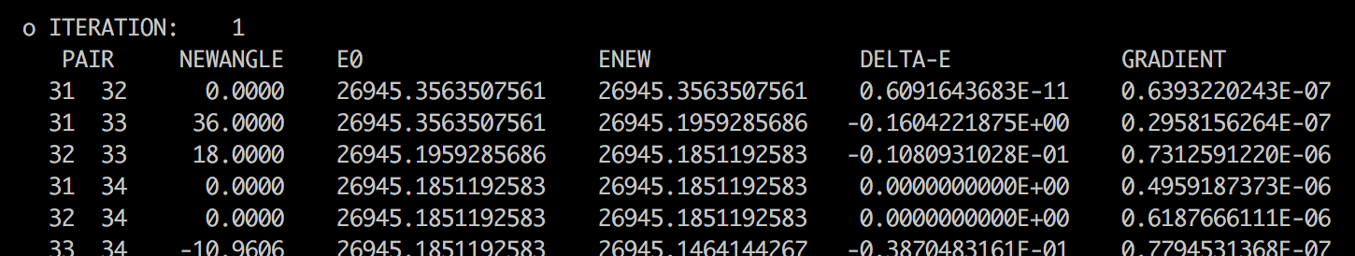
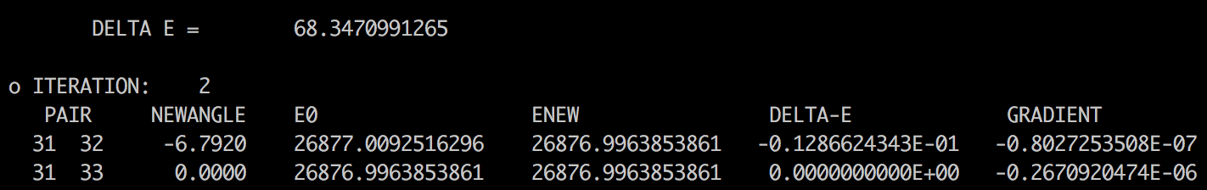
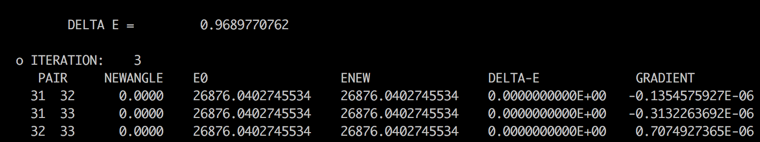
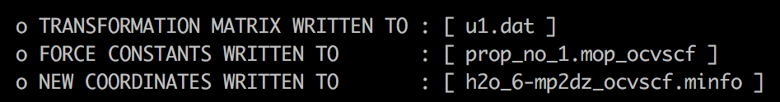
log/ocvscf.out
iteration over mode pairs
..
..
iteration over Jacobi sweep
These files are used in subsequent VSCF calculations.

Slide 10
ncvci.inp, ncvqdpt2.inp
VCI and VQDPT2 calculations based on normal coordinates. They read h2o_6-mp2dz.minfo and prop_no_1.mop.
ocvci.inp, ocvqdpt2.inp
VCI and VQDPT2 calculations based on optimized coordinates.
The read h2o_6-mp2dz_ocvscf.minfo and prop_no_1.mop_ocvscf.

Slide 11
Quiz
Visualize the normal and optimized coordinates of water hexamer, and discuss on their differences.

