Slide 1
User’s guide of FSindo
Kiyoshi Yagi
kiyoshi.yagi@riken.jp
Theoretical Molecular Science Laboratory
RIKEN Cluster for Pioneering Research
2019/05/14

Slide 2
Contents of Sample Files
Sample files are found in sindo-4.0/doc/FSindo/sample_FSindo
1.water/
VSCF, VCI[3]-(8), VMP2-(4), VQDPT2-(4)
2.ethylene/
VCI[3]-(6), VMP2-(4), VQDPT2-(4)
3.water-hexamer/
nc-VCI[3]-(6), nc-VQDPT2-(4)
3.water-hexamer_oc/
oc-VSCF, oc-VCI[3]-(6), oc-VQDPT2-(4)
How to run SINDO
$ sindo < xxx.inp > xxx.out

Slide 3
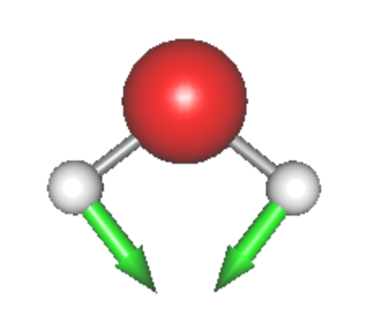
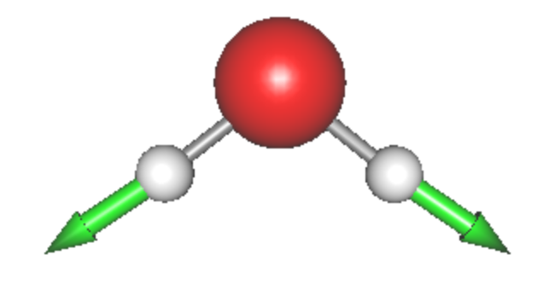
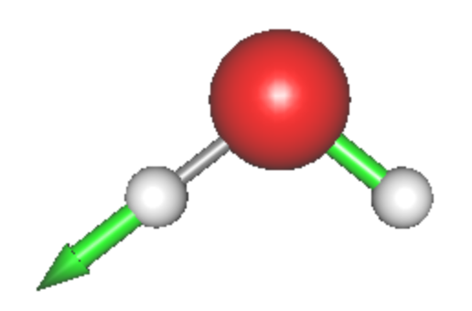
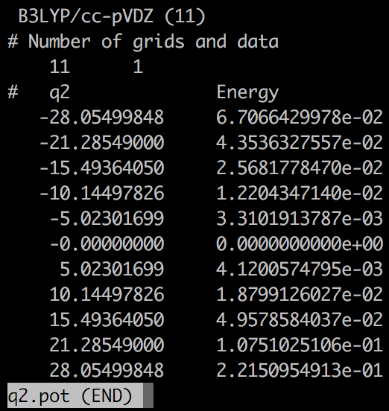
1. Water
h2o.minfo
Includes the equilibrium geometry, harmonic frequencies, and vibrational displacement vectors. They can be visualized by JSindo.
Q1
HOH bending
Q2
Sym. OH stretching
Q3
Asym. OH stretching
*.pot
Includes the information of grid potential.
eq. q0.pot
1MR q1.pot, q2.pot, q3.pot
2MR q2q1.pot, q3q1.pot, q3q2.pot
3MR q3q2q1.pot

Slide 4
vscf.inp
#--- [ INPUT PARAMETER ]
&mol minfofile='h2o.minfo' /
&sys maxmem=10 /
#--- [ VIB ]
&vib MR=3 vmaxAll=10 vscf=.t. /
#--- [ TARGET STATES ]
&states fund=.t. /
#--- [ VSCF ]
&vscf Maxitr=20 Ethresh=1.D-03 /
input minfo file
max memory in MB
MR : Mode coupling order of the PES
vmaxAll : Max num of quanta of HO basis sets for all modes.
vscf : true invokes VSCF.
Targets all fundamental levels.
Maxitr : Max iteration for VSCF
Ethresh : Threshold of convergence in cm⁻¹.

Slide 5
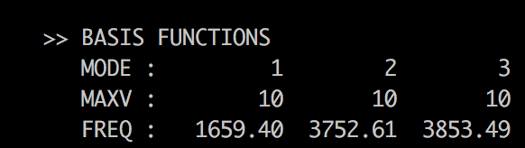
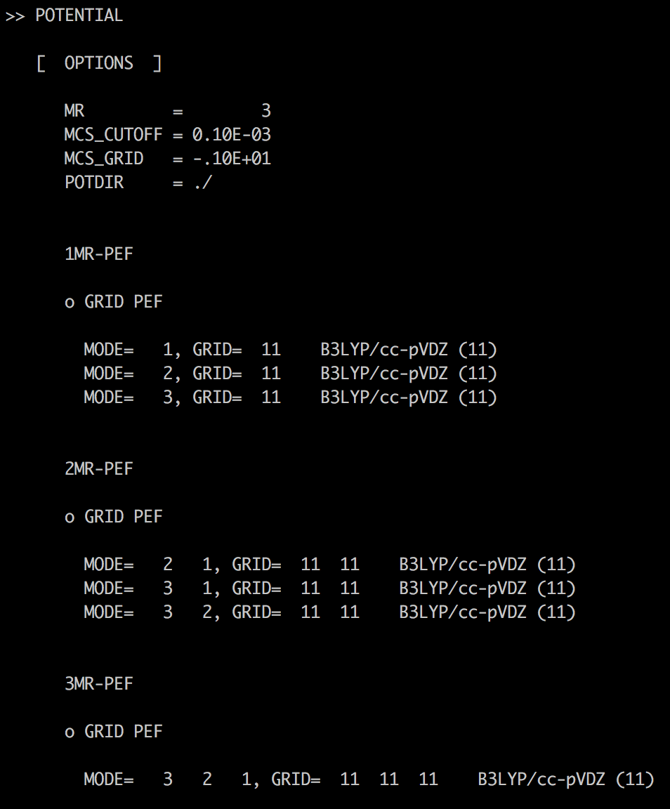
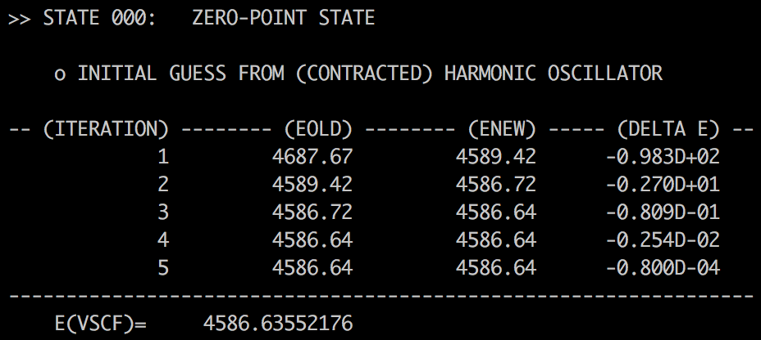
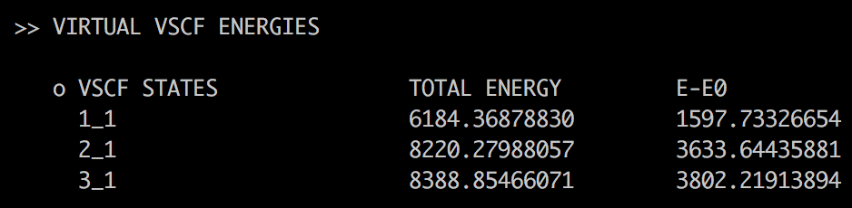
log/vscf.out
Setting of HO basis sets. Frequencies are taken from the minfo file.
1MR
VSCF iteration
Zero-point Energy
2MR
3MR
It’s a good practice to check if the PES is specified in the way you intended.
Virtual VSCF energies for the fundamental levels.

Slide 6
vci.inp
#--- [ VIB ]
&vib MR=3 vmaxAll=10 vscf=.t. vci=.t. /
#--- [ VCI ]
&vci nstate=20 nCUP=3 maxSum=8 /
vscf = .t. and vci = .t. invokes VSCF/VCI.
nstate : Number of states to obtain.
nCUP : Max number of modes to excite.
maxSum : Max sum of quantum numbers to excite.
* nCUP=3 and maxSum=8 means VCI[3]-(8).

Slide 7
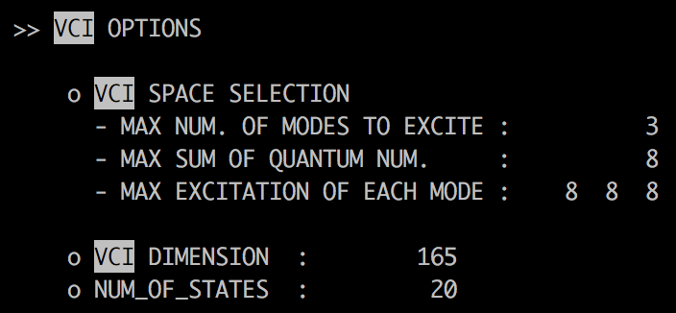
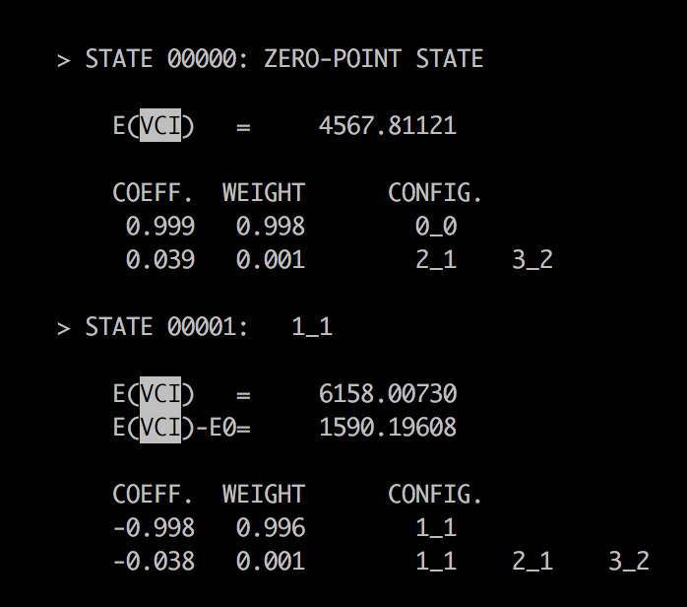
log/vci.out
VCI[3]-(8)
Dimension of VCI matrix
Zero-point energy
CI coeff.
1st excitation of the 1st mode
Total energy and excitation energy
CI coeff.

Slide 8
vmp2.inp
#--- [ VIB ]
&vib MR=3 vmaxAll=10 vscf=.t. vpt=.t. /
#--- [ VPT ]
&vpt maxSum=4 /
vscf = .t. and vpt = .t. invokes VMP2.
maxSum : Max sum of quantum numbers to excite.
* maxSum=4 means VMP2-(4).

Slide 9
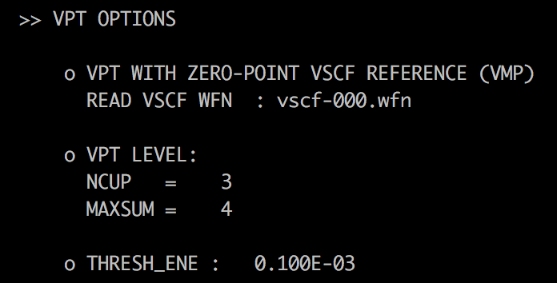
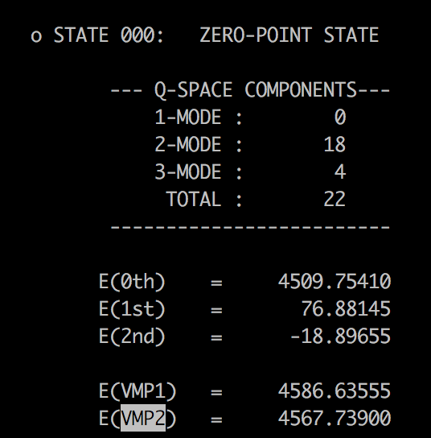
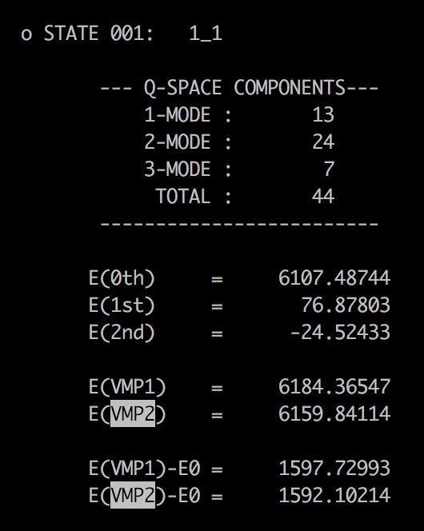
log/vmp2.out
VMP2-(4)
1st excitation of the 1st mode
1st and 2nd order energy
1st and 2nd order energy
1st and 2nd order excitation energy

Slide 10
vqdpt2.inp
#--- [ VIB ]
&vib MR=3 vmaxAll=10 vscf=.t. vqdpt=.t. /
&states
fund=.t.
nstate=3
target_state(2,1)=2
target_state(2,2)=1
target_state(3,2)=1
target_state(3,3)=2
/
#--- [ VPT ]
&vqdpt nGen=3 maxSum=4 /
vscf = .t. and vqdpt = .t. invokes VQDPT2.
All fundamental levels.
add (020), (011), (002)
nGen : Max number of iteration for generating the P space.
maxSum : Max sum of quantum numbers to excite.

Slide 11
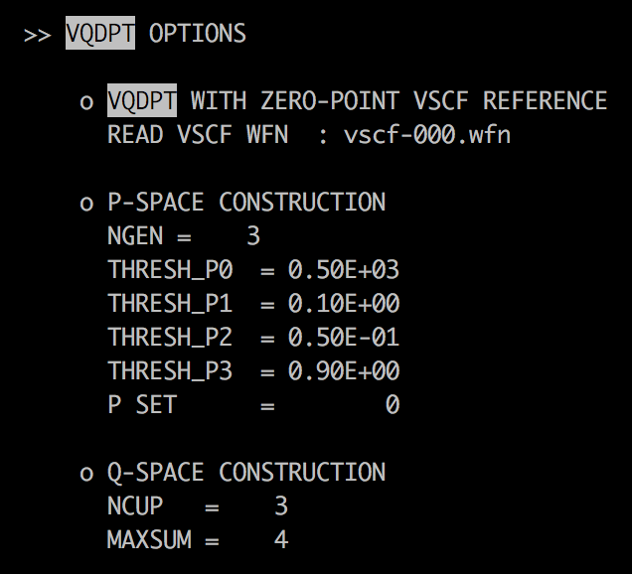
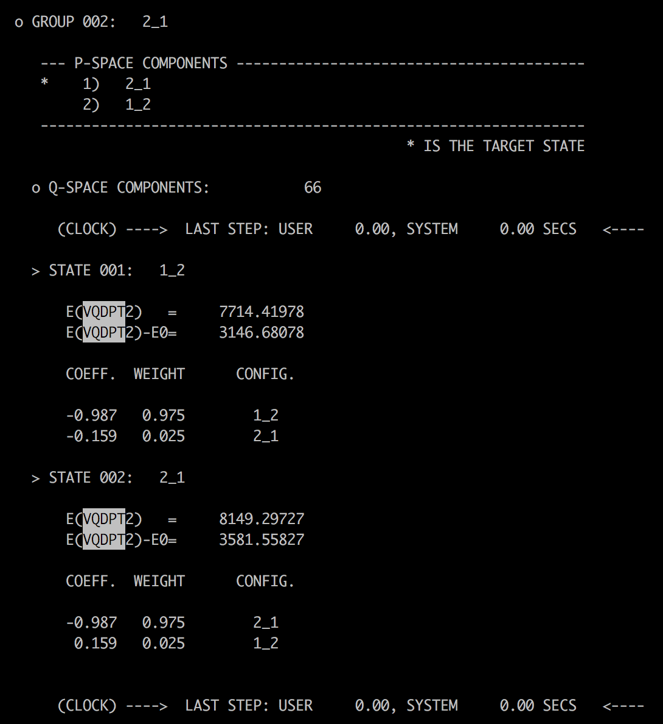
log/vqdpt2.out
P space components.
Parameters for the P space.
Parameters for the Q space.
VCI-like output for the P space.
1st and 2nd order correction
1st and 2nd order energy

Slide 12
Quiz
Find the fundamental frequencies of H₂O from the output files, and fill in a table below.
 | Harm | VCI[3]-(8) | VMP2-(4) | VQDPT2-(4) | Exp.
1 |  |  |  |  | 1595
2 |  |  |  |  | 3652
3 |  |  |  |  | 3756

Slide 13
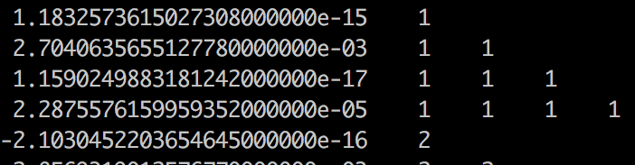
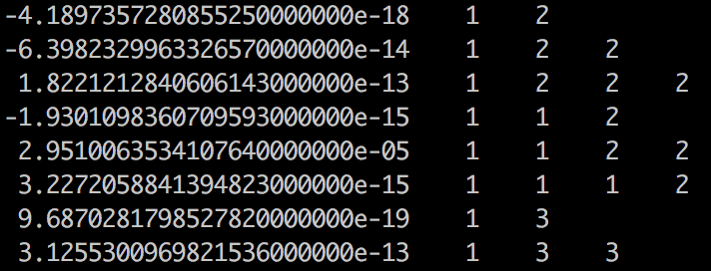
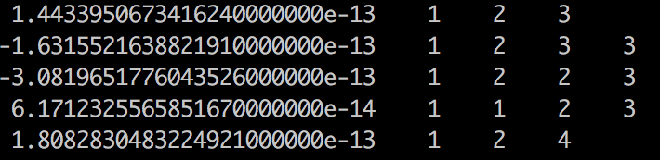
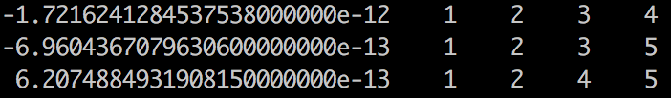
2. Ethylene
eq-mp2dz.minfo
Includes the equilibrium geometry, harmonic frequencies, and vibrational displacement vectors. They can be visualized by JSindo.
prop_no_1.mop
Includes the information of QFF
one-body terms:
ci, cii, ciii, ciiii
…
two-body terms:
cij, cijj, cijjj, ciij, ciijj, ciiij
…
three-body terms:
cijk, cijkk, cijjk, ciijk
…
four-body terms: cijkl

Slide 14
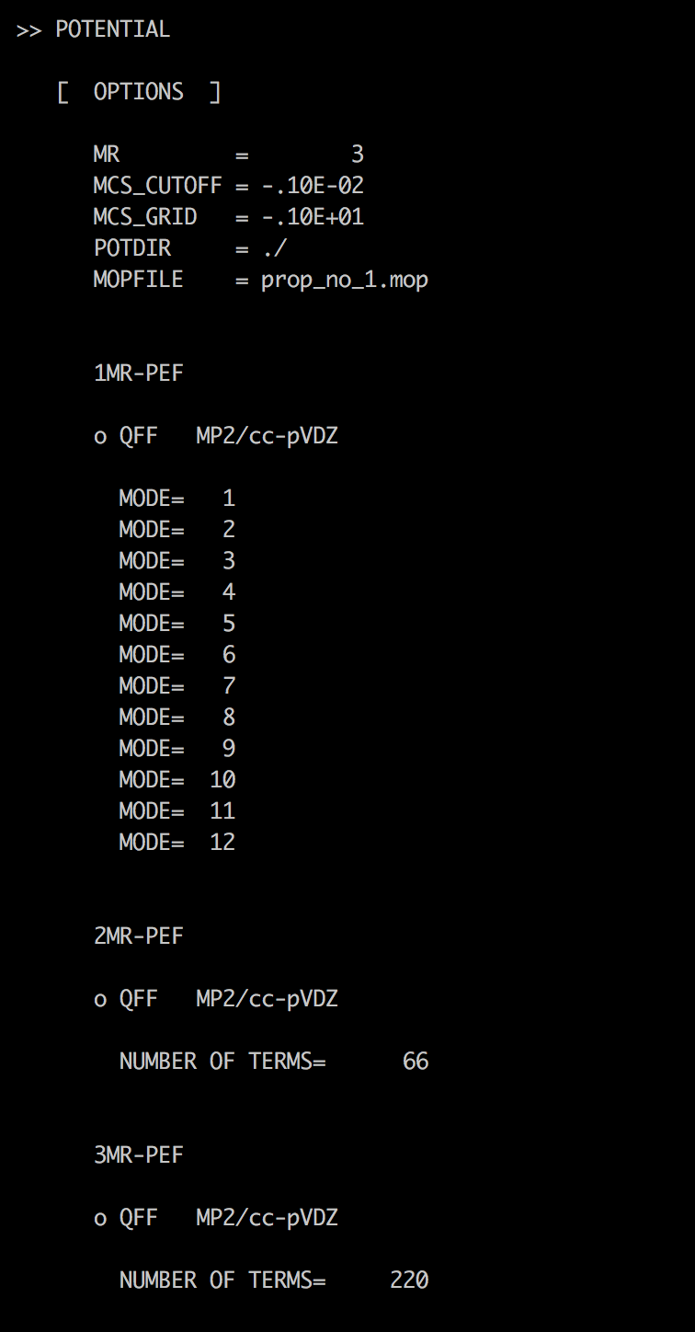
vci.inp, vmp2.inp, vqdpt2.inp
Input for QFF
#--- [ MRPES ]
&mrpes mopFile='prop_no_1.mop' mcs_cutoff=-1.0D-03 /
mopFile : Name of a QFF file.
mcs_cutoff : Cut-off threshold for coupling terms based on MCS.
Input for VCI, VMP2, VQDPT2 is the same as in the case of water.
Output for QFF
1MR
2MR
3MR

Slide 15
Quiz
Find the fundamental frequencies of C₂H₄ from the output files, and fill in a table below.
 | Harm | VCI[3]-(8) | VMP2-(4) | VQDPT2-(4) | Exp.
1 |  |  |  |  | 826
2 |  |  |  |  | 940
3 |  |  |  |  | 949
4 |  |  |  |  | 1026
5 |  |  |  |  | 1222
6 |  |  |  |  | 1344
7 |  |  |  |  | 1442
8 |  |  |  |  | 1625
 |  |  |  |  | 1662
9 |  |  |  |  | 2989
10 |  |  |  |  | 3022
11 |  |  |  |  | 3083
12 |  |  |  |  | 3105

Slide 16
3. Water Hexamer
h2o_6-mp2dz.minfo
Includes the equilibrium geometry, harmonic frequencies, and vibrational displacement vectors. They can be visualized by JSindo. In this example, we only treat internal vibration of water molecules (i.e., OH stretching and HOH bending modes) neglecting intermolecular modes. We set modes 31 – 40 to active, and others to inactive.
prop_no_1.mop
Includes the information of QFF. This is 4MR-QFF for all 48 modes. (In fact, it is costly to get this QFF.)

Slide 17
ocvscf.inp
#--- [ VIB ]
&vib MR=4 ocvscf=.t. vscf=.f. vci=.f. vpt=.f.
vmaxAll = -1
vmax(31) = 10
vmax(32) = 10
…
vmax(48) = 10
/
#--- [ OCVSCF ]
&ocvscf mopfile='prop_no_1.mop' /
ocvscf = .t. invokes oc-VSCF.
Make all modes inactive.
Make 31-48 active.
mopFile : Name of a QFF file.
* For oc-VSCF, QFF needs to be full 4MR-QFF.

Slide 18
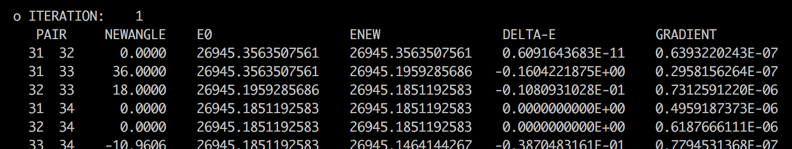
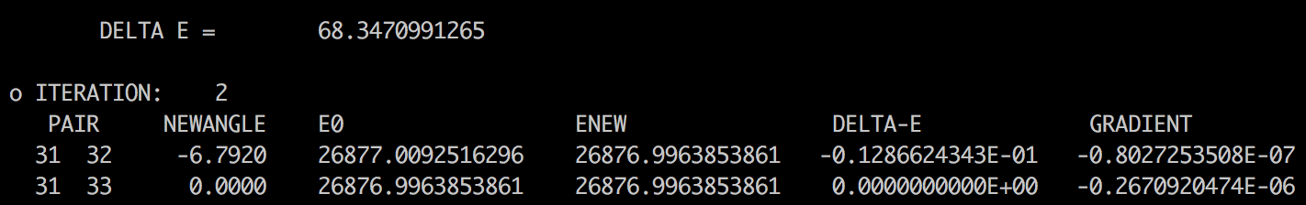
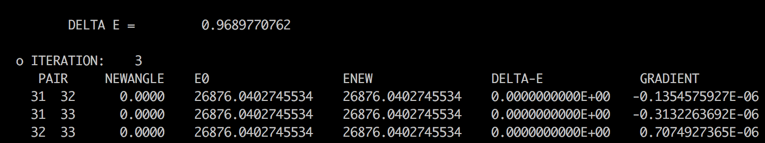
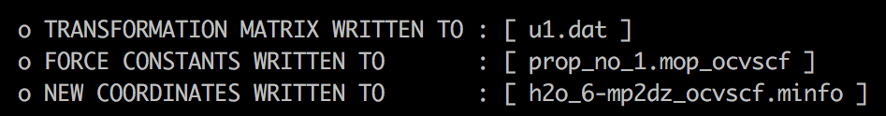
log/ocvscf.out
iteration over mode pairs
..
..
iteration over Jacobi sweep
These files are used in subsequent VSCF calculations.

Slide 19
ncvci.inp, ncvqdpt2.inp
VCI and VQDPT2 calculations based on normal coordinates. They read h2o_6-mp2dz.minfo and prop_no_1.mop.
ocvci.inp, ocvqdpt2.inp
VCI and VQDPT2 calculations based on optimized coordinates.
The read h2o_6-mp2dz_ocvscf.minfo and prop_no_1.mop_ocvscf.

Slide 20
Quiz
Visualize the normal and optimized coordinates of water hexamer, and discuss on their differences.

Slide 21
List of all Options
&mol
Character(80) :: minfoFile
The name of the .minfo file, in which the information of molecule is written.
Integer :: Nat
The number of atoms
Real(8), dimension(Nat) :: Mass
The mass of each atoms (in atomic mass unit)
Real(8), dimension(3,Nat) :: x
The reference (equilibrium) geometry (in Angstrom)
Real(8), dimension(Nfree) :: omega
The frequencies for the HO basis sets (in cm−1)
Real(8), dimension(Nat*3,Nfree) :: L
The vibrational displacement vectors
[Note] ’minfoFile’ is mutually exclusive from others.
&sys
Integer(8) :: Maxmem
Maximum size of memory (MB)

Slide 22
&mrpes
Integer :: MR
Mode representation (MR=1-4)
Real(8) :: mcs_cutoff
Cutoff of QFF based on MCS in cm-1 (default = 1.d-04)
Logical :: au
The grid data in atomic unit (default = true)
Character(80) :: mopFile
The name of the mop file.
&vib
Integer :: Nfree
Number of degrees of freedom (default = 3Nat - 6)
Integer :: MR
Mode representation (MR=1-4)
Integer, dimension(Nfree) :: vmax
Number of basis functions for each mode (default=10)
Integer :: vmaxALL
Number of basis functions for all modes (default=10)
Integer :: vmax base
same as vmaxALL
Logical :: vscf, ocvscf, vci, vpt, vqdpt
invoke vscf/ocvscf/vci/vpt/vqdpt
Logical :: prpt
invoke property calculation
Logical :: readBasis
read the basis functions from cho.basis

Slide 23
&states
Integer :: Nstate
Number of states to calculate
Integer, dimension(Nfree,Nstate) :: target state
Labels of the target states
Logical :: fund
Compute fundamentals
&vscf
Logical :: state specific
State specific VSCF if true (default = .false.)
Logical :: restart
Restart from vscf xxx.wfn (default = .false.)
Integer :: Maxitr
Maximum number of iteration (default = 10)
Real(8) :: Ethresh
Threshold of convergence (default = 1e-03 cm−1)

Slide 24
&ocvscf
Integer :: maxOptIter
Maximum number of iteration (default = 30)
Real(8) :: ethresh
Threshold of the energy (default = 1e-06 cm−1)
Real(8) :: gthresh
Threshold of the gradient (default = 1e-06 cm−1 rad−1)
Integer :: pfit
Order of the Fourier fitting (default = 2)
Character(80) :: mopFile
The name of the mopfile
Character(80) :: u1File
The name of the file to write the transformation matrix (default = u1.dat)
Integer :: icff
Switch on CFF when icff = 1 and QFF when icff = 0 (default = 0)
Integer :: iscreen
Switch off/on pair selection when iscreen=0/1 (default = 1)
Real(8) :: eta12thresh
Threshold value for the pair screening (default = 500 cm−1)

Slide 25
&vci
Integer :: Nstate
Number of states to calculate
Integer :: nCI
Max CI dimension (cutoff based on the energy)
Integer(Nfree) :: maxEx
Max quantum number to excite for each mode
Integer :: maxExALL
Max quantum number to excite for all the modes
Integer :: maxSum
Max sum of quantum number
Integer :: nCUP
Max number of modes to excite
Logical :: geomAv
If true, calculate vibrationally averaged geometry
Logical :: dump
If true, dump the vci wavefunction to vci-w.wfn
Real(8) :: printWeight
Print the configuration with the weight larger than this threshold
Logical :: readCIbasis
If true, read CI basis from vci-w.wfn
Logical :: dumpHmat
If true, write the VCI hamiltonian matrix
Logical :: noDiag
If true, the diagonalization is skipped

Slide 26
&vpt
Integer :: maxSum
Max sum of quantum number to excite (default = -1)
Integer :: maxEx
Max quantum number to excite (default = -1)
Integer :: nCUP
Max number of modes to excite (default = MR)
Real(8) :: thresh ene
Threshold energy to avoid divergence (default=1e-04 Hartree)
Logical :: dump
Dump the information to vmp-w.wfn
&vqdpt
Integer :: nGen
The generation of P space (default=3)
Real(8) :: thresh p0
E0 pruning (default=500 cm−1)
Real(8) :: thresh p1
VPT based pruning (default=0.1)
Real(8) :: thresh p2
VCI pruning (default=0.05)
Real(8) :: thresh p3
VCI pruning (default=0.9)
Integer :: pset
Combine the p-space generated from several target states
=0 when the target states have an overlap (default)
=1 when the p-space components have an overlap

Slide 27
Integer :: maxSum
Max sum of quantum number to excite (default = -1)
Integer :: nCUP
Max number of modes to excite (default = MR)
Integer :: pqSum
P/Q interaction scheme
> 0 prune the interaction when λpq > maxSum (default)
< 0 full interaction
Integer :: vqdpt2 loop
=0 loop over q, then p, p’ (default)
=1 loop over p, then p’, q
Real(8) :: thresh ene
Threshold energy to avoid divergence (default=1e-04 Hartree)
Real(8) :: printWeight
Print the configuration with the weight larger than this threshold (default=0.001)
Logical :: dump
Dump the information to vqdpt-w.wfn (default=true)
&prpt
Logical :: vscfprpt, vciprpt, vptprpt, vqdptprpt
Invoke property calculation for vscf, vci, vpt, vqpdt wavefuncion
Integer :: MR
Mode representation (default = 3)
Character :: extn(*)
The extension of the property files
Integer :: matrix(*)
= 0 calculate only the average
> 0 calculate the matrix
Logical :: infrared
If true, calculate the IR intensity.

Slide 28
&prptvci
Integer :: Nstate
The number of states
&IRspectrum
Real(8) :: minOmega, maxOmega
Min/Max value of the spectrum (default = 100 - 4000 cm−1)
Real(8) :: delOmega
Interval of the data (default = 1 cm−1)
Real(8) :: fwhm
Full-width half maximum of the Lorentz function for convolutions (default = 20 cm−1)
Real(8) :: cutoff
Cutoff of the band (default = -1 km mol−1)

