Slide 1
Users’ guide of JSindo
Kiyoshi Yagi
kiyoshi.yagi@riken.jp
Theoretical Molecular Science Laboratory
RIKEN Cluster for Pioneering Research
2018/09/20

Slide 2
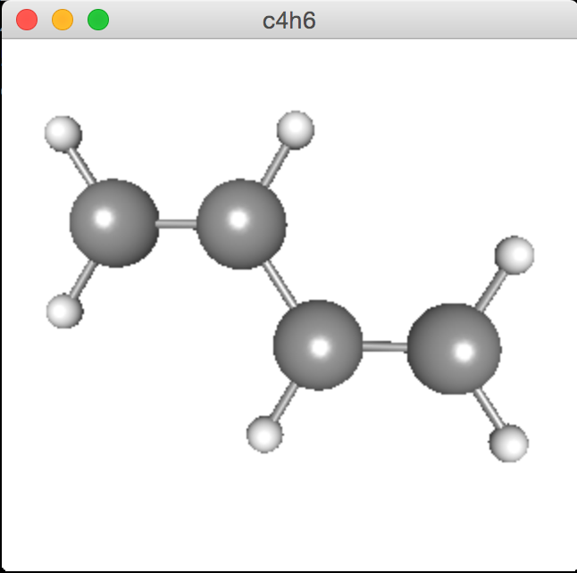
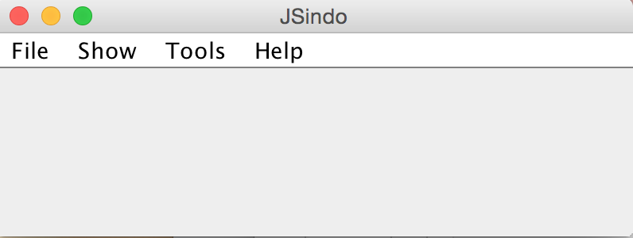
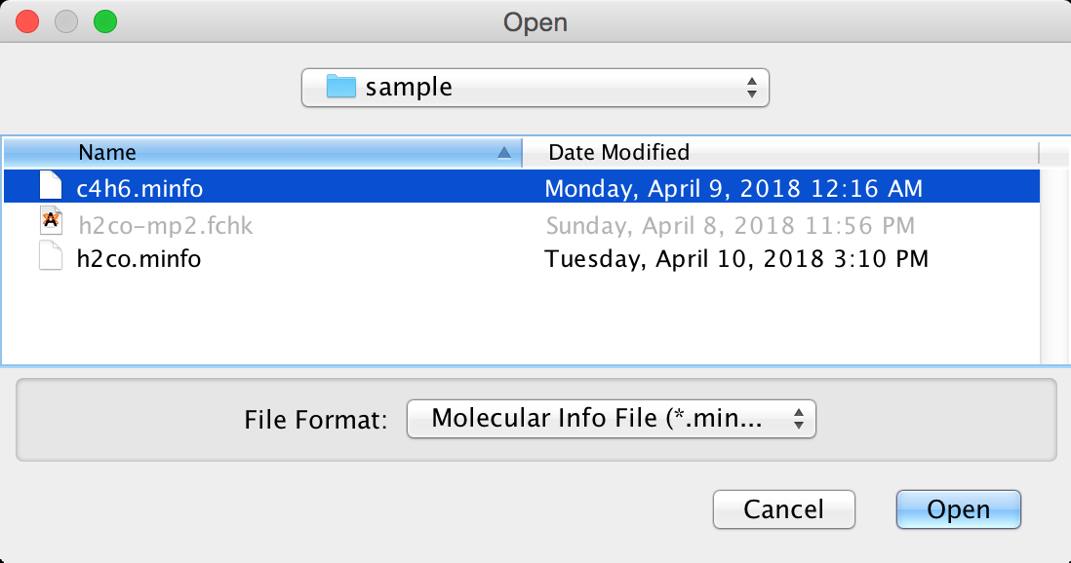
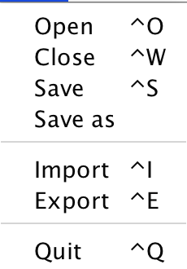
1. Basic Usage
1.1. Open a minfo file
The first window you see when you start up JSindo is called a controler panel. This panel provides an access to all functions of JSindo.
JSindo reads and stores the information of a system in a file called ”minfo” (See Sec.3 for the format). Let’s start using JSindo by opening a minfo file. Sample files are provided along with this document in a “sample” folder. You can open a minfo file in the following step (see Fig. 1, too):
“File -> Open” pops up a filechooser. Ctrl+o is a shortcut.
Goto “sample_JSindo” folder, choose “c4h6.minfo”, and click open.
Then, a viewer panel pops up to show C₄H₆ (1,3-butadiene).
You can rotate the molecule with a left button of your mouse, translate with a right button, and zoom up or out with a middle roller.
click
Figure 1. (Left) Controler panal, (Middle) File chooser, and (Right) Molecule viewer panel.

Slide 3
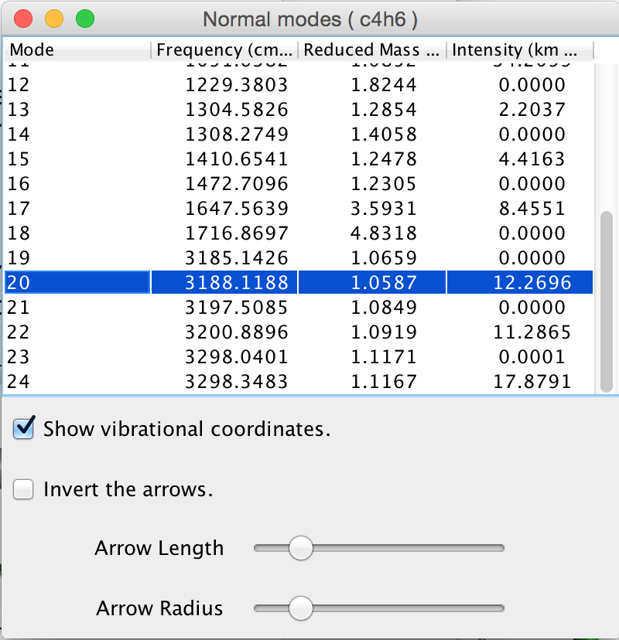
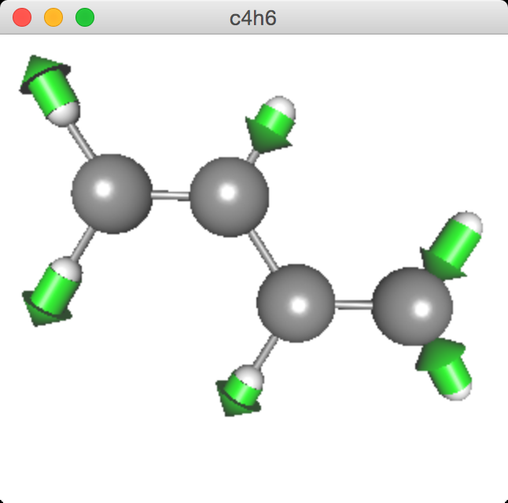
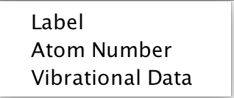
1.2. Visualize normal modes
Now, click the “Show” menu in the control panel. You will find that “Vibrational Data” is active. This means that the minfo file you opened contains data of vibrational modes. Otherwise, the label is inactive (that is, unclickable).
Click “Vibrational Data”, then a table of vibrational modes pops up which lists frequency, reduced mass, and infrared intensity. Click one of the mode, and you will see an arrow representation of the mode in the viewer panel. The example in Fig. 2 is one of the CH stretching modes of C₄H₆.
click
checkbox
slider
Figure 2. (Left) Controler panal, (Middle) table of modes, and (Right) mode 20 represented with arrows.
The arrows can be inverted by a checkbox in front of “Invert the arrows”. Also, the size of arrows can be changed with a slider.

Slide 4
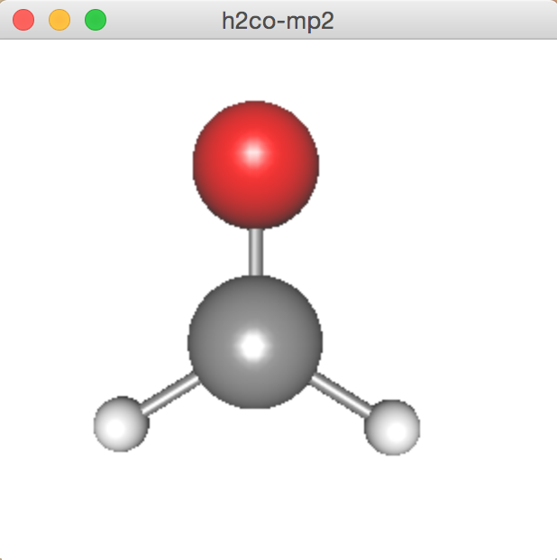
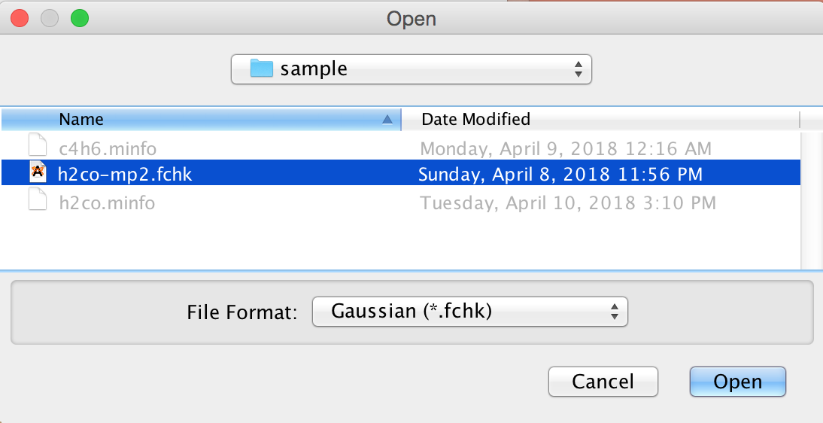
1.3. Import fchk file of Gaussian
JSindo can import a formatted checkpoint (fchk) file of Gaussian09/16. The fchk file is an archive of Gaussian job. It can be created by setting %chk=xxx.chk in the root section of Gaussian input, and by converting a binary file (xxx.chk) to an ascii file using formchk utility. See the manual of Gaussian for more details.
You can import a fchk file in the following step (see Fig. 3, too):
“File -> Import” pops up a filechooser. Ctrl+i is a shortcut.
Goto “sample” folder, choose “h2co-mp2.fchk”, and click to open.
Then, you will see H₂CO (formaldehyde) in a viewer panel.
Note that the extension of the file must be fchk (case insensitive, Fchk, FChk, are OK) but not others.
click
Figure 3. (Left) “Import” in File menu, (Middle) choose h2co-mp2.fchk, then (Right) the gaussian data for formaldehyde is imported.

Slide 5
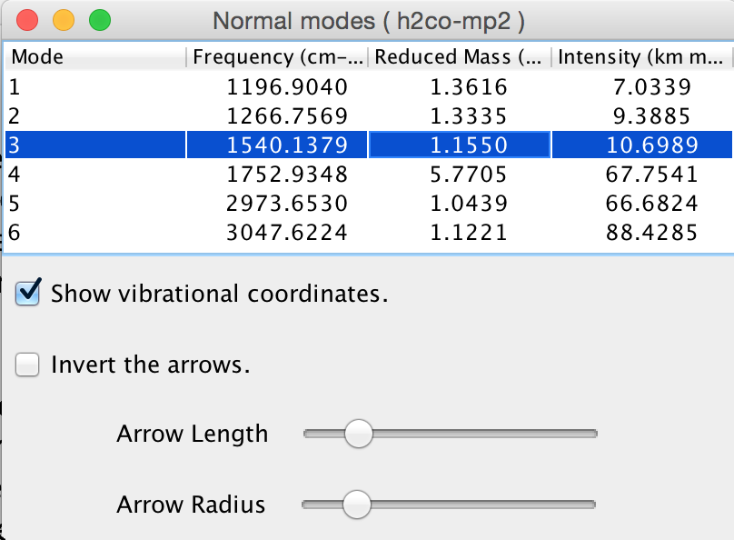
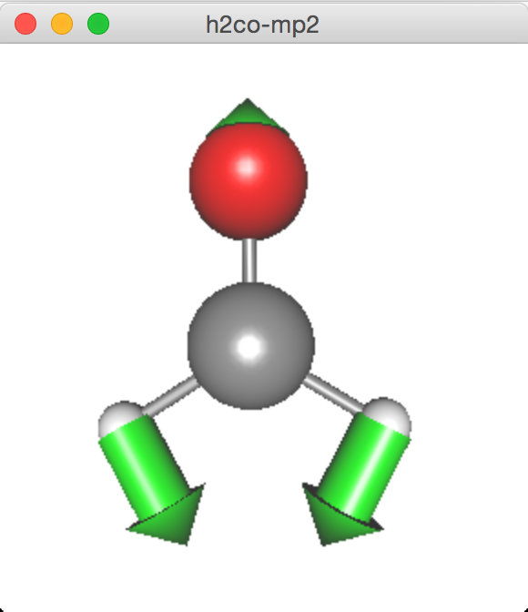

Now, let’s inspect the normal modes. You might have attempted “Show -> Vibrational Data” to notice that the label is inactive. Although a bit confusing, “Vibrational Data” is initially inactive even if you feed JSindo the output of frequency calculation, because the fchk file contains the force constants (Hessian) matrix, but not the frequencies and normal displacement vectors themselves.
Thus, we calculate the normal modes and frequencies from the Hessian matrix, which can be done by “Tools -> Harmonic Analysis” (see Fig. 4). Once you create the normal modes, “Vibrational Data” becomes active. If you close the table, you can show it again by “Show -> Vibrational Data” whenever you like.
Figure 4. “Harmonic Analysis” in Tool menu calculates the harmonic frequencies and normal modes, which are shown in the table and the viewer panel.

Slide 6
Finally, we save the data to a minfo file.
“File -> Save” or Ctrl+s saves the data to “h2co-mp2.minfo. The filename is automatically set by replacing fchk by minfo. Note that this procedure overwrites an existing file without warning, so be careful!
“File -> Save as” saves the data to a file with your preferred name. It pops up a filechooser and you are asked to enter the name.
This data contains not only the information of atoms and structure, but also that of vibrational modes and frequencies.

Slide 7
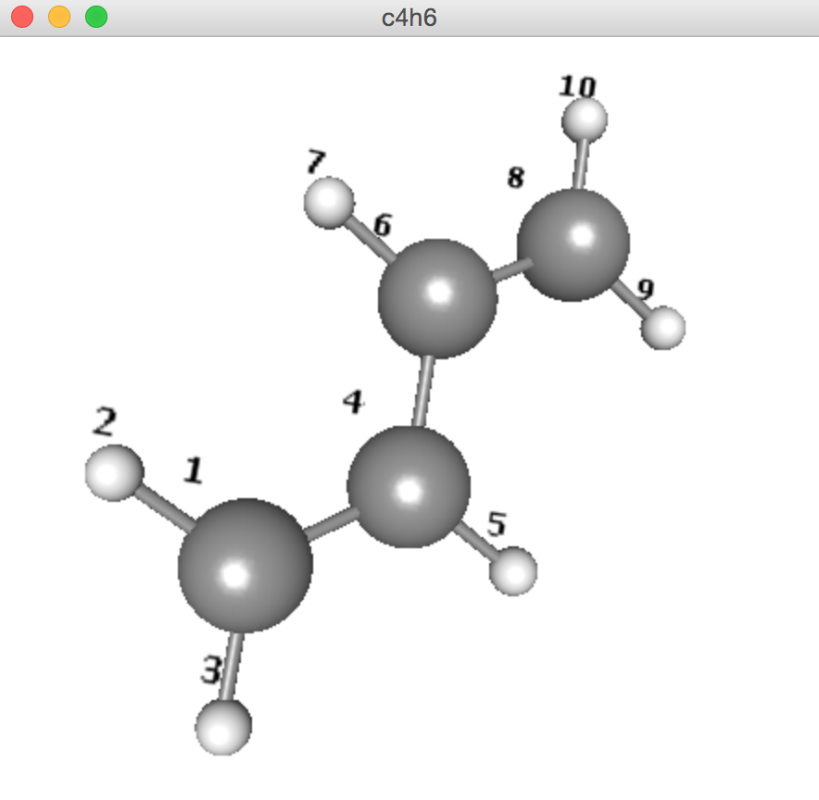
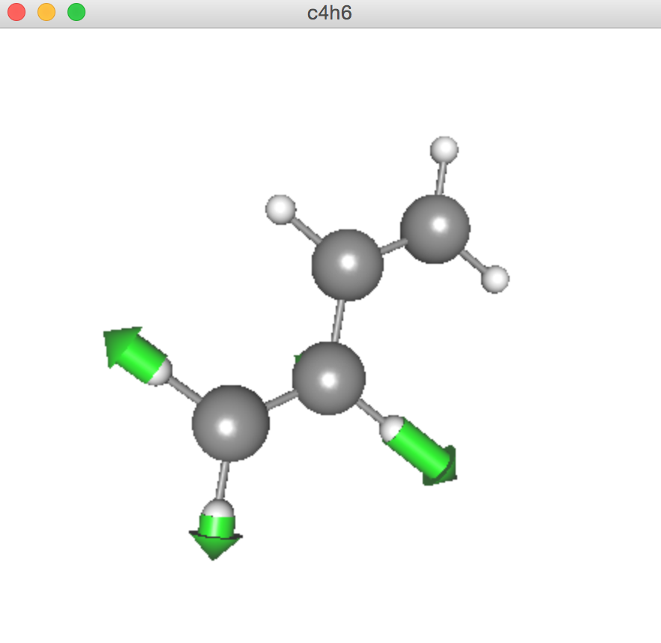
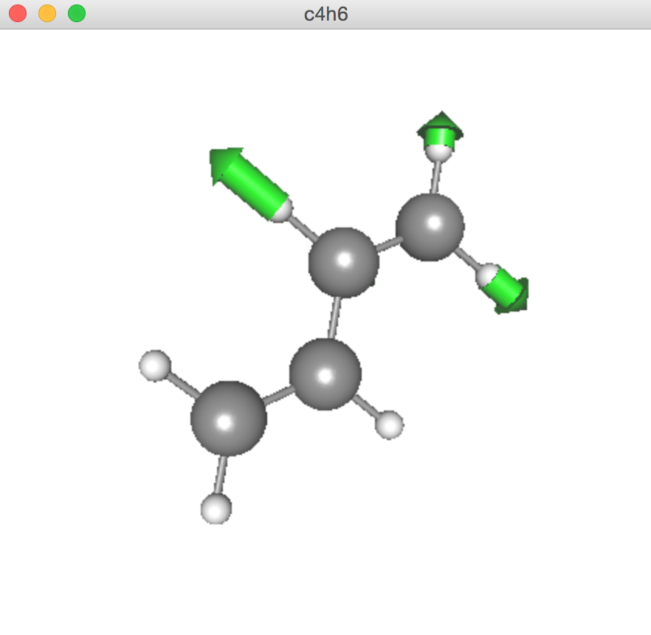
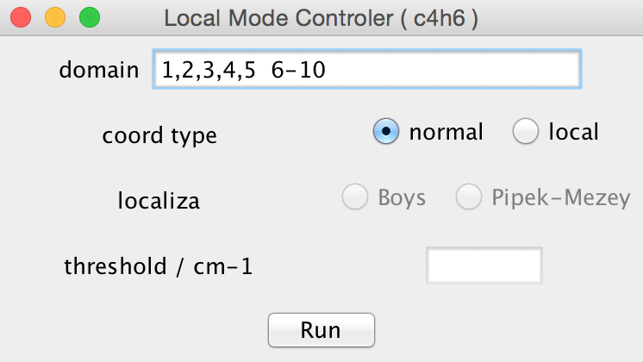
1.4. Creating local modes
JSindo implements two methods to create local modes from normal modes. The first localizes the modes to a certain domain of a molecule specified by the user. The other creates local modes by a linear combination of normal modes using an algorithm proposed by Jacob and Reiher [1]. Here, we demonstrate the program using butadiene as an example.
Let’s divide butadiene in two domains of -CHCH₂ as in Fig. 5 (a). The first domain is atom 1 to 5 and the other is 6 to 10. The number is shown by “Show -> Atom Number”.
“Tools -> Create Local Modes” opens a controller of local mode generator. We enter the domain in a text box as shown in Fig. 5 (b). The domain is specified by atom numbers separated with camma or hyphen. “1,2,3,4,5” is the first domain. Then, the second domain follows after a space. Hyphen means a sequence of numbers, that is, 6-10 is equivalent to “6,7,8,9,10”.
[1] Jacob and Reiher, J. Chem. Phys. 130, 084106 (2009).
(a)
(b)
1st
2nd
(c)
1,2,3,4,5 6-10
Figure 5. (a) Domains of butadiene, (b) Local mode controller, (c) One of CH stretching modes localized to domain 1 and 2.

Slide 8
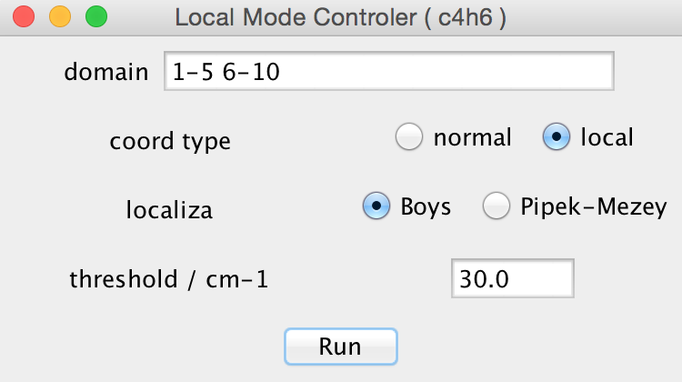
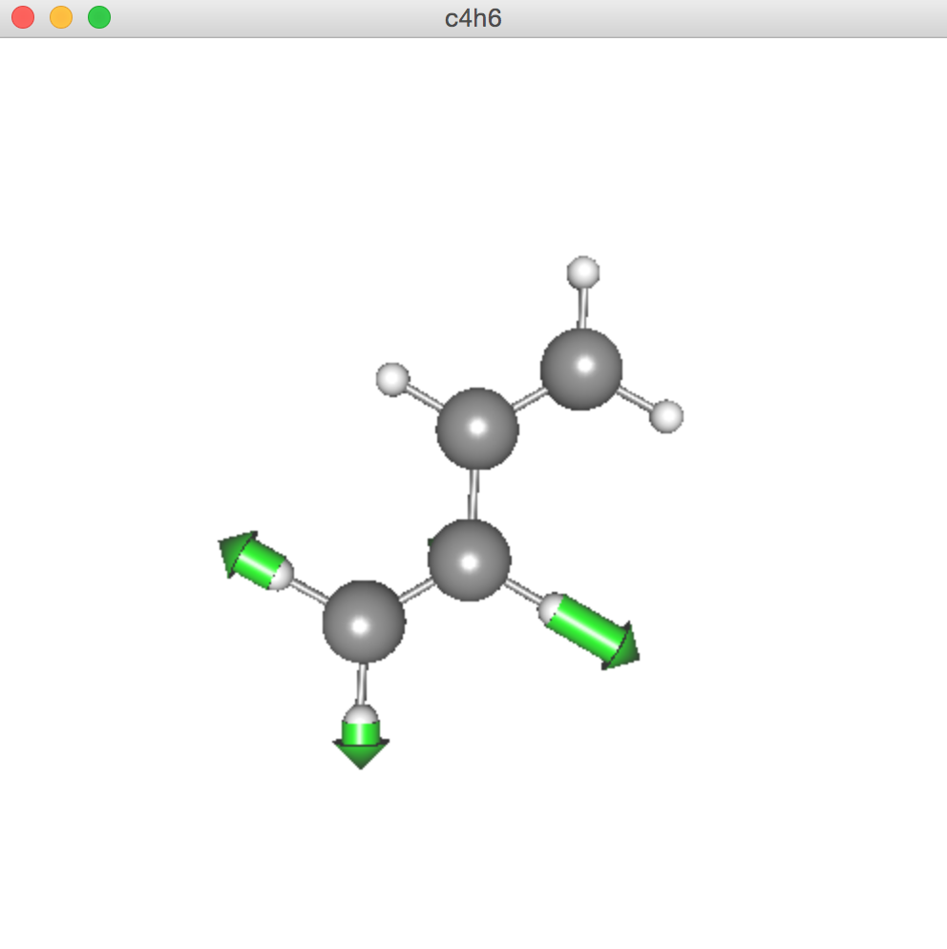
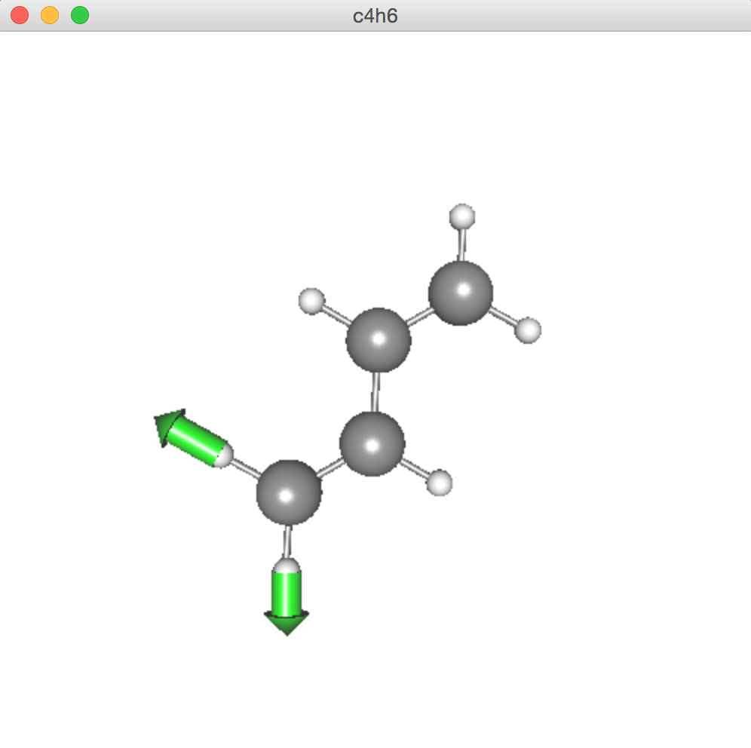
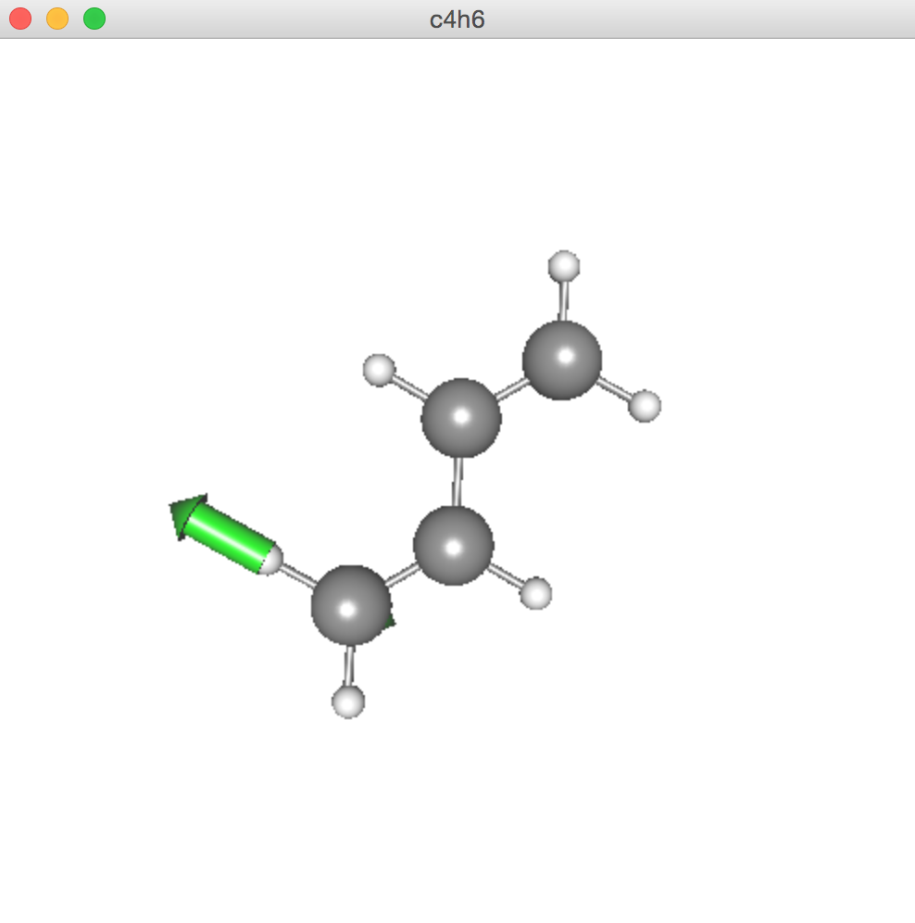
Click “run” to create local modes of each domain. Fig. 5 (c) shows one of the CH stretching modes localized to domain 1 and 2. Note that the two domains are equivalent by symmetry, and so are the resulting local modes.
The domain normal modes can be further localized by Jacob/Reiher method [1]. In the local mode controller, check the radio button “local” and one of the two methods of localization, Boys or Pipek-Mezey, as in Fig. 6 (a). The text box is a window frequency to select the mode pairs to mix proposed by Steele and coworkers [2]. Fig. 6 (b), (c), and (d) shows that the locality increase as we increase the window.
[1] Jacob and Reiher, J. Chem. Phys. 130, 084106 (2009).
[2] Cheng, Talbot, and Steele, J. Chem. Phys. 145, 124112 (2016).
(a)
(b)
(c)
(d)
check
window
Figure 6. (a) Local mode controller, (b) local normal mode, and localized modes using window frequency of (c) 30 cm⁻¹ and (d) 150 cm⁻¹.

Slide 9
2. A list of commands
File
Open : opens a minfo file
Close : closes a currently active panel
Save : overwrites the data to a current minfo file
Save as : saves the data to a new file
Import : imports the output of quantum chemistry program
Export : exports the viewer panel to an image file (png format)
Quit : quits the program
Show
Label : Shows or hides the label of each atom
Atom Number : Shows or hides the number of each atom
Vibrational Data : Shows or hides the frequency table
Tools
Harmonic Analysis : Performs normal mode analysis
Create Local Modes : Creates local modes
Help
About SINDO : Shows a version info

Slide 10
3. Format of a minfo file
Overall rule:
The data is divided by sections indicated by [].
Each colomn is separated by camma.
Space and digit length is free.
Units in atomic unit unless noted.
Vector and matrix are stored in 5 raws.
Version of the format.
# minfo File version 2:
#
currently latest version is 2.

Slide 11
[ Atomic Data ]
Label, atomic number, mass, x, y, z
# of atoms
[ Atomic Data ]
4
C, 6, 12.0000, 0.00000000, 0.00000000, -1.00940804
O, 8, 15.9949, -0.00000000, -0.00000000, 1.28265243
H, 1, 1.0078, 0.00000000, 1.76852012, -2.10238559
H, 1, 1.0078, -0.00000000, -1.76852012, -2.10238559
146
CG, 6, 12.0110, -4.64483751, 15.45444558, 10.32213350
CD1, 6, 12.0110, -4.68245616, 13.36297734, 8.69397502
.
.
# of additional
atoms
Mass in atomic mass unit.
Additional atoms are visualized in the viewer as well. However, they are not counted for the data of the electronic and vibrational structure.

Slide 12
[ Electronic Data ]
This section stores the data of electronic structure calculation.
[ Electronic Data ]
Energy
-114.3164100989564
Charge
0.0
Multiplicity
1.0
Total Energy
4x3
Gradient
12
6.08238873e-16, -1.23521925e-15, 8.72713047e-06, 2.96292226e-16, 2.61768319e-17
4.62326833e-05, 6.56879380e-17, -3.98085885e-05, -2.74799069e-05, -9.70219037e-16
3.98085885e-05, -2.74799069e-05
Hessian
78
1.70832787e-01, -1.58970728e-15, 6.08420051e-01, -8.70846734e-16, 5.25585008e-13
9.34223231e-01, -5.51567063e-02, 9.21940113e-18, -6.78757444e-17, 1.78229593e-02
.
.
Gradient
12x13/2
Hessian
Lower half of Hessian:
h11, h21, h22, h31, h32,
h33, …

Slide 13
xx, xy, yy, xz, yz,
zz
Dipole
Moment
Dipole Moment
3
-6.37682076e-17, -4.43373891e-16, -9.43652021e-01
Polarizability
6
1.29463446e+01, 2.76306294e-16, 1.76999249e+01, 1.97531367e-16, -7.91415445e-15
2.21862314e+01
Dipole Derivative
36
1.26598783e-01, 7.23656891e-16, -3.15167754e-18, -7.52954113e-16, 7.41115904e-01
1.08317036e-13, -1.12642811e-15, 7.36576072e-14, 8.86128593e-01, -3.19648292e-01
.
.
Polarizability
Dipole
Derivatives
ux/x1, uy/x1, uz/x1, ux/y1, uy/y1
uz/y1, ...
Even if some entries are absent, JSindo can still read the file and show the molecule. Note, however, that some functions may become unavaliable. For example, ”Harmonic Analysis” is not feasible without Hessian. Also, infrared intensity don’t appear without dipole derivatives.

Slide 14
[ Vibrational Data ]
This section stores the data of vibrational modes and frequencies. For isolated systems, translational and rotational modes are printed, followed by vibrational modes.
[ Vibrational Data ]
Normal modes
Translational Frequency
3
1.62527861e-02, 4.40127528e-02, 4.15427483e-02
Translational vector
T 1
12
6.32344200e-01, 0.00000000e+00, 0.00000000e+00, 7.30052141e-01, 0.00000000e+00
.
.
Rotational Frequency
3
3.54328808e+00, 9.69080902e+00, -2.43125260e+01
Rotational vector
.
.
Vibrational Frequency
6
1.19690403e+03, 1.26675689e+03, 1.54013789e+03, 1.75293483e+03, 2.97365303e+03
3.04762239e+03
Vibrational vector
.
.
Title
dx1, dy1, dz1, dx2, dy2
dz2, …
# of modes
Translation
Rotation
Vibration

Slide 15
For domain local modes, vibrational data is printed for each domain after the definition of atom numbers in the domain.
[ Vibrational Data ]
Number of Domain
2
Domain 1
Atom Index
3
1, 3, 4
Local Normal modes
Vibrational Frequency
9
-2.43128280e+01, 2.68618727e+00, 7.14816266e+00, 1.18456867e+03, 1.21881521e+03
1.21933152e+03, 1.61714130e+03, 2.97368185e+03, 3.04764597e+03
Vibrational vector
Mode 1
9
5.33281141e-13, -1.87886496e-12, 1.30340137e-15, -7.07106781e-01, -8.03650361e-13
-4.21498697e-13, 7.07106781e-01, -8.05671490e-13, 4.28566028e-13
.
.
Domain 2
Atom Index
.
.
# of Domain
atom number
1st
Domain
Title
dx1, dy1, dz1, dx3, dy3,
dz3, dx4, dy4, dz4
# of modes
2nd
Domain

