Slide 1
How to Install JSindo
for LINUX
Kiyoshi Yagi
kiyoshi.yagi@riken.jp
Theoretical Molecular Science Laboratory
RIKEN Pioneering Research Cluster
2018/05/21

Slide 2


1. Install Java
Install Java of Oracle (left), Open JDK (right), or any other.
https://www.java.com/en/
http://openjdk.java.net/
Click here and follow the instructions.
Note: Although Java 9 and 10 have been released since 2017/09 and 2018/03, respectively, Java 8 (1.8.x) is still recommended for JSindo, because it uses Java3D which may or may not be compatible with the newer Java.

Slide 3
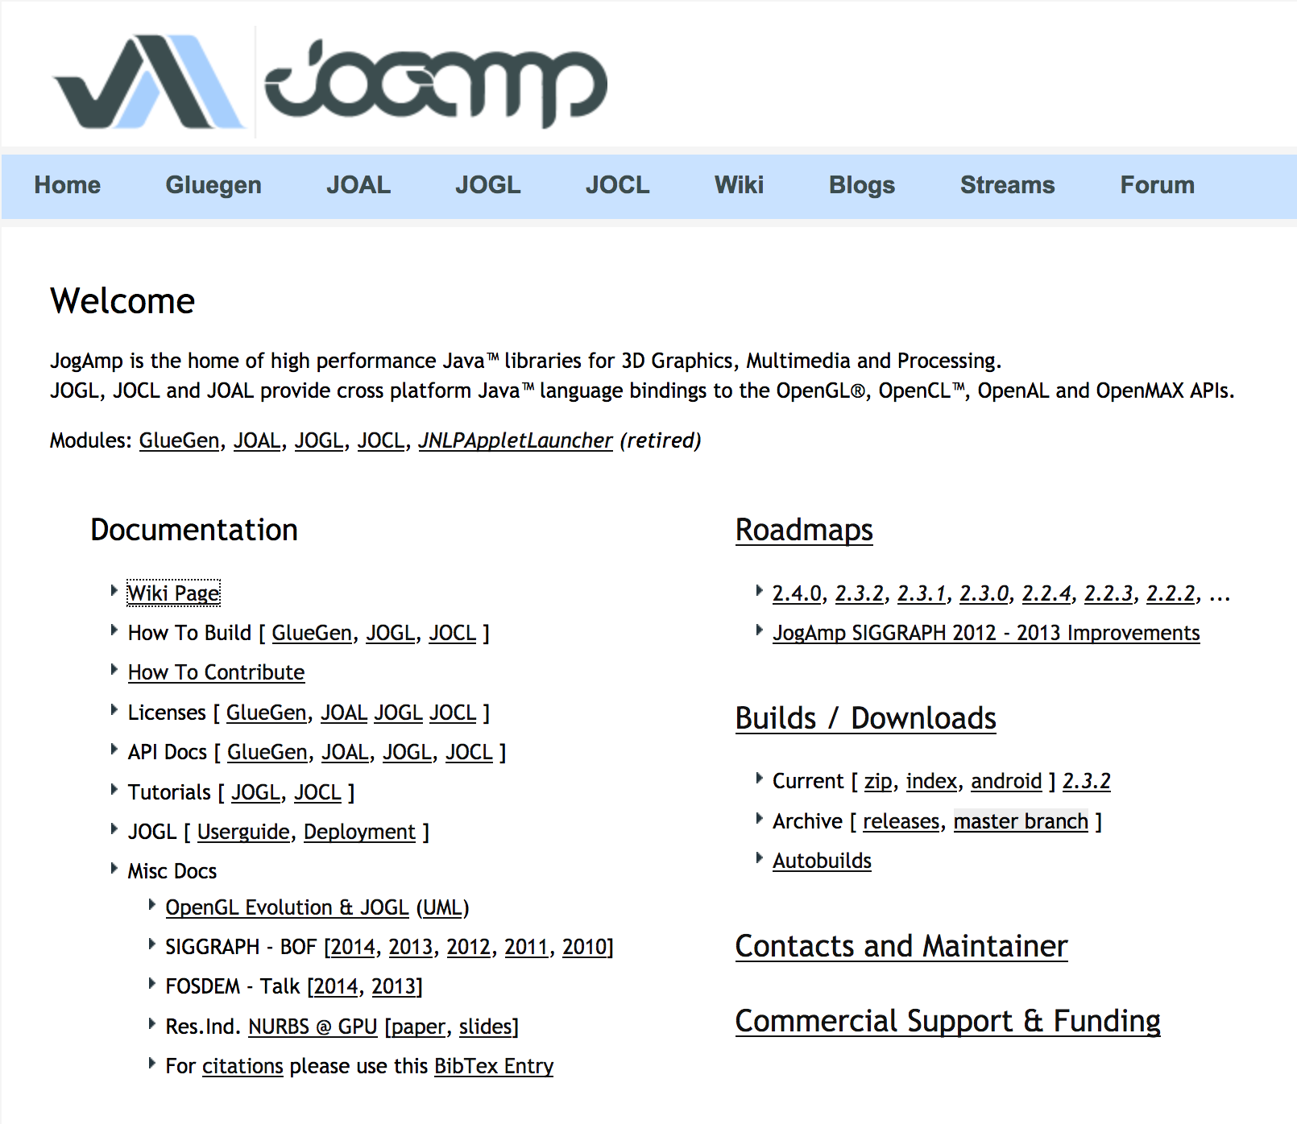
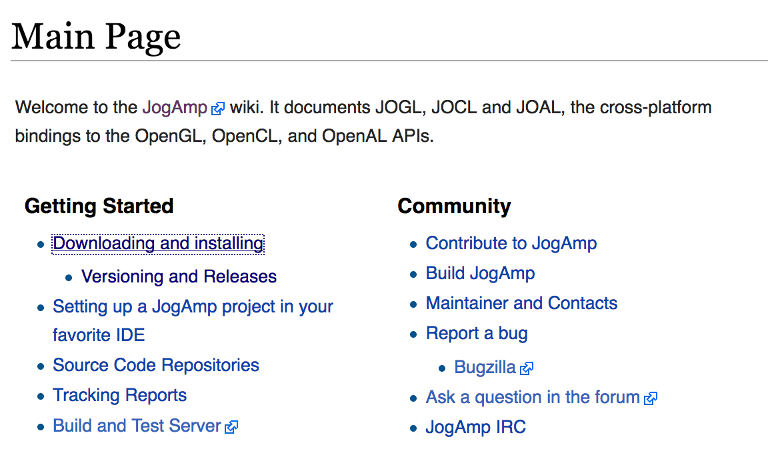
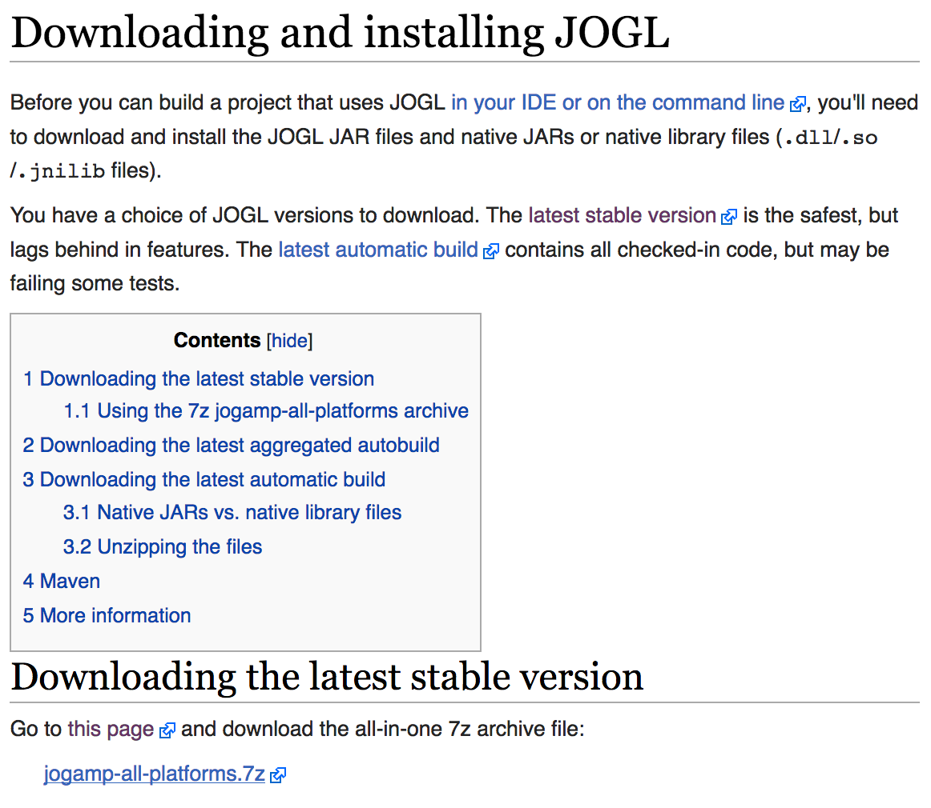
2. Download Java3D
JSindo uses Java3D for visualization. A stable version, 1.6.0, is available from JogAmp. Goto http://jogamp.org
click here
click here
click here and download
jogamp-all-platforms.7z

Slide 4
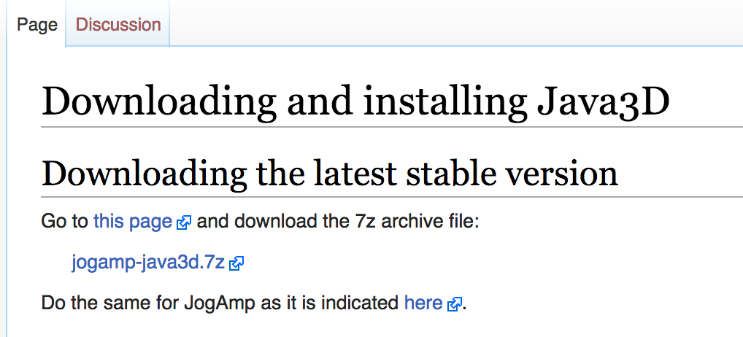
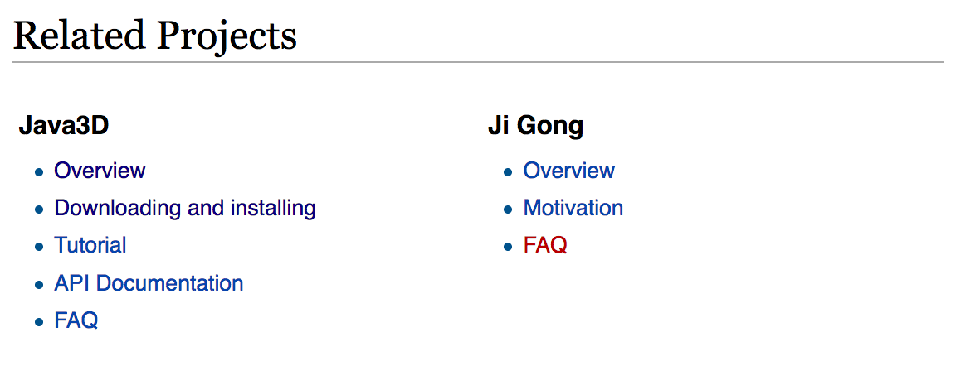
Go back to the Main page and scroll down
…
Scroll down
click here and download
jogamp-java3d.7z
click here
Unarchive the two files you’ve just downloaded. 7z files can be unarchived by,
> 7za e jogamp-all-platforms.7z
> 7za e jogamp-java3d.7z
If you don’t have the command, install p7zip package,
> yum install p7zip
(Fedora)
> sudo apt-get install p7zip
(Debian and Ubuntu)

Slide 5
You will find jar files in jogamp-all-platforms/jar and in jogamp-java3d. The following jar files are needed for JSindo:
jogamp-all-platforms/jar/
gluegen-rt.jar
gluegen.jar
gluegen-rt-natives-linux-XXX.jar
jogl-all.jar
jogl-all-natives-linux-XXX.jar
jogamp-java3d/
j3dcore.jar
j3dutils.jar
vecmath.jar
where XXX = amd64 or i586 for 64 or 32-bit, respectively.
(* XXX = armv6 and armv6hf are for ARM cpus, which are used for phones.)

Slide 6
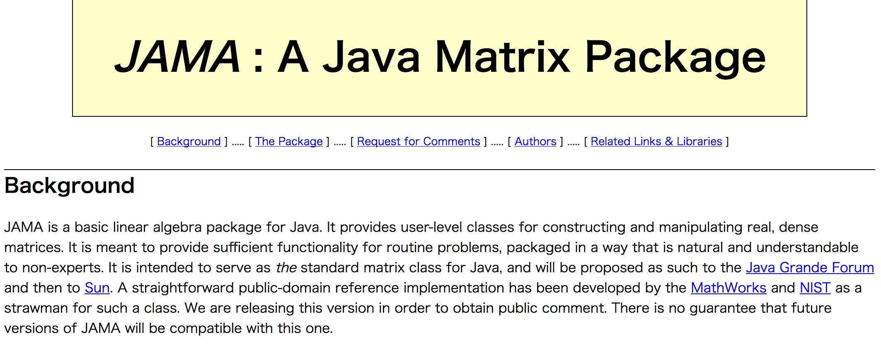
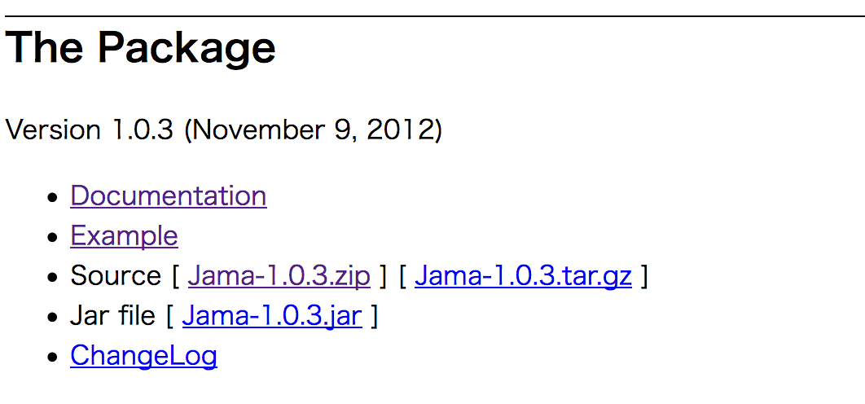
3. Download JAMA
JAMA is a linear algebra library for JAVA. We use it for matrix maltiplications, diagonalization, and so on. It can be downloaded from,
https://math.nist.gov/javanumerics/jama/
…
Scroll down
click here and download a jarfile.

Slide 7
4. Setup the jar files
Let’s first check if your Java is 32- or 64-bit. In the terminal, type “java -version” and you will see a message like this:
This is an example of 64-bit. If “64-Bit” is absent, then it’s 32-bit.
Now, we add the jar files to an environment variable CLASSPATH. If you are in bash,
where xxx = amd64 or i586 for 64-bit or 32-bit, respectively. You may want to add these lines in your ~/.bashrc, so that they take effect upon login.
>java –version
openjdk version "1.8.0_121”
OpenJDK Runtime Environment (build 1.8.0_121-b13)
OpenJDK 64-Bit Server VM (build 25.121-b13, mixed mode)
JOGAMP_JAR=${HOME}/lib/jogamp-all-platforms/jar
export CLASSPATH=${CLASSPATH}:${JOGAMP_JAR}/gluegen.jar
export CLASSPATH=${CLASSPATH}:${JOGAMP_JAR}/gluegen-rt.jar
export CLASSPATH=${CLASSPATH}:${JOGAMP_JAR}/jogl-all.jar
export CLASSPATH=${CLASSPATH}:${JOGAMP_JAR}/gluegen-rt-natives-linux-xxx.jar
export CLASSPATH=${CLASSPATH}:${JOGAMP_JAR}/jogl-all-natives-linux-xxx.jar
J3D_JAR=${HOME}/lib/jogamp-java3d
export CLASSPATH=${CLASSPATH}:${J3D_JAR}/j3dcore.jar
export CLASSPATH=${CLASSPATH}:${J3D_JAR}/j3dutils.jar
export CLASSPATH=${CLASSPATH}:${J3D_JAR}/vecmath.jar
export CLASSPATH=${CLASSPATH}:${HOME}/lib/jama/Jama-1.0.3.jar

Slide 8
5. Test JSindo
Use the following command:
I cannot or don’t want to copy jarfiles into an extension folder.
Specify all jarfiles using “:” as a separator,
Is there an alternative to “-cp”? The command is too long.
The environment variable, CLASSPATH, does the same thing. Set CLASSPATH for all jarfiles,
Then, you can start simply by,
I save the setting to ~/.bashrc, so that the CLASSPATH is configured upon login.
>java –cp JSindo-4.0_xxxxxx.jar:Jama-1.0.3.jar:... JSindo
> export CLASSPATH=${CLASSPATH}:/path/to/JSindo-4.0_xxxxxx.jar
> export CLASSPATH=${CLASSPATH}:/path/to/Jama-1.0.3.jar
...
> java JSindo

Slide 9
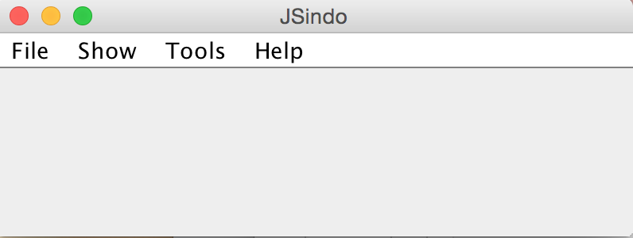
5. Test JSindo
Type the following command to invoke JSindo:
>java –cp /path/to/JSindo-4.0.jar JSindo
Alternately, you may add in your ~/.bashrc as before,
> export CLASSPATH=${CLASSPATH}:/path/to/JSindo-4.0.jar
Then, you can simply start by,
> java JSindo
With this command, you should see a control panel of JSindo.
If you don’t see the panel, review the installation of Java.

Slide 10
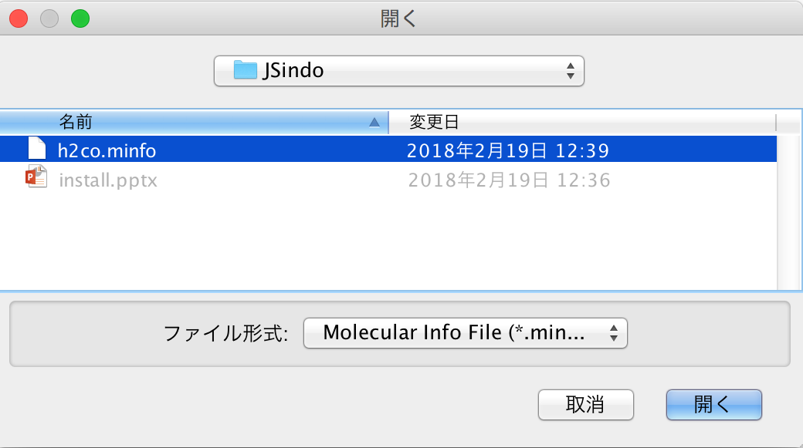
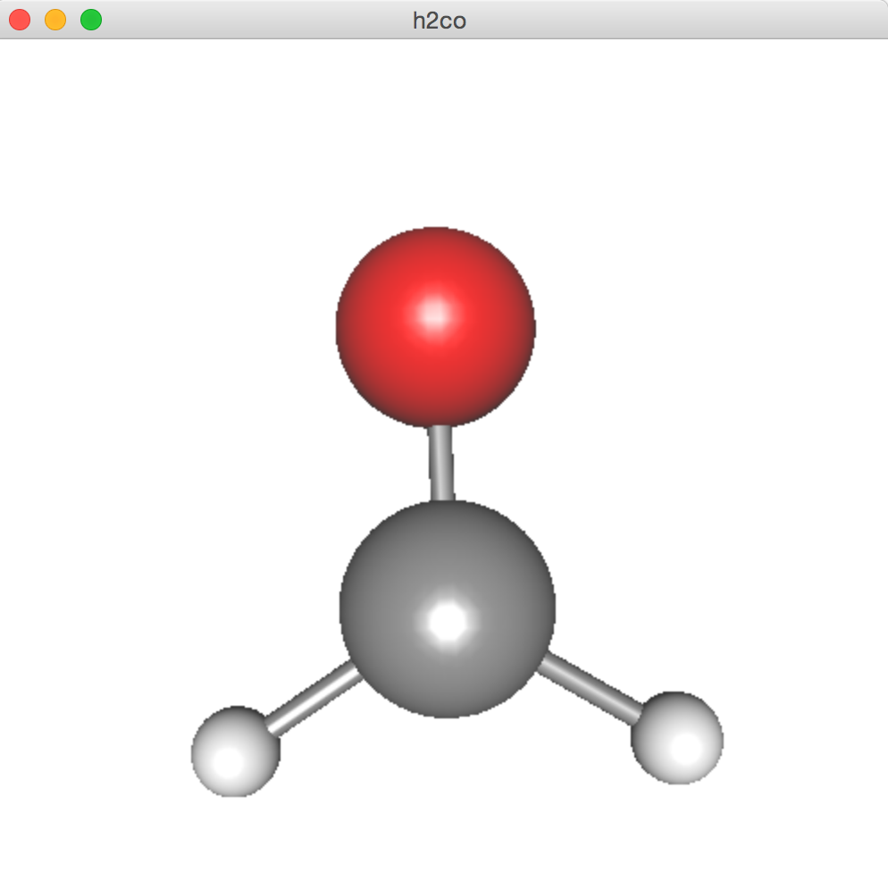
Open
Let’s open “sample/h2co.minfo”, which comes with this document. It contains data of formaldehyde.
Click, File -> Open, choose “h2co.minfo”, and click Open. If you see formaldehyde, you’re done with the first step!
If this step fails, it is highly likely that Java3D has a problem. Double check if the jarfiles are set correctly, that is, if the right files are set to CLASSPATH.
click to choose

Slide 11
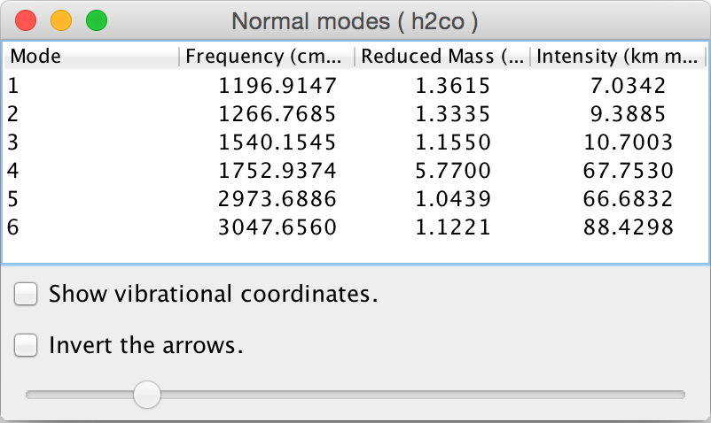
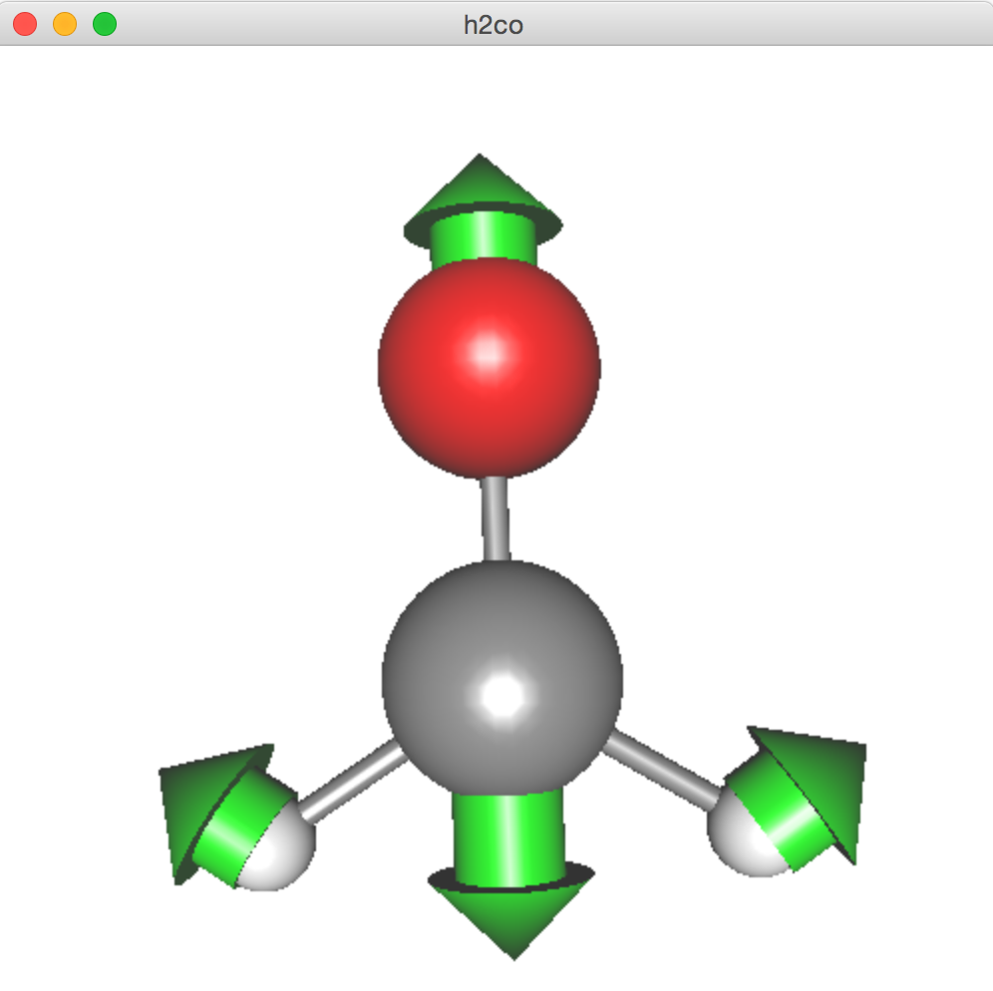
Finally, goto Tools -> Harmonic Analysis. This should create a panel of “Normal modes”.
If you don’t see this panel, JAMA isn’t working. Check if the jarfile of JAMA is set correctly.
If the panel appears, you’re all set! Congradulations!
Check on ”show vibrational coordinates”, and choose a mode you want to see. Vibrational motion will be indicated by arrows. You can “Invert the arrows” by a check box, and change the magnitude using a slider.
Thanks for using JSindo!
Enjoy!
Harmonic Analysis

