Slide 1
How to Install JSindo
for Mac
Kiyoshi Yagi
kiyoshi.yagi@riken.jp
Theoretical Molecular Science Laboratory
RIKEN Pioneering Research Cluster
2018/05/21

Slide 2


1. Install Java
Install Java of Oracle (left), Open JDK (right), or any other.
https://www.java.com/en/
http://openjdk.java.net/
Click here and follow the instructions.
Note: Although Java 9 and 10 have been released since 2017/09 and 2018/03, respectively, Java 8 (1.8.x) is still recommended for JSindo, because it uses Java3D which may or may not be compatible with the newer Java.

Slide 3
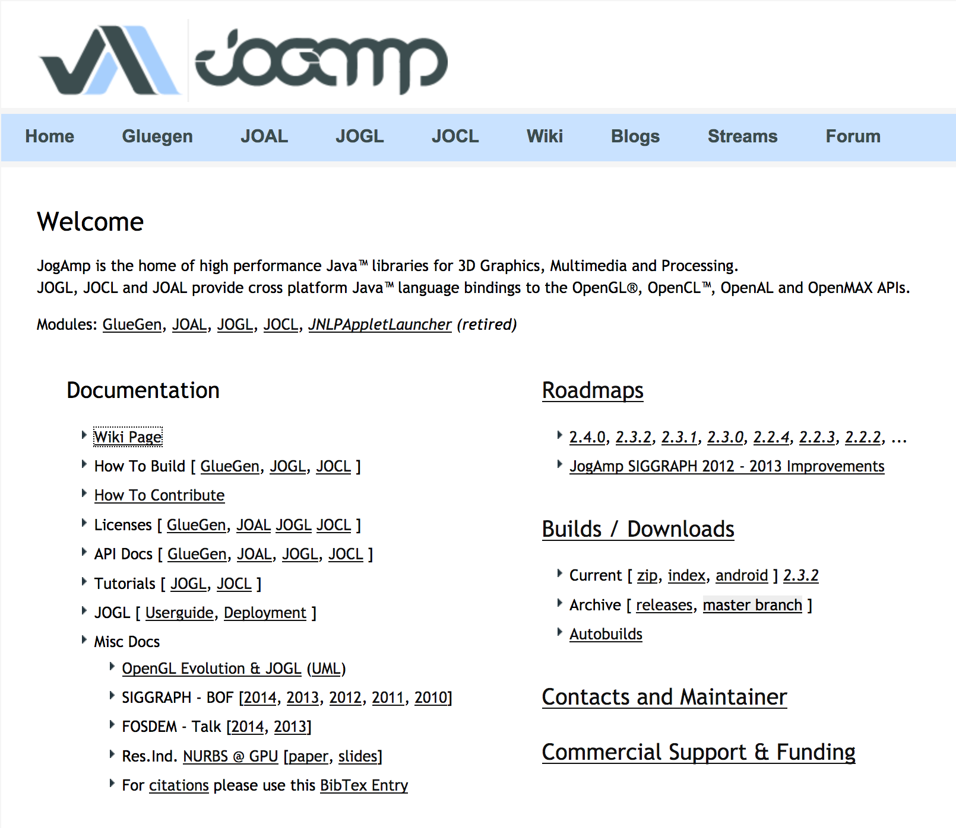
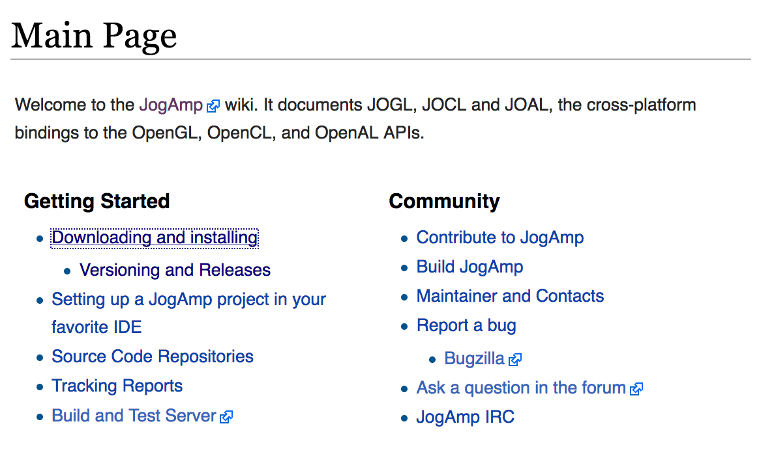
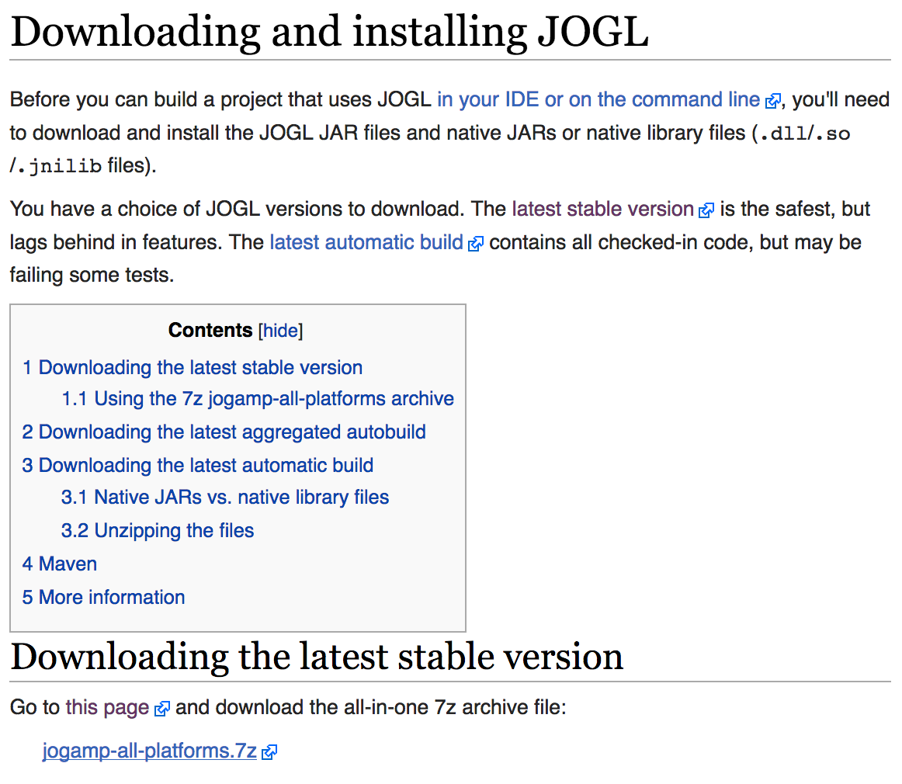
2. Download Java3D
JSindo uses Java3D for visualization. A stable version, 1.6.0, is available from JogAmp. Goto http://jogamp.org
click here
click here
click here and download
jogamp-all-platforms.7z

Slide 4
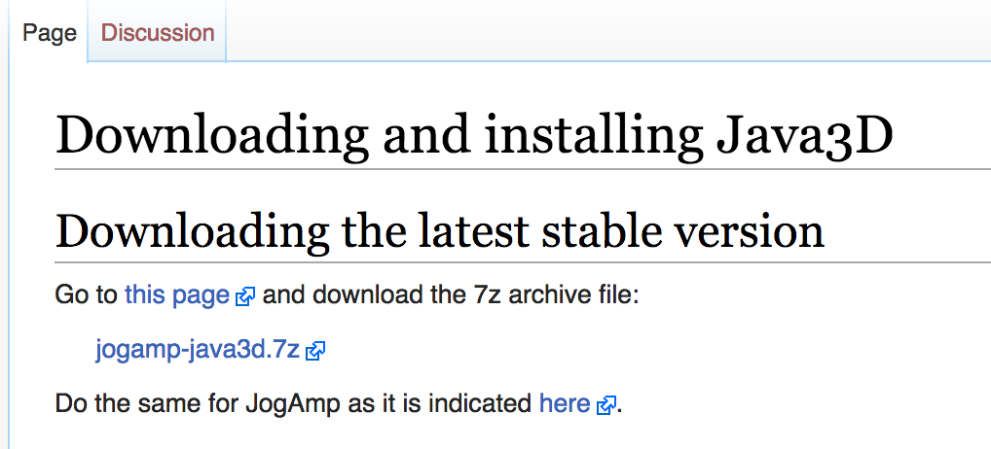
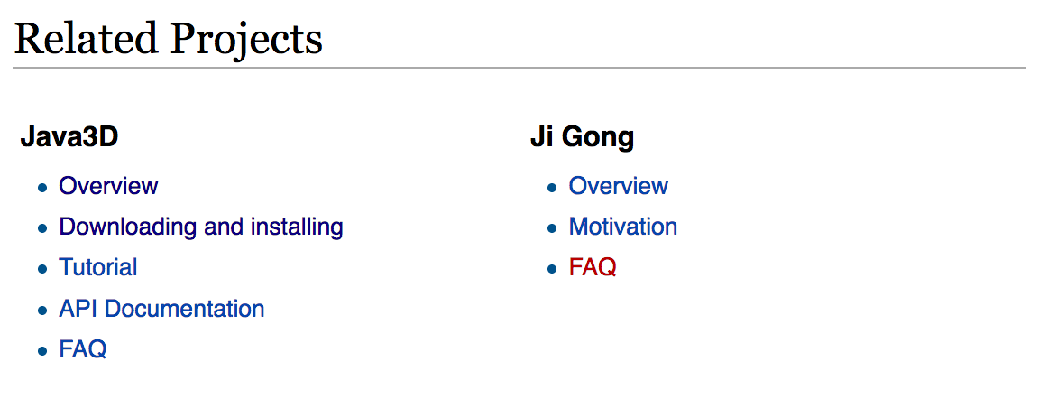

Go back to the Main page and scroll down
…
Scroll down
click here and download
jogamp-java3d.7z
click here
Unarchive the two files you’ve just downloaded. 7z files can be unarchived using, for example, “The Unarchiver”,
The Unarchiver
MacPaw Inc.

Slide 5
You will find jar files in jogamp-all-platforms/jar and in jogamp-java3d. The following jar files are needed for JSindo:
jogamp-all-platforms/jar/
gluegen-rt.jar
gluegen.jar
gluegen-rt-natives-macosx-universal.jar
jogl-all.jar
jogl-all-natives-macosx-universal.jar
jogamp-java3d/
j3dcore.jar
j3dutils.jar
vecmath.jar

Slide 6
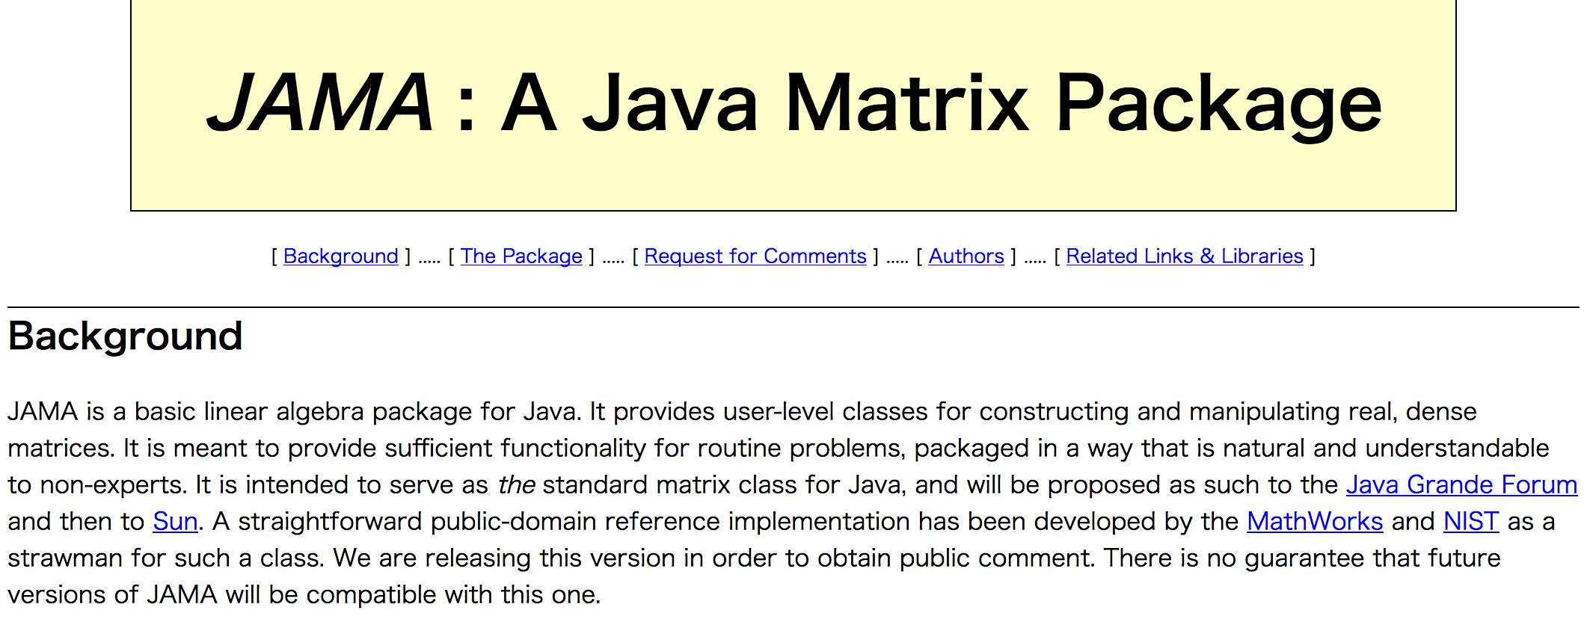
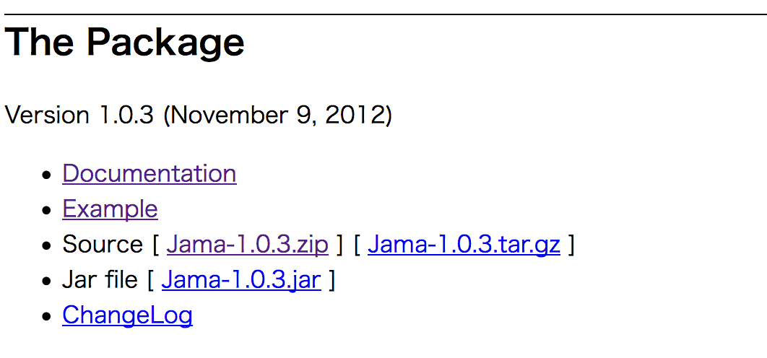
3. Download JAMA
JAMA is a linear algebra library for JAVA. We use it for matrix maltiplications, diagonalization, and so on. It can be downloaded from,
https://math.nist.gov/javanumerics/jama/
…
Scroll down
click here and download a jarfile.

Slide 7
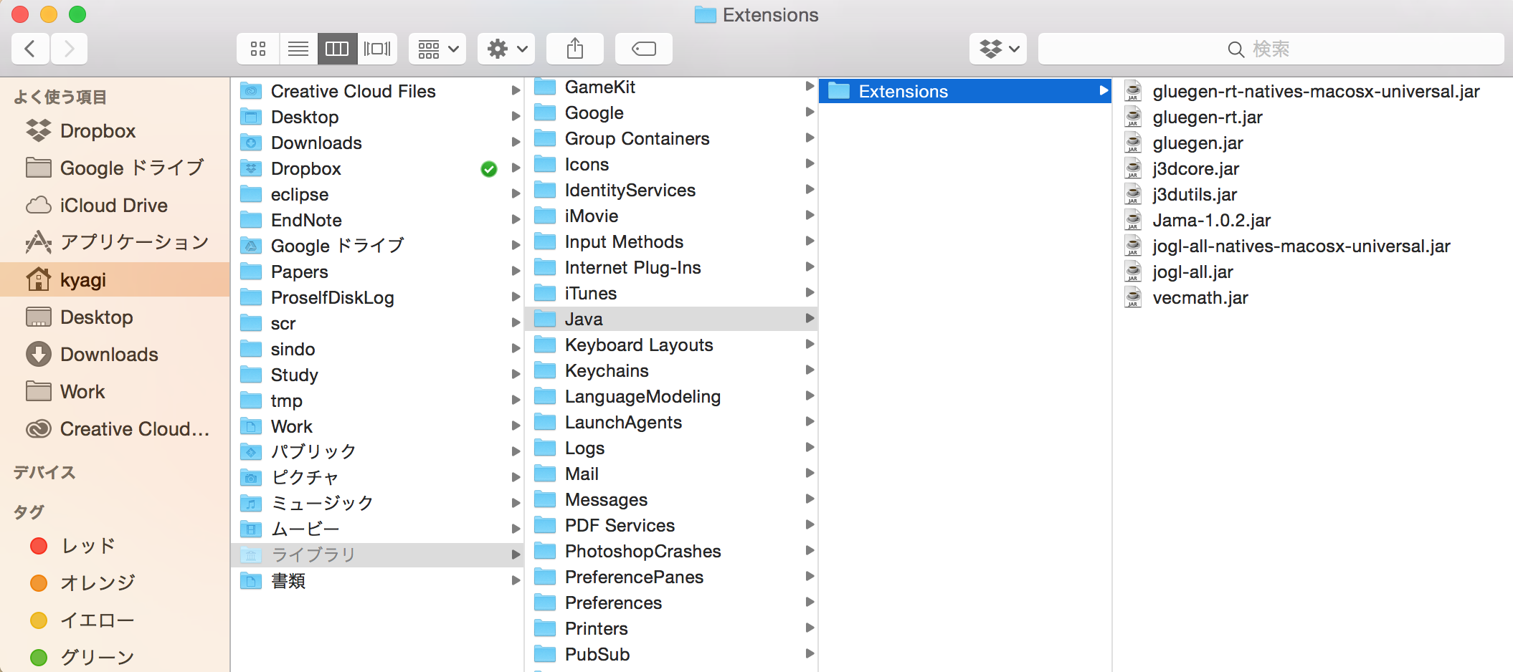
4. Install jar files
The easiest way of install is to copy the jar files to an extension folder, which is set to ~/Library/Java/Extensions. Click Go menu of finder with opion key pressed (~/Library is hidden) and choose Library. Create the folder if you don‘t have it yet, then copy the jar files in this folder.
Library

Slide 8
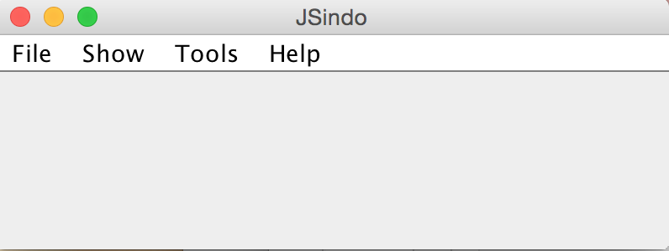
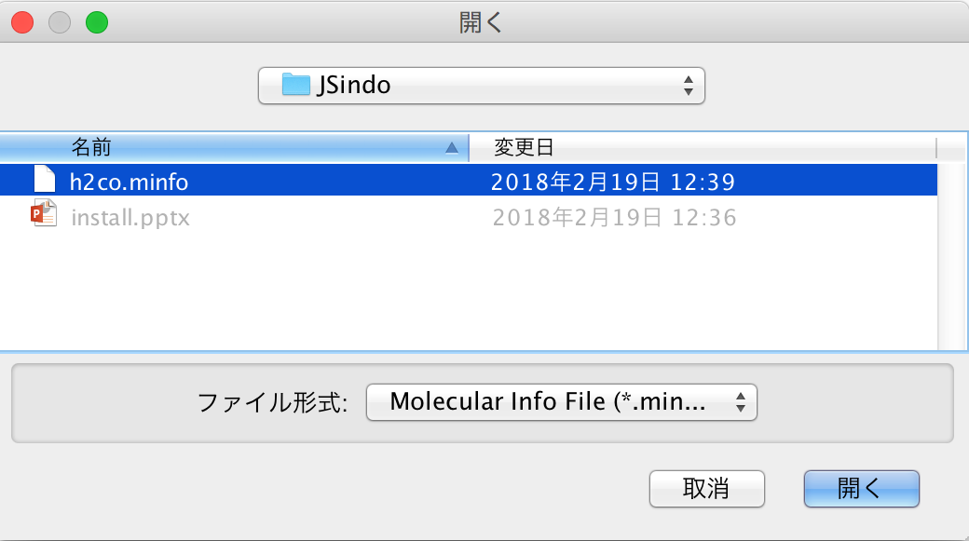
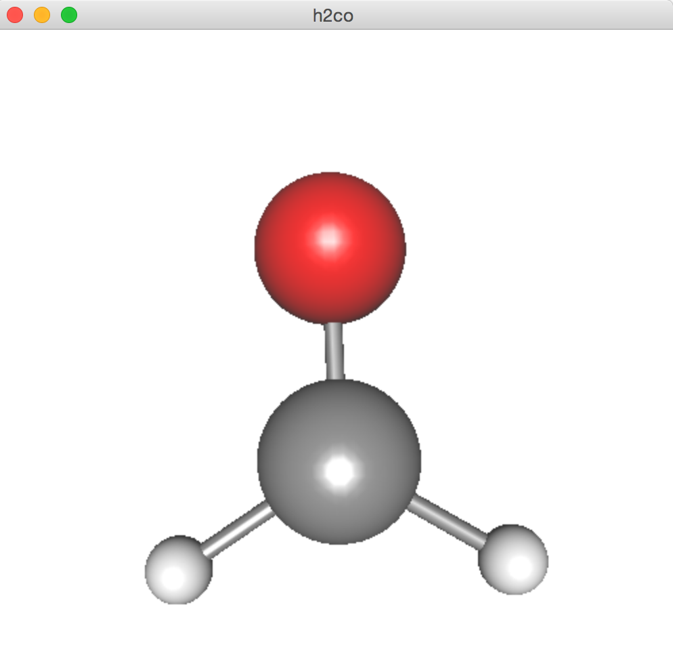
5. Test JSindo
Now, double click JSindo-4.0.jar. You should see a control panel of JSindo.
If you don’t see the panel, review the installation of Java.
Let’s open “sample/h2co.minfo”, which comes with this document. It contains data of formaldehyde.
Click, File -> Open, choose “h2co.minfo”, and click Open. If you see formaldehyde, you’re done with the first step!
If this step fails, it is highly likely that Java3D has a problem. Double check if the jarfiles are copied to the right extension folder or set to CLASSPATH.
Open
click to choose

Slide 9
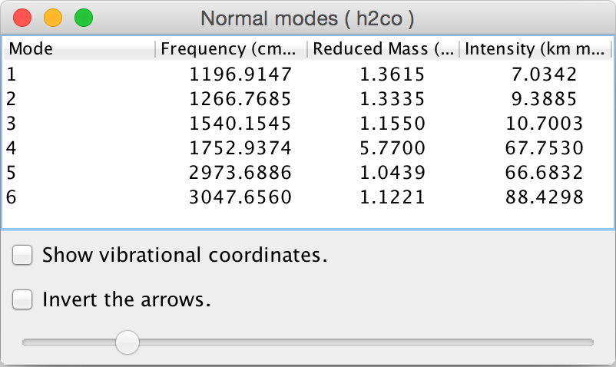
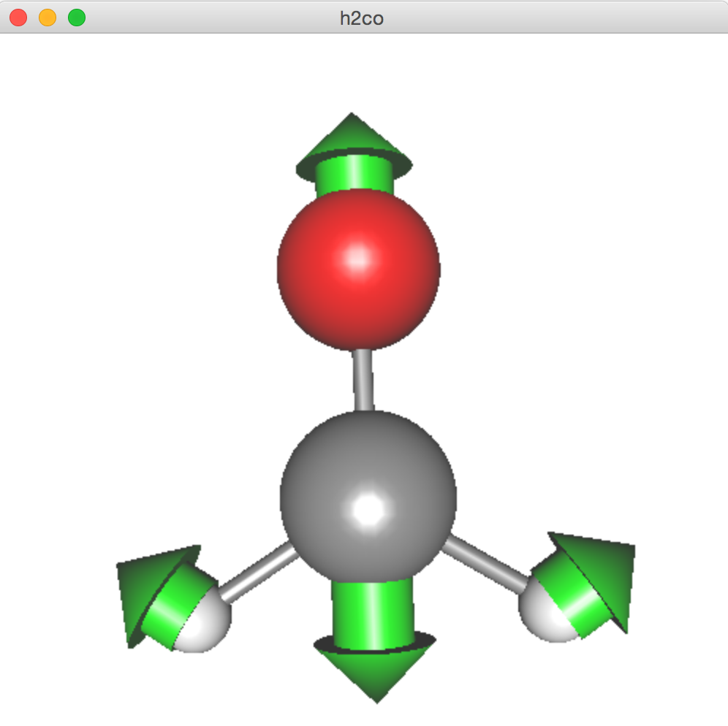
Finally, goto Tools -> Harmonic Analysis. This should create a panel of “Normal modes”.
If you don’t see this panel, JAMA isn’t working. Check if the jarfile of JAMA is set correctly.
If the panel appears, you’re all set! Congradulations!
Check on ”show vibrational coordinates”, and choose a mode you want to see. Vibrational motion will be indicated by arrows. You can “Invert the arrows” by a check box, and change the magnitude using a slider.
Thanks for using JSindo!
Enjoy!
Harmonic Analysis

