Slide 1
How to Install JSindo
Kiyoshi Yagi
kiyoshi.yagi@riken.jp
Theoretical Molecular Science Laboratory
RIKEN Pioneering Research Cluster
2018/04/19

Slide 2
Windows

Slide 3


1. Install Java
Install Java of Oracle (left), Open JDK (right), or any other.
https://www.java.com/en/
http://openjdk.java.net/
Click here and follow the instructions.
Note: Although Java 9 and 10 have been released since 2017/09 and 2018/03, respectively, Java 8 (1.8.x) is still recommended for JSindo, because it uses Java3D which may or may not be compatible with the newer Java.

Slide 4
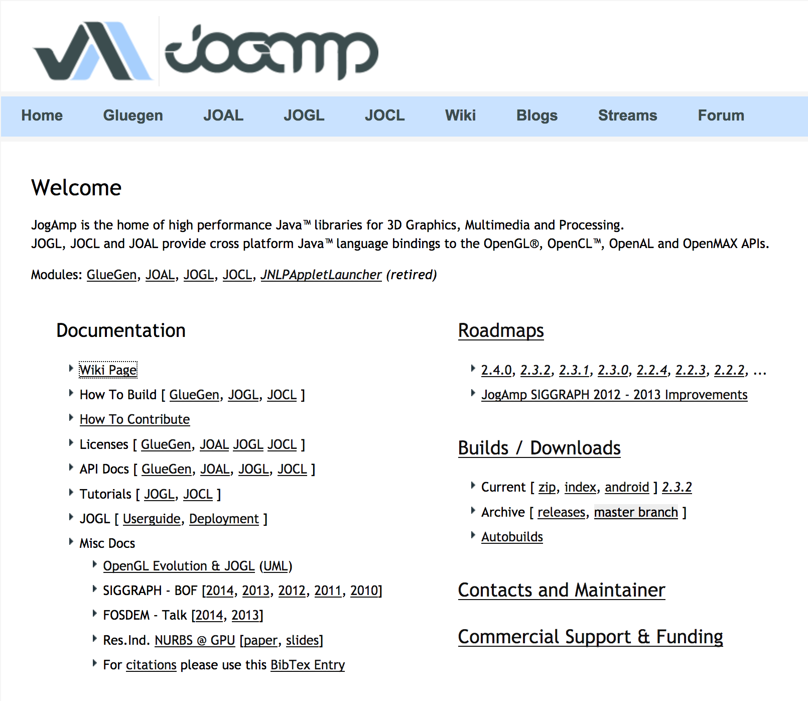
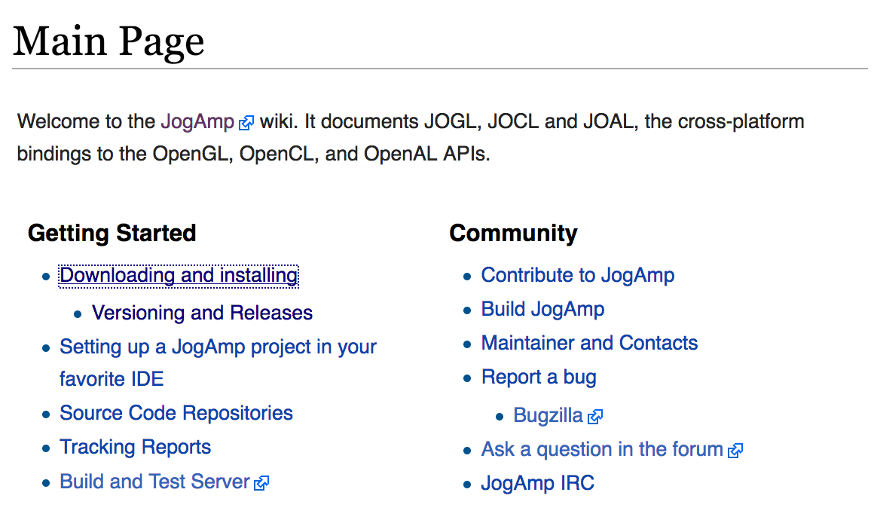
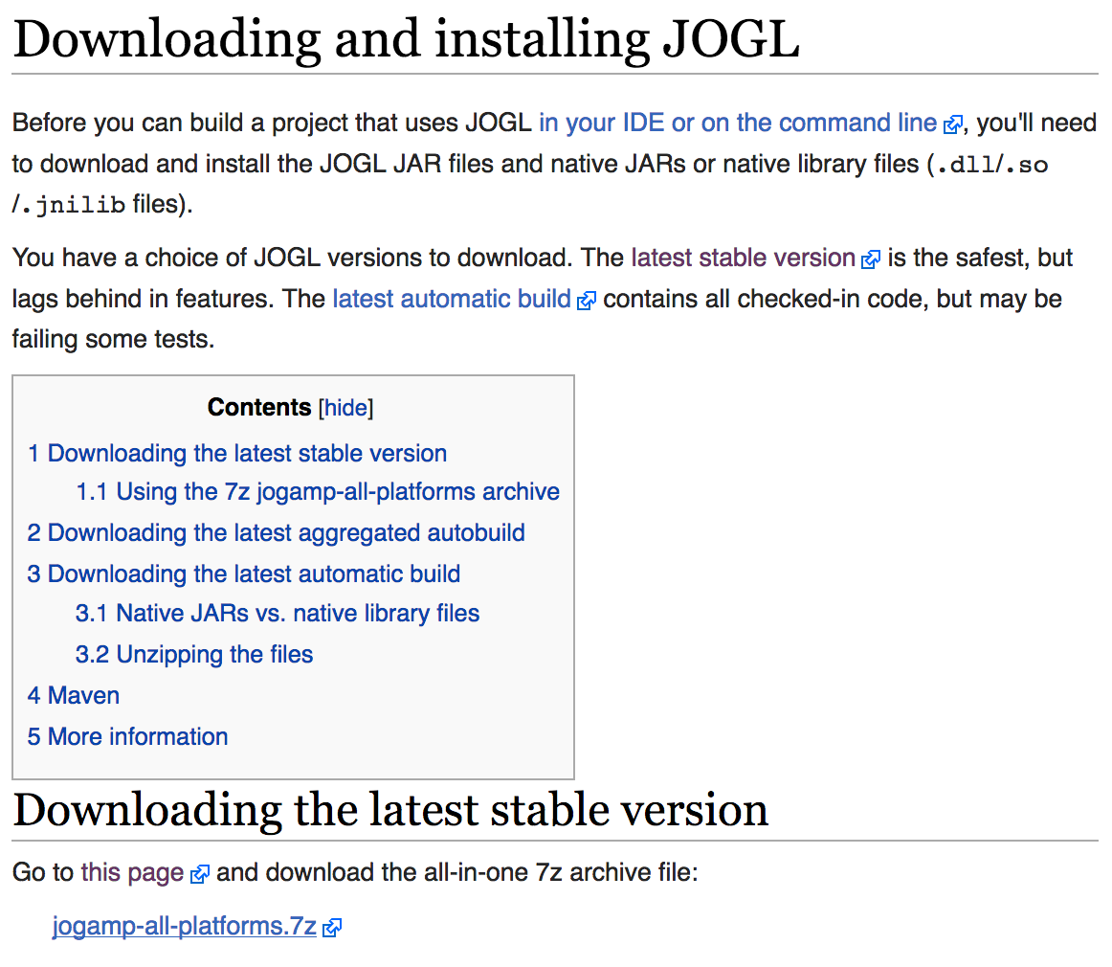
2. Download Java3D
JSindo uses Java3D for visualization. A stable version, 1.6.0, is available from JogAmp. Goto http://jogamp.org
click here
click here
click here and download
jogamp-all-platforms.7z

Slide 5
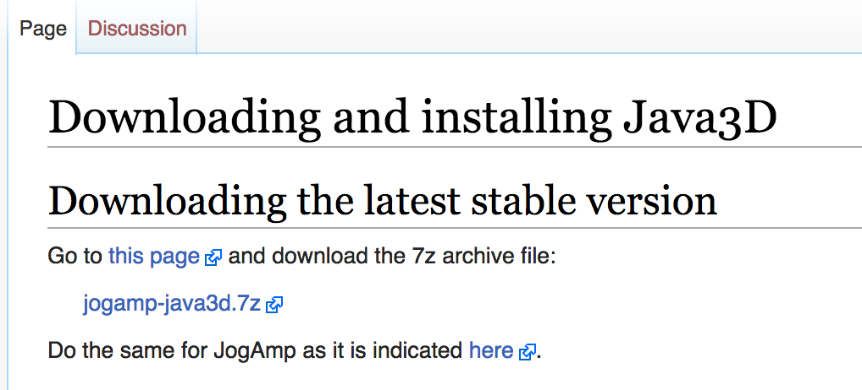
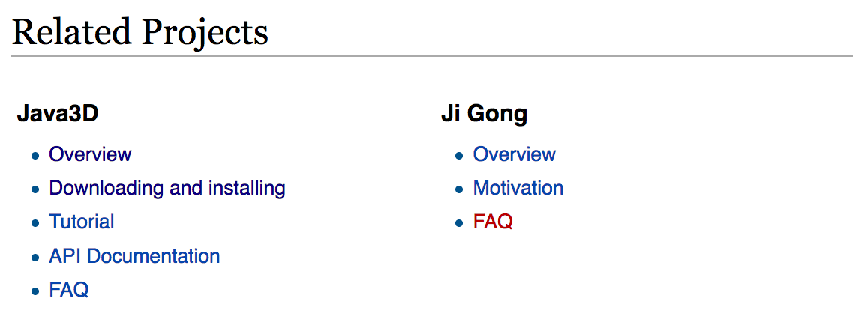
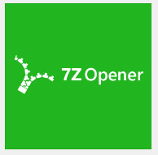
Go back to the Main page and scroll down
…
Scroll down
click here and download
jogamp-java3d.7z
click here
Unarchive the two files you’ve just downloaded. 7z files can be unarchived using, for example, “7Z Opener”
7Z Opener
Tiny Opener

Slide 6
You will find jar files in jogamp-all-platforms/jar and in jogamp-java3d. The following jar files are needed for JSindo:
jogamp-all-platforms/jar/
gluegen-rt.jar
gluegen.jar
gluegen-rt-natives-windows-XXX.jar
jogl-all.jar
jogl-all-natives-windows-XXX.jar
jogamp-java3d/
j3dcore.jar
j3dutils.jar
vecmath.jar
where XXX = amd64 or i586 for 64 or 32-bit, respectively.

Slide 7
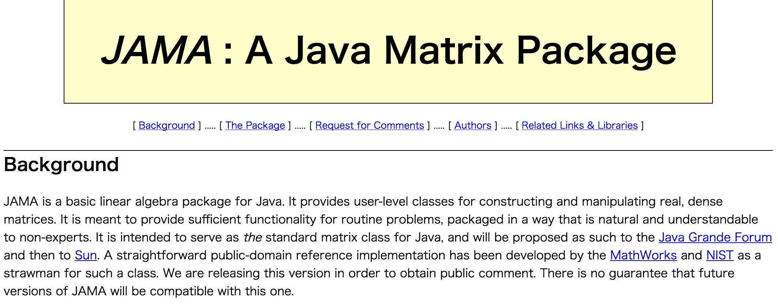
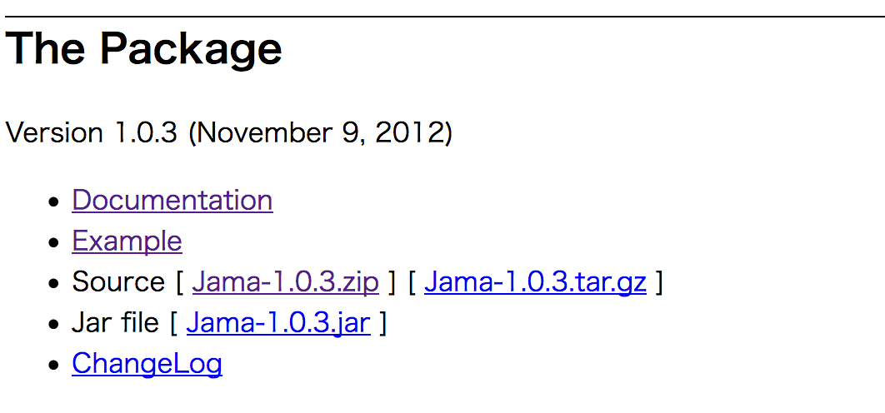
3. Download JAMA
JAMA is a linear algebra library for JAVA. We use it for matrix maltiplications, diagonalization, and so on. It can be downloaded from,
https://math.nist.gov/javanumerics/jama/
…
Scroll down
click here and download a jarfile.

Slide 8
4. Install jar files
Let’s first check if your Java is 32- or 64-bit. In the DOS prompt, type “java -version” and you will see a message like this:
This is an example of 64-bit. If “64-Bit” is absent, then it’s 32-bit. (It doesn’t explicitly state “32-Bit”, unfortunately.)
Now, we will copy the jar files to an extension folder, which are located in
32-bit c:\Program Files(x86)\Java\jre1.x.x_xxx\lib\ext
64-bit c:\Program Files\Java\jre1.x.x_xxx\lib\ext
Copy the following jar files in this folder,
>java –version
java version "1.8.0_45”
Java(TM) SE Runtime Environment (build 1.8.0_45-b14)
Java HotSpot(TM) 64-Bit Server VM (build 25.45-b02, mixed mode)
gluegen-rt.jar
gluegen.jar
gluegen-rt-natives-windows-xxx.jar
jogl-all.jar
jogl-all-natives-windows-xxx.jar
j3dcore.jar
j3dutils.jar
vecmath.jar
Jama-1.0.3.jar
where XXX = amd64 (64-bit) or i586 (32-bit).

Slide 9
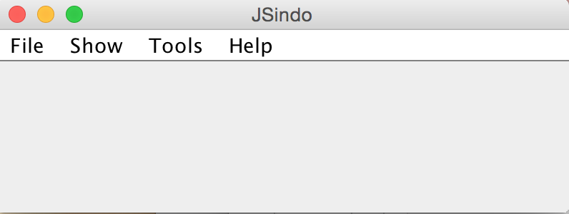
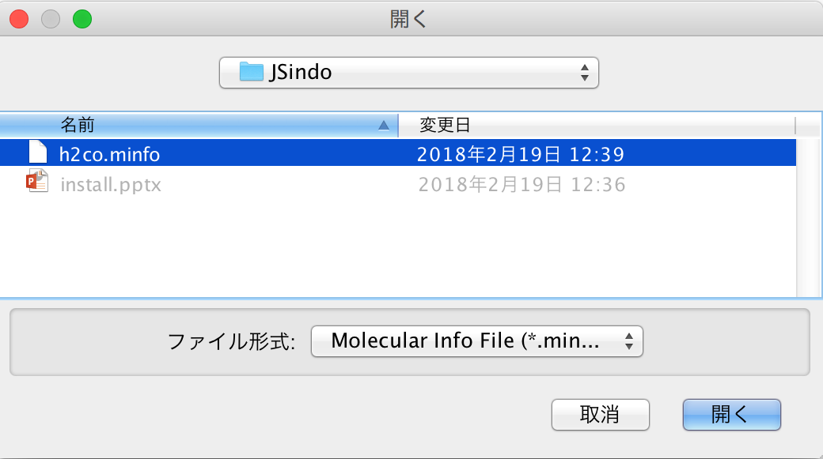
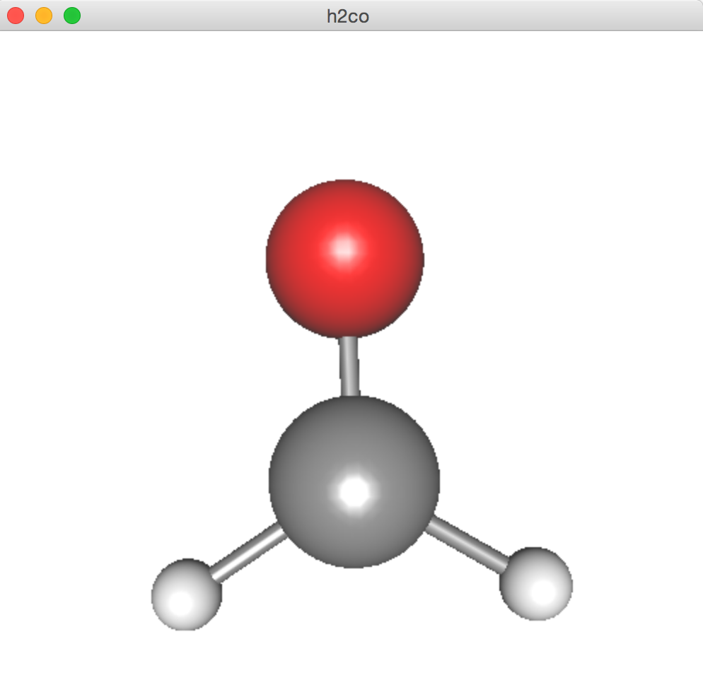
5. Test JSindo
Now, double click JSindo-4.0.jar. You should see a control panel of JSindo.
If you don’t see the panel, review the installation of Java.
Let’s open “sample/h2co.minfo”, which comes with this document. It contains data of formaldehyde.
Click, File -> Open, choose “h2co.minfo”, and click Open. If you see formaldehyde, you’re done with the first step!
If this step fails, it is highly likely that Java3D has a problem. Double check if the jarfiles are copied to the right extension folder.
Open
click to choose

Slide 10
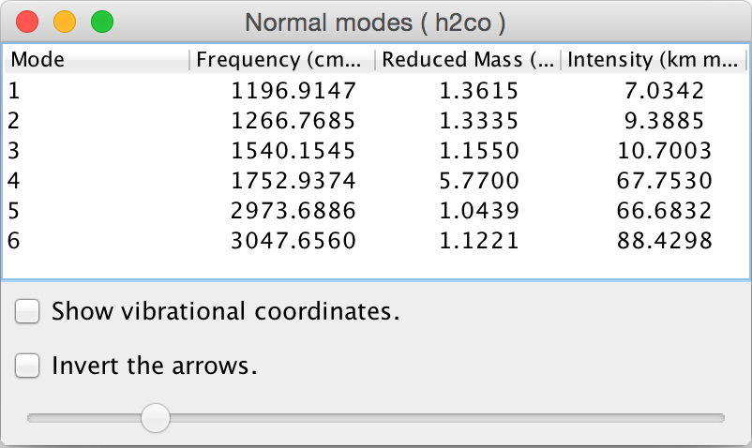
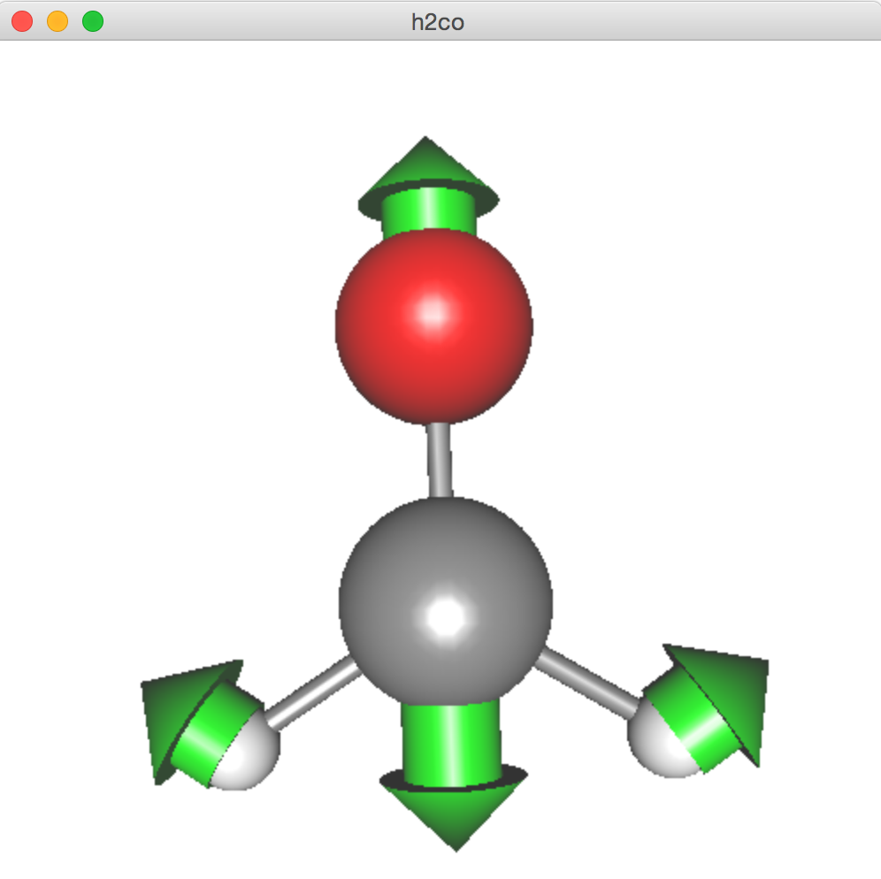
Finally, goto Tools -> Harmonic Analysis. This should create a panel of “Normal modes”.
If you don’t see this panel, JAMA isn’t working. Make sure the jarfile of JAMA is copied to the right extension folder.
If the panel appears, you’re all set! Congradulations!
Check on ”show vibrational coordinates”, and choose a mode you want to see. Vibrational motion will be indicated by arrows. You can “Invert the arrows” by a check box, and change the magnitude using a slider.
Thanks for using JSindo!
Enjoy!
Harmonic Analysis

Slide 11
Mac

Slide 12
1. Install Java
Install Java of Oracle (left), Open JDK (right), or any other.
https://www.java.com/en/
http://openjdk.java.net/
Click here and follow the instructions.
Note: Although Java 9 and 10 have been released since 2017/09 and 2018/03, respectively, Java 8 (1.8.x) is still recommended for JSindo, because it uses Java3D which may or may not be compatible with the newer Java.

Slide 13
2. Download Java3D
JSindo uses Java3D for visualization. A stable version, 1.6.0, is available from JogAmp. Goto http://jogamp.org
click here
click here
click here and download
jogamp-all-platforms.7z

Slide 14

Go back to the Main page and scroll down
…
Scroll down
click here and download
jogamp-java3d.7z
click here
Unarchive the two files you’ve just downloaded. 7z files can be unarchived using, for example, “The Unarchiver”,
The Unarchiver
MacPaw Inc.

Slide 15
You will find jar files in jogamp-all-platforms/jar and in jogamp-java3d. The following jar files are needed for JSindo:
jogamp-all-platforms/jar/
gluegen-rt.jar
gluegen.jar
gluegen-rt-natives-macosx-universal.jar
jogl-all.jar
jogl-all-natives-macosx-universal.jar
jogamp-java3d/
j3dcore.jar
j3dutils.jar
vecmath.jar

Slide 16
3. Download JAMA
JAMA is a linear algebra library for JAVA. We use it for matrix maltiplications, diagonalization, and so on. It can be downloaded from,
https://math.nist.gov/javanumerics/jama/
…
Scroll down
click here and download a jarfile.

Slide 17
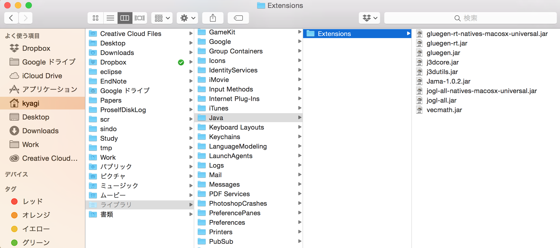
4. Install jar files
The easiest way of install is to copy the jar files to an extension folder, which is set to ~/Library/Java/Extensions. Click Go menu of finder with opion key pressed (~/Library is hidden) and choose Library. Create the folder if you don‘t have it yet, then copy the jar files in this folder.
Library

Slide 18
5. Test JSindo
Now, double click JSindo-4.0.jar. You should see a control panel of JSindo.
If you don’t see the panel, review the installation of Java.
Let’s open “sample/h2co.minfo”, which comes with this document. It contains data of formaldehyde.
Click, File -> Open, choose “h2co.minfo”, and click Open. If you see formaldehyde, you’re done with the first step!
If this step fails, it is highly likely that Java3D has a problem. Double check if the jarfiles are copied to the right extension folder or set to CLASSPATH.
Open
click to choose

Slide 19
Finally, goto Tools -> Harmonic Analysis. This should create a panel of “Normal modes”.
If you don’t see this panel, JAMA isn’t working. Check if the jarfile of JAMA is set correctly.
If the panel appears, you’re all set! Congradulations!
Check on ”show vibrational coordinates”, and choose a mode you want to see. Vibrational motion will be indicated by arrows. You can “Invert the arrows” by a check box, and change the magnitude using a slider.
Thanks for using JSindo!
Enjoy!
Harmonic Analysis

Slide 20
Linux

Slide 21
1. Install Java
Install Java of Oracle (left), Open JDK (right), or any other.
https://www.java.com/en/
http://openjdk.java.net/
Click here and follow the instructions.
Note: Although Java 9 and 10 have been released since 2017/09 and 2018/03, respectively, Java 8 (1.8.x) is still recommended for JSindo, because it uses Java3D which may or may not be compatible with the newer Java.

Slide 22
2. Download Java3D
JSindo uses Java3D for visualization. A stable version, 1.6.0, is available from JogAmp. Goto http://jogamp.org
click here
click here
click here and download
jogamp-all-platforms.7z

Slide 23
Go back to the Main page and scroll down
…
Scroll down
click here and download
jogamp-java3d.7z
click here
Unarchive the two files you’ve just downloaded. 7z files can be unarchived by,
> 7za e jogamp-all-platforms.7z
> 7za e jogamp-java3d.7z
If you don’t have the command, install p7zip package,
> yum install p7zip
(Fedora)
> sudo apt-get install p7zip
(Debian and Ubuntu)

Slide 24
You will find jar files in jogamp-all-platforms/jar and in jogamp-java3d. The following jar files are needed for JSindo:
jogamp-all-platforms/jar/
gluegen-rt.jar
gluegen.jar
gluegen-rt-natives-linux-XXX.jar
jogl-all.jar
jogl-all-natives-linux-XXX.jar
jogamp-java3d/
j3dcore.jar
j3dutils.jar
vecmath.jar
where XXX = amd64 or i586 for 64 or 32-bit, respectively.
(* XXX = armv6 and armv6hf are for ARM cpus, which are used for phones.)

Slide 25
3. Download JAMA
JAMA is a linear algebra library for JAVA. We use it for matrix maltiplications, diagonalization, and so on. It can be downloaded from,
https://math.nist.gov/javanumerics/jama/
…
Scroll down
click here and download a jarfile.

Slide 26
4. Setup the jar files
Let’s first check if your Java is 32- or 64-bit. In the terminal, type “java -version” and you will see a message like this:
This is an example of 64-bit. If “64-Bit” is absent, then it’s 32-bit.
Now, we add the jar files to an environment variable CLASSPATH. If you are in bash,
where xxx = amd64 or i586 for 64-bit or 32-bit, respectively. You may want to add these lines in your ~/.bashrc, so that they take effect upon login.
>java –version
openjdk version "1.8.0_121”
OpenJDK Runtime Environment (build 1.8.0_121-b13)
OpenJDK 64-Bit Server VM (build 25.121-b13, mixed mode)
JOGAMP_JAR=${HOME}/lib/jogamp-all-platforms/jar
export CLASSPATH=${CLASSPATH}:${JOGAMP_JAR}/gluegen.jar
export CLASSPATH=${CLASSPATH}:${JOGAMP_JAR}/gluegen-rt.jar
export CLASSPATH=${CLASSPATH}:${JOGAMP_JAR}/jogl-all.jar
export CLASSPATH=${CLASSPATH}:${JOGAMP_JAR}/gluegen-rt-natives-linux-xxx.jar
export CLASSPATH=${CLASSPATH}:${JOGAMP_JAR}/jogl-all-natives-linux-xxx.jar
J3D_JAR=${HOME}/lib/jogamp-java3d
export CLASSPATH=${CLASSPATH}:${J3D_JAR}/j3dcore.jar
export CLASSPATH=${CLASSPATH}:${J3D_JAR}/j3dutils.jar
export CLASSPATH=${CLASSPATH}:${J3D_JAR}/vecmath.jar
export CLASSPATH=${CLASSPATH}:${HOME}/lib/jama/Jama-1.0.3.jar

Slide 27
5. Test JSindo
Use the following command:
I cannot or don’t want to copy jarfiles into an extension folder.
Specify all jarfiles using “:” as a separator,
Is there an alternative to “-cp”? The command is too long.
The environment variable, CLASSPATH, does the same thing. Set CLASSPATH for all jarfiles,
Then, you can start simply by,
I save the setting to ~/.bashrc, so that the CLASSPATH is configured upon login.
>java –cp JSindo-4.0_xxxxxx.jar:Jama-1.0.3.jar:... JSindo
> export CLASSPATH=${CLASSPATH}:/path/to/JSindo-4.0_xxxxxx.jar
> export CLASSPATH=${CLASSPATH}:/path/to/Jama-1.0.3.jar
...
> java JSindo

Slide 28
5. Test JSindo
Type the following command to invoke JSindo:
>java –cp /path/to/JSindo-4.0.jar JSindo
Alternately, you may add in your ~/.bashrc as before,
> export CLASSPATH=${CLASSPATH}:/path/to/JSindo-4.0.jar
Then, you can simply start by,
> java JSindo
With this command, you should see a control panel of JSindo.
If you don’t see the panel, review the installation of Java.

Slide 29
Open
Let’s open “sample/h2co.minfo”, which comes with this document. It contains data of formaldehyde.
Click, File -> Open, choose “h2co.minfo”, and click Open. If you see formaldehyde, you’re done with the first step!
If this step fails, it is highly likely that Java3D has a problem. Double check if the jarfiles are set correctly, that is, if the right files are set to CLASSPATH.
click to choose

Slide 30
Finally, goto Tools -> Harmonic Analysis. This should create a panel of “Normal modes”.
If you don’t see this panel, JAMA isn’t working. Check if the jarfile of JAMA is set correctly.
If the panel appears, you’re all set! Congradulations!
Check on ”show vibrational coordinates”, and choose a mode you want to see. Vibrational motion will be indicated by arrows. You can “Invert the arrows” by a check box, and change the magnitude using a slider.
Thanks for using JSindo!
Enjoy!
Harmonic Analysis

Slide 31
FAQ
Fonts and Icons are too tiny.
Although we are aware of this problem that most likely happens in Win 10 (and perhaps Linux) with a high DPI diplay, we don’t know the solution at this moment. This seems to be a general issue of Java/Swing applications, which some people says it is fixed in JRE9. However, JRE9 is reported to be incompatible with JogAmp/Java3D.
Your feedback on this issue is greatly appreciated!

Slide 33
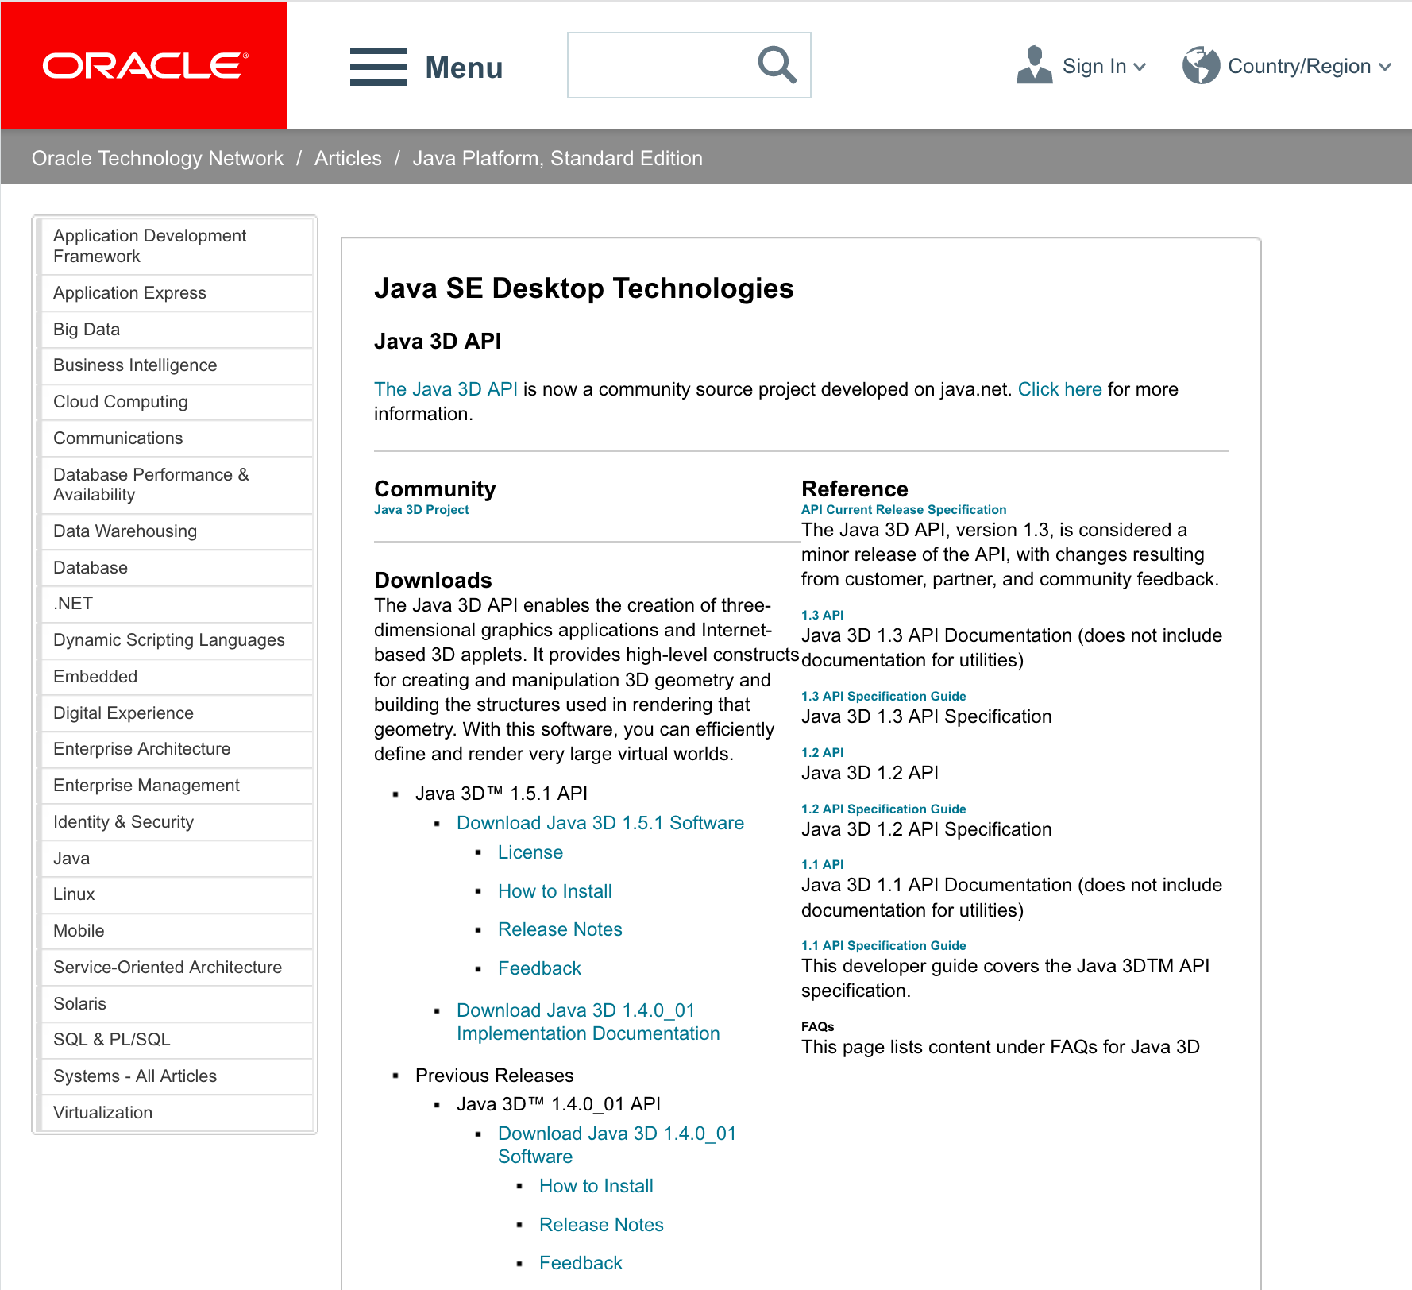
ORACLE Java3D (1.5.1)
Search for “java3d” in the web to find Java3D API of ORACLE,
http://www.oracle.com/technetwork/articles/javase/index-jsp-138252.html
click here

Slide 34
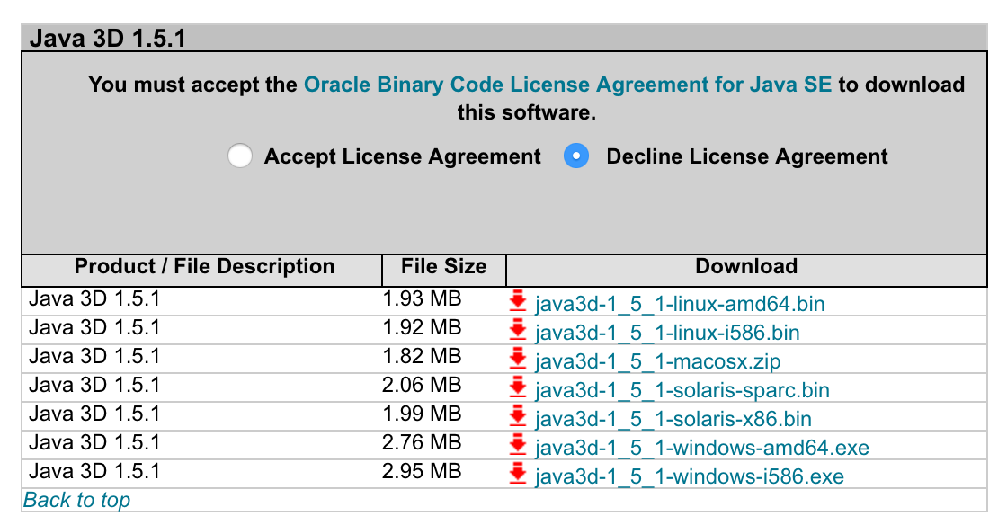
Now, download the installer,
click accept
Click here to download
amd64 for 64-bit.
i586 for 32-bit (x86).
Double click the installer and follow the instruction. The installer creats a new folder, Java3D, in a Java folder,
32-bit c:\Program Files(x86)\Java\Java3D
64-bit c:\Program Files\Java\Java3D
In this folder, you will find three jarfiles,
Java3D\1.5.1\lib\ext\
j3dcore.jar
j3dutil.jar
vecmath.jar
Copy these three jarfiles to an extension folder of JRE,
Java\jre1.x.x_xxx\lib\ext

Slide 35
OS | Java | Java3D | Result | Note
MacOSX (Yosemite) 10.10.5 | Oracle 1.8.0_45 64-bit | Oracle 1.5.1_macosx | NO | yagi mac
MacOSX (Yosemite) 10.10.5 | Oracle 1.8.0_45 64-bit | JogAmp2.3.2 1.6.0-pre12 | OK | yagi mac
MacOSX (El Capitan) 10.11.6 | Oracle 1.8.0_40 64-bit | JogAmp2.3.2 1.6.0-pre12 | OK | yamada mac
Windows10 Pro | Oracle 1.8.0_161 32-bit | Oracle 1.5.1 (i586) | OK | yagi PC vaio
Windows10 Pro | Oracle 1.8.0_161 32-bit | JogAmp2.3.2 1.6.0-pre12 (i586) | OK | yagi PC vaio

Slide 36
OS | Java | Java3D | Result | Note
CentOS 6.7 | OpenJDK 1.7.0_91 64-bit | Oracle 1.5.1(amd64) | NO | beluga
CentOS 6.7 | OpenJDK 1.7.0_91 64-bit | JogAmp2.3.2 1.6.0-pre12 (amd64) | NO | beluga
CentOS 7.3.1611 | OpenJDK 1.8.0_121 64-bit | Oracle 1.5.1(amd64) | NO | angler
CentOS 7.3.1611 | OpenJDK 1.8.0_121 64-bit | JogAmp2.3.2 1.6.0-pre12 (amd64) | NO | angler
Linuxサーバは、以下のエラー。ドライバーが足りないか、競合してる？あるいは、XQuartz越しがダメ？
libGL error: No matching fbConfigs or visuals found
libGL error: failed to load driver: swrast

