Slide 1
Tutorial of Sindo
Kiyoshi Yagi
kiyoshi.yagi@riken.jp
Theoretical Molecular Science Laboratory
RIKEN Pioneering Research Cluster
2018/10/14

Slide 2
Contents of Tutorial Files
1.water/
0.eq/ Opt&Freq by Gaussian
1.grid/ Grid PES generation
2.vib/ VSCF, VCI[3]-(8), VMP2-(4), VQDPT2-(4)
2.ethylene/
0.eq/ Opt&Freq by Gaussian
1.mkqff/ QFF generation
2.mrpes/ Mutiresolution PES
3.vib/ VCI[3]-(6), VMP2-(4), VQDPT2-(4)
3.water-hexamer/
0.eq/ Opt&Freq by Gaussian
1.mkqff/ QFF generation
2.ocvscf/ oc-VSCF
3.vib/ nc-VCI[3]-(6), oc-VCI[3]-(6)
nc-VQDPT2-(4), oc-VQDPT2-(4)

Slide 3
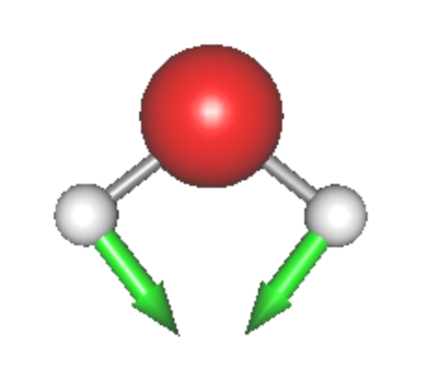
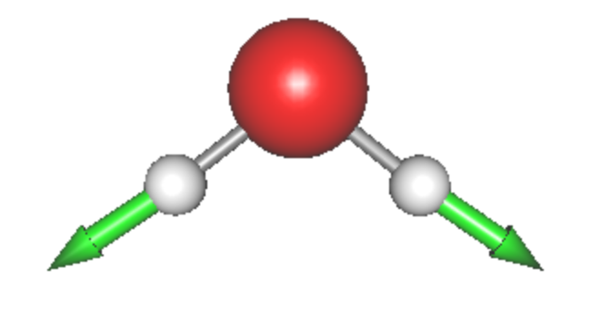

1. water
0.eq: Geometry opt. and Harmonic analysis using Gaussian
Input file : h2o.com
Output files : h2o.out, h2o.chk
h2o.chk → h2o.fchk → h2o.minfo
formchk
JSindo
Q1
HOH bending
Q2
Sym. OH stretching
Q3
Asym. OH stretching

Slide 4
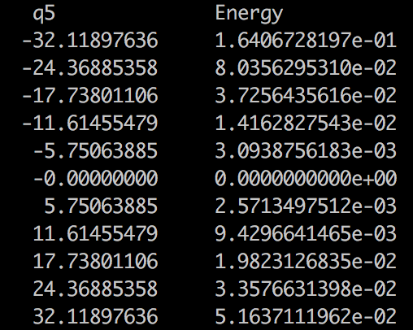
1.grid: Generation of 3MR-Grid PES
Energies on grid points are written in pot files. (log/*.pot)
eq.: q0.pot
1MR: q1.pot, q2.pot, q3.pot
2MR: q2q1.pot, q3q1.pot, q3q2.pot
3MR: q3q2q1.pot
V₅ / Hartree
Q₅ / bohr (emu)^{1/2}

Slide 5
2.vib: Vibrational calculations
Input file for VSCF calc. (vscf.inp)
#--- [ INPUT PARAMETER ]
&mol minfofile='h2o.minfo' /
&sys maxmem=10 /
#--- [ VIB ]
&vib MR=3 vmaxAll=10 vscf=.t. /
#--- [ TARGET STATES ]
&states fund=.t. /
#--- [ VSCF ]
&vscf Maxitr=20 Ethresh=1.D-03 /
input minfo file
max memory in MB
MR: Mode coupling order of the PES
vmaxAll: Max num of quanta of HO basis sets for all modes.
vscf = .t. invokes VSCF.
Target states are all fundamental levels.
Maxitr: Max iteration for VSCF
Ethresh: Threshold of convergence in cm⁻¹.
Run SINDO
> sindo < vscf.inp > vscf.out

Slide 6
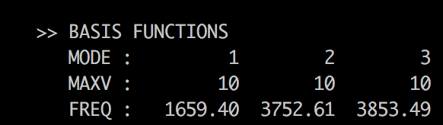
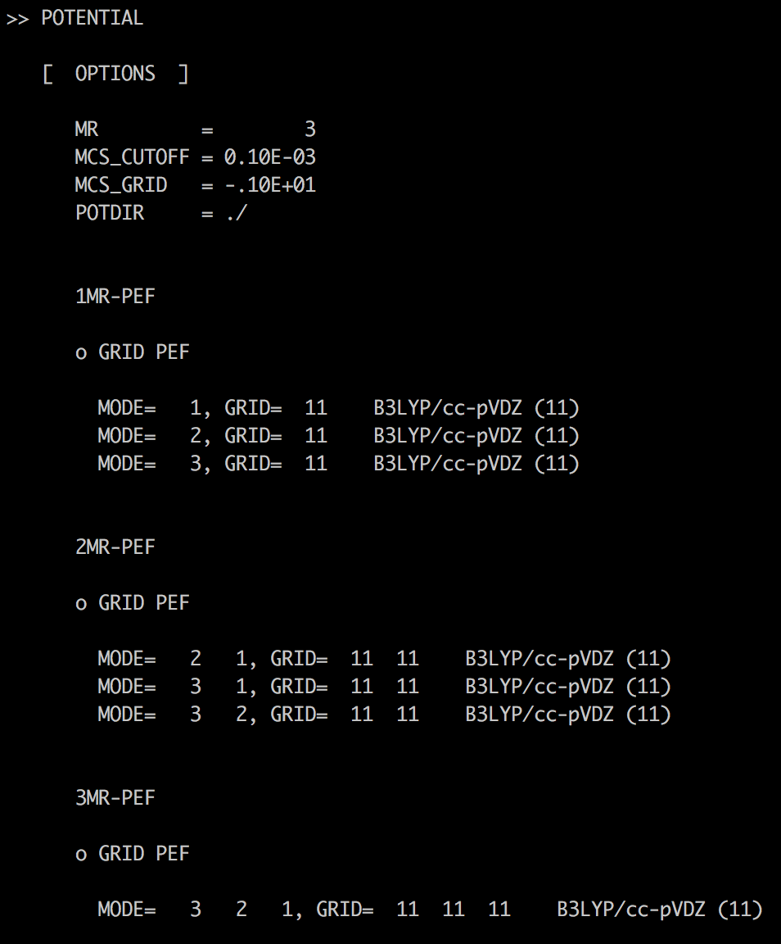
Output file for VSCF calc. (vscf.out)
Setting of HO basis sets. Frequencies are taken from a minfo file.
PES specification
1MR
2MR
3MR

Slide 7
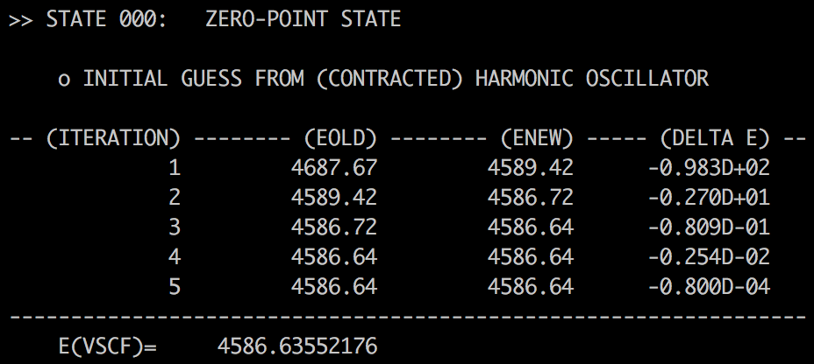
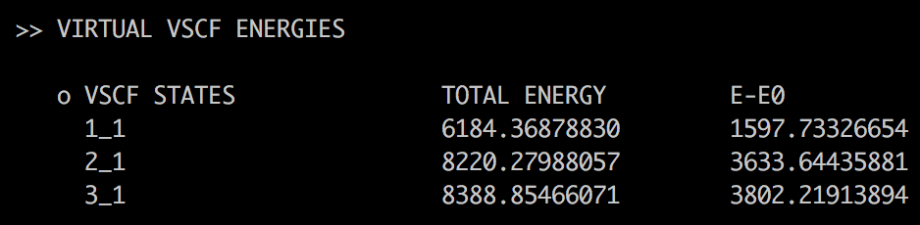
VSCF iteration
VSCF energy for the zero-point.
Virtual VSCF energies for the funamental levels.

