Slide 1
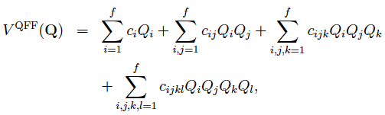
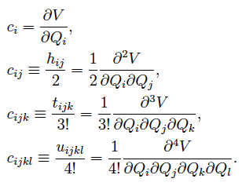




4th-order Taylor Expansion PES
Quartic Force Field (QFF)
(1)
(2)
(3)
(4)
(5)
3rd and 4th-order terms by numerical differentiations
(6)
(7)
(8)
(9)

Slide 2








(10)
(11)
(12)
n-mode represenation (nMR) QFF
(13)
(14)
(15)
(16)
(17)

Slide 3





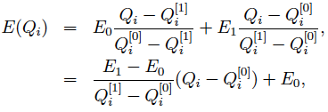
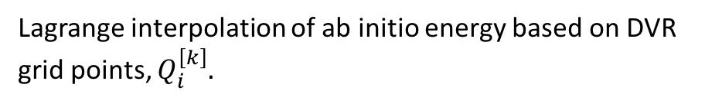
Grid PES
Lagrange interpolation of ab initio energy based on DVR grid points, $Q_{i}^{\left[k\right]}.$
(18)
(19)
(20)
(21)
(22)
(ex.) when M = 1:
(23)

Slide 4

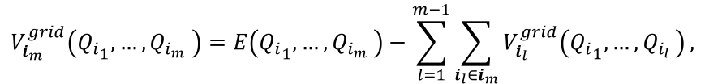
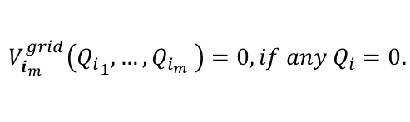
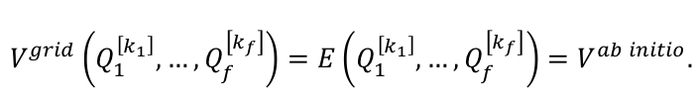
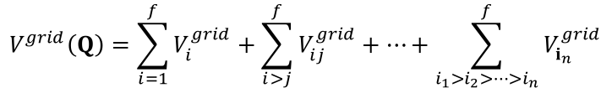
nMR Grid PES
$$V^{grid}\left(Q\right)=\sum_{i=1}^{f}{V_{i}^{grid}}+\sum_{i>j}^{f}{V_{ij}^{grid}}+⋯+\sum_{i_{1}>i_{2}>⋯>i_{n}}^{f}{V_{i_{n}}^{grid}}$$
(24)
$$V_{i}^{grid}\left(Q_{i}\right)=E\left(Q_{i}\right),$$
(25)
$$V_{ij}^{grid}\left(Q_{i},Q_{j}\right)=E\left(Q_{i},Q_{j}\right)−V_{i}^{grid}\left(Q_{i}\right)−V_{j}^{grid}\left(Q_{j}\right),$$
(26)
$$V_{i_{m}}^{grid}\left({Q_{i}}_{1},{…,Q}_{i_{m}}\right)=E\left({Q_{i}}_{1},{…,Q}_{i_{m}}\right)−\sum_{l=1}^{m−1}{\sum_{i_{l}∈i_{m}}{V_{i_{l}}^{grid}\left({Q_{i}}_{1},{…,Q}_{i_{l}}\right)}},$$
(27)
$$V_{i_{m}}^{grid}\left({Q_{i}}_{1},{…,Q}_{i_{m}}\right)=0, if any Q_{i}=0.$$
(28)
$$V^{grid}\left(Q_{1}^{\left[k_{1}\right]},…,Q_{f}^{\left[k_{f}\right]}\right)=E\left(Q_{1}^{\left[k_{1}\right]},…,Q_{f}^{\left[k_{f}\right]}\right)=V^{ab initio}.$$
(29)

Slide 5


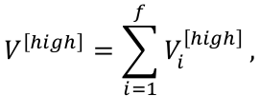
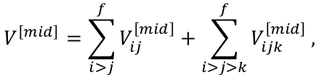
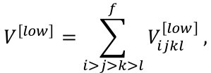

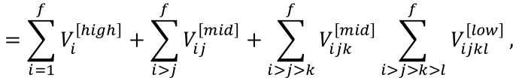
Multiresolution method
[r] : Resolution (QFF/Grid, level of ab initio)
(30)
Multiresolution PES
(31)
(ex.) Divide the resolution by coupling order:
$$V^{\left[high\right]}=\sum_{i=1}^{f}{V_{i}^{\left[high\right]}},$$
(32)
$$V^{\left[mid\right]}=\sum_{i>j}^{f}{V_{ij}^{\left[mid\right]}}+\sum_{i>j>k}^{f}{V_{ijk}^{\left[mid\right]}},$$
(33)
$$V^{\left[low\right]}=\sum_{i>j>k>l}^{f}{V_{ijkl}^{\left[low\right]}},$$
(34)
$$V=V^{\left[high\right]}+V^{\left[mid\right]}+V^{\left[low\right]}$$
$$=\sum_{i=1}^{f}{V_{i}^{\left[high\right]}}+\sum_{i>j}^{f}{V_{ij}^{\left[mid\right]}}+\sum_{i>j>k}^{f}{V_{ijk}^{\left[mid\right]}}\sum_{i>j>k>l}^{f}{V_{ijkl}^{\left[low\right]}},$$
(35)

Slide 6

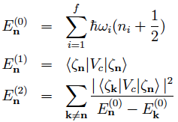


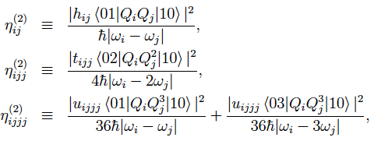
Mode Coupling Strength
(33)
Perturbation theory based on HO
(34)
(35)
(36)
MCS2
(37)
- 2-mode, 1st order:
(38)
- 2-mode, 2nd order:
(39)
(40)
(41)

Slide 7

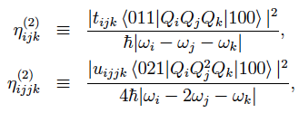


MCS3
(42)
- 3-mode, 2nd order:
(43)
(44)
MCS4
(45)
- 4-mode, 2nd order:
(46)

Slide 8
H₂CO
 |  | 2MCS | 3MCS | 4MCS
MCS > 1 | direct | 13 | 3 | 2
1e-4 < MCS < 1 | QFF | 2 | 10 | 1
MCS < 1e-5 | neglect | 0 | 7 | 12
C₂H₄
 |  | 2MCS | 3MCS | 4MCS
MCS > 1 | direct | 58 | 17 | 28
1e-4 < MCS < 1 | QFF | 8 | 54 | 36
MCS < 1e-5 | neglect | 0 | 149 | 431
Guanine (C₅N₅OH₅)
 |  | 2MCS | 3MCS | 4MCS
MCS > 1 | direct | 202 | 260 | 124
1e-4 < MCS < 1 | QFF | 658 | 9684 | 34185
MCS < 1e-4 | neglect | 1 | 1536 | 77621

Slide 9
References
Multiresolution PES
Yagi, Hirata, Hirao, Theor. Chem. Acc. 118, 681-691 (2007).
Mode Coupling Strength
Seidler, Kaga, Yagi, Christiansen, Hirao, Chem. Phys. Lett. 483, 138-142 (2009).
Direct (Grid) PES
Yagi, Taketsugu, Hirao, Gordon, J. Chem. Phys. 113, 1005-1017 (2000).
Quartic Force Field
Yagi, Taketsugu, Hirao, Gordon, J. Chem. Phys. 113, 1005-1017 (2000).
Yagi, Hirao, Taketsugu, Schmidt, and Gordon, J. Chem. Phys. 121, 1383-1389 (2004).
Shepard interpolation
Yagi, Taketsugu, Hirao, Gordon, J. Chem. Phys. 113, 1005-1017 (2000).
Yagi, Taketsugu, Hirao, J. Chem. Phys. 116, 3963-3966 (2002).
Yagi, Oyanagi, Taketsugu, Hirao, J. Chem. Phys. 118, 1653-1660 (2003).
Oyanagi, Yagi, Taketsugu, Hirao, J. Chem. Phys. 124, 064311 (2006).

