Slide 1







Vibrational Self-Consistent Field Method
Vibrational Schrödinger equation
(1)
(2)
(3)
VSCF wave function
(4)
(5)
Variational principles
(6)
(7)

Slide 2


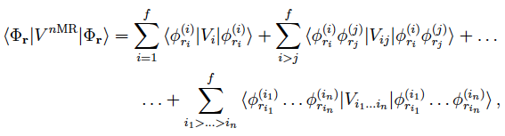
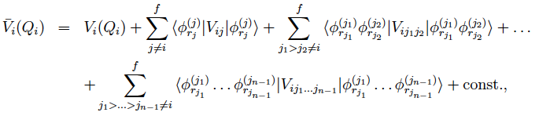
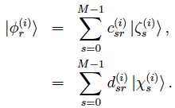

VSCF equation
(8)
(9)
Integral over the potential using DVR method
(10)
(11)
(12)
(13)
(14)

Slide 3

VSCF equation in matrix form
(15)
(16)
Iterative algorithm

Slide 4







VSCF Configuration Functions
VSCF configuration functions
(17)
(18)
- the number of configurations:
(19)
(M is the number of basis sets for each mode)
Excited configurations
- one-mode excitation:
(20)
- many-mode excitation:
(21)
- the number of m-mode excitation:
(22)
(23)

Slide 5

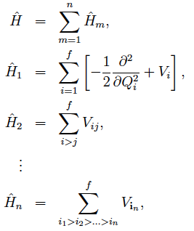
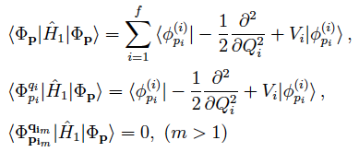
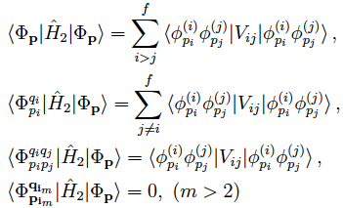
Hamiltonian matrix element
(24)
(25)
(26)
(27)
(28)
- one-mode operator:
(29)
(30)
(31)
- two-mode operator:
(32)
(33)
(34)
(35)

Slide 6








- general rule:
(36)
(37)
- Brillouin’s theorem:
(38)
(r is a reference VSCF state)
Approximation based on λ_{pq}
(39)
(40)
We assume the following equations, which are exact for HO, hold also for VSCF:
(41)
(42)
Then, we obtain,
(43)
(44)

Slide 7



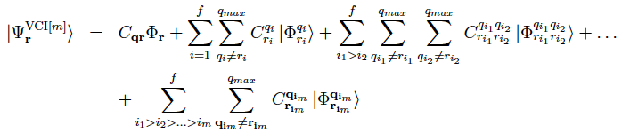

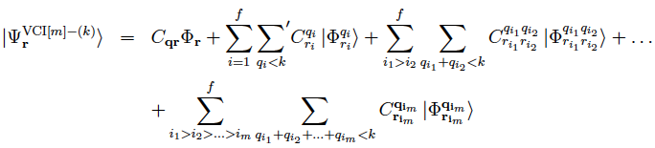

Vibrational Configuration Interaction
VCI wavefunction
(1)
VCI equation
(2)
(3)
Truncated VCI
VCI[m] : m-mode excitation
(4)
(5)
(qmax is max quanta of excitation)
VCI[m]-(k) : m-mode excitation, maximum sum of quanta k
(6)
(7)

Slide 8
VCI matrix for a 2MR system

Slide 9
問題
1. 振動版Brillouin’s定理である式(38)を証明せよ。
2. Table 1と同様にVCI[6], VCI[6]-(6)の配置数を自由度の数で表を作れ

